Slide 1
Products and Services Council
Greater Charlotte Apartment Association
August 5, 2021

Slide 2
Agenda
Welcome
2021 PSC Calendar
PSC Sub-Committees
2021 Trade Show Exhibitor Review
GCAA Events & Sponsorship Opportunities
2022 PSC Secretary Nominee Speeches
Q & A
Vote for 2022 PSC Secretary

Slide 3
PSC Calendar
PSC Business Meetings
October 14, 2021
GCAA Events
August 19, 2021 – Trade Show
September 24, 2021 – New Construction Bus Tour
October 2021 – GCAA Bowling Tournament
December 9, 2021 – Bravo Awards
Morning Perks
September 17, 2021
November 19, 2021

Slide 4
PSC Involvement
Sub-Committees

Slide 5
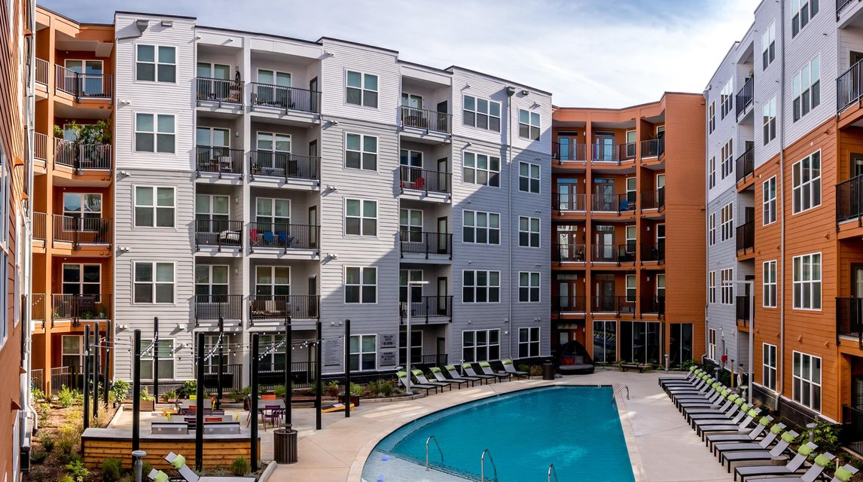
Associate Development
Upcoming Morning Perks
A Coffee Mixer for all GCAA Members
November 19, 2021
Polish your Professionalism
@One305 Central
September 17, 2021
Building your Own Brand
@Pine25 NorthEnd
**Sponsorships Available

Slide 6
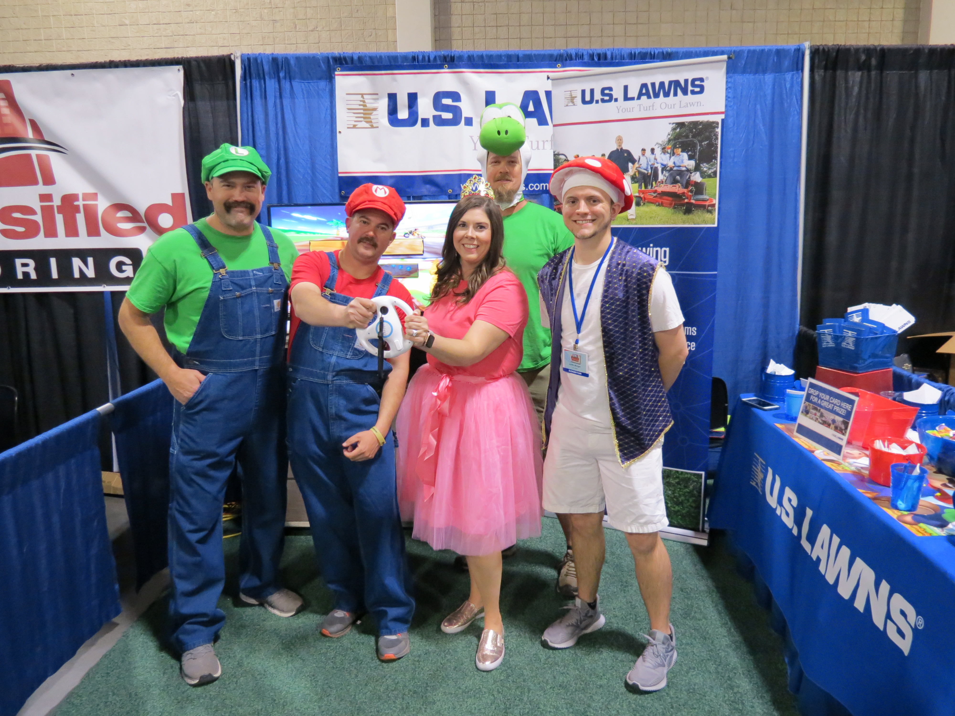
Trade Show
August 19, 2021
3:30pm – 8:00pm
@
Park Expo & Conference Center
Registration is open & Sponsorships Available

Slide 7
VIPER Exhibitor Packet Booth Workers Form Ancillary Services Form Exhibitor Rules and Regulations NEW!! FINAL EXHIBITOR INFO
IMPORTANT TRADE SHOW DETAILS
IMPORTANT EXHIBITOR FORMS

Slide 8
IMPORTANT TRADE SHOW Details
Viper Service Desk
The service desk will be located on the show floor for any questions or show site orders. A Viper representative will be at the Viper Service Desk if you see any discrepancy. Credits are not provided to claims made post show
Booth orders & freight delivery – A booth and freight check will be completed prior to setup and everything that was pre‐ordered and/or sent to the Advance Warehouse will be in your booth.

Slide 9
COVID-19 Mask Updates
As of 8.5.2021 – We will be STRONGLY encouraging our exhibitors and attendees to wear masks, regardless of vaccination status. IF this changes, we will send out mass communication to all members.
We will be implementing the following safety protocols for the safety of all members:
Covid Waiver (Signed by all Exhibitors and Attendees)
There will be a COVID check-in station for those do not fill out the google form before the show
Masks and Sanitizer Provided
Larger aisles to allow for social distancing
Green and Red Stickers for Name Tags (Indicating your personal contact preference)
Caution Tape (Provided for those who want to limit attendee access to their booth)
* At this time, we will NOT be implementing Temperature Checks at the Trade Show, after consideration we felt this could be a hinderance to attendees getting into the show. *

Slide 10
Trade Show SPONSORSHIPS
Web Ad $250 (6 Available)
Your logo, company website link, booth number will be featured on the Guest Registration page for 2-3 months giving you exposure to the 1000+ Trade Show registrants.
Silver Featured Exhibitor $150 (10 Available)
Featured Exhibitor will be listed on various Trade Show collateral and promotional materials:
Logo will be displayed on window decal
List of attendees in Excel Format
Gold Featured Exhibitor $200 (6 Available)
Featured Exhibitor will be listed on various Trade Show collateral and promotional materials.
Logo will be displayed on window decal
List of attendees in Excel Format
Drawing prize give away via Facebook Live
Picture to be featured in Apartment Times Magazine
Platinum Featured Exhibitor $250 (1 Available)
Featured Exhibitor will be listed on various Trade Show collateral and promotional materials.
Logo will be displayed on window decal
List of Attendees in Excel Format
Drawing prize give away (Choice of in-person at Trade Show or via Facebook Live)
Picture to be featured in Apartment Times Magazine

Slide 11
UPCOMING GCAA Events & SPONSORSHIPS
CAM/CAS Fast Track
September 27, 28, 29, 30, and October 1
Breakfast and Lunch Sponsorships
Sponsorships Cost: $100 plus the cost of food
Contact Wesley@greatercaa.org to purchase!
New Construction Bus Tour
September 24, 2021
Event Sponsorships Available
Sponsorships Includes: Tote Sponsors, Lunch Sponsors, Advertising Sponsorships, and Bus Sponsors.
Morning Perks
Breakfast Sponsorships Available for November 19, 2021

Slide 12
PSC SECRETARY NOMINEES
Stephanie Caudill
Stealth Monitoring
Liz Newkirk
Loebsack & Brownlee, PLLC
Dana Flaherty
BG Multifamily

Slide 13
Questions? If you have questions and would like to contact Ashley directly, feel free to email at ashley@greatercaa.org

Slide 14
SUBMIT YOUR 2022 PSC SECRETARY VOTE

