Slide 1

ANNUAL SURVEY 2026
Using insights from industry professionals, this survey report analyzes responses from 208 participants to understand the current state of GALA member satisfaction and nonmember interests. Respondents appraised our association's value, ranked our programs, shared their challenges, and highlighted professional development needs.

Slide 2

SURVEY PARTICIAPTION
MEMBERS AND NONMEMBERS
Survey questions were asked based on member status. 60% of respondents were members and 40% were nonmembers.
Yes
No

Slide 3
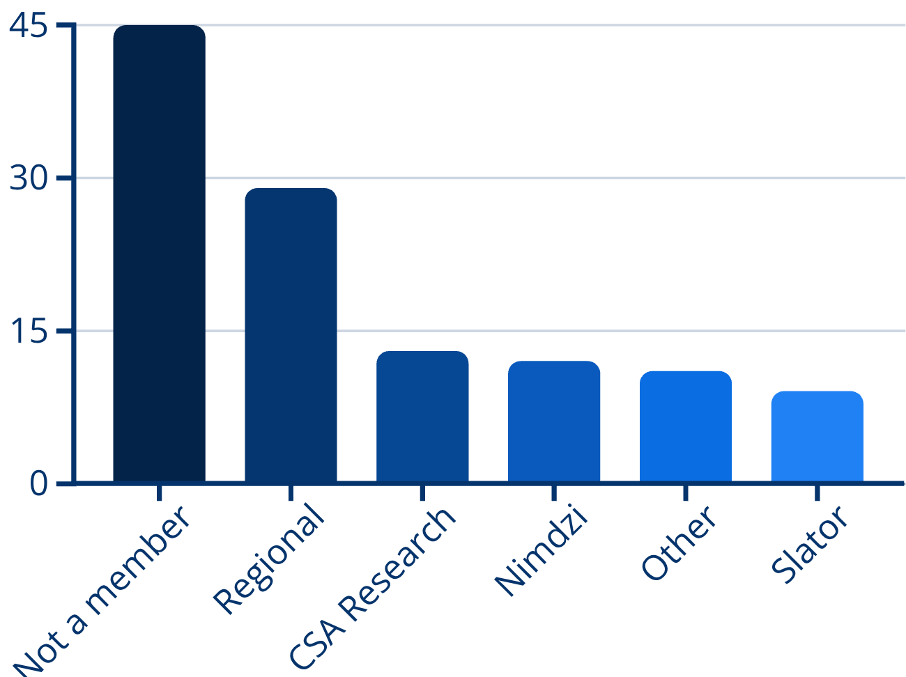
OTHER INDUSTRY ORGANIZATIONS
MEMBERSHIP LANDSCAPE
Nearly half of respondents (member and nonmember alike) are not members of other industry associations.
Of those who have multiple memberships, they are most likely to also be members of their regional association.

Slide 4
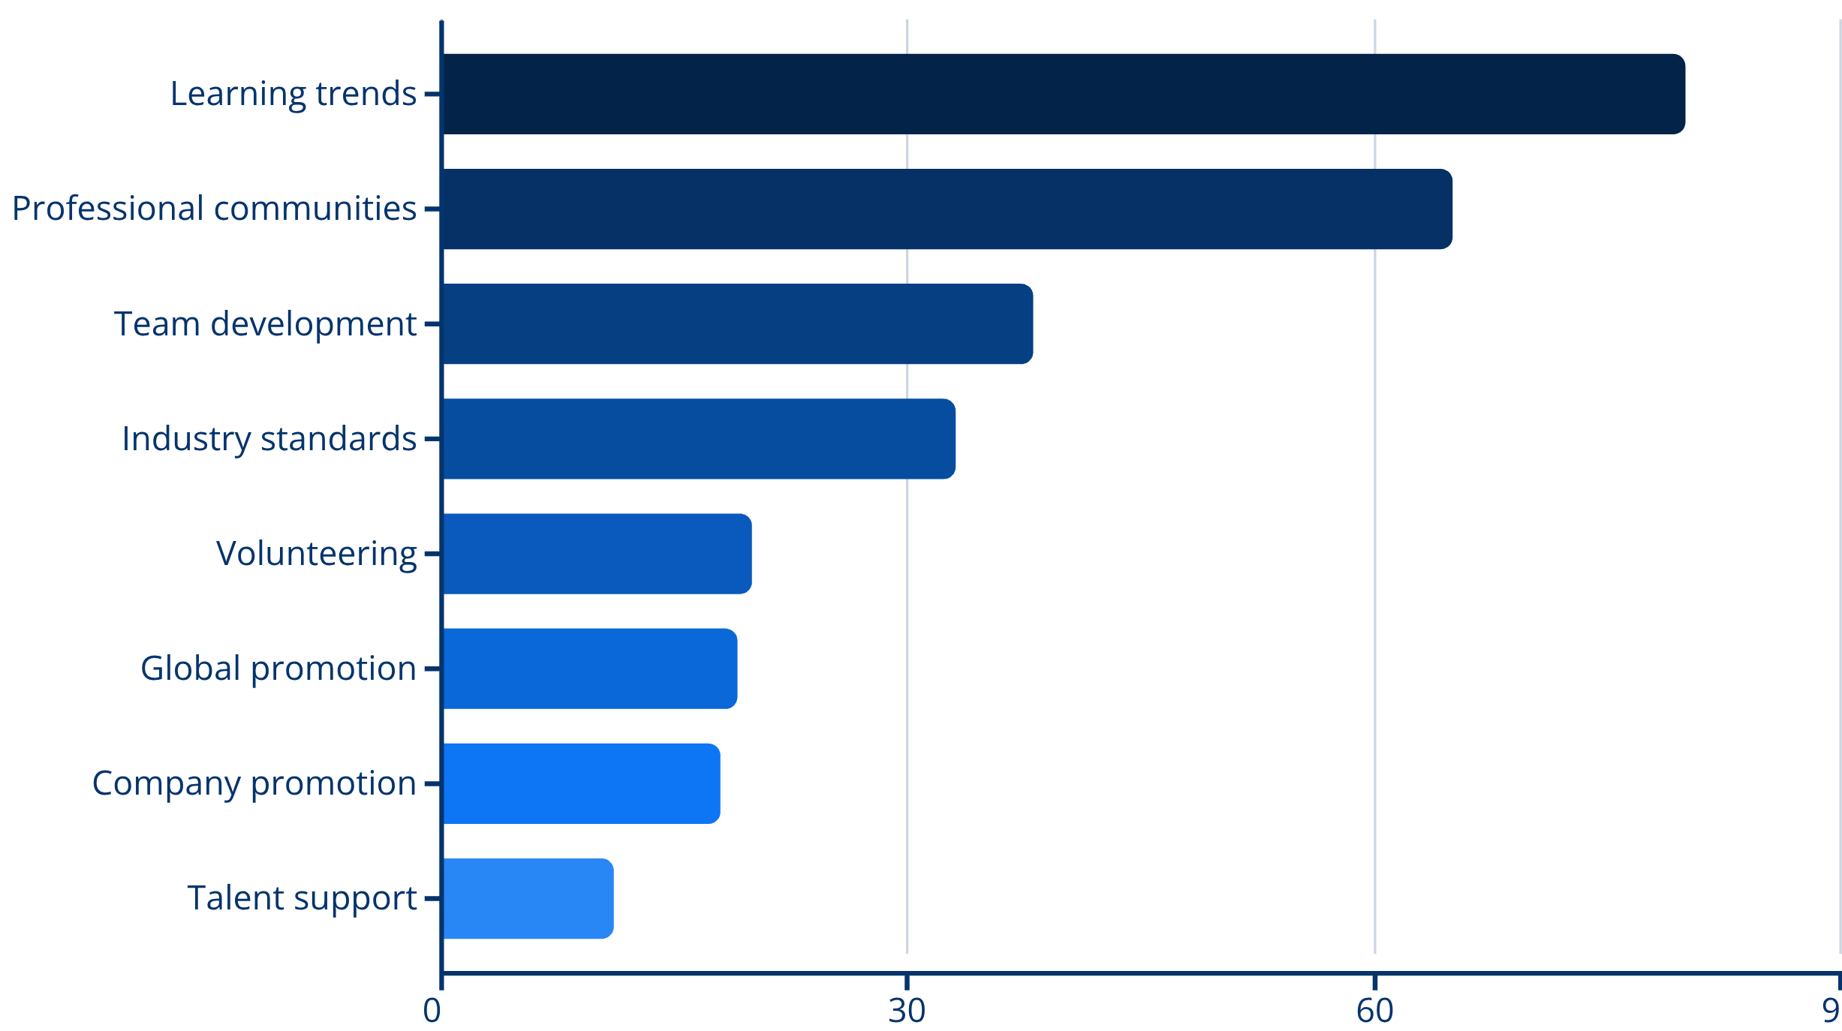
TOP REASONS FOR GALA MEMBERSHIP
GALA members prioritize learning and professional community above all else. Understanding trends, best practices, and emerging technologies drives 80% of respondents.

Slide 5
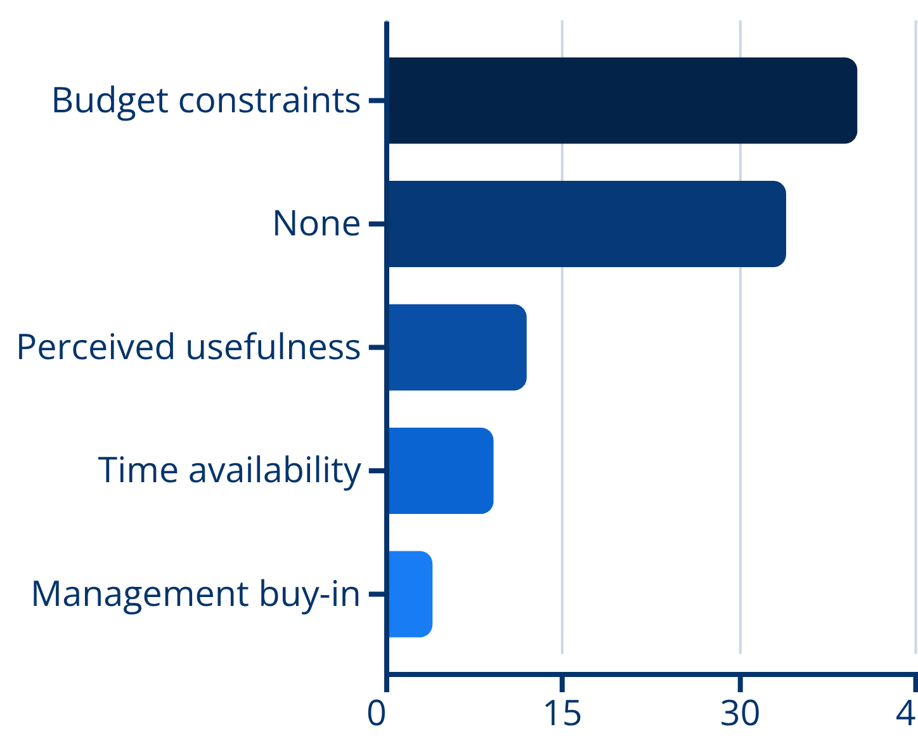
BARRIERS TO RENEWAL
KEY FINDINGS
Budget constraints are the primary challenge for renewal, affecting 40% of members.

Slide 6

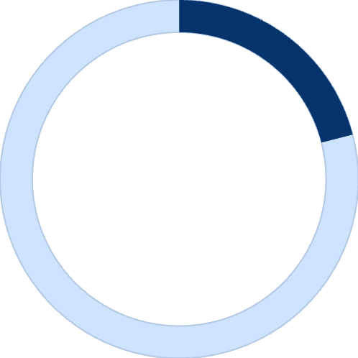

BARRIERS TO JOINING GALA
62%
21%
BUDGET CONSTRAINTS
PERCEIVED USEFULNESS
5%
5%
MANAGEMENT BUY-IN
TIME CONSTRAINTS

Slide 7
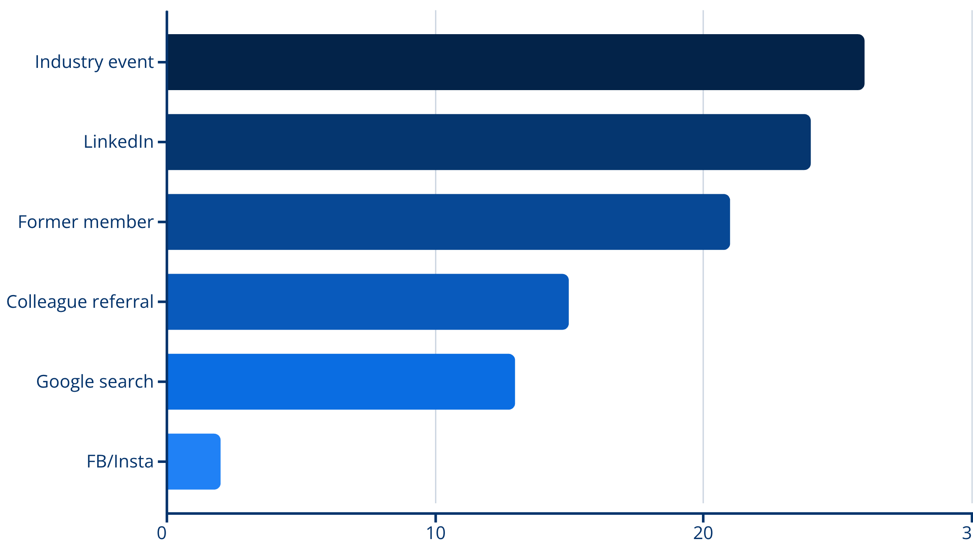
HOW NONMEMBERS DISCOVERED GALA

Slide 8
INDIVIDUAL MEMBERSHIP OPTION
STRONG INTEREST
52%
Nonmembers show significant interest in GALA's new individual membership option, with half requesting more information.
YES - REACH OUT
48%
NO - DECLINED
The introduction of individual membership represents a strategic response to budget obstacles.

Slide 9
PROGRAM ENGAGEMENT
HIGH ENGAGEMENT
MODERATE ENGAGEMENT
LOW
Webinars (95%)
Barometer Reports (85%)
Resource Center (87%)
Barometer Surveys (81%)
Academies (72%)
ENGAGEMENT
SIGs (65%)
Member Directory (50%)
Contributing content (41%)
Volunteering (42%)
Roadshows (31%)
Event/press postings (25%)
Advertising (19%)
This is not a critique of the value of the programs, only a measure of their usage. For example, programs like Roadshows are not as popular since they are restricted to audiences in certain geographic areas, yet they consistently receive positive feedback.
Notes:
Overall lack of awareness is down 3% since 2023, its stepped down every year.

Slide 10
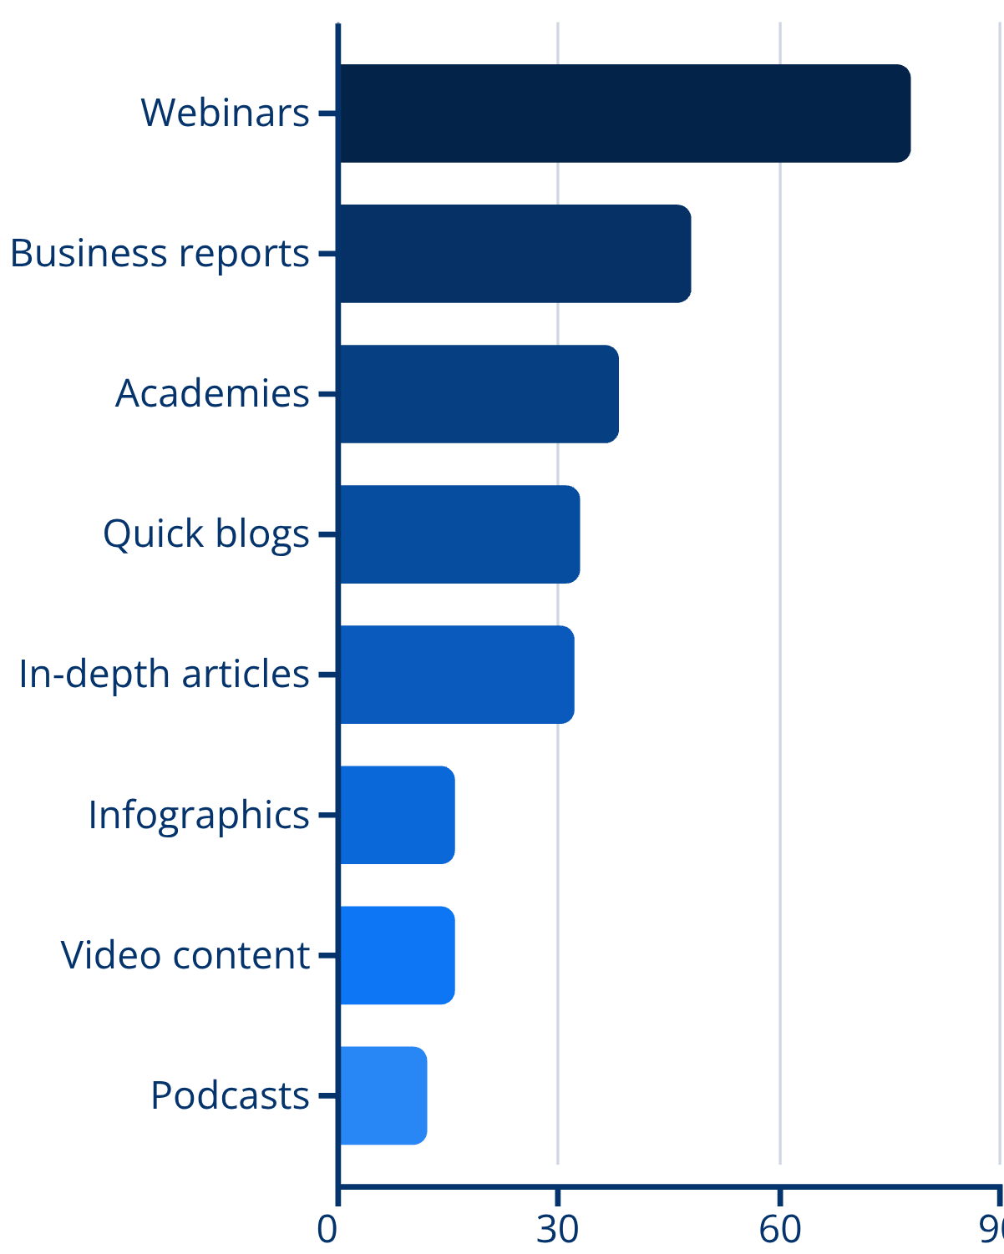
MOST USEFUL CONTENT FORMATS
FORMAT PREFERENCES
Webinars dominate content preferences with 78% rating them the most useful format for remote learning.
Business reports (48%) and academies (38%) are popular, and complementary: one provides data-driven insights and the other deep-dive educational experiences. Meanwhile, interest in blogs and articles, while widely accessible, hover in the middle.

Slide 11

PREFERRED PROFESSIONAL DEVELOPMENT FORMATS
LEARNING PREFERENCES
Live webinars are a favorite for developing professionals, according to 41% of respondents.
27% prefer multi-day conferences.
Live webinars
Multi-day conferences
Self-paced courses
Industry reports
Single-day workshops

Slide 12
CONTENT TOPIC CONSUMPTION
The top five content preferences reflect the industry's ongoing digital transformation, and highlight members' needs to deliver service and position themselves competitively.
1
TECHNOLOGY
AI, Automation, ML, MT, NLP, Speech technologies
2
LINGUISTIC MATTERS
Terminology, Quality assurance, Language standards
3
BUSINESS DEVELOPMENT
Growth strategies, Market expansion, Sales
4
LEADERSHIP
Management skills, Team development, Strategy
5
INDUSTRY STANDARDS
ISO, ASTM, Best practices, Compliance

Slide 13
EMERGING TOPICS AND INDUSTRY CHALLENGES
Member feedback shows AI as the primary challenge, reflecting profound industry uncertainty about technology's impact on workflows, pricing models, job roles, and service delivery. Professionals seek practical guidance on AI implementation, ethical considerations, quality evaluation of AI outputs, and sustainable workforce models.
AI IMPLEMENTATION
BUSINESS MODEL EVOLUTION
WORKFORCE SUSTAINABILITY
Practical strategies for integrating AI tools, ethical considerations, quality assurance, and workflow adaptation
New pricing structures beyond per-word rates, service diversification, transformation strategies for SME LSPs
Career paths in AI era, linguist compensation models, talent development, attracting new professionals
INDUSTRY-EDUCATION GAP
CLIENT RELATIONS
SOFT SKILLS
Curriculum modernization, practical skills training, university-industry collaboration, preparing graduates
Managing AI expectations, demonstrating human value, positioning localization strategically, measuring ROI
Cross-functional collaboration, sales transformation, negotiation, C-level communication, change management

Slide 14
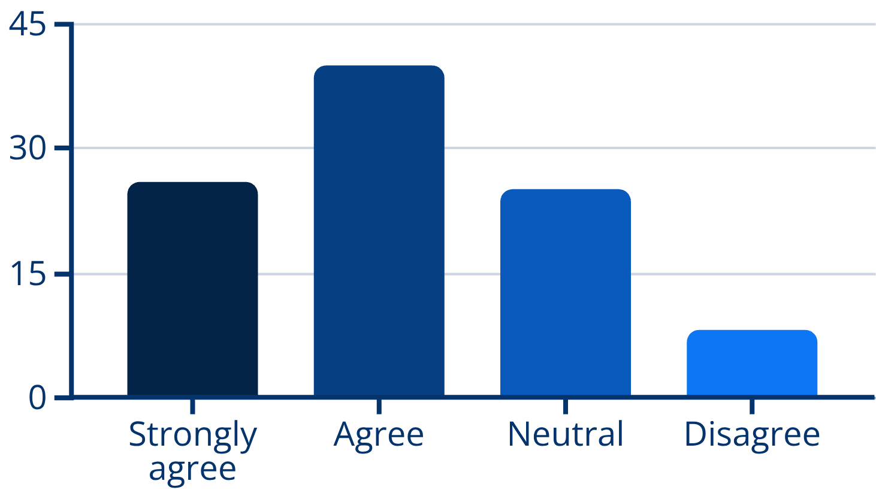
MEMBER ENGAGEMENT
ENGAGEMENT SENTIMENT
Two-thirds of members feel engaged, while one quarter feel a neutral level of engagement. Not a single respondent strongly disagreed.

Slide 15
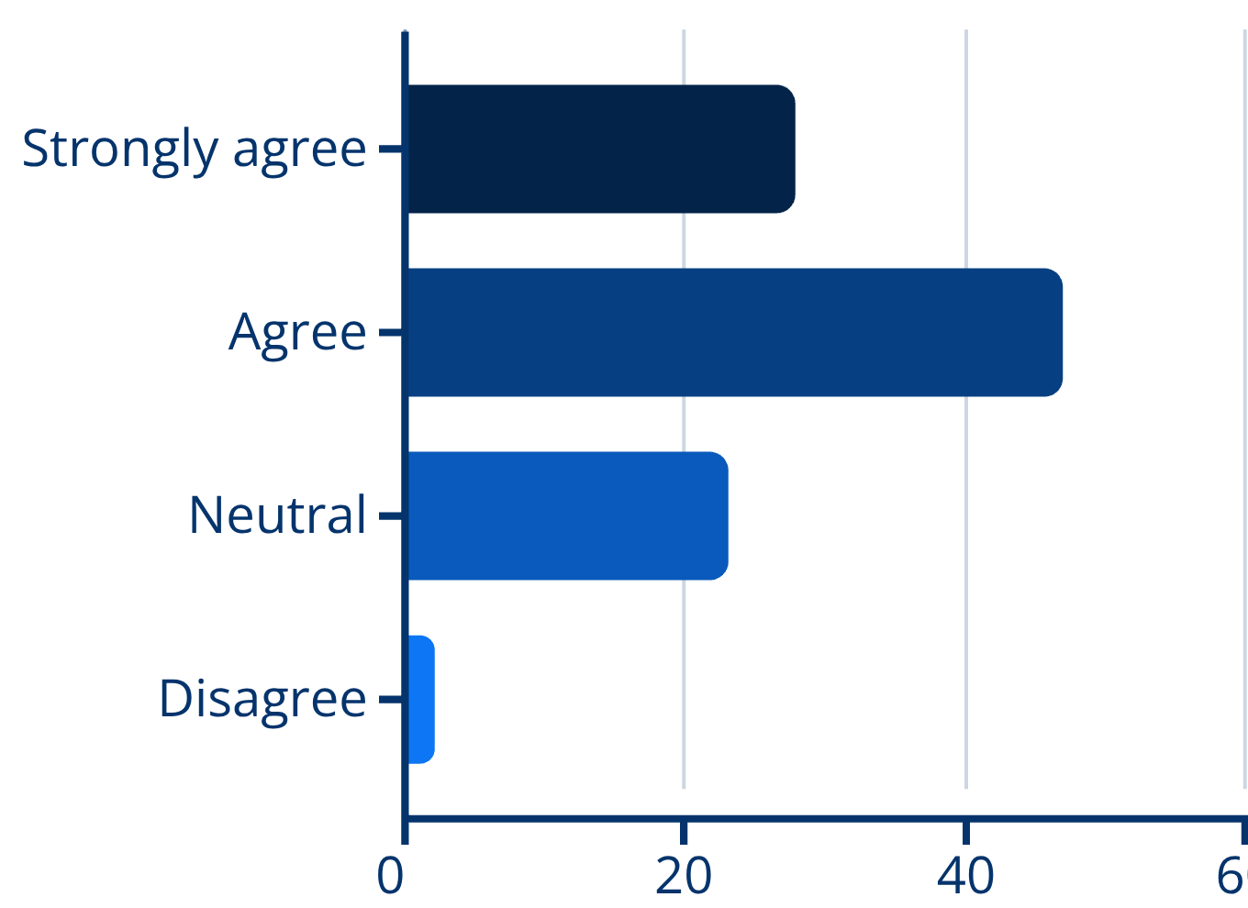
GALA'S PROFESSIONAL IMPACT
POSITIVE CAREER INFLUENCE
Three-quarters of member respondents agree or strongly agree that GALA positively impacts their professional life and career. No one strongly disagreed.
The fact that the engagement sentiment correlates almost exactly with impact highlights that the more engaged someone is, the more likely they are to positively benefit from GALA membership.

Slide 16
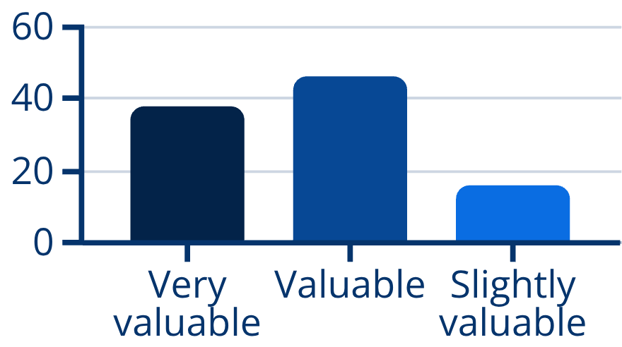
MEMBERSHIP VALUE
Member satisfaction remains high, with 84% rating their membership as valuable or very valuable. 2026 is the highest "very valuable" rating from members in any known annual survey. For eight years in a row every single respondent has reported they find value in GALA membership.
STRONG VALUE RECOGNITION
100%
FIND VALUE
38%
VERY VALUABLE

Slide 17
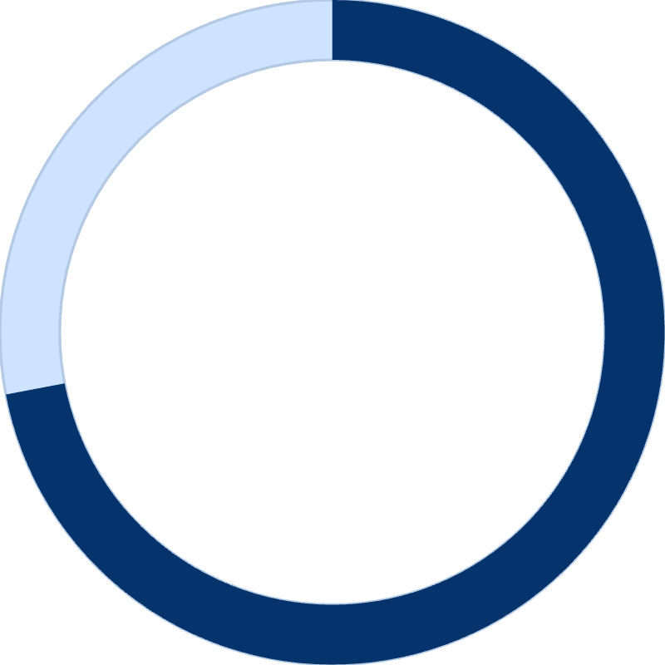
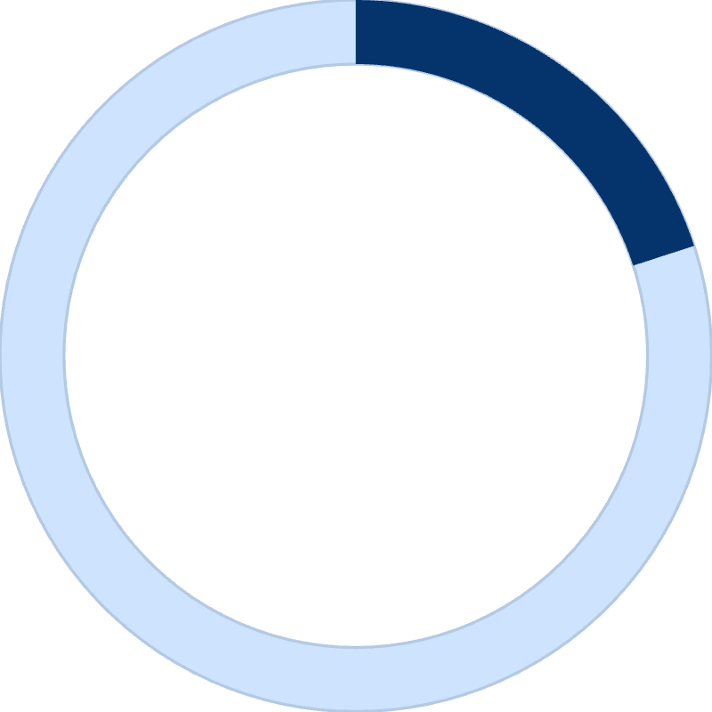
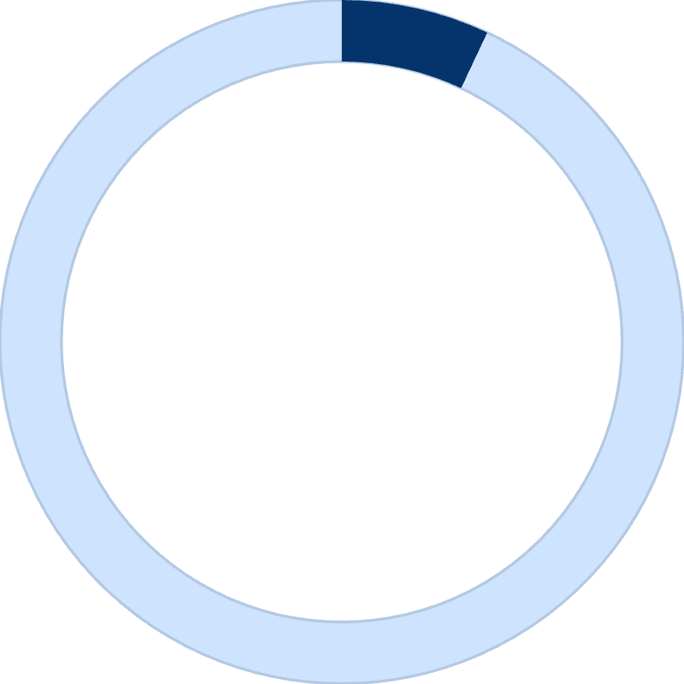
CLARITY OF VALUE PROPOSITION
Members demonstrate a strong understanding of GALA's value proposition, with 72% of the membership base agreeing or strongly agreeing they have a clear sense of our offerings.
72%
20%
7%
CLEAR VALUE
NEUTRAL POSITION
UNCLEAR VALUE

Slide 18
BRAND ASSOCIATIONS WITH GALA
When asked what comes to mind about GALA, members and nonmembers have distinct but complementary brand perceptions.
MEMBER PERCEPTIONS
NONMEMBER PERCEPTIONS
Professional community and networking
Annual conference and events
Industry knowledge sharing
Collegiality and tight-knit community
Localization focus and expertise
Educational webinars and learning
US and Europe industry focus
LSP-oriented organization
Conference and educational events
Global professional community
Localization business emphasis
Operational rather than strategic focus

Slide 19
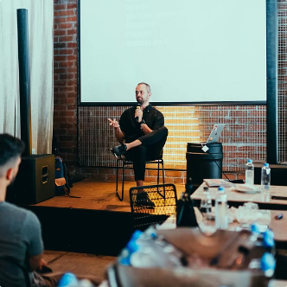
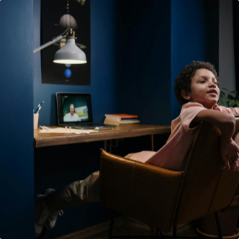
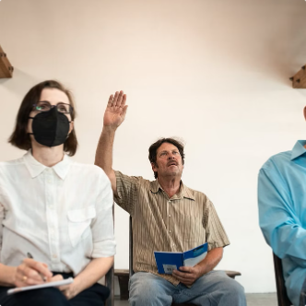
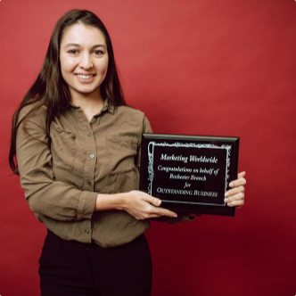
FAVORITE GALA EXPERIENCES
Annual conferences are consistently members' most memorable GALA experiences, with Montreal 2025 and roadshow events highlighting the value of in-person connection.
Members say conference provides opportunities to reconnect with peers, discover new partnerships, and "fall in love with the industry all over again."
ANNUAL CONFERENCES
EDUCATIONAL WEBINARS
SPECIAL INTEREST GROUPS
VOLUNTEERING OPPORTUNITIES
Premier networking events creating lasting connections and industry enthusiasm
Accessible learning on emerging topics from AI to inclusive language
Focused communities enabling deep engagement with specialist topics
Board service, committees, and leadership roles creating meaningful involvement
Members emphasize the personal fulfillment and energy they gain from being involved with GALA.
Notes:
Maybe we could use this card in social promo

Slide 20
MEMBER FEEDBACK AND RECOMMENDATIONS
MEMBERSHIP MODEL EVOLUTION
CONTENT PRIORITIES
GEOGRAPHIC REPRESENTATION
Members celebrate the new individual membership while requesting more inclusive pricing for SMEs, economic regions, and further revenue-based tiers.
Requests for fresh perspectives, diverse speakers, practical implementation, case studies, and content beyond traditional localization focus toward global growth and user experience.
Members from Latin American and Asia request more regional event representation, noting conferences heavily favor European and North American locations, creating participation barriers.
COMMUNITY BUILDING
INCLUSIVE PERSPECTIVES
EDUCATIONAL PARTNERSHIPS
Appreciation for GALA's collegial spirit with suggestions for even more personal interactions and platforms for collaborative problem-solving.
Requests to amplify voices beyond large LSPs, including individual linguists, client-side professionals, and specialists in interpreting and public service language access.
Closer industry-university collaboration could modernize curricula, prepare graduates for current realities, and address the gap between education and industry needs.
Multiple respondents expressed appreciation for GALA staff professionalism and volunteer leadership quality. Calls for transparency around industry challenges, particularly AI's market impact and sustainable pricing models, suggests members value GALA as a trusted truth-teller capable of facilitating honest dialogue.

