Slide 1




PFAS
By Julie Guimond
of
Sensible Water Solutions, LLC
and
Sensible Municipal Water Systems, Inc.

Slide 2


Sensible Municipal Water Systems, Inc. is in the process of patenting a DBPs and PFAS Reduction System that can be retro fit to existing facilities and included in the construction of new facilities.
We currently have several systems around the state. Please come see one of us if you have questions after the presentation.

Slide 3





Sensible Water Solutions has been in business since 2012. We have installed commercial, community and residential water systems all over the state of Florida.
Sensible Water Solutions has completed over 50 Lead Service Line Inventories (LSLI) throughout the state. If you need assistance with your LSLI or your UNKNOWNS let us KNOW.

Slide 4
What are PFAS?
PFAS per-and polyflouroakyl substances are a large class of man-made chemicals designed to resist heat, oil grease and water. They have been used since the 1940's in products such as nonstick cookware, stain-resistant fabrics, firefighting foams, ski wax, and food packaging. PFAS are often called forever chemicals because they do not break down easily in the environment and the human body, leading to contamination in water, soil, air and food.
PFOA perfluorooctanoic acid and PFOS perfluorooctanoic sulfonate are two of the most studied PFAS compounds. Both are synthetic chemicals of carbon atoms fully bonded to fluorine which makes them both extremely stable.
Health concerns liked to PFAS include:
Immune system suppression Elevated risks of certain cancer
Liver and kidney damage Developmental delays in children
Increased cholesterol levels Fertility and Pregnancy complications

Slide 5
Community Water Systems and
Non-Transient Non-Community Water Systems
On April 26, 2024 the EPA amended CFR (Code of Federal Regulations) Part 141 (National Primary Drinking Water Regulations), to incorporate monitoring and compliance requirements for PFAS for all community water systems and non-transient non-community systems.
Initial Sampling Requirements:
All community water systems and non-transient non-community water systems must conduct initial monitoring or obtain approval to use previously collected monitoring data for per and polyfluoroalkyl substances (PFAS) by April 26, 2027. As of today this is still the requirement.

Slide 6
Initial Monitoring Requirements are based on the size of the system and the system's source water
All Surface Water Systems regardless of population size.
  Quarterly within a 12-month period
  Samples must be collected 2 to 4 months apart
Groundwater Systems serving more than 10,000 customers
  Quarterly within a 12-month period
  Samples must be collected 2 to 4 months apart
Groundwater Systems serving less than or equal to 10,000 customers
  Twice within a 12-month period
  Samples must be collected 5 to 7 months apart

Slide 7
General Initial Monitoring Requirements (40 CFR 141.902(b)(1))
Groundwater CWSs and NTNCWSs serving
10,000 or fewer persons:
  Initial MonitoringRequirements ¹
    For entry points to the distribution systems that only use groundwater sources, two (2) consecutive samples per entry point within a 12-month period, unless the exemption below applies² Samples must be taken five (5) to seven (7) months apart.
¹ Conducted at each entry point, under normal/representative operating conditions. Consecutive system interconnections that transmit finished water are not entry points.
² Water systems can use previously acquired data to satisfy some or all of these requirements. If a system has some previously collected results meeting PFAS requirements, but less than necessary to meet the initial monitoring requirements, the system can supplement with additional monitoring events such that all required calendar periods are represented, ,regardless of the year. See 40 CFR 141.902(b)(1)(viii).

Slide 8
General Initial Monitoring Requirements (40 CFR 141.902(b)(1))
All Other CWS and NTNCWSs including:
  All surface water systems
  All groundwater under direct influence (GWUDI)
  Groundwater systems serving more than 10,000 persons or more
  Any entry point that blends surface water and groundwater
  Systems that change the source water type seasonally (e.g., surface water one part of the year, groundwater the remaining part of the year)
  Initial Monitoring Requirements¹
    Four (4) consecutive quarters of samples per entry point within a 12-month period, unless the exception below applies.² Samples must be taken two (2) to four (4) calendar months apart.
¹ Conducted at each entry point, under normal/representative operating conditions. Consecutive system interconnections that transmit finished water are not entry points.
² Water systems can use previously acquired data to satisfy some or all of these requirements. If a system has some previously collected results meeting PFAS requirements, but less than necessary to meet the initial monitoring requirements, the system can supplement with additional monitoring events such that all required calendar periods are represented, ,regardless of the year. See 40 CFR 141.902(b)(1)(viii).

Slide 9
Initial Monitoring: A Quick Reference Guide
Rule Title
  Per-and Polyfluoroalkyl Substances (PFAS) National Primary Drinking Water Regulations (NPDWR), 89FR 32532, April 26, 2024, Vol. 89, No. 82
Utilities Covered
  The PFAS Rule applies to all community water systems (CWSs) and non-transient non-community water systems (NTNCWSs), hereafter referred to collectively as water systems.
Key Milestones
  April 26, 2027 – Initial Monitoring ends and compliance monitoring begins.
  April 26, 2029 – Deadline for compliance with Maximum Contaminant Levels (MCLs)
Practical Quantitative Level (PQL)
  The lowest level at which a contaminant can be reliably quantified within specific limits of precision and accuracy during routine laboratory operating conditions using the approved methods (89 FR 32573. The PQLs are used as part of determining compliance with PFAS MCLs.
Trigger Levels
  The trigger levels are used to determine an appropriate monitoring frequency and are set at one-half of te MCLs for Regulated PFAS (see 40 CFR 141.902(a)(5)).

Slide 10
Compliance Monitoring MCL Chart
 | Contamination | Trigger Level | MCL
 | PFAS | 2.0 ppt | 4.0 ppt
 | PFOS | 2.0 ppt | 4.0 ppt
 | HFPO-DA | 5 ppt | 10 ppt
 | PFHxS | 5 ppt | 10 ppt
 | PFNA | 5ppt | 10 ppt

Slide 11
The final rule established on
April 10, 2024 made these items mandatory
Public water systems must monitor for the PFAS listed in the previous chart and have three years to complete initial monitoring (by 2027), followed by ongoing compliance monitoring. Water systems must also provide the public with information on the levels of these PFAS in their drinking water beginning in 2027.
Public water systems have five years (by 2029) to implement solutions that reduce these PFAS if monitoring shows that drinking water levels exceed these MCLs listed in the chart on the previous slide.
Beginning in 5 years (2029), public water systems that have PFAS in drinking water which violates one or more of these MCLs must take action to reduce levels of these PFAS in their drinking water and must provide notifications to the public of the violation.

Slide 12
Stay Informed
Focus on Change
Contact you FDEP rep.
Contact Florida Rural Water Association
Contact us at Sensible Water Solutions and Sensible Municipal Water SMWSinc.com. SMWSinc@gmail.com
This is a hot issue and there is a lot of attention on it from government and public.
Stay informed.
This issue is constantly evolving and changing.

Slide 13
Testing for PFOA and PFAS
DOH ID | Organization Name - | Current Selections: | Current Selections: EPA 533, EPA 537.1, EPA 537.1 (Rev. 2), GEL SOP EPA 537.1 Modified / LC-MS-MS | Certification Status - Current Selections: Accredited | Street Address | City - Current Selections: | State - Current Selections: | Phone | County
E52459 | JEA Laboratory Services | Drinking Water | EPA 533 | Accredited | 1002 N. Main Street | Jacksonville | FL | 9046654517 | Duval
E54715 | Tampa Bay Water | Drinking Water | EPA 533 | Accredited | 8825 Pump Station Road | Land O Lakes | FL | 8139294511 | Pasco
E54715 | Tampa Bay Water | Drinking Water | EPA 537.1 | Accredited | 8825 Pump Station Road | Land O Lakes | FL | 8139294511 | Pasco
E56386 | City of Boca Raton Quality Control Laboratory | Drinking Water | EPA 537.1 (Rev. 2) | Accredited | 1401 Glades Road | Boca Raton | FL | 5613387327 | Palm Beach
E82574 | Advanced Environmental Laboratories, Inc. | Drinking Water | EPA 533 | Accredited | 6681 Southpoint Parkway | Jacksonville | FL | 9043639350 | Duval
E82574 | Advanced Environmental Laboratories, Inc. | Drinking Water | EPA 537.1 (Rev. 2) | Accredited | 6681 Southpoint Parkway | Jacksonville | FL | 9043639350 | Duval
E83079 | Pace Analytical Services, LLC - Ormond Beach FL | Drinking Water | EPA 533 | Accredited | 8 East Tower Circle | Ormond Beach | FL | 3866725668 | Volusia
E83079 | Pace Analytical Services, LLC - Ormond Beach FL | Drinking Water | EPA 537.1 (Rev. 2) | Accredited | 8 East Tower Circle | Ormond Beach | FL | 3866725668 | Volusia
E83510 | SGS North America, Inc. - Orlando | Drinking Water | EPA 533 | Accredited | 4405 Vineland Road, Suite C-15 | Orlando | FL | 4074256700 | Orange
E83510 | SGS North America, Inc. - Orlando | Drinking Water | EPA 537.1 (Rev. 2) | Accredited | 4405 Vineland Road, Suite C-15 | Orlando | FL | 4074256700 | Orange

Slide 14
Testing Methods
Laboratory Testing
The most accurate PFAS testing is performed in a certified laboratory using the EPA Methods 533 and 537.1 which employ liquid chromatography-tandem mass spectrometry (LC-MS/MS) to detect 29 PFAS compounds. These methods are validated for regulatory monitoring under the PFAS National Primary Drinking Water Regulations (NPDWR) and the Unregulated Contaminant Monitoring Rule (UCMR 5).
If you are going to collect the samples yourselves, use only bottles supplied by the certified lab and avoid contamination from personal care products, clothing
Follow the lab’s flow and preservation instructions.

Slide 15
How can you remove PFAS and PFOA from your water system?
Granular Activated Carbon
Ion Exchange Resin
Reverse Osmosis and Nanofiltration
Which one is best for your water system?

Slide 16

Granulated Activated Carbon
  Granular activated carbon (GAC) is a porous adsorption media with extremely high internal surface area. GAC is made from a variety of materials: bituminous coal, lignite coal, peat, wood, coconut shells.
  Advantages:
    Has an extremely high removal rate for TTHM, HAA5, PFAS, PFOA and many other contaminants.
    GAC works well on longer-chain PFAS like PFOA and PFOS
  Disadvantages
    Re-bedding when carbon is loaded can be expensive
    Disposal – has to be incinerated if it contains PFAS. Cannot be put in a landfill.
    GAC does not adsorb shorter chains PFAS like Perfluorobutanesulfonic acid (PFBS) and Perfluorobutyrate (PFBA)

Slide 17
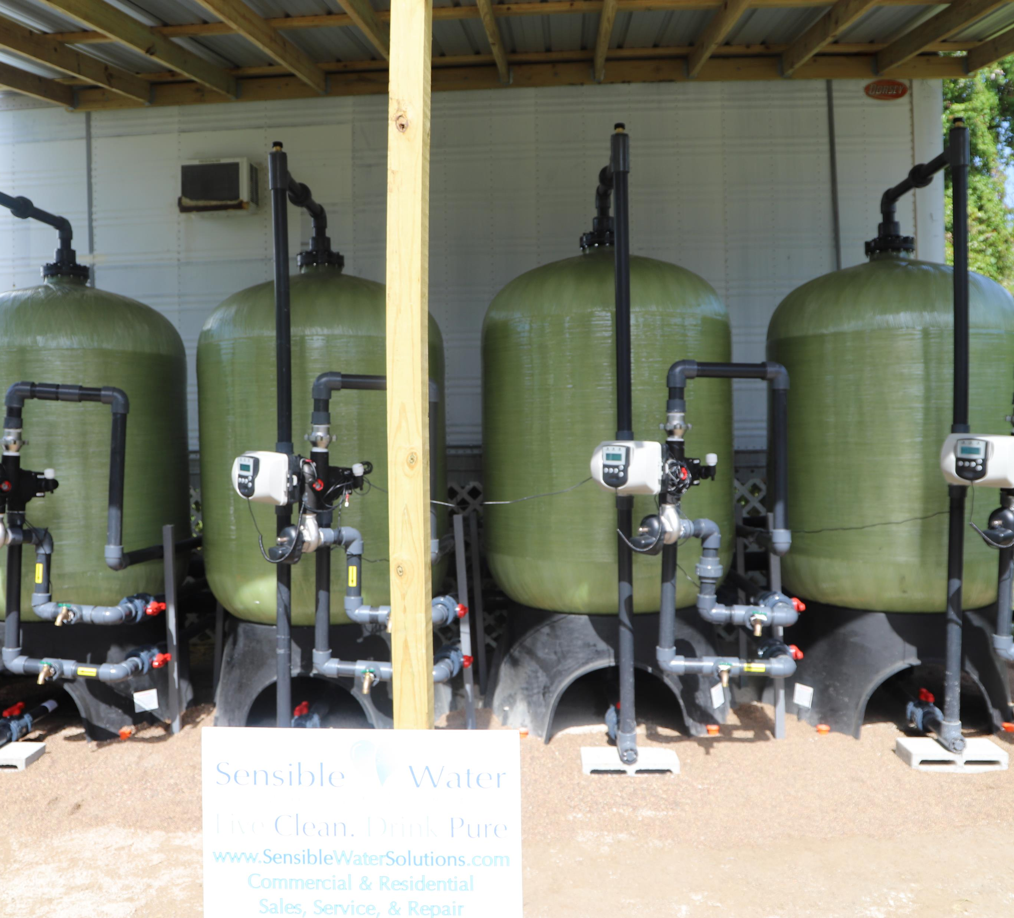
Carbon Filtration
Carbon Filtration can be used in a variety of ways for a variety of reason.
DBPs – Disinfection byproducts -TTHM and HAA5
PFOA and PFOS
Taste and Odor.
Natural Organic Matter
Volatile Organic Compounds (VOCs)
Synthetic organic compounds
And a host of other contaminants.

Slide 18
Ion Exchange Resin
Cationic Exchange Resin and Anion Exchange Resin
CER – Cationic Exchange Resin – Negatively charged cationic exchange resin are effective at removing positively charged contaminants like calcium and magnesium. These are used in water softening and demineralization.
  Must be regenerated with either hydrochloric acid (HCl) for hydrogen-form resin or sodium chloride (NaCl) for sodium form resin.
AER – Anion Exchange Resin – Positively charged anion exchange resins are effective for removing negatively charged contaminants like PFAS.
  AER have shown to have a high capacity for many PFAS.
  Advantage – Does not have to be regenerated.
  Does have to be incinerated when loaded with PFAS.
  Like GAC, AER removes 100% of the PFAS for a period of time before the resin has to be removed and replaced. This is dictated by the choice of resin, bed depth, flow rate, which PFAS needs to be removed, and the degree and type of background organic mater and other contaminants present in the water being treated.

Slide 19

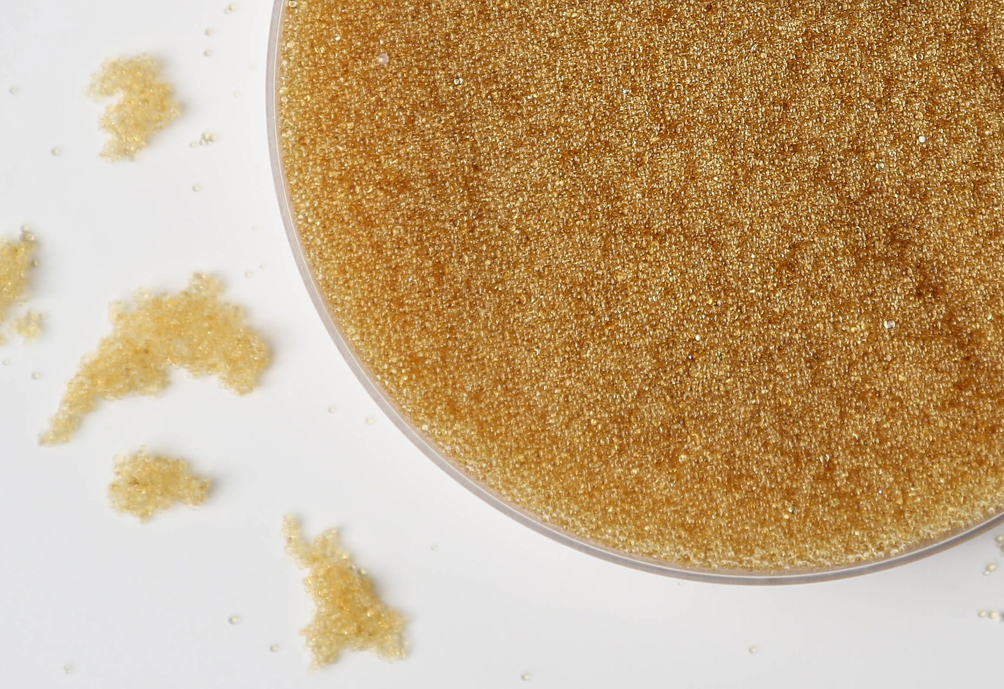
Strong Acid Cation
Weak Acid Cation
Strong Base Anion
Weak Base Anion
Acrylic Gel
Acrylic Macroporous
Styrenic Gel
Styrenic Macroporous
Styrenic Porous Gel
Many Different Types of Resin
Which one is best for your water?

Slide 20
Reverse Osmosis and Nanofiltration
Reverse Osmosis Advantages
Removes PFAS very effectively, 99%.
Removes all salts and minerals.
Reverse Osmosis Disadvantages
Expensive to install and maintain.
Has a waste stream of about 20% - to 50% of the feed flow. Difficult to dispose of, especially with PFAS present.
Must have pretreatment to remove the hardness, THM, iron, sulfur and other contaminants.
Nanofiltration Advantages
Excellent removal of long-chain compounds and partial short-chain removal.
Runs at lower pressure that Reverse Osmosis saving 30% to 50% in energy costs.
Only 5% to 20% of the water becomes waste compared to a much higher percentage in reverse osmosis.
Simultaneously removes hardness, iron, and organic materials. So not as much pretreatment is required.
Nanofiltration Disadvantages
Waste stream and its disposal.
Expensive to install and maintain.

Slide 21

Thank you!

Slide 22

What we can do for you! Contact us.
PFOS & PFOA REDUCTION SYSTEMS [PATENT PENDING]
DPB REDUCTION SYSTEMS [PATENT PENDING]
AERATION SYSTEMS
SULFUR/IRON/HARDNESS REMOVAL SYSTEMS
PFAS SAMPLE TESTING
LEAD SERVICE LINE INVENTORY
LEAD SAMPLE TESTING IN SCHOOLS
GIS WATER METER MAPPING
GIS SEWER MAPPING
WATER METER REPLACEMENT
MEDIA TANK REBED
POTABLE WATER BACKFLOW PREVENTER TESTING/INSPECTION
POTABLE WATER TANK CLEANING

