Slide 1





PFAS Removal in Gas-Liquid Plasma Reactors
Robert J. Wandell, Rachel Gallan, Radha Bulusu, Karam Eeso, Mojtaba Nouri, *Youneng Tang, *Bruce R. Locke
*Principal Investigators
Department of Chemical and Biomedical Engineering
Department of Civil and Environmental Engineering
FAMU-FSU College of Engineering
Tallahassee, FL
Funding and Collaboration
National Science Foundation CBET – 1236225, 1702166
Hinkley Center for Solid and Hazardous Waste Management
Geosyntec/FSU Research Agreement
Florida Department of Environmental Protection – PFAS analysis
Professor Igor Alabugin – FSU Department of Chemistry and Biochemistry

Slide 2
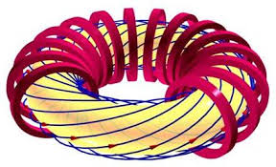
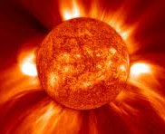
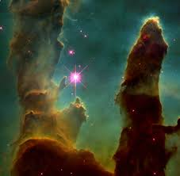
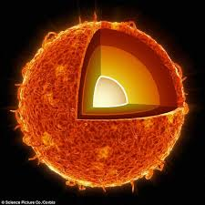
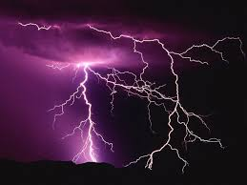



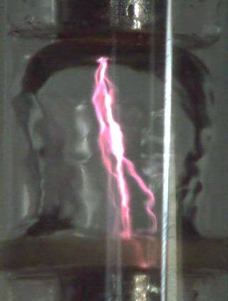
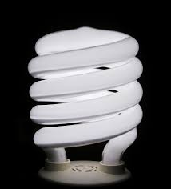

Plasma
Most common state of matter in the Universe (excluding dark matter)
Field of free electrons and ions
Key factors
  Electron temperature
  Electron density
  Background gas (plasma) temperature
Thermal
  T_{e} ≈ T_{i} ≈ T_{p}
  Lightning, fusion, arc welding
Non-thermal
  T_{e} >> T_{i} , T_{p}
  Aura Borealis, fluorescent lighting
This work ≈ 500 K

Slide 3
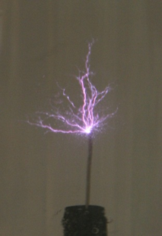
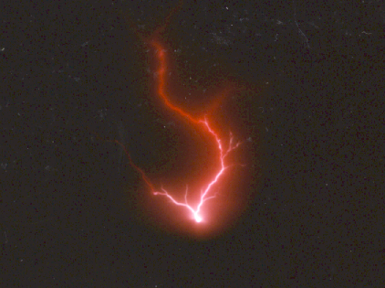
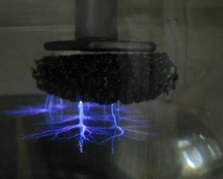
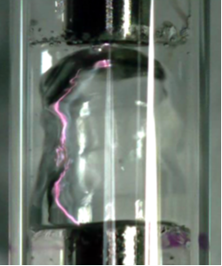
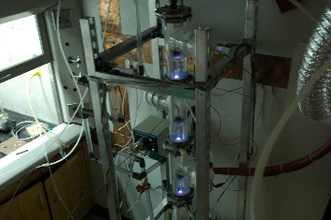
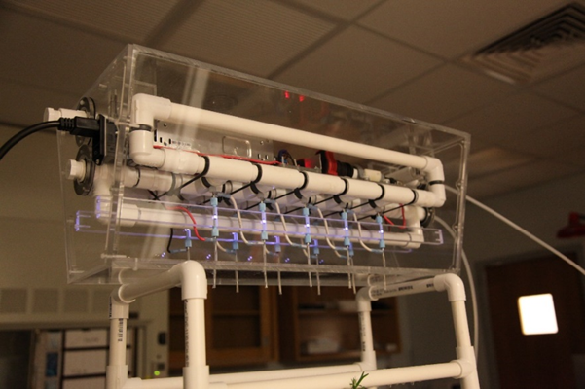
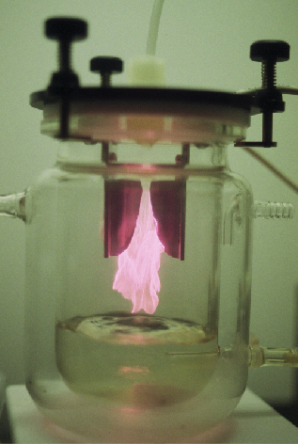
Contacting Non-Thermal Plasma with Liquid Water
Underwater
Electrical discharge underwater (pulsed, RF, microwave)
- 10⁻³ to 1 J/pulse (also ns to μs pulses possible)
- up to kJ/pulse - electrohydraulic discharge,
arc formation, exploding wire
- breakdown underwater: 1 MV/cm
Gas-liquid Interface
(AC, DC, or pulsed)
Discharge in gas
- plasma in gas
- gas phase breakdown
- plasma touches water
surface
- liquid properties can
be important (conductivity)
Gliding arc
Planar
Bubbles
Films
Scaled prototypes
For scaling, many reactors are placed in parallel
Notes:
Examples from our work – not meant to be exhaustive – there are other methods as well, diaphragm discharge etc.

Slide 4
Applications of Plasma with Liquid Water
Water pollution treatment
  Wide range of organic and some inorganic compounds – emerging contaminants – perfluorinated species, antibiotics, personal care products
Air pollution treatment (wet plasma – water sprays and films)
  Nitrogen and sulfur oxides, volatile organic compounds (VOCs)
Disinfection and biomedical
  Bacteria, yeast, viruses
  Biomedical – wound healing, cancer treatment
Chemical synthesis
  Partial oxidation – alcohols, aldehydes…
  Nanoparticle synthesis
  Polymer coatings
  Plasma activated water for agriculture uses – nitrates/nitrites, seed germination…
Many reviews on this subject published in last 10 years: Akiyama, Malik, Locke, Sunka,
Sato, Bruggeman, Lukes, Thagard, Weltmann, Brandenburg,…..
P. Bruggeman, M.J. Kushner, B.R. Locke, et al., Plasma-Liquid Interactions:
A Review and Roadmap, Plasma Sources Science and Technology, 2016
Notes:
Recent review of the fundamental aspects of this topic will be published based upon the Lorentz Workshop held in Leiden Netherlands summer of 2014.

Slide 5
Complexities of Gas-Liquid Water Plasma Chemistry
(With air or argon)
Chemistry strongly dependent on gas composition (air, N₂, O₂, Ar, He)
Not all factors equally important or occur in all types of gas-liquid plasma
P. Bruggeman, M.J. Kushner, B.R. Locke, et al., Plasma Sources Science and Technology, 2016
Notes:
Gas –liquid plasma and the interactions of plasma at the surface of a liquid can be quite complex
Here we are not dealing with underwater discharges per se – have published extensively on that subject in previous work.

Slide 6
Key Chemical Species from Electrical Discharge with Water
Standard oxidation potentials
Electron dissociation
•OH = 2.80 V
O = 2.42 V
O₃ = 2.07 V
H₂O₂ = 1.77 V
•HO₂ = 1.7 V
H₂O +e⁻ → H + ·OH + e⁻
Thermal dissociation
H₂O + M → H + ·OH + M
Possible Products and active species
Molecules: (stable)
H₂, O₂, H₂O₂, (O₃)
Radicals and atoms: (short life)
O, ·H, ·OH, HO₂
Ions:
H⁺(H₃O⁺), O⁺
H⁻, O⁻, O_{2·}⁻, OH⁻
e_{aq}⁻
Disinfection, chemical destruction
Stable molecular carrier for OH radicals
May be important for reduction reactions
Notes:
Key species – simplified with oxygen and hydrogen only – not air.

Slide 7
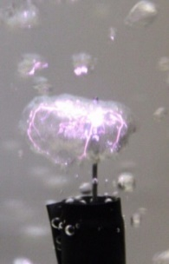
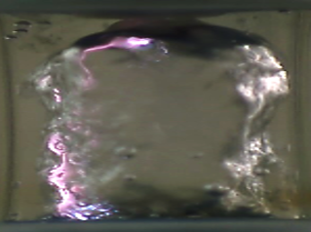

Discharges at Gas-Liquid Interface
Plasma propagates in gas phase along the gas/liquid interface
Requires lower electric field to generate plasma than inside water
More efficient generation of plasma
Planar Surface
Bubbles
Water film reactor
electrode
Gas phase
H₂O_{liq}
H₂O_{liq}
electrode
Vapor
bubble
Flow direction
Gas flow
4 mm
H₂O_{liq}
5 cm
1 cm
electrode
(Grymonpre et al., 2004)
(Shih and Locke, 2009)
(Wandell and Locke, 2014)
Continuous flow system
Batch, semi-batch systems
Flow system useful to control gas/liquid, residence times
Measure gas and liquid products and reactants at reactor exit
  (immediately quench to prevent post plasma interactions)
Notes:
Here are a few of the many ways to generate plasma at the interface with liquid water.
focus on the continuous flow small reactor since we can control the gas and liquids (semi-independently) and can focus on a small section of the plasma at the gas-liquid interface.
Show where electrodes are placed.

Slide 8
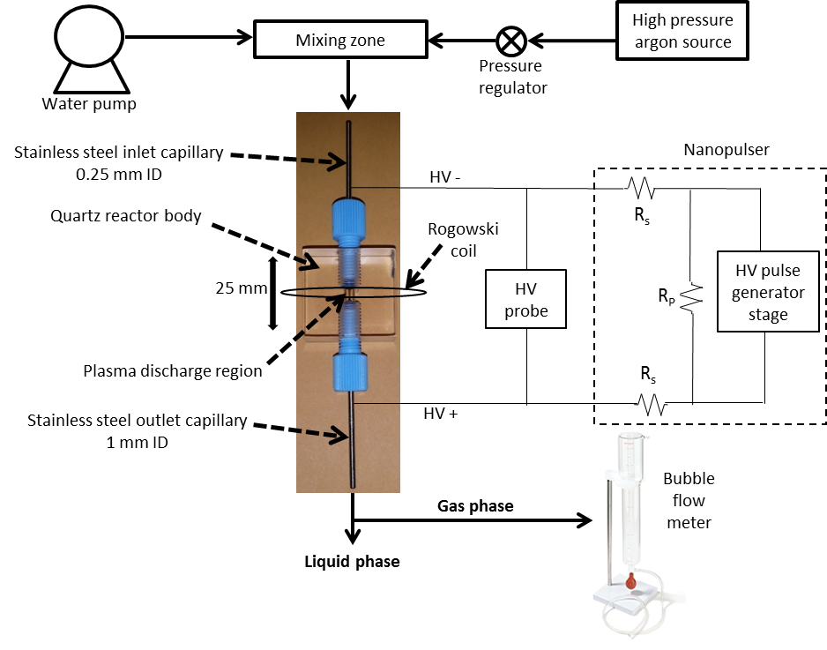
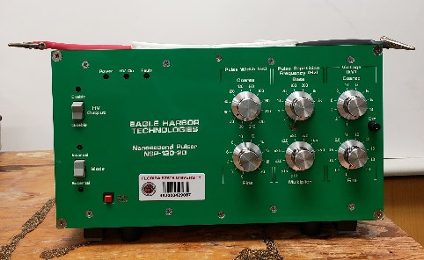
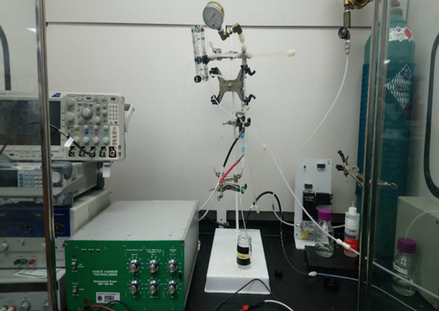
Water Film Plasma Reactor System
High pressure gas source
(60 psig)
Optical emissions
Spectrometer
(w/ optical fiber)
Eagle Harbor, LLC
Gas samples:
FTIR (in-line),
GC/MS,
GC/FID
Liquid samples:
IC, GC/MS,
NMR, GC/FID, UV spectroscopy
Notes:
This is process schematic for the water film plasma reactor system
- The inputs to this system are water, delivered with a high pressure reciprocating pump. And a high pressure gas source
The gas/liquid mixture enters and exits the plasma discharge region through S.S. inlet capillary tubes which also act as the plasma electrodes
After exiting they system the gas liquid mixture is separated and can be analyzed by several analytical quantification techniques we have available, including IC, GC, FTIR and UV vis.
A commercially available power supply is used to generate the plasma discharge and current and voltage are measured with a rogowski coil centered around the discharge region and an HV probe attached across the electrodes.
And finally, plasma diagnostics are performed with OES
We have also performed extensive high speed imaging to assess what is physically occurring inside the plasma discharge region.

Slide 9
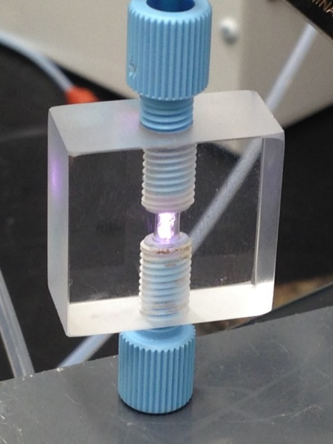
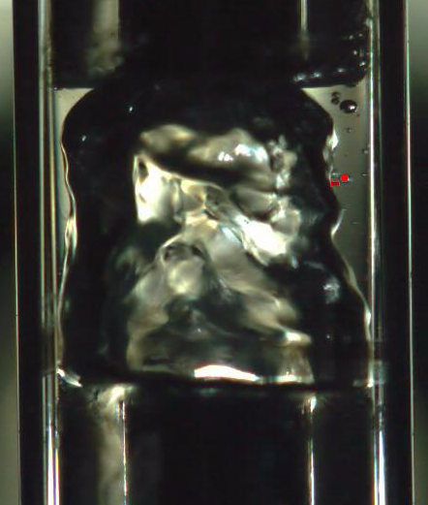
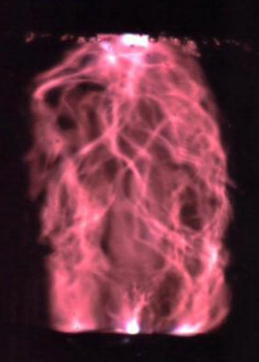
High Speed Imaging of Water Film Reactor
3 mm
Liquid film flow region
4 mm
Flow direction
Gas flow region
Gas-liquid interface / Plasma discharge region
*4,000 fps
Geometrical Properties
  Volumes of liquids and gases
  Interfacial area (gas-liquid and plasma-liquid)
  Residence times of liquids and gases
    100-250 ms (liquid), 2–5 ms (gas); nozzle size dependent
Hydrodynamics
  Flow patterns and regimes (annular flow)
  Pressure in reactor (choked flow at inlet) higher pressure forces liquid to form film on walls
  No evidence of plasma discharge affecting hydrodynamics
*1/60 sec. shutter speed
*1/12,000 sec. shutter speed
Notes:
- Gas and liquid phases
- Plasma propagates along interface
- Then long exposure
- Fast exposure
- Show video
- Can also use images to estimate gas and liquid volumes to calculate residence time
- As well as analyze flow patters

Slide 10
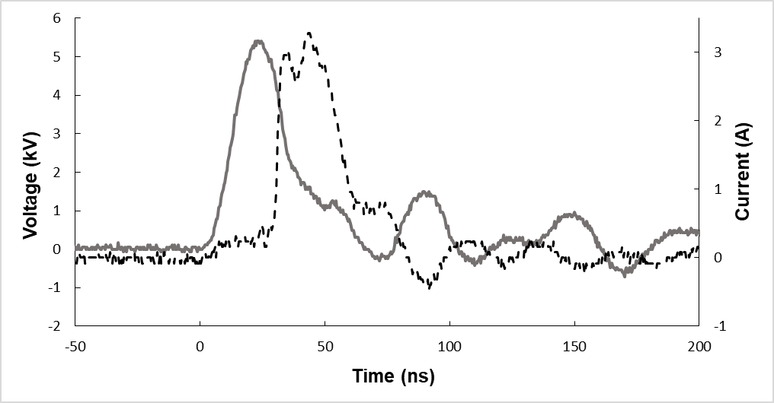
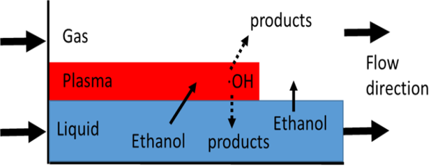
Reactor/Plasma Characterization
Electrical properties
  Breakdown voltage, and rise rate
  Peak / total current per pulse
  Energy per pulse / Power
Plasma properties (time averaged OES)
  Plasma gas temperature ≈ 500 K
  Electron density ≈ 4 x 10¹⁶ cm⁻³
  Electron energy ≈ 4 eV
  Plasma volume ≈ 0.04 mm³
voltage
current
5.5 kV peak, 0.3 kV/ns, 3 A peak,
150 μJ/pulse, 0.30 W @ 2 kHz (argon)
Mass and energy transfer
  Liquid and gas (film theory)
  Liquid and plasma
  Chemical probes (scavengers)
(Hsieh et al. 2016, Wandell et al. 2018, Wang et al. 2018, 2019)
Notes:
- We have also fully characterized the system with respect to electrical and properties such as breakdown voltage and energy per pulse
- As well as plasma prosperities such as gas temperature, electron density, electron energy, and plasma volume
- By employing various chemical probes we can also investigate mass and energy transfer between gas and liquid phases as well as the plasma channel
- For example we can employ a highly water soluble OH probe to investigate the mass transferrer of OH into the liquid film.

Slide 11
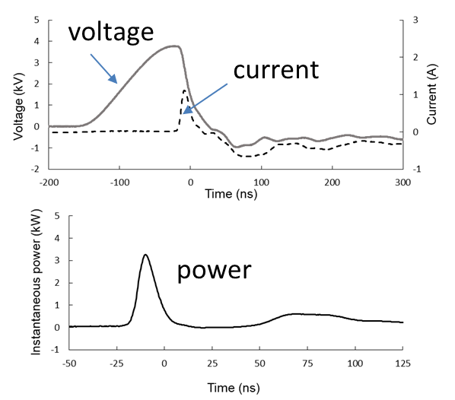
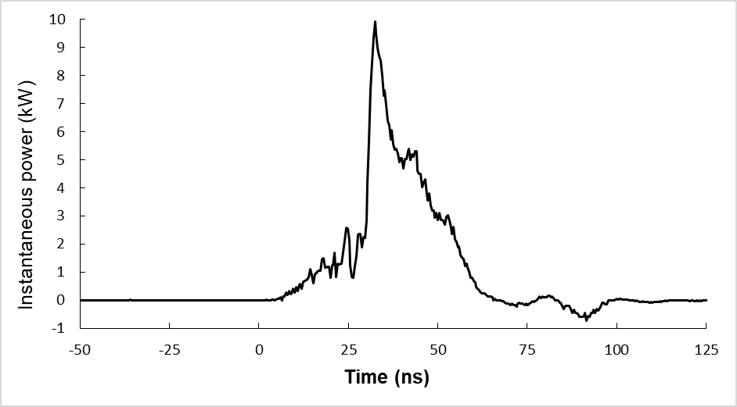
Power Supplies - Nanopulsers
1) Airity Technologies (custom)
2) Eagle Harbor Technologies (commercial)
1 kHz, 3.8 kV peak, 140 ns (rise)
130 μJ/pulse, 0.13 W, argon
2 kHz, 5.5 kV peak, 20 ns (rise), 0.3 kV/ns,
150 μJ/pulse, 0.30 W, argon
voltage
voltage
current
current
power
power
Energy: 80 to 140 μJ/pulse
Frequency Ranges: to > 60 kHz
Frequency range: to 10 kHz
Pulse width range: 20 to 260 ns

Slide 12
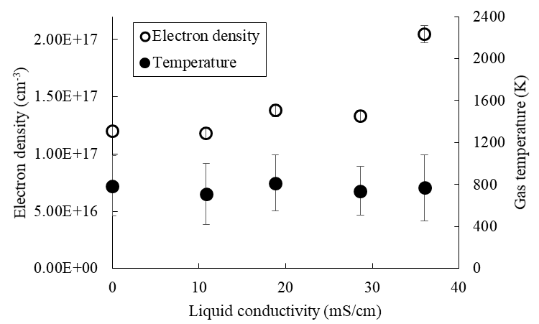
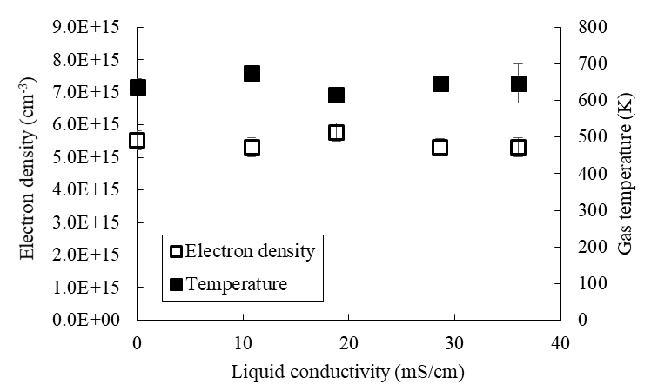
Influence of Liquid Conductivity
(Eagle Harbor nanopulser)
Argon
Helium
Plasma properties relatively unaffected by large changes in liquid conductivity.
(Discharges effectively in near seawater, (seawater = 50 mS/cm), conductivity.)
Unique for nano-pulsers (not found with microsecond pulser), fast rise time.
Some effects of conductivity above 36 mS/cm seen for argon, but not helium.
Essential for treating real world samples
(Wang et al., 2019)

Slide 13
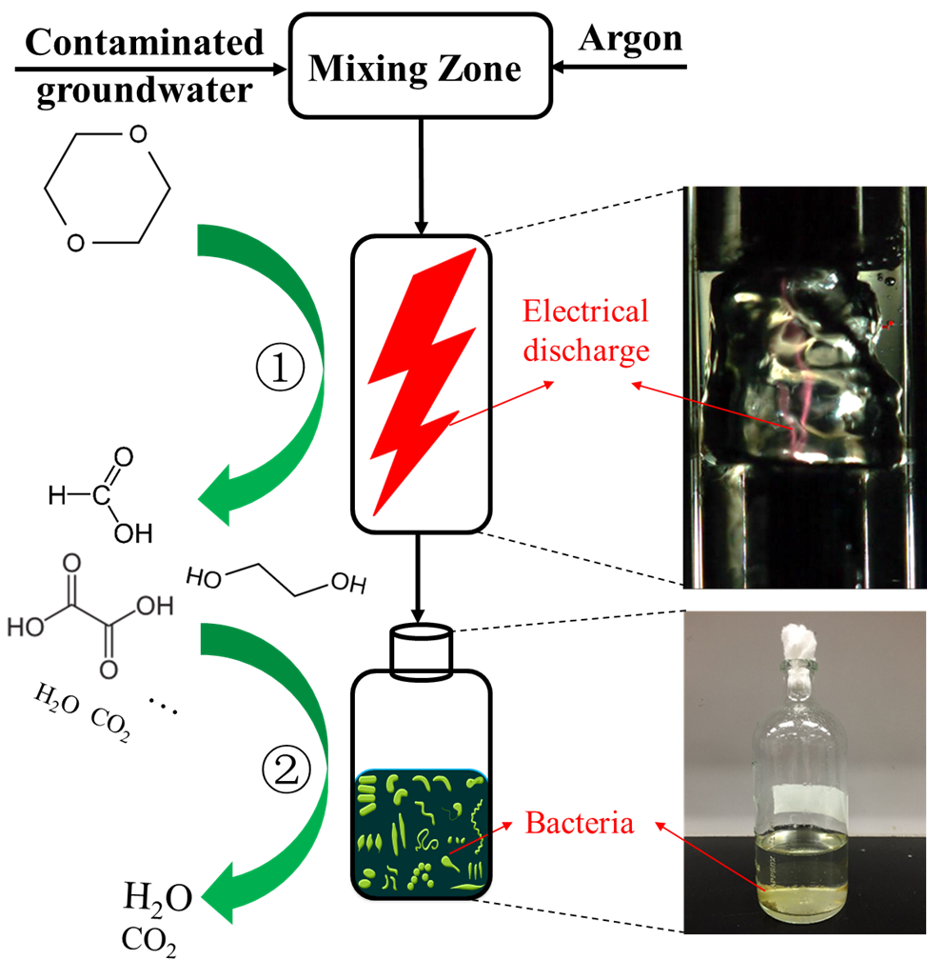
Post-plasma Considerations
1,4 dioxane degradation
Example Application
Partial degradation of 1,4 dioxane by plasma
  1, 4 dioxane highly water soluble, non-volatile
  Emerging groundwater contaminant found in combination with chlorinated contaminants
Mineralization in bioreactor after plasma reactor
Seeking to improve overall efficiency by reducing overall energy cost by combining plasma for initial degradation with bioreactor for complete mineriization of products from plasma.
(Xiong et al., 2019)

Slide 14
Plasma/Bioreactor Treatment Performance
Plasma reactor performance
Bioreactor performance
Optimum HRT in plasma reactor occurs when majority of dioxane is converted to intermediates in plasma reactor, but organic products remain
Plasma degrades 1, 4 dioxane; bioreactor degrades remaining products.
Plasma/bioreactor utilizes 5 times less power than plasma alone
and bioreactor is about 5 times faster than without plasma.
Bioreactor alone can only partially remove 1, 4 dioxane and organic carbon.
Notes:
Starts from case 6 dioxane-TOC-comparision between these two

Slide 15
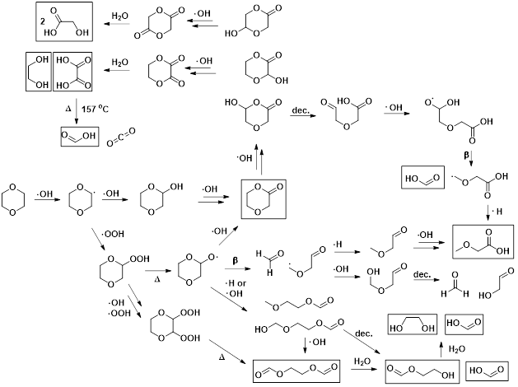
Dioxane Plasma Degradation Pathway
(liquid phase, ·OH based)
(boxed products detected
By GC/MS and NMR)
Products from 1, 4 dioxane suggest oxidation by ·OH.

Slide 16
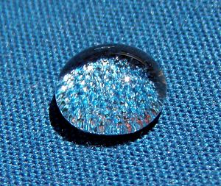
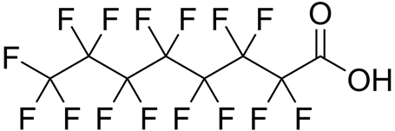
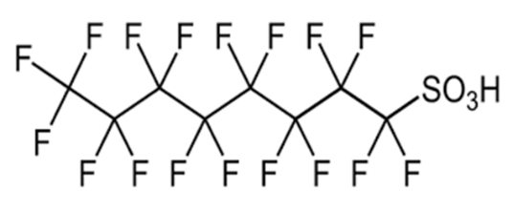
Perfluorinated alkylated substances (PFASs)
Key economic player for major chemical production companies
Used in emulsion polymerization to produce fluoropolymers
  Extremely resistant to heat and chemical reactions
    Teflon coatings
  Extreme surfactant
    Firefighting foams
    Paint industry
    Clothing industry
$1 billion annual market for use in stain repellents
$100 million annual market for use in polishes, paints, and coatings
Fluorine-containing repellent makes fabrics water-resistant
(Wikipedia)
Many other similar compounds found
You have to know what to look for to know if its there!
Perfluorooctanoic acid (PFOA)
Chemical formula – C₈HF₁₅O₂
Molecular weight – 414 g/mole
Boiling point – 189°C
Perfluorooctanesulfonic acid (PFOS)
Chemical formula – C₈HF₁₇O₃S
Molecular weight – 500 g/mole
Boiling point – 133°C
(Wikipedia)

Slide 17
Perfluorinated alkylated substances (PFASs)
First utilized in the 1940s
  Considered to be “inert” molecules
“Forever chemical” (4-5 year half life)
  Highly recalcitrant (extremely resistant to natural degradation)
Initially considered harmless to humans and animals due to its “inert” quality
Bioaccumulation
  Accumulation of chemicals in the body (animals and humans)
  No natural enzymes to break them down
Now linked to many serious health complications such as thyroid disease and various cancers (testicular, kidney)
Currently found in low concentrations in almost all ground water
  Advancements in analytical analysis now allow for detection at very low levels
US-EPA advisory level (PFOA, 2009) – 70 ppt
(Wikipedia)

Slide 18
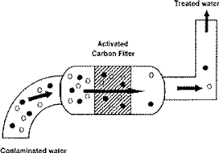
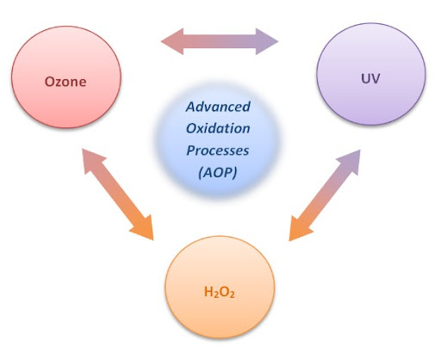
PFAS Removal Methods
  Filtration (current industry standard)
    Activated carbon, Reverse osmosis
      Requires further treatment for reuse
      Disposing residue
  Advanced oxidation
    Sonolysis, electrolysis, activated persulfate
      Enhanced by addition of chemicals
      Low removal efficiency
    Non thermal plasma water treatment
      Uses electricity and water
      Plasma produces reductive species like H, e⁻_{aq}, OH
      The reductive species mineralizes PFOA to F⁻
Plasma is a destructive method
Current industry standards of removal only transport the problem to an alternate location

Slide 19
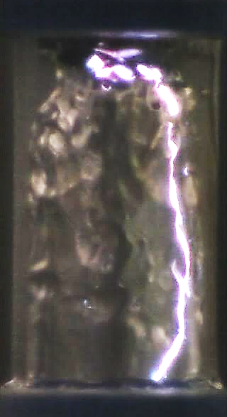
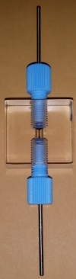
Initial Experiments at FSU (2018)
High concentration synthetic PFOA solution
Perfluorooctanoic acid – 50 ppm in deionized water, argon carrier gas, liquid flow rate 2 ml/min
Power supply settings – 16 kV, 40 ns, 0.25-10 kHz
Fluoride measure by ion chromatography
Mixing zone
Argon (60 psi)
50 ppm PFOA in DI water
@ 2 mL/min
Due to the difficulty of analytical analysis, we were limited to indirect indication of degradation
High initial PFOA concentration used for easy quantification
Only fluoride measured in initial experiments
  PFOA quantification very difficult
Defluorination used as an indicator for PFOA degradation
4 mm
Ion-chronography ( F-)
UV-Vis (H2O2)

Slide 20
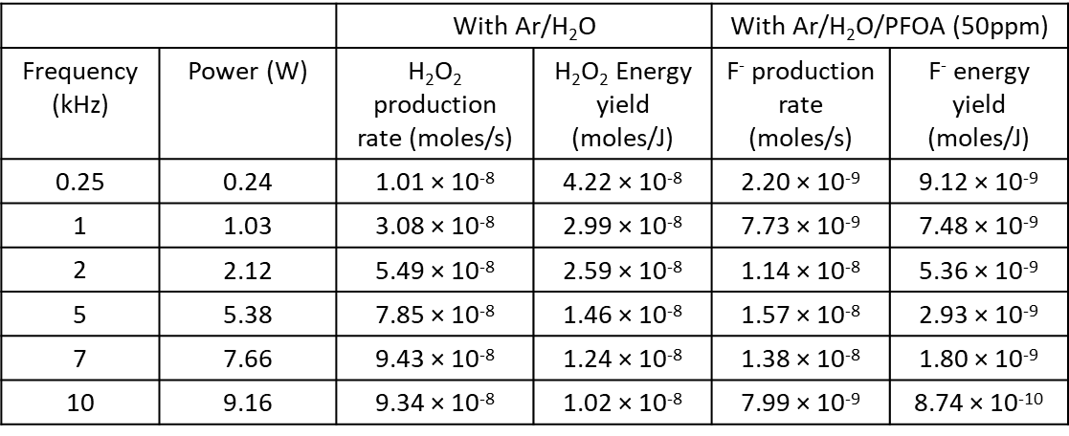
Initial Experiments at FSU (2018)
High concentration (50 ppm) synthetic PFOA solution
Initial results showed significant evidence of effectiveness
H₂O₂ production unaffected by PFOA
(Bulusu et al., Plasma Processes and Polymers, 2020, http://dx.doi.org/10.1002/ppap.202000074)

Slide 21
Performance comparison with other plasma systems
Fluoride energy yield comparison
 | Initial PFOA concentration (µM, ppm) | Production rate (moles/s) | Energy yield (nmoles/J) | Power (W) | % defluorination
Yasouka et. al. (2011) | 120, 50 | 1.1 × 10⁻⁹ | 0.87 | 1.25 | 17.5
Stratton et. al. (2017) (high removal efficiency) | 20, 8.28 | 1.17 × 10⁻⁹ | 2.8 | 4.1 | 5
Stratton et. al. (2017) (high removal rate) | 20, 8.28 | 6.3 × 10⁻⁸ | 0.82 | 76.5 | 27
This work (16kV, 40ns, 250Hz) (high removal efficiency) | 120, 50 | 2.2 × 10⁻⁹ | 9.12 | 0.24 | 3.65
This work (16kV, 40ns, 5kHz) (high removal rate) | 120, 50 | 1.6 × 10⁻⁸ | 2.93 | 5.38 | 26
All early experiments used fluoride as indicator for degradation
Performance of thin-film plasma reactor better than other plasma systems
(Bulusu et al., Plasma Processes and Polymers, 2020, http://dx.doi.org/10.1002/ppap.202000074)

Slide 22
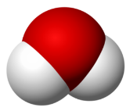


Hypothesis for why gas/liquid plasma treatment works well compared to other AOPs
Liquid
High pressure mixing
Gas
Argon (Ar)
H₂O
Liquid film
Liquid film
Hydrophobic
Hydrophilic
Gas-Liquid interface
Gas phase
Plasma discharge along interface
Surfactant nature of PFOA induces a high concentration at the plasma interface where the concentration of reactive species is extremely high
Experiments with other non-surfactant compounds show a significant drop in efficiency at low concentrations

Slide 23
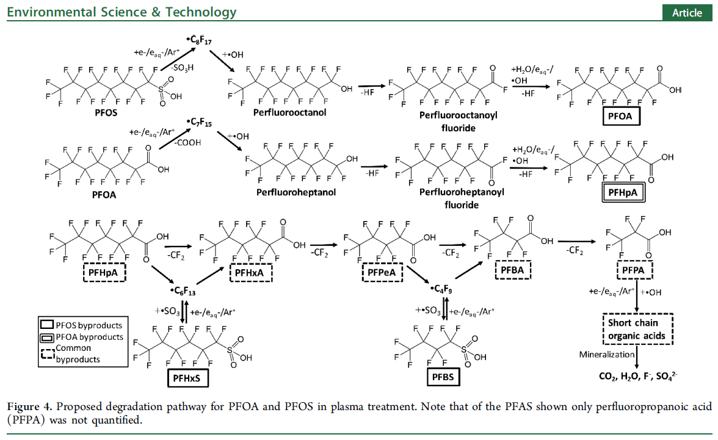
Proposed PFOS/PFOA degradation mechanism with plasma treatment
Literature suggests stepwise defloration degradation pathway
8 carbons → 7 carbons → 6 carbons → 5 carbons → 4 carbons → 3 carbons → mineralization
Singh, Raj Kamal, et al. "Breakdown products from perfluorinated alkyl substances (PFAS) degradation in a plasma-based water treatment process." Environmental science & technology 53.5 (2019): 2731-2738.

Slide 24
New Experimental Results at FSU (2021)
Mixing zone
Argon (60 psi)
Untreated sample
@ 2 mL/min
Method 533: Determination of Per- and Polyfluoroalkyl Substances in Drinking Water by Isotope Dilution Anion Exchange Solid Phase Extraction and Liquid Chromatography/Tandem Mass Spectrometry
Method 537.1: Determination of Selected Per- and Polyfluorinated Alkyl Substances in Drinking Water by Solid Phase Extraction and Liquid Chromatography/Tandem Mass Spectrometry (LC/MS/MS)
Method 537: Determination of Selected Perfluorinated Alkyl Acids in Drinking Water by Solid Phase Extraction and Liquid Chromatography/Tandem Mass Spectrometry (LC/MS/MS)
Influents
Synthetic PFOA/PFOS solutions (10 ppb)
Ground water
Landfill Leachate
Plasma treated sample
LC/MS/MS
(DEP)
Recent collaboration with DEP allows for critical analytical analysis
Allows for analysis of concentrations relevant to actual ground water
Analysis of degradation products allows for assessment of degradation pathway

Slide 25
New Experimental Results
Low Concentration (10 ppb) synthetic solutions
10 kHz pulsed plasma, 2 ml/min water flow, PFOA/PFOS in DI water, argon carrier gas
 | control | w/ plasma | Percent Removal
PFOA ppb | 9.800 | 4.500 | 54%
PFOS ppb | 0.610 | 0.620 | --
 | control | w/ plasma
PFOA ppb | 0.470 | 0.160 | 66%
PFOS ppb | 11.00 | 6.000 | 45%
Results confirm indirect fluoride measurements for degradation
Confirms significant removal is still possible at relevant concentrations (ground water)

Slide 26
Variation of plasma parameters
Frequency Effects
5 and 10 kHz pulsed plasma, 2 ml/min water flow, PFAS in DI water, argon carrier gas
Control (ppb) | plasma 5kHz (ppb) | % reduction
7.65 | 2.10 | 73
Control (ppb) | plasma 10kHz (ppb) | % reduction
7.65 | 5.20 | 32
Variation of plasma parameters strongly affects degradation
Significant optimization is to improve performance may be possible

Slide 27
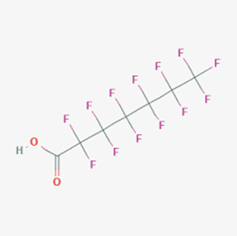
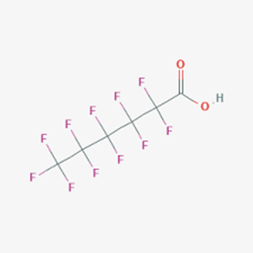
Major Byproducts of PFOA from Plasma Treatment
PFHpA (ppb)
Control (no plasma) | plasma 5kHz | plasma 10kHz
0.005 | 0.29 | 0.49
PFHxA (ppb)
Control (no plasma) | plasma 5kHz | plasma 10kHz
0.006 | 0.18 | 0.21
PFOA
(8 carbon)
PFHpA (7 carbon)
PFHxA (6 carbon)
Results support previously proposed stepwise degradation mechanism
Collaboration with Organic Chemistry Dept. (Prof. Alabugin) to investigate further

Slide 28
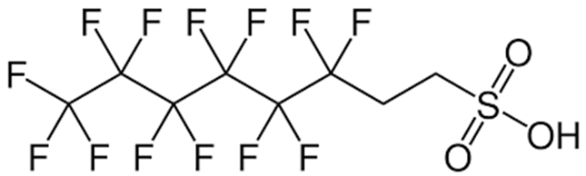
Groundwater Treatment with Plasma
GW1
Sample 1
pH – 7.4, Conductivity – 0.43 (mS/cm)
Compound | C atoms | F atoms | Untreated (ppb) | After plasma treatment (ppb) | % reduction
PFBA | 4 | 5 | 11.0 | 20 | -82
PFBS | 4 | 9 | 3.2 | 3.5 | -9
PFPeA | 5 | 9 | 32.5 | 55 | -69
PFHxA | 6 | 11 | 68.5 | 160 | -134
PFHxS | 6 | 13 | 11.0 | 11 | 0
PFHpA | 7 | 13 | 7.3 | 200 | -2659
PFPeS | 5 | 11 | 2.3 | 1.4 | 38
PFOA | 8 | 15 | 4.2 | 5.7 | -36
PFOS | 8 | 17 | 68.0 | 52 | 24
6:2 FTS | 8 | 13 | 615.0 | 100 | 84
PFNA | 9 | 17 | 1.0 | 4 | -300
8:2 FTS | 10 | 17 | 9.2 | 4.1 | 55
6:2 FTS (major contaminant)
*Extremely “hot” sample
Total PFAS 833.1 616.7 26
 | Untreated (ppb) | After plasma treatment (ppb) | % reduction
Net F atoms | 10804 | 7577 | 30
Net C atoms | 6369 | 4153 | 35
Total PFASs reduction 26%, total F reduction 30%, total C reduction 35%
8 carbon chain species reduced to 7 and 6 carbon chain

Slide 29
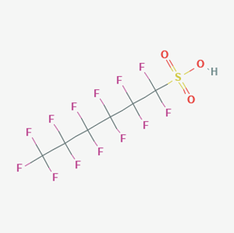
Groundwater Treatment with Plasma
GW3
Sample 2
pH – 7.1, Conductivity – 0.69 (mS/cm)
Compound | C Atoms | F atoms | Untreated (ppb) | After plasma treatment (ppb) | % reduction
PFBA | 4 | 5 | 0.4 | 0.8 | -116
PFBS | 4 | 9 | 1.6 | 1.3 | 16
PFPeA | 5 | 9 | 0.7 | 1.3 | -87
PFHxA | 6 | 11 | 1.5 | 2.3 | -59
PFHxS | 6 | 13 | 10.5 | 6.4 | 39
PFHpA | 7 | 13 | 0.4 | 0.6 | -40
PFPeS | 5 | 11 | 1.2 | 0.9 | 28
PFHpS | 7 | 15 | 0.3 | 0.2 | 41
PFOA | 8 | 15 | 1.3 | 0.7 | 45
PFOS | 8 | 17 | 9.9 | 4.9 | 50
6:2 FTS | 8 | 13 | 0.8 | 0.1 | 92
PFNA | 9 | 17 | 0.3 | 0.1 | 61
PFHxS (major contaminant)
Total PFAS 14.1 7.1 32
Total PFASs reduction 32%, total F reduction 37%, total C reduction 36%
Likely conversion of PFHxS to PFHxA (removal of sulfate group)
Similar performance even though total PFASs concentration Is much lower
 | Untreated (ppb) | After plasma treatment (ppb) | % reduction
Net F atoms | 402 | 254 | 37
Net C atoms | 193 | 124 | 36

Slide 30
Landfill Leachate Treatment with Plasma
pH – 7.5, Conductivity – 15.7 ms/cm
Compound | C atoms | F atoms | Untreated (ppb) | After plasma treatment (ppb) | % reduction
PFBA | 4 | 5 | 0.5 | 1.40 | -186
PFBS | 4 | 9 | 1.4 | 0.86 | 39
PFPeA | 5 | 9 | 1.1 | 1.20 | -9
PFPeS | 5 | 11 | 0.1 | 0.06 | 54
PFHxS | 6 | 13 | 0.6 | 0.19 | 69
4:2 FTS | 6 | 9 | 0.2 | 0.08 | 49
PFHxA | 6 | 11 | 2.6 | 1.40 | 46
PFHpA | 7 | 13 | 0.6 | 0.24 | 57
6:2 FTS | 8 | 13 | 3.4 | 0.92 | 73
PFOS | 8 | 17 | 1.1 | 0.19 | 83
PFOA | 8 | 15 | 1.4 | 0.34 | 76
PFNA | 9 | 17 | 1.1 | 0.29 | 74
6:2 FTS (major contaminant)
Total PFAS 14.1 7.1 49
 | Untreated (ppb) | After plasma treatment (ppb) | % reduction
Net F atoms | 174 | 73 | 58
Net C atoms | 95 | 41 | 57
Total PFASs reduction 49%, total F reduction 58%, total C reduction 57%
Degradation of PFASs still high even at high conductivity and in presence of other compounds

Slide 31
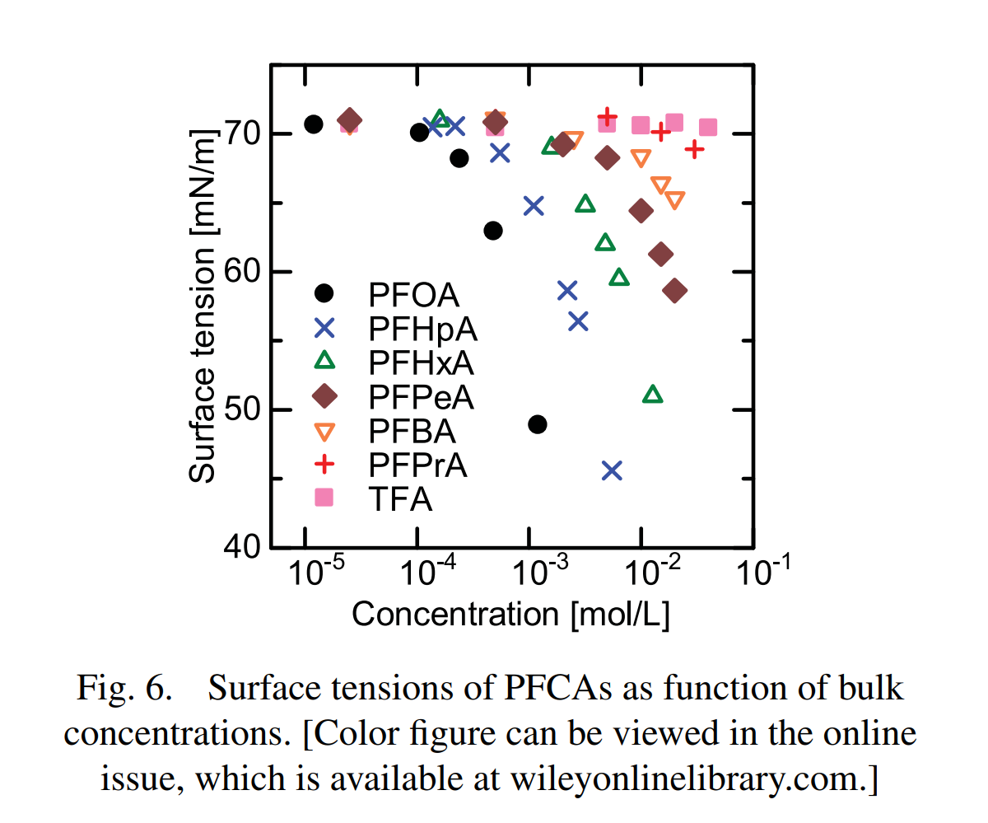
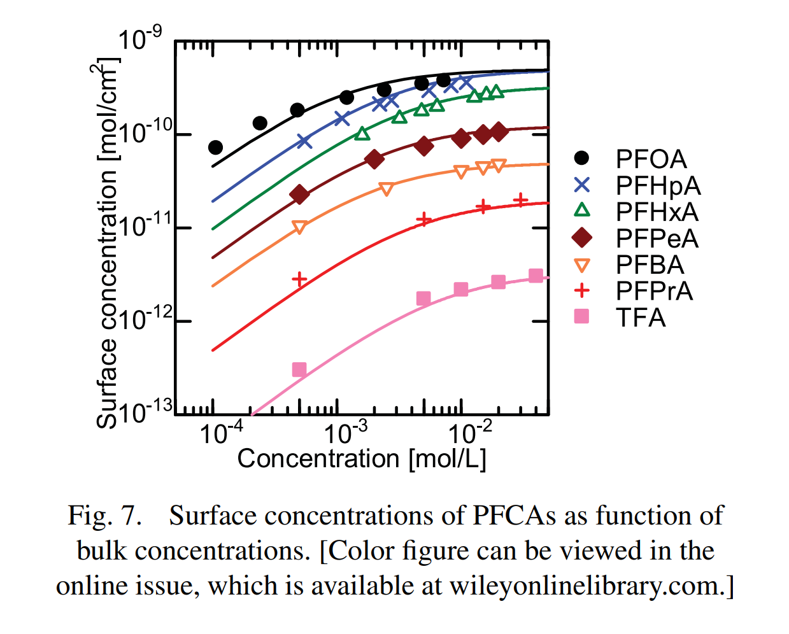
Effect of chain length on surface activity
From ground water and leachate samples, it is evident that longer chain PFASs are degraded more readily than shorter chain compounds
Literature shows that surface activity increases as a function of chain length
Supports hypotheses that surface activity is key to effectiveness of PFASs plasma treatment
  Longer chain compounds will be at a higher concentration at the gas/liquid interface
More experiments with various chain lengths are needed to investigate further
Yasuoka et. al. 2011

Slide 32
Conclusions
Thin film Gas-liquid reactor utilized can efficiently remove PFOA and PFOS from deionized water solutions
  Highest efficiency determined for PFOA (based upon fluoride) starting with 50 ppm compared to other plasma and advanced oxidation methods
Significant degradation (50%) also found with low concentration synthetic solutions of PFOA and PFOS (10 ppb)
  Proves effectiveness at relevant working concentrations
  Further improvement likely possible with optimization of plasma parameters
Degradation of PFOA into shorter chain PFASs support stepwise defluorination degradation pathway
Groundwater samples show average total PFASs reduction of 30%
  Total carbon and fluorine reduction is 10% higher than total PFASs reduction
  Longer chain compounds are more readily degraded
  Longer chain compounds degrade into shorter chain compounds
PFASs degradation in leachate was even higher than that in ground water, 50%
  Shows performance is not affected by high conductivity or the presence of other compounds
  High surface activity of PFASs likely responsible

Slide 33






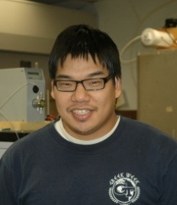



Collaborators on this work
Prof. Bruce Locke
(Principal Investigator)
Prof. Youneng Tang
(Civil Envir. Engr.)
Dr. Stefan Bresch
(Chem PhD 2015)
Dr. Huihui Wang
(ChE PhD 2018)
Dr. Yi Xiong
(CEE PhD 2020)
Prof. Igor Alabugin
(Chem/Biochem)
Dr. Kevin Hsieh
(ChE PhD 2015)
Rachel Gallan
(ChE MS candidate)
Radha Bulusu
(ChE PhD candidate)
Undergraduates
Karam Eeso
Mojtaba Nouri

Slide 34
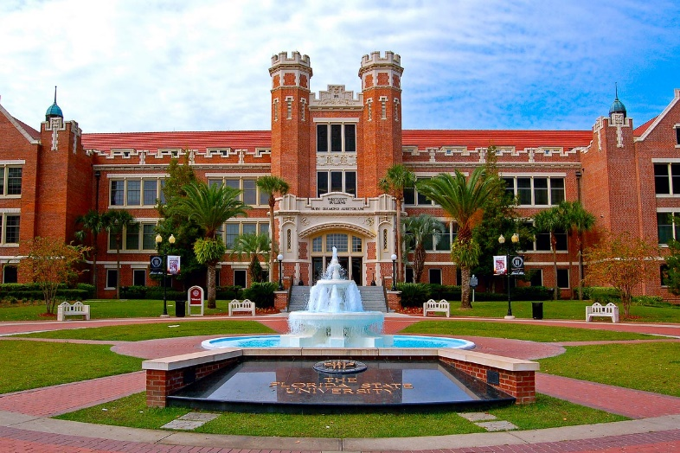
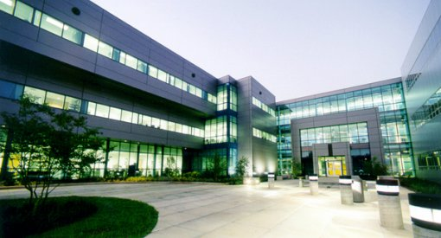
Thank you!
Questions??
Westcott building FSU
FAMU/FSU College of Engineering

Slide 35
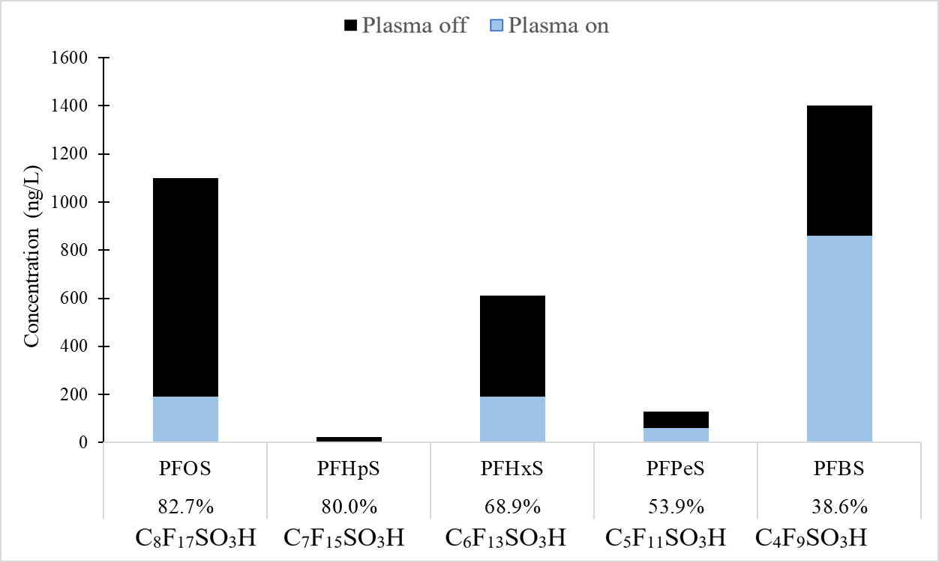
Landfill Leachate Treatment with Plasma
PFSAs (sulphur containing compounds)

Slide 36

Landfill Leachate Treatment with Plasma
PFCAs

