Slide 1



SCADA – Evolution, Anatomy and Security
Bryan Sinkler, Regional Technical Sales Mgr
bryan.sinkler@trihedral.com

Slide 2

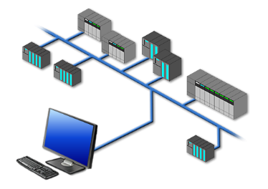
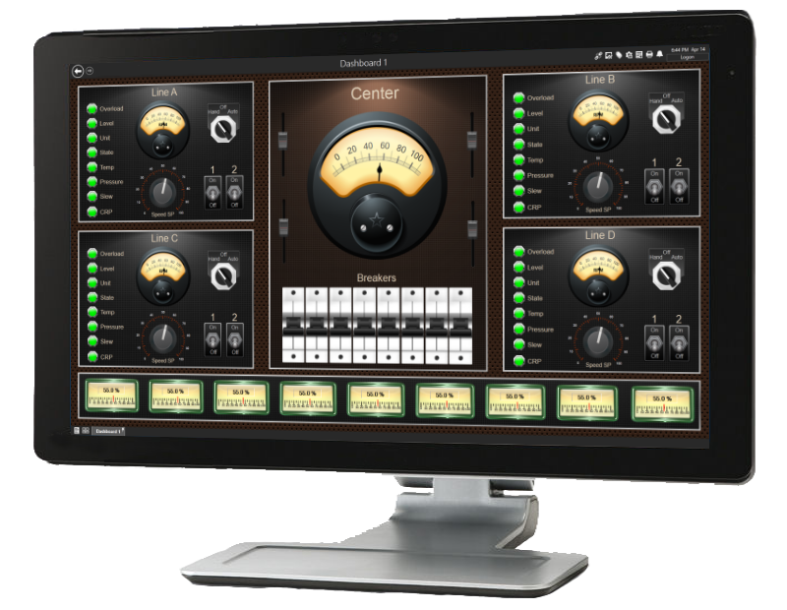
Topics Covered
SCADA Evolution
Types of SCADA Systems
SCADA Anatomy: Definitions and How HMIs are Created
SCADA Security

Slide 3

Evolution of SCADA

Slide 4
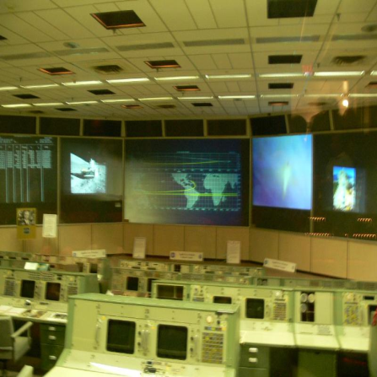
Made to Order SCADA
1960’s
Limited to monitoring and direct control
All sensors/controls wired to command center
Special-purpose
Extremely expensive
Large operational staff

Slide 5
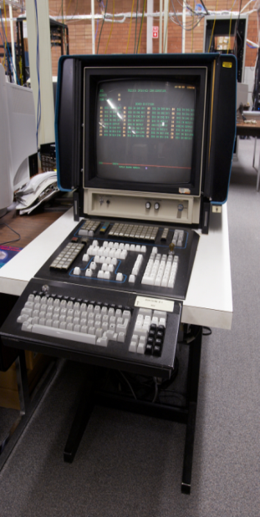
Dedicate SCADA
1970’s
Embedded control loop functionality
Less expensive than made-to-order
Common components/specialized
integration
Distributed control
Sensors/controls wired to device
concentrators
Fewer operational staff required
Honeywell
TDC 2000

Slide 6
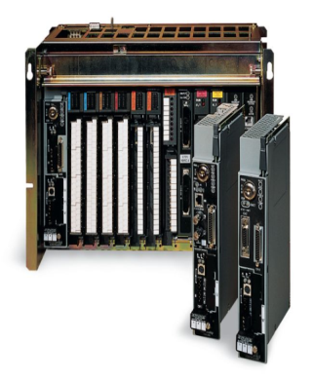
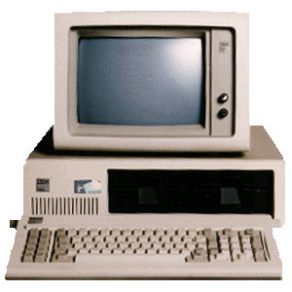
Human Machine Interface
1980’s
Programmable Logic - PLC’s, RTU’s and PC’s
Significant cost reduction
Control localized to assets/reduced wiring
Independent integrators
Proprietary networks
Reallocation of operational staff

Slide 7
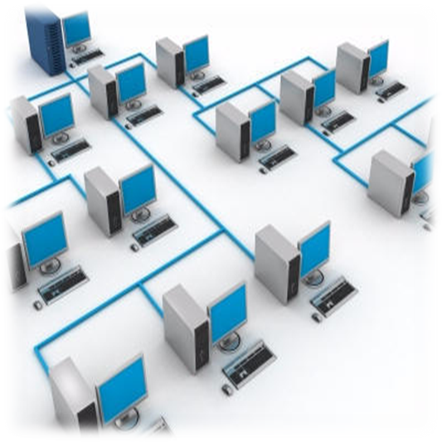
Open/Networked
1990 – 2000’s
Open communication protocols
New communication mediums (cellular, satellite)
Many new system integrators
Low cost instrumentation
Emergence of wide-area SCADA

Slide 8
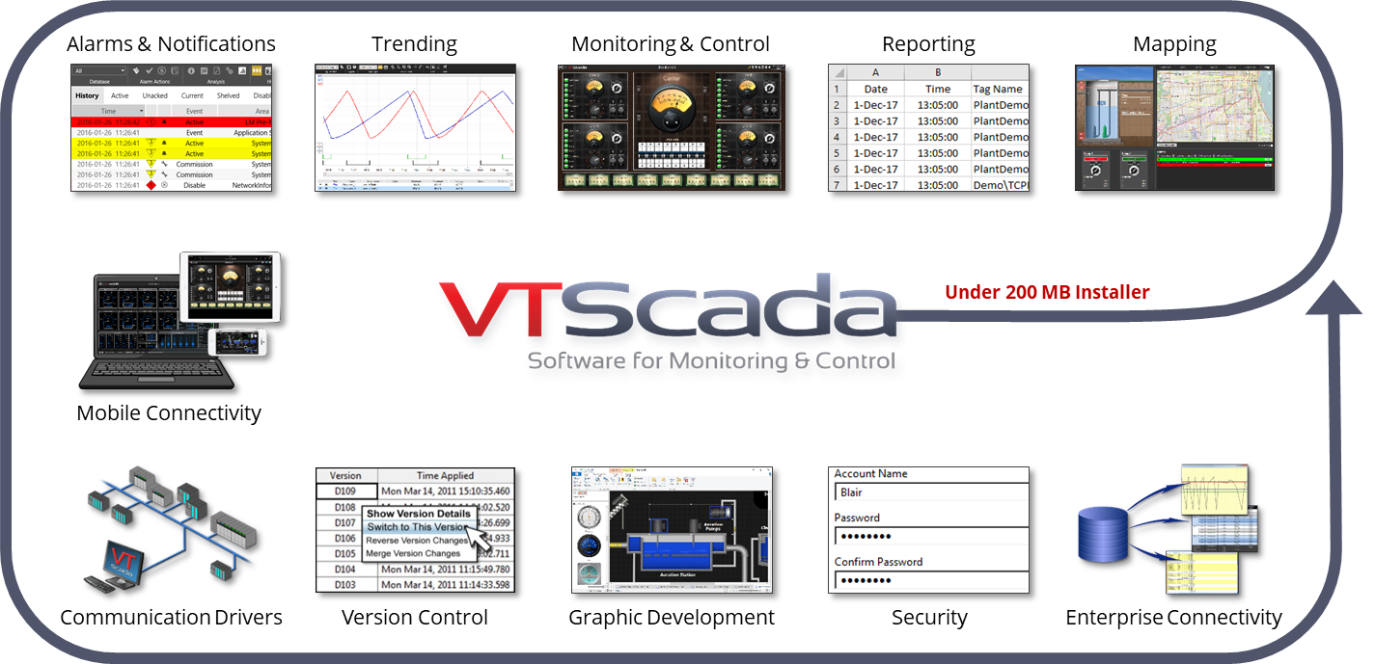
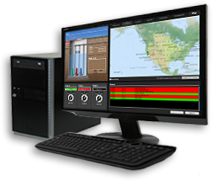
Integrated SCADA
2000 - 2010
Integrated Alarm Notification
Integrated Historian
Integrated Mapping
Ability to Interface to 3rd Parties Such as GIS, CMMS, LIMS, Reporting Software

Slide 9
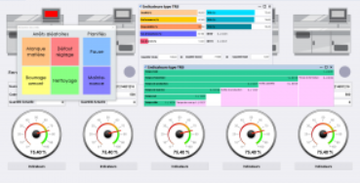
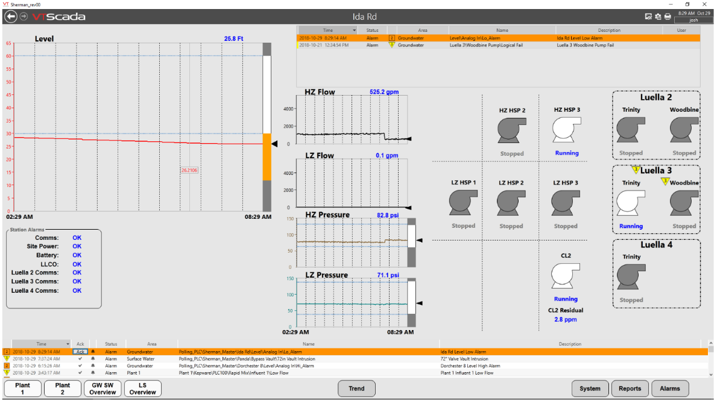
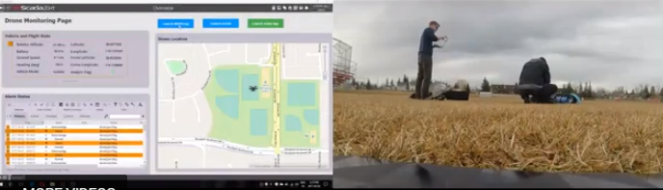
Analytics - Predictive
2010 - Now
Built In Analytics in Reporting
Interaction With GIS and CMMS
Focus on Cyber Security
IoT and IIoT
Data Scraping via Web Services – USGS, NOAA
Situational Awareness Graphics
Heading Towards Predictive SCADA – AI and Machine Learning via 3rd Party Software

Slide 10
Types of SCADA Systems

Slide 11
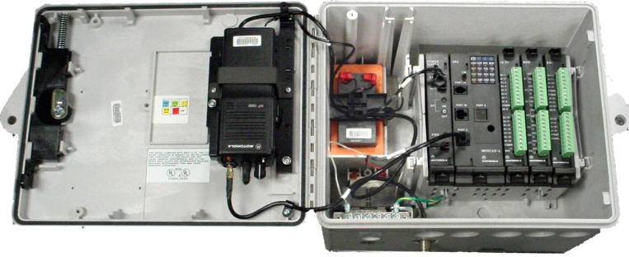
Proprietary/DCS SCADA Systems
All components manufactured by one supplier
Installation and service from same single source
Typically lack compatibility with other products
Uses proprietary communications protocol and programming
Use of communications systems that are not compatible with any other system components
HMI typically runs on Linux/Unix Operating System

Slide 12
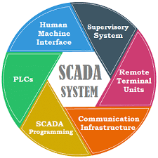
Traditional SCADA (Mix and Match) Systems
    Uses off the shelf PLC/RTU, radios, cell modems, etc.
    Utilizes open source protocols
    HMI is specifically designed for application
    Radios, Power Supplies, etc are readily available
    The source code for the RTU and HMI were supplied for end user
    System can be maintained, expanded, and serviced by several local or national sources

Slide 13

Data Logger SCADA Systems
Usually proprietary communications
Low cost
Stores large quantity of Data
Low cost for monitoring analog data
Frequent polling difficult
Usually heavily in Environmental Monitoring Applications

Slide 14
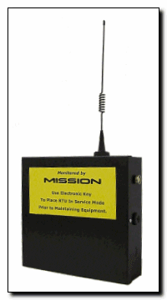
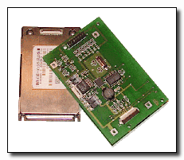
Cloud Based Solutions
Examples: Mission, Omni-Site, Xylem Pump View
Low cost of RTUs – easily installed
No HMI initial cost – connect via internet
Software not user configurable
HMI and data are at providers server
Monthly charge for cellular and web site varies $25-35 month (but can be higher)

Slide 15
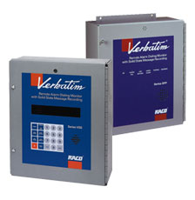
Auto Dialers
Relatively Low Cost
Easy to program
Upgrade existing units
Protocol – Either MODBUS or Proprietary
Slow polling with existing telephone line
Limited information storage

Slide 16
SCADA Anatomy

Slide 17
SCADA – A Working Definition
A monitoring and/or control system that utilizes a central computer for storing information and on site/remote hardware to monitor facilities and processes.
Control may be automatic or manual and may occur at the remote units or the central computer.

Slide 18
SCADA Definitions
TELEMETRY
    Transmitting & Receiving Information
    System Measurements / OFF/ON Control
SCADA
    Supervisory – Remotely turn OFF/ON
    Control – Automated & Programmable Control
    And
    Data Acquisition – Data stored on Computer
HMI
    Human Machine Interface

Slide 19
SCADA Definitions - Continued
RTU
    Remote Telemetry Unit
OPC
    OLE for Process Control
OLE
    Object Linking and Embedding (standards created in 1996 by ISA Task Force) defines communications of real time plant data between control devices from different manufacturers.
ISA
    International Society of Automation
PLC
    Programmable Logic Controller (Delta, AB, Siemens, Motorola, etc.)

Slide 20
Communications Methods
Dedicated Wire / Phone Line
Ethernet
Cellular Modem
Satellite
Private Cable Networks
Fiber Optic
Analog/Digital Radio
    Unlicensed CB Band
    Licensed VHF/UHF
    Unlicensed Spread Spectrum

Slide 21
Common Water/WW Protocols
MODBUS – ASCII, RTU, Modbus Plus, Modbus TCP/IP and Open Modbus
Allen Bradley DF-1, Data Highway, CIP
OPC – Ole for Process Control (OPC Server, OPC Client) e.g. Matrikon
DNP3 – Distributed Network Protocol –Back-fills data
Profibus, STD Bus, Devicenet, etc.
Siemens S7

Slide 22
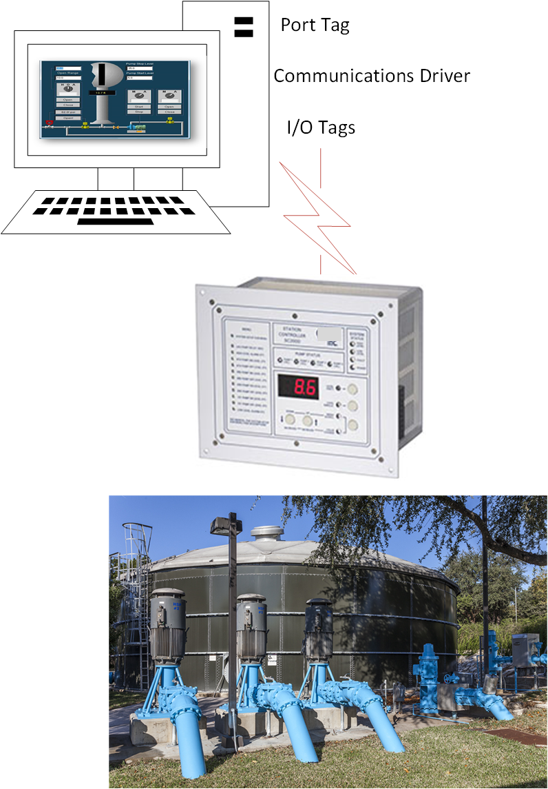
How SCADA HMIs are Built

Slide 23

SCADA System Security

Slide 24


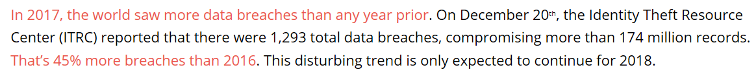
A Timely Message …

Slide 25
Some Notable Attacks in 2018 …
January 8: VTech - cyberattack that exposed the personal data of an estimated 6.4 million children worldwide.
January 11: Jason’s Deli – used malware to steal 2 million customers’ credit card information and sell it on the dark web.
January 17: Aetna - violating the privacy of about 12,000 members.
February 2: CarePlus - 11,200 members were exposed as a result of this breach.
February 5: Partners HealthCare - exposed the personal information of 2,600 patients.
February 15: FedEx - information of 119,000 customers from an unsecured Amazon Web Services (AWS) cloud storage server.
March 12: BJC Healthcare - exposed scanned images of documents from 33,420 patients.
March13:St. Peter’s Surgery & Endoscopy Center - 134,512 individuals may have been impacted
March 20: Orbitz - data breach affecting 880,000 consumers.
March 22: ATI Physical Therapy - 35,136 patients exposed
March 23: Massive Hack Sponsored by Iran - systematically hacked into the computer networks of 144 U.S. universities by performing a phishing scam and breaching the email accounts of roughly 4,000 professors.
March 29: Under Armour - one of the largest cyberattacks on record150 million users of its app, MyFitnessPal.
April 1: Saks Fifth Avenue, Lord & Taylor - hackers stole the data of more than 5 million credit and debit cards..
April 2: Panera Bread – the information of up to 37 million customers in plain text accessible from its website.

Slide 26
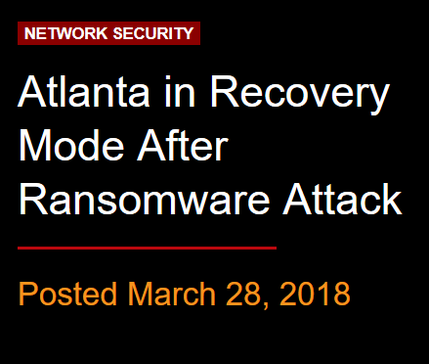
The City of Atlanta
"Today, the City of Atlanta is advising its employees to turn on computers and printers for the first time since the March 22 cyberattack," Mayor Keisha Lance Bottoms' office said in a statement late Tuesday morning.
Several computer systems used by the city remained offline as of Monday afternoon, and at least one of the affected entities -- the website for Atlanta's Department of Watershed Management -- still appeared to be impacted as of Tuesday afternoon.

Slide 27
Lessons from The City of Atlanta Attack
Secure your networks
  Through VPNs, segmented networks, etc.
Educate employees
  What to do (or not do), risky behaviors, etc.
Stay up-to-date
  Software vulnerabilities, procedures, etc.

Slide 28

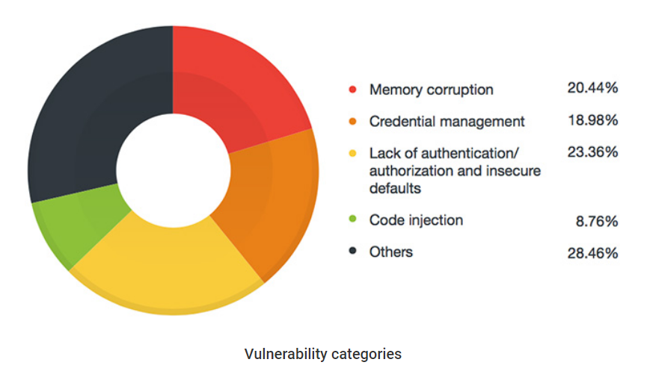
TrendMicro’s Report
www.trendmicro.com/vinfo/us/security/news/vulnerabilities-and-exploits/the-state-of-scada-hmi-vulnerabilities

Slide 29
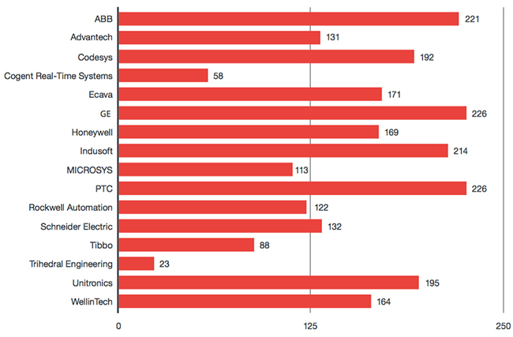
SCADA System Vulnerabilities – Average Days to Patch
Redacted
www.helpnetsecurity.com/2017/05/23/scada-systems-insecure/

Slide 30
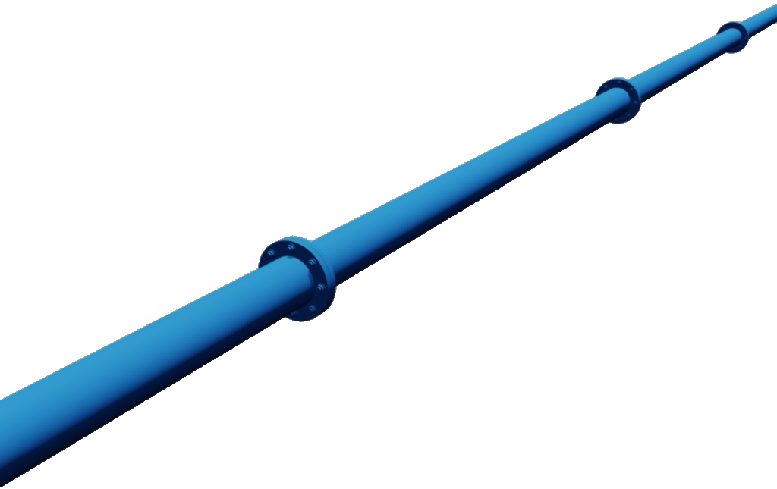
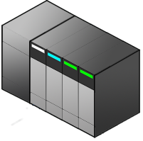

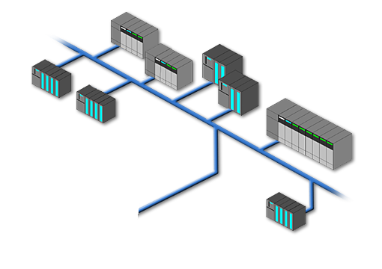
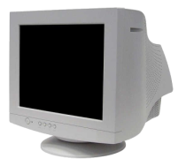
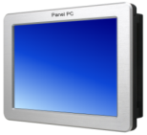







Create Multi-Level Secure Networks
Consider separate networks for:
Office Computers
SCADA Computers
PLCs / RTUs
Remote Devices
Remote Connections
Maybe “Contractor Laptops” to minimize unauthorized exposure?

Slide 31
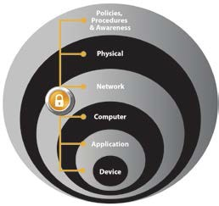
Follow Practical Procedures and Best Practices
Physical Security – limit physical access to authorized personnel: areas, control panels, devices, cabling, and control room – escort and track visitors
Network Security – infrastructure framework, firewalls with intrusion detection and intrusion prevention systems (IDS/IPS), and integrated protection of networking equipment such as switches and routers
Computer Hardening – patch management, antivirus software as well as removal of unused applications, protocols, and services
Application Security – authentication, authorization, and audit software
Device Hardening – change management and restrictive access
Data Access – Secure Data Accessibility

Slide 32
Network Examples
Level 5
Router
Enterprise Network
Enterprise
Zone
Level 4
E-Mail, Intranet, etc.
Site Business Planning and Logistics Network
Terminal Services
Patch Management
AV
Server
Firewall
Web
E-Mail
CIP
DMZ
Historian Mirror
Web Services Operations
Application
Server
SCADA Server
Data Historian
Engineering Workstation
Domain Controller
Firewall
SCADA
Zone
Level 3
Site Operations and Control
SCADA
Client
SCADA
Client
Area Supervisory Control
Level 2
Operator Interface
Engineering Workstation
Operator Interface
Cell/Area
Zone
Basic Control
Level 1
Batch Control
Discrete Control
Drive Control
Continuous
Process Control
Safety Control
Level 0
Sensors
Drives
Actuators
Robots
Process

Slide 33





Many groups working to keep networks secure…
International Electrotechnical Commission
  IEC-62443 (Formerly ISA-99), Industrial Automation and Control Systems (IACS) Security
  Zones and Conduits
    Defense-in-Depth
    Segmentation, IDMZ
National Institute of Standards and Technology
  NIST 800-82, Industrial Control System (ICS) Security
  Cybersecurity Framework: Identify, Protect, Detect, Respond, Recover
    Defense-in-Depth
    Segmentation, IDMZ
Department of Homeland Security / The Industrial Control Systems Cyber Emergency Response Team (ICS- CERT)
  Recommended Practices, Secure Network Architecture
    Defense-in-Depth
    Segmentation, IDMZ
Department of Homeland Security / Idaho National Lab
  DHS INL/EXT-06-11478
  Control Systems Cyber Security:
    Defense-in- Depth
    Segmentation, IDMZ

Slide 34
Security - Final Thoughts
Take Responsibility
Embrace Technologies Wisely
Consult and Collaborate Using Best Practices
Develop Written Strategies and Contingencies
Have Individual Credentials (where possible)
Educate Continually
http://www.youtube.com/watch?v=xtZvOmn5OvE&feature=youtu.be&hd=1

Slide 35
Questions????

