Slide 1

Separating Inflow Reduction and Infiltration Removal
Eric McRoberts, Dion Vlasak | USSI, Inc.
Frederick Bloetscher, PhD, PE | Florida Atlantic University

Slide 2

About Us
USSI was established with the express purpose of eliminating rainwater inflow into the wastewater collections systems. Over the years we have developed the G7 program (now AIIM) which provides unique products, procedures and systems.
When rainwater is prevented from entering the front end of the collection system, the AIIM program reduces overflows and spillages by increasing sewer capacity. The AIIM program is not only effective in preventing “Inflow” but it is also cost effective.

Slide 3
Outline:
Basics of I&I
Water Sales versus Wastewater Flows
SSES SB712 Methods and Requirements
USSI AIIM (Annual Inflow and Infiltration Maintenance)

Slide 4
Infiltration / Inflow (I/I)
Infiltration
Groundwater that enters the sewer through defective pipes, joints, connections & manholes
Inflow
Stormwater discharged directly into sewers from roof drains and stormwater runoff. This includes broken cleanouts and manholes.
Both overload the collection system & reduces treatment efficiency
- Function of age

Slide 5
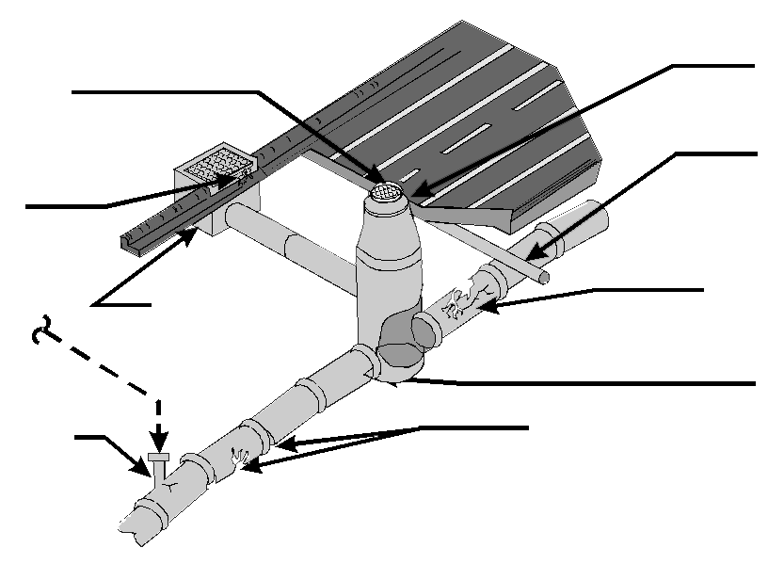
What is Inflow & Infiltration?
Inflow: Rainwater
Manhole Frame
- Loose
Manhole Cover
- Vented
- Poor Fit
Cross-Over
- Water
- Storm Pipe
- Cracked
Corbel
- Cracked
Sanitary Sewer Pipe
- Cracked
Storm Sewer
- Illegal Connection
To Private Sector
Pipe Seal
- Cracked
Connections
- Cracked
- Illegal
- Taps/Wyes
Joints
- Cracked
- Broken
- Offset
Infiltration: Groundwater
Rain & High Groundwater Effects Wastewater Collections System

Slide 6
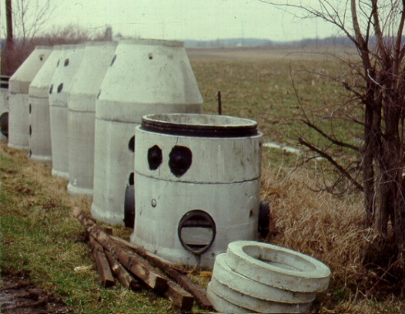
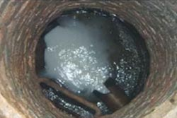
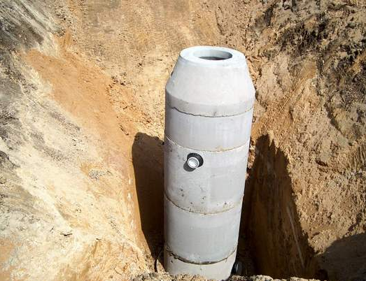
Types Of Manholes
Precast
Brick
Drop

Slide 7
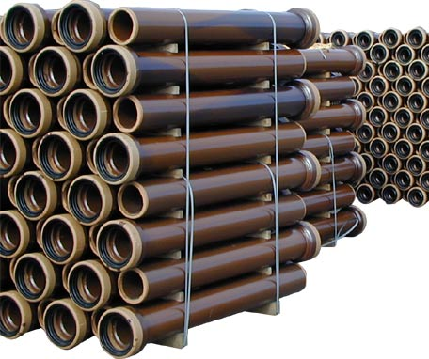
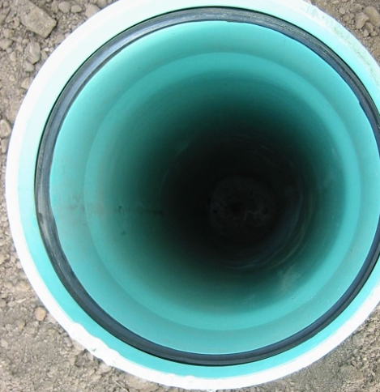
The Problem - Sanitary Pipe Materials
Small lines:
  PVC
  Vitrified clay
  Asbestos cement
Larger lines:
  Ductile iron
  Asbestos cement
  Concrete

Slide 8

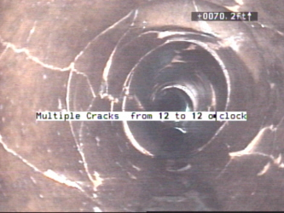
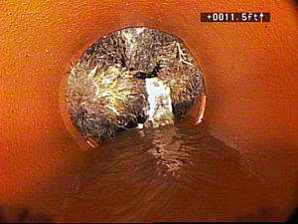
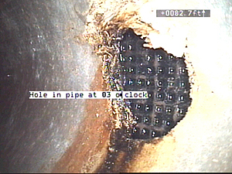
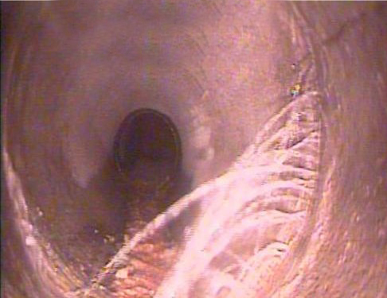
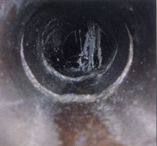
Broken Pipe = Infiltration
Infiltration

Slide 9
Age & Water = Infiltration & Inflow
Through trackable data water sales are lower than the flows at Wastewater Treatment Plants
That is not possible w/o I&I
Blue Line = Water Sales
Pink Line = Wastewater Plant Flow

Slide 10
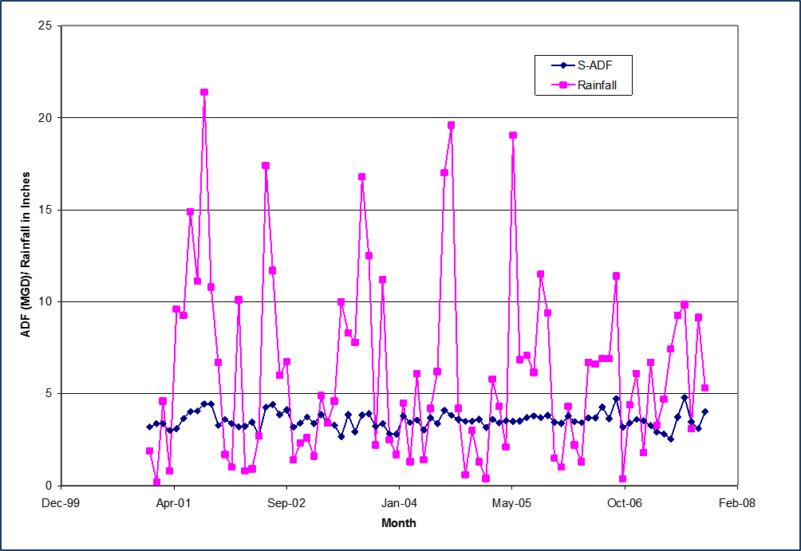
Sewer Flows V. Rainfall
We Can See…INFLOW!
Sewer flow peaks during rain events.
The size of the storm event matters -
A larger storm event will create
more inflow.
During storm events, wastewater flow is linearly related to rainfall.
Based on an analysis of flow vs.
rainfall graphs from pre and post construction activities inflow reduction will be calculated.
Potential Sanitary Sewer Overflows

Slide 11
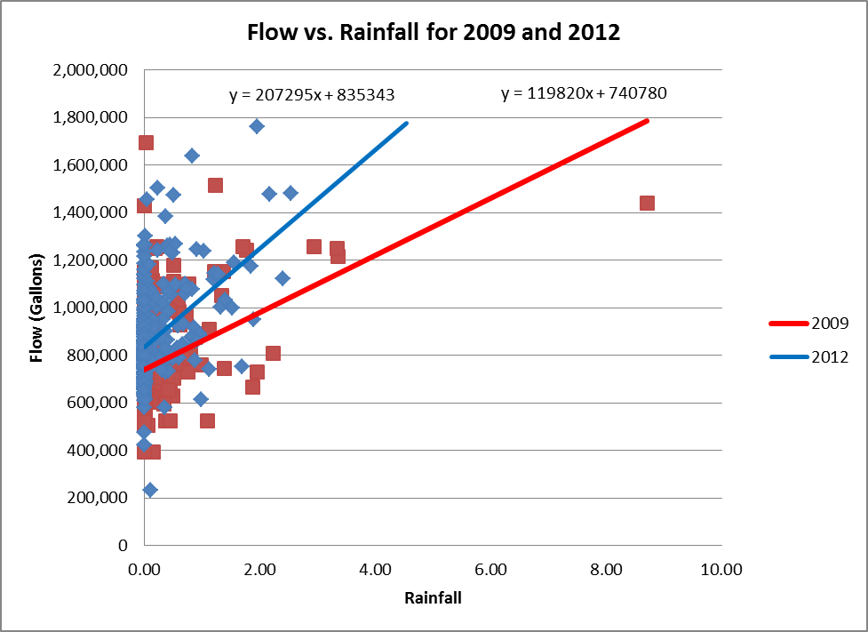
Flows Get Worse With Time
Track rainfall vs Flow - Data from a utility/no growth shows how the deterioration of the sewer system increases flow to treatment plants.

Slide 12
DEP and SSES Policy Changes

Slide 13
The Legislature Passed a SB712: SSOs
Passed unanimously during the 2020 Legislative Session.
The issue results from the Pinellas County overflows in 2015, but also Largo, Gulfport, St. Petersburg, Clearwater, St. Augustine, JEA.
The department shall adopt rules to reasonably limit, reduce, and eliminate domestic wastewater collection and transmission system pipe leakages and inflow and infiltration.
100%
INCREASE IN PENALTIES
for sanitary sewer overflows (SSO)

Slide 14

SSOs
A sanitary sewer overflow can spill domestic wastewater out of manholes, onto streets and into stormwater systems or surface water bodies before it is able to reach a treatment facility
A Key Concern
SSOs
entering rivers, lakes or streams is their negative effect on water quality.

Slide 15
Gov DeSantis
Penalties for violating environmental laws should do what they’re meant to do: Serve as a meaningful deterrent against bad actors.
Many of the state’s existing fines and penalties had not been adjusted since 2001 and had lost their deterrent effect. This penalty increase will enhance the department’s enforcement ability, better protecting our environment and ensuring that our environmental investments are safeguarded.

Slide 16

How does DEP respond to SSOs
An investigation is undertaken:
Was the violation inadvertent or beyond reasonable control?
Can any damage to the environment be undone or remediated quickly?
Is it a first-time violator or a chronic offender?
How serious was the violation?

Slide 17
Sewer System Cleaning & Maintenance
Reducing inflow through system rehabilitation and repairing
broken or leaking lines. (CIPP, Lateral Lining, Manhole Rehab)
Enlarging or upgrading sewer, pump station or sewage
treatment plant capacity and/or reliability.
Construction of wet weather storage and treatment
facilities to treat excess flows.

Slide 18
Requirements
The department shall adopt rules regarding the implementation of inflow and infiltration studies and leakage surveys;
All sewage disposal facilities under subsection (2) which control a collection or transmission system of pipes and pumps to collect and transmit wastewater from domestic or industrial sources to the facility shall take steps to prevent sanitary sewer overflows or underground pipe leaks and ensure that collected wastewater reaches the facility for appropriate treatment.
FDEP must annually report the number of overflows
YIKES!
FEES CAN BE $50K PER INCIDENT

Slide 19
MORE Requirements
Plan must have 5-year planning horizon that complies with department rule to limit, reduce, and eliminate leaks, seepages, or inputs into wastewater treatment systems’ underground pipes.
A deliberate, proactive approach to investigating or surveying a significant percentage of the domestic wastewater collection system throughout the duration of the permit to determine
pipe integrity.
Facilities must use inflow and infiltration studies and leakage surveys to develop pipe assessment, repair, and replacement action plans.

Slide 20
And Just a Few MORE Requirements
The pipe assessment, repair, and replacement action plans must be reported to the department. The facility action plans must include information regarding the annual expenditures dedicated to the inflow and infiltration studies and the required replacement action plans.
The report must detail any deviation of annual expenditures from identified system needs related to inflow and infiltration studies; model plans for pipe assessment, repair, and replacement; and pipe assessment, repair, and replacement.
Expenditures that are dedicated to pipe assessment, repair, and replacement; and expenditures designed to limit the
presence of fats, roots, oils, and grease in the
facility’s collection system.

Slide 21

The EASY Solution
USSI has a program to take care of these requirements…
so now you can get back to the real work.

Slide 23

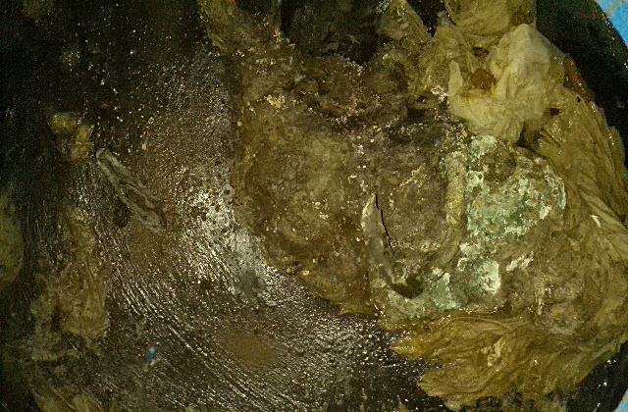
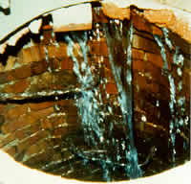
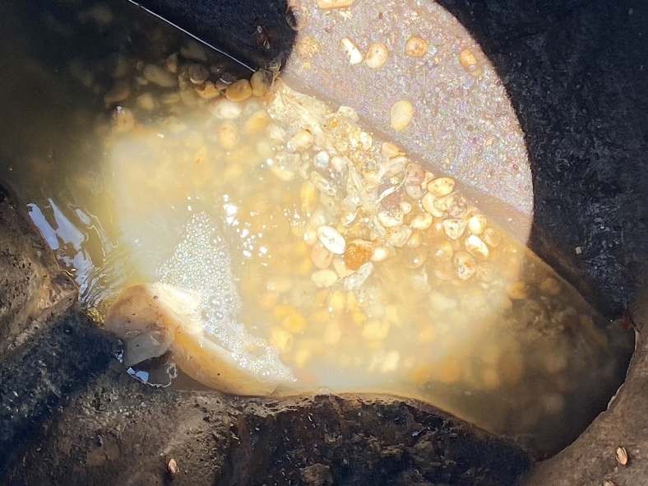
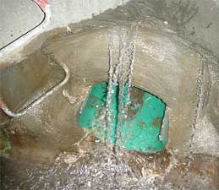
Manhole Inspections
{
Manhole inspections reveal surcharge in the collection system and evaluates condition of ring and cover, corbel and chimney. USSI has a 48 point inspection.

Slide 24
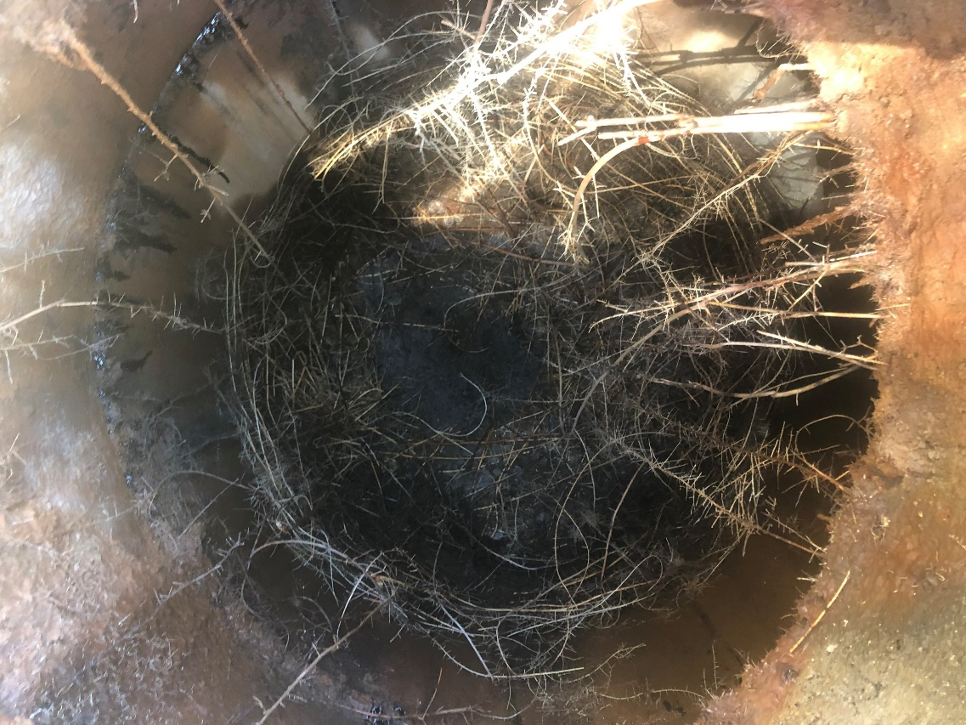
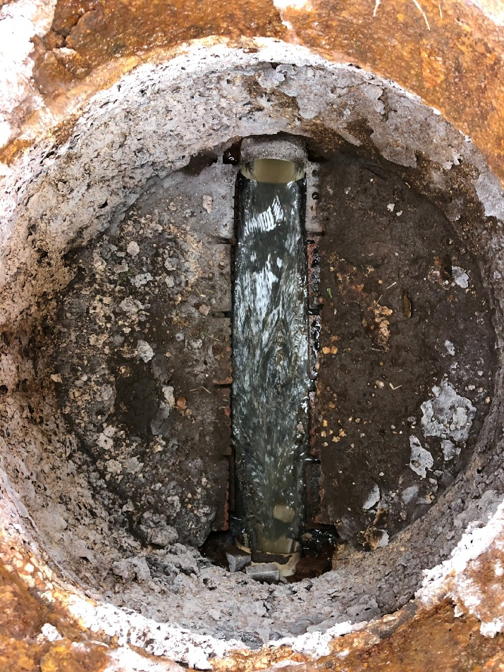
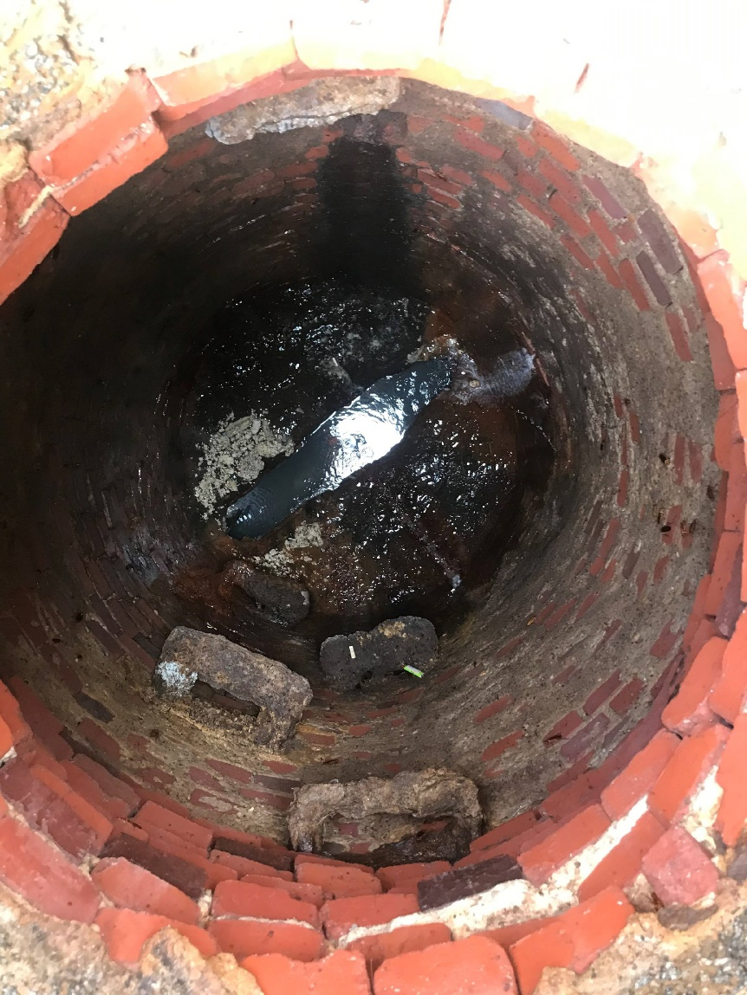
Manhole Inspections are critical for Surveying Collection Systems.
USSI crews average 60-80 Inspections per day.

Slide 25
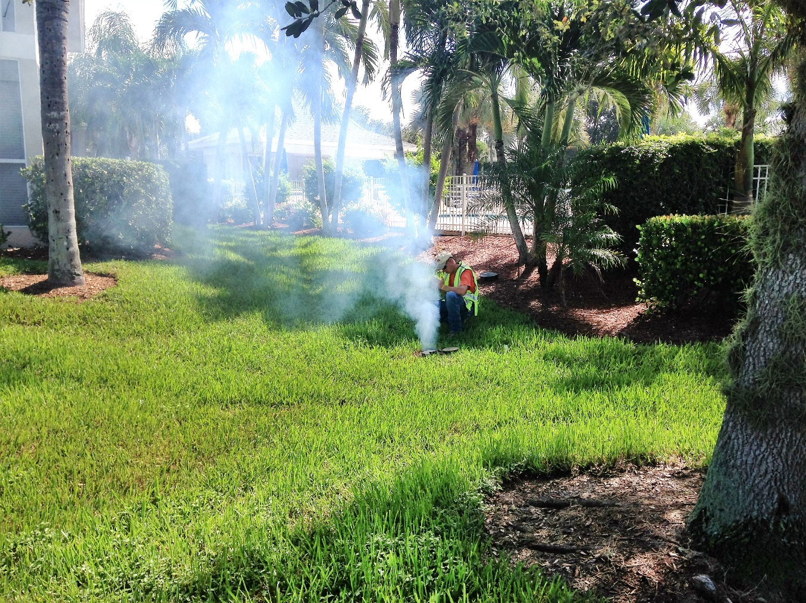
Smoke Testing
{
Smoke testing reveals location of breaks within the sewer system. (Broken clean-outs, illegal tie-ins, cross connections and potential broken sewer lines).
Infiltration
Rain or Shine
Water Table

Slide 26
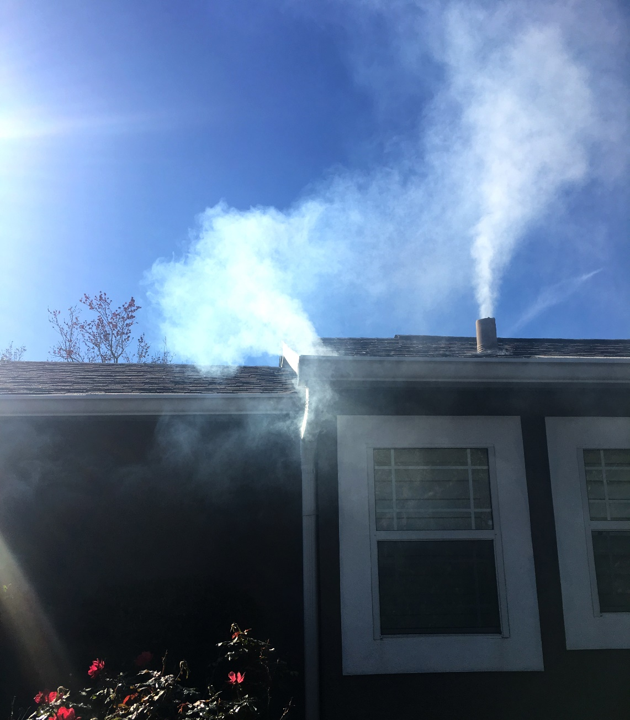
{
Illegal Connection to
Sewer System

Slide 27
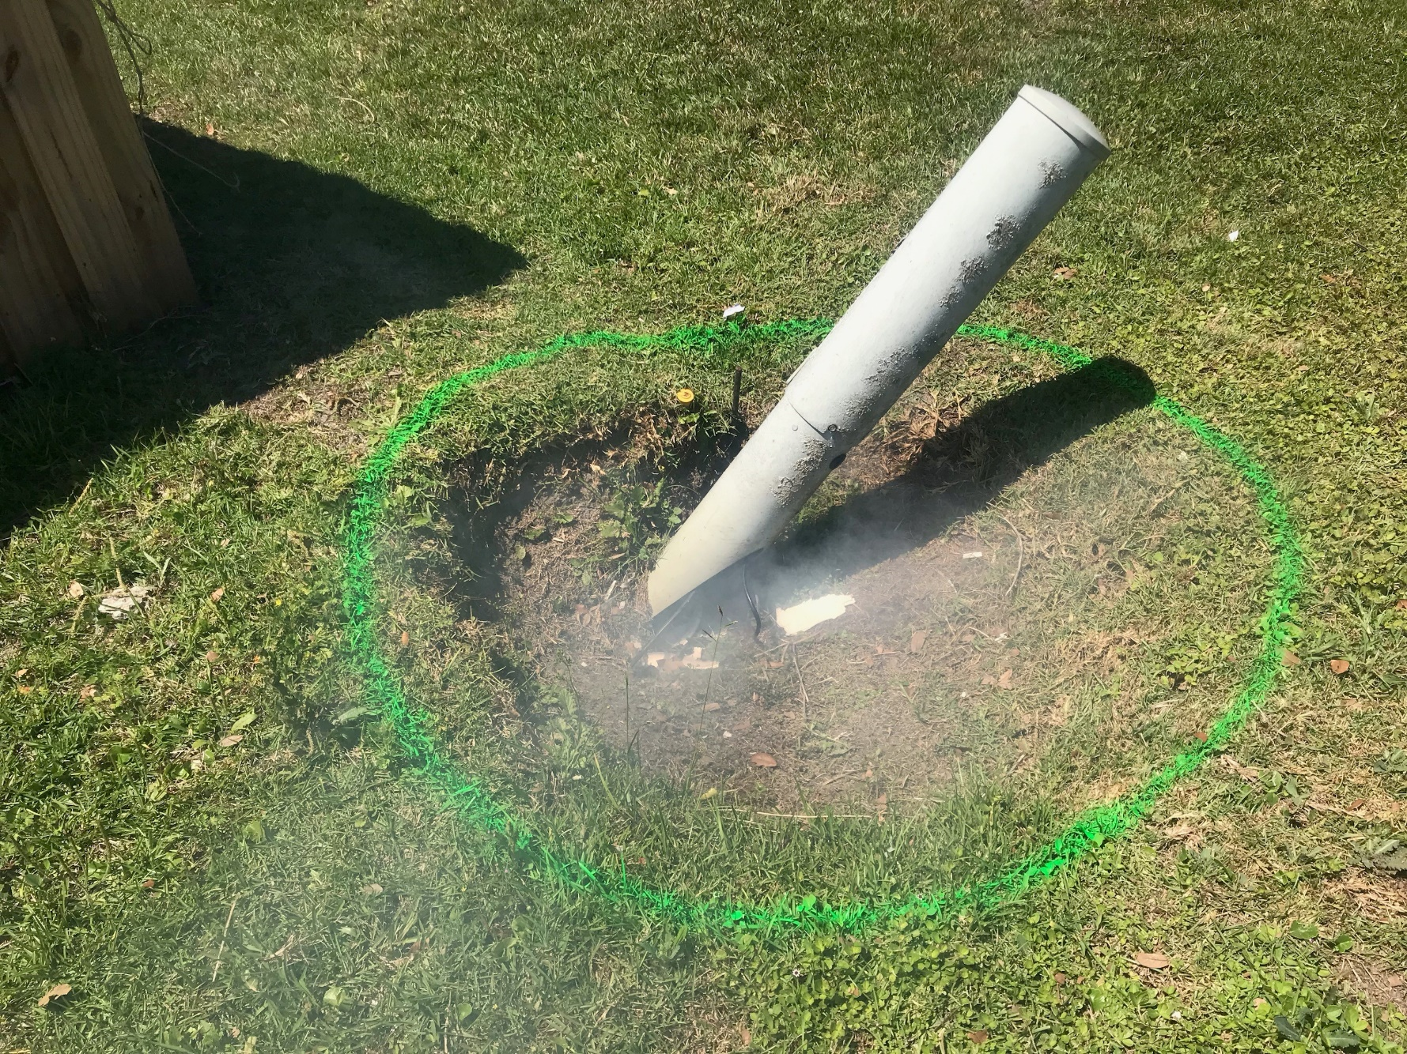
{
Broken Cleanout in a newer development that was in a swale. Large I&I defect.

Slide 28
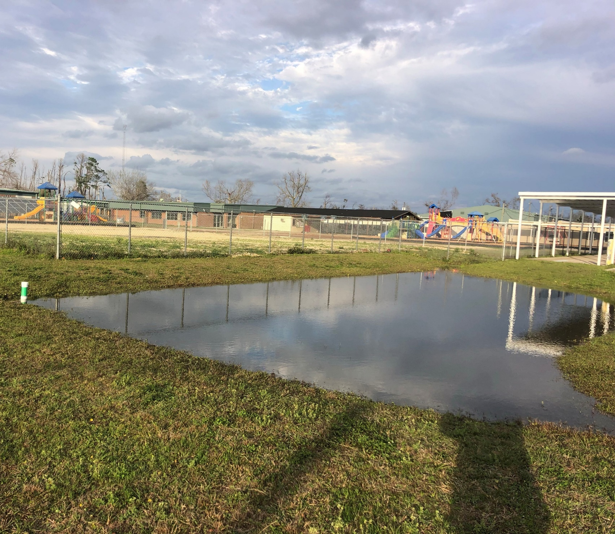
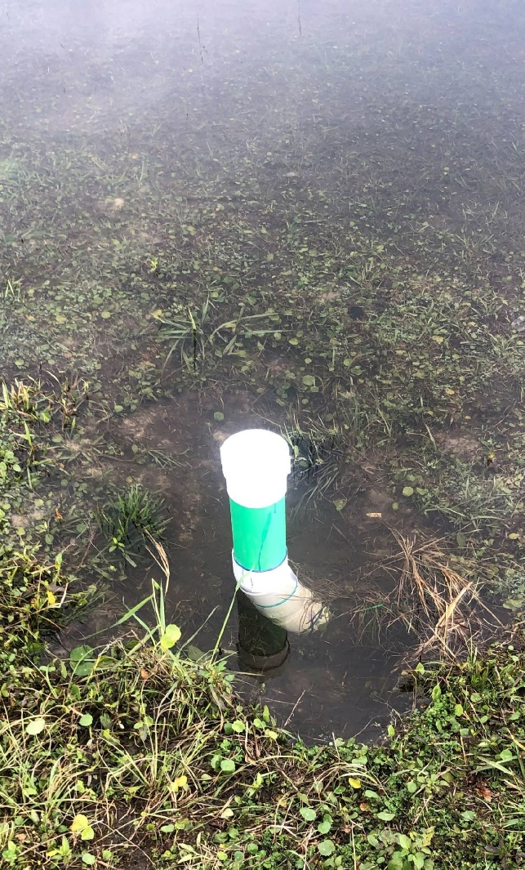
{
Smoke Testing revealed a broken cleanout in a storm pond that was never wet. Repaired and results are obvious.

Slide 29
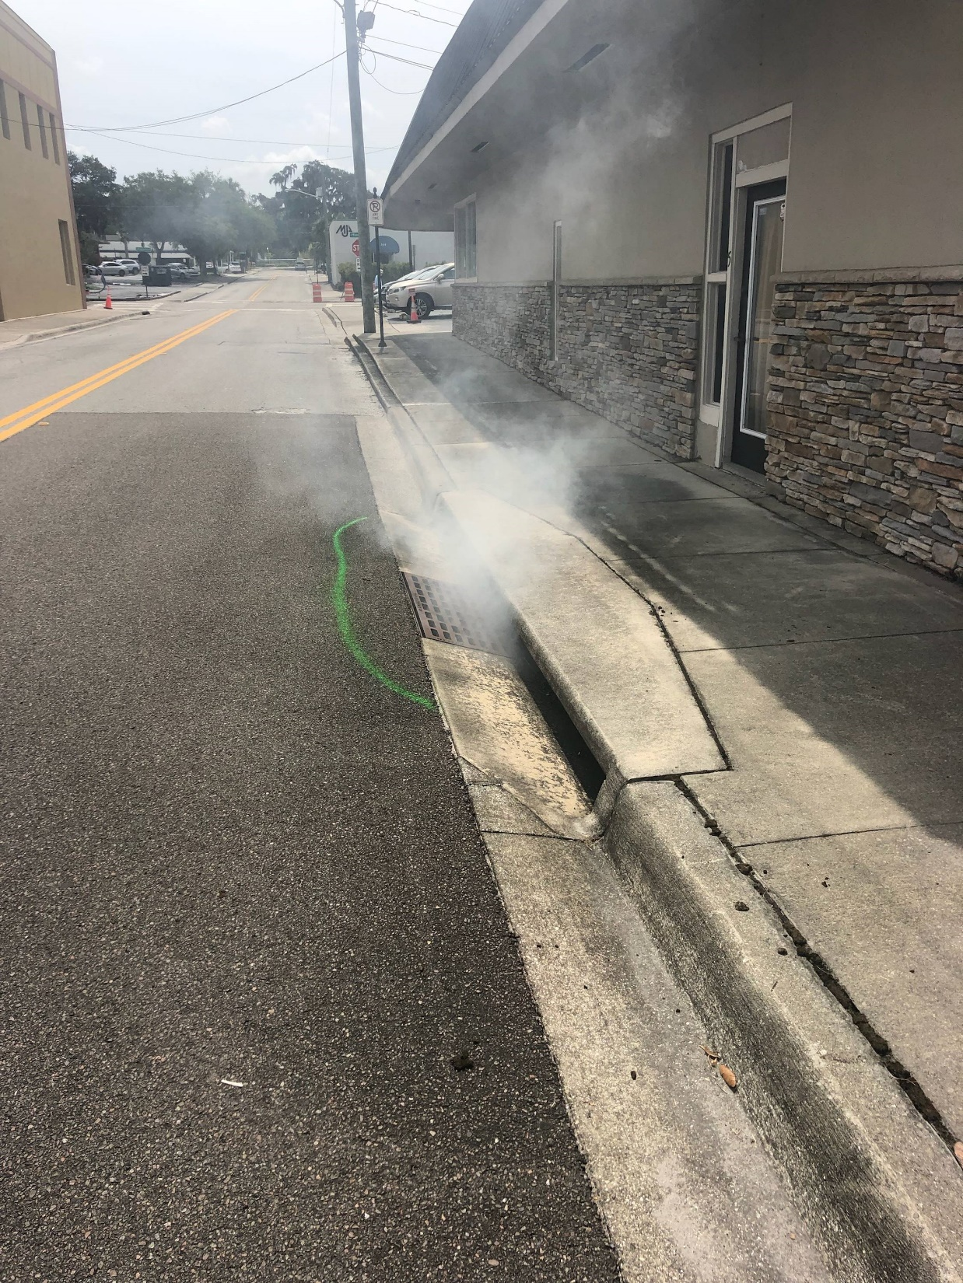
{
Smoke Testing
Revealed a Crossover

Slide 30
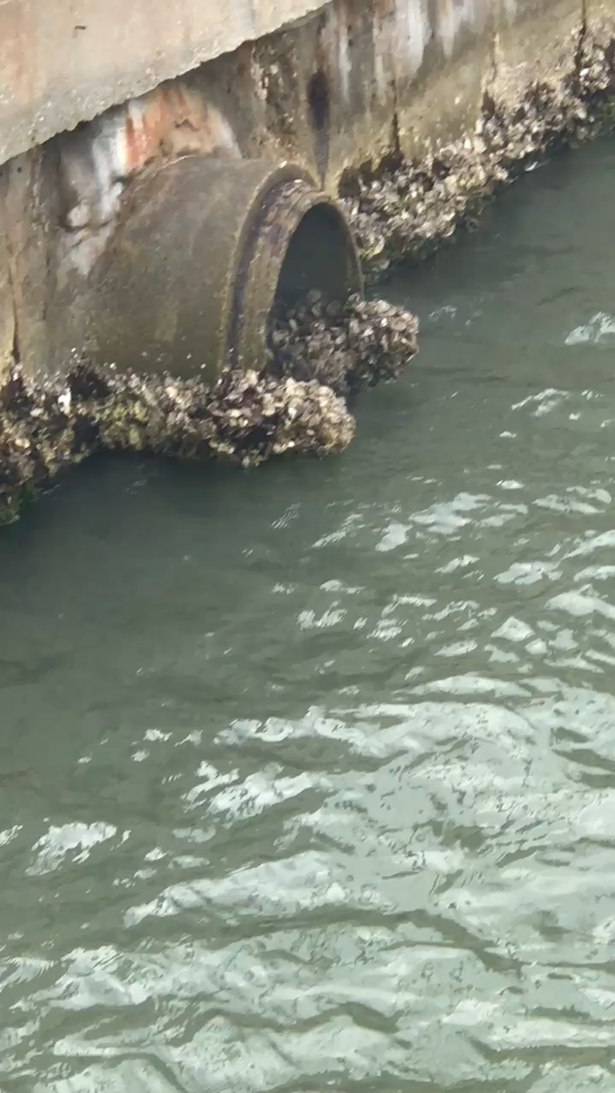
{
Found this defect in a coastal Marina where high tide submerged entire pipe. Very Serious.

Slide 31
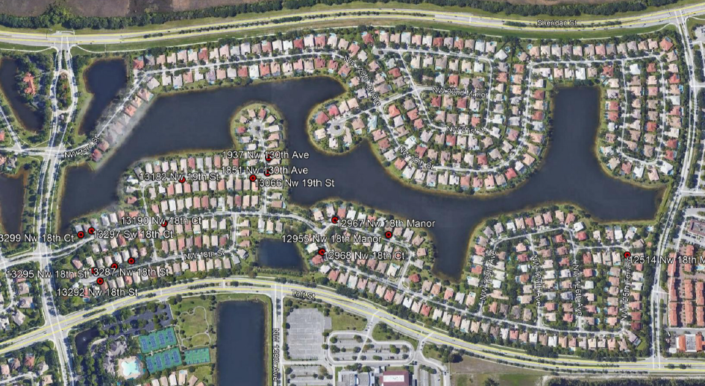
USSI’s Smoke Test Results Report Includes:
GPS
Address
Type of Defect
Severity
Elevation of Defect
Public/Private
{

Slide 32
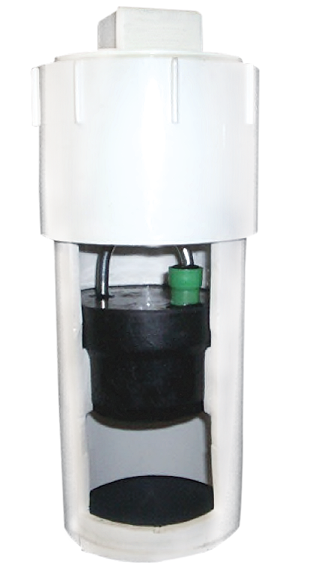
LDL™ Clean-out Smart Plug
Designed to abate rainwater inflow from entering the lateral line clean-out access points, while also providing location. Installation of the LDL™ Clean-out Smart Plug and Plug seat are depicted as shown. The outer sleeve and cap installs to the existing vertical PVC Pipe.

Slide 33
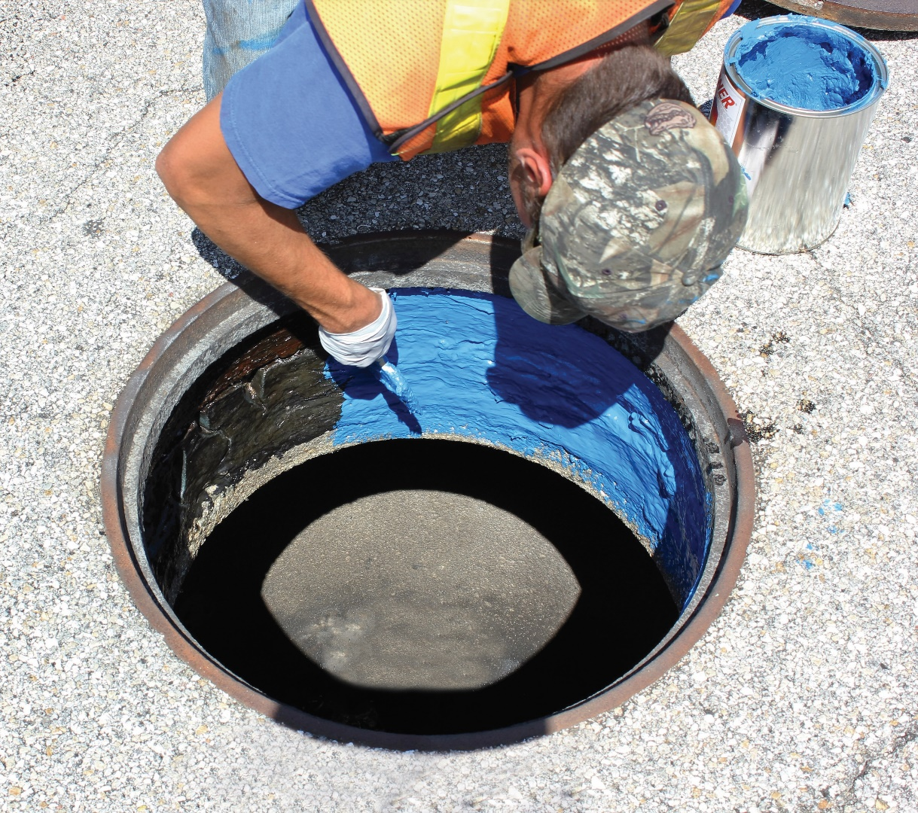
ElastaSeal®
USSI will begin by sandblasting the
frame and chimney. Elastaseal® is applied which provides a tough high build 4,800 psi tensile strength. The Elastaseal® protective coating is chemical and corrosion resistant.

Slide 34
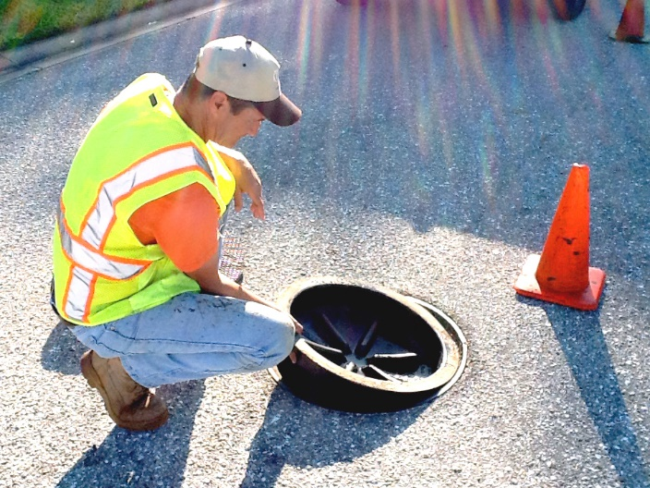
Inflow Defender®
The Inflow Defender® has a watertight gasket seal (resealable), a unique design for a longer life. It is custom designed and installed by our USSI technician team. This product resists all gases in a sanitary system.

Slide 35
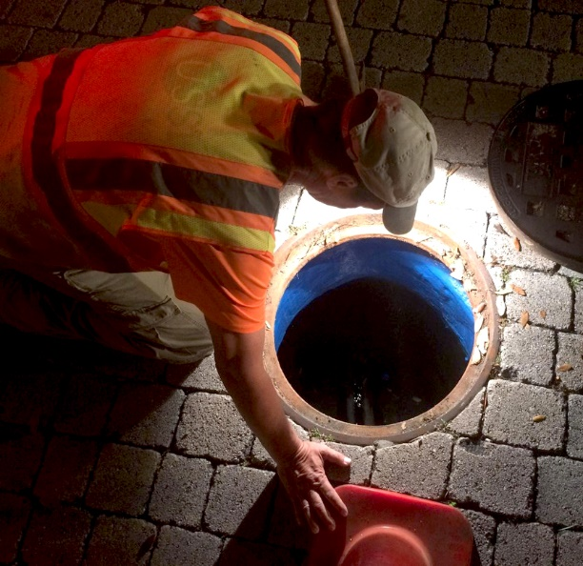
Night-Time Monitoring
Night-time monitoring is intended to target the location of infiltrations in the piping system. Typically, the best time for such an analysis occurs from 1am to 5am when consumer water usage is low. Our technicians monitor the flow and determine where the infiltration
is occurring.

Slide 36
Midnight Run
flow. 2 inch wide flow, 1/4 in deep at 2 ft/s = | 0.77917 | gpm
flow. 3 inch wide flow, 1/2 in deep at 2 ft/s = | 2.3375 | gpm
flow. 4 inch wide flow, .75 in deep at 2 ft/s = | 4.675 | gpm
flow. 6 inch wide flow, 1.25 in deep at 2 ft/s = | 28.05 | gpm
flow. 8 inch wide flow, 4 in deep at 2 ft/s = | 49.8667 | gpm

Slide 37
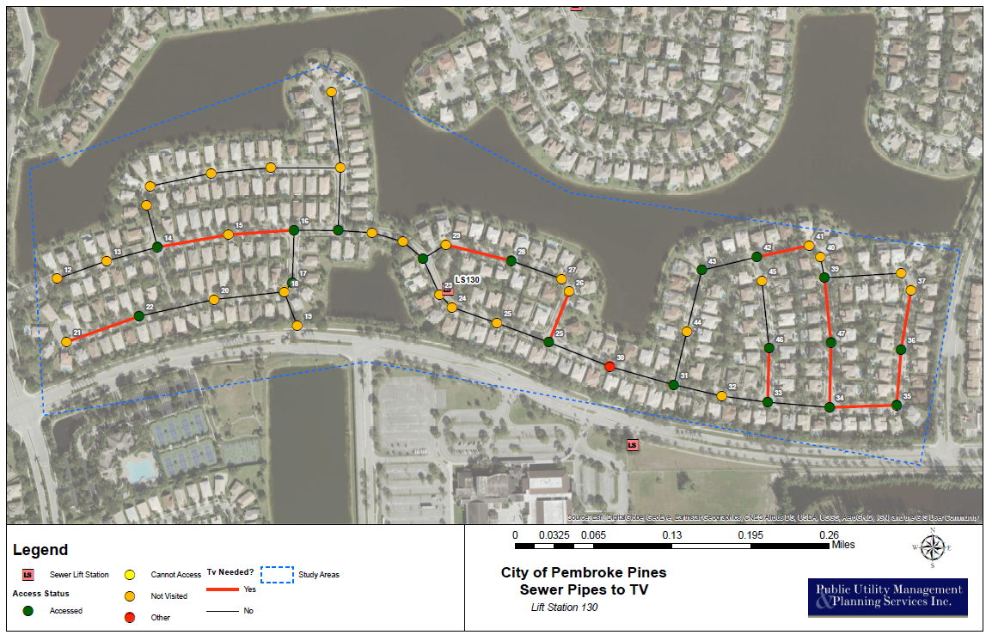
We p
{
USSI provides an overview map of each basin which shows lines that need TV.

Slide 38
Green = Good/Leave Alone Red = TV more investigation

Slide 39
Benefits of Utilizing Midnight Run Monitoring:
USSI is able to narrow down the sewer lines that have infiltration issues.
Reduces the need for jetting, cleaning, and CCTV an entire basin.
Saves time, labor, money and reduces liability
*This particular project USSI Midnight Run Monitoring indicated that only 20% of pipes needed to be inspected

Slide 40
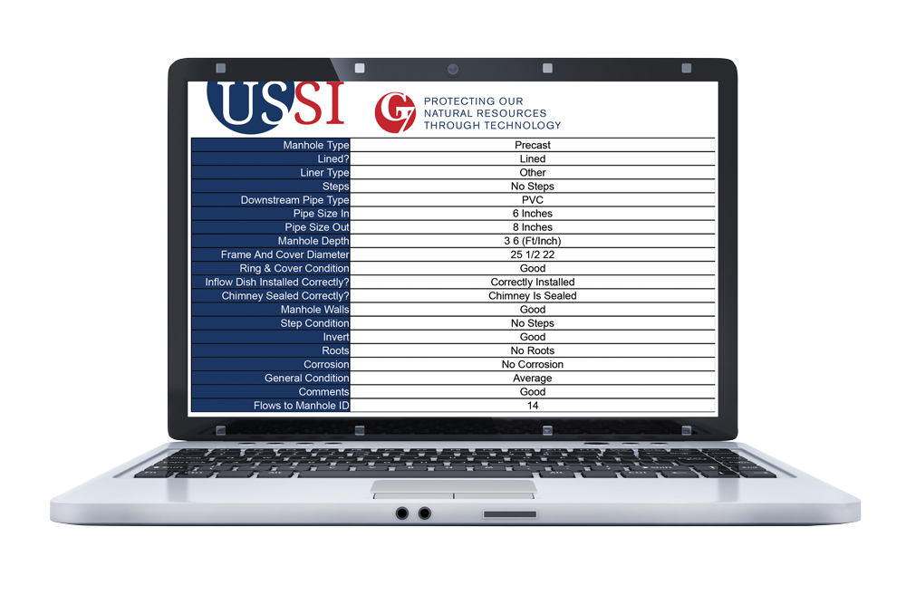
Inspections/Reports
Time is important, that is why USSI provides online reporting within 3 days. Our reports are compatible with utility GIS systems and our data can be stored in multiple formats. When it comes to basin smoke testing, manhole inspections and LDL Plugs, USSI’s reports are accurate
and timely.

Slide 41
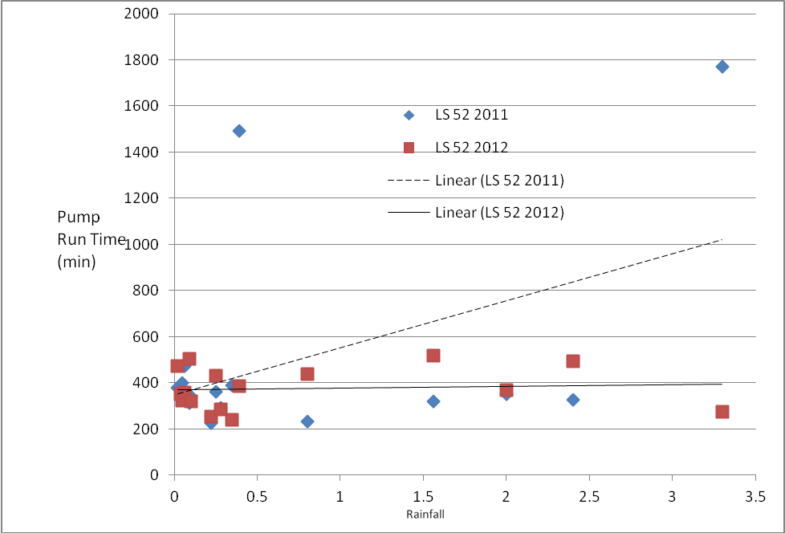
It works!!! LS 52 – Cooper City

Slide 42
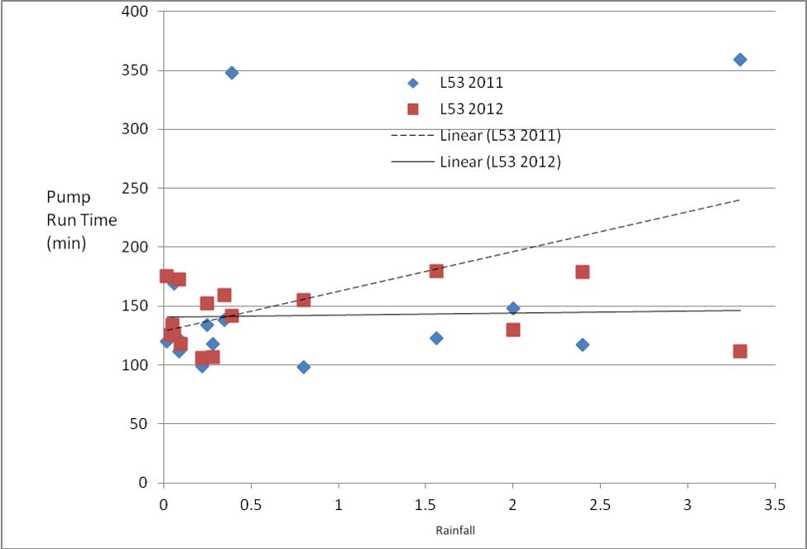
Results = LS 53 – Cooper City

Slide 43
Results
COMMUNITY | % CHANGE (PRE VS. POST)
Dania Beach (2006 vs. 2009) | -31.9%
Cooper City (2011 vs. 2013) | -62.8%
Results may vary. Pipeline repairs may be necessary in addition to the G7
Once Stormwater inflow is out….
Pipelines…

Slide 44
Infiltration
USSI has developed a model which has determined an estimated 8.5% increase of I&I annually if a sewer system is not maintained correctly.
A comparison of slopes developed the following findings:
2006 Slope | 2009 Slope | Total % Change | % Change/Year
0.4147x | 0.5558x | 25.4% | 8.5%
In total Dania Beach experienced a 25.4% increase in infiltration
between 2006 and 2009.
Based on the findings above it is assumed that without any
improvements utilities can expect approximately an 8.5%
increase in infiltration per year.

Slide 45
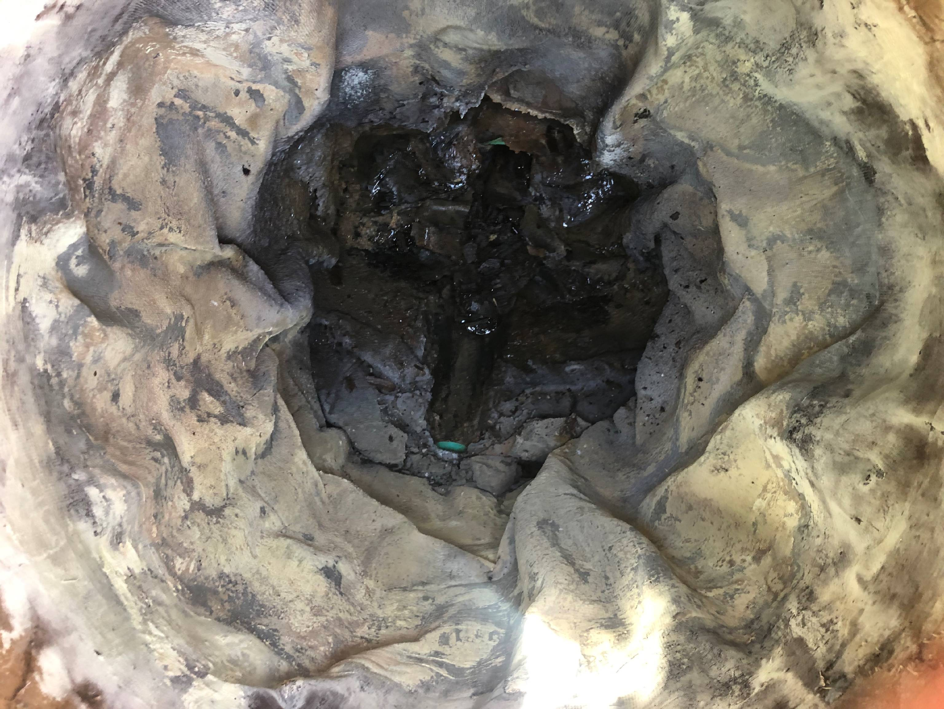
{
Manhole with
Completely
Failed Coating

Slide 46
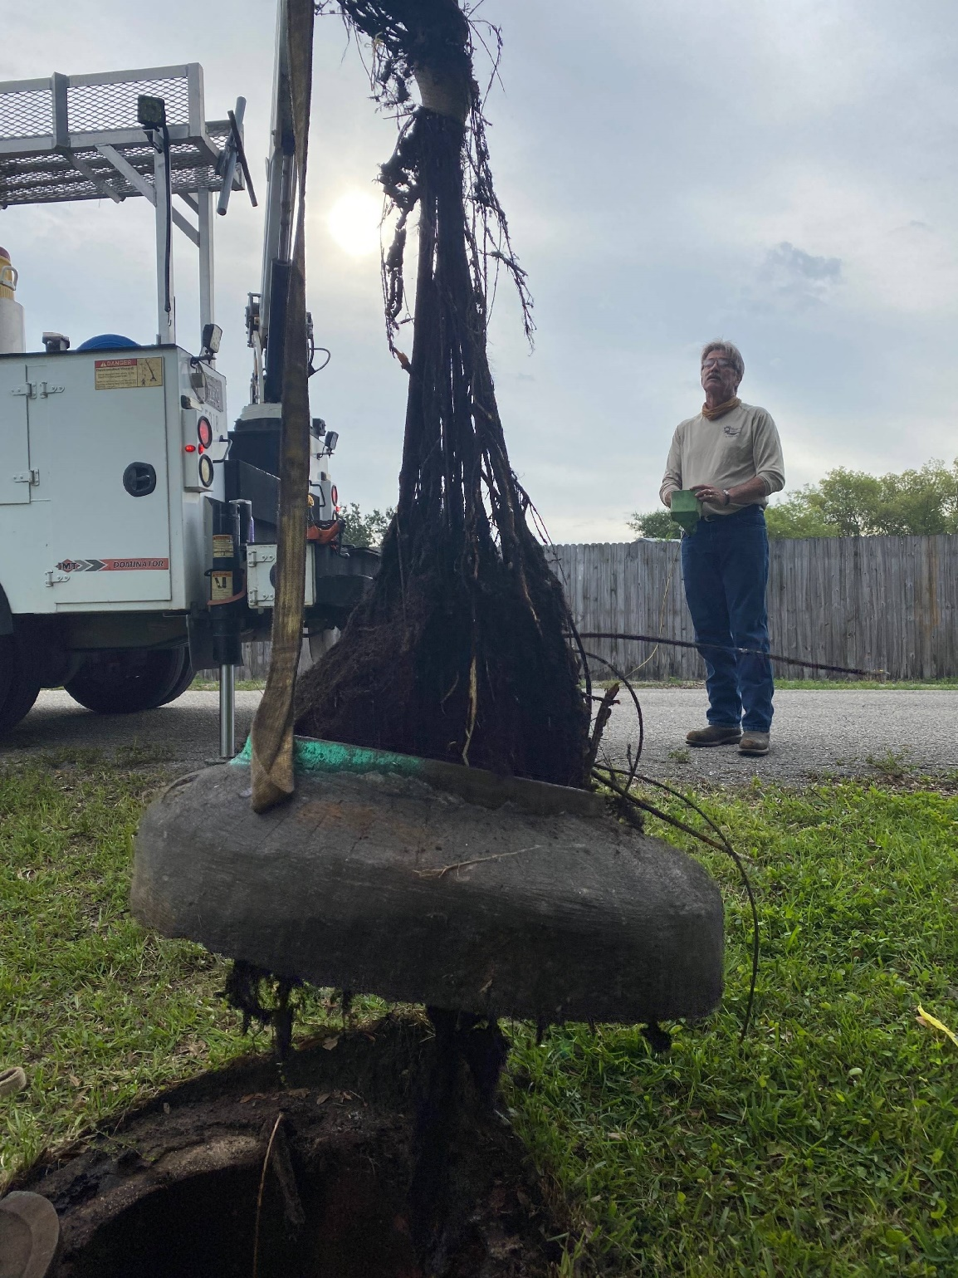
{
Failure to carry out
SSES can lead to this
serious situation.

Slide 47
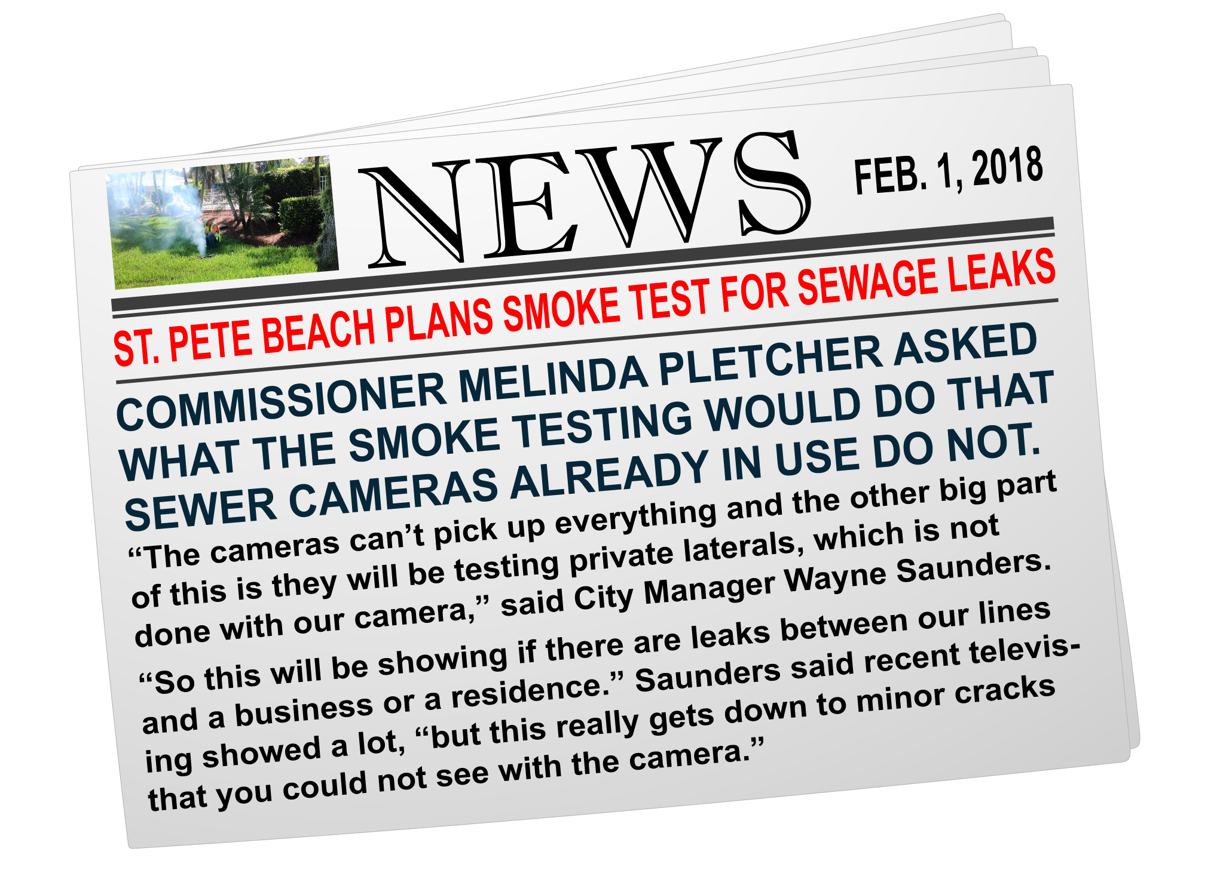
“City officials are planning a sewer system smoke test project designed to locate previously undetected sewer leaks.”

Slide 48
Conclusion
Full implementation of the AIIM Program helps to
reduce the risk of overflows
due to an increased hydraulic loading on the sewer system.
By limiting Inflow you will reduce pump run times, esp during critical rain events, and less wear and tear on mechanicals.
All this together leads to cost savings to any utility, in regards to maintenance and treatment at the wastewater facility.

Slide 49

Q&A

