Slide 1
SCADA SET UP
BY BILL PITTMAN

Slide 2
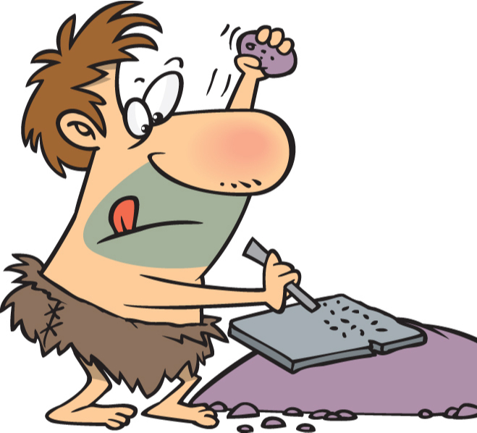
PROGRESS IS SOMETIMES GOOD

Slide 3
What does SCADA mean?
Supervisory
Control
And
Data
Acquisition

Slide 4
When was SCADA first used?
SCADA started in the early 70’s
SCADA is used in all types of utilities
Early SCADA was for IT types only
SCADA evolved to be used by modern day operator

Slide 5
Monitor vs. Control
Monitor
control
Visual
Alarm notifications
24-hour SURVEILLANCE
ON and OFF with a click
Emergency control when distance is factor
Comes with responsibility

Slide 6
Best Practices
RELATIONSHIPS
SCADA works best when there is a working relationship between SCADA user & IT department
KNOWLEDGE
Know your system limits
GOALS
What are you wanting to achieve?
PEOPLE
Who will have access?

Slide 7
Understanding Your System
/
Operators are in touch with their plants
1
Operators understand how it lives and breathes
2
Operators can be reluctant to change
3

Slide 8
Analog & Digital
analog
Digital
Give an example of something analog
Give an example of something digital

Slide 9
What is a PLC?
Give an example of how PLC functions within a SCADA system?

Slide 10
Highs & Lows
Know your plants highs and lows
What are examples of highs and lows?
Are they analog or digital?

Slide 11
EFFICIENT
With a good SCADA system regulatory agencies can reduce onsite visits
1
FAST
SCADA can provide useful information such as 24-hour trends with the click of a button
2
CONVENIENT
The use of mobile technology for SCADA is a key part of the operator evolution.
3
SCADA as a source of records

Slide 12
Q&A
Bill Pittman, U.S. Water

