Slide 1
t
RevPlan and (Expected) Loss of Revenue during COVID-19
Florida Rural Water Association Annual Conference
August 2021

Slide 2
RevPlan and (Expected) Loss of Revenue during COVID-19
Discussion Overview:
Preparing for expected loss of revenue
Capital finance planning
RevPlan...an overview

Slide 3
Loss of Revenue during COVID
How ready is your utility for revenue disruptions?
Hurricanes
Epidemic/pandemic
Other events
Revenue and collection
Financial policies
Minimum reserves targets
Reserves by purpose
Debt levels / cash flow
Financial planning and cash flow stress testing

Slide 4
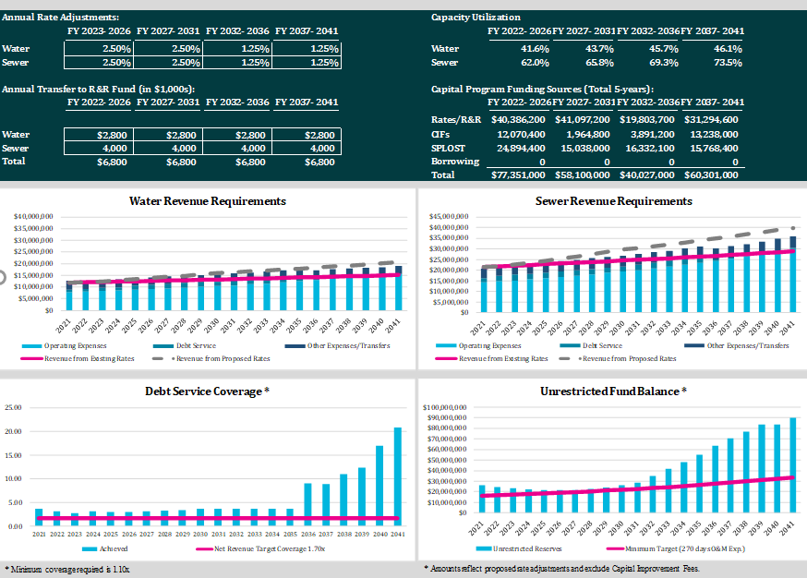
Financial Plan Dashboard

Slide 5
Capital Funding

Slide 6
Why is capital funding so difficult?
Capital costs are “lumpy” from year to year and project to project
Projects often can be postponed or delayed
Significant amount underground and hidden assets
Other…
Bottlenecks on project execution
Regulatory uncertainty
Growth uncertainty
Cost uncertainty
Playing “catch up”
Budget accrual v. cash outlays (and corresponding reports)

Slide 7
Capital Finance Planning
Start with an initial 5- to 10-year capital plan
Build a financial model
Revenues, operating costs, existing debt, transfers, etc.
Existing reserves
Identify financial metrics
Minimum reserve levels (e.g., 6 months of revenue)
Minimum annual debt service coverage (cash flow)

Slide 8
Capital Finance Planning (cont’d.)
Build in capital funding into financial model
How much $ should rate revenue contribute to pay-go capital by the end of the forecast?
What other funding sources are available that don’t need to be repaid? (e.g., grants)
Explore debt solutions that will smooth out the funding “lumpiness”

Slide 9
Capital Finance Planning for XYZ Utility
 | $ Million
Revenue | $6.3
Operating Expenses | (3.5)
Net Revenue | 2.8
Debt Service | (1.4)
Net Available | $1.4 Million
Capital plan: $30 million ($5 million/year)
Existing cash flow:

Slide 10
Anywhere Utility Funding by Year
Strategically use reserves and connection fees
Align with projects and growth outcomes
“Sustainable” pay-go funding by the end of forecast
$1.0 to $1.3 million per year
Use of debt for appropriate projects based on cost, timing, etc.
Mitigate size of rate increases based on optimal pay-go and debt
Funding Sources | 2022 | 2023 | 2024 | 2025 | 2026 | 2027 | Total
Connection Fees | $600,000 | $350,000 | $0 | $1,250,000 | $0 | $0 | $2,200,000
Rate Revenue (Pay-Go) | 700,000 | 650,000 | 533,000 | 835,000 | 1,270,000 | 1,098,000 | 5,286,000
Reserve Funds | 1,800,000 | 1,648,000 | 650,000 | 500,000 | 250,000 | 0 | 4,648,000
Federal Relief Money | 1,575,000 | 1,790,000 | 75,000 | 0 | 0 | 0 | 3,440,000
New Debt | 0 | 0 | 2,530,000 | 8,920,000 | 1,900,000 | 1,600,000 | 14,950,000
Total | $4,675,000 | $4,438,000 | $3,788,000 | $11,505,000 | $3,420,000 | $2,698,000 | $30,524,000

Slide 11
Debt
Why debt?
Utility business is capital intensive
Long-lived service lives
“Intergenerational rate equity”
Existing rate payers and future ratepayers
Growth and aging population
Get utility rates adopted!

Slide 12
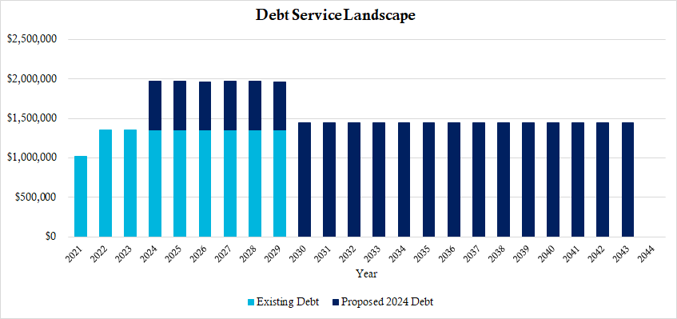
Debt (cont’d.)
Example of proposed debt structured around existing debt
Interest-only until existing debt matures in 2029

Slide 13
Debt (cont’d.)
Avoiding too much debt
Number of repayment years <= asset service life
Scenario planning (what if growth doesn’t materialize, or water sales/collections decline unexpectedly?)
Develop reasonable financial forecast projections
Work with a finance team
Internal stakeholders
Financial advisor
Rate consultant
Consulting engineers

Slide 14
RevPlan
Overview

Slide 15
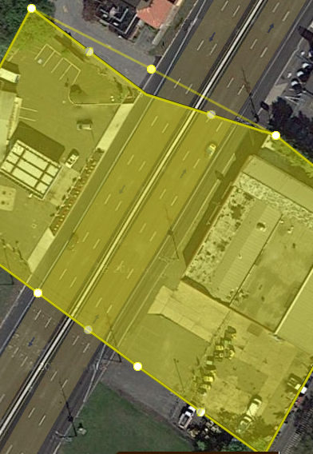
Genesis of the Project
Florida Department of Environmental Protection assisting funding FRWA clients
Asset sustainability
Financial sustainability
Asset Management Plan – DiamondMaps
AMP tool built for clients
Needed financial component
Question: Can Raftelis build a web-based financial model to work with DiamondMaps?
Yes!

Slide 16
Project Goals
Replace aging asset management financial planning software supplied by the EPA
Strengthen usage of web-based asset management mapping tool (DiamondMaps)
Increase engagement with member communities
Provide a reality check on the resources needed to maintain these small systems
Help communities to qualify for state revolving fund low interest loans

Slide 17
Software Project Process
Data and Systems Review
Design and Requirements
Prototyping
Programming and Database Development
Systems Integration
Documentation and Training
Post Go-Live Support
Continued Maintenance

Slide 18
Demonstration

Slide 19
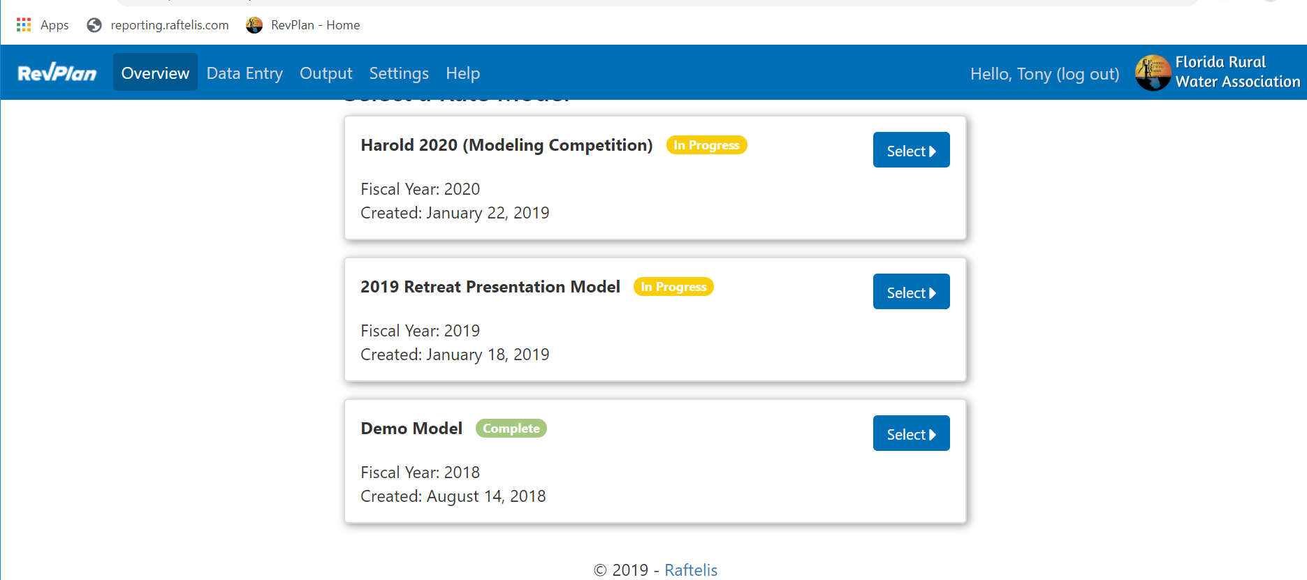
Overview
When a user logs in, they land on the Overview screen.
Here they can create a new rate model or continue working on an existing one.

Slide 20
Data Entry
We arrive at a series of Data Entry screens.
These screens guide the user through entering financial data for their utility.
The progress bars fill in as the user marks screens as complete, so they can see their overall progress and which items they still need to attend to. Here you can see we’ve left a screen incomplete to show a little data entry.
Clicking Resume would bring us to the first not completed screen. Instead we’ll click Next to go to the first screen in the progression.

Slide 21
System Statistics
We begin by asking the user for high-level information about their system.
This information isn't directly used in the model outputs, but it’s used to "gut checks" some of the data they’ll enter later in the model.
These “?” buttons open the Help panel with additional guidance for each line item.

Slide 22
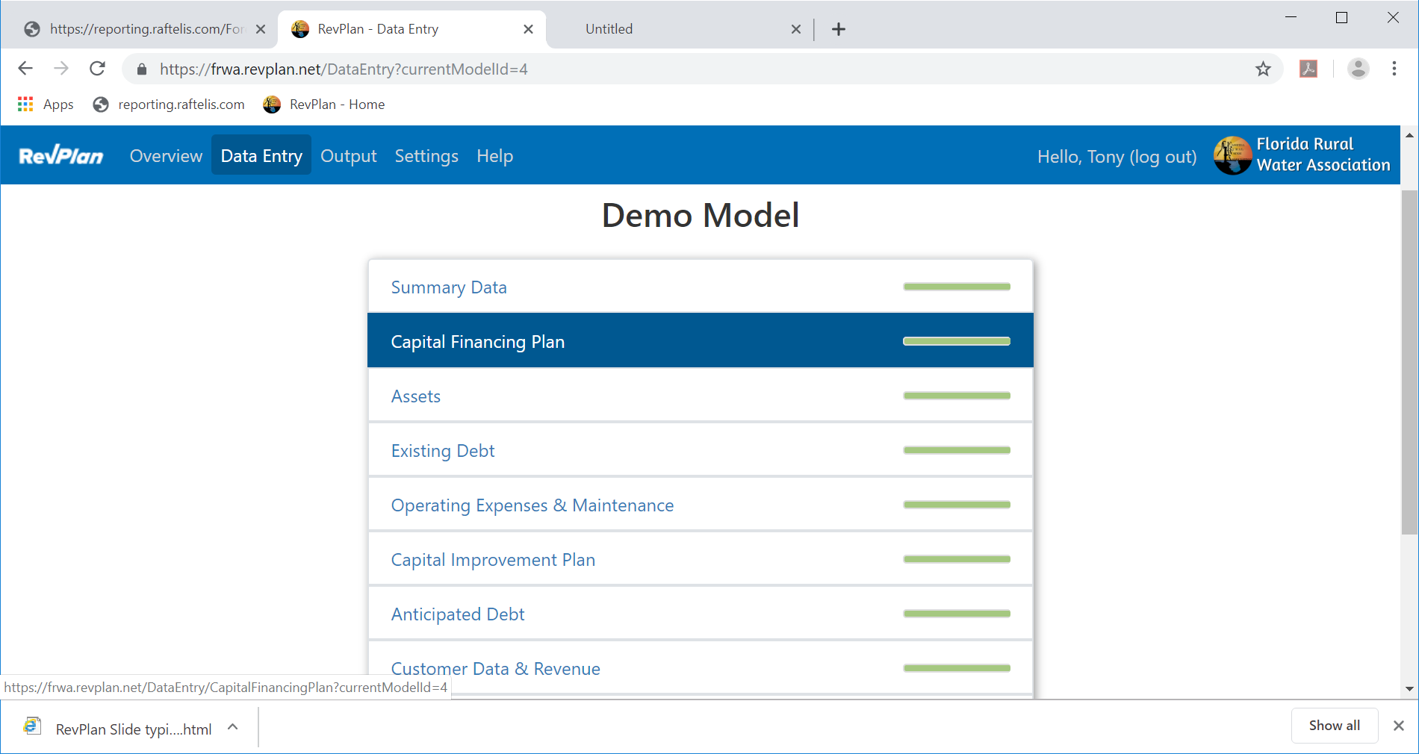
Data Entry

Slide 23
Capital Financing Plan
This is another screen gathering high-level information.
This screen is modeled after one of the forms required by FDEP for applications to State Revolving Fund loans.

Slide 24
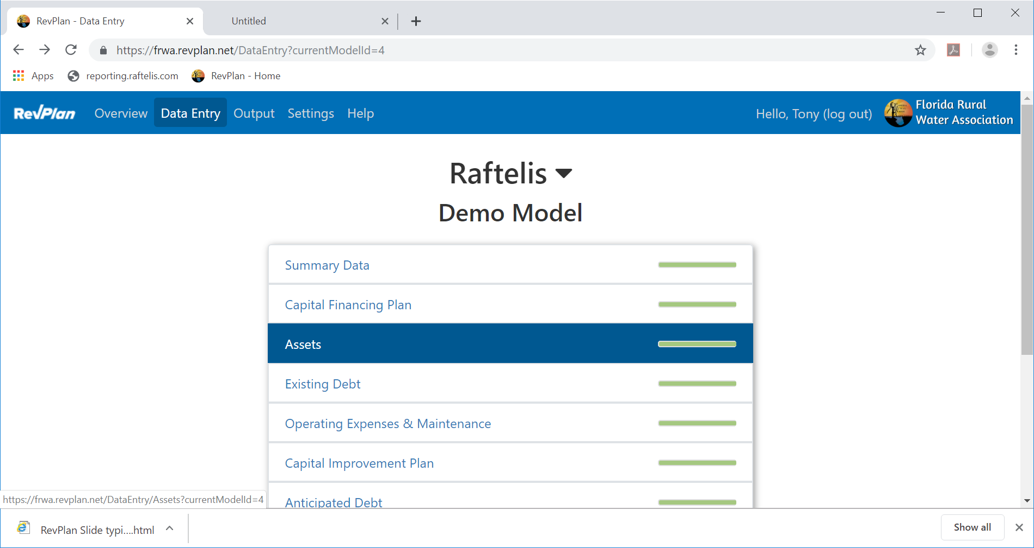
Assets

Slide 25
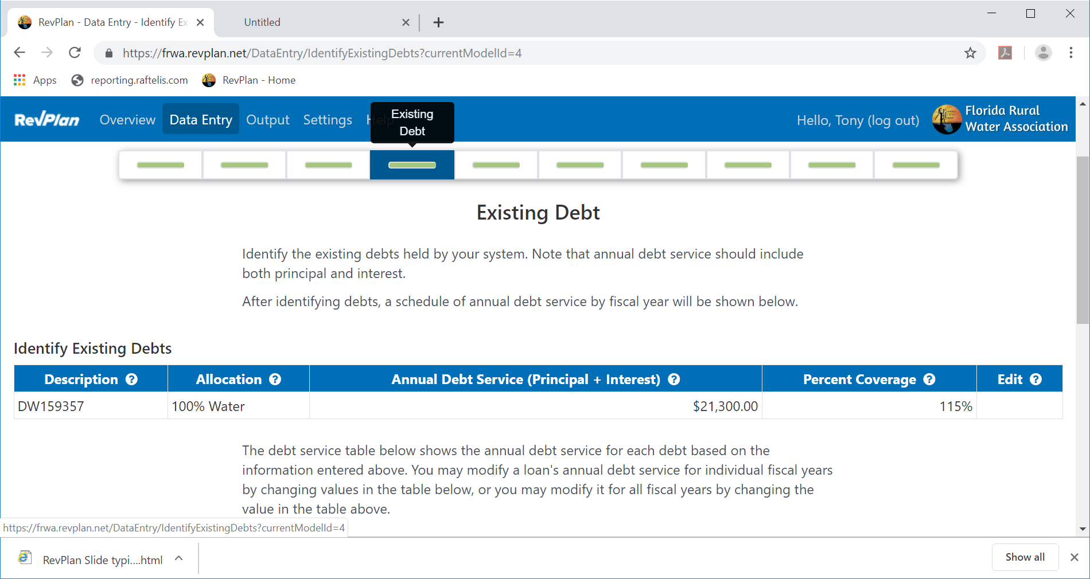
Existing Debt

Slide 26
Operating Expenses & Maintenance
Next, we ask for the utility’s operating expenses.

Slide 27
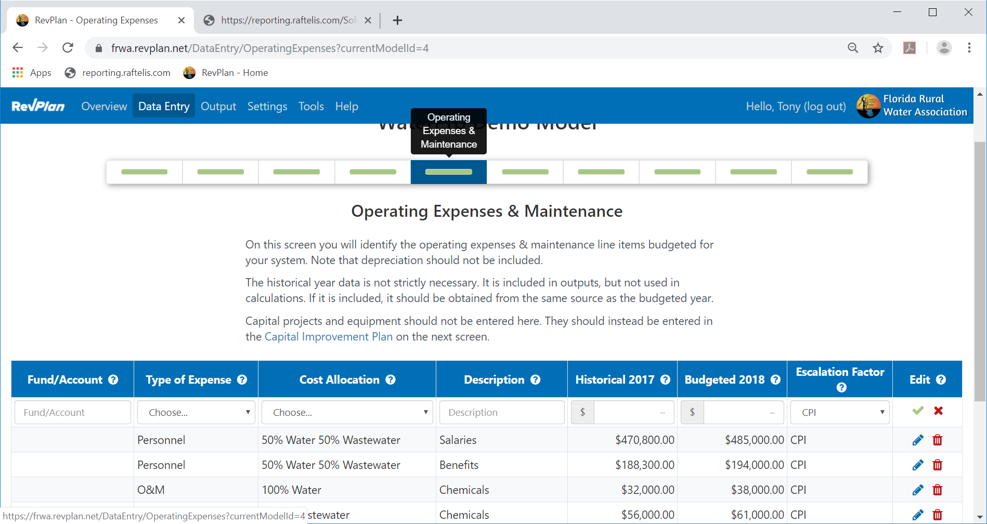
Operating Expenses & Maintenance (cont’d.)

Slide 28
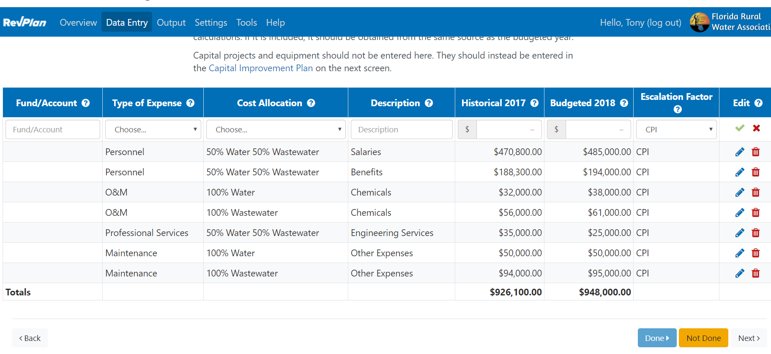
Operating Expenses & Maintenance (cont’d.)

Slide 29
Capital Improvement Plan
And here the user identifies capital improvement projects anticipated during the forecast period.
We see those rolled up Annual Replacement Cost numbers from the Assets screen have been automatically as “Wastewater Collection” and “Water Distribution”.
If a project is entered here that’s funded by a Future Loan, a corresponding loan is created on the Anticipated Loans screen coming next.

Slide 30
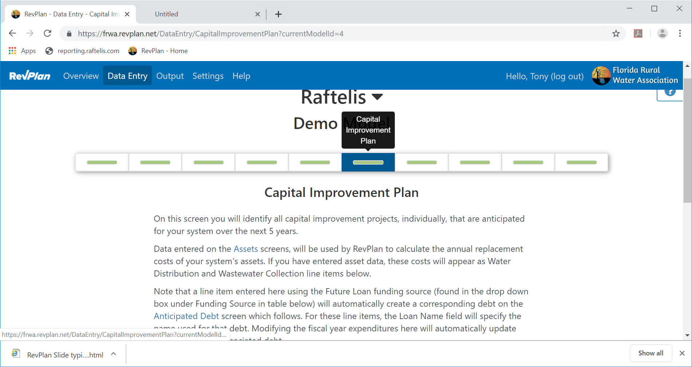
Capital Improvement Plan (cont’d.)

Slide 31
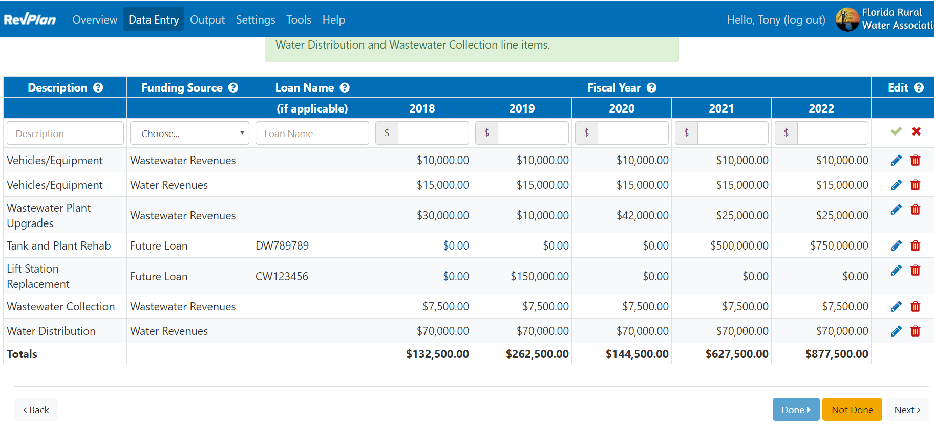
Capital Improvement Plan (cont’d.)
31

Slide 32
Anticipated Loans
Here we see the anticipated loans associated with the loan-funded CIP line items.
RevPlan populates these loans with default properties which the user can modify. But the Project Funds value is directly tied to the CIP line item and changes when the user edits that.

Slide 33
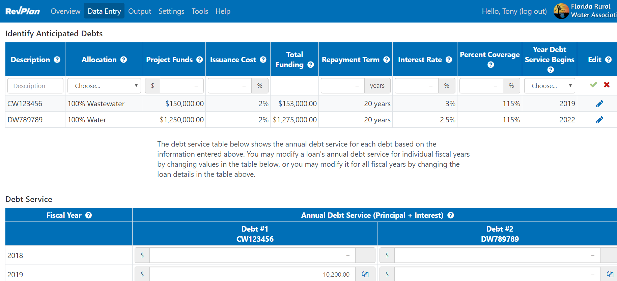
Anticipated Loans (cont’d.)

Slide 34
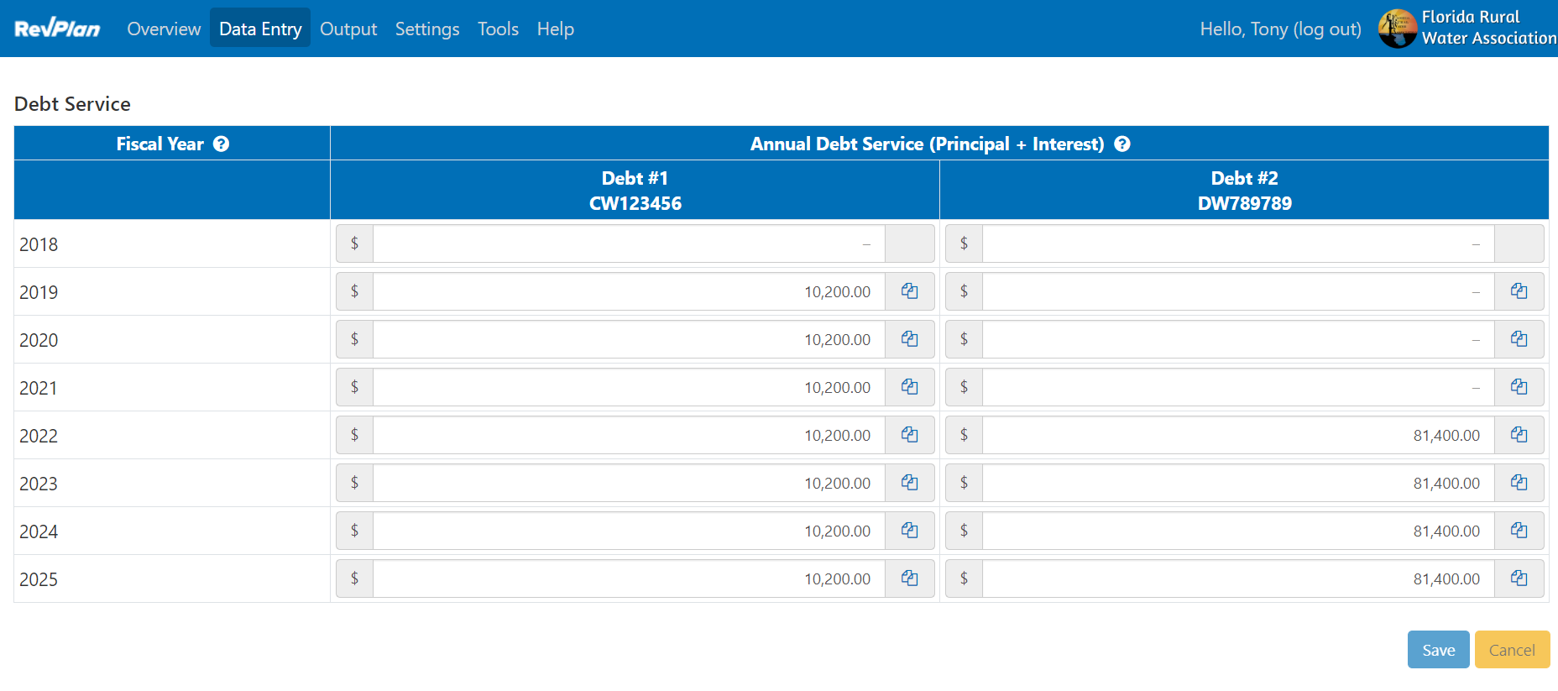
Anticipated Loans (cont’d.)

Slide 35
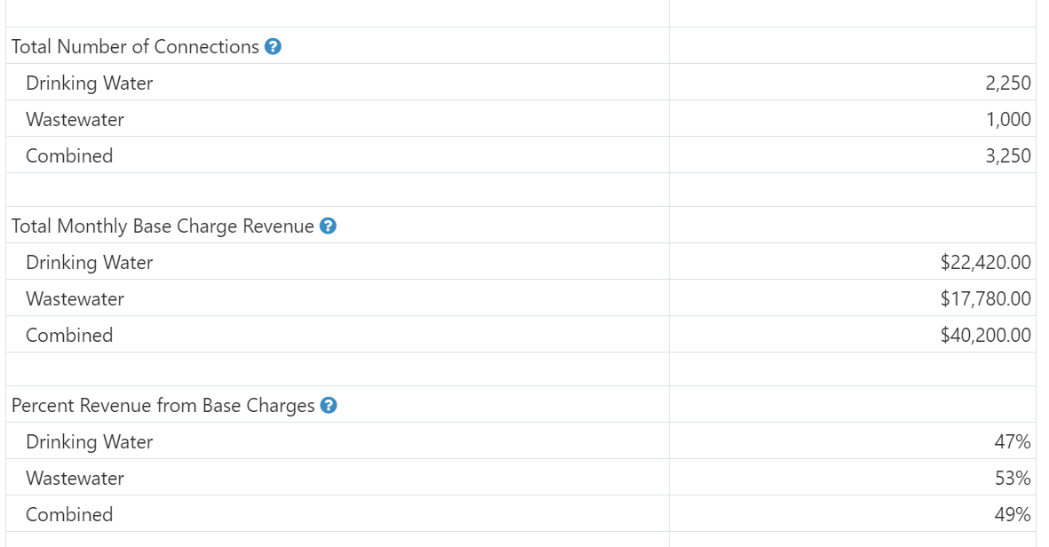
Rates & Revenue

Slide 36
Utility Reserves
And here they and can enter the amounts held in reserve by the utility.
After completing this screen, the we’re brought to the outputs.

Slide 37
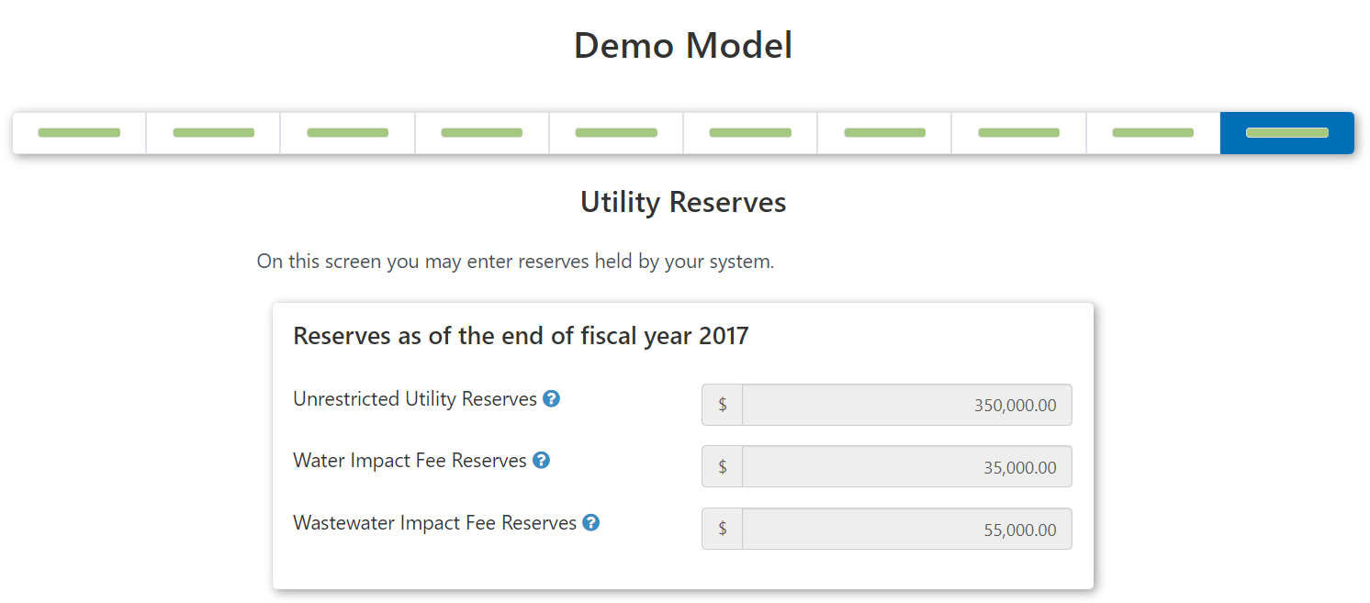
Utility Reserves (cont’d.)

Slide 38
Output
Here we have the Dashboard and Tabular Schedules output screens.

Slide 39
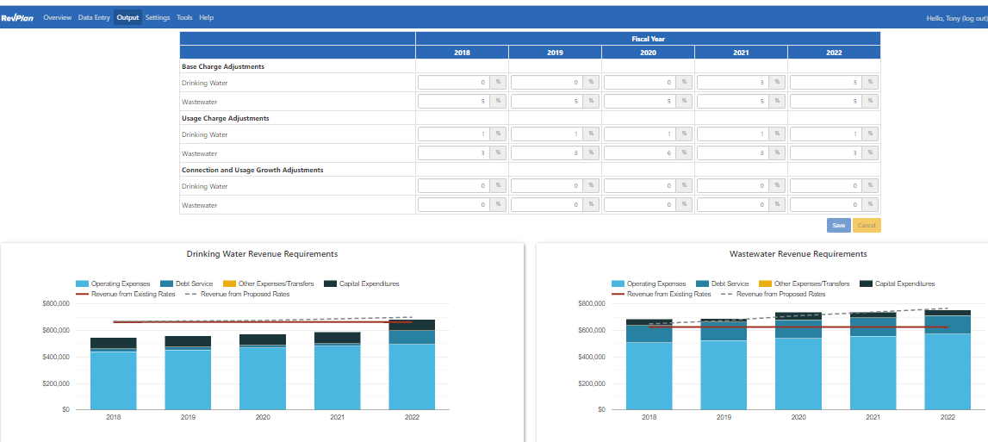
Dashboard

Slide 40
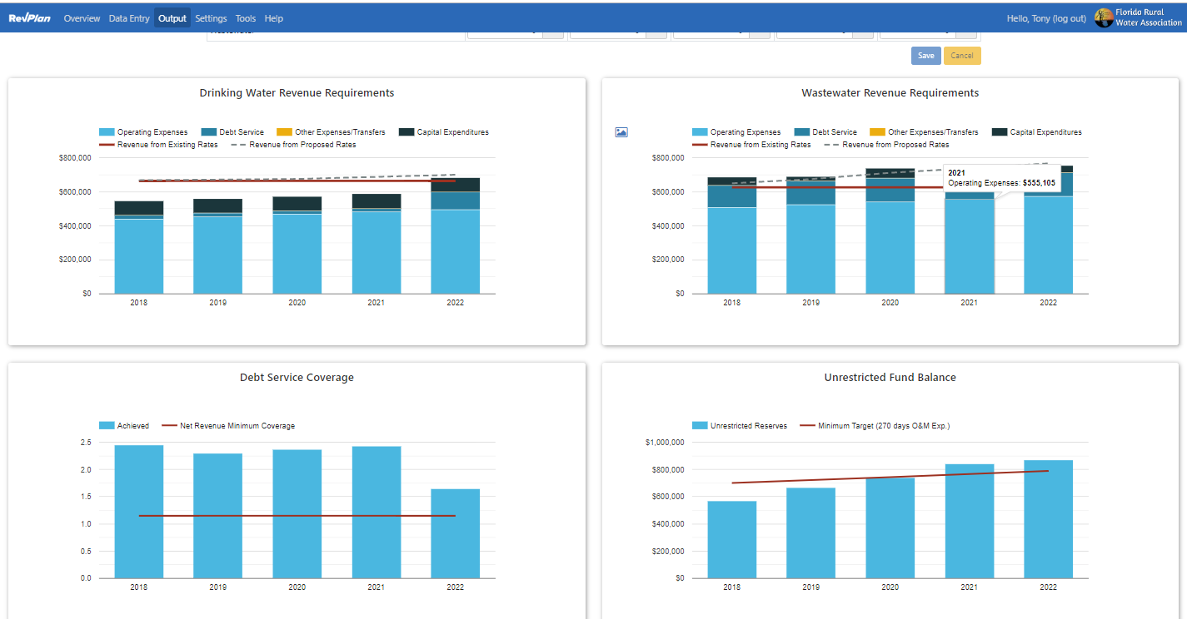
Dashboard (cont’d.)

Slide 41
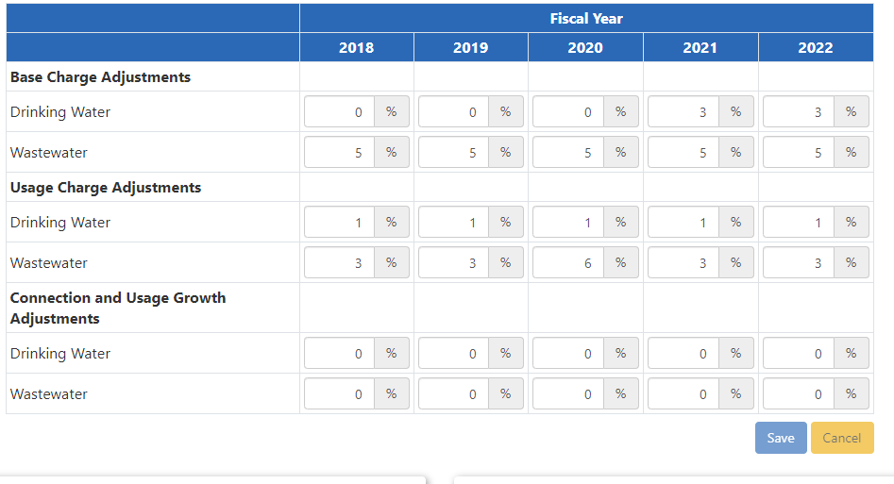
Dashboard (cont’d.)

Slide 42
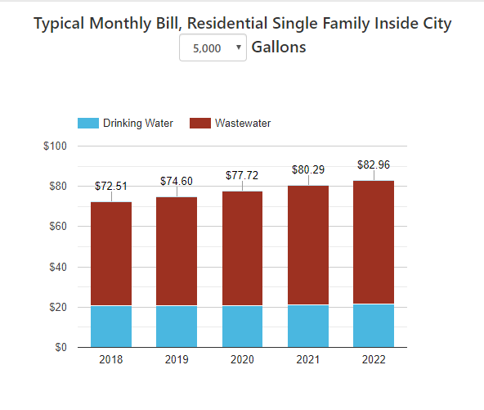
Dashboard (cont’d.)

Slide 43
Tabular Schedules
And here we have Tabular Schedules:
breaking down the numbers shown in the dashboard charts (Revenue Requirements)
providing detail, summaries, and forecasts of info from data entry screens (CIP Schedule, Debt Service Schedule, Operating Expense Projection)
a detailed rate schedule with adjustments applied (Rate Schedule)
and a detailed breakdown of current rate revenues for each customer class. (Rate Revenue)

Slide 44
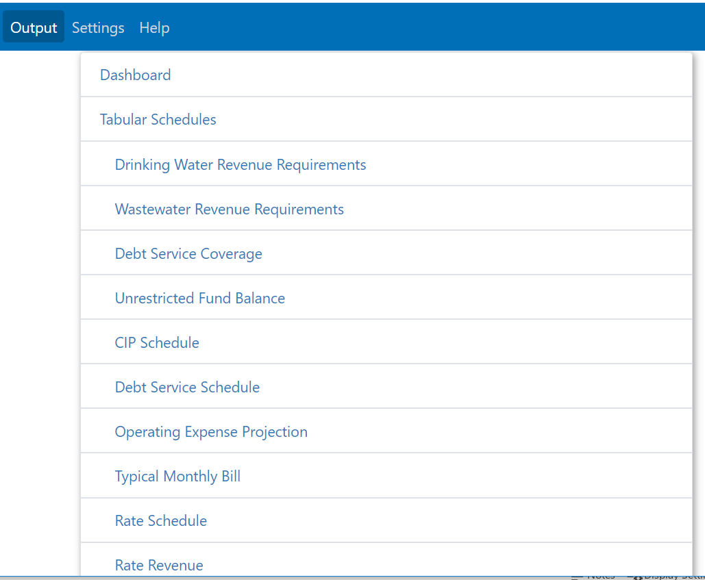
Dashboard

Slide 45
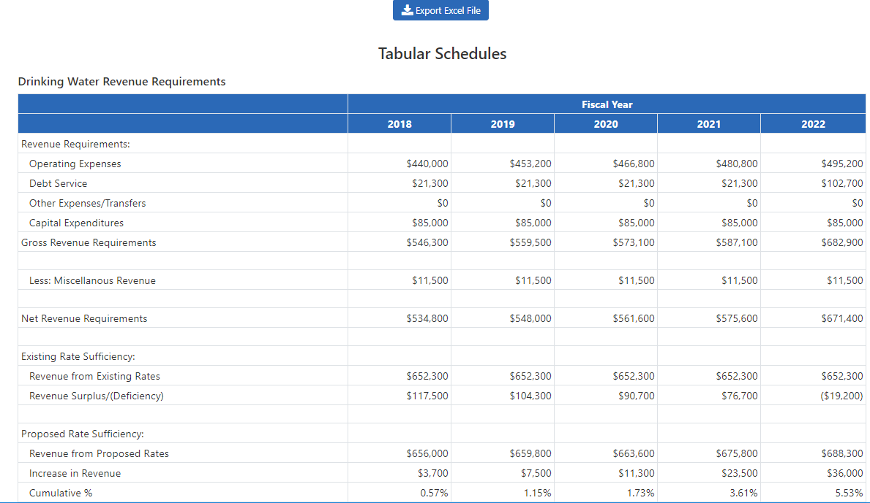
Tabular Schedules

Slide 46
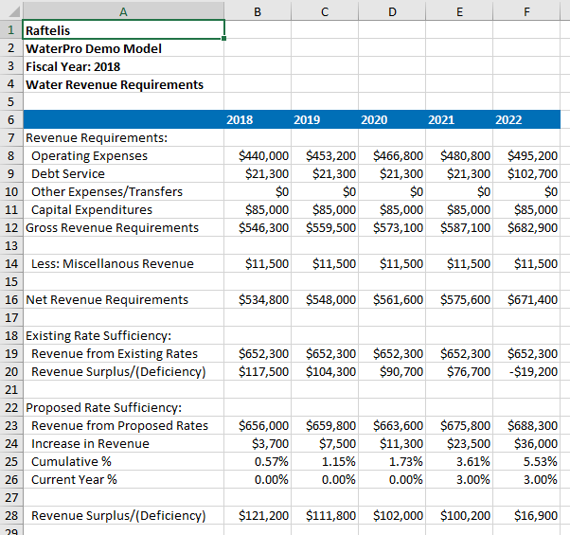
Tabular Schedules (cont’d.)

Slide 47
Florida Utilities using RevPlan
Arcadia
Baldwin
Bartow
Bowling Green
Century
Chattahoochee
Clewiston
Eatonville
Everglades City
Florida City
Freeport
Homosassa Special Water District
Jay DW
Madison
Milton
Monticello
Orange City
Palatka
Penney Farms
Plantation Bay
Polk City
Ponce de Leon
Quincy
South Santa Rosa Utility System
(SSRUS)
Spring Lake Improvement District
(SLID)
Springfield
White Springs
Yankeetown

Slide 48
Resources
Florida RevPlan www.frwa.net/revplan
Florida Rate Survey (https://www.raftelis.com/insights/surveys/)

Slide 49
CONTACTS Tony Hairston 407 960 1811 / ahairston@raftelis.com

