Slide 1

Proper Distribution Flushing for Water Systems
Stan Epperly
State Water Circuit Rider
Florida Rural Water Association
2971 Wellington Circle
Tallahassee, FL 32309
Phone 850.668.2746
Cell 941.916.5285
E-Mail Stan.Epperly@frwa.net

Slide 2
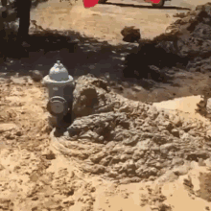
      Why do we flush?
      Respond to customer complaints
      Expel contaminants from backflow episode
      Remove sediment and loose deposits
      Scouring
      Decreasing water age in dead end mains
      Restore chlorine residuals
      Prevent or respond to nitrification

Slide 3
Eliminating the Most Common Water Distribution System Problems
Disinfectant Residual
a. increase residual by turning over the water in the distribution system’s pipelines.
2. Sediment
b. ensure that sediment in dead-end lines does not accumulate and is removed
3. Water Storage Tank Chlorine Residual
c. ensure residual is maintained and DBP are minimized by managing the water levels and detention times
All of these tasks are accomplished by Flushing !
Notes:
Reducing the detention times consists of ensuring that water in the distribution systems turns over in less than two to three days and ensuring that chlorinated water in storage tanks is emptied and refilled each day.
Starting a proactive distribution maintenance program to keep your system as clean as possible is very important and is a DEP requirement. Where known problems exist with dead end lines the water systems should be looped to provide water movement.

Slide 4
Air and Vacuum Problems
How can you release air from a newly installed or repaired water main?
Through a corporation stop or fire hydrant
Air can cause serious pipeline problems.
Air may get into water through pumps, packing glands, leaky joints or may already be in the water.
Air collects at high points in the lines.
  Increase resistance to flow by 10 to 15 percent.
  Create possible air lock condition and stop flow.
Vacuum condition can cause pipe collapse.
Notes:
One of the challenging issues in designing water pipe systems is to remove the entrained air getting into pipes either from the water itself or through external sources such as pumps and valves. In practice, the popular alternatives for removing air from water systems are the use of air valves and air vents.
Air collects at high points in the lines and can increase resistance to flow by 10 to 15 percent. It can also create a possible air lock condition and stop flow.
Vacuum conditions sometimes develop when the mains are being drained and can cause pipe collapse.

Slide 5
Water Distribution System Bacteriological Hot Spots
Location in Water System Relative # Coliform*
Low Flow, Dead End High
Low Flow, Internal Medium
Extended Flushing Low
High Flow Lowest
*The majority of microbial growth within a water distribution system occurs in dead end water lines.
Notes:
Where in the distribution system do you think you have the highest bacteriological counts?

Slide 6
Water Detention Time in a Water Distribution System Can Be Very High
Typical Distribution System Water Age (Days)
Population | Miles of WM | Water Age Range
> 750,000 | > 1,000 | 1 – 7 days
< 100,000 | < 400 | > 16 days
< 25,000 | < 100 | 12 – 24 days
Notes:
Many water distribution systems have extremely high water ages. Water with high water age will frequently not have enough chlorine residual leading to growth of bacteria in dead end distribution lines and in storage tanks. The sediment that has been deposited in the dead end lines and in the water tanks will contain concentrations of compounds that will support biological growth.

Slide 7
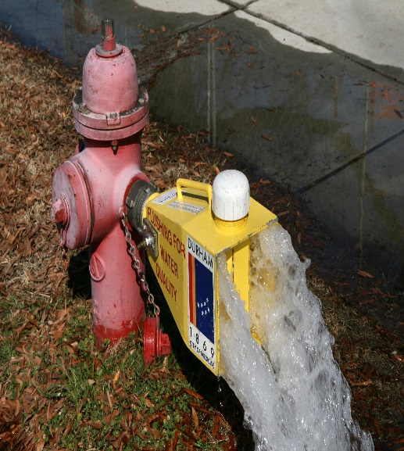

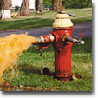
Purpose of Conventional Flushing
Reducing Water Age and maintain water quality
Increasing or Maintaining Disinfectant Residual
Removing Sedimentation and Coloration
Notes:
Flushing is done to clean out distribution pipelines by removing impurities or sediment that may be present in the pipe. Routine flushing is often necessary to avoid taste and odor complaints.

Slide 8
Problems Minimized by Water System Flushing
Water that stands still, moves slowly, or does not circulate in water mains eventually
loses disinfection residuals.
With inadequate disinfectant residuals, bacterial growth
increases in the water distribution system.
Excessive bacterial growth leads to
color and taste and odor complaints from customers.
Bacterial growth results in
corrosion problems
Coliform bacteria and water borne pathogens survive longer and the public’s health is compromised when stagnant water loses its
disinfectant residual.
Suspended matter that contains organic material settles in the main further compromising
the ability to maintain disinfectant residual
Water with a long detention time results in
higher concentrations of regulated disinfection by-products
Notes:
Microbial control requires a good disinfectant residual. This can be accomplished with chlorine as either free chlorine, chloramines, or carbon dioxide. While chlorine is a more powerful disinfectant, chloramines are more persistent in the distribution system and will eventually penetrate farther into the system for a longer time. Free chlorine will attack biofilms and exhaust itself more quickly, whereas chloramines will continue to attack the biofilm and slowly break down the defenses of the biofilm.
If water is stagnant or has inadequate disinfectant residuals, biofilm growth increases. Excessive bacterial growth leads to color and taste and odor complaints from customers and results in corrosion problems.
Coliform bacteria and water borne pathogens survive longer and the public’s health is compromised when stagnant water loses its disinfectant residual. Suspended matter that contains organic material that settles in the main further compromises the ability to maintain disinfectant residual. Water with long detention time results in higher concentrations of regulated disinfection by-products
Some Microbes can develop chloramine resistance
Free chlorine is absorbed by biofilm surface (4 ppm free chlorine ineffective in controlling biofilm on pipe surface)
Chloramines at 2 mg/l continuous dose was found effective for control

Slide 9
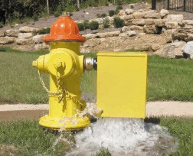

Determining the Correct Amount of Water to Flush
Methods of Flushing Fire Hydrants for Maintaining Chlorine or Chloramine Residuals
Flush ~ 3 pipe volumes or until the disinfectant residual is restored.
Flush until color and turbidity are restored to normal levels.
Flush at a rate that keeps the main pressure above 35 psi.
To minimize water loss, flush for the least amount of time needed.
Automated Flushing Valve Installation
Florida Rural Water Association

Slide 10
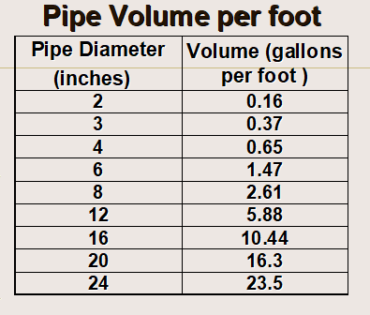
Determining Gallons per Foot of Pipe
Notes:
There are tables that can give you the volume per foot based on pipe diameter.

Slide 11
Gallons to Flush to Achieve
Three (3) Volumes of Pipeline
Main Size dia” | Feet of Pipeline
 | 100 | 200 | 300 | 400 | 500
2 | 50 | 100 | 150 | 200 | 250
3 | 110 | 220 | 330 | 440 | 550
4 | 200 | 400 | 600 | 800 | 1000
6 | 440 | 880 | 1320 | 1600 | 2200
8 | 800 | 1600 | 2400 | 3200 | 4000
Notes:
Values are approximate
For a 8” pipe, 1,000 ft long pipe, how many gallons would I flush for 3 volumes?
(2,611 gals)(3) = 7,833 gallons ~ 8,000 gals

Slide 12
How Often to Flush
Monthly, quarterly, semiannually, yearly, etc.
    Dead-end mains at least quarterly 62-555.350(2)
    At intervals necessary to maintain consistent water quality throughout the distribution system
    Often enough to maintain adequate disinfection residuals throughout the distribution system
    Whenever Customer complaints of bad taste, odor, clarity or turbidity are received (DEP requirement)
    Before and after main disinfection
Notes:
How often to flush
Monthly, quarterly, semiannually, yearly, etc.
Seasonally, usually spring or fall for large areas
Before and after main disinfection
In response to complaints
In response to regulatory violations (i.e., high bacterial counts or low chlorine residual)
Coincides with related programs (i.e., fire hydrant testing or valve inspection programs)

Slide 13
Flow (gpm) to Achieve Sediment Removal Velocity of 3 to 5 feet per second
In flushing we want the flows high enough to flush any sediment. Therefore, we want velocities greater than 2.5 fps. To make sure our velocities are high enough we can measure the flow. The flow is going to vary depending on the size of the pipe.

Slide 14
Flow (gpm) to Achieve Sediment Removal Velocity of 3 to 5 feet per second
 | Velocity in Pipeline
Size of Main dia” | 3 fps | 5 fps
2 | 29 | 52
4 | 118 | 200
6 | 264 | 450
8 | 470 | 775
12 | 1,060 | 1,760
16 | 7,500 | 12,500

Slide 15
Approximating Conventional Flushing Velocities for a 2” Blow Off
This condition represents a velocity of 2 feet per second. Approximately Correct!
This condition represents a velocity of 15 feet per second. Wasteful and likely to stir sediment

Slide 16

Measuring Fire Hydrant Flow for Flushing Purposes
Pitot Meter
Pitot Gauge and Flow Calculation
Pitot Gauge and Chart
Yardstick

Slide 17
Measuring Fire Hydrant Flow for Flushing Purposes
Pitot Gauge and Diffuser Pollard Water Co.
Notes:
A pitot tube is a pressure measurement instrument used to measure fluid flow velocity.

Slide 18
Approximate Flow Rates (gpm) from 2½” Fire Hydrant for Pitot Readings (psi)
Pressure at Pitot | Approx. FH Flow | Pressure at Pitot | Approx. FH Flow
1 | 170 | 11 | 555
2 | 240 | 12 | 580
3 | 290 | 13 | 605
4 | 340 | 14 | 630
5 | 380 | 15 | 650
6 | 410 | 16 | 670
7 | 440 | 17 | 690
8 | 480 | 18 | 710
9 | 500 | 19 | 730
10 | 530 | 20 | 750

Slide 19
Approximate Flow (gpm) from Hydrant Using Level and Tape
X | Flow
6 | 30
8 | 40
10 | 50
12 | 60
14 | 70
16 | 80
18 | 90
20 | 100
30 | 150
X Distance inches
12”
Distance to Top of Water is Always 12”
Florida Rural Water Association

Slide 20
Results of Flushing too Fast
More is not Better!
Excessive Water Loss
Low Water System Pressures
Customer Complaints
An acceptable Flushing Program includes measuring the flow rate and flush time, then calculating and recording the total gallons used.

Slide 21
Approximate Time To Flush in a Flushing Program
 | Length of Pipeline and Time for Three (3) pipe volumes
Flushing Velocity | 100 feet | 200 feet | 300 feet | 400 feet | 500 feet
3 fps | 1:40 | 3:20 | 5:00 | 6:40 | 8:20
4 fps | 1:15 | 2:30 | 3:45 | 5:00 | 6:15
5 fps | 1:00 | 2:00 | 3:00 | 4:00 | 5:00
Unidirectional Conventional
Florida Rural Water Association
Notes:
Time = Volume/Flow = (A x L x 3)/(Vel x A) = (L x 3)/Vel = (100 x 3)/3 = 100 sec or 1:40

Slide 22
Informing the Customer with the Flushing Schedule
Purpose of Flushing and Water Quality Objectives i.e. improving taste, color and eliminating odor
Duration of Flushing Program
Dates, Times and Street Addresses Targeted
Customer notification methods i.e. universal and personal methods to be used
Customer Requirements for using water during flushing period

Slide 23
Suggested Customer Information to be Included in a Flushing Program
Avoid using water each day during flushing period regardless of where water main flushing is being performed.
Turn off and by-pass any water softening system before 8:00 a.m. on the days flushing will be performed. Do not return your softener to service until after you have flushed your water lead.
DO YOUR LAUNDRY ON ANOTHER DAY TO PREVENT STAINING..
Turn off any automatic water systems, such as time-delayed dishwashers or timed lawn sprinkling systems.
After 4:00 p.m. on the days flushing is performed, or when a notice is posted on your front door, and prior to using water in your home, open the faucet closest to the point where the water enters your home. Allow the water to run into the nearest drain until it runs clear. If appropriate, return you water softener and/or automatic systems to service.
If you use water while we flush the main waterlines it is possible that some of the rust that collects in the supply lines could enter your household pipes and water softener.
Problems: Call Phone # --- -----
Notes:
The pipeline flushing process tends to remove most deposits, encrustations, sediments and other debris. Customers should be notified to expect a residual amount of sediment coming into the dwelling for a least a few hours so it would be best to flush their own lines after flushing is completed.

Slide 24
Flushing Benefits Summarized
    Restores disinfectant residual
    Maintains or improves water quality
      a. Reduces bacterial growth
      b. Reduces customer complaints
    Restores flow and pressure in the distribution system
      a. Reduces sediment
      b. Reduces corrosion and tuberculation in mains
    Reduces DBP problems and lowers disinfection costs
    Reduces pipeline maintenance costs
    Increases life expectancy of the distribution system
    Typically results in a fire hydrant maintenance program

Slide 25


Slide 26

Stan Epperly
State Water Circuit Rider Region 5
Florida Rural Water Association
2970 Wellington Circle
Tallahassee, FL 32309
Phone 850.668.2746
Cell 941.916.5285
E-Mail Stan.Epperly@frwa.net

