Slide 1
Pipe Condition Analysis
When to Replace

Slide 2
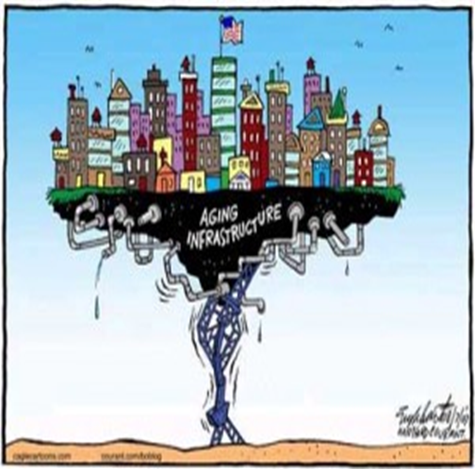
Aging Infrastructure Has A Negative Impact
On Your Utilities Health
The American Society of Civil Engineers gave the nation’s utility a grade of D plus in its latest report card.
Nationwide 700 water main breaks occur each day resulting in the loss of water, property, inconvenience, and threats to public heath.
Six billion gallons of treated water is lost due to leaking pipes.
30% of pipes (and therefore valves/hydrants associated with them) are between 40 and 80 years old, 10% of those are even older.
Repairs associated with leaks cost valuable time and resources to fix.
The American Water Works Association’s (AWWA’s) State of the Water Industry (SOTWI) report for 2020 lists renewal and replacement of water and wastewater infrastructure as the most important issue faced by the US water industry.

Slide 3
Why Perform a Condition Assessment of your Underground Infrastructure?
One of the challenges of maintaining distribution and collection systems is that so much of the process takes place underground, out of view.
Most municipal systems are at least 60 years old and many communities have sewer or water lines that are older than 100 years. Many past replacement philosophies are “run until failure.”
Given the age of the systems, many communities and utilities are turning their attention to assessing the condition of their underground pipes and associated infrastructure.

Slide 4
Present Replacement Philosophy
A Condition Assessment is an investment – an investment in managing risk and that knowing the structural condition of your assets will allow you to avoid emergencies, prioritize repair and replacement projects, and plan for the future.
Risk analysis can be simple or complex. It is based on the Likelihood of Failure (LOF) and Consequence of Failure (COF).
LOF x COF = Risk

Slide 5
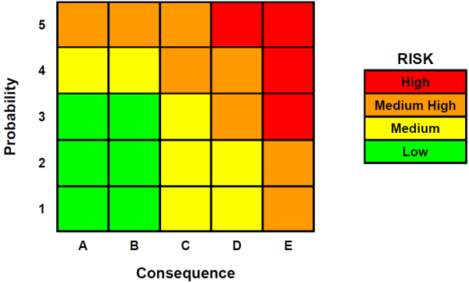
Likelihood of Failure x Consequence of Failure = Risk

Slide 6
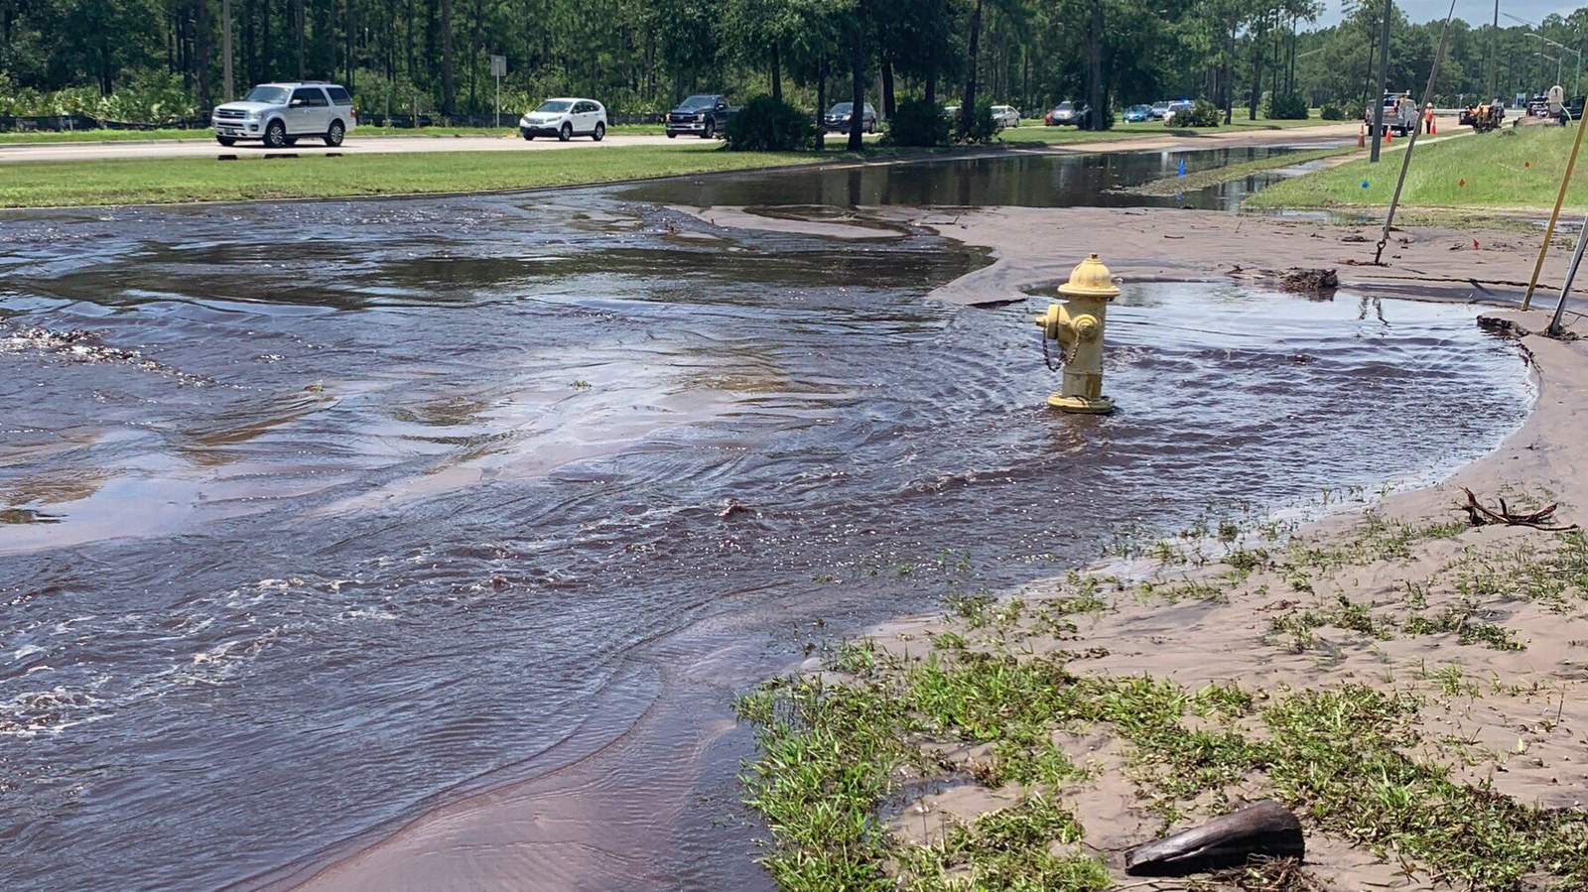
Physical Factors for Likelihood of Failure
Pipe Length
Pipe Material
Pipe Age
Surrounding Environment
Electrical Currents
Pipe Breaks/Leak Data
AWWA Standard (M77 Condition Assessment of Water Mains, 2019)

Slide 7
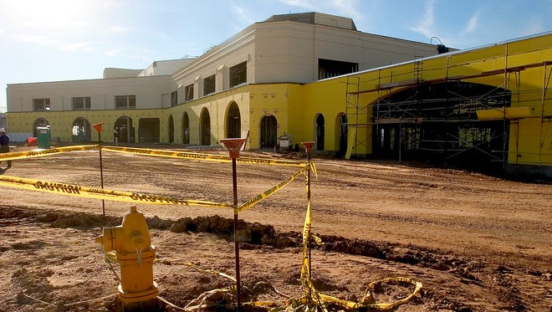
Factors for Consequence of Failure
Pipe Diameter
Pipe Alignment
Pipe Physical Location
Service Area
Land Use
Estimated Duration of Service Interruption
Specific Customers (e.g. Eldercare Facilities, Hospitals, Schools)

Slide 8

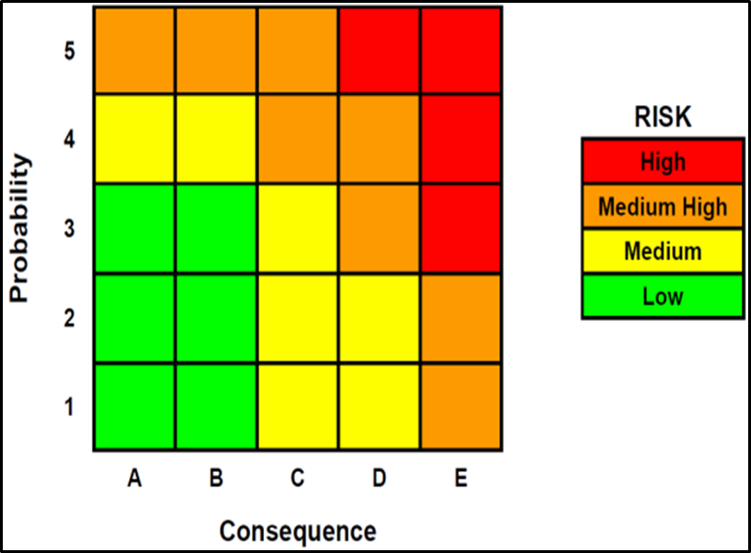
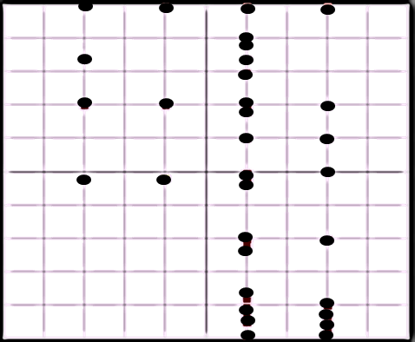
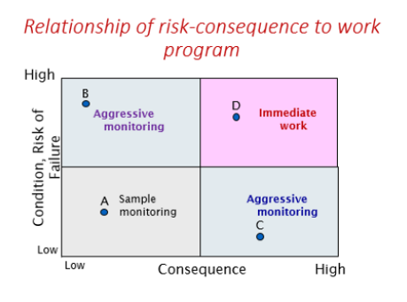
Relationship of Risk Consequence to Work Program
Population 2,700

Slide 9
Where Do We Start?

Slide 10
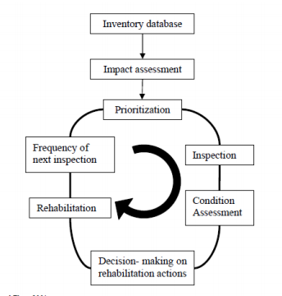
Condition Assessment is an Ongoing Process
To assess the condition of a system, data and information are gathered through observation, direct inspection, investigation, and indirect monitoring and reporting. An analysis of the data and information helps determine structural and operational issues, and performance of the system. Condition assessment also includes failure analysis to determine the causes of infrastructure failures and to develop ways to prevent future breakdowns. Condition assessment enhances the ability of utilities to make technically sound judgments regarding asset management.

Slide 11
Condition Assessment Process
Step 1:
Get Started
Step 2:
Develop Strategy
Step 3:
Identify and Inventory
Step 4:
Update CMMS/GIS
Start now
Start after the news
Develop Framework
Develop Priorities
Prepare list of pipes
Prepare pipeline ages, material and diameters
GIS pipe lengths and sizes
Update maps with correct GIS information

Slide 12
Condition Assessment Process
Step 5:
Prioritize Pipelines
Step 6:
Conduct Condition Assessment
Step 7:
Incorporate Work
into CIP
Identify inspection technologies
Conduct inspections; indirect and direct
Develop planning level repair/rehab/replace action plan
Develop criteria for LOF and COF
Estimate remaining life of pipe
Prioritize high risk assets for rehabilitation

Slide 13

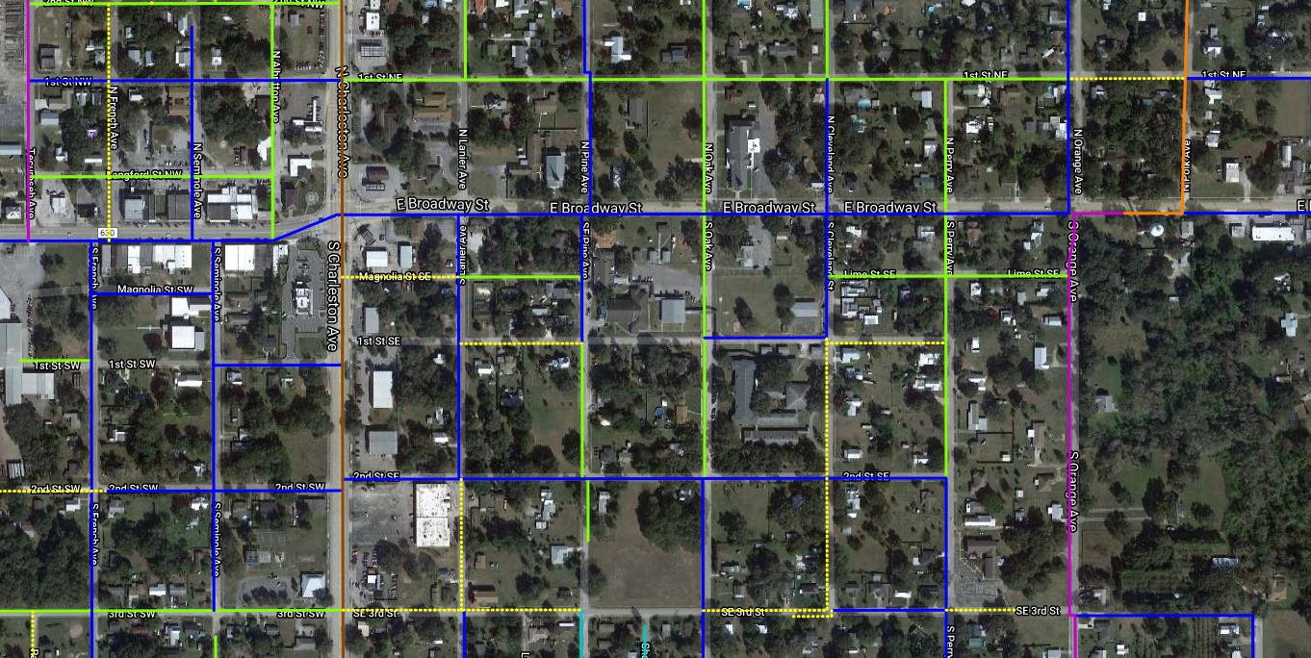
Identify and Inventory

Slide 14
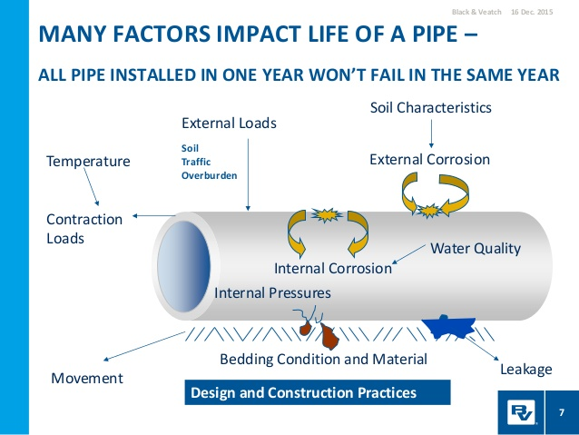
Some utilities presume that older pipe must be in poorer condition than newer pipe, which is not always the case. There are many examples showing 80 year old pipe in excellent condition and 30 year old pipe near failure. The only way to know for sure is to take a look – perform a condition assessment.

Slide 15
Conduct Condition Assessment

Slide 16
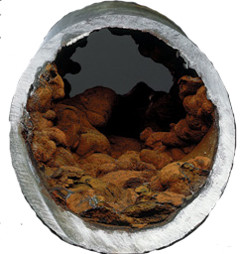
Issues Found in Different Types of Pipe
A very common but crucial challenge many encounter is to define and adopt the right strategy regarding efficiency issues, taking into account the difficult to predict corrosion and high replacement cost of pipes.
 | Pipeline Type | Pipe Considerations
1 | Galvanized Steel Pipe | Susceptible to Corrosion & Tuberculation
2 | PVC (schedule 40; thick wall, glued joints) | Susceptible to affects of external Organic Solvents
3 | Polybutylene (compression or banded Joints) | Susceptible to affects of Chlorine
4 | Copper (Type K; soft and Type L; hard) | Susceptible to Internal and External Corrosion

Slide 17
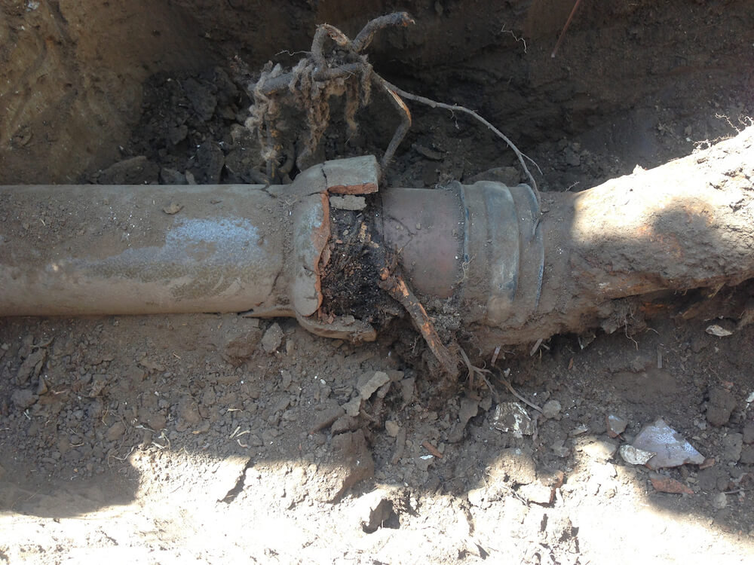
Common Pipeline Problems
Crushed or displaced pipe.
Roots from trees or shrubs. usually grow in at a number of points. If neglected the hair like roots will develop into much larger roots that can break the pipe.
Leaking pipes or joints can cause soil to wash away. Weight of ground on top of pipe accelerates issue leading to crush or breaks
Number of different potential causes including improper backfill, heavy rock placed on top of it during installation, settlement of surrounding topography, inferior materials.

Slide 18
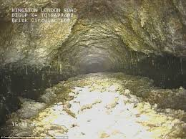
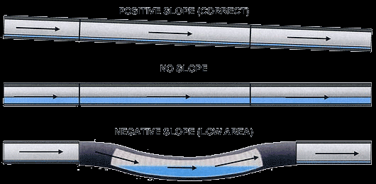
Common Pipeline Problems
Fats, oils and grease buildup. When poured down a drain, these materials cool and harden while sticking to the inner walls of the pipe.
Inadequate sloping and sewer pipe belly. This doesn’t allow material to flow freely, leading to backup during high flow situations.

Slide 19

What Are Your Options?
Tier 1
Tier 2
Semi-intrusive
Tier 3
Fully-intrusive
Pipe remains in service
Survey-level information
Pipe remains in service
Portions of pipe are exposed
Quantitative & detailed information
Instruments inserted through pipe
Flow must be controlled or drained
Most specific and detailed information
Non-intrusive
Non-destructive

Slide 20
Tier 1 Approaches
Leak Detection, Structural Condition & Hydraulic Performance

Slide 21
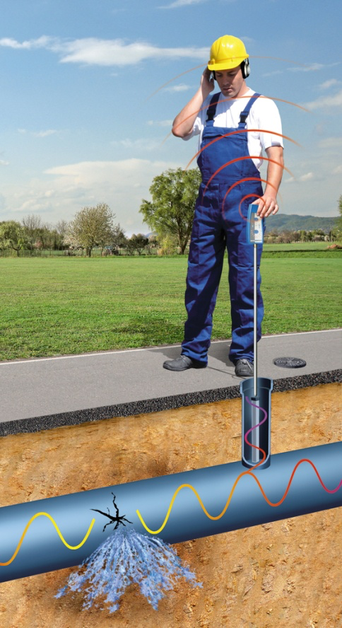
Leak Detection
Advantages
  Pipe remains in service
  No entry is required
  A wide range of tools available
  Provides information quickly on pipe’s condition
Limitations
  Will vary depending on method selected
Some Ways to Identify Leaks
  Visual and Physical Inspections
  Customer Complaints
  Standing water in dry periods
  Continuous flow in storm sewers
  Use of leak detection equipment

Slide 22
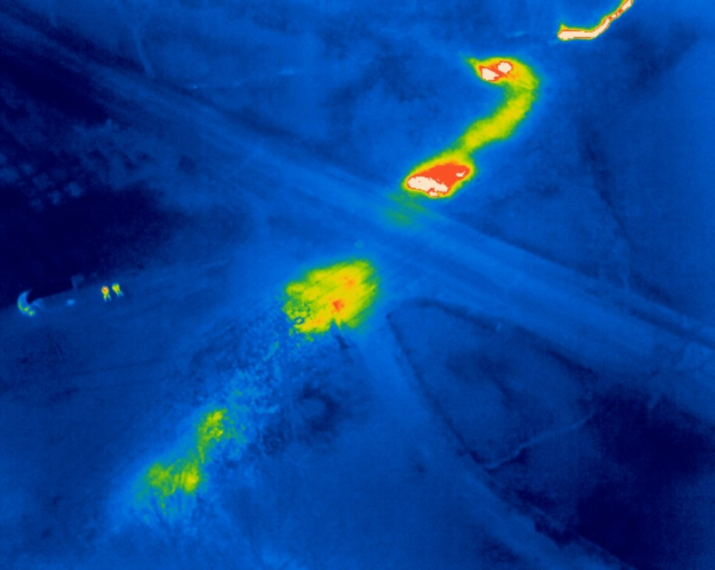
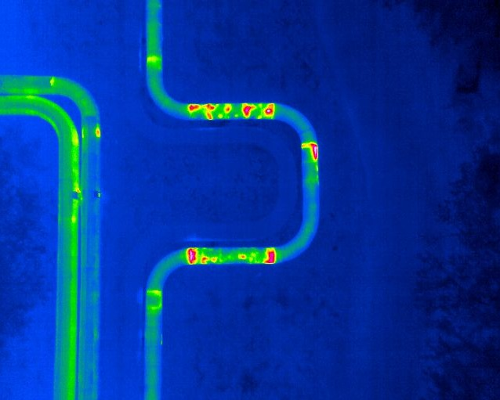
Infrared Thermal
  This survey level technology method provides heat signature images which may indicate leaks in water lines or effluent discharges.
Advantages:
  Allow rapid scanning of objects
  No direct contact and intrusion is required
  Equipment commercially available
Limitations:
    In order to identify the anomalies, a temperature difference is necessary.
    Moderate training required

Slide 23

Acoustic Inspection
These methods use acoustic detection technology to locate and characterize pipeline.
Advantages:
  Cost-effective.
  Locates leaks along the pipe.
  Works in a wide variety of pipe geometries, diameters, and materials.
  Acoustic visualization lets operators attack the worst blocks first.
Limitations:
  Background noise can interfere.
  Best in low traffic areas.
  Does not quantify leak rate.
  May vary depending on the method chosen.

Slide 24
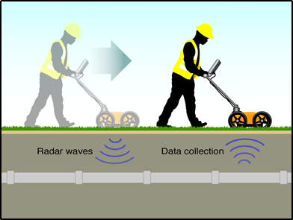
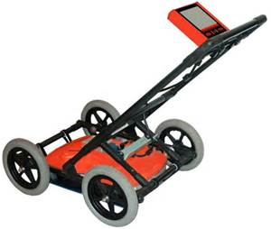
Ground Penetrating Radar (GPR)
Ground-penetrating radar (GPR) is a geophysical method that uses radar pulses to image the subsurface. This nondestructive method uses electromagnetic radiation in the microwave band (UHF/VHF frequencies) of the radio spectrum, and detects the reflected signals from subsurface structures. GPR can have applications in a variety of media, including rock, soil, ice, fresh water, pavements and structures. In the right conditions, practitioners can use GPR to detect subsurface objects, changes in material properties, and voids and cracks.
Made of three main components:
  Control unit
  Antenna
  Power Supply

Slide 25
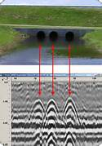
Ground Penetrating Radar (GPR)
Advantages:
  Able to locate pipes of all materials.
  Relatively high inspection speed.
  Inspection can be performed from the surface non-intrusively.
  A GPR survey can provide information on the condition of the soil surrounding the pipe.
Limitations:
  Data interpretation needs skilled operators.
  Variations in soil conditions can affect results.
*FRWA can use (GPR) to attempt to locate difficult-to-find lines.
(GPR) will tell if there is a change in contour, but not WHAT is below ground.
System may have to dig to double check.

Slide 26

Pressure and Flow Monitoring
Pressure management in pipe networks is fundamental to the physical integrity of pipelines as well as providing safe drinking water. Surges in pressure have been known to create additional leaks, main breaks and/or greatly reduce infrastructure life. Accurate pressure data allows system operators to reduce leakage volumes, energy costs, system maintenance costs, customer complaints, and water quality problems.
The video below illustrates some of the technologies used in monitoring pressure and flow in a system:

Slide 27
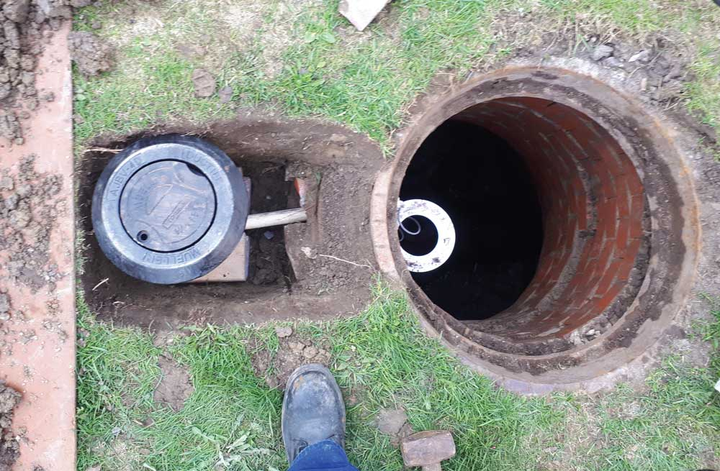
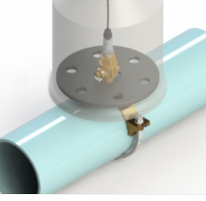
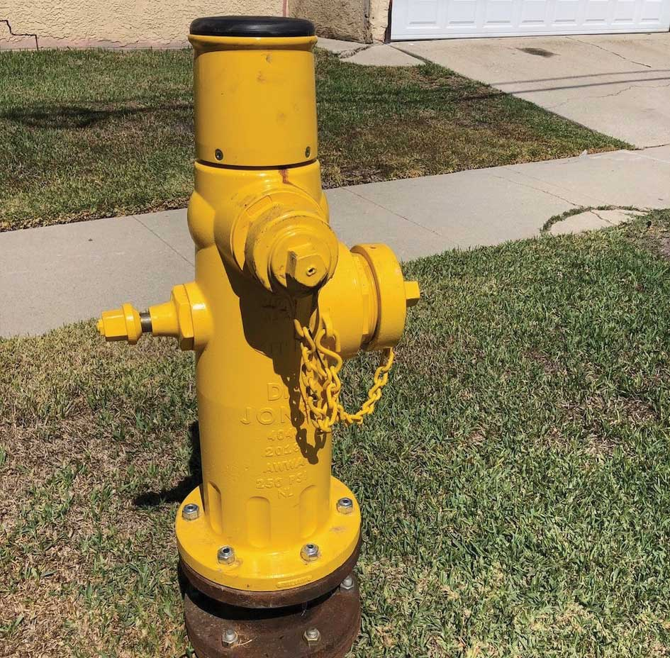
Pressure and Flow Monitoring
Advantages:
  Reduces unaccounted for (non-revenue) water
  Identify potential infrastructure failures related to pressure
  Can reduce costs
  Reduce pumping and energy costs
  Improve public safety
Limitations:
  Accuracy depends on pressure sensor
  May vary based on method used
  Usually needs to be installed by way of saddle or direct tap
Notes:
Secondary leak detection methods utilize pressure differences. These are measured by strategically located flow meters and pressure gauges that can, by differences in the readings, bracket the location of the leak. For example, if flow rates at the start of the pipe length are significantly higher than at its terminus, it is likely that there is a leak occurring between these two points. Pressure drops compared to initial operating condition immediately after installation will indicate the escape of water and subsequent lowering of pressure from its original state. The two systems can be used together with the pressure and flow differentials used to bracket the leak’s location and mobile acoustic sensors running along this bracketed length to pinpoint its location. The use of the former saves considerable time and tedious effort by the latter.

Slide 28
Tier 2 Approaches
Leak Detection & Structural Condition

Slide 29
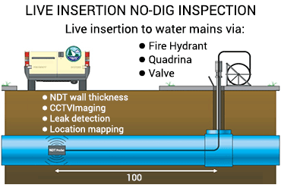
CCTV & Leak Detection
Basic Steps of CCTV Inspection Include:
  Use a CCTV camera on a carrier in the pipe via access points.
  Analyze Images in the Field or office.
Possible Uses:
  Location of lost valve(s)
  Corrosion/Tuberculation
  Liner Inspection
  Repair Planning

Slide 30
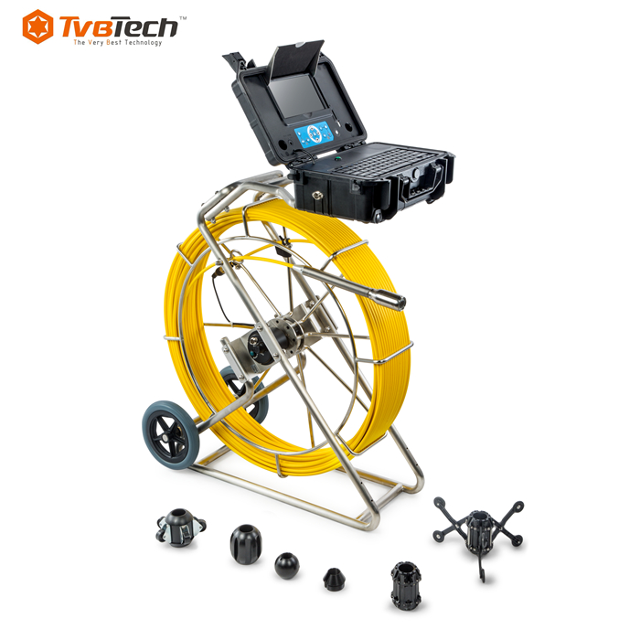
CCTV & Leak Detection
Advantages:
  Simple, relatively inexpensive, suitable for small and large pipes.
  New systems with multi-camera/fish-eye technology can record a full view of a pipe.
  Digital recording and storage is very convenient.
Limitations:
  Provides information only on defects that are manifested on the pipe inner surface.
  Inspection results are qualitative and need interpretation.

Slide 31
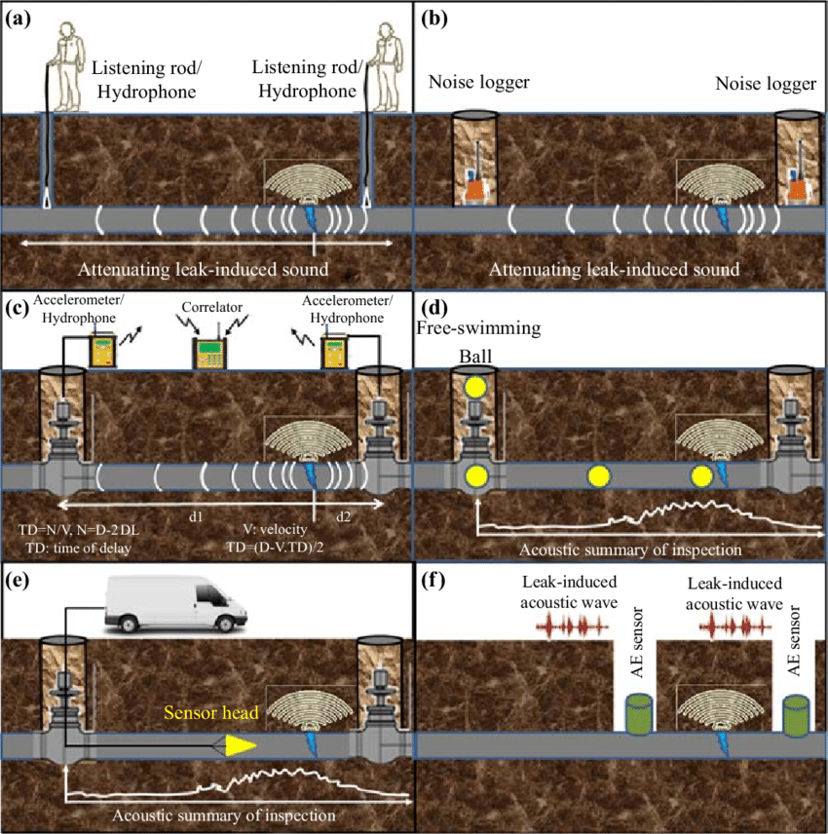
Internal Hydrophones
A hydrophone is an underwater listening device. Just as a microphone is used to detect sound in the air, a hydrophone detects sounds in the water and converts the acoustic energy into electrical energy.
Advantages:
  Locates leaks and gas pockets.
  Beneficial locating leaks in difficult situations like the following:
    Large diameter or trunk mains.
    Plastic Pipes
    Large distances between available pipe access points.
    When high acoustic background noise exists, often due to traffic.
Limitations:
  Tethered systems require numerous access points.

Slide 32
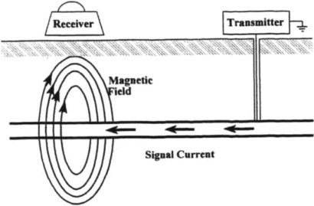
Electromagnetic Inspection
Types:
Overview:
Electromagnetic testing is a form of nondestructive inspection. It uses the process of inducing electric currents, magnetic fields, or both, inside a test object and observing the electromagnetic response. If the test is set up properly, a defect inside the object creates a measurable response.
“Electromagnetic testing” is often referring to eddy-current testing (ECT). However, the expanding number of testing methods available is changing that.
Remote Field Eddy Current
Broadband Electromagnetic
Magnetic Flux Leakage
Ground Penetrating Radar (GPR)

Slide 33
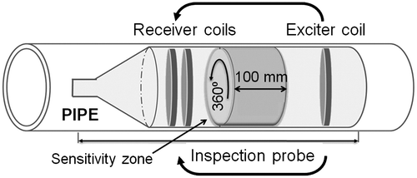
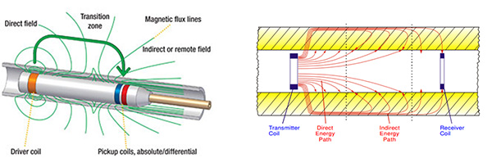
Remote Field Eddy Current
  Advantages:
  Can be applied to different applications (e.g. detect broken wire, measure corrosion pits).
  Measures wall thickness and location of pits.
  Doesn’t Require Contact.
  Operated in wet or dry conditions.
  Used for inspecting lined pipe without needing direct contact with pipe.
Limitations:
Data interpretation needs experience and skill.
Some tools require pipe cleaning and/or dewatering before inspection.
Reduced accuracy and sensitivity at conductive and magnetic objects on or near the outside of the pipe, such as attachments or tube support plates.

Slide 34
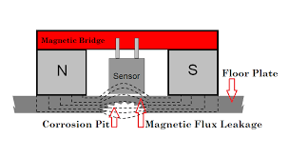
Magnetic Flux Leakage
Measure and Identify metal loss due to corrosion in ferrous pipes.
This technology is primarily used in the oil industry.
Advantages:
  High degree of accuracy for wall thickness measurement.
  Identifies size and location of defects (including pits).
  External surface inspection does not require service interruption.
Limitations:
  Technology is still emerging for water pipeline applications.
  Requires excavation of buried pipes and replacement of coating or insulation.
  Is not widely used in-line due to the high cost associated.

Slide 35
Tier 3 Approaches
Structural Condition

Slide 36
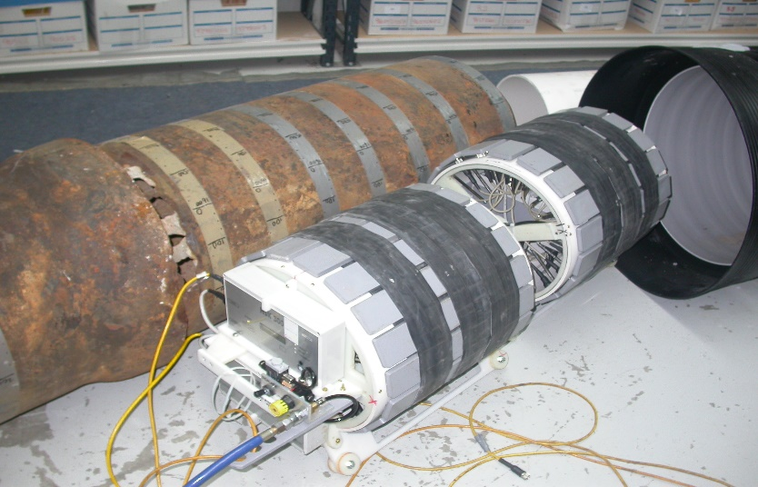
Broadband Electromagnetic
Provides a testing method to measure metallic structures wall thickness.
  This technology has been primarily used for condition assessment of water mains.
  Being further modified to facilitate the inspection of pipes exposed in keyhole excavations.
Advantages:
  Can be used externally or internally
  Effective for investigating all diameters.
  Does not require contact with metallic pipe.
  Able to scan through coatings, linings, and insulation.
Limitations:
  Unable to detect pin-hole failures or isolated pits.
  For in-line inspection, pipe needs to be emptied and cleaned.
  Inspection process is time consuming.

Slide 37
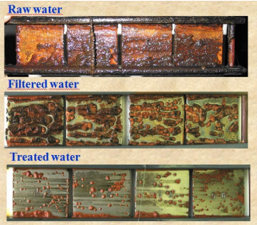
Coupon Analysis
Any time you are doing a water tap or have an opportunity to evaluate the exterior of a pipe, getting a coupon of that section is highly beneficial.
Advantages:
  Most definitive data set.
  Possible to remove coupons from an operational main by using tapping technologies.
  Multiple tests may be run on the coupon.
Limitations:
  Provides discrete point information only.
  Requires portion of the pipe to be exposed.

Slide 38
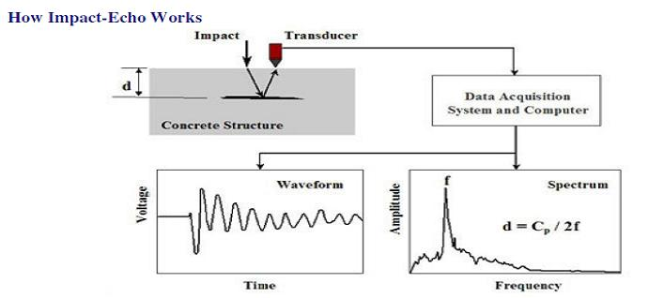
Acoustic Impact Echo
  This testing method is based on the use of impact-generated stress waves that propagate through and are reflected by the object under test. Results can help determine the location and extent of flaws such as depth and width of surface cracks and other damages.
Advantages:
  Only one side of the structure needs to be accessible
  Detects voids beyond the pipe wall
  Can be applied to varied materials
  Detects delamination of concrete pipes
Limitations:
  Not applicable to metals
  Embedded items may affect wave behavior and test results
  Requires dewatered pipe

Slide 39
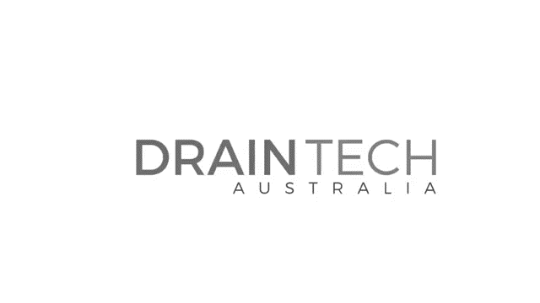
Internal Laser Technology
Advantages:
  High-Precision scan of pipe interior dimensions to measure deformation
  Contributes to design for CIPP, sliplining, swagelining, etc.
Limitations:
  Only functions above water level
  Cannot always distinguish scanned materials (can be influenced by tuberculation or buildup)

Slide 40
When to Replace?

Slide 41
Summary
According to the EPA:
Condition assessment is either not used or not used routinely by most utilities.
Utilities often have little data in the system besides the type of pipe, type of service, and, installation date. If inspection have been conducted, systems usually only have qualitative (good or bad) information, which is not useful.
Utilities are leery of new inspection techniques and need to be educated on how to use them effectively.
Repair or replacement typically only occurs after major failure event and associated negative attention.

Slide 42
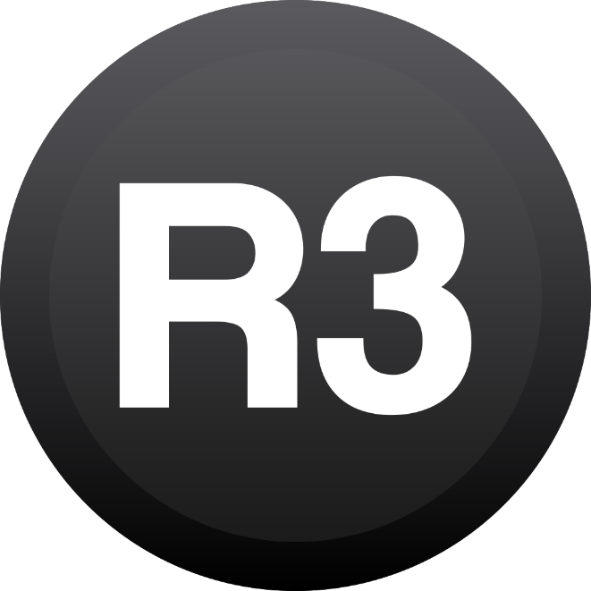
Summary
R3 = Replace: Right pipe, Right time, Right Material
Overcome individual system barriers
Develop a plan for your system
Determine the value of condition assessment for your system
Implement a logical approach for technologies
Use the information to develop a repair/replacement plan
Incorporate the plan into your CIP and Budget document

Slide 43
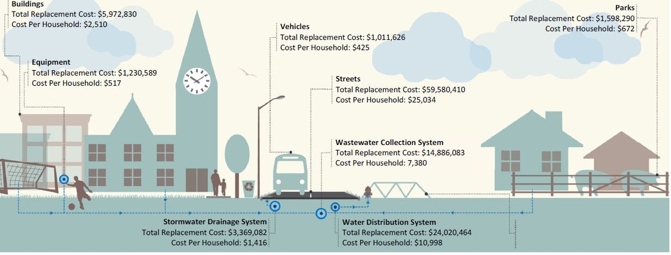
Summary
Empowers utility to act as stewards of community systems
Encourages Proactive Investment
Facilitates continuous improvement
Requires Prioritization of Pipes in the System and Condition (emphasis on collecting the quantity and quality of data collected need to determine status of pipelines.

Slide 44
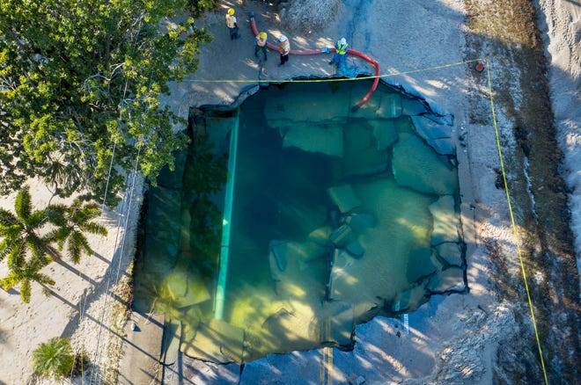
R3 = Replace: Right Pipe, Right Time, Right Material
Start Now Or Start After The News!

Slide 45
Questions?
Brian Feltman
Brian.Feltman@FRWA.net
Phone: 772-214-8651
Ron Nalley
Ron.Nalley@FRWA.net
Phone: 828-747-2110

