Slide 1
Level 1 and Level 2 Assessments
Amada Fernandez
Florida Department of Environmental Protection
August 2021

Slide 2
Agenda
Definitions
Triggers
Assessments
Corrective Action
Violations

Slide 3
Revised Total Coliform Rule
40 CFR § 141.859
# TC+ occurrences
Triggers
Level 1 or Level 2 Assessment
Identify sanitary defects
Corrective action
Correct sanitary defects
Notes:
Public Water systems that exceed a specified frequency of total coliform positive occurrences in the distribution system must conduct an assessment to determine whether any sanitary defects exist. And if sanitary defects are found, the public water system must complete corrective action. We’re going to go into each of these steps in more depth, but first let’s start with some definitions.

Slide 4
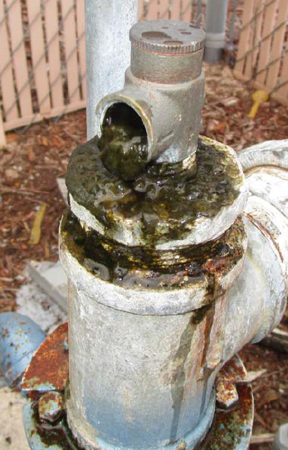
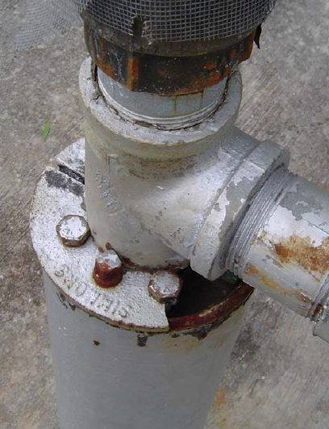
Definitions
Rule 62-550.200, Florida Administrative Code (F.A.C.)
Sanitary Defect:
A defect that could provide pathway for entry of microbial contamination into the distribution system. A sanitary defect is indicative of failure, or imminent failure, of a barrier in place.
Notes:
First, a sanitary defect is a defect that…

Slide 5
Definitions
Rule 62-550.200, Florida Administrative Code (F.A.C.)
Level 1 Assessment:
an evaluation to identify the possible presence of sanitary defects, defects in distribution system coliform monitoring practices, and (when possible) the likely reason that the system triggered the assessment. It is conducted by the system operator or owner. It is meant to be a self-assessment by the PWS. Minimum elements include:
changes in distribution system maintenance and operation that could affect water quality (including water storage)
source and treatment
existing water quality monitoring data
inadequacies in sample sites, sampling protocol, and sample processing
identify atypical events that could affect water quality

Slide 6
Definitions
Rule 62-550.200, Florida Administrative Code (F.A.C.)
Level 2 Assessment:
A Level 2 assessment provides a more detailed examination of the system (including the system’s monitoring and operational practices) than does a Level 1 assessment through the use of more comprehensive investigation and review of available information and additional internal and external resources. It is conducted by an individual approved by the State, which may include the system operator.
Notes:
Level 2 assessment may be completed by the operator, as long as the operator did not conduct a Level 1 assessment for the system in the past 12 months. Otherwise, an FRWA circuit rider could perform the assessment.
State personnel,
An operator certified by the state to operate a system of similar size, type and complexity,
Technical assistance provider such as a circuit rider,
A supervisor or manager from the water system, supported by other experts or employees of the system, or
A consultant/consulting engineer

Slide 7
Level 1 Assessment Triggers
40 CFR § 141.859
PWS taking < 40 samples/month has 2 or more TC+ routine/repeat samples in one month
PWS taking 40 or more samples/month has > 5.0% TC+ routine/repeat samples in one month
PWS fails to take every required repeat sample after any TC+ routine/repeat sample

Slide 8
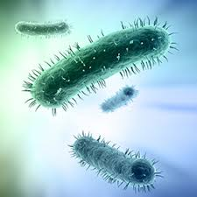
Level 2 Assessment Triggers
40 CFR § 141.859
E. coli MCL violation
2nd Level 1 Assessment triggered within rolling 12-month period
Notes:
Level 2 Assessments:
Level 2 must be conducted by a party approved by the state, which is typically going to be either an operator who meets the minimum certification requirements for the system or a Florida rural water circuit rider.
Keep in mind that if an operator completes a level 1 assessment, and a level 2 assessment is triggered within a rolling 12 months, the same operator is not allowed to complete the level 2.
The system must comply with any expedited actions or additional actions required by the State in the case of an E. coli MCL violation.

Slide 9
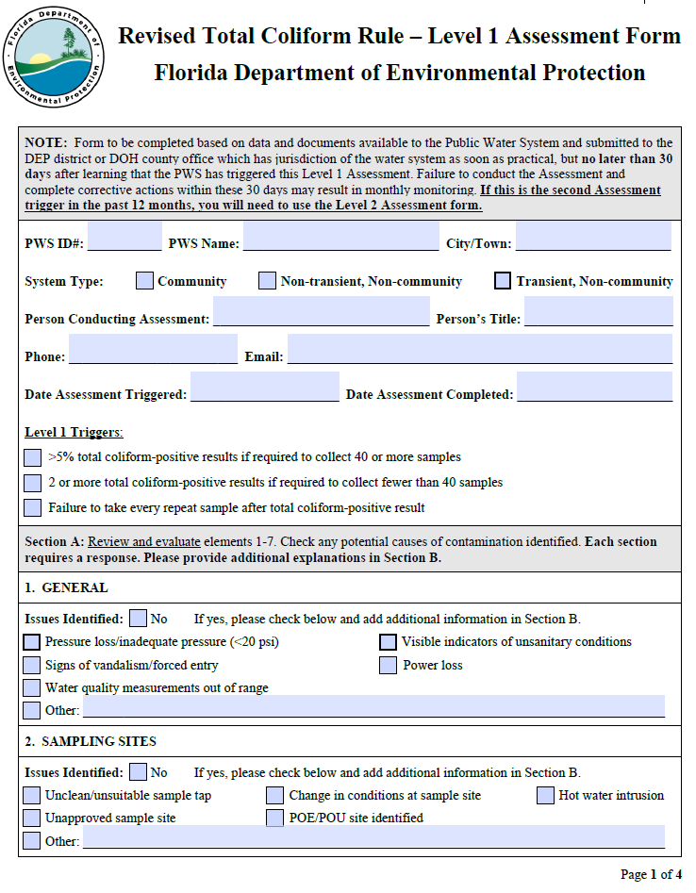
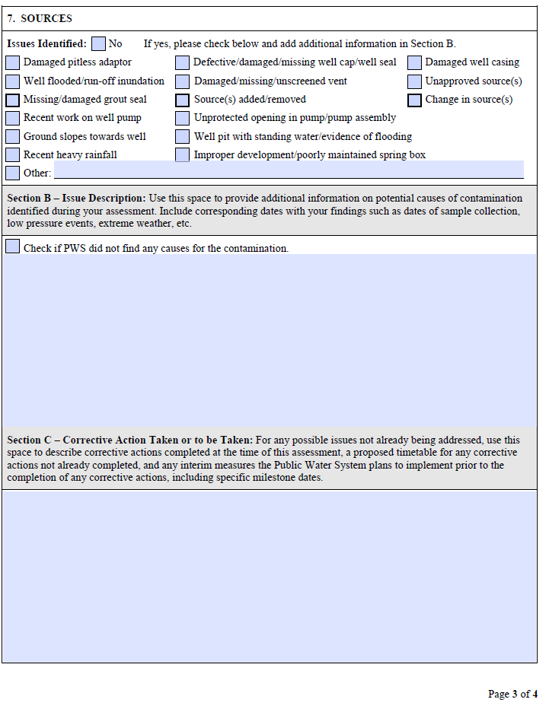
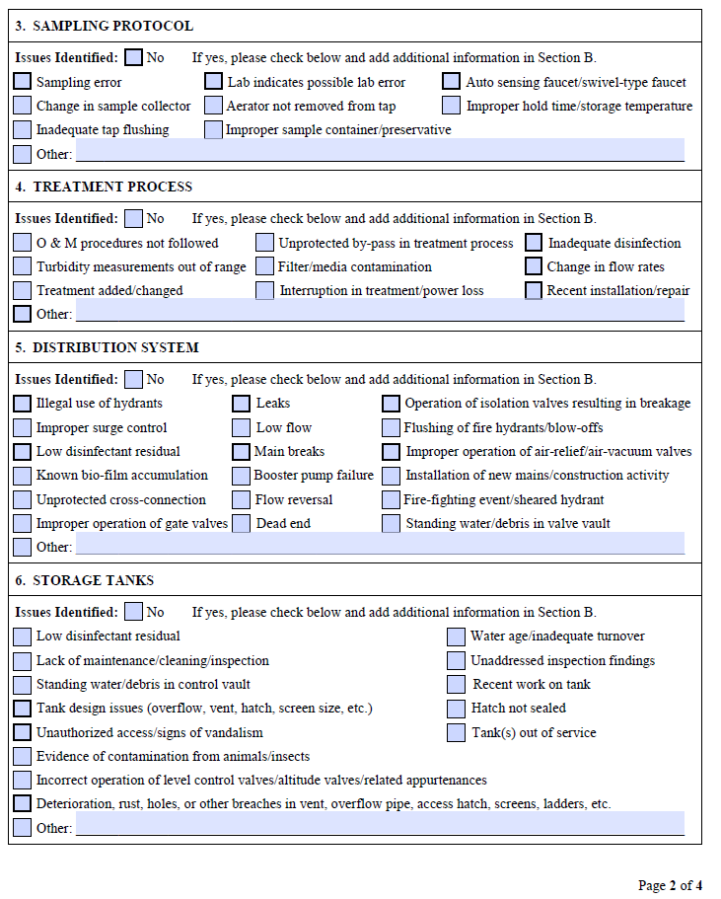
Level 1 Assessment
Form
Notes:
4 pages. Sampling sites, sampling protocol, treatment process, distribution system, storage tanks, sources. Can indicate that no sanitary defects or causes for the contamination were found. Corrective action and timeline.

Slide 10
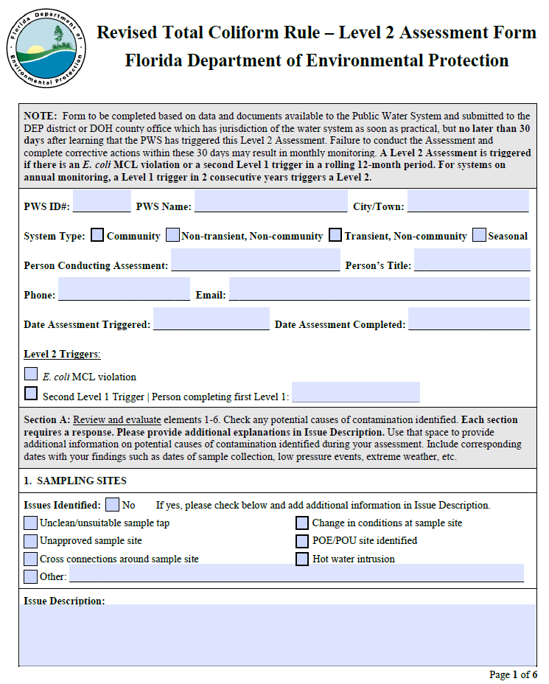
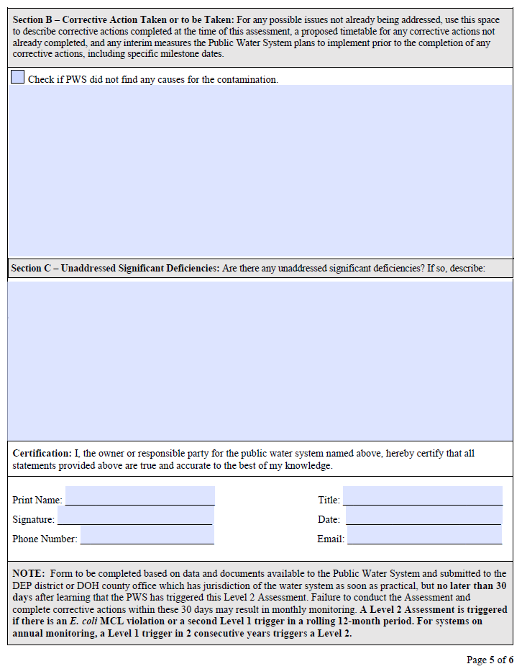
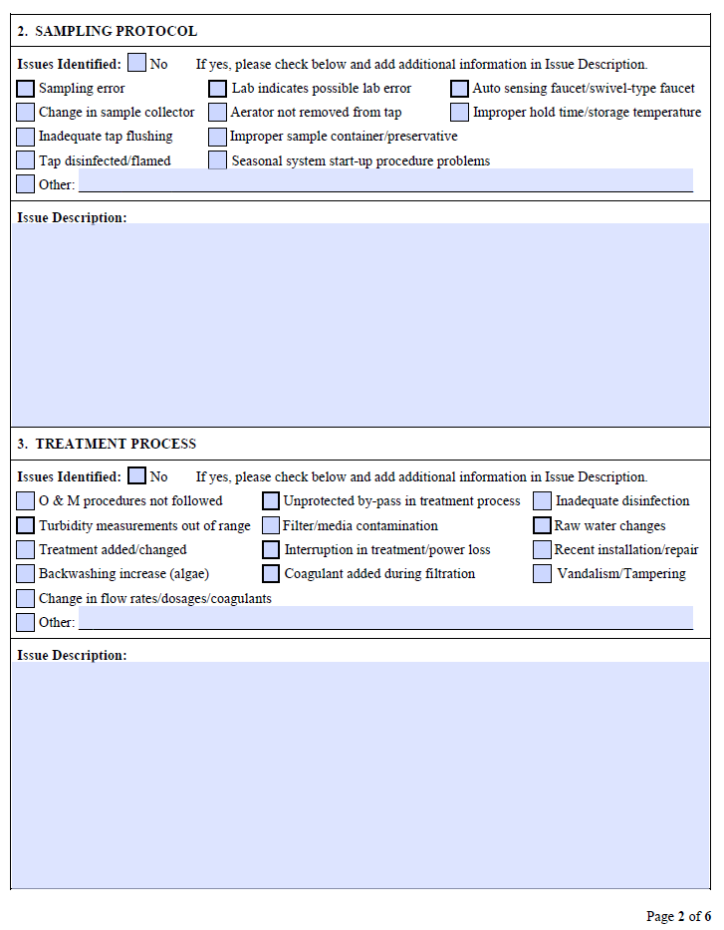
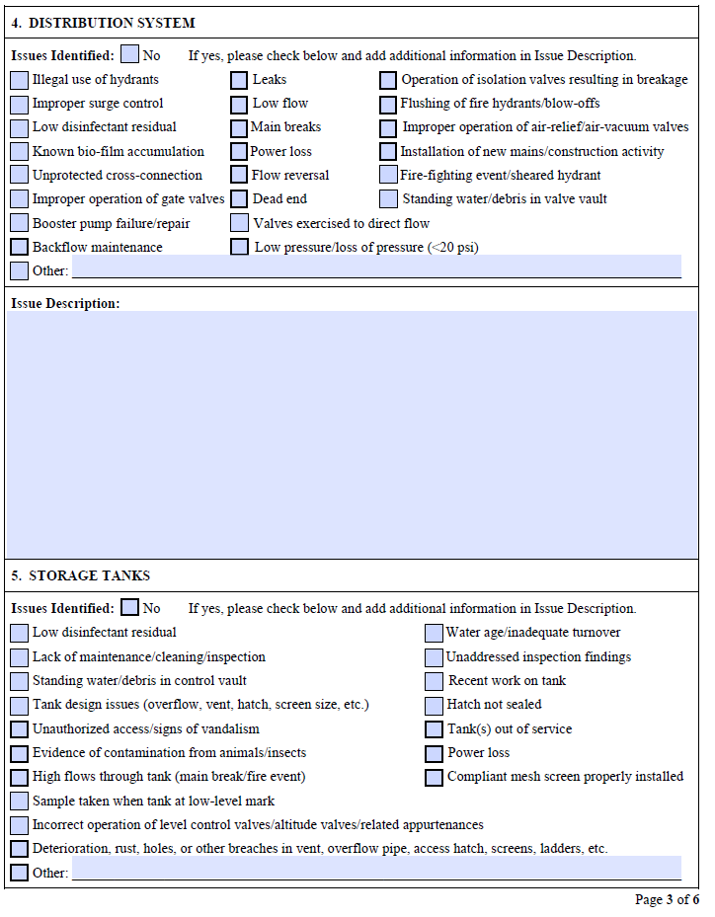
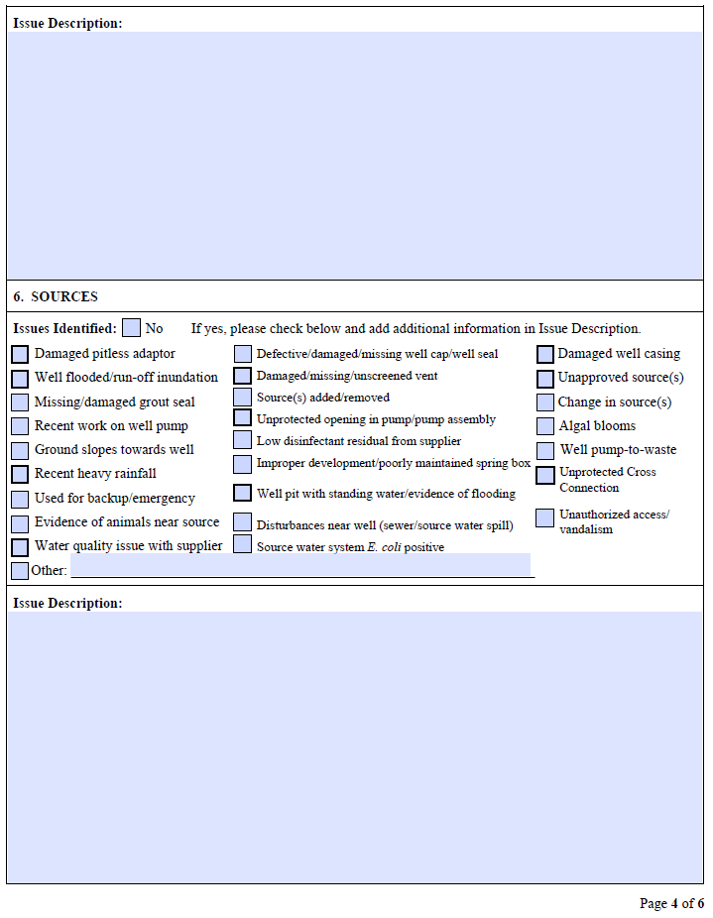
Level 2 Assessment
Form
Notes:
6 pages. Evaluating the same elements, but more in depth. Can indicate that no sanitary defects or causes for the contamination were found. Corrective action and timeline.

Slide 11
Assessments and Corrective Action
Assessment must include:
Any sanitary defects found (if none were found, indicate on form)
Any corrective actions completed
Proposed schedule for any corrective actions not already completed
PWS must submit assessment form to DEP within 30 days after learning assessment is required
DEP will review and either accept or request revisions

Slide 12
RTCR Treatment Technique (TT) Violations
Triggering a Level 1 or 2 Assessment is not a violation in and of itself.
However,
Failure to submit Assessment form to DEP within 30 days of notification will result in a TT violation.
Failure to correct all sanitary defects from Level 1 or Level 2 Assessment within 30 days of trigger, or in accordance with the state-approved timeframe, will result in a TT violation.

Slide 13
Amada Fernandez
407-897-4159
Amada.M.Fernandez@FloridaDEP.gov

