Slide 1

Compliance Solutions for Health Based Issues
Techniques and Tools
Sterling L. Carroll, P.E., M.P.A.
FRWA State Engineer
Florida Rural Water Assn
Notes:
In this presentation we will discuss the mechanism that produce disinfection by products, how to control their formation by the production of chloramines and how to prevent Nitrification as an unintended consequence of chloramination.

Slide 2
Most Important Factor in providing Excellent Water Quality
The Operator
  Professional Attention & Care
  Proactive (not reactive)
    Look for problems
    Flushing
  Preventive Maintenance
    Calendared
    List actions that need to be taken
    Budget time and materials

Slide 3
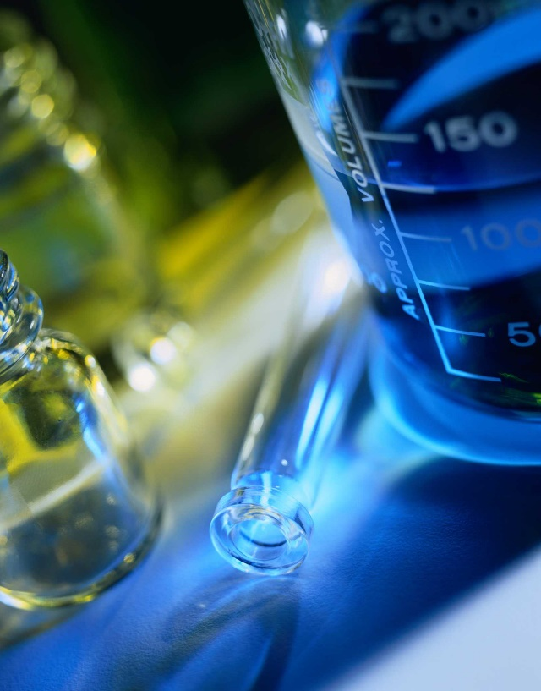
Source Water Quality Factors
Evaluate your source water first
  VOCs, SOCs, Inorganics
  Iron (Fe)
  Hydrogen Sulfide (H₂S),
  Organics (TOC),
  TDS,
  Hardness (CaCO₃),
  etc.

Slide 4
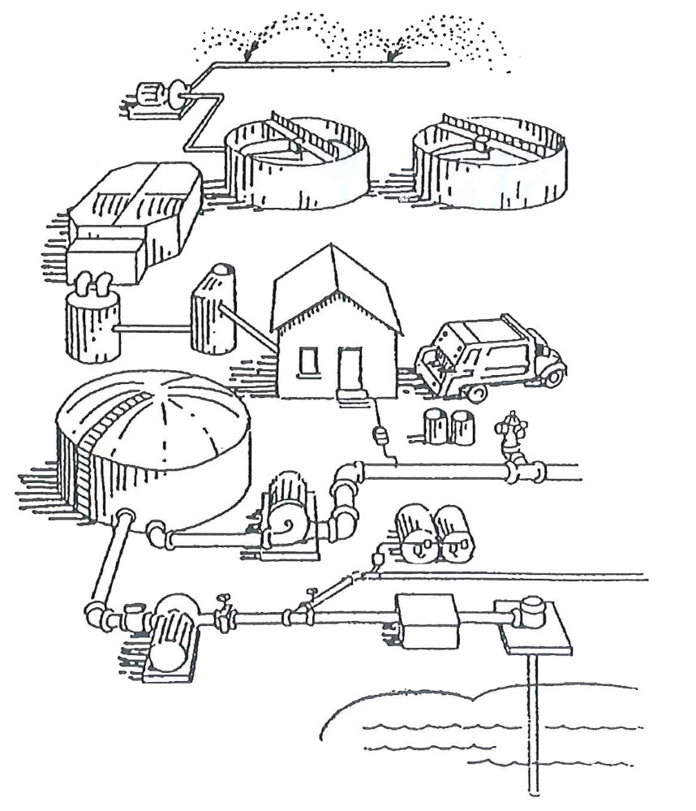
Water Quality Factors
Treatment type & efficiency
  Is it effectively removing impurities?
  Chlorine feed
Distribution system conditions
  Age, pipe material, diameter, dead-ends…
  Biofilm, tuberculation, etc.
Homeowner’s piping

Slide 5

Compliance Solutions Techniques and Tools
Oxidation by Aeration
Chemical Preoxidation
  Hydrogen Peroxide (H₂O₂)
  Permanganate (KMnO₄, NaMnO₄)
Absorption
  Activated Alumina Filtration
  GAC Filters
Ion / Anion Exchange
Reverse Osmosis

Slide 6
Sources of Naturally Occurring Organic Material in Surface Water
Rain Events wash organic matter into receiving body - surface water
  Hydrophilic
  Dissolved organic matter
  Water can pass thru soil into Ground Waters
Algae Blooms are an example of organic material that is suspended or insoluble in water, hydrophobic
  Particulates easily removed by treatment
Notes:
Natural Organic Matter makes up the humic content in source waters. NOM is either hydrophilic (more soluble in water) or hydrophobic (less soluble and a more aromatic fraction.) Hydrophobic matter is easier to remove in the treatment process.

Slide 7
Naturally Occurring Organic Material
Hydro-PHILIC NOM
Hydro-PHOBIC NOM
Attracted to water
Dissolved organic matter
Lighter molecular weight
Not easily removed by treatment
Not as reactive
Insoluble in water
Suspended in water
Heavier molecular weight
  Long chain tannins
Particulates easily removed by treatment
Creates more TTHMs
Notes:
Natural Organic Matter makes up the humic content in source waters. NOM is either hydrophilic (more soluble in water) or hydrophobic (less soluble and a more aromatic fraction.) Hydrophobic matter is easier to remove in the treatment process.

Slide 8
Total Organic Content & Florida’s Groundwater
Sea Water
Most Groundwaters
Florida Groundwater
Swamps
Surface Water Median = 3.5 mg/L
Surface Waters
WWTP Effluent
Wastewaters
0.1
0.5
1.0
3
5
10
50
100
500
1,000
TOC (mg/L)

Slide 9


Dissolved Organic Materials
Examples
TEA
COFFEE

Slide 10
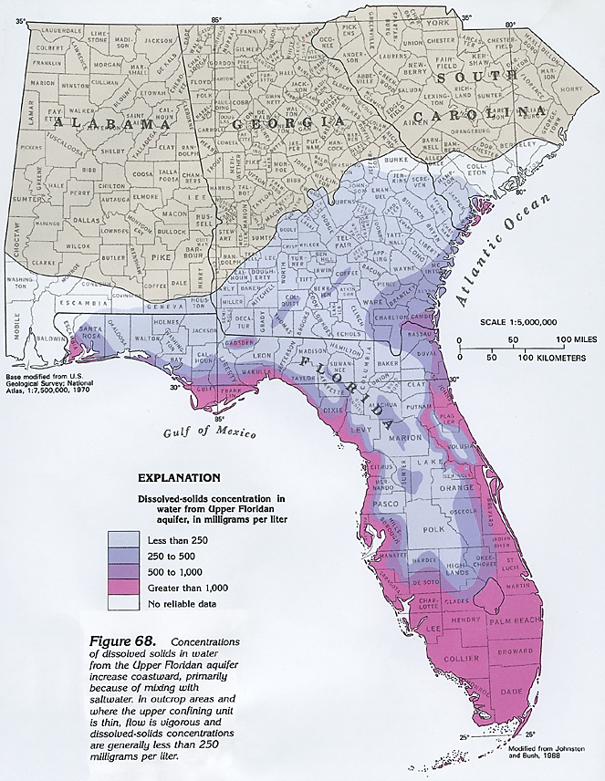
Map of TDS
Groundwater Quality relationship w/ TOC, Fe, H₂S, etc.

Slide 11
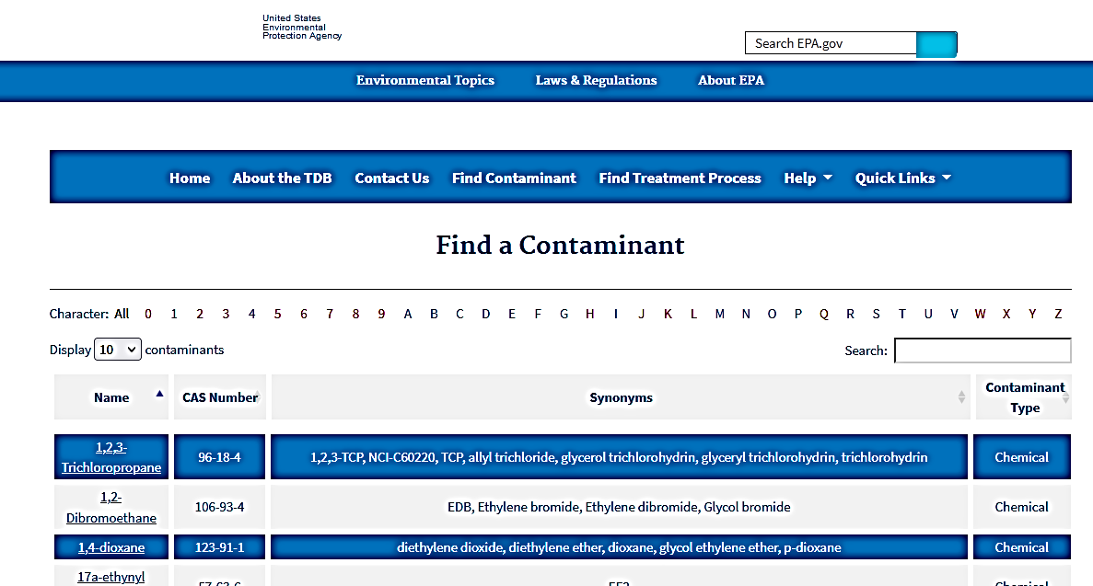
EPA Drinking Water Treatability Database https://oaspub.epa.gov/tdb/pages/general/home.do

Slide 12
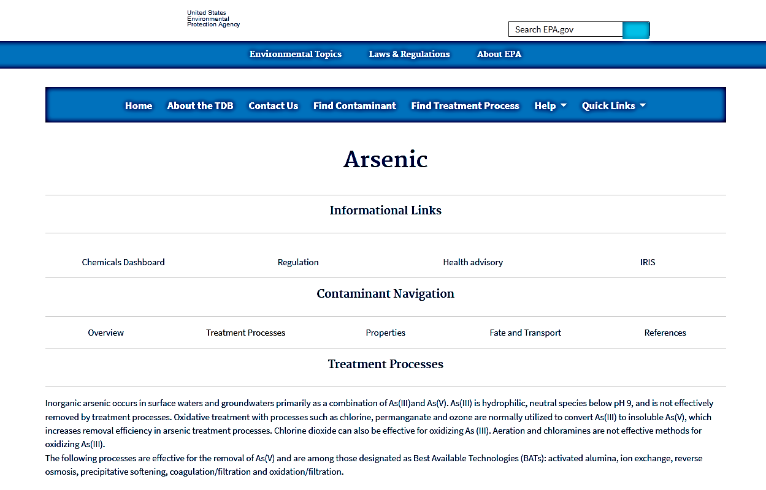
12

Slide 13
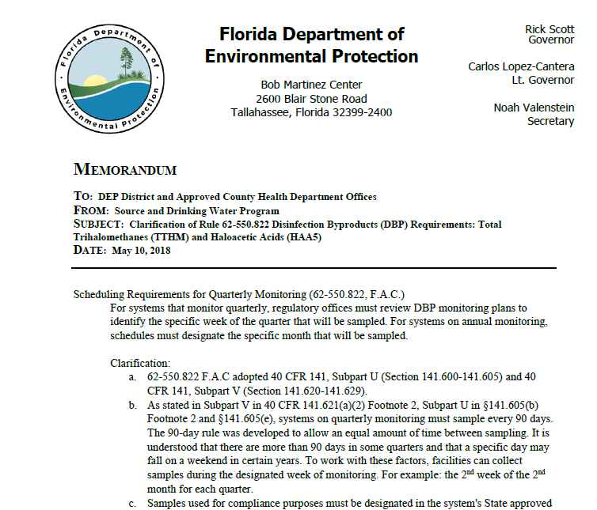
Chloramines
(The Last Choice Option)
A chlorine burn is considered “normal operations” & part of periodic maintenance
DBP Formation
Water line breaks are considered non-normal operating condition
Length of chlorine burns max. 21 days

Slide 14
FDEP Memorandum
May 10, 2018
To: DEP District and Approved County Health Department Offices
From: Source and Drinking Water Program
Subject: Clarification of Rule 62-550.822 Disinfection Byproducts (DBP) Requirements: Total Trihalomethanes (TTHM) and Haloacetic Acids (HAA5)

Slide 15
FDEP Memorandum
May 10, 2018
Scheduling Requirements for Quarterly Monitoring (62-550.822, F.A.C.)
For systems that monitor quarterly, regulatory offices must review DBP monitoring plans to identify the specific week of the quarter that will be sampled. For systems on annual monitoring, schedules must designate the specific month that will be sampled.

Slide 16
FDEP Memorandum
May 10, 2018
Clarification:
62-550.822 F.A.C adopted 40 CFR 141, Subpart U (Section 141.600-141.605) and 40 CFR 141, Subpart V (Section 141.620-141.629).
As stated in Subpart V in 40 CFR 141.621(a)(2) Footnote 2, Subpart U in §141.605(b) Footnote 2 and §141.605(e), systems on quarterly monitoring must sample every 90 days.
The 90-day rule was developed to allow an equal amount of time between sampling…

Slide 17
FDEP Memorandum
May 10, 2018
c. Samples used for compliance purposes must be designated in the system's State approved monitoring plan. Systems may collect more than the required number and frequency of sampling. However, in order to be used in the calculation of the quarterly average used for compliance purposes, the additional samples must be included in the monitoring plan and approved prior to collecting samples. Consideration should be given to assuring that the sampling is equally separated.

Slide 18
FDEP Memorandum
May 10, 2018
d. The definition of “normal operating conditions” include any routine maintenance practices. An event such as a chlorine burn, a switch from chloramine to chlorine, is considered to be part of the normal operations of a system for periodic maintenance. A water line break or other disruptive event which is outside the control of the facility is considered non-normal operating condition.

Slide 19
FDEP Memorandum
May 10, 2018
e. The length of chlorine burns should be kept to a maximum of 21 days. Whenever possible, systems should try to optimize processes using guidance such as AWWA manual “A Guide for the Implementation and Use of Chloramines” (2004).

Slide 20
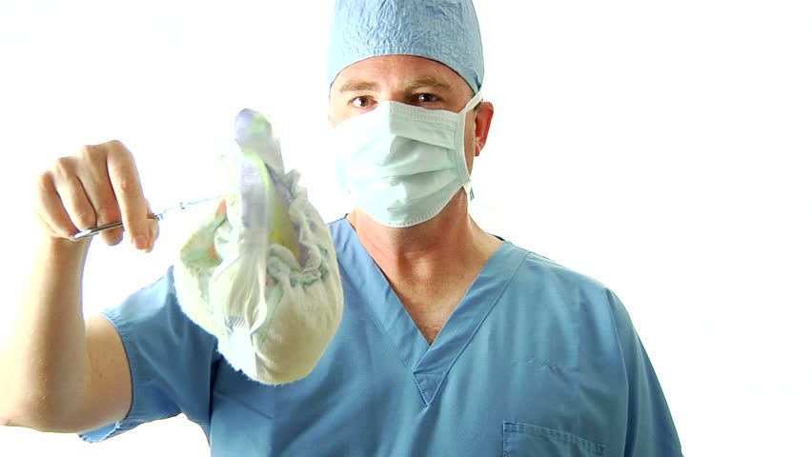
Chloramines NH₂Cl
(FRWA recommends against using ammonia)
Ammonia is a Waste By-product
  Ammonia does not improve water quality!
NH₂Cl By-Products
  may be ultimately more health adverse
  future EPA regulation
Simultaneous Compliance & Water Quality Problems
  Nitrification - total loss of residual occurs w/o notice
  More flushing is needed – increased frequency & volume
  Do free chlorine burns deliver more DBPs than the MCL?
  Biofilm Regrowth
  Difficulty achieving CT 4-log compliance

Slide 21
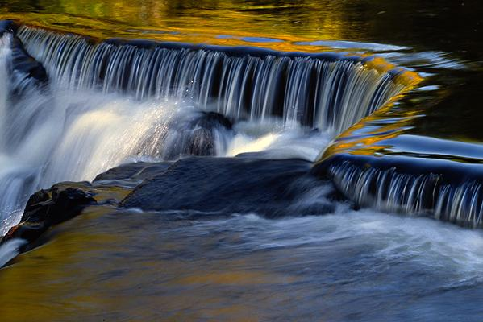
Oxidation by Aeration
Tank Aeration / Mixing
Aeration Techniques
Cascade Trays
Forced Draft Towers
Bubble Diffusers
Spray or
Air Induction
Notes:
This is most common effective oxidation method

Slide 22
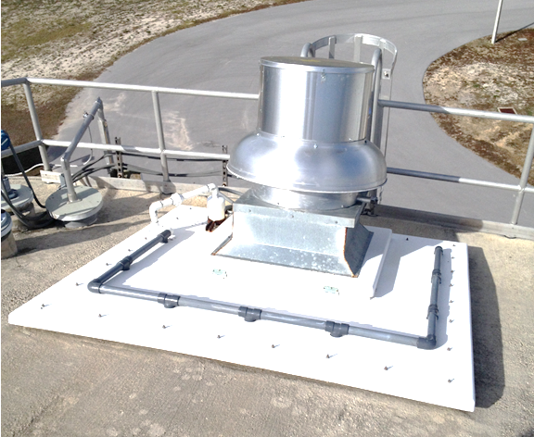
Tank Aerators & Mixers
50 - 60 ppb 2nd Quarter
100 ppb 3rd Quarter
After DYI Aeration
20-40 ppb 4th Quarter
68% Decrease across all monitoring locations
Port St Joe
Commercial ventilation fan
Small submersible pump
1¼” PVC piping
8 household showerheads
< $7,500 ~ Port St Joe DYI solution
$25,000 to $35,000 Commercial Mixers

Slide 23
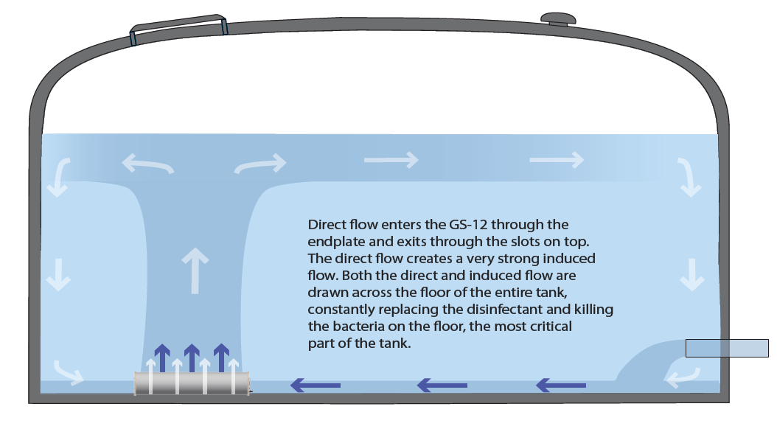
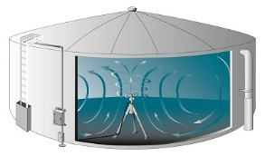
Commercial Tank Mixers
PAX Water Technology
GridBee GS-12 Submersible Mixer

Slide 24
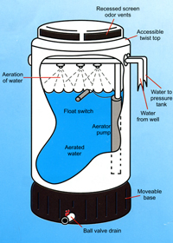
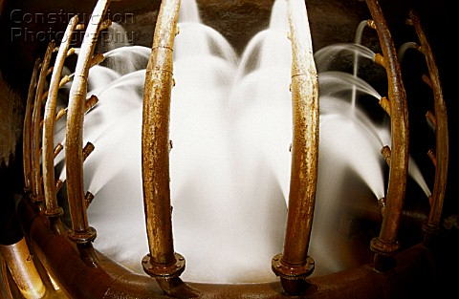
Spray Aerators
Inexpensive
Less effective
More effective

Slide 25
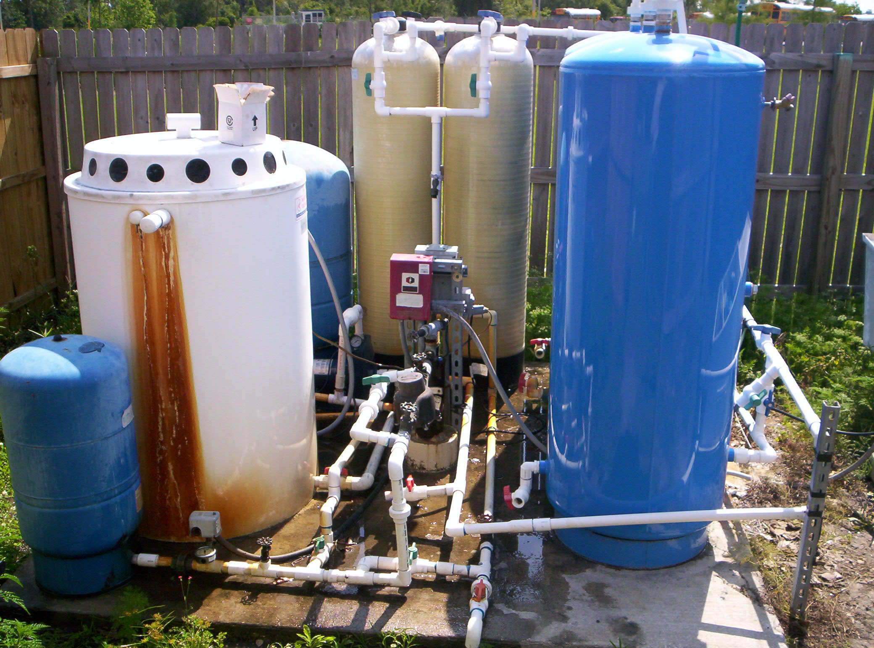
Spray Aerators
Inexpensive
Less effective

Slide 26
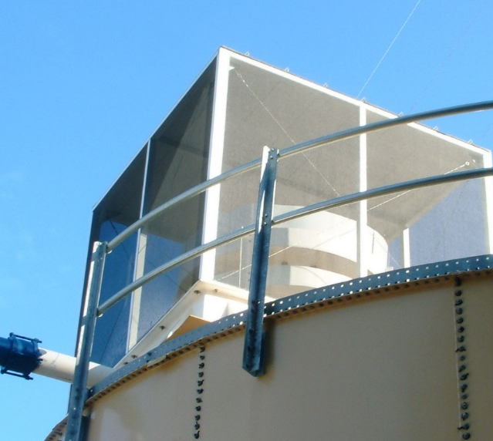
Cascade Tray Aerators
Splashing & cascading
Produces small water drops that fall through the air
Approx. 15% to 25% total sulfide removal
Enhanced with H₂O₂
  H₂O 18 g/mol
  H₂O₂ 34 g/mol
Notes:
Should be screened - #24 mesh

Slide 27
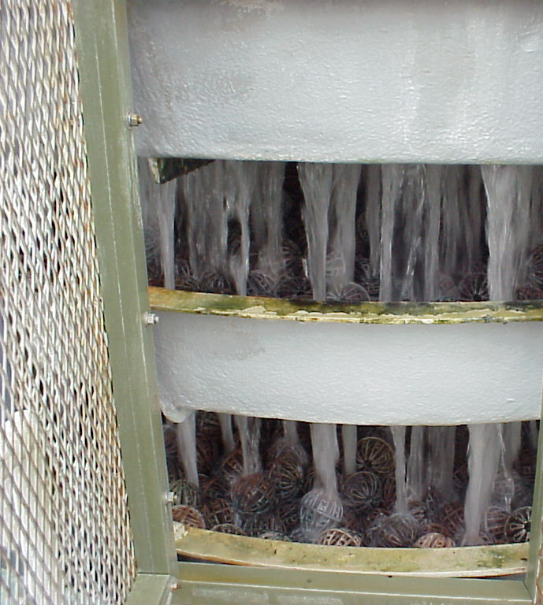
Cascade Aerator w/ Packing
Packing increases the surface to air ratio ➔ increases the gas exchange rate
More effective
Notes:
Other aeration techniques include forced draft multiple trays, cascades. The cascade method shown directs water from tray to tray from top to bottom causing a high degree of exchange of oxygen with the water.

Slide 28
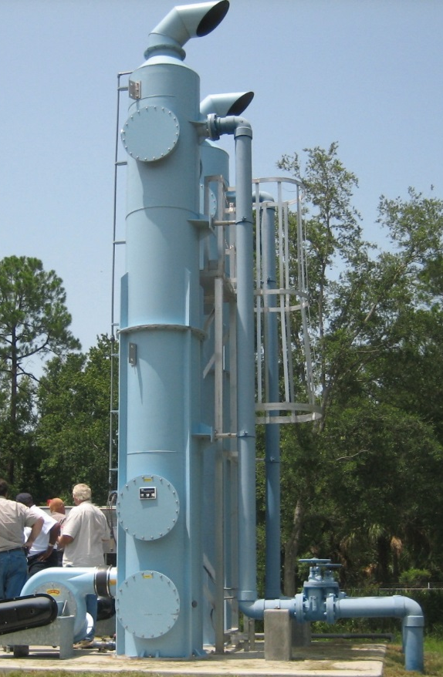
Packed Tower Forced Draft Aerators
Forcing air up through column and packing as water falls
Most effective aeration
FDEP says > 90%
Notes:
Packed towers are used to remove offensive odors such as hydrogen sulfide or Iron and Manganese from the water. Water is directed over synthetic media with large surface area to force contact of oxygen with water containing high concentrations of hydrogen sulfide. Removal efficiencies of 99% can be obtained with these systems.
Where high degrees of gas must be removed, a forced air system can be employed.
Following the aeration system a filtration system is employed to remove particulate iron, manganese and turbidity resulting from sulfur oxidation.

Slide 29
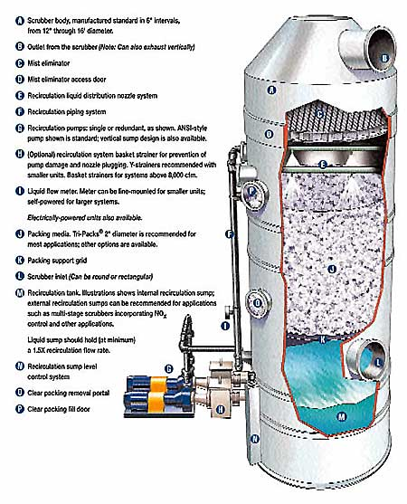
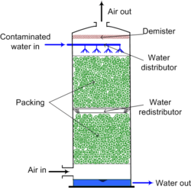
Packed Tower Forced Draft Aerators
Notes:
Packed towers are used to remove offensive odors such as hydrogen sulfide or Iron and Manganese from the water. Water is directed over synthetic media with large surface area to force contact of oxygen with water containing high concentrations of hydrogen sulfide. Removal efficiencies of 99% can be obtained with these systems.
Where high degrees of gas must be removed, a forced air system can be employed.
Following the aeration system a filtration system is employed to remove particulate iron, manganese and turbidity resulting from sulfur oxidation.

Slide 30
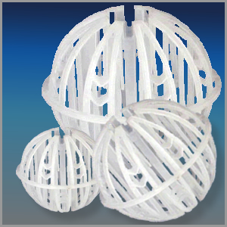
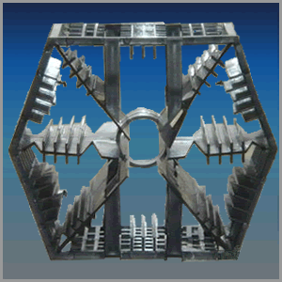
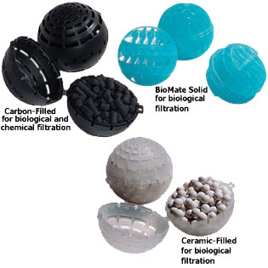
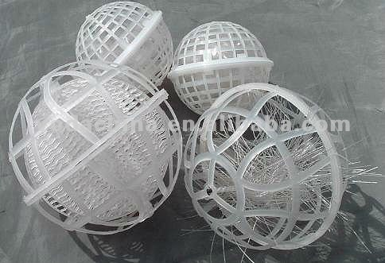
Aerator Packing
Notes:
Other aeration techniques include forced draft multiple trays, cascades. The cascade method shown directs water from tray to tray from top to bottom causing a high degree of exchange of oxygen with the water.

Slide 31
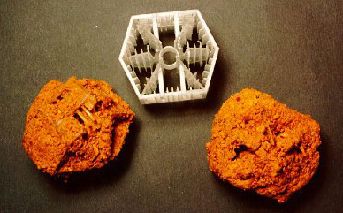
Aerator Packing
Maintenance is REQUIRED!
Annual or Semiannual cleaning of aerator packing
Citric / Acetic Acid (potable)
Notes:
Other aeration techniques include forced draft multiple trays, cascades. The cascade method shown directs water from tray to tray from top to bottom causing a high degree of exchange of oxygen with the water.

Slide 32
Air Entrainment
Air Vent w/ down turned elbow
Install Screen on air line to protect against insects, frogs & debris
Air
Venturi Tee
From Pump
To Tank
But not before a hydropneumatic tank…

Slide 33
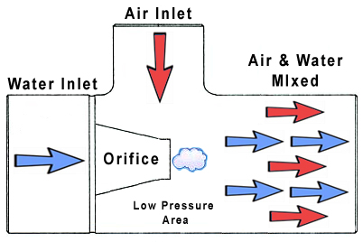
Air Entrainment
Venturi Tee

Slide 34
Chemical Preoxidation
Hydrogen Peroxide (H₂O₂)
Potassium Permanganate (KMnO₄ solid granules) and Greensand Filtration
Sodium Permanganate (NaMnO₄ solution) and Greensand Filtration

Slide 35
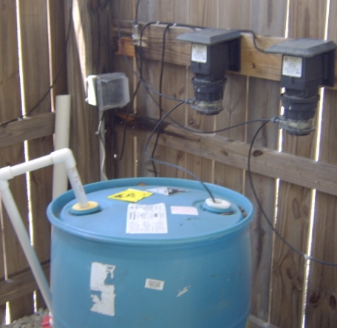
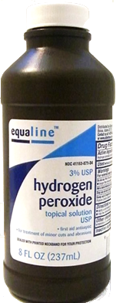
Hydrogen Peroxide (H₂O₂)
Pharmacy Grade
3% Concentration
Industrial Grade
35% Concentration
3% solution = 30,000 mg/L
Feed Rate ~ 3 mg/L
Same safety protocols as 12.5% NaOCl
55 gallon drum & Stenner pump

Slide 36
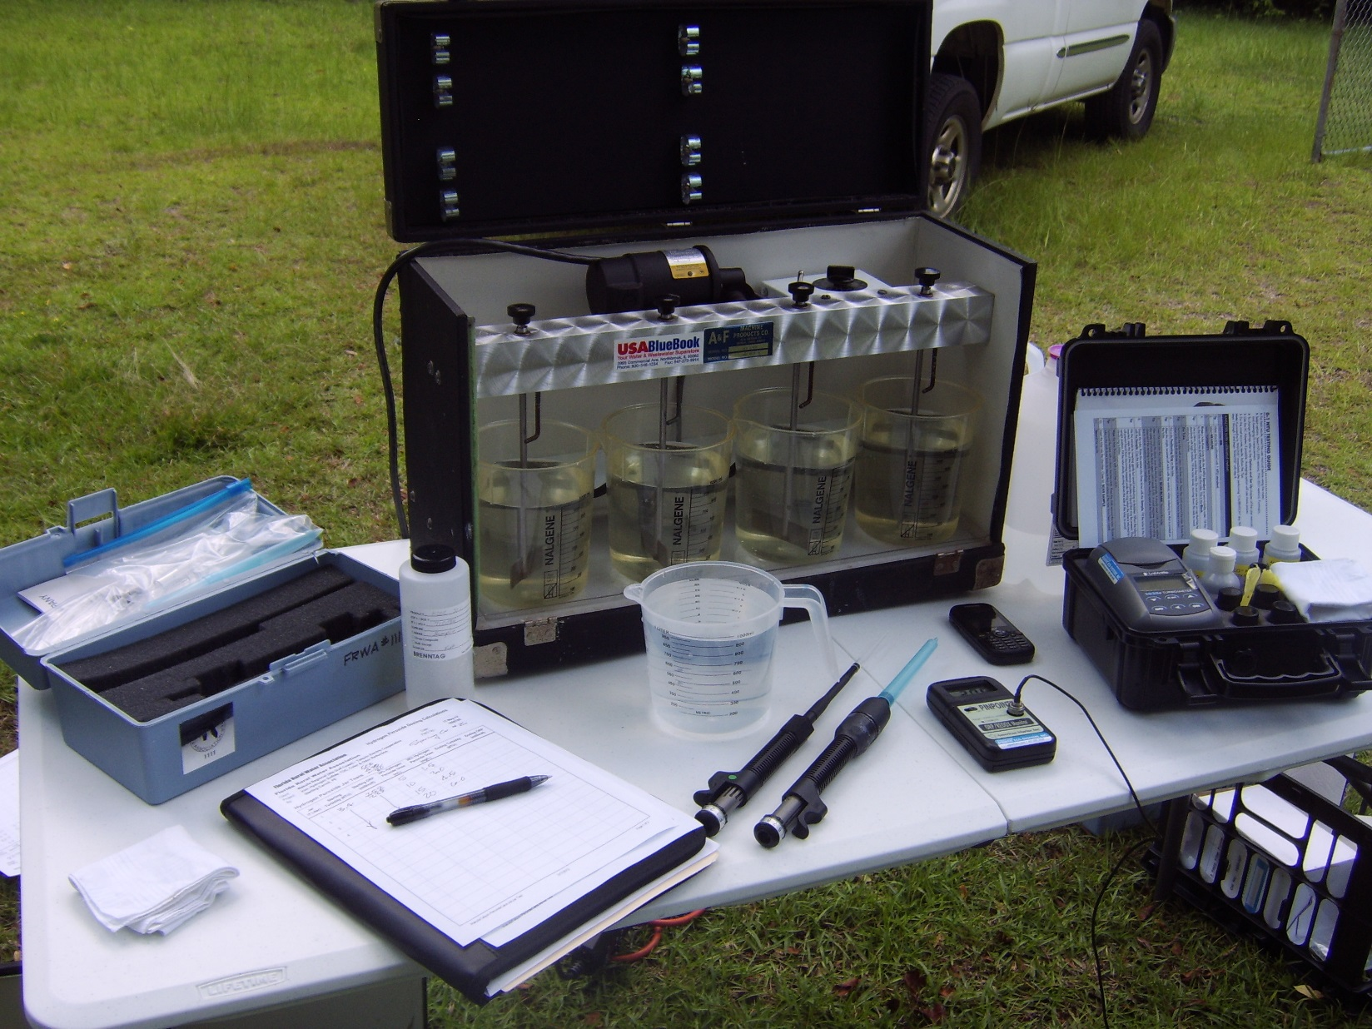
Jar Testing Hydrogen Peroxide
May 2012

Slide 37
Hydrogen Peroxide (H₂O₂)
H₂O₂ is a Preoxidant
Chemically Oxidizes (Reduces) Impurities
  Iron, Sulfur, Organics, Tannins & TOC – all contribute to color, odor, and taste
Lowers chlorine demand = lowers DBPs
Installed Costs under $1,000
  easy to install
Treatment cost is about 5¢ / 1,000 gal treated
  Reduces chlorine usage by 50%

Slide 38
Hydrogen Peroxide (H₂O₂)
Advantages
Disadvantages
Controllable process
Inexpensive capital installation
Inexpensive chemical cost
Reduces ORGANIC color, odor & taste
Operation easy to understand & monitor
Long shelf life
  does not off gas
NO residuals
  only H₂O & Oxygen
Reaction / Contact Times 15-20 minutes
Incomplete oxidation
Dechlorinating agent
Does not reduce INORGANIC color, odor & taste
Must be jar tested
Turbidity – requires filtration
No direct sunlight

Slide 39
Hydrogen Peroxide Vendors
(H₂O₂)
Dave Symonds & Associates, Inc.
Leesburg FL 34788
800-226-0340
dsymonds@embarqmail.com
The Dumont Company, Inc.
Oviedo, Florida 32765
800-330-1369
ron.cartwright@dumontchemicals.com
Val-Co Marketing & Research
Quitman GA 31643
229-263-5120
Fax 207-729-6604
Hawkins Water Treatment Group
Thomasville, GA 31792
Cell: 850-712-3670
Russell.Burton@hawkinsinc.com

Slide 40
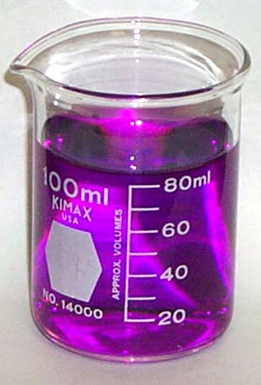
Permanganate Pre-Oxidation
Oxygen
KMnO₄
Manganese
Potassium
NaMnO₄
Oxygen
Manganese
Sodium
Notes:
The following four case study application of Sodium Permanganate were performed by FRWA. These studies demonstrate the benefit in using the chemical in selected applications. These application include the water systems at Fowlers Bluff, Otter Creek, Floral and Cross City. An additional application at Lake City was not included since high levels of H2S prohibited effective use of the chemical and the City has since started up a new water treatment facility.

Slide 41
Permanganate Pre-Oxidation
Coagulation (10-15 min) and filtration required
Potassium Permanganate (KMnO₄) used for decades in water treatment
Sodium Permanganate (NaMnO₄) specific use because of higher cost
NaMnO₄ is 15x more soluble than KMnO₄, thus maintenance concerns are minimal

Slide 42
Permanganate Pre-Oxidation
Permanganate do not create DBP’s
Strong oxidant / poor disinfectant
Difficult to overfeed since they are destroyed by chlorine oxidation
Good for TOC & Fe removal (poor H₂S)

Slide 43
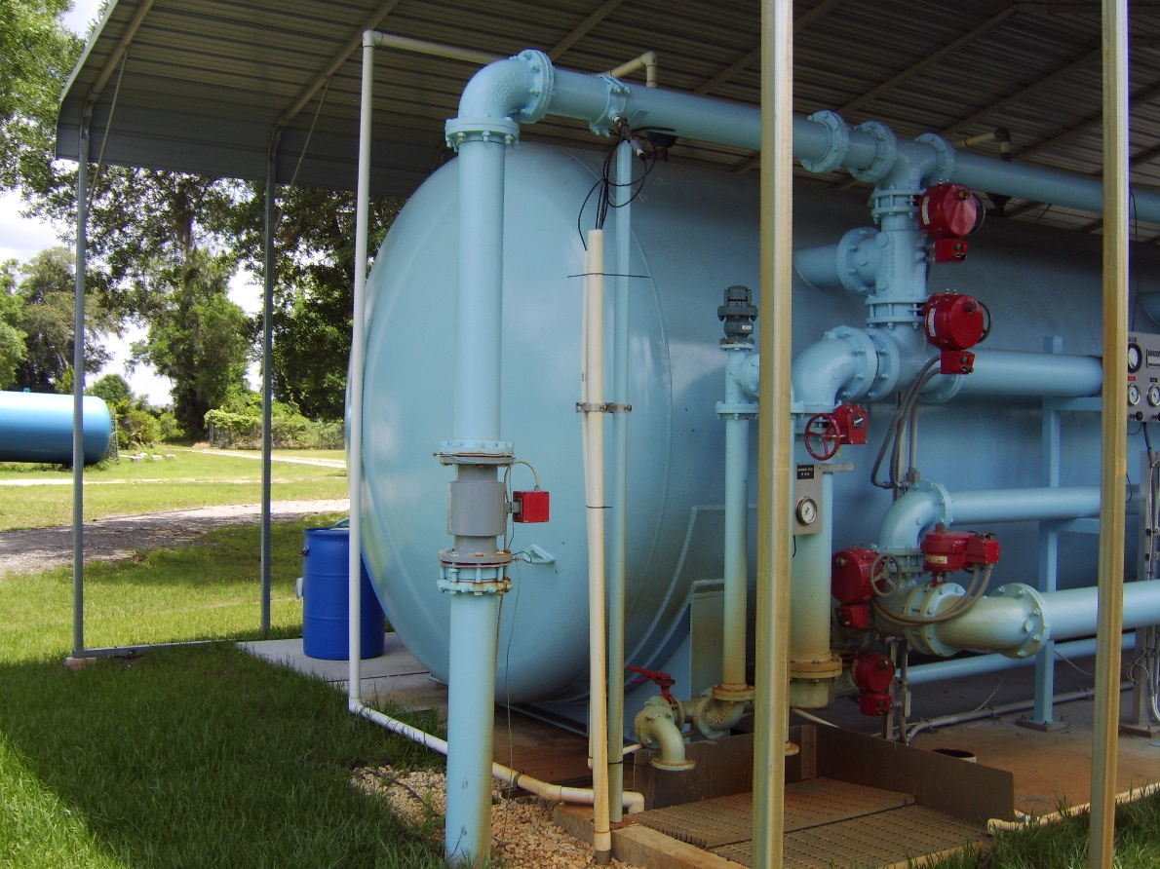
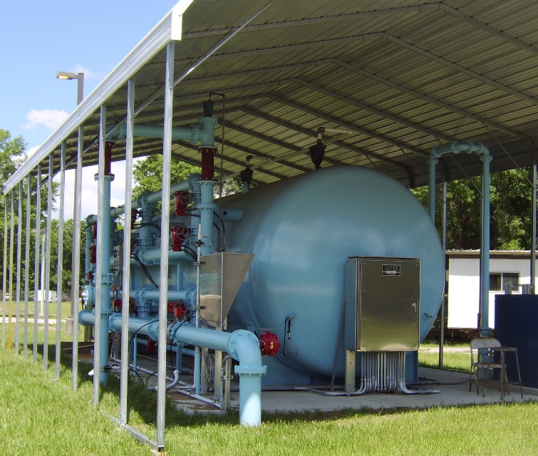
Permanganate Pre-Oxidation

Slide 44
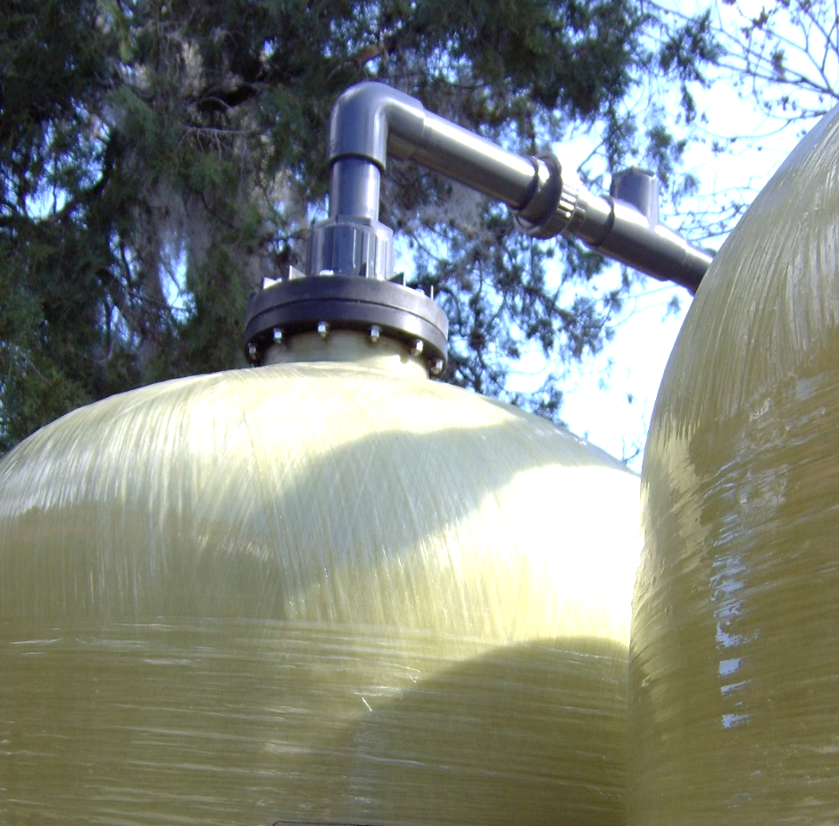
Granular Activated Carbon Filters
EPA Best Available Technology for removal of DBP Precursors
Expected DBP Reduction 50% to 70%
Pilot Study Required
  Ten States Standards
  FDEP

Slide 45
Granular Activated Carbon
Most common adsorbent
Irregular particles, 0.2-5 mm dia.
  char of carbon material (wood or coal)
Activated exposure to steam at high temperature
  made more porous
1,000 m² of adsorbing surface area per gram (~ 1 teaspoon)
  equivalent to 40 acre farm in one handful!

Slide 46
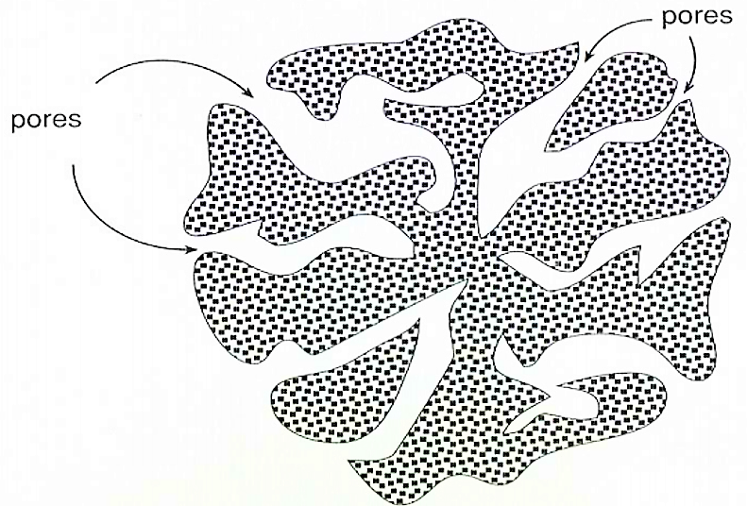
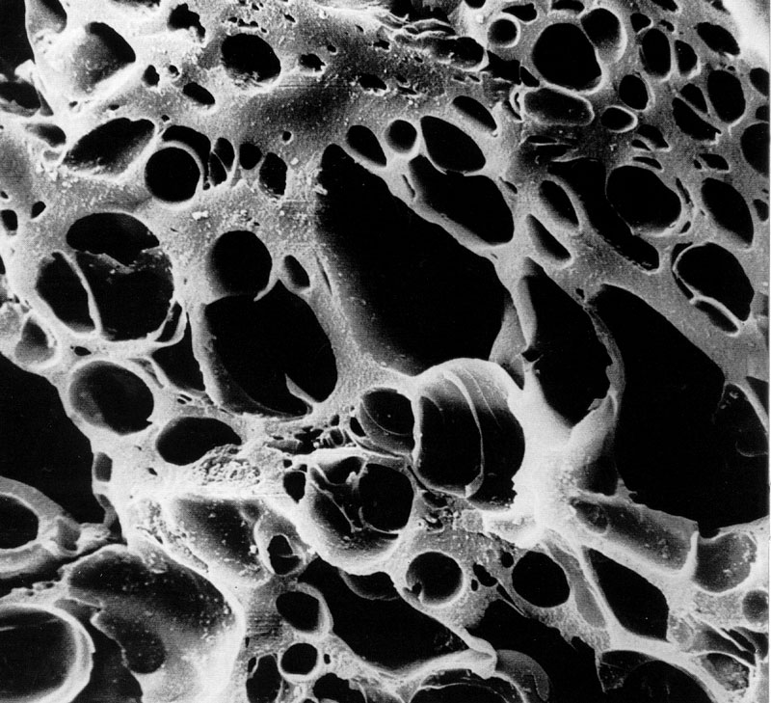
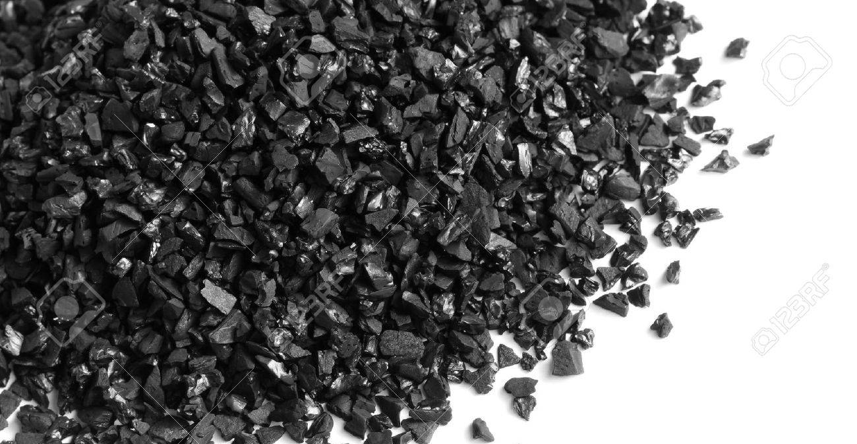
The Adsorption Process

Slide 47
The Adsorption Process
Adsorption:
the physical-chemical attraction of a solid material for a chemical in solution
In adsorption, the chemical being adsorbed is termed the ADSORBATE and the solid to which it sorbs is the ADSORBENT
Influent stream

Slide 48
PFAS ~ Per- and Polyfluoroalkyl Substances
GAC Media
Bench, pilot studies and full-scale applications, removals of up to greater than 99%
GAC can be quite effective for many PFAS compounds
  Perfluorobutanoic Acid (PFBA) 99%+ removal
  Perfluorobutyl Sulfonate (PFBS) 98%+ removal
  Perfluorohexyl Sulfonate (PFHxS) up to 98% removal
  Perfluorohexanoic Acid (PFHxA) up to 95% removal
  Perfluorononanoic Acid (PFNA) 93%+ removal
  Perfluorodecanoic Acid (PFDA) up to 97% removal

Slide 49
PFAS ~ Per- and Polyfluoroalkyl Substances
Ion Exchange
Bench, pilot studies and full-scale applications, removals 57% to 99%
Effective for many PFAS compounds
  Perfluorobutanoic Acid (PFBA) 97%+ removal
  Perfluorobutyl Sulfonate (PFBS) 98%+ removal
  Perfluorohexyl Sulfonate (PFHxS) 99%+ removal
  Perfluorohexanoic Acid (PFHxA) 97%+ removal
  Perfluorononanoic Acid (PFNA) up to 98% removal
  Perfluorodecanoic Acid (PFDA) up to 98% removal

Slide 50
Activated Alumina Filtration
(Oxidation & Adsorption)
If nothing else works, this will…

Slide 51
Activated Alumina Filtration
(Adsorption)
Activated Alumina substrate
  Very hard & Durable
  Porous (exposed surface area >350m²/gm)
  Patented Chemistry - creates a new complex
  A strong oxidant
  High Adsorption capacity & Kinetics rate
  Effective over a wide pH range
  Contaminant metals bond permanently to media
Manufacturing Process
  Enables chemistry to penetrate Inner spaces of Activated Alumina to take full advantage of the surface area

Slide 52
AP Oxidation Media
On-demand Oxidation & Adsorption Capability
  Very efficient Anti-Microbial capability
    Coliform, Iron & Sulfur Reducing Bacteria
  Arsenic III can be rapidly oxidized to Arsenic V
  Adsorption capability
Effective in any water
  industrial streams with high concentration of metals at varying oxidation states
No chlorine/dechlorination steps are required
  Removes annoying taste and odor.
  No generation of Disinfectant By Products (DBPs)

Slide 53
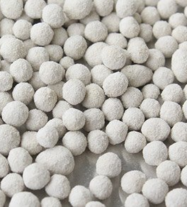
AM Adsorption Media
Adsorption Only (no oxidation)
  Removes metals and semi-metals
    Arsenic,
    Fluoride,
    Iron &
    20 other metals and semi-metals
  Only Metals – No Hardness
  Creates a complex with media
  Metal contaminant will not leach out
  Spent media disposed in Landfill or Concrete Additive
  Very little pressure drop
    Fluoride,
    Selenium,
    Lead,

Slide 54
AP Oxidation Field Test
SR-6 / I-75 Hamilton County Water System, PWS: 2244150
Raw water is high in TDS, coliform hits, organics, etc.
  Tested Empty Bed Contact Times (EBCT )
    5 min. & and 10 min.
    Chlorine added: 4 drops NaOCl to a 16.9 oz bottle
Sample TOC HAA5 TTHM
(mg/L) (µg/L) (µg/L)
Raw well 5.5 - - - - - -
5 minute EBCT 1.4 0.52 0.14
10 minute EBCT 1.2 0.52 0.14
Chlorine added - - - 13.89 16.09

Slide 55
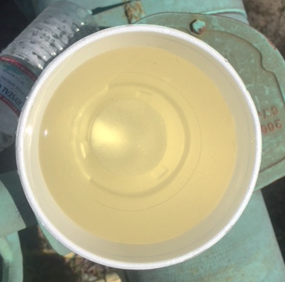
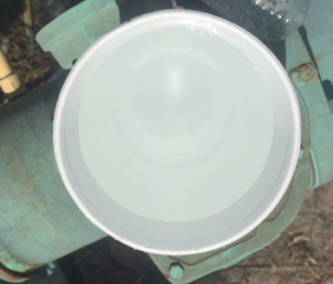
AP Oxidation Field Test
SR-6 / I-75 Hamilton County Water System, PWS: 2244150

Slide 57
AP Oxidation Field Test
SR-6 / I-75 Hamilton County Water System, PWS: 2244150
Current DBPs
Last 4 quarters TTHMs HAA5s
(µg/L) (µg/L)
21-Jun-17 57.8 55.3
27-Sep-17 531 792
5-Dec-17 300 231
14-Mar-18 704 546
LRAA 398.2 406.1

Slide 58
AP Oxidation Field Test
SR-6 / I-75 Hamilton County Water System, PWS: 2244150
74.5% of TOC was removed with 5 min. EBCT
76.4% of TOC was removed with 10 min. EBCT
99.87% of TTHM reduction with 5 or 10 min. EBCT
  398.2 to 0.52 µg/L
99.72% of HAA5 reduction with 5 or 10 min. EBCT
  406.1 to 1.14 µg/L

Slide 59
Typical Adsorption Media Installation
Potable Water to Distribution System
Pressure Gauges both sides of all filters (typ. 4 places)
M
NaOCl
Sample Tap with threads removed after all filters (typ. 4 places)
Filter By-Pass Valve Normally Closed
Duplex AP/AM Filters piped in Series
(no backwash)
10-Micron Cartridge Filter

Slide 60
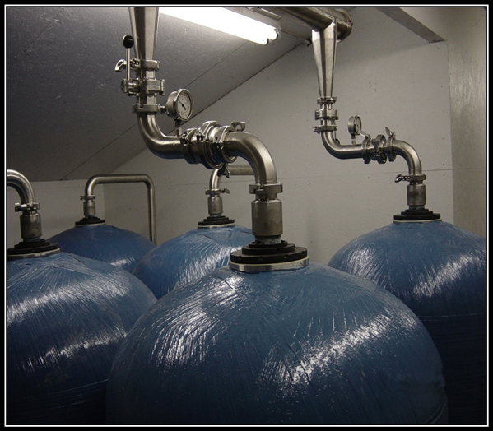
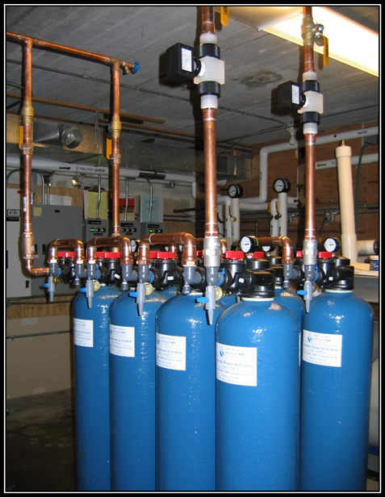

Slide 61
AP Oxidation Costs
NSF Std. 60
Installed Costs about $3.65 / 1,000 gal treated
Treatment cost is about 53¢ / 1,000 gal treated
Much more effective than GAC
  More costly than GAC
Soon to be testing media life
  Hoping that it lasts 4 to 6 longer than GAC medias

Slide 62
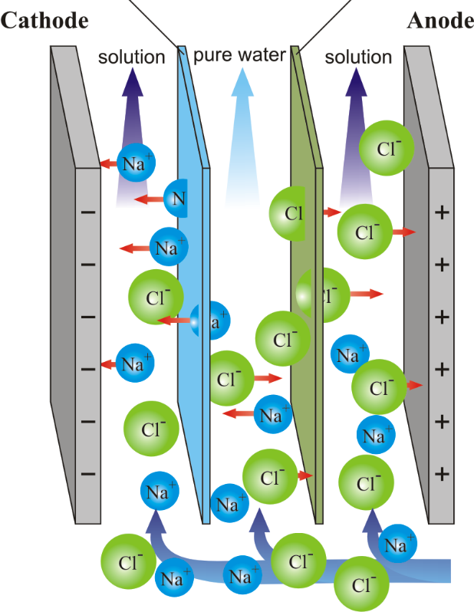
ElectroCoagulation
Gerber Pumps International, Inc.
Passing electrical current through water, to attract salt ions on one plate and anions to another.
effective removal of contaminants

Slide 63
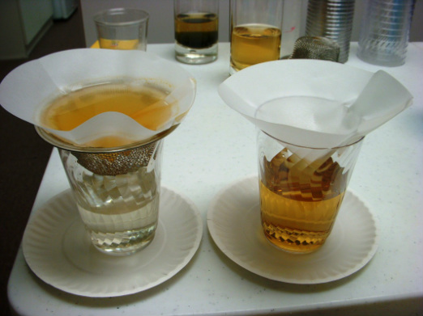
ElectroCoagulation
Gerber Pumps International, Inc.

Slide 64
ElectroCoagulation
Gerber Pumps International, Inc.

Slide 65
ElectroCoagulation
Gerber Pumps International, Inc.
1.5 gpm unit $8,500 / month
10 gpm unit $15,000 / month
Technician/Engineering Support @ $1,000 / day
O&M costs
Energy costs: 2-7 kwh/1000 gal processed
Blade replacement: $0.04 -0.08/1000 gal
Typically $0.20 - $0.50/1000 gal

Slide 66
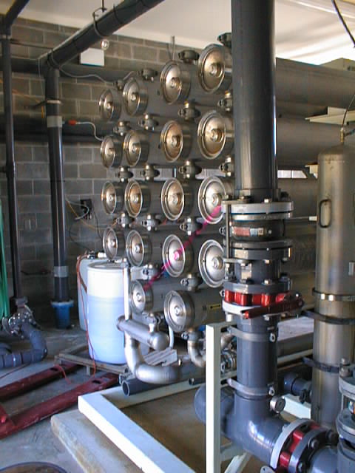
Reverse Osmosis ~ Nanofiltration
Suwannee W&S District Bids
RO Plant 375,000 gpd
Total Cost $4,165,035
$11.11 per gallon - 2004
$26.40 per gallon - 2021
Uses Wastewater Sprayfield

Slide 67
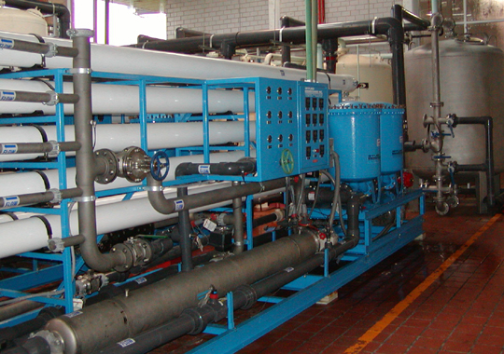
Reverse Osmosis ~ Nanofiltration
St Johns Harbor Water Assn
Near Palatka 355 Population
RO Plant 130,000 gpd
Const Cost $2,000,000 ~ Bare Bones
  Bid Costs $2,900,000 ~ Removed Some Components from Design Plans
$15 per gallon - 2006
$31.80 per gallon - 2021
Percolation Ponds for Brine Disposal

Slide 68
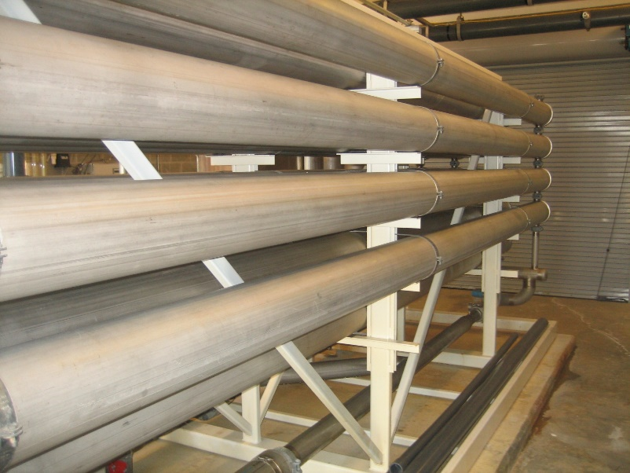
Reverse Osmosis ~ Nanofiltration
Town of Inglis
Firm RO Plant Capacity: 648,000 gpd
Const Cost $1,000,000 +/-
Completed 2000
NO Iron Pretreatment 2007 + $516,000
$2.34 per gallon
$6.30 per gallon – 2021
Very Low Bid = Osmonics trying to break into Potable Water Market
WWTP Sprayfield for Brine Disposal

Slide 69
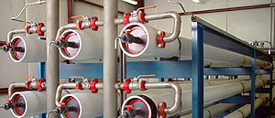
Reverse Osmosis ~ Nanofiltration
Preliminary Cost Estimates $20M to $32M
Most Expensive O&M of All Power & Chemicals
Sprayfield Disposal Costs $500,000+
Deep Well Disposal over $5 million

Slide 70
Water Treatment Plant Construction Costs
$25
$20
Project Costs – $ per gal
$15
Category II
$10
Category III
$5
Category IV
$0
0
1
2
3
4
5
Plant Capacity (MGD)
Notes:
Reaction continues to occur as long as:
Residual Chlorine
Organics Available to React

Slide 71
Summary of Options to Improve Water Quality
Option | Application | Installation Costs | Treatment Costs
Automatic Flushing Valves | Reduce water age, DBPs & chlorine demand | $300 to 5,000 | None
Tank Aerators & Mixers | Turnover tank water, lower DBPs & chlorine demand | $7,500 to $35,000 | Minimal power
Air Entrainment via Venturi Tee | Increase aeration, lowers DBPs & chlorine demand | < $500 | None
Hydrogen Peroxide (H2O2) | Chemical oxidation, lowers DBPs & chlorine demand | < $1,000 | 5¢ / 1,000 gal
Chlorine Dioxide (ClO2) Applied Oxidation | Chemical oxidation, greatly reduces DBPs, lowers or completely replaces chlorine | $2,000 | 7 to 10¢ / 1,000 gal
Activated Alumina Adsorption / Oxidation Media | Chemical oxidation & media adsorption of impurities, greatly reduces DBPs & chlorine | $3.65 / 1,000 gal | 53¢ / 1,000 gal
Reverse Osmosis ~ Nanofiltration | Removal of particulate & microbial contaminants and large organic molecules | $25 to $32 / gal
71

