Slide 1
Orange City Public Works Department
FY 2020/21 Budget Presentation
Presented by:
Brian Reynolds, H&T
Migdalia Hernandez, MSE
Orange City Public Works Director

Slide 2
Water Quality Improvements – goals and Challenges

Slide 3
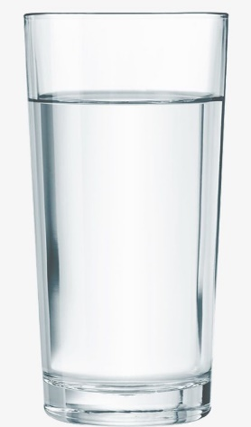
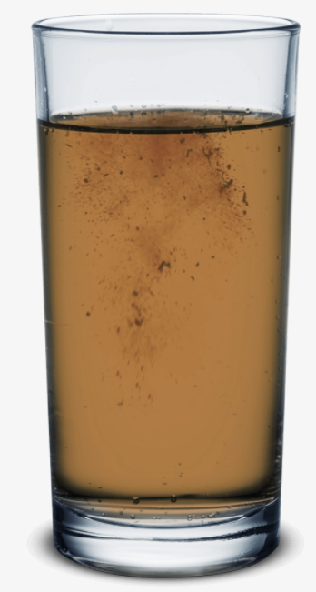
Public perception Vs. Regulations
Iron and Manganese
DBPs

Slide 4
Orange City Safe Drinking Water Act Compliance
City of Orange City TTHM Potential Formation Pilot Study
A. Before Water Quality Improvements | Mar-15
Plant #1 (Main) Effluent Detention Time All Wells Running | Chlorine Residual (mg/L) | TTHMs (ug/L)
0 hr | 1.1 | 65.3
24 hrs | 0.67 | 91.8
48 hrs | 0.62 | 104
72 hrs | 0.45 | 130
Plant #6 (South) Effluent Detention Time All Wells Running | Chlorine Residual (mg/L) | TTHMs (ug/L)
0 hr | 1.6 | 73.1
24 hrs | 1.24* | 93
48 hrs | 1.65 | 112
72 hrs | 1.61 | 117
*Lower chlorine as compared with 48-72 hrs detention time could be caused by bottle contamination.
B. After Water Quality Improvements | Sept 2019 & January 2020
Plant #1 (Main) Effluent Detention Time Wells 1&4 | Chlorine Residual (mg/L) | TTHMs (ug/L)
0 hr | 0.78 | 38
24 hrs | 0.33 | 62
48 hrs | 0.25 | 60
72 hrs | 0.15 | 74
Plant #6 (South) Effluent Detention Time Well 6 & 7 | Chlorine Residual (mg/L) | TTHMs (ug/L)
0 hr | 1.23 | 32
24 hrs | 0.59 | 63
48 hrs | 0.36 | 77
72 hrs | 0.18 | 79.5
Primary contaminants are substances that can be toxic in small amounts. Some examples are: Pb, Cu, Hg, As, and TTHMs. Legally enforceable with possible penalties
Secondary contaminants are not health threatening are less toxic species (Mg, Fe and Zn) and would cause cosmetic issues (color, taste, and odor) of drinking water. Not enforceable and without regulatory penalties. However Regulatory Agency (DOH) may request treatment, should there are public health concerns

Slide 5
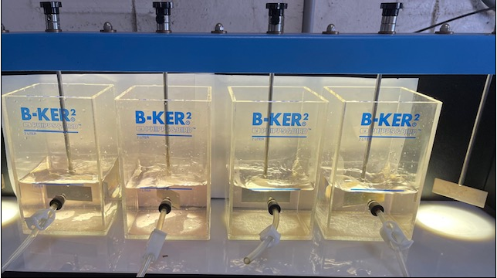
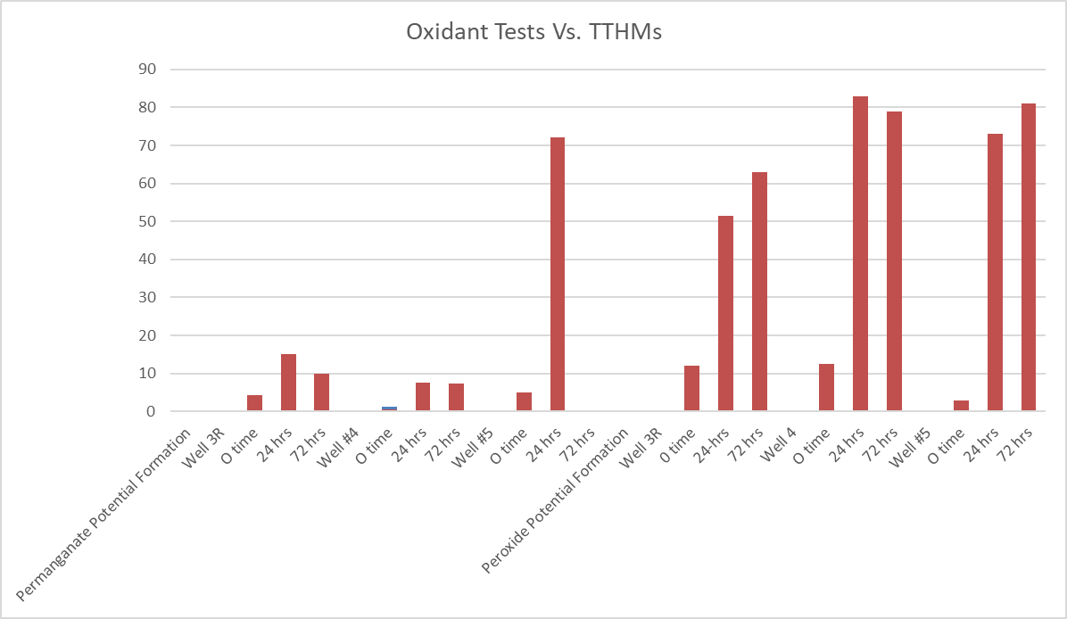
Main Water Plant - Oxidant Selection
(Discolored Water and TTHMs)
EPA’s Approved Oxidants
Filtration needed

Slide 6
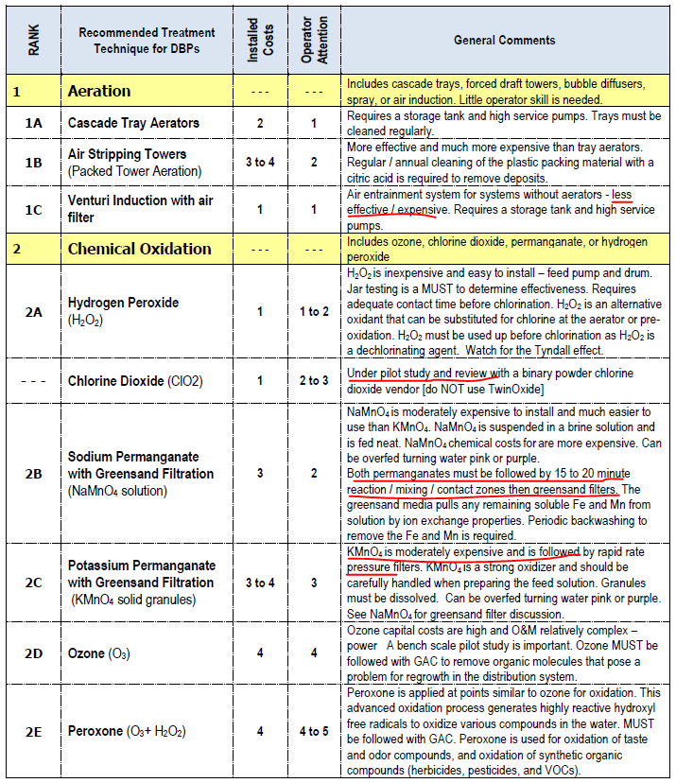
FRWA Assistance with Filter Selection

Slide 7
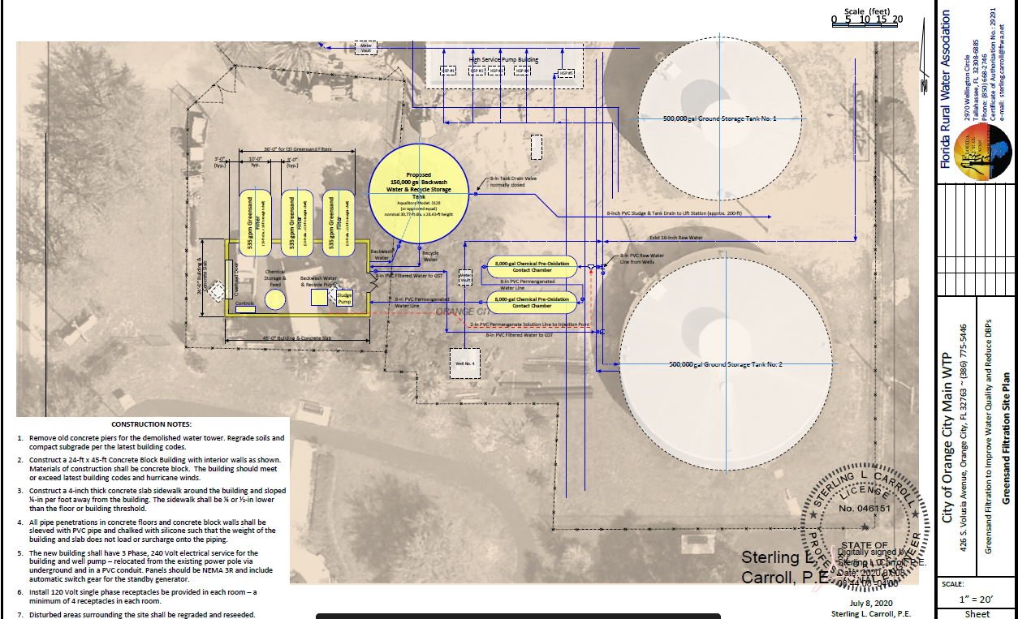
SRF Funds – Greensand Filter Construction Loan
Loan Amount = $2,197,998
$2,154,900 = construction costs = Cost at 0% capitalized interest
- discount for Davis-Bacon Act wage requirements, American Iron and Steel Requirement (AIS), and asset management plan (AMP).
$43,098 = Loan Service Fee (2% of construction cost).
Semi-Annual Loan Payment for 20 years= $54,950

Slide 8
Questions?

Slide 9
Hungerford & Terry, Inc.
Design and Operation Considerations
For
Pressure Filtration Equipment
Presented
by
Brian Reynolds
National Sales Manager
Manufacturers of
Water Treatment Systems
Since 1909

Slide 10
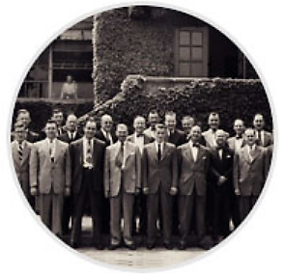
Company Profile:
Founded in 1909
Employee Owned and Operated
Mechanical, Electrical & Chemical Engineering Design
3-Buildings on 5-Acre Campus
To date over 13,000 contracts delivered

Slide 11
Hungerford & Terry Inc. “Over a Century of Water Treatment Experience”
This presentation will address multiple factors related to project coordination that include sizing, fabrication and operation of pressure
filtration equipment used in the treatment of ground water.
Sizing requirements
Vessel design considerations
Media selection
Backwash options
Layout
Future expansion

Slide 12
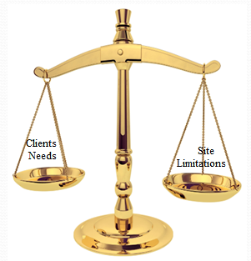
Project Design - Balancing Act
Existing building
Door Opening
Ceiling elevations
Available Sqft
Process Conditions
Flow rate
Raw water analysis
Water Temperature
Waste Discharge
Sewer
Settling Pond
Reclaim
Interrelated Parameters
Backwash source
Vessel Size
Temperature

Slide 13
Data Collection
1
2
3
4
5
6
7
System
Design
Flow
GPM
Raw Water
Quality
Report
Effluent
Goals
Flux Rate
In
GPM/sqft
Redundancy
Backwash
Source
PSI
Rating
8
9
10
11
12
13
14
Controls
Auto/Man
Elec./Pneu.
Location
Indoors
Or
Outdoors
Existing
Installation
Or
New
Backwash
Discharge
Backwash
Reclaim
System
AIS
Requirement
Future
Expansion
14 Steps to a Water Treatment System Design
Depending upon number of boxes checked determines the accuracy of a proposal
Quick response with little information will produce elevated proposal containing contingency assumptions
Eventually all boxes must be checked for complete system design

Slide 14
Raw Water Source
Minimum Raw Water Quality Analysis
Target Contaminants (Iron, Manganese, Arsenic, Radium, Etc.)
pH
Temperature
DO
Turbidity
Sodium
Hardness
Alkalinity
NH3
H2S
Effluent Goals

Slide 15
Flux Rate or Loading Rate of Filter
Defined as the amount of water flowing through 1 sqft of surface area
10 States Standard for Greensand Pressure Filters is 4gpm/sqft. as a guideline.
Higher rates possible with GreensandPlus (≤12gpm/ft²) but may require pilot study to verify performance.
Clarification on Flux rate prior to sizing vessels.
Higher flux rate will allow the use of smaller vessels to reduce cost.
Face Piping velocity recommendation to be 8ft/sec or less to avoid water hammer / cavitation.

Slide 16
System Design Flow
Application Example: Iron & Manganese Removal
Filter Media: Greensand Plus
Well #1
950gpm
100psi
10 States Standard Apply
950gpm ÷ 4gpm sq./ft. = 237.5 total surface area required
10ft Diameter Filter
78.54sqft surface area ea.
78.54x 3Vessels=235.62sqft
(1) 10’x24’ Straight Shell
(2) Cell Horizontal Filter
*Approx. 240sqft surface area
Easy, Right?
Notes:
The system design flow can be influenced by backwash source.
Backwash from online units may require more small filters since source is from the well pump.
Backwash from storage tank requires enough volume for one filter plus safety factor.

Slide 17
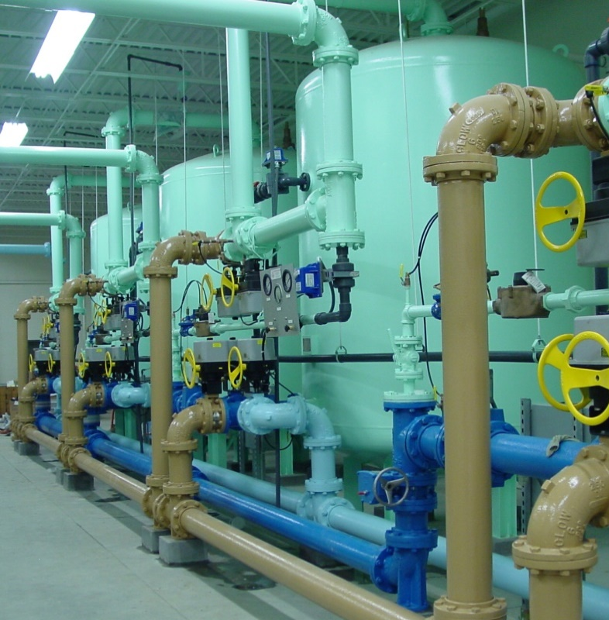
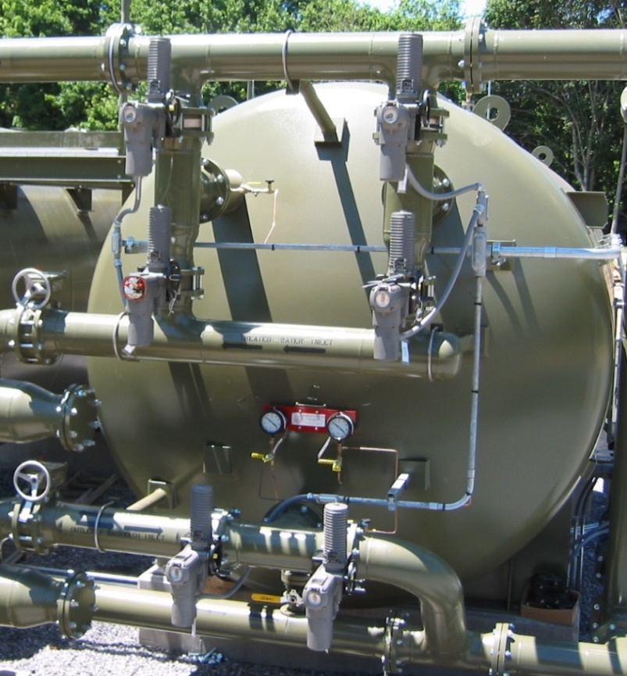
System Design Flow
Defined as “Total” flow through system which can be spread across multiple filters. Many Vertical vessels or fewer Horizontal.
10ft Diameter Filter
78sqft surface area
(1) 10’x24’ Horizontal Filter
*Approx. 240sqft surface area
Notes:
The system design flow can be influenced by backwash source.
Backwash from online units may require more small filters since source is from the well pump.
Backwash from storage tank requires enough volume for one filter plus safety factor.

Slide 18
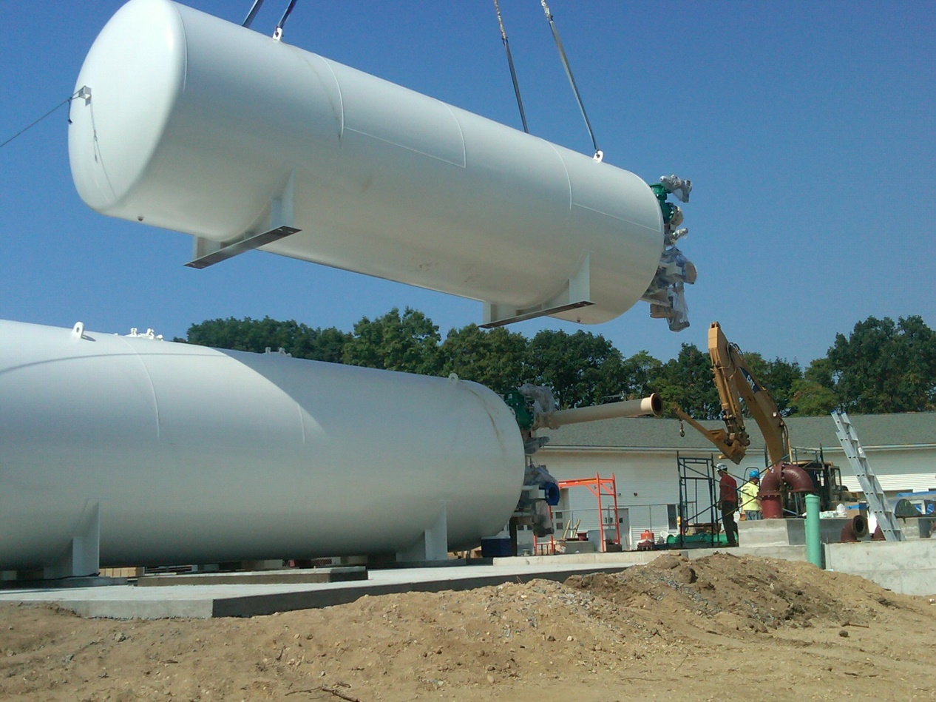
System Design – Physical Considerations
Calculated sizing is easy. Making it fit mechanically is a challenge.
Design new building for clearance in both sqft and elevation to allow for media loading & future maintenance.
20ft “Rule of Thumb”

Slide 19
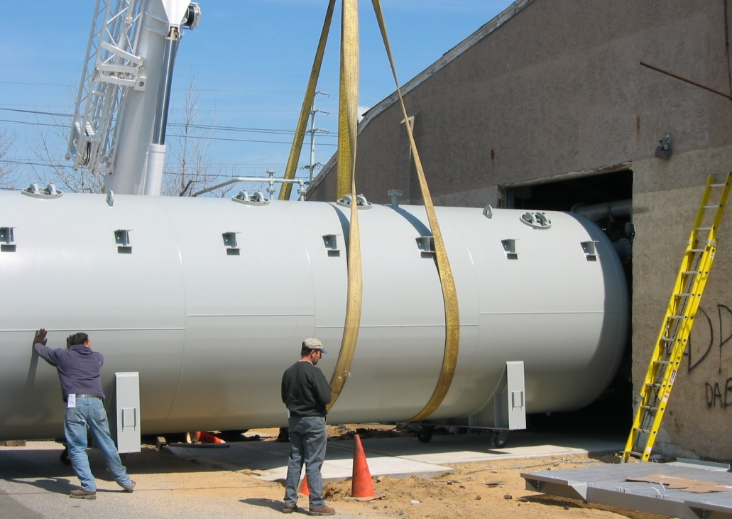
System Design – Physical Considerations
Existing buildings may need modification to allow installation of filter vessels. Multiple vertical filters may be more practical relative to installation allowances.

Slide 20
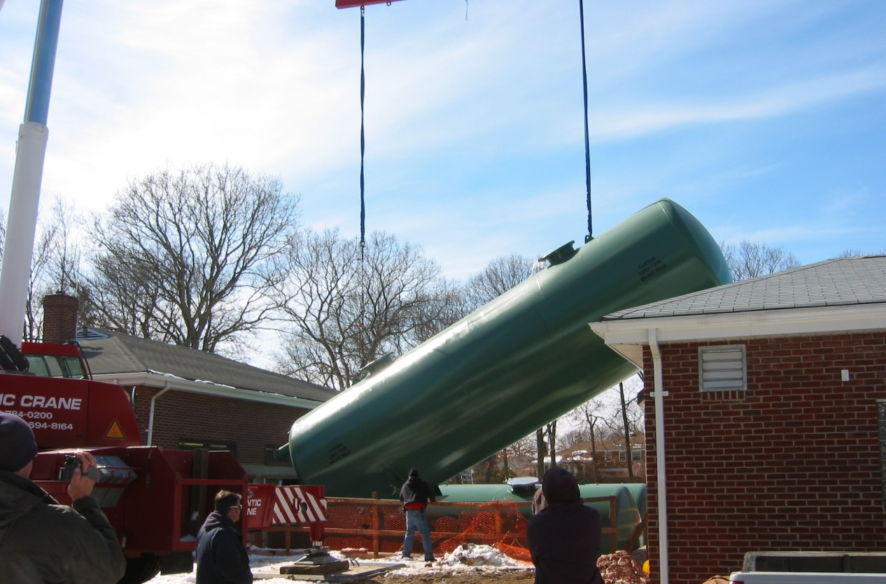
System Design – Physical Considerations
And when you just have to make it fit available space.

Slide 21
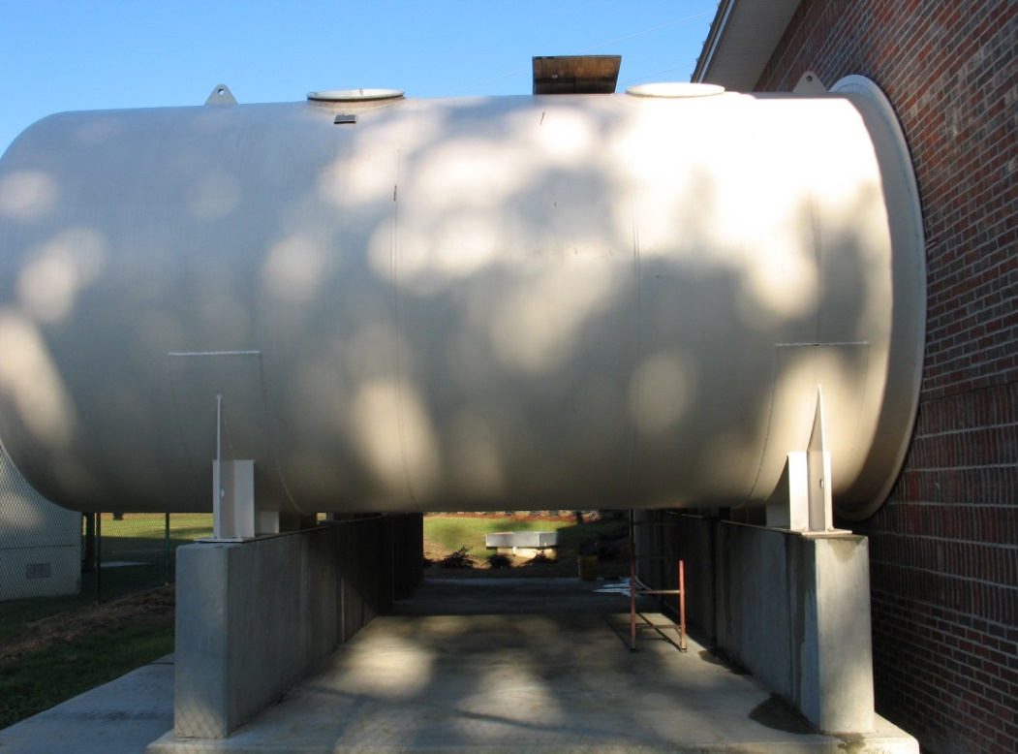
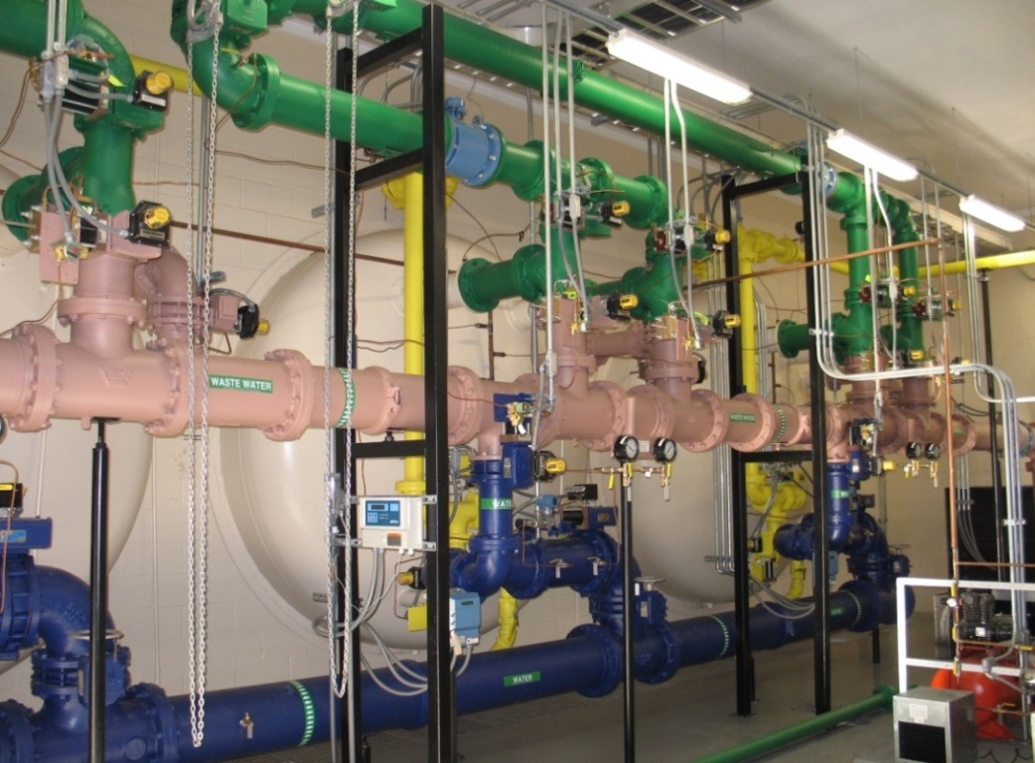
System Design – Physical Considerations
When weather conditions will allow, reduce building footprint with only tank heads and face piping indoors.
2 Saddle supports for horizontal vessels

Slide 22
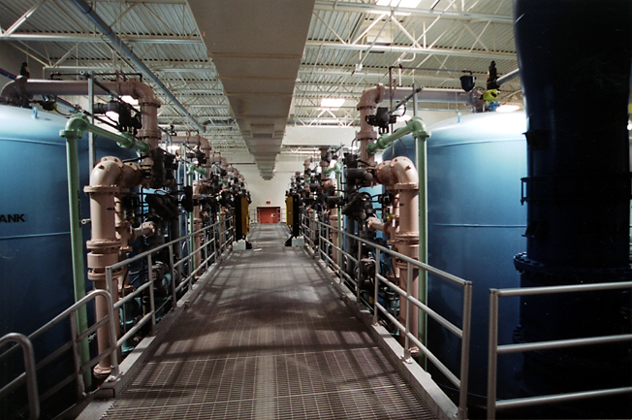
System Design – Physical Considerations
Similar installation requirements for vertical vessels but there are some options to reduce overhead requirements.

Slide 23
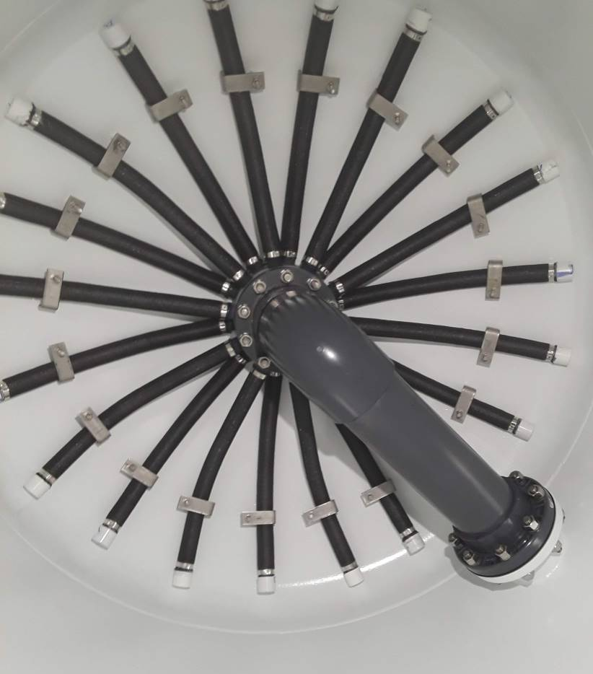
System Design – Physical Considerations
If available vertical space is limited, side shell process connections can reduce the overall height in vertical vessels. Using Hub – Radial under drain with graded gravel support bed.

Slide 24
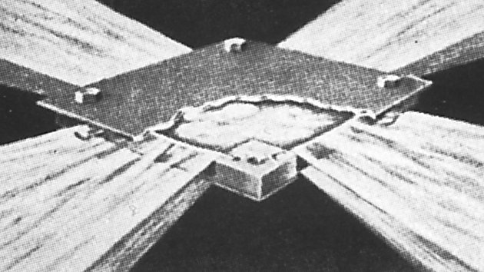
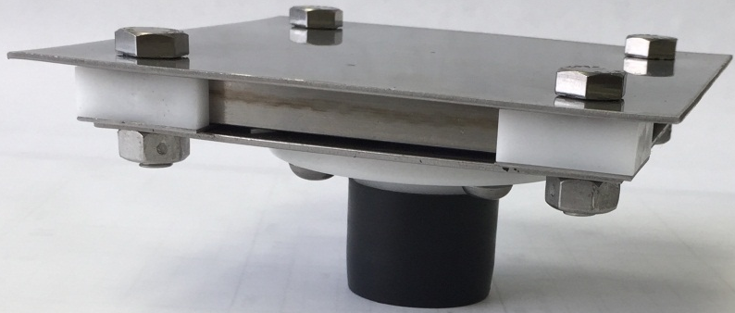
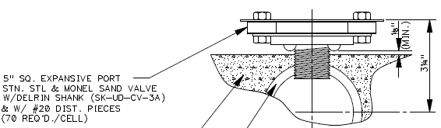
Underdrain Components – Header / Laterals
Self-cleaning design
304SS top/bottom plates
Delrin Shank
304SS Spacer
Monel Spline
Spaced on 15” centers
Cement Lateral

Slide 25
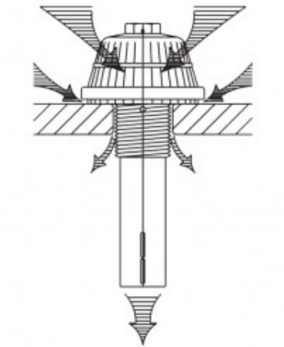
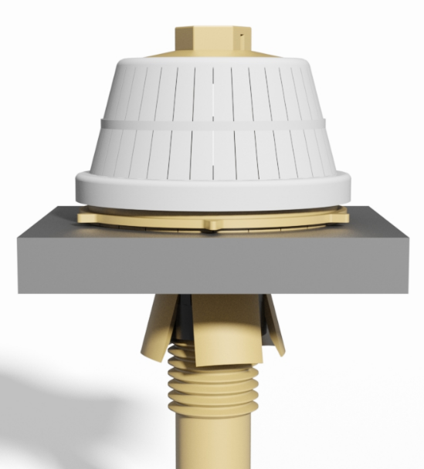
Underdrain Components
Spaced on 6” centers
Plastic construction
Fixed orifice
Potential for mineral deposits
False Bottom Plate

Slide 26
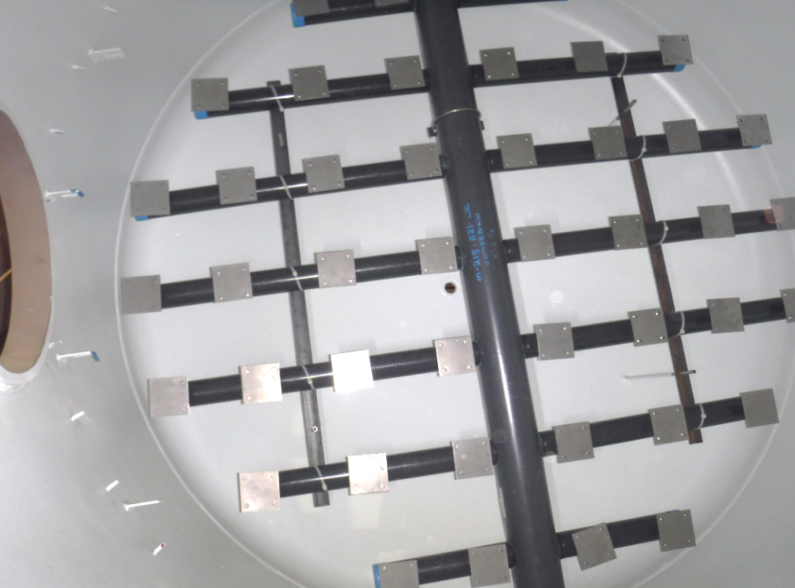
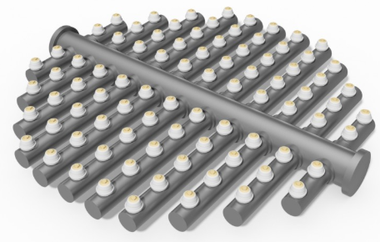
Header Lateral Underdrain in Vertical Vessels
Concrete head fill required to remove “hold out” zones
Sch.80 PVC piping for corrosion resistance
Spacing of nozzles for uniform flow
15” Spacing
6” Spacing

Slide 27
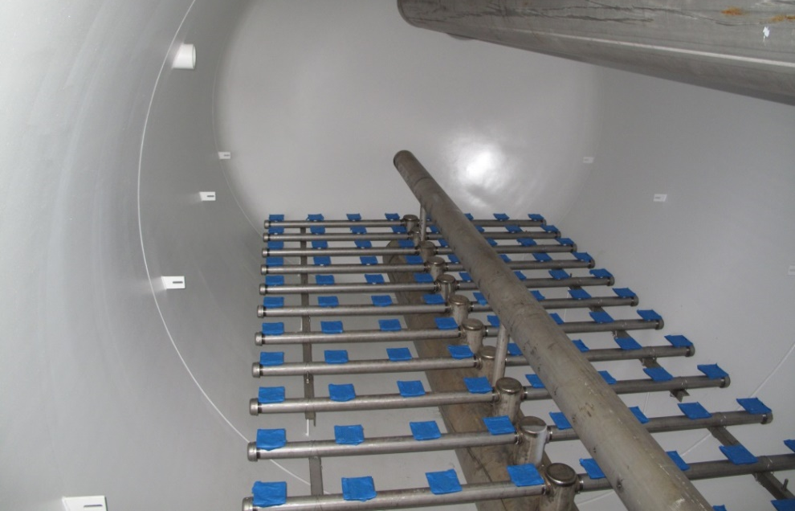
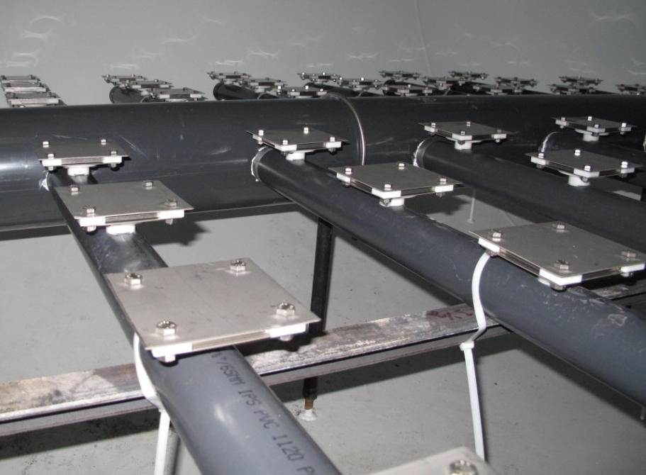
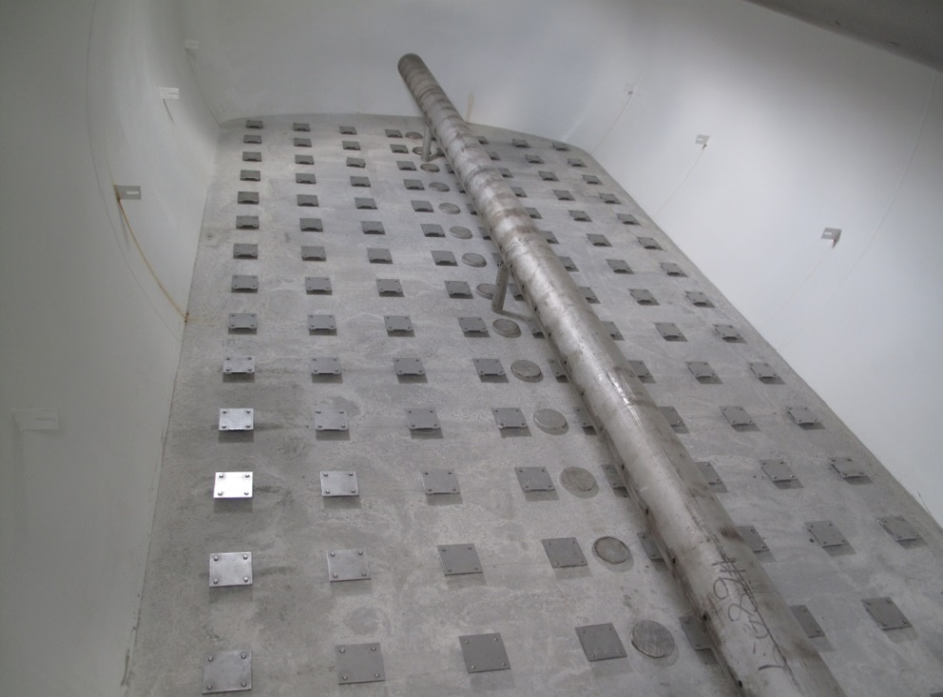
Header Lateral Underdrain using Sand valves with Concrete Fill
Sch.80 PVC Pipe
Stainless Steel Pipe

Slide 28
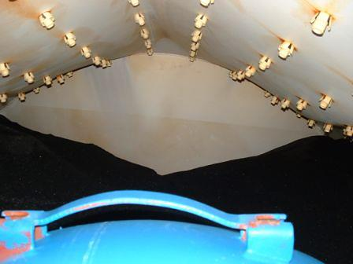
Curved False Bottom Failures

Slide 29
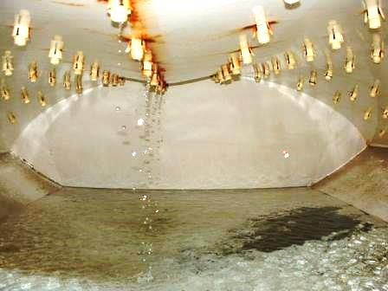
Curved False Bottom Failures

Slide 30
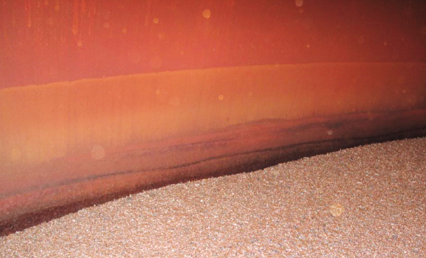
Lining Vessels / Corrosion
Unlined vessels corrode evenly
Oxide layer minimizes
continued corrosion

Slide 31
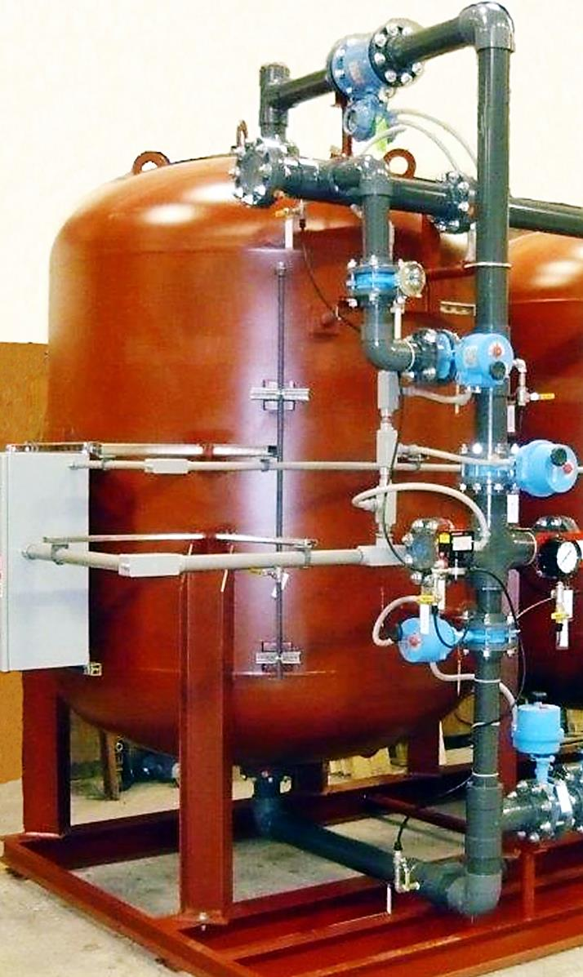
Backwash Tell Tale Sample Port
Startup of filtration system includes the setting of backwash flow rates.
The ability to sample water within the expanded bed column is beneficial.
The addition of “Tell Tale” sample port at the elevation just below backwash collector piping, allows for real-time samples during valve position setup.

Slide 32
Redundancy
Eventually filters will require backwashing which will take them offline.
Can plant demand handle reduced production during backwash?
Is there enough capacity in distribution to handle demand?
If capacity must remain constant then additional filters are required.
Taking one filter offline for backwashing will increase loading rate temporarily in other filters without redundancy.
In addition to increased number of vessels and face piping, there will need to be I/O capacity in electrical control.

Slide 33
System Design – Backwash Mode
To properly clean filter media and expand bed by 40%.
Filter Sand (100lb/ft³) Backwash 15gpm/sqft @ 55DegF
Greensand (88lb/ft³) Backwash 12gpm/sqft @ 55DegF
Backwash supply source options:
From Online units
Requires well pump and sufficient number of vessels to supply flow rate.
From Storage
Requires onsite storage tank, pump and additional controls.
From Distribution
Requires pressurized distribution system to bring water back to the filter plant at required flow rate.

Slide 34
System Design – Backwash Mode
Application Example: Iron & Manganese Removal
Media: Greensand Plus
Well #1
950gpm
100psi
10 States Standard Apply
950gpm ÷ 4gpm sq./ft. = 237.5 total surface area required
10ft Diameter Filter
78.54sqft surface area ea.
3 Vessels = 235.62sq./ft.
(1) 10’x24’ Straight Shell
(2) Cell Horizontal Filter
Approx*. 240sqft surface area
Backwash flow rate required
12gpm x 78.54sqft = 942gpm
*Per Vessel
28,260gal/ 3-Vessel Total
12gpm/sqft x 100sqft = 1200gpm
*Per cell
24,000gal/ 1 Vessel Total
* 1,554,900gal Difference Annually (Assuming 24Hr/runtime)
Notes:
The system design flow can be influenced by backwash source.
Backwash from online units may require more small filters since source is from the well pump.
Backwash from storage tank requires enough volume for one filter plus safety factor.

Slide 35
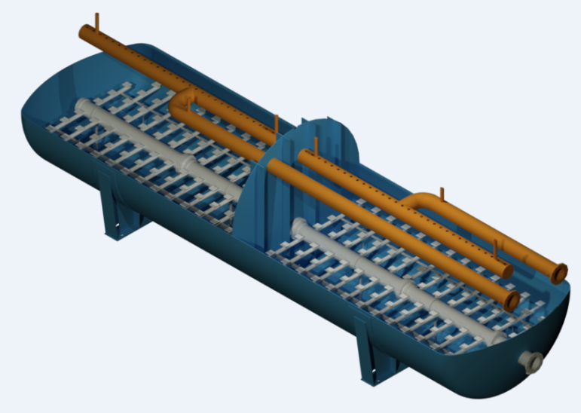
System Design – Backwash
Horizontal Filters should be designed with multi cell compartments to reduce the required backwash flow rate.
Common Underdrain design allows for backwash water supply to come from online units.
Keep in mind 12 – 15gpm/sqft backwash flow rates x Sqft surface area is required for 40% bed expansion.
Ideal cell size should maintain as close to a 1:1 ratio in W/L dimension as possible for better hydraulic characteristics.

Slide 36
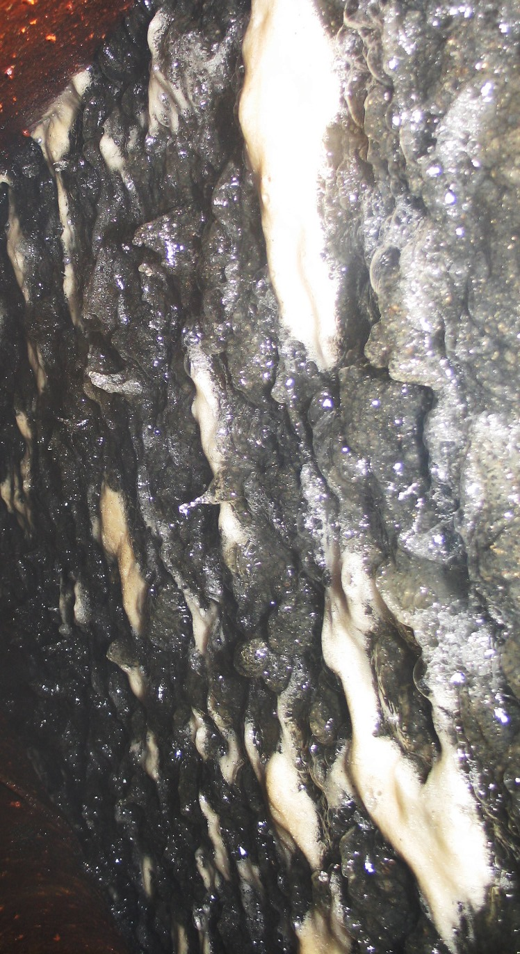
Backwash Option - Air Scour
High Manganese levels (+0.5mg/l) can form “mud balls” requiring aggressive high turbulence to assist in breaking up and removal during backwash.
Failure to break up mud balls and remove will Mn will create high DP and short run times.

Slide 37
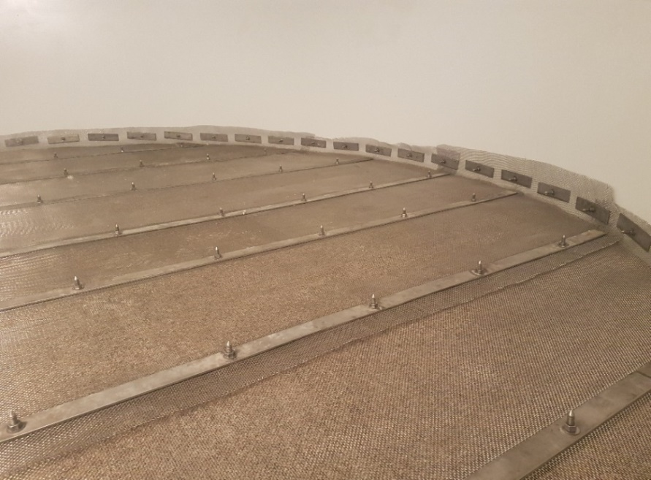
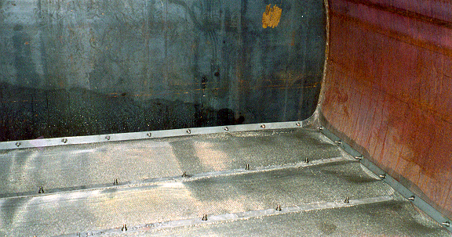
Gravel Retaining Screen
Not Mandatory but can be beneficial during rebed projects.
Vacuum down to screen without disrupting gravel bed.
During backwash top layer of graded gravel remains stationary

Slide 38
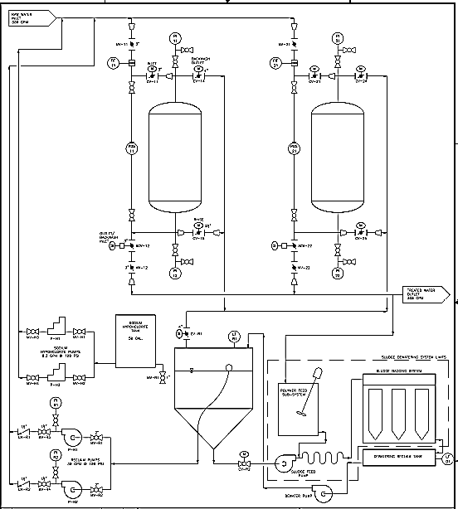
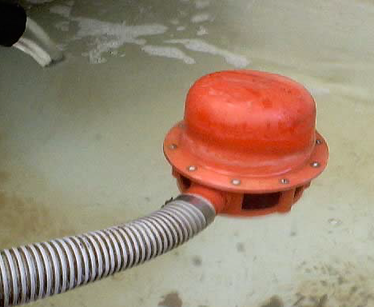
Backwash Reclaim P&ID
Reclaim approx. 85% of backwash waste water easily
Filter press can increase over 90% but cost increases exponentially
Floating suction or stand pipe to backwash recycle pumps

Slide 39
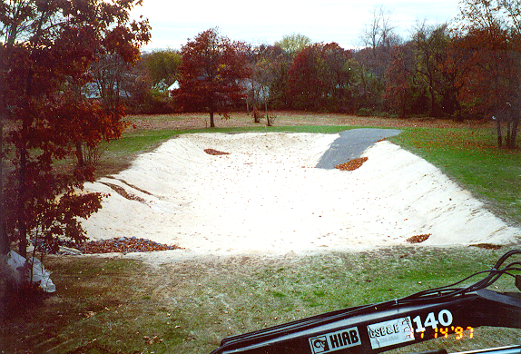
Typical Backwash Waste Collection Basin

Slide 40
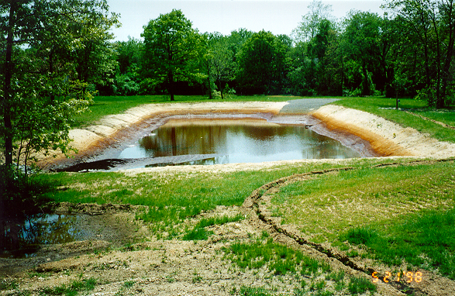
Typical Backwash Waste Collection Basin

Slide 41
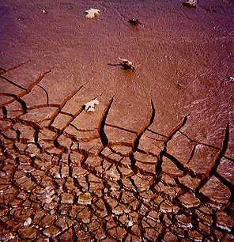
Dried Fe & Mn Sludge – Collection Basin
Depending on filter loading rate and backwash frequency, cleanout can be annually or longer.
Settled sludge can be removed using bobcat by removing top 6” of sand.
Disposed of cake in landfill and fresh sand installed.

Slide 42
Closing Comments
To speed up conceptual design time line, collect the minimum data below:
Obtain complete water quality report
Determine max flow rate & required loading (flux) rate
Backwash supply source
Redundancy
Thank you for your time and feel free to contact me in the future on this presentation and any other water treatment project questions.
Breynolds@hungerfordterry.com
Phone: 856-881-3200

