Slide 1


Improving Revenue Collections
for Utilities
Presented by
Gary Sanders
August 10, 2021

Slide 2

Presenter Background
Gary Sanders
  Senior Consultant at Edmunds GovTech
  Worked with local government software since 1979
  Founding partner of Logics in 1983, acquired by Edmunds GovTech in 2019
  Worked with over 200 utilities
  Publish a blog and bi-weekly e-mail newsletter – edmundsgovtech.com/blog

Slide 3
Company Background
Local Government and Utility Solution Provider
  Consulting
  Software
  Training
  Implementation
Home Office in Northfield, New Jersey
Logics based in Raleigh, North Carolina
In business since 1972
Over 1,900 customers in 26 states

Slide 4
What Other Utilities Have Done

Slide 5
Applicant’s Identifying Information
Can you identify deadbeats after they move?
  Social Security Number
  Driver’s License Number
  Date of Birth
Can you contact them after they move?
  E-mail address
  Cell phone number
  Employer information
  Reference information

Slide 6
Written-Off Account Lookup
Name
Driver’s License Number
Social Security Number
Date of Birth

Slide 7
Collect Co-applicant Information
Spouse
Roommate
Parent
Record all names on the lease or rental agreement on the account

Slide 8
Application for Service Best Practices
Require a copy of rental agreement or closing documents
List all names on the rental agreement on the service application
Require a photo ID for each applicant
Perform a bad debt search for each applicant
Charge an application fee
Print an application form that the applicant(s) sign

Slide 9
Delinquent Process
Is your late payment penalty high enough to be a disincentive?
Is your cut-off fee high enough to recover the costs associated with administering the disconnection and reconnection of service?
Is every account on the cut-off list assessed a fee on cut-off day?
The next few slides are from the 2021 Utility Fee Survey (the full results are available on my blog):

Slide 10
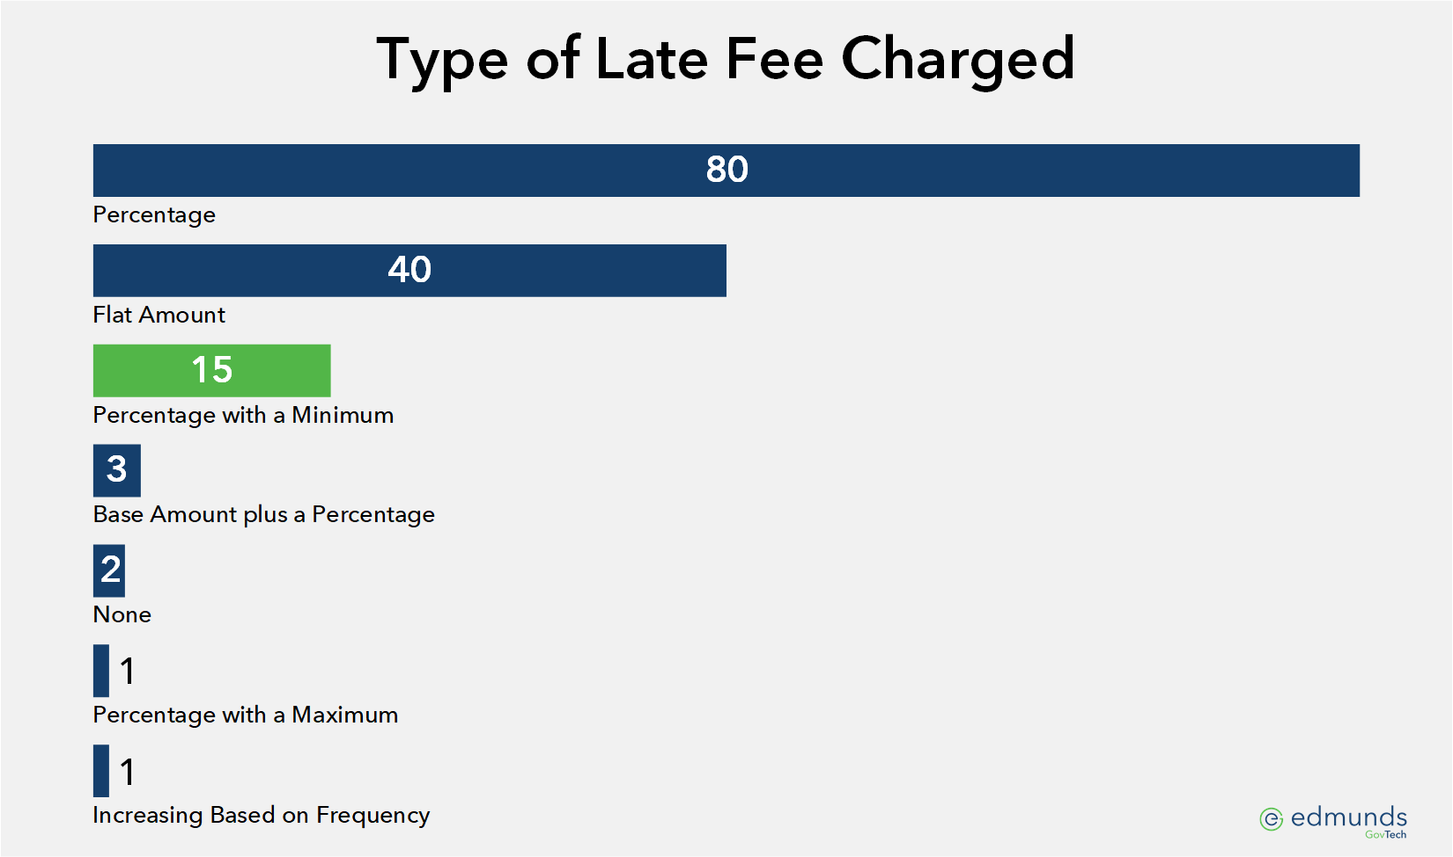
Late Fee–Flat Amount or Percentage?

Slide 11
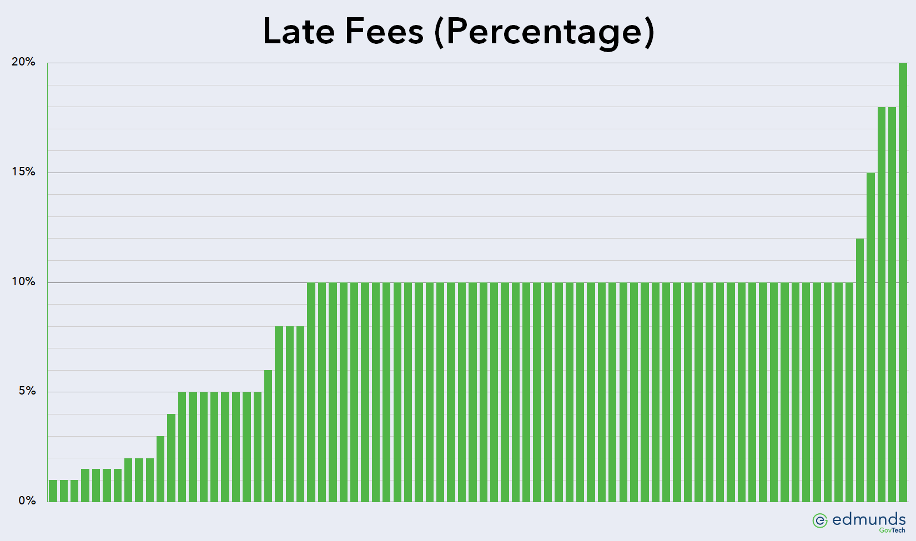
Late Fee Percentages

Slide 12
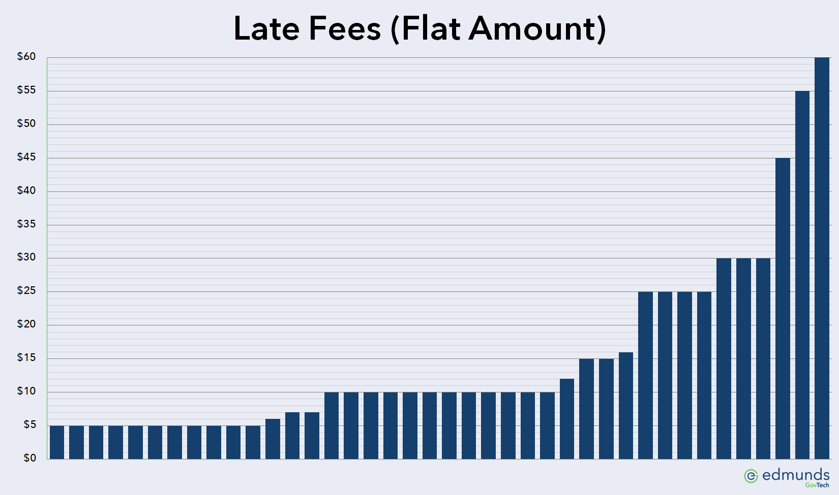
Late Fee Flat Amounts

Slide 13
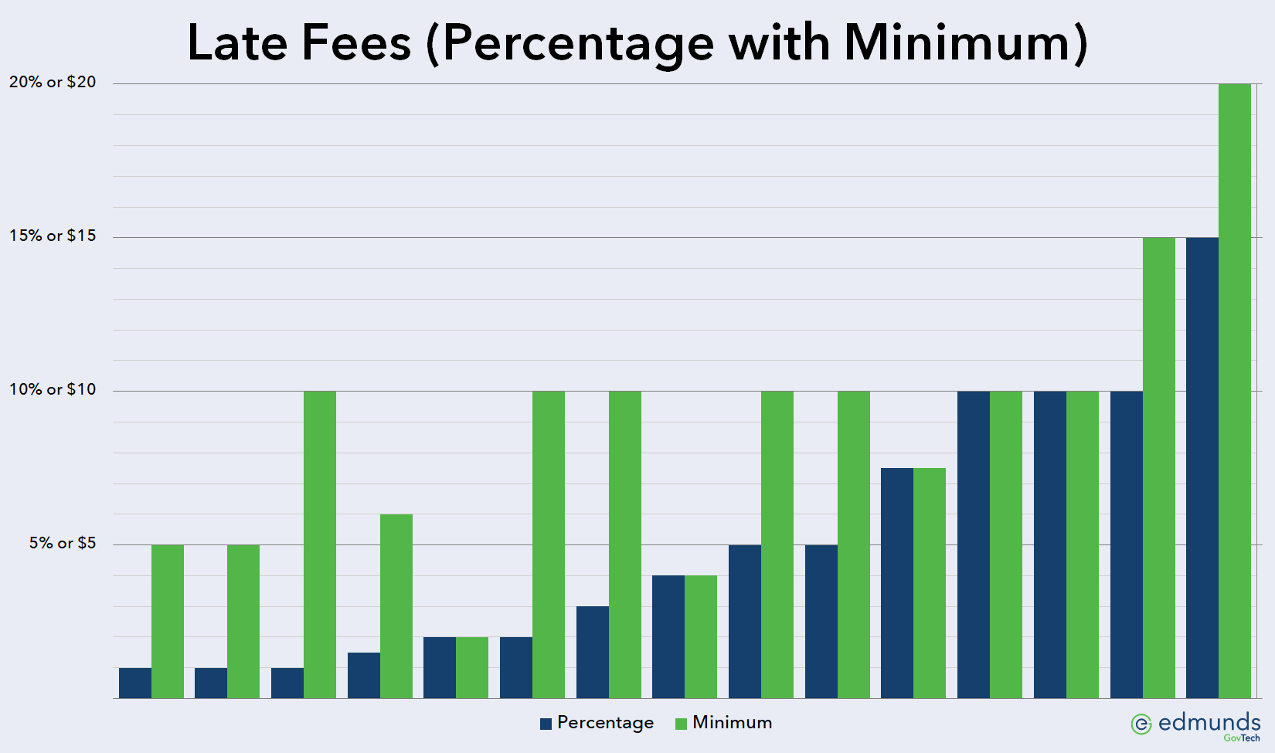
Late Fee Percentage with Minimum

Slide 14
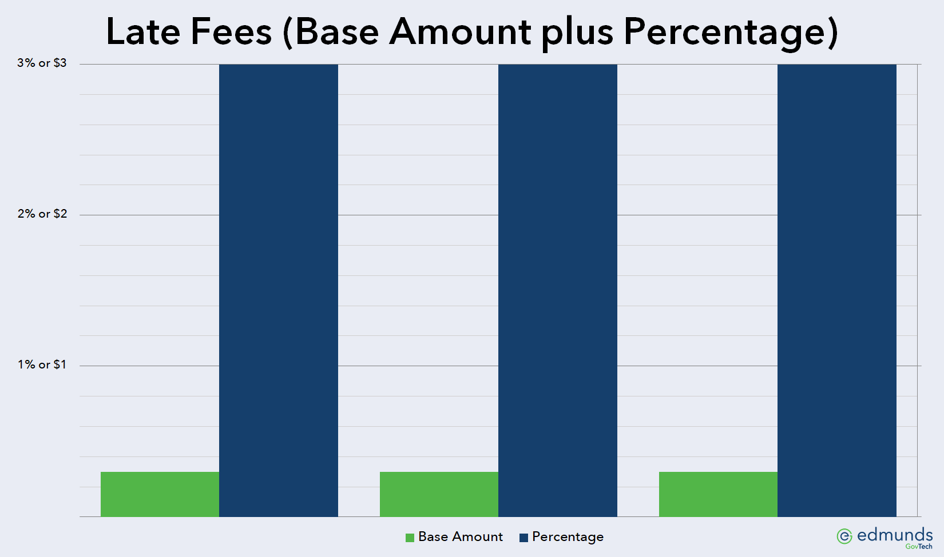
Late Fee Amount plus Percentage

Slide 15
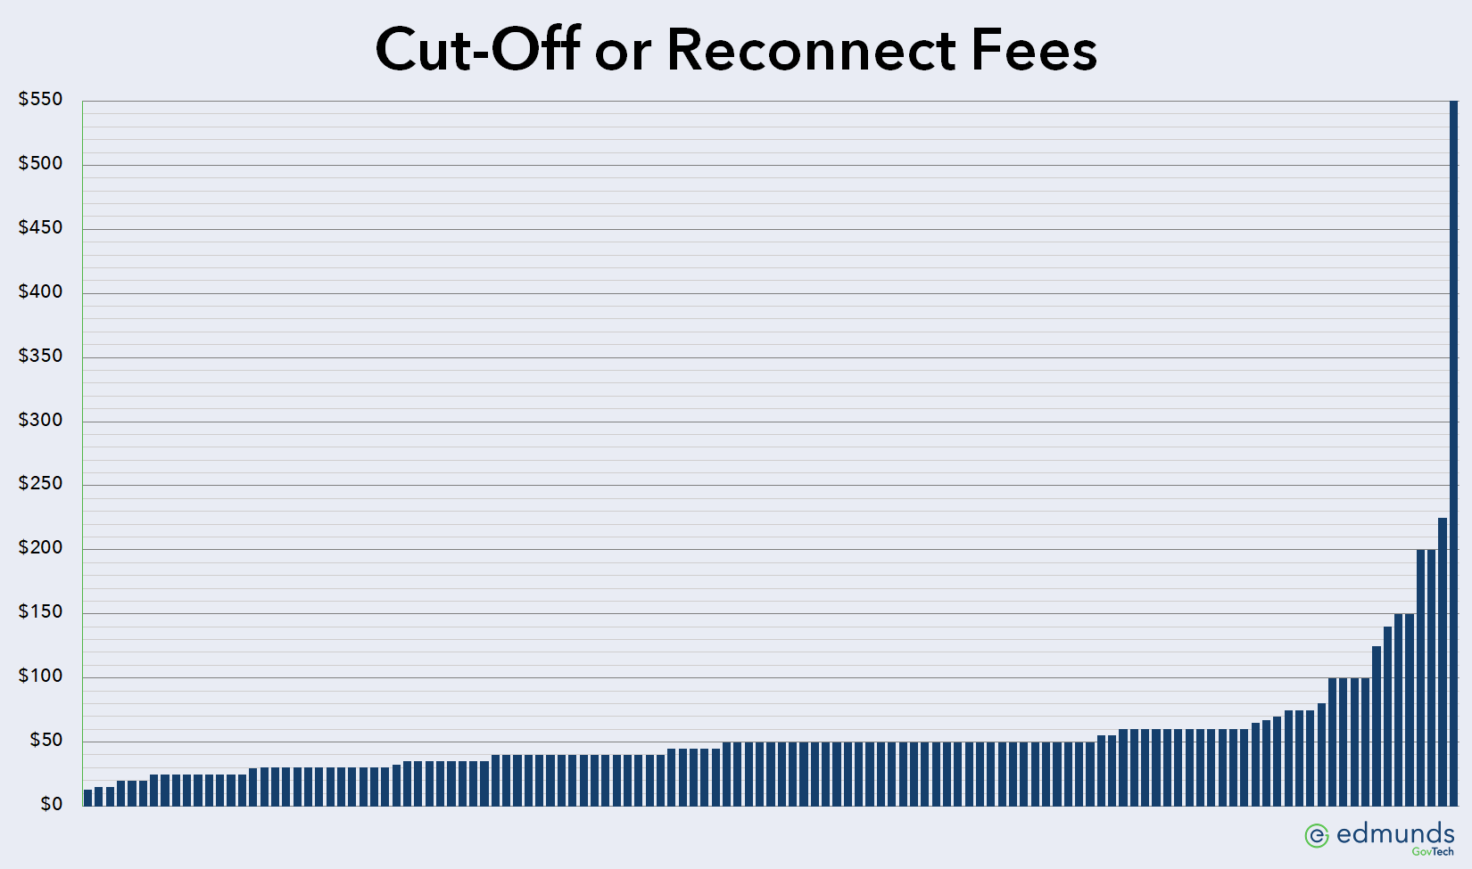
Cut-Off or Reconnect Fees

Slide 16
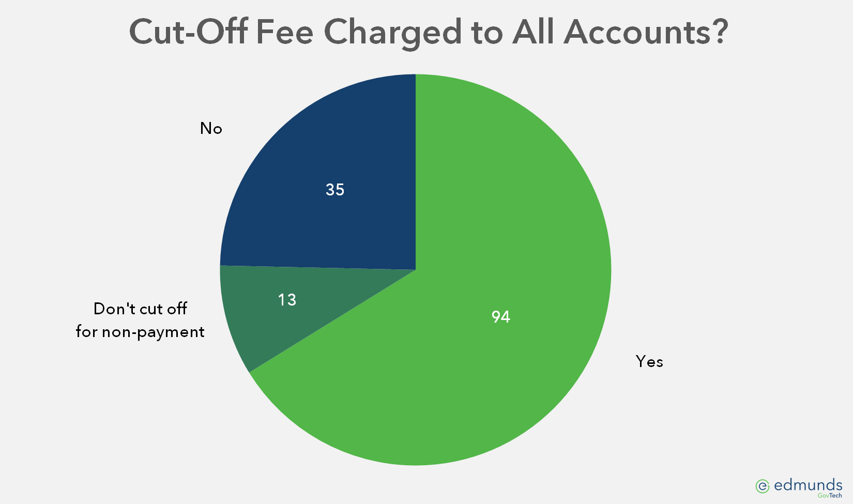
Cut-Off Fee Charged to All Accounts?

Slide 17
Delinquent Process (continued)
Does cut-off for non-payment happen in a timely fashion? Consider the following scenarios…

Slide 18
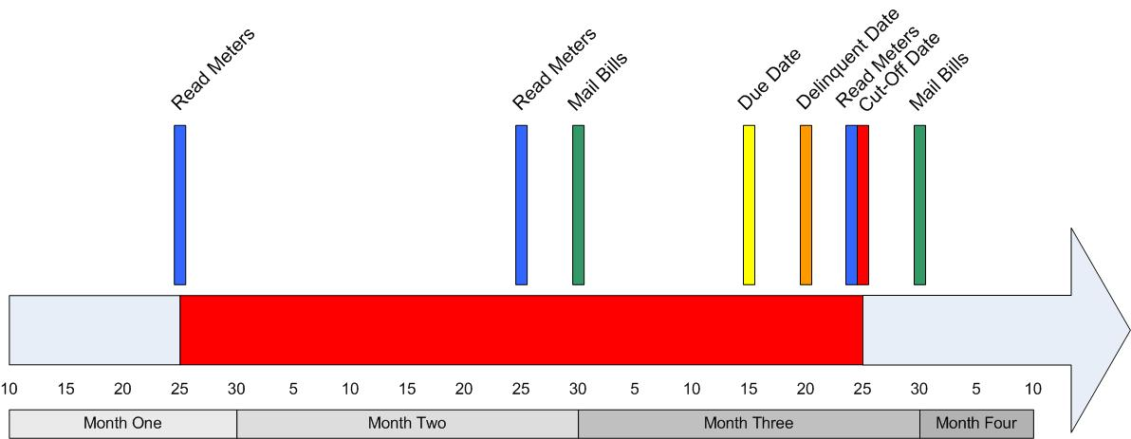
Scenario One
Read Meters | 25th
Mail Bills | 30th
Due Date | 15th
Delinquent Date | 20th
Cut-off Date | 25th
Days of Exposure | 60

Slide 19
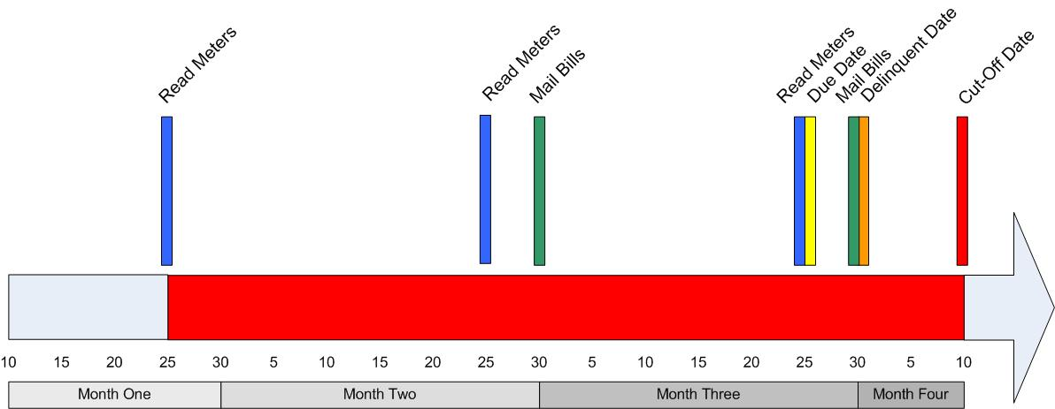
Scenario Two
Read Meters | 25th
Mail Bills | 30th
Due Date | 25th
Delinquent Date | 30th
Cut-off Date | 10th
Days of Exposure | 75

Slide 20
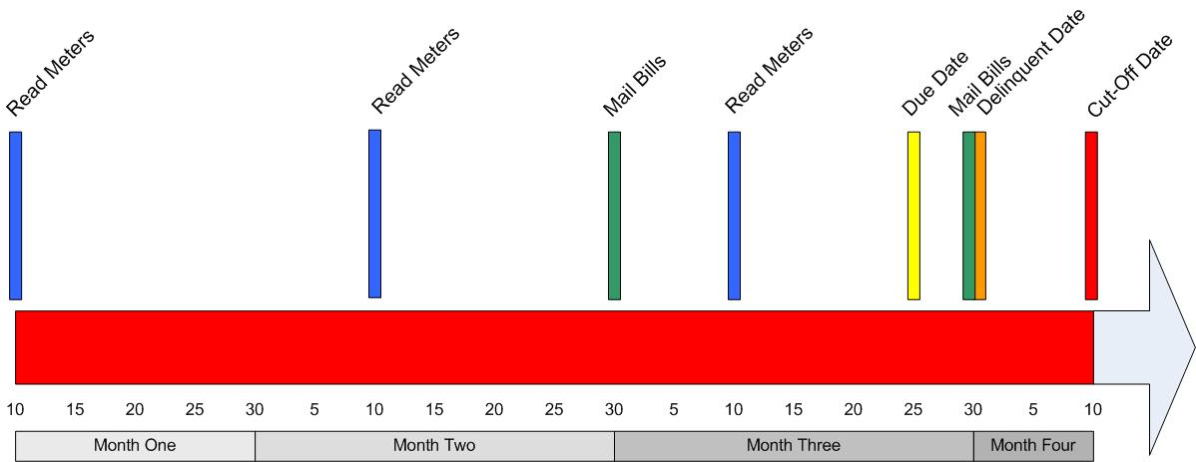
Scenario Three
Read Meters | 10th
Mail Bills | 30th
Due Date | 25th
Delinquent Date | 30th
Cut-off Date | 10th
Days of Exposure | 90

Slide 21
Days of Exposure Worksheet
Please refer to the worksheet you downloaded or you can complete this online at https://garysandersonline.com/days-of-exposure/

Slide 22
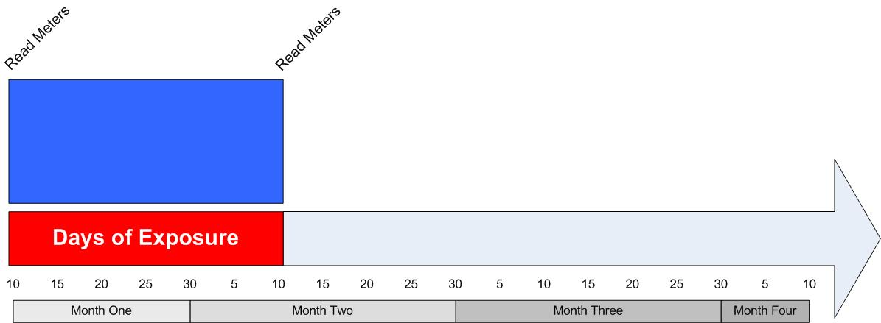
Days of Exposure Worksheet
A | How many days between meter readings?

Slide 23
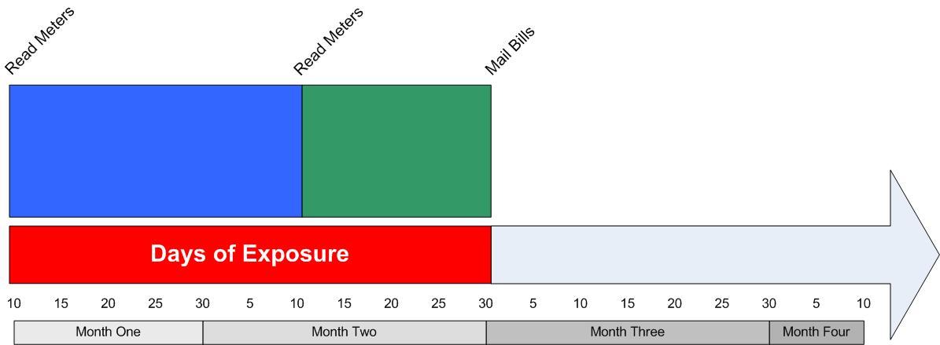
Days of Exposure Worksheet
A | How many days between meter readings?
B | How many days after reading meters is your billing date?

Slide 24
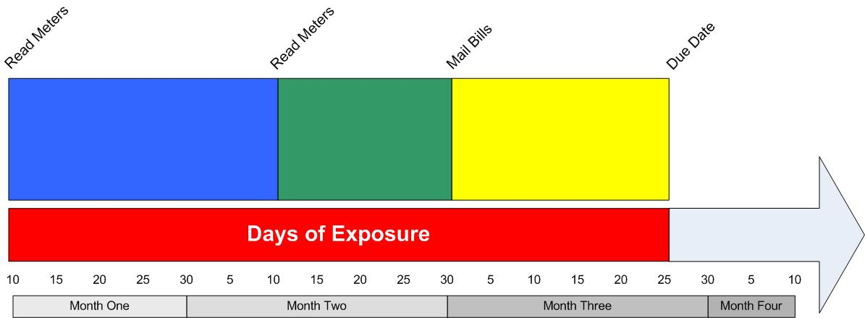
Days of Exposure Worksheet
A | How many days between meter readings?
B | How many days after reading meters is your billing date?
C | How many days after the billing date are bills due?

Slide 25
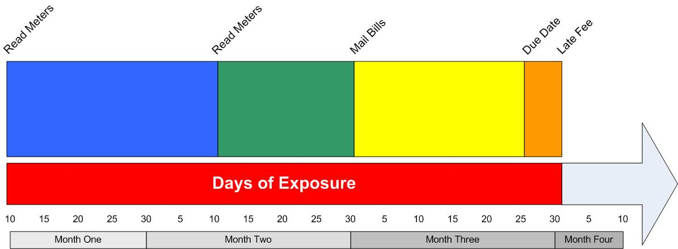
Days of Exposure Worksheet
A | How many days between meter readings?
B | How many days after reading meters is your billing date?
C | How many days after the billing date are bills due?
D | How many days after the due date do you charge a late fee?

Slide 26
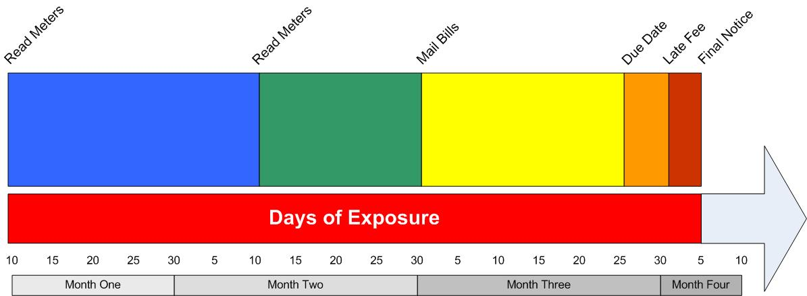
Days of Exposure Worksheet
A | How many days between meter readings?
B | How many days after reading meters is your billing date?
C | How many days after the billing date are bills due?
D | How many days after the due date do you charge a late fee?
E | How many days after the late fee do you issue a final notice?

Slide 27
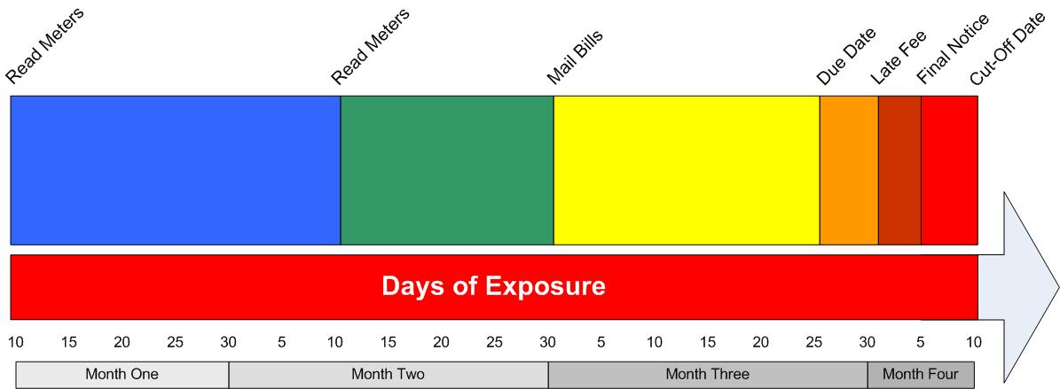
Days of Exposure Worksheet
A | How many days between meter readings?
B | How many days after reading meters is your billing date?
C | How many days after the billing date are bills due?
D | How many days after the due date do you charge a late fee?
E | How many days after the late fee do you issue a final notice?
F | How many days after the final notice do you cut off for non-payment?

Slide 28
Days of Exposure Worksheet
A | How many days between meter readings?
B | How many days after reading meters is your billing date?
C | How many days after the billing date are bills due?
D | How many days after the due date do you charge a late fee?
E | How many days after the late fee do you issue a final notice?
F | How many days after the final notice do you cut off for non-payment?
G | Days of Exposure (A+B+C+D+E+F)

Slide 29
Security Deposits
Is your minimum deposit amount equal to at least two month’s (best case) average bill?

Slide 30
Security Deposits
Is your minimum deposit amount equal to at least two month’s (best case) average bill?
H | Months of Exposure (G/A)
I | How much is your average security deposit?
J | How much is your average residential utility bill?
K | Total due at time of cut-off for non-payment (H*J)
L | Less: deposit applied (I*-1)
M | Bad debt write-off (K-L)

Slide 31
Security Deposits (continued)
Consider charging a variable deposit based on customer’s credit rating
Do all customers pay a deposit?
Consider charging all customers a deposit then refund it once they have established good credit
Are out of date deposits required to be brought up to current policy if account is cut off for non-payment?
Update your deposit policy with each rate increase

Slide 32


Which would you choose?

Slide 33


Which would you choose?
98% of what is owed to you
0% of what is owed to you

Slide 34
Credit Card Payments
Do you accept credit cards?
Do you charge an additional fee for credit card payments?
Can your customers pay by credit card when your office is closed?

Slide 35
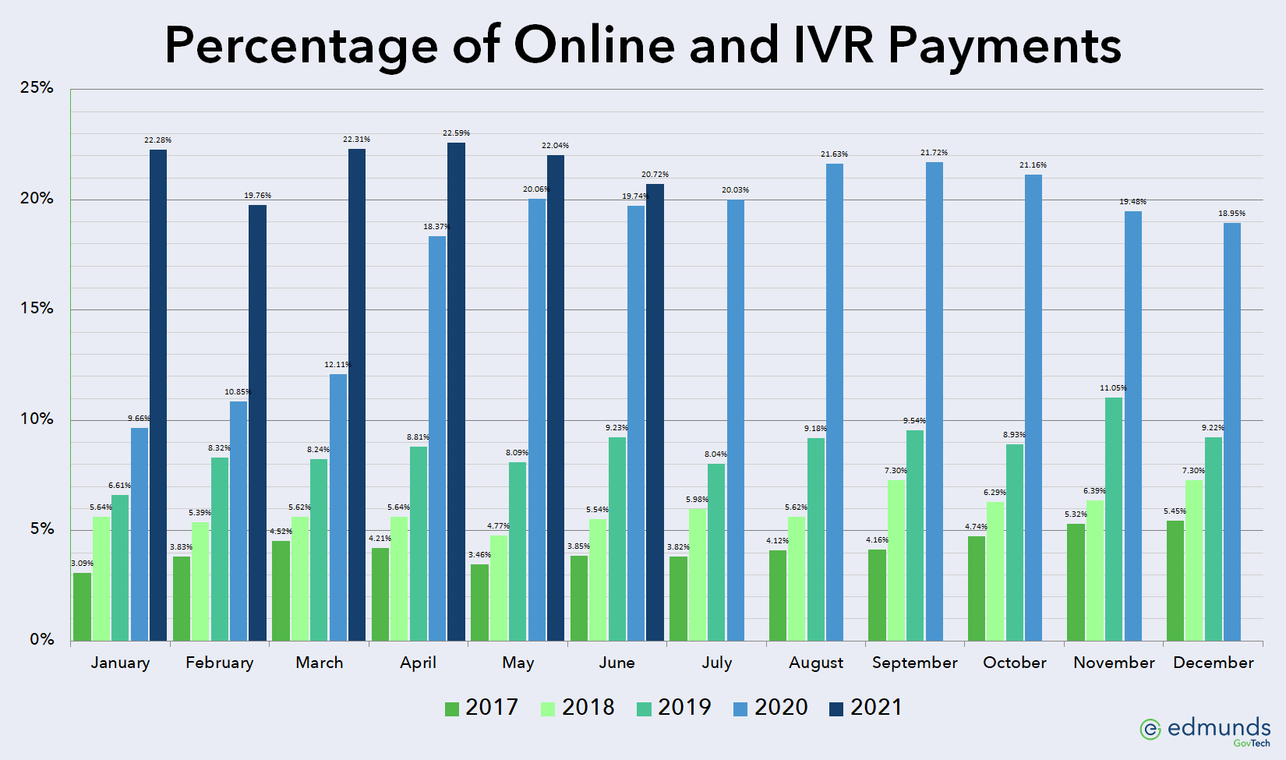
Credit Card Convenience Fee

Slide 36
Additional Ways to Pay
Bank Drafts
Recurring Credit Cards
Online Bill Pay via the Internet
Electronically receive Online Banking Checks
Interactive Voice Response (IVR)
Kiosks

Slide 37
Final Bills
Are final bills processed promptly?
Forwarding Address
  From Customer if possible
  Use proper USPS endorsement on bills
Do you send delinquent notices to final billed accounts?

Slide 38
USPS Endorsements
Address Service Requested
  Mail forwarded, new address notification provided, address correction fee charged
Return Service Requested
  Mail returned, new address notification provided
Change Service Requested
  Mail disposed of, new address notification provided
Forwarding Service Requested
  Mail forwarded, no new address notification provided
Source: http://pe.usps.com/text/dmm300/507.htm

Slide 39
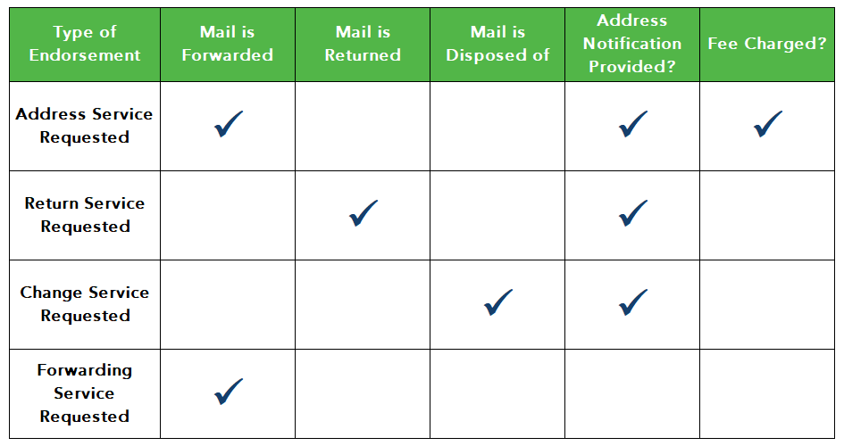
USPS Endorsements
Source: http://pe.usps.com/text/dmm300/507.htm

Slide 40
Third Party Solutions

Slide 41
Credit Reporting and
Collection Agencies
Equifax – www.equifax.com
Experian – www.experian.com
TransUnion – www.transunion.com

Slide 42
ONLINE Utility Exchange
www.onlineutilityexchange.com
SSN validation and fraudulent SSN detection
Credit score
Optional variable deposit calculation based on credit score
Shared information with other utilities

Slide 43
Set-Off Debt
Attaches personal state income tax refunds for delinquent public debts
Extremely successful for our customers in states where it is available
If it’s available, use it!
If it’s not available, contact your state legislators!

Slide 44
Questions?

Slide 45





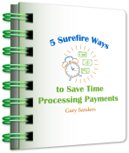
For more information…
Gary Sanders
919-673-4050
gsanders@edmundsgovtech.com
www.edmundsgovtech.com/blog
www.facebook.com/UtilityInformationPipeline
@GaryASanders
garysandersonline.com/book

