Slide 1
Optimizing Polymer Mixing and Activation:
Following the Science
FRWA Annual Conference
August 10, 2021

Slide 2




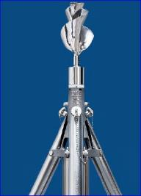
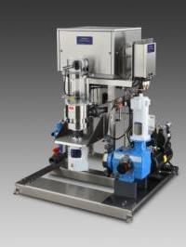
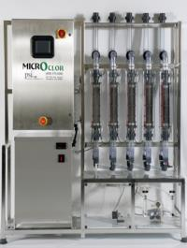
UGSI Solutions, Inc. is one of the fastest growing and innovative companies in the water industry
PAX Tank Mixers
Tank Shark®
Polyblend® Fluid DynamicsTM Encore® Wallace & Tiernan®
Microclor® Monoclor® RCS PAX TRS™ ChemLockerTM
Notes:
UGSI Solutions is positioned to capitalize on the most lucrative opportunities in the water industry based on 30 years of experience and success in running water industry companies. Experienced management, strong balance sheet and intense focus on chemical feed and disinfection solutions

Slide 3
Agenda
Science of Polymer Activation
  Viscosity as an indicator of polymer solution quality
  Effect of dilution water
  Two-stage mixing for dry and emulsion polymers
  Residence time sufficient for polymer uncoiling/dissolution
Polymer Activation
  Mechanical activation system
  Hydraulic activation system
Case Studies
  Neshaminy Water Treatment Plant, PA – emulsion polymer
  Fairfield-Suisun Sewer District, CA – dry polymer
  F. Wayne Hill WRC, Gwinnett County, GA – emulsion polymer
Questions

Slide 4
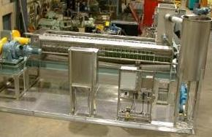
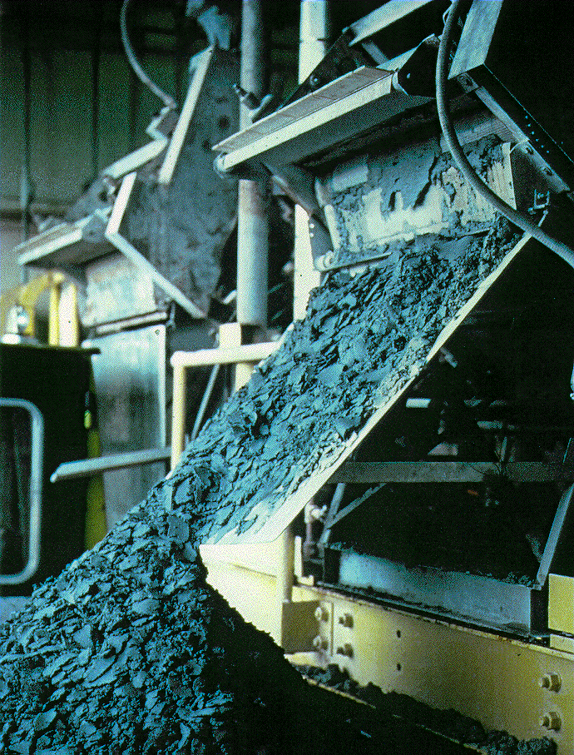
Polymers vastly improve the operation of water and wastewater plants by accelerating the settling of particles and improving sludge dewatering
Clarification, Sludge Dewatering,
& Thickening
Belt filter Presses
Centrifuges
Screw Presses
Plate & Frame Presses
Gravity Belt Thickeners (GBT)
Diffused Air Flotation (DAF)
Polymer Use Must Be Managed
Polymers are expensive – often the 3rd or 4th highest operating cost in a wastewater plant
Handling and storage can affect efficiency
Dilution and activation are key for maximizing impact – up to 25% to 40%+ efficiency improvements are possible
Special equipment is required to optimize the capabilities of water treatment polymers
Notes:
Why are polymers necessary in liquid-solids separation? The answer is to accelerate the separation process. Naturally occurring colloidal particles, bacteria, and silt can take hours or even days to gravimetrically settle unless we accelerate the process.
Stokes Law tells us that the settling velocity of a particle is a function of the square of the radius of that particle. Therefore, if we can increase the size of those particles, we can reduce the time required for them to settle. The function of polymers is to bring those small particles together to form larger particles, thereby increasing the settling velocity and reducing the time required for settling.
Without polymers, the solids would leak through the screens on the Belt Thickeners. In DAF’s the floatation layer would not form an acceptable filter bed, etc.

Slide 5

UGSI Chemical Feed is the only polymer equipment manufacturer backed by decades of scientific research
Dr. Yong Kim, PhD
Education:
  PhD, Chemical Engineering, Kansas State University, 1987
Patents:
  (6) for polymer activation/mixing
  (1) for water disinfection
Publications:
  Authored a book:
  Coagulants and Flocculants: Theory and Practice
  Published 40+ technical papers
Member, WEF Solids Separation Subcommittee
  Fact Sheet “Polymer/Flocculant 101”
Notes:
Performance and operating parameters are derived from extensive research and testing to confirm and validate performance across a wide variety of polymers – over many decades of experience.

Slide 6
Polymers are long chained hydrocarbons that have functional groups or charge features that are designed to “grab” particles or impurities and force them to settle faster
Important Aspects of Polymers
Polymers have different charges and charge density (strength of attraction):
  Anionic (-) (typically used in potable water)
  Cationic (+) (typically used in wastewater)
  Non-ionic (neutral) (typically used for color removal - potable)
Molecular Weight (MW) – (<100,000 - low to >10,000,000 - very high)
Physical delivered form:
  Solution (in water, cationic)
    Low MW come fully activated – no activation step, typically coagulants
  Emulsion (in oil as carrier)
    Higher active polymer concentrations with any charge
    Highly entangled polymers – need activation step
  Dry (ex. powder or beaded)
    Very high active polymer concentration with any charge
    Highly entangled polymers – need activation step
Molecular View
Macro-Molecular View
Notes:
The word polymer is derived from the Greek language. It is a combination of Poly meaning many, and Meros meaning parts. So, polymer means many parts.
As we said earlier, polymers are molecules that are formed by joining together identical building blocks in a repeating chain. For example, polyacrylamide is a long chain consisting of many (thousands or millions) acrylamide monomers.
Anionic polymers are typically used in potable water treatment applications. Cationic is typically used in wastewater applications. Non-ionic is not frequently used but is sometimes used for color removal in potable water applications.
There is a wide diversity of polymer types and characteristics.
There are three basic Forms of Polymer – Dry or Neat, Solution and Emulsion
In addition to molecular weight and charge, polymers are categorized by their physical forms (solution, emulsion, and dry).
Solution polymers are, as the name implies, true solutions of polymer in water. They are low molecular weight cationic polymers, and are typically used as coagulants in clarification process at drinking water plants. Since solution polymers are fully activated, you do not need any specialized equipment to feed them other than a metering pump designed to handle the viscosity.
Mannich polymers are also solution polymers, but they have a higher molecular weight and much lower active polymer concentration. One downside to Mannich polymer is that you are limited to a maximum active polymer concentration of approximately 4 - 6%, so you pay to ship a lot of water. Because Mannich polymers are non-Newtonian fluids that are extremely viscous, they are typically fed with a gear pump and require dilution in order to deliver them to the feed point. Mannich polymers are most commonly used in dewatering applications at wastewater treatment plants and fed using one of our liquid Polyblend® or Dynablend systems that we will discuss later.
Emulsions are non-homogeneous mixtures of two or more components (e.g. oil based paint). Emulsion polymers are mixtures of polymer gel and a hydrocarbon oil. By emulsifying the polymer, higher active polymer concentrations can be achieved. In recent years we have seen emulsion products with active polymer concentrations in excess of 60-65%.
Emulsion polymers are typically flocculants, and can be either cationic, anionic, or nonionic. The oil used in the emulsion polymer enables the product to be transferred by metering pump.
Polymer molecules contained in polymer gels are in highly entangled state and need to be “uncoiled” to perform as flocculant. The best analogy I can think of is a rubber band that is coiled verses being stretched out. In order to get the maximum utilization from the polymer in the process, we need to uncoil the polymer (or activate it), prior to using it. Therefore, specialized feed systems such as the liquid Polyblend® system are required for emulsion polymers.
Dry polymers are exactly what the name implies. They have a very high active polymer concentration, with the remaining content being a small amount of anti-caking ingredient. Cationic, anionic, and nonionic polymers are all available as dry products. Dry polymers are typically used as flocculants.
As with emulsions, the dry polymer molecules are highly entangled and require activation, or uncoiling, prior to use. Obviously, dry polymers also have to be made into a solution prior to use. Specialized equipment such as the UGSI Polyblend® DP or Dynajet is required to dissolve and activate the dry polymer.

Slide 7

A properly activated polymer retains its intended (high) molecular weight, is long chained and has many active charge sites
Well Activated Anionic Flocculant or Polymer
-
+
-
-
-
-
-
-
-
-
-
-
-
-
Contaminant
-
-
-
-
-
-
-
-
-
-
-
-
-
-
-
-
-
Negative Charge Site Exposure
Notes:
`During the first several years following the introduction of the we did a lot of plant pilots. We still have demonstration units available, by the way. Typically the pilot would pit a Polyblend® unit against a batch tank system or a competitor’s system, the results are pretty consistent. The Polyblend® would allow the plant to use less polymer and get better results (higher cake solids, etc). Better polymer activation reduces polymer usage – less efficiency robbing agglomerations and more charge site exposure.
Remember from our earlier discussion that polymers have charge sites attached to the chains, and it is the charge sites that actually do much of the work in the process. If we do a better job of activating the polymer, we expose more of those charge sites per pound of polymer used. More charge sites exposed yields more “work value” from the same (or less) amount of polymer. This allows us to get better separation results from less polymer.

Slide 8
Polymer Activation (Mixing, Dissolution)
(I) Initial Wetting (Inversion)
Sticky layer formed
High-energy mixing -> No fisheyes
Most Critical Stage
(II) Dissolution
Reptation* or Uncoiling
Low-energy mixing -> No damage to polymer
time
Oil
Polymer (gel)
Water
(I)
(II)
Sticky Layer
* de Gennes, P.G., J. Chem. Phys., 55, 572 (1971)

Slide 9
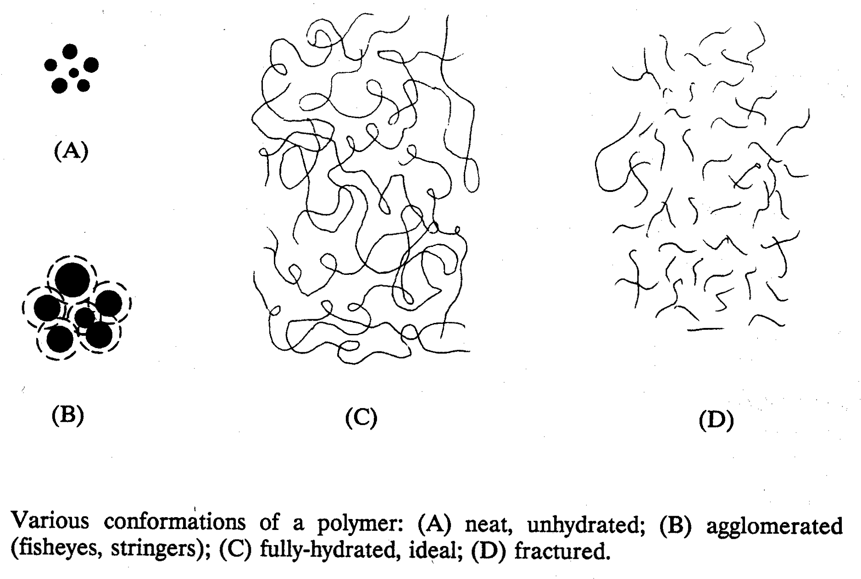
Three Forms of Polymer Solutions
Neat polymer
Fisheyes due to poor initial wetting
Ideal polymer chains by two-stage mixing
Broken polymer chains by conventional batch mixing

Slide 10
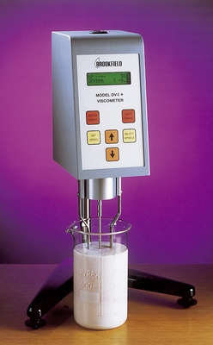
Viscosity of Polymer Solution and Settling Rate
(Higher Viscosities Accelerate Settling Rate)
Viscosity is the most reliable indicator of polymer solution activation – directly related to charge site exposure
Settling Rate, mm/min
Intrinsic Solution Viscosity
Sakaguchi, K.; Nagase, K., Bull. Chem. Soc. Japan, 39, p.88 (1966)
Notes:
This slide should be used to state how polymers are measured for effectiveness. Best known way of determining how a polymer is being activated. This is how we assess the performance of our equipment with a given polymer. Point to the research that was completed by a third party and is the industry standard.
Intrinsic viscosity of polymer solution is a technical term which is difficult to explain. We can say that it is a “kind of relative concept” of solution viscosity. Higher the intrinsic viscosity relates to longer chain length in hydrated structures in the solution. The slide shows that the polymer solution with higher solution viscosity achieves better performance of particle settling. The goal in polymer activation is to achieve higher solution viscosities.

Slide 11
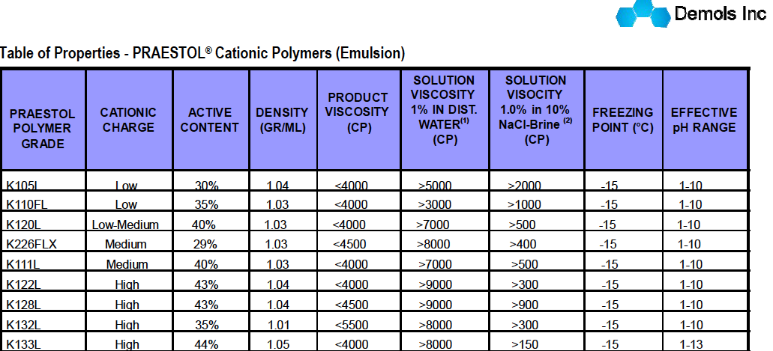

Polymer supplier data sheet provides a starting point for viscosity – critical factor for polymer efficiency
Solenis, Inc.
Notes:
Use this slide to encourage the audience to refer to the polymer data sheet for a base line on viscosity expectations. Start setting up the presentation to continue to emphasize mechanical energy equals higher viscosity which yields better performance and less chemical (Savings $$)

Slide 12
Effect of Dilution Water Quality
Ionic strength (Hardness): multi-valent ion hinders polymer activation
- Soft water helps polymer molecules fully-extend faster
- Hardness over 400 ppm may need softener
Oxidizer (chlorine): chlorine attacks/breaks polymer chains
- Should be less than 3 ppm
- Caution in using reclaimed water for polymer mixing
+ Serious negative impact on aging/maturing
Temperature*: higher temperature, better polymer activation
- Water below 40 ºF may need water heater
- Water over 100 ºF may damage polymer chains
Suspended Solids/ Turbidity:
- In-line strainer recommended
- Caution in using reclaimed water for polymer mixing
*David Oerke, 20% less polymer with warm water, 40% more polymer with 140F sludge, Residuals and Biosolids (2014)

Slide 13
Effect of Dilution Water Chlorine Content
When reclaimed water used for polymer mixing, chlorine < 3 mg/L

Slide 14
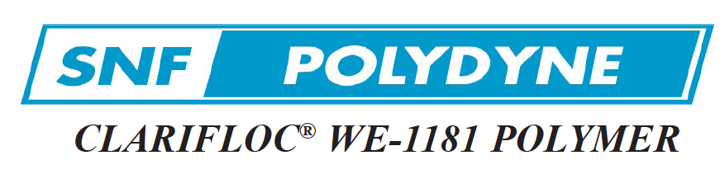

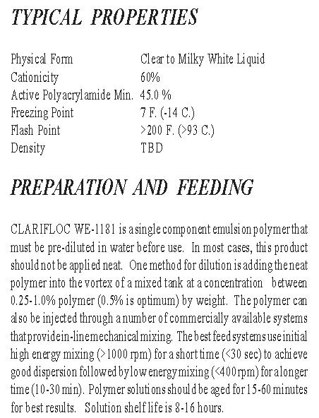
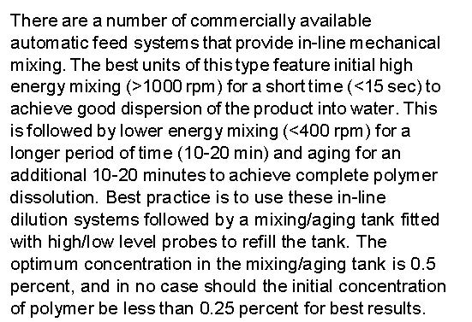
Two-Stage Mixing (in mix chamber) higher energy mixing → low energy mixing
“Discrete” Two-Stage Mixing -
discrete means “separation of high
and low energy mixing zones”
Notes:
Continue to reinforce two stage dilution and two stage mixing

Slide 15
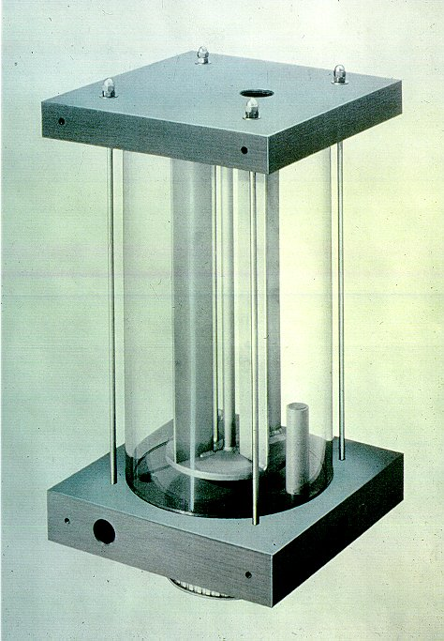
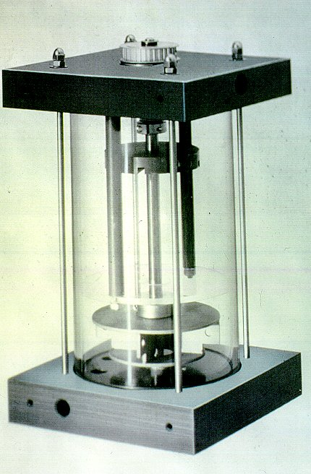
One-Stage vs Two-Stage Mixer (Emulsion Polymer)
1- stage mixer
2- stage mixer
1,100
Low-Energy Zone
Dividing Baffle
1,700
4,000
High-Energy Zone
G-value, mean shear rate (sec⁻¹)

Slide 16
One-Stage Mixing vs. Two-Stage Mixing
Two-stage mixing → significant increase of polymer solution efficiency
37% increase
22% increase

Slide 17
Residence Time of Low Energy Mixing Zone
Low energy mixing stage requires “longer” residence time than initial high energy mixing stage
Notes:
Continue to reinforce two stage dilution and two stage mixing

Slide 18
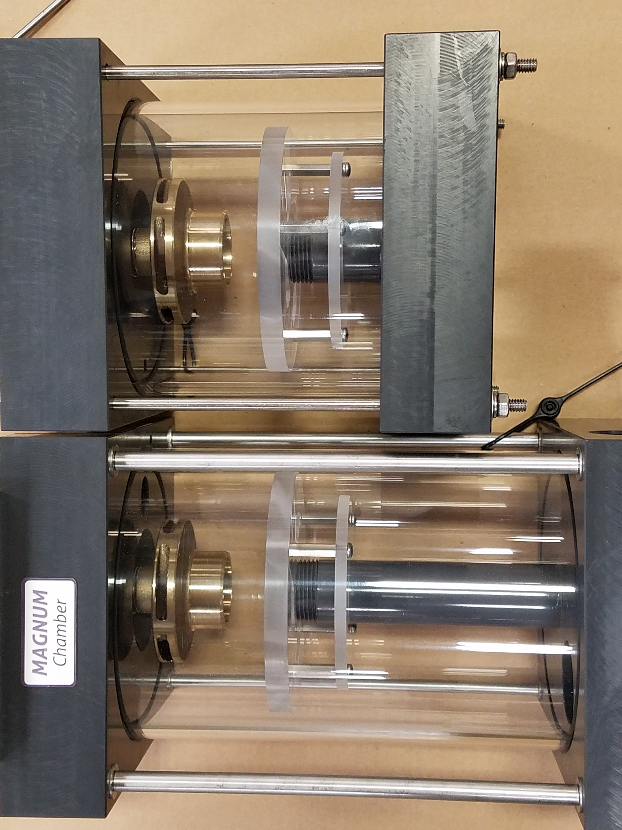
Effect of Residence Time in Mix Chamber
Baffle
Volume of low-energy zone: V_{L}
V_{L,MM} = 3* V_{L,M}
M, 0.5 gal
MM, 1.0 gal
High Energy Zone
Low Energy Zone

Slide 19
Two stage dilution is required to properly activate emulsion polymers
Inverting Surfactant helps to “invert (or break)” stable emulsion state
Hydrocarbon Oil: 30%
Polymer Gel: Polymer 40%
Water 30%
d
Inverting (breaker) surfactant
To enable inverting surfactant to work best,
first make polymer solution at high concentration*
First, 1.0% - 1.25% primary mixing/dilution
Then, 0.25% - 0.5% secondary mixing/dilution
d = 0.1 - 2 µm
* AWWA Standard for Polyacrylamide (ANSI-AWWA B453-06), 11, 2006
Notes:
Emulsion polymers are manufactured and stored in a compact state (neat polymer) - embedded in hydrocarbon oil – ready to be released and expanded with the proper sequence of mixing and dilution.

Slide 20
Two-Step Dilution: Expediting Polymer Activation
Primary mixing at “high %” → Post-dilution to feed %
Primary Mixing
Post-Dilution
Ideal Design
Polymer 1.0 gph
1.0%
0.25% solution
Water
300 gph
Water
100 gph
4 x higher content of inverting surfactant to expedite polymer activation
Primary Mixing
Polymer 1.0 gph
0.25%
0.25% solution
Water
400 gph

Slide 21
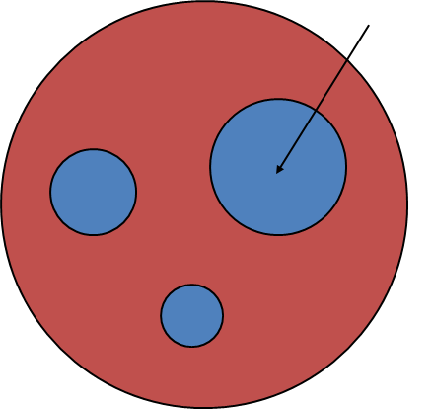


Polymer science dictates the most effective way of activating polymers- Your activation equipment should follow:
Adequate
Residence time
High Energy at MOIW
Fully activated polymer solution at desired concentration
Transition to low energy “quiescent zone”
Notes:
This is a transition slide that should be used to set up the following section. The following section deals with the mechanics of mixing equipment and how the design should support the science.
Restate the fact that all UGSI mixing equipment follows the science- while most competitors do not.
Each click brings up the next stage. Use this to frame your delivery.
Control the clicking, delivery will assist in helping the audience get the concept of moving through stages.

Slide 22
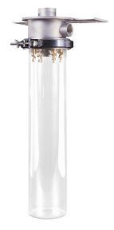
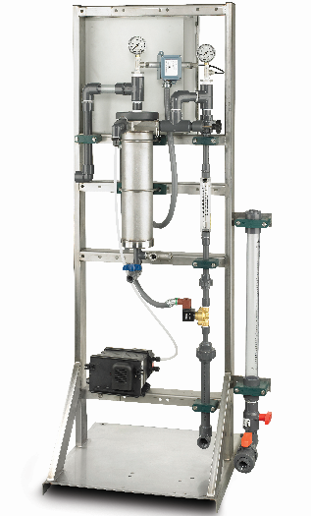
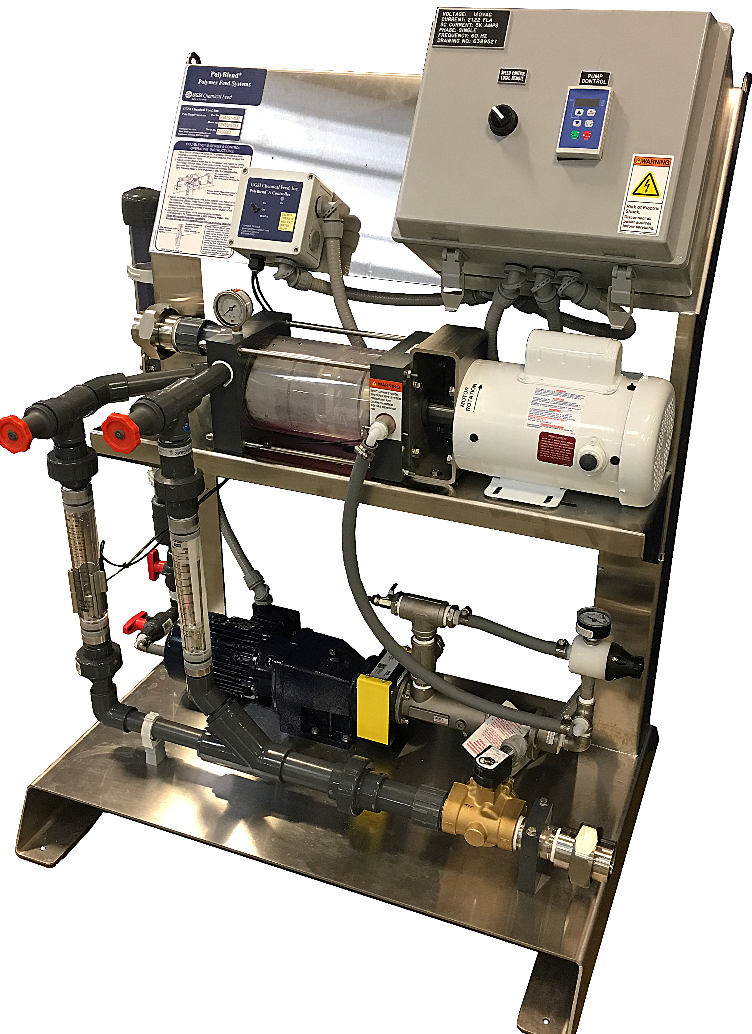
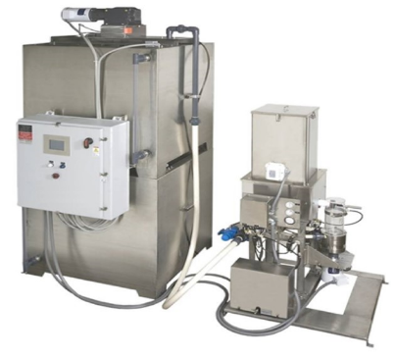
Polymer Activation Systems
UGSI Solutions understands the science of polymer activation:
65 years of experience and tens of thousands of installations
POLYBLEND® DYNABLEND™
Notes:
Use this side a set-up slide for a review of our products.
Point out that Polyblend is synonymous with mechanical mixing and Dynablend is with hydrodynamic mixing.
Both Polyblend and Dynablend offer liquid/emulsion and dry mixing technologies. (Point to the pictures)
In the water and wastewater industry, experience counts – site variation, polymer types, climate and application all influence process equipment configuration choices. With over 30 years of experience and over 10,000 installations – UGSI Solutions personnel and brands have seen it all.

Slide 23
Mechanical or non-mechanical (hydraulic) mixing – both can provide effective mixing energy at MOIW
Mechanical Mixing
Hydraulic Mixing
Mean Shear Rate
Contact Force
Sum(F) = Sum(β*m*V_{out}) - Sum(β*m*V_{in})
G = (P / µV)^{1/2}
F: force, m: mass
β: momentum flux correction factor
V_{in} : velocity in the x direction, zero in y
V_{out} : V*cos(θ) in the x-direction and
V*sin(θ) in the y-direction
θ: bending (colliding) angle
G: mean shear rate
P: power delivered to fluid
µ: viscosity
V: mixing volume
Notes:
Selecting activation technology is based on a number of factors. Understanding application, plant operation, and polymer types will assist in equipment feature selection.
Mechanically activated systems can precisely quantify the energy input (G value)- which can be very important for high molecular weight polymers or polymers that have a tight tolerance for activation residence time.
Hydraulic mixing energy is calculated differently but can efficiently activate a wide variety of polymers.
Hydrodynamic forces in the form of a high energy water jet are what activates the polymer.
How this force is applied is important.
The equitation under mechanical mixing calculates the magnitude of force at a given angle between the outlet and inlet momentum at constant pressure.
A perpendicular impingement angle will impart the double the energy at the MOIW. A tangential angle at MIOW is less effective. (Our competitors have less).
Magnitude of force increase with the angle.

Slide 24
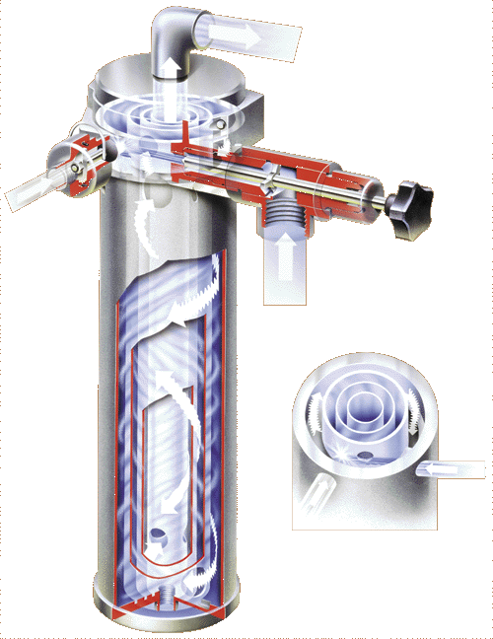
DynablendTM Mix chamber design induces high energy at the MOIW
Water jet traveling at 70 fps
Polymer is introduced and intersects with the water jet at a right angle- providing the most direct force and maximizing energy
Orifice can be sized/adjusted to meet flow requirements
Linear Actuated Variable Orifice: LAVO available for automatic flow adjustments
Sum(F) = Sum(β*m*V_{out})-Sum(β*m*V_{in})
Notes:
Give in-depth information on how Dynablend introduces high energy at the MOIW.
Touch on all key design points.
Follows Polymer Science: High energy at MOIW
LAVO
Sized to meet application

Slide 25
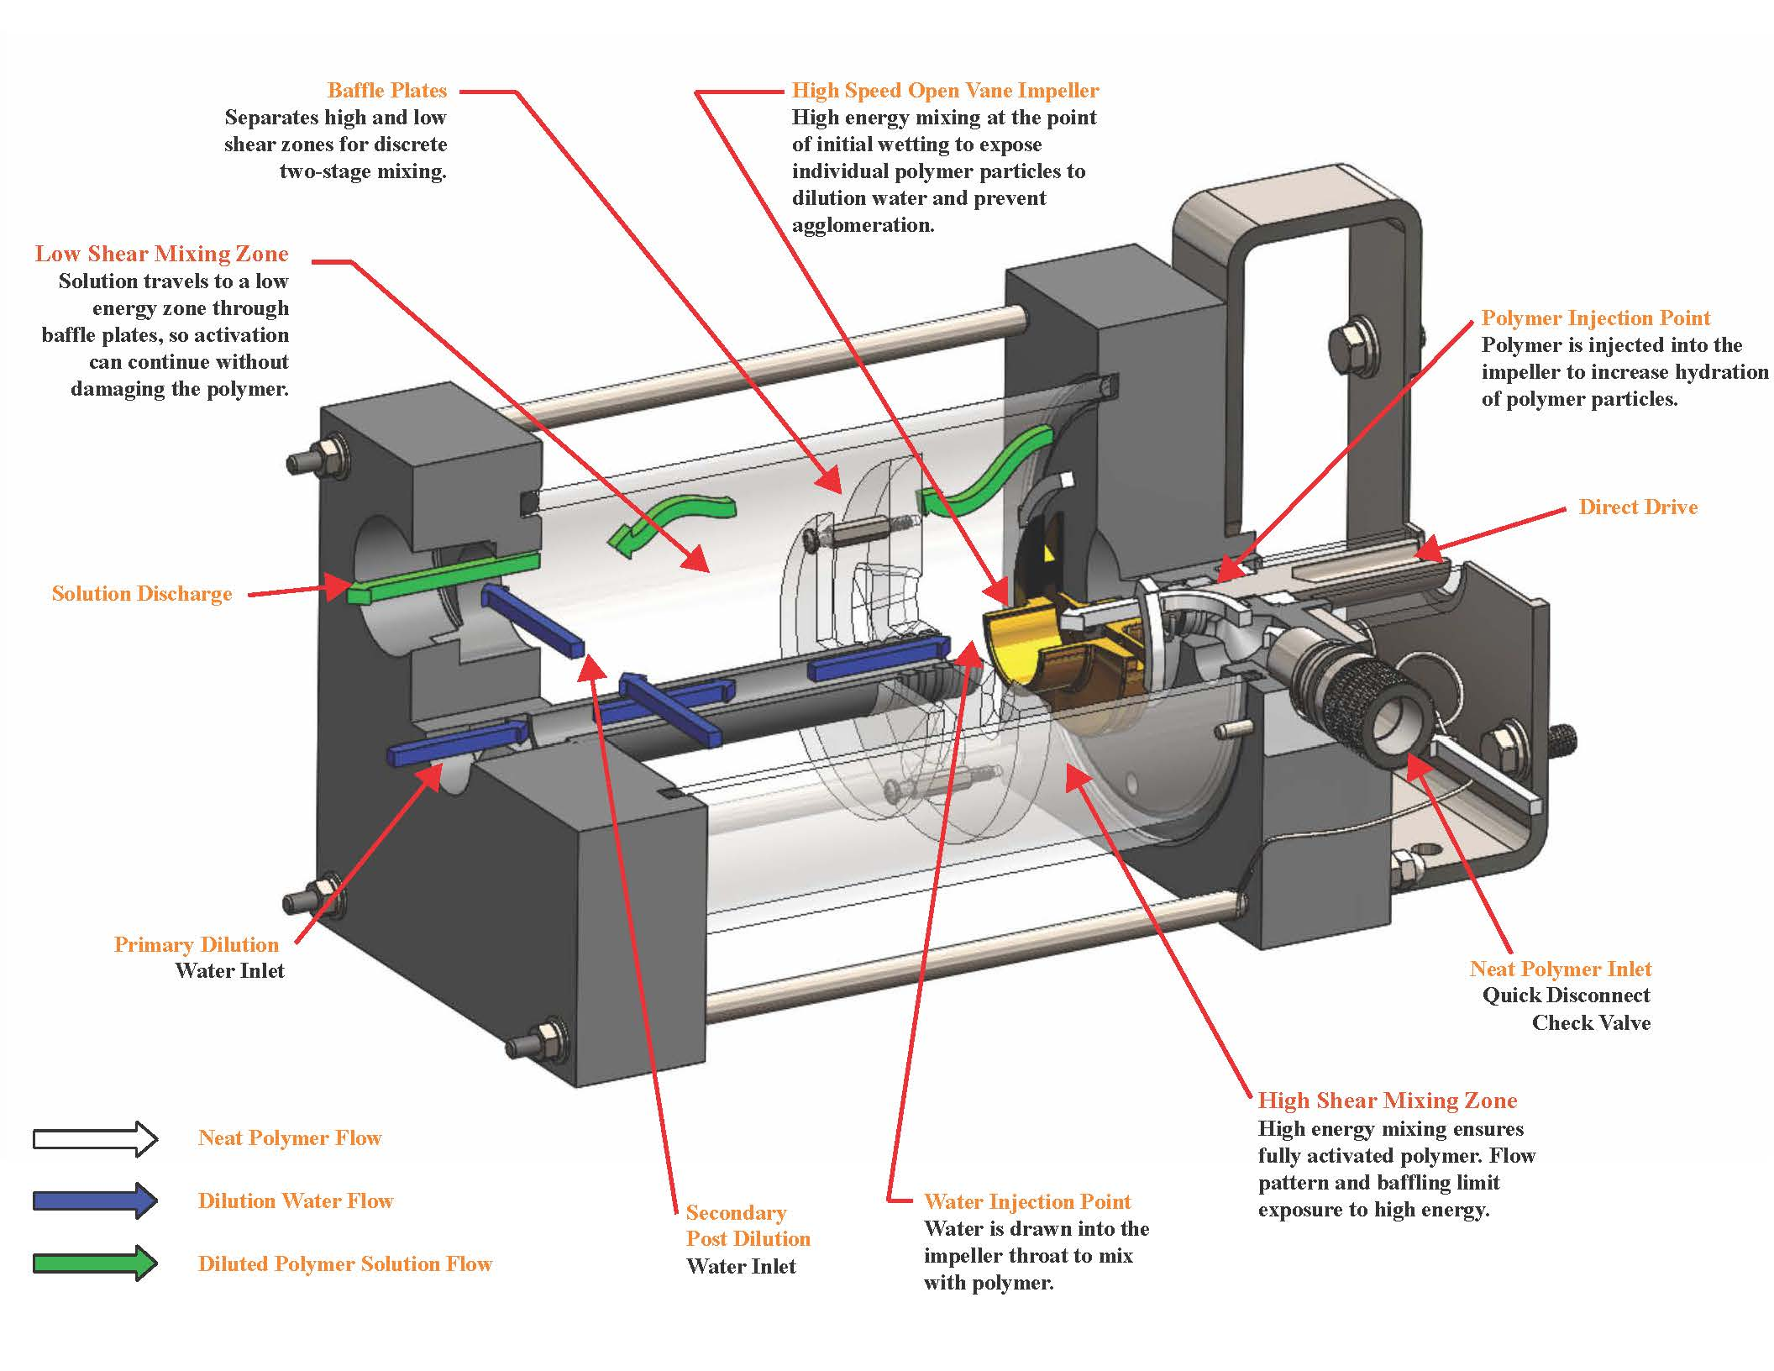
POLYBLEND® M Series two-stage mechanical mix chamber
Highly efficient mixing process results in polymer savings
Excels at high molecular weight polymers
Optimal G-values: 14,700 sec⁻¹ in high shear zone
Secondary dilution standard – in compliance of AWWA B453
Low maintenance cost
Wide variety of size options
Largest installation base of any mechanical activation unit
Notes:
Discuss the virtues of the old mix chamber design but also start mentioned some of the areas that we improved on with the magnum. Removable check valve to decrease periodic maintenance, eliminate bearing frame that was problematic under the Siemens days due to poor alignment of the shafts. Keep hitting on fact multi zone and low energy/no mechanical mixing after MOIW.

Slide 26
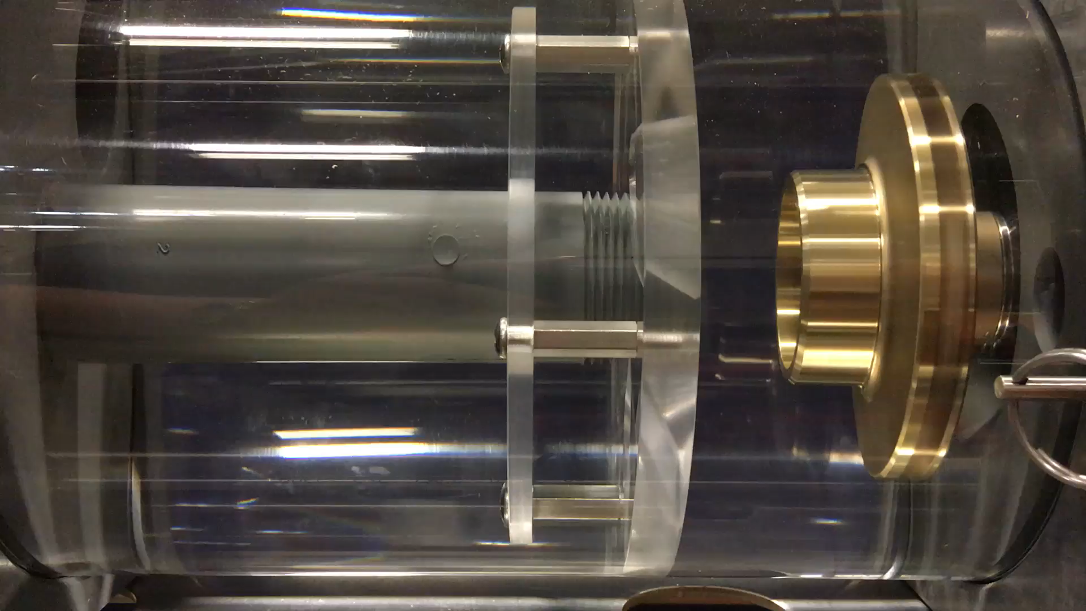
Example of high energy and low energy mixing zones to achieve the best results and maximize polymer savings.

Slide 27
Which activation technology better assists in meeting your process objectives?
OPERATOR EXPERIENCE:
Available manpower; skill levels
BUDGET CONSTRAINTS:
Operations costs vs cap-ex
PLANT SERVICES:
Water and air pressure
SPACE CONSTRAINTS:
Dry polymer conveyance;
tank configuration; headroom, etc.
OPERATING CYCLE:
Batch or continuous
Polymer Activation Solution
COMFORT LEVEL:
Polymer activation technology history
SPECIALTY APPLICATION:
Explosion-proof; hazardous
environments
FEED WATER MAKE-UP
Chlorine level , temperature and hardness
POLYMER TYPE:
High; medium; low molecular weight branched, Anionic, Cationic, Other
POLYMER CONSUMPTION
Notes:
The lack of operator experience and the system operational cycle caused the initial issues- understanding this in front end could have eliminated product issues.
Having to fit the new unit in the existing footprint was a design concern that had to be considered before recommending either system. Common on replacement and/or retrofit projects.

Slide 28
PolyBlend® / DynaBlend Dry Polymer Systems
Two-Stage Mixing
First Stage
High Energy Mixing
(3,450 rpm, < 0.5 sec)
Second Stage
Low Energy Mixing
(60 rpm, 20 min)
Polymer Solution Storage/Holding
(no mixing)
DD4 Disperser
Mix and Hold Tanks
Notes:
The DD4 disperser is where the polymer wetting occurs, utilizing a high energy volute mixer for maximum polymer activation. The water flow rate is preset at either 20 or 30 gpm and the dry feeder speed can be adjusted to give the desired polymer concentration.
The valves on the DP units are pneumatically actuated. If good quality (dry) plant air is available, that can be used. If not, an optional air compressor is available.
The DP unit can include an optional emulsion polymer pump to allow the unit to feed either dry or liquid polymer.
The next cut-away view shows some of the features of the mix chamber.
Many traditional dry polymer wetting systems utilized a funnel flushed with water to prevent dry polymer agglomeration. The "wetting cone" approach was unreliable due to plugging/maintenance issues. The DD4 utilizes water injected tangentially into the wetting interface to form the funnel and prevents dry polymer from contacting any solid surfaces where the polymer can agglomerate.

Slide 29
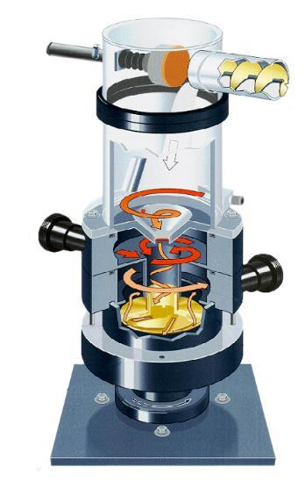
POLYBLEND® Dry Disperser (DD4) accomplishes mission of high energy initial wetting
DD4 Dry Disperser
High-energy mix at MOIW
Prevents fisheye formation
Precise control of polymer to water ratio
Dispersing individual polymer particles
Fully automatic controls
Pneumatic plunger
Optional emulsion pump
Optional compressor
Polymer In
Water In
Solution Out
Notes:
The DD4 disperser is where the polymer wetting occurs, utilizing a high energy volute mixer for maximum polymer activation. The water flow rate is preset at either 20 or 30 gpm and the dry feeder speed can be adjusted to give the desired polymer concentration.
The valves on the DP units are pneumatically actuated. If good quality (dry) plant air is available, that can be used. If not, an optional air compressor is available.
The DP unit can include an optional emulsion polymer pump to allow the unit to feed either dry or liquid polymer.
This cut-away view shows some of the features of the mix chamber. There is a pneumatic plunger to prevent moisture from contacting the polymer when the unit is not feeding polymer. This prevents the polymer caking problem often associated with dry polymer units in the past.
The volute creates a vortex, which is where the dry polymer first contacts the water. The high mixing energy generated by the volute prevents agglomerations from forming. The clear mix chamber allows you to visually verify that the polymer is falling into the center of the vortex. If not, the feeder spout can be adjusted to correct this.
This cut-away view shows some of the features of the mix chamber. There is a pneumatic plunger to prevent moisture from contacting the polymer when the unit is not feeding polymer. This prevents the polymer caking problem often associated with dry polymer units in the past.
The volute creates a vortex, which is where the dry polymer first contacts the water. The high mixing energy generated by the volute prevents agglomerations from forming. The clear mix chamber allows you to visually verify that the polymer is falling into the center of the vortex. If not, the feeder spout can be adjusted to correct this.

Slide 30
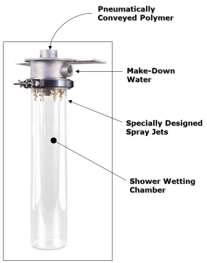
DYNAJETTM (pneumatic dispersion) utilizes specially designed spray jets for high energy wetting
DYNAJETTM
High-energy mix at MOIW
Prevents fisheye formation
No moving parts
Pneumatic conveyance limited only to size of blower
Zero dusting
Separate wetting heads for liquid back-up option
Separates water from polymer
Capable of up to 50 lbs/minute
Notes:
Key Features:
System uses blower-induced pneumatic conveyance system to convey polymer from volumetric feeder to the wetting head.
The polymer is naturally dispersed (atomized) in the conveyance air prior to being introduced to the dilution water, providing optimal polymer wetting polymer-particle wetting.
A full 90 degree cone allows for clog resistant flow and high energy polymer wetting.
High capacity systems are available. (Almost any size)
Tanks can be Remote from Feeder
Stairs and steps are not required for bag loading. (Easy on the operator)

Slide 31
Why Initial High-Energy Mixing is So Critical?
Polymer dissolution time, t_{s} ~ (diameter)² Tanaka (1979)*
Assume t_{s} → 1 min
d
t_{s} → 100 min
10*d
Initial high-energy mixing → No fisheye formation → Significantly short mixing time
* Tanaka, T., Fillmore, D.J., J. Chem. Phys., 70 (3), 1214 (1979)

Slide 32
Second stage dry polymer mixing tank should not damage activated polymers: Impeller diameter in relation to tank diameter
1
1
15
4
14
50
300
60
d/D = 0.3
d/D = 0.5
Cutter (1966)*
Okamoto (1981)**
Non-Uniform Mixing Energy
More Uniform Mixing Energy
Impeller with large diameter provides low-energy uniform mixing energy, which is critical to prevent damaging polymer chains
d: impeller diameter
D: tank diameter
* Cutter, L.A., AIChE J., 12 (1), 35 (1966)
** Okamoto, Y., Nishikawa, M., Hashimoto, K., Int. Chem. Eng, 21, 88 (1981)
Notes:
Our Mixing design reduces excessive shear during the aging process thereby minimizing damage to the long chain polymers.
Velocity at mixer tip is higher for small diameter mixer resulting in less uniform mixing – mixing only occurring at mixer impeller tip – versus larger diameter mixer.
Reminder: Highest shear/velocity is at impeller tip.
In red shows magnitude of shear forces in fluid. This REPRESENTS MIXING INTENSITY.

Slide 33
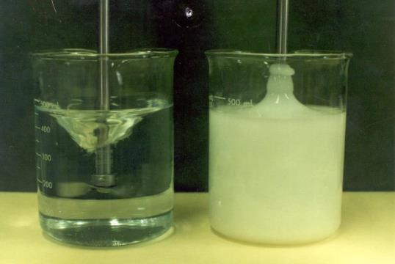
During the polymer second-stage mixing, Weissenberg effect should be avoided
Polymer solution exceeding “critical concentration” climbs up mixing shaft
Extremely non-uniform mixing
Critical factor in designing polymer mix tank - 0.5% limit for HMW polymer
extremely low mixing energy
very high mixing energy
extremely low mixing energy
Water (Newtonian)
Polymer Solution
(Non-Newtonian, pseudoplastic)
Notes:
Weissenberg effect reduces the uniform mixing and negates the benefits of a properly designed tank.
As the polymer market continues to advance toward high molecular weight polymers this phenomena will become more prevalent.
You can see the normalized mixing intensity at the impeller tip is very high while above and below are low.
This can reduce the efficiency of your polymers.

Slide 34
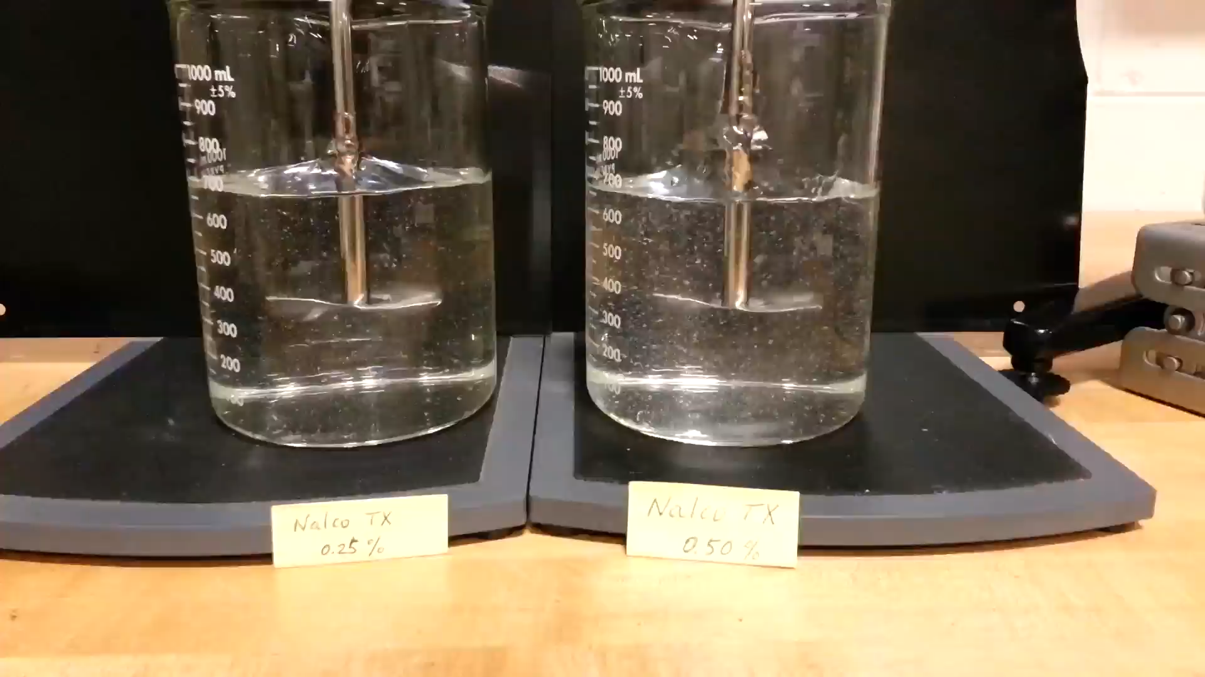
Notice polymer solution is “climbing” up the mixer shaft
(30 min after mixing (Nalco TX13182): 0.25%, 0.50%)

Slide 35
Second-stage mixing tank for dissolution of dry polymer
Hollow-wing impeller
  No Weissenberg Effect
Large impeller, d/D > 0.7
  Uniform mixing energy
Low RPM, 60 rpm
  Low-intensity mixing
  Minimize damage to polymer chain
Square tank design
  No Weissenberg Effect
  No baffles needed, no dead zone
Shorter mixing time
  20 minutes for cationic polymer
  30 minutes for anionic polymer
  Minimize damage to polymer chain
Notes:
UGSI has designed a tank that maximizes mixing efficiency and eliminates the Weissenberg effect.
This is accomplished with a hollow wing impeller that is very large relative to other impellers.
The square tank design eliminates dead zones in a tank
This design results in a shorter mixing time for both Cationic and Anionic polymers with out damaging the polymer chains.
Various tank sizes up to ~2,000 gallons.
Design allows for you to make higher concentrations which reduces tank sizing and provides flexibility to the operator.

Slide 36
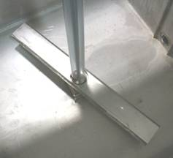
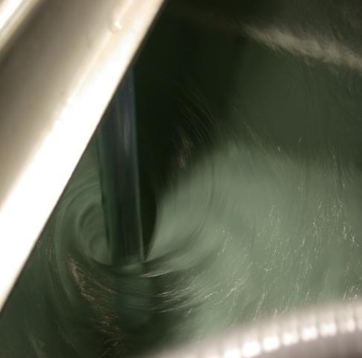
Polymer Mixing Tank without Weissenberg Effect
PVC sleeve around mixer shaft
separates mixer shaft from polymer solution
Why high % polymer solution
* Smaller tank size
* Longer solution shelf life
Rotating shaft
Eye of impeller
Hollow-bladed impeller
Impeller / tank diameter > 0.7
Cationic Polymer Solution @ 0.75%

Slide 37
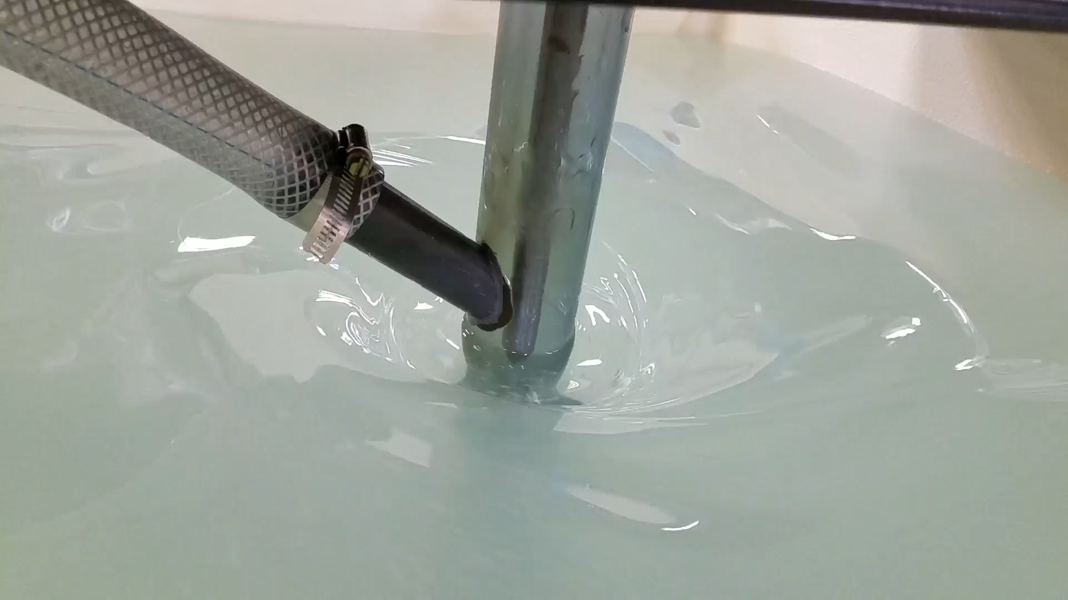
Polymer Mixing Tank without Weissenberg Effect
30 min mixing (Clarifloc C-3289): 0.65%, 2710 cP

Slide 38
Case Studies

Slide 39
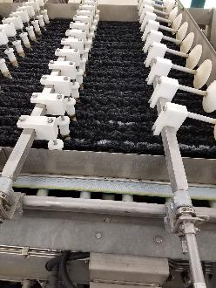
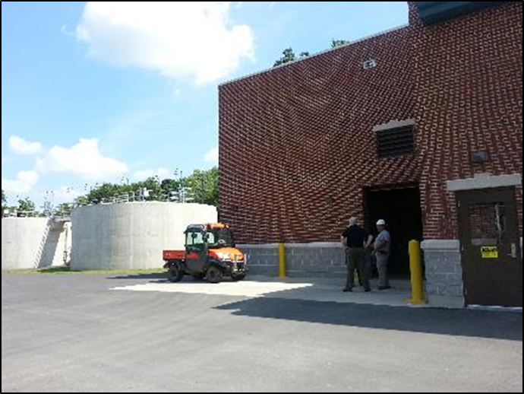
Case Study: Neshaminy Water Treatment Plant in PA
Liquid emulsion polymer system
Drinking Water plant in Philadelphia area - Large Investor Owned Utility
Design capacity: 15 MGD
Population served: 40,000
Polymer used for dewatering (two 2M belt filter presses)
Averaging 20% to 22% cake solids
M-Series POLYBLEND® M2400-D10 installed in 2012
Komline-Sanderson belt filter presses running at average ~85 gpm of sludge (2.3% average solids content)
Notes:
We had a unique opportunity to work with a customer to gather side-by-side data of our smaller M-series and our new magnum series chamber.
There was 2 of the same belt presses running at the same time treating the same sludge. Truly apples-to-apples application.

Slide 40
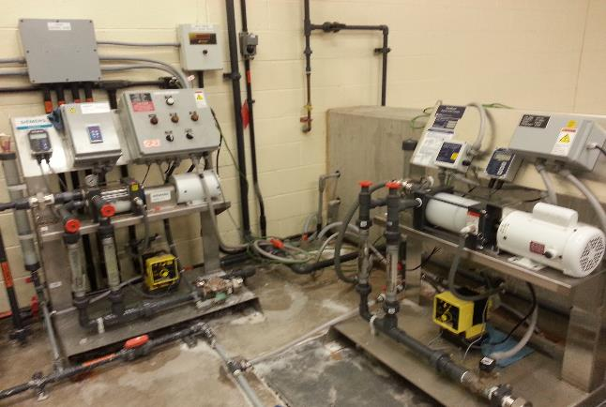
Footprint for the Magnum is the same as the legacy M-unit
Existing Polymer System
Siemens M2400-D10AA
New Polymer System
UGSI Magnum MM2400-D10AA
Notes:
Point out that the magnum sits on the same frame and the M-series can be retrofitted without easily with minimal parts and effort.

Slide 41
The POLYBLEND® Magnum mix chamber outperformed the existing M-unit under the same conditions
Side-by-side trial from February through May 2016
Polymer savings > 30%
Increased processing sludge volume ~ 10%
Slightly better cake solids from 22% to 22.9%
M, 0.5 gal
MM, 1.0 gal
Notes:
We see both units tracking the same over 10 days. However, the polymer consumption on the Magnum was significant.

Slide 42
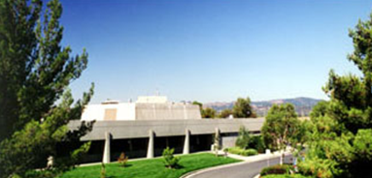
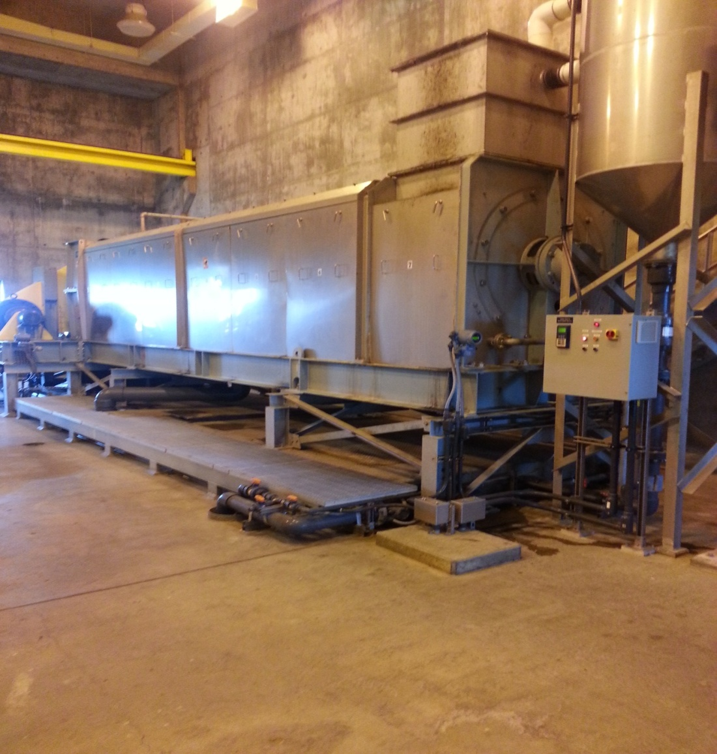
Case Study: Fairfield Sewer District, CA
Solano County, CA, 40 miles North San Francisco
Design capacity: 24 MGD tertiary treatment/ UV
Population served: 135,000
Polymer use for dewatering (screw press) and thickening (GBT)
Problems with existing polymer system
Struggled to make proper polymer solution
Non-homogeneous polymer solution
Frequent maintenance issues
FKC screw press runs at average 70 gpm of sludge
(2% solids content)

Slide 43
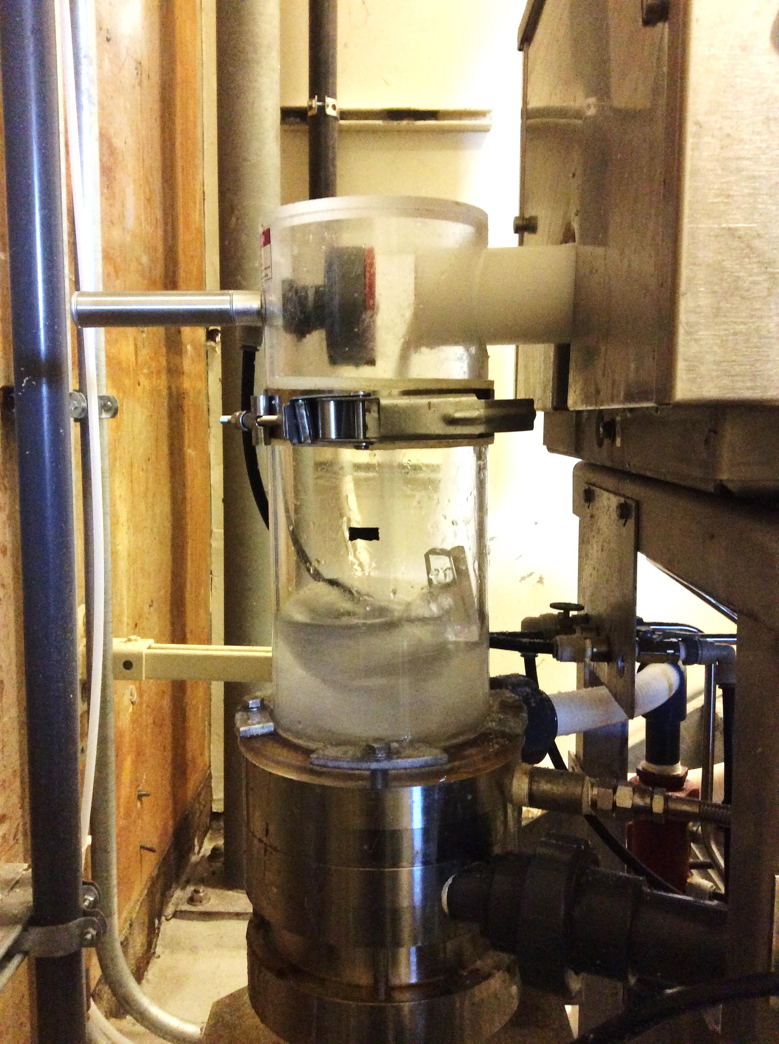
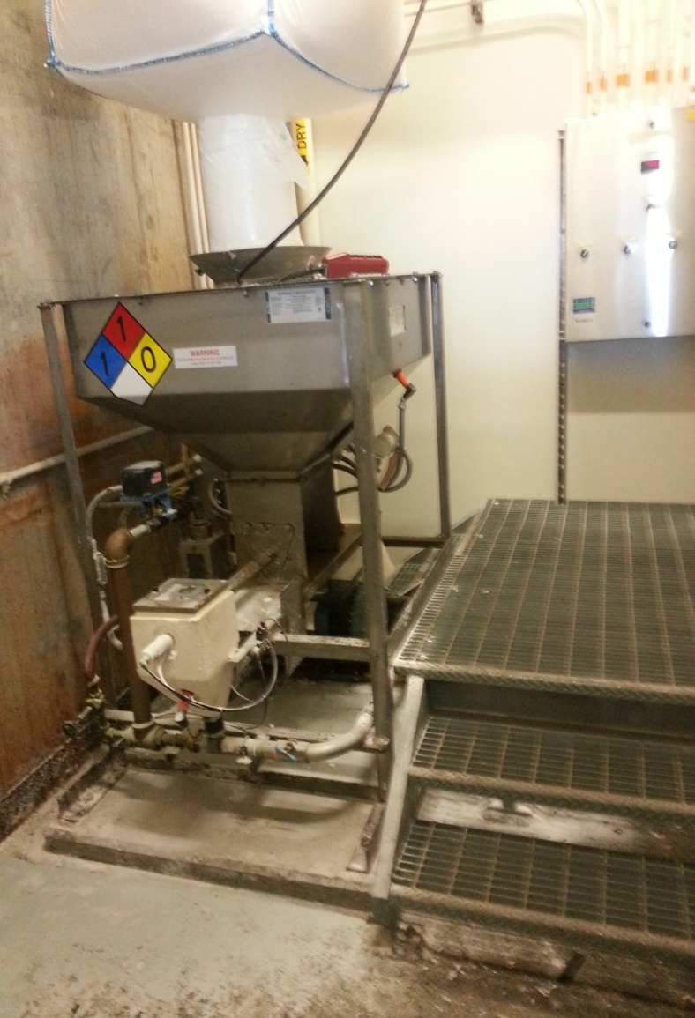
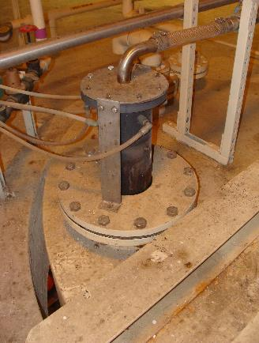
Pilot Testing with Two Polymer Mix Equipment
Existing Polymer System
Initial wetting: air blower –> wetting head
Mixing: two (2) 4,600 gal mix/age tanks
1 hour mixing and 2 - 6 hour aging time
UGSI PolyBlend Dry Polymer System
Initial wetting: high-energy mechanical mixing
Mixing: two (2) 360 gal mix tanks with hollow-blade impeller
20 minute mixing, 10+ minute transfer time

Slide 44
New System (PolyBlend® DP2000) Performance
Polymer Dose, Lb/Dry Ton
Sludge Processed, DT/year
FSSD saved over 40% on Screw Press Polymer in 2016
despite an increase in solids throughput of 18%

Slide 45
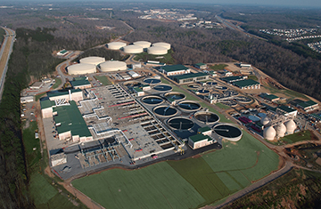
Case Study: Emulsion Polymer System
F. Wayne Hill WRC, Gwinnett County, GA
Design capacity: 60 MGD
Annual cost of polymer is significant ($1.2 million)
  Thickening ~ $400,000 (RDT)
  Dewatering ~ $800,000 (Centrifuge)
SNF/Polydyne Clarifloc SE-873 - Cationic, crosslinked (branched)
Courtesy - Jacobs Engineering and Gwinnett County
Notes:
Existing plant uses FloQuip single stage hydraulic mixing technology that is around 15 years old.
GCDWR hired Jacobs to design improvements to the rotary drum thickener and centrifuge polymer systems that incorporate the two-stage biosolids/polymer blending equipment and new polymer feed pumps along with other auxiliary equipment to enhance the effectiveness of both polymer systems. David Oreke suggested a pilot study be performed to verify which polymer mixing technology would perform best in this scenario.

Slide 46
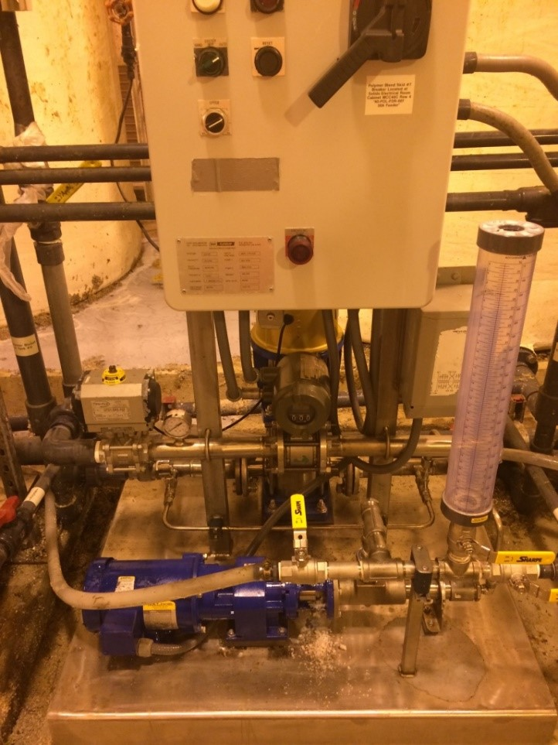
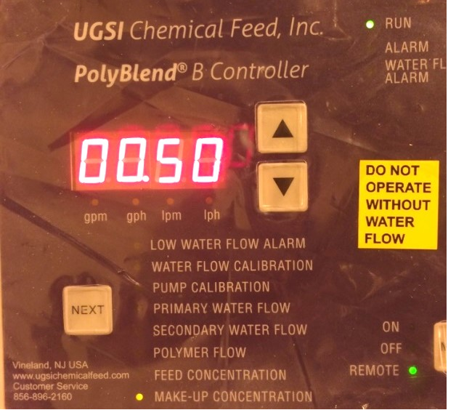
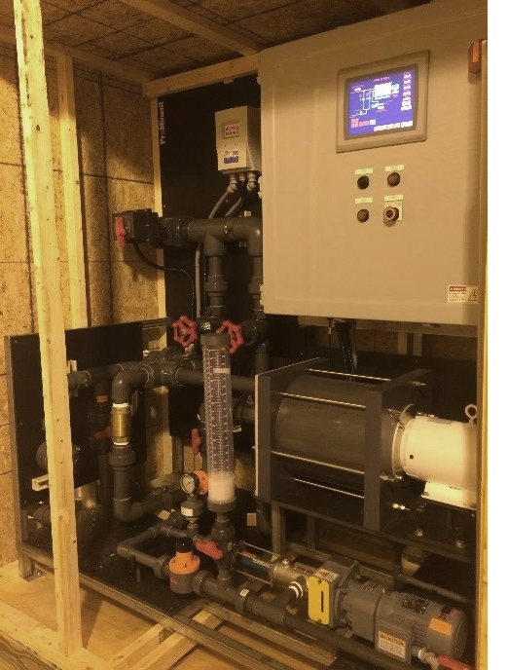
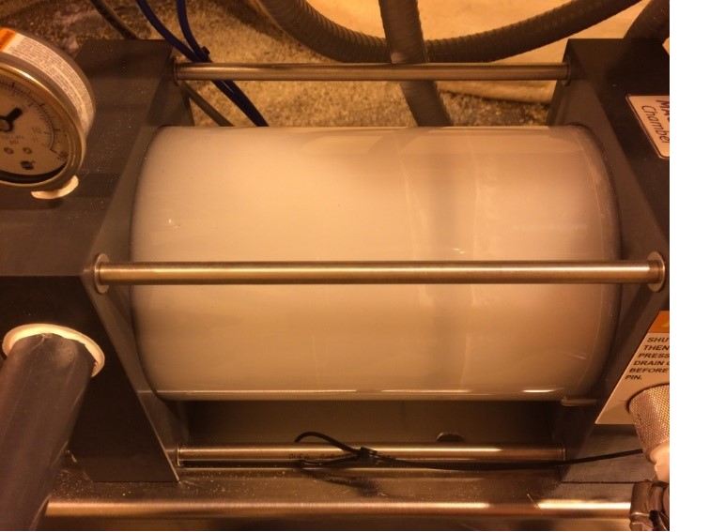
Three Polymer Systems for Pilot Trials
Optimum feed concentration: 0.5% to 0.7%
FloQuip EA70P
(4200 gph/30 gph)
One-stage mixing
Mechanical, 3450 rpm
UGSI MM2400-P30AB (2400 gph/30 gph)
Two-stage mixing
Mechanical, 3450 rpm
ProMix L6000-30P
(6000gph /30 gph)
Three-stage mixing
Mechanical, 1725 rpm
Courtesy - Jacobs Engineering and Gwinnett County

Slide 47
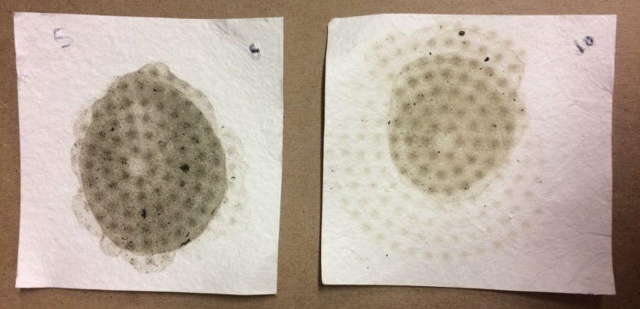
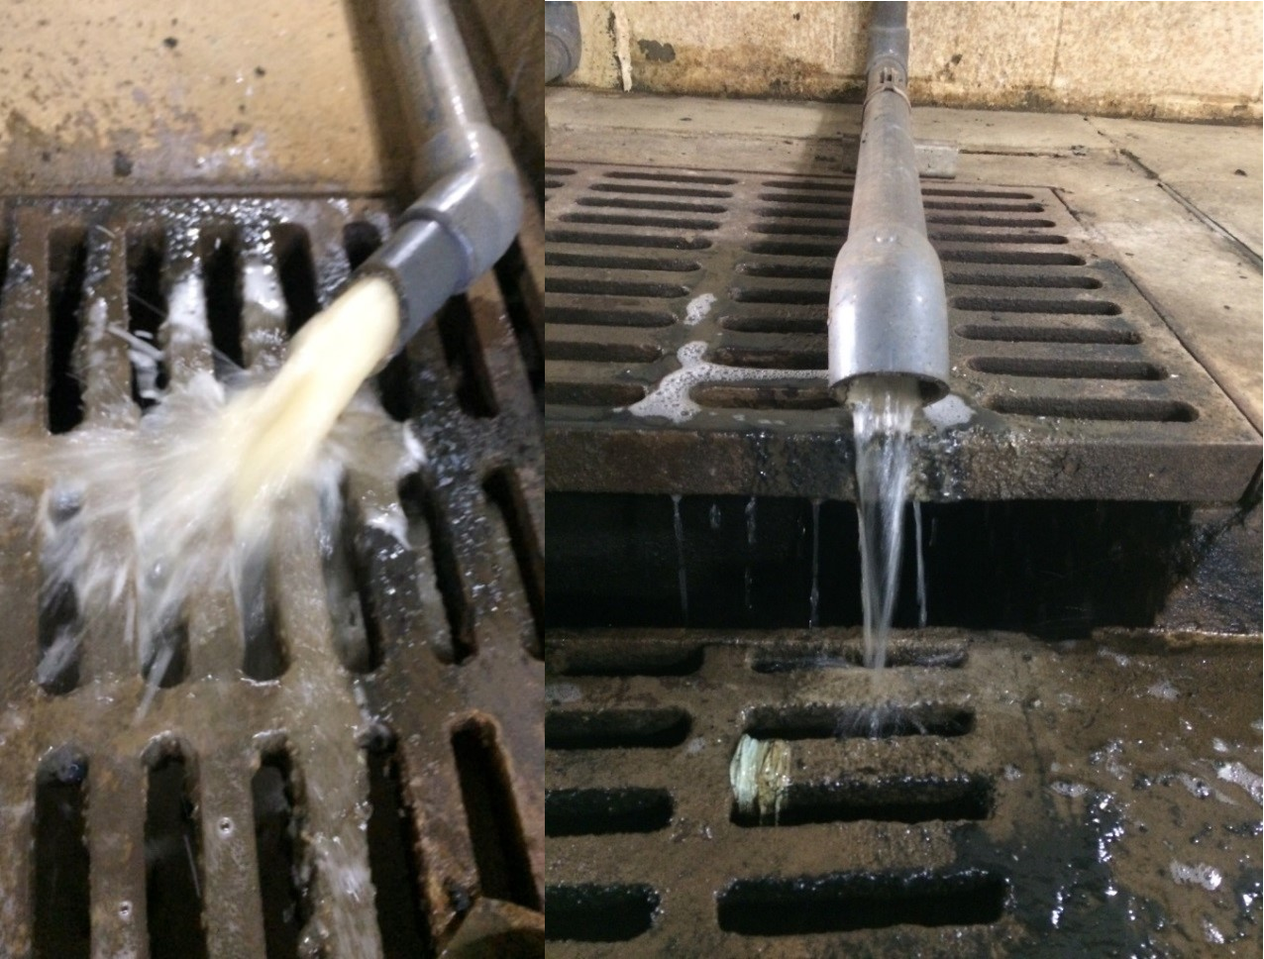
Polymer Dose during Each Pilot Test
Courtesy - Jacobs Engineering and Gwinnett County

Slide 48
Trial results demonstrate that UGSI two-stage mixing provides significant polymer savings vs. FloQuip
(UGSI: 25%, ProMinent: 10%)
Test | Polymer Blending Unit & Centrifuge | Average Polymer Dose (lbact/dT) | Centrifuge Sludge Feed Flow Range (gpm) | Average Dry Cake Solids, TS (%) | Average Centrate TSS (mg/L) | Average Percent Capture (%) | Percent Savings in Polymer Consumption (%)
Pilot 1 | UGSI Polyblend® Centrifuge #10 | 25.7 (± 4.2) | 100 - 180 | 20.4 (± 1.7) | 184.4 (± 48.4) | 99.5 (± 0.1) | 24.18%
 | SNF FloQuip Centrifuge #5 | 33.9 (± 4.1) | 100 - 200 | 21.5 (± 0.8) | 193.5 (± 34.5) | 99.5 (± 0.1) | 0.00%
Pilot 2 | ProMinent® Centrifuge #10 | 28.0 (± 3.2) | 100 - 180 | 20.1 (± 1.8) | 190.6 (± 41.4) | 99.5 (± 0.1) | 10.54%
 | SNF FloQuip Centrifuge #5 | 31.3 (± 1.8) | 100 - 200 | 21.7 (± 1.5) | 183.0 (± 20.2) | 99.5 (± 0.1) | 0.00%
PolyBlend® MM: 25% less polymer dosage, lower centrate TSS than FloQuip.
ProMix® L: 10% less polymer, higher centrate TSS than FloQuip.
PolyBlend® MM is expected to provide an annual savings of $200,000 for dewatering only.
Courtesy - Jacobs Engineering and Gwinnett County
Notes:
This table shows the results of the pilot test. The chart does an excellent job of visually demonstrating how the different mixing profiles performed with an “apples-to-apples” comparison.
Note the following:
The final recommended concentration of the two-stage mixer was .5% vs. .74%
Polymer Dose
Average Dry Cake
Average Centrate TSS
Average percent capture
Recommendations of the engineer:
Replace polymer makeup units. The existing polymer makeup units do not provide the ability to set a desired polymer concentration, and control of the polymer is inconsistent. It is recommended to replace these with one of the products piloted in the dewatering system. These units have features that effectively activate the bulk polymer and provide more advanced controls to set and maintain consistent polymer solution concentration.
Add TSS instrumentation on RDT sludge feed and filtrate. Valmet TSS instrumentation has been successfully used to automate and optimize polymer usage at other utilities. The feed solids to the RDTs varies more than the digested sludge and knowledge of real time solids content could improve both RDT capture and polymer usage. However, it should be noted that significant improvement of the current 8.3 lb/dT (4.2 kg/dMT) average polymer dose is unlikely and cost of the TSS meters may not be recovered in the short term. GCDWR is currently planning a pilot test of the Valmet meters at FWHWRC. It is recommended that the addition of these instruments on the thickening and dewatering polymer system be evaluated after pilot results are obtained.
Do not add aging tanks on thickening polymer system. Replacement of the makeup units will provide sufficient activation of the polymer and better control of polymer solution concentration. It is not believed that the cost savings associated with potential polymer reduction would lead to a timely payback of the cost of installing and maintaining thickening polymer aging tanks.
Conclusion:
Bench- and pilot-scale testing results showed the two-stage pilot equipment used 10 to 25 percent less polymer than the existing one-stage equipment, while producing much cleaner centrate with no decrease in cake solids dryness. Reduction in polymer usage was attributed to improved activation of the polymer solution. Replacing the existing one-stage polymer feed system with a state-of-the-practice two-stage polymer feed system that was successfully pilot tested is anticipated to provide and annual savings of $100,000 to $200,000 (10 to 25 percent polymer savings).

Slide 49
Polymer Sizing References and Demo Program

Slide 50
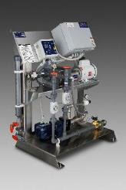
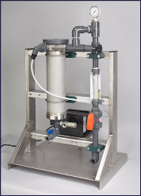
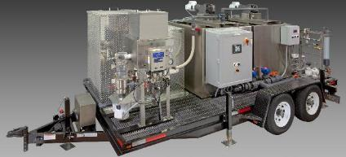
UGSI Demo Program – Savings Customers Can Experience
Inventory of various models – dry and emulsion polymer systems
  Typically 10 emulsion systems in the field in pilots
  Two trailer mounted dry polymer systems available
Highly successful program
  For customers and consulting engineers
  Direct evidence of demonstrated polymer savings
  Case studies available
Notes:
We have demo units for our Liquid POLYBLEND® and Dynblend systems. These demo units are especially helpful if a plant wants to compare a POLYBLEND® system to an existing system.
Fill Out Form – Submit to Your RSM - Minimum of Three Demos Required
Share Demos with Other Customers, Consulting Engineers
Very High Success Rate – They Try It, They Usually Buy it

Slide 51
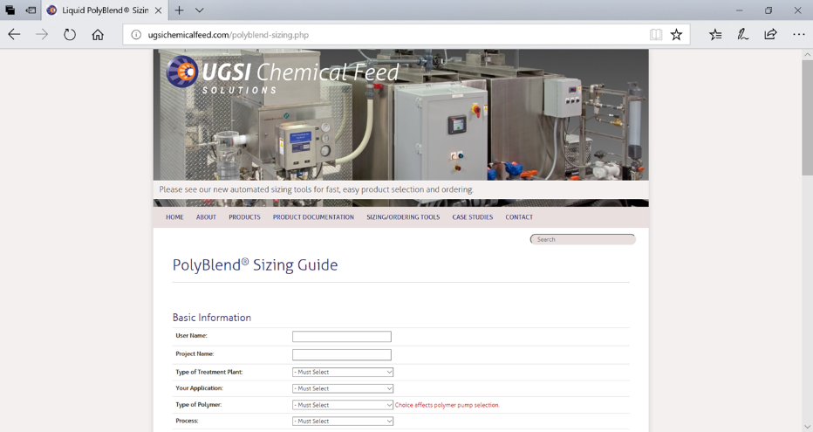
Liquid POLYBLEND® and DYNABLEND™ Polymer Sizing Guide
www.ugsichemicalfeed.com
Notes:
Equipment sizing on website.
Good tool but please do not hesitate to reach out to us.

Slide 52
Using the UGSI Chemical Feed Online Sizing Guide:
Typical polymer dosage for various applications
Sludge Dewatering
* Belt Filter Press: 10 - 15 lb active polymer/ ton of dry solids
* Centrifuge: 20 - 30 lb active polymer/ ton of dry solids
* Screw Press: 20 - 30 lb active polymer/ ton of dry solids
Sludge Thickening
* Gravity Belt Thickener: 4 - 8 lb active polymer/ ton of dry solids
* Diffused Air Floatation: 4 - 8 lb active polymer/ ton of dry solids
Clarification:
0.5 - 5 mg/L
Filtration (filter-aid):
0.05 - 0.1 mg/L
Online Sizing Program: http://ugsichemicalfeed.com/Polyblend-sizing.php
Notes:
Sizing guidance on web site.

Slide 53
Summary
Good quality dilution water will yield to more efficient polymer solution
Emulsion polymer activation
  Two-stage mixing: very high-energy mixing at initial wetting stage is critical to prevent fisheye formation, followed by low-energy mixing to minimize damaging polymer chain.
  Sufficient residence time of low-energy mixing stage is required to achieve fully dissolved homogeneous solution.
  Two-step dilution helps proper polymer activation by maximizing the value of breaker surfactant.
Dry polymer activation
  Implementing two-stage mixing is critical in designing efficient dry polymer mixing system.
  Low-speed and uniform mixing impeller that can prevent Weissenberg effect should be used at the second stage mixing tank.

Slide 54
Thank You
Any Questions?
Gary Schaeffer
Regional Product Manager
609-364-4363
Gschaeffer@ugsicorp.com

