Slide 1

Professional Engineers Laws, Rules & Ethics
PDH Laws & Rules Course
FBPE Provider No. 0004742
Sterling L. Carroll, P.E., M.P.A.
Florida Rural Water Assn
Sterling@frwa.net

Slide 2
Laws & Rules Course
Course conforms to 61G15-22.0105(2), FAC
Approved by Florida Board of Professional Engineers
Combination Presentation & Discussion
Ask questions at any time!

Slide 3
Laws & Rules Agenda
Review of L&R
  Chapter 455, FS – Dept Business Prof Regulation
  Chapter 471, FS – Engineering Practice
  471.025 – Signing, Sealing & Dating
  Rule 61G15, FAC – Florida Board of Prof Engrs
  Recent Case Law, Amended & Repealed Rules
Engineering Professionalism & Ethics

Slide 4
CE / PDH Hours
18 continuing education hours every 2 years renewal
  1 hour Florida PE Laws & Rules
  1 hour Professional Ethics
  4 hours must relate to Area Of Practice
  remaining 12 hours may be related to any topic pertinent to the practice of engineering

Slide 5
CE Record Retention
Rule 61G15-22.008, FAC, Record Keeping
  maintaining sufficient records
  completion of qualifying PDHs
  at least 2 licensure cycles or 4 years
  PE Laws & Rules, Ethics
  Area Of Practice
  pertinent to practice of engineering

Slide 6
CE Record Retention
Rule 61G15-22.006, FAC, Demonstrating Compliance,
  Board will audit at random a number of licensees
  June following a renewal cycle
  receipts, vouchers, certificates, or other papers as may be necessary to document
  respond within 30 days of receipt of notification
CE providers are no longer report CE credits

Slide 7

Signing, Sealing & Dating Engineering Documents
61G15-23.005 Procedures Electronically Signing & Sealing

Slide 8
Signing & Sealing
An engineer using a digital signature must:
Create an electronic version of the document
Compute an SHA‐1 authentication code for each electronic engineering document;
Create a printable “signature report” that contains the licensee’s given name, license number, and table of content for each document;
Print and physically sign, date and seal the “signature report”

Slide 9
Signing & Sealing
An engineer using a digital signature must:
Transmit the signed, dated and sealed “signature report” to the receiving party along with each electronically signed, dated and sealed engineering document either by hardcopy or electronic scan.
Each engineering document is considered to be electronically signed and sealed if the document’s SHA authentication code matches the SHA authentication code on the physically signed, dated and sealed “signature report.”

Slide 10
Signing & Sealing
(4) The affixing of an electronic signature will be equal to the signing and sealing of documents.
(a) A digitally created seal may be placed where it would appear if the item were being physically signed, dated and sealed.

Slide 11
Signing & Sealing
(b) The date of signature must appear on the document where it would appear if the item were being physically signed, dated and sealed.
(c) The documents being electronically signed and sealed should include indicate the place where an original signature would appear if physically signed

Slide 12
Signing & Sealing
The engineering plans, specifications, reports or other documents being electronically signed and sealed shall include text to indicate the following and place it where an original signature would appear if the item were being physically signed, dated and sealed

Slide 13
Signing & Sealing
1. Same info required by 61G15‐23.002(2), FAC if a digitally created seal is not used,
2. The item has been electronically signed and sealed using a SHA authentication codes; and,
3. Printed copies of the document are not considered signed and sealed and all SHA authentication code must be verified on any electronic copies.

Slide 14
Signing & Sealing
(d) Formatting of seals and text similar to that depicted below shall be used. While the formatting may be altered, the text must remain identical.

Slide 15
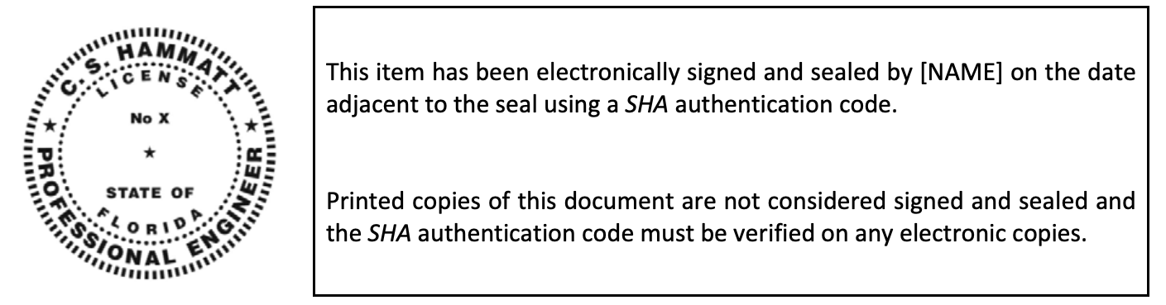
Signing & Sealing
This item has been digitally signed and sealed by Sterling L. Carroll, P.E. on the date adjacent to the seal. Printed copies of this document are not considered signed and sealed and the signature must be verified on any electronic copies.

Slide 16
Stolen Digital PE Stamps?
Watch for and report…
Appears to be happening nationally
  More common in the building industry
  Reuse of Plans / Details with PE seals & signatures copied onto wire-less project plans
  Without PE knowledge / permission

Slide 17
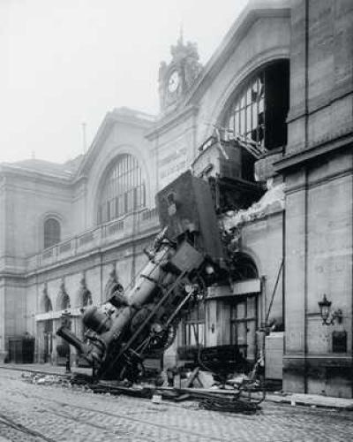
Chapter 455 FS
Licensing Engineers
For the preservation of public health, safety, and welfare.

Slide 18
455 Business & Professional Regulation
455.201 ~ Professions & Occupations
Persons desiring to engage in regulated lawful professions…
  Are entitled to do so as a MATTER OF RIGHT
  If otherwise qualified
Professions regulated…
ONLY for the preservation of the health, safety, and welfare of the public
Under the police powers of the state.

Slide 19
Chapter 471, FS
Engineering Practice
Professional Engineers Act
Establishes the Florida Board of Professional Engineers, to balance public health & safety against against anticompetitive impacts of regulation

Slide 20
Chapter 471 FS
Key Topics
Licensing Organization
  FEMC/FBPE
Rulemaking Authority
Qualifications for Engineers
Examinations/ NCEES
Definition of Engineering
Prohibitions
Entering 3rd Party Lands
Threshold Inspections

Slide 21
Professional Engineers Act
471.005(5) ~ Definitions
"Engineer"
includes the terms
  "Professional Engineer"
  "Licensed Engineer"
Means a person who is licensed to engage in the practice of engineering under Chap 471
"Engineer Intern"
means a person who has graduated from an engineering curriculum approved by the board and
has passed the fundamentals of engineering examination as provided by rules adopted by the board ~ FE Exam

Slide 22
Professional Engineers Act
471.005(7) ~ Definitions
"Engineering"
"Professional Engineering"
means any service or creative work, the adequate performance of which requires engineering education, training, and experience in the application of special knowledge of the mathematical, physical, and engineering sciences to such services or creative work as consultation, investigation, evaluation, planning, and design of engineering works and systems, planning the use of land and water, teaching of the principles and methods of engineering design, engineering surveys, and the inspection of construction for the purpose of determining in general if the work is proceeding in compliance with drawings and specifications, any of which embraces such services or work, either public or private, in connection with any utilities, structures, buildings, machines, equipment, processes, work systems, projects, and industrial or consumer products or equipment of a mechanical, electrical, hydraulic, pneumatic, or thermal nature, insofar as they involve safeguarding life, health, or property; and includes such other professional services as may be necessary to the planning, progress, and completion of any engineering services. A person who practices any branch of engineering; who, by verbal claim, sign, advertisement, letterhead, or card, or in any other way, represents himself or herself to be an engineer or, through the use of some other title, implies that he or she is an engineer or that he or she is licensed under this chapter; or who holds himself or herself out as able to perform, or does perform, any engineering service or work or any other service designated by the practitioner which is recognized as engineering shall be construed to practice or offer to practice engineering within the meaning and intent of this chapter.

Slide 23
Professional Engineers Act
471.027 ~ Entering Lands
Engineers authorized to enter lands of third parties under certain conditions / purposes
  Right granted permission and authority
  To go on, over, and upon the lands of others
  When necessary to make engineering surveys
  To carry with them agents & employees
Entry does not constitute trespass
  Engineers and duly authorized agents / employees
  Shall not be liable to arrest or civil action
Do NOT destroy, injure, damage, or move anything on lands of another without written permission of landowner

Slide 25
Professional Engineering Ethics
Ethical Behavior

Slide 26
Engineering Ethics?
What is it?
The study of moral decisions that must be made by engineers in the course of engineering practice
For the preservation of the health, safety, and welfare of the public…
What study it?
To find reasonable options to ethical dilemmas
  Options may not be Obvious
  There may NOT be a Correct Option
May involve conflicting ethical principles

Slide 27
Challenges of Life
For most of life’s dilemmas doing what we think / feel is right is more than adequate…
However when there is a head-on collision over contending values, principles, and consequences the nominal self-sufficiency we have always used may not provide the critical analysis and options we may need to consider.

Slide 28
Engineering Code of Ethics
Accreditation Board for Engineering & Technology
National Society of Professional Engineers
American Society of Civil Engineers
American Society of Mechanical Engineers
Institute of Electrical and Electronics Engineers
American Institute of Chemical Engineers
The National Institute for Engineering Ethics
American Consulting Engineers Council

Slide 29
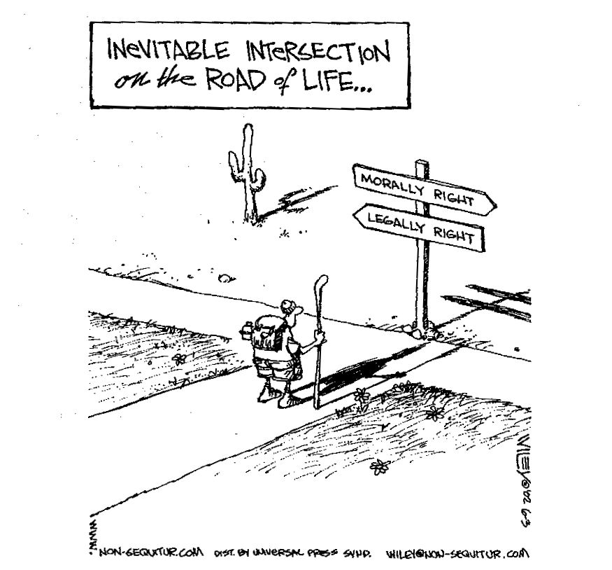
Engineering Ethics in the Real World

Slide 30
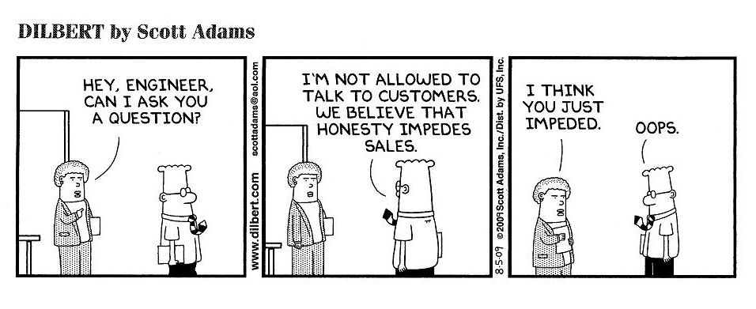
Dilbert on Ethics

Slide 31
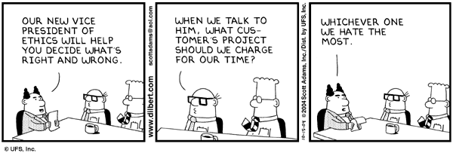
Pointy Haired Boss on Ethics

Slide 32
Morals, a definition:
Morality is defined by the Stanford Encyclopedia of Philosophy as
“a code of conduct put forward by a society, …accepted by an individual for her own behavior, or normatively to refer to a code of conduct that, given specified conditions, would be put forward by all rational persons.”
Morals refer to behavior customary in our culture or society. Morals may change as you move from one society to the next.
A
R
U
R
A
L
I
D
W
R
A
O
T
L
F
E
F
R
W
R
Laws, Rules & Ethics 2021, Slide 32
A
A
N
S
S
O
C
I
A
T
I
O

Slide 33
Ethics, a definition:
Ethics is the “study of morals”
“a set of moral principles: a theory or system of moral values”
  Merriam-Webster Dictionary
Ethics are the standards of conduct, or personal principles of what is considered good or bad, right or wrong, and valuable or worthless.
“ethics tell people to do things they don’t want to do” Rachels p. 43-44

Slide 34
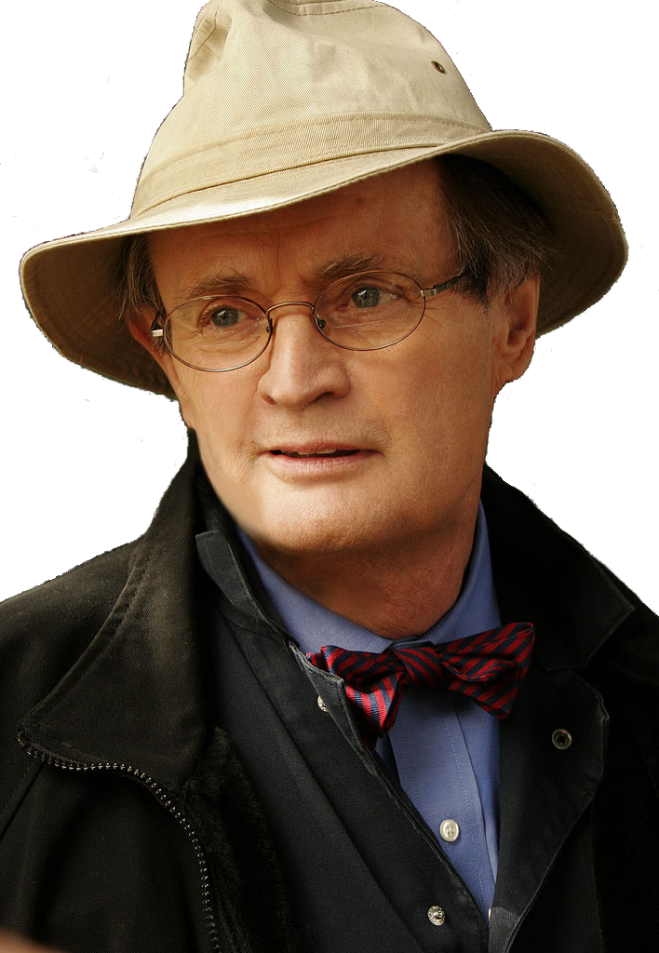
Morals vs. Ethics
A moral man knows that he should not cheat on his wife,
An ethical man doesn’t.
NCIS (Naval Criminal Investigative Service), a CBS television show (- - -, 2006, Sept 26). Doctor ‘Ducky’ Mallard is being quizzed for a Master's degree oral exam in Forensic Psychology by Jimmy Palmer.

Slide 35
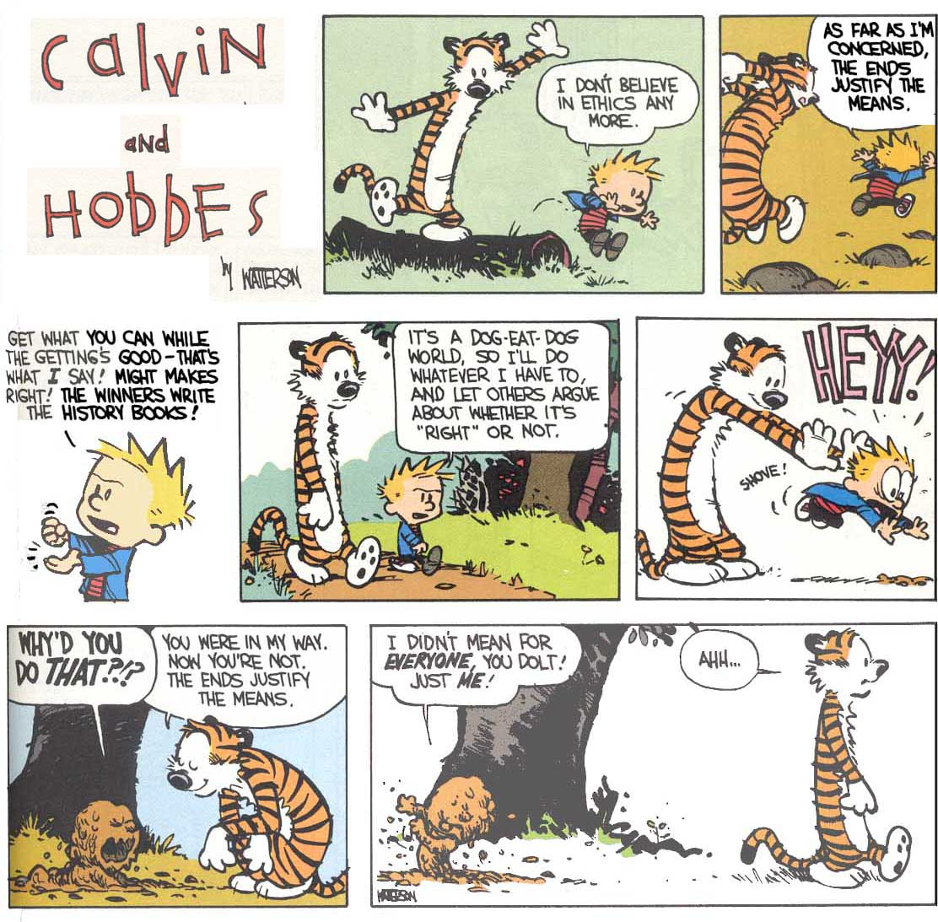
Calvin & Hobbes on Ethics

Slide 39
Major Ethical Models
Three Major Approaches in Normative Ethics
Virtue Ethics ~ Aristotle
  What kind of person should we be? (in terms of character traits) Integrity
Duty-Based Ethics ~ Deontological, Kant
  What ought we do? Justice & Fairness
Results-Based Ethics ~ Utilitarianism, Teleological
  What actions are good? Of all the things a person might do at any given moment, the morally right action is the one with the best overall consequences. Greatest Good
A
R
U
R
A
L
I
D
W
R
A
O
T
L
F
E
F
R
W
R
Laws, Rules & Ethics 2021, Slide 39
A
A
N
S
S
O
C
I
A
T
I
O

Slide 40
Virtue Ethics ~ Aristotle
What kind of person should we be?
  In terms of character traits
Virtue ethics is "Agent-Centered"
  rather than "act-centered"
Dynamic and virtuous character traits enable an individual to see what is best or required, and act appropriately, in a wide range of circumstances.

Slide 41
Duty-Based Ethics ~ Deontological
What ought we do?
Deontological (duty-based) ethics are concerned with what people do, not with the consequences of their actions.
  Do the right thing.
    Do it because it's the right thing to do.
  Don't do wrong things.
    Avoid them because they are wrong.

Slide 42
Duty-Based Ethics ~ Deontological
Follows moral rules such as…
  Do unto others as you would be done by
  Choices are either
    Morally Required,
    Forbidden, or
    Permitted.
  Categorical Imperative
    Is an absolute, unconditional requirement that allows no exceptions commanding a certain course of action

Slide 43
Results-Based Ethics ~ Utilitarianism, Teleological
What actions are good?
  Of all the things a person might do at any given moment, the morally right action is the one with the best overall consequences.
Utilitarianism is based on 2 principles:
  Whether an act is right or wrong depends only on the results of that act
  The more good consequences an act produces, the better or more right that act

Slide 44
A final thought about
Ethical Models taken to Extremes
Virtue Ethics ~ Integrity
  Exclusive focus on virtues – courage, moderation…
  Blindly following a mentor / the crowd – Everybody does it
  Refusing to consider all perspectives – I can’t be bought …
Duty-Based Ethics ~ Justice & Fairness
  Blindly following orders or standard practices / traditions
  Rigid application of the RULES
  Letter rather than Spirit of law (to justify actions…)
Results-Based Ethics ~ Greatest Good
  Expediency – devaluing societal outcasts / human life
  Self-serving behavior & self-gratification – hedonism

Slide 45
Balancing Ethical Approaches
Contemporary democratic society has been unwilling or unable to reconcile the duty-based and results-based traditions or choose between them.
  Cognitive Approaches
  Results or Rules
However, the virtue or character of the Professional Engineer is assumed in most philosophical discussions.
A
R
U
R
A
L
I
D
W
R
A
O
T
L
F
E
F
R
W
R
Laws, Rules & Ethics 2021, Slide 45
Lewis, C.W., & Gilman, S.C., (2005). The Ethics Challenges in Public Service. Jossey-Bass, p. 126
A
A
N
S
S
O
C
I
A
T
I
O

Slide 46
Balancing Ethical Approaches
Virtue Ethics Aristotle
Balancing Traditions
Results-Based Ethics Utilitarianism, Teleological
Duty-Based Ethics Deontological
Immanuel Kant

Slide 47
Using Ethical Models
Three Major Approaches in Normative Ethics
Multivariate approach to decision-making using all three major philosophical approaches.
Use the three diverse schools of thought to evaluate, filter, consider, and develop a single solution that concurs or makes sense with them all, then the solution may be used with a degree of confidence.

Slide 48
Questions Using Ethical Models
Three Major Approaches in Normative Ethics
Virtue Ethics
  What kind of person should we be?
Duty-Based Ethics
  What ought we do?
Results-Based Ethics
  What actions are good?
A
R
U
R
A
L
I
D
W
R
A
O
T
L
F
E
F
R
W
R
Laws, Rules & Ethics 2021, Slide 48
A
A
N
S
S
O
C
I
A
T
I
O

Slide 49
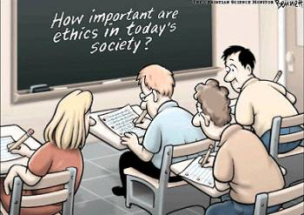
Ethics Test
QUESTIONS?
A
R
U
R
A
L
I
D
W
R
A
O
T
L
F
E
F
R
W
R
Laws, Rules & Ethics 2021, Slide 49
A
A
N
S
S
O
C
I
A
T
I
O

Slide 50
Engineering Ethics Case Studies
The Rainy Night &
Public Works Consulting

Slide 51
Ethical Case Study #1
The Rainy Night
It’s a night not fit anyone sane to be out – it's wet, late, and bone chilling cold. This is weather where you can see your own breath. You pull into the deserted parking lot. The rain is pounding on the windshield; no wonder no one is there at the convenience store.
You must run in for one moment to pick up a carton of milk. The vacant parking space right in front of the quickie mart entrance is reserved for handicapped parking and you do not qualify. It starts to rain harder and you forgot your umbrella.
What is the ethical choice?
What should you think about?

Slide 52
Ethical Case Study #Duex
Public Works Consulting
An influential community leader lets you know that you are expected to sign off on a shoddily completed public works job by an independent contractor who has political connections in towns across the state.
You suppose that this leader sincerely wants to avoid a public ruckus that would embarrass your municipality and believes that a possible malfunction wouldn’t really hurt anyone.
Although you genuinely disapprove, as a sole-supporting, single parent you can ill-afford the luxury of intemperate indignation or sentimentality.
How should you handle this?

Slide 53
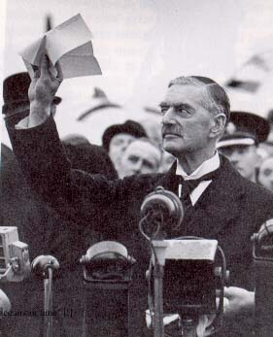
Balancing Major Approaches
Using Ethical Approaches to Finding Answers
You might be able to strike a compromise.
But beware of the easy victory.

