Slide 1
Notes:
Economic overview – May 2026:
The economy is growing around its long-term potential of 2%. Growth was 2.1% in 2025. Growth in Q1 was 1.6%. The economy grew faster than that in 2023 and 2024.
The economy has withstood the headwinds of tariffs and immigration restrictions, which clamped down on workforce growth, but the economy would be growing over 3% without those impediments.
The Iran war is another major headwind. We are fortunate to have a resilient economy that exists because of our Free Enterprise system. Other countries would have no growth if facing the headwinds we've imposed on our economy, never mind 2%.
The long-term impacts of the war still aren't fully apparent. The longer it drags out the worse it will be for the global economy. The impact in the U.S. is probably a few tenths of percentage points of lost growth in Q2. The primary reason for slower growth is because of the downstream impacts of higher energy prices and less available oil.
Consumers and businesses say the economy isn't doing well. Affordability for families and higher input prices and policy uncertainty for businesses helps explain why they feel the economy is bad despite steady growth.
Tariffs are continuing to make their way into prices as businesses continue to work through the huge stock of inventory they bought in Q1 of 2025 to get ahead of the tariffs.
Inflation was 3.8% annually in April. On a monthly basis, it was up 0.6%.
The inflation metric the Fed watches most, Core PCE was 3.2% in March, still well above the 2% target.
There are no rate cuts coming from the Fed soon. This sets up a potential early clash between the President and Fed Chair nominees Kevin Warsh.
On an annual basis, wages are surpassing inflation, which is helping to keep consumer spending strong.
Retail sales for April were strong, even after discounting higher gas prices.
Total consumer spending was strong in March too.
We added 115,000 jobs in April.
Demographic changes (immigration restrictions and an aging society) are driving down the available labor pool. Analysts haven't fully adjusted to the fact that to keep the unemployment rate steady we need to create about one-third the jobs each month we previously had to generate. For instance, before recently 50,000 jobs created in a month would've been a very bad sign, now it's the upper end of what will be the new status quo. This combined with economic uncertainty and the continuing adoption of AI makes pinning down what's occurring in the labor market in any given month extremely difficult.

Slide 2
Curtis Dubay
Chief Economist, U.S. Chamber of Commerce
cdubay@uschamber.com

Slide 3
Growth is Steady, but Slower than in 2023 and 2024
Notes:
The economy grew 1.6% in the first quarter. A recession is not imminent, but growth has slowed.
Source: Bureau of Economic Analysis

Slide 4
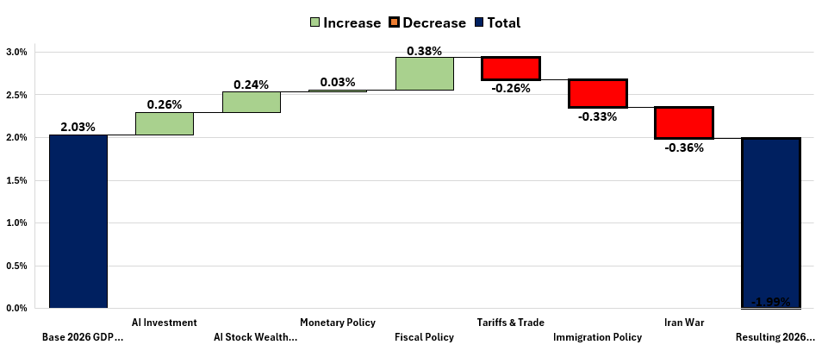
Forecast Sources of Change in 2026 Real GDP Growth
Source: Moody’s Analytics
1.99%
Before Negative Contributions: 2.94%
After Negative Contributions from Trade and Immigration: 2.35%

Slide 5
Consumer Sentiment Down Again in May – Lowest on Record
Notes:
Consumer Sentiment was down in May for the third straight month. This comes after three consecutive monthly increases previously.
“﻿﻿﻿﻿﻿﻿﻿﻿﻿﻿﻿﻿﻿﻿Consumer sentiment fell for the third straight month as supply disruptions in the Strait of Hormuz continue to boost gasoline prices. Sentiment is now just below the previous historical trough seen in June 2022. The cost of living continues to be a first-order concern, with 57% of consumers spontaneously mentioning that high prices were eroding their personal finances, up from 50% last month. Lower-income consumers and those without college degrees posted particularly strong sentiment declines; these groups are more sensitive to increases in the cost of gas and other essentials. Independents and Republicans saw decreases in sentiment, with both groups reaching their lowest readings of the current presidential administration. Meanwhile, sentiment of Democrats was little changed from last month. Critically, consumers appear worried that inflation will increase and proliferate beyond fuel prices, even in the long run.”
Source: University of Michigan - see: http://www.sca.isr.umich.edu/

Slide 6
Small Business Optimism Steady in April – Remains Below 52-Year Average
52-year average
Notes:
Small business optimism was steady in april.
It is below its 50-year average for the second straight month.
“The Small Business Optimism Index for April was 95.9, up 0.1 points from March and below its 52-year average of 98.0. Of the 10 Optimism Index components, seven increased and three decreased. Earnings trends improved, but were offset by a deterioration in expected business conditions...In April, when more small business owners reported paying higher interest rates on their loans, the market raised those rates, not the Fed. The frequency of price increases for goods and services also rose, adding more to inflationary pressures. The percent making capital outlays is down nine percentage points so far this year; there doesn’t appear to be an AI investment surge on Main Street. With the April 15 Tax Day behind us, the benefits of the OBBB should start to feed into the private sector, and perhaps capital spending will respond later in the year as owners sort out the actual changes in the bill. Corporate profits are booming and the stock markets are hitting records, so hopefully Main Street will follow. But consumers have been “quiet”; sales are lagging, and hiring is weak. Consumer and Small Business Optimism are weak. Many uncertainties remain unresolved, but this process will likely get underway over the next few months.”
https://www.nfib.com/wp-content/uploads/2026/05/NFIB-SBET-Report-April-2026.pdf

Slide 7
Manufacturing Sentiment Stayed in Growth Territory in April – Fourth Straight Month
Notes:
Manufacturer’s sentiment stayed above 50 in April for the fourth straight month and only the 6th time in the last 41 months. A reading below 50 means the manufacturing sector is contracting; above expanding.
The 52.7 reading in April is consistent with 1.8% growth in the overall economy.
The slump in manufacturing had been persistent since it hit highest level in 37 years in March 2021.
Source: ISM

Slide 8
Services Optimism Down Slightly in April– Still in Growth Territory
Notes:
Optimism in the service sector was down in April, from 54 in March to 53.6 in April. Above 50 means the service sector is growing, below contracting.
The 53.6 reading is consistent with 1.7% growth in the overall economy.
Source: ISM

Slide 9
Consumer Spending Up in April, but Fell Behind High Inflation
Notes:
Consumer spending was up 0.5% before inflation in April.
Real (accounting for inflation) spending was up 0.1% because inflation was 0.4%.
Inflation-adjusted spending on goods was -.01% (durables -0.6% & nondurables +.02%). Real spending on services was up 0.2%.
The strength of consumer spending remains impressive given all they’re facing.
Source: Bureau of Economic Analysis

Slide 10
High Income Earners Spending Rising Faster than Middle and Low-Income Consumers
Notes:
Spending by the top income group has risen faster than spending for middle and low-income consumers.
Source: New York Federal Reserve: https://libertystreeteconomics.newyorkfed.org/2026/05/tracking-the-k-shaped-economy-whos-driving-spending/

Slide 11
Wages were Growing Faster than Inflation
Notes:
Wage growth remains strong and is running above inflation on an annual basis. This has been the case each month since May 2023.
Wages grew 3.6% on an annual basis in April; inflation rose 3.8%.
The growth in real wages is buttressing spending.
Caveat: Cumulative since March of 2021, when inflation first took off: Wages +24.5%; Inflation +25.4%. The gap has closed, but prices are way up from where they were and people notice that more than they notice their wages have risen commensurately.

Slide 12
Credit Card and Auto Loan Delinquencies Rising
% of Balance 90+ Days Delinquent

Slide 13
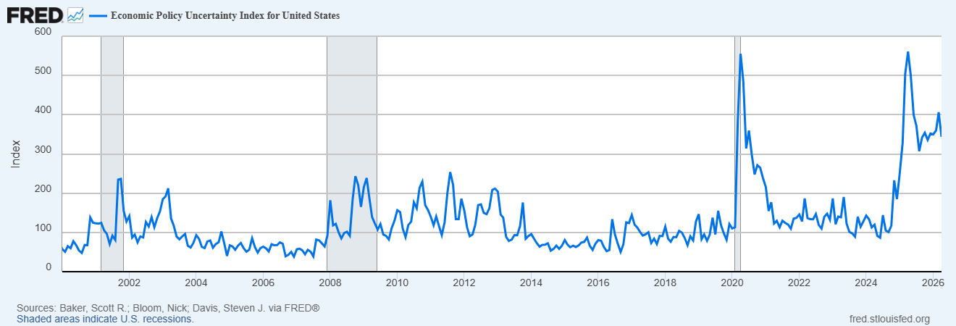
Economic Policy Uncertainty at Financial Crisis and Covid Levels
Notes:
Source: https://fred.stlouisfed.org/series/USEPUINDXD

Slide 14
Tariff Costs Continue to Move to Consumers
Source: Goldman Sachs

Slide 15
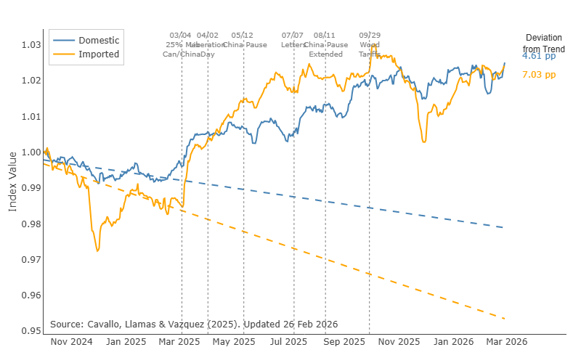
Tariffs are Raising the Prices of Imported and Domestic Goods
Notes:
Source: The Pricing Lab: https://www.pricinglab.org/tariff-tracker/

Slide 16
There were 373,000 More Unemployed Workers than Job Openings in March
Notes:
Job openings were 6.9 million at the end of March.
That is -56,000 less than in February.
There were 373,000 more unemployed workers than job openings.
Hiring was still strong in March at 5.6 million new hires, up 655,000 from February.
Separations were similar as in February, up 356,000, to almost 5.4 million.
Quits were up 125,000
Layoffs were up 153,000
Other separations were up 76,000 (Other Separations includes retirements; transfers to other locations; deaths; or separations due to employee disability.)
The labor market isn’t as tight as it was, but businesses are still hiring and workers are still confident they can quit their current jobs and find better ones. More importantly for the current environment, businesses are still not laying off workers in large numbers.
Worker Shortage Index number (used to be Worker Availability Ratio) was 1.3 in March. (There are 1.3 workers for every available position in the economy.)
Source: BLS

Slide 17
We are Short more than 4 Million Workers From Population Factors
Notes:
Chamber’s take on the jobs report:
The April jobs report is encouraging because the economy added 115,000 jobs. Expectations were for 55,000, so this was much higher.
The labor market is exceptionally volatile right now. We had a bad month in February (-156,000) but added a substantial number of jobs in January (+160,000), March (+185,000), and now April (+115,000). We’ve added 304,000 jobs in total this year.
There is always churn in the labor market, but we are in a period of exceptionally high disruption for three reasons:
AI-driven productivity and automation may be dampening hiring growth in some roles, while adding jobs in more value-adding positions. The net impact of this is uncertain right now;
Tariffs and trade uncertainty are still weighing on particular sectors (manufacturing and construction in April); and
Slower population growth and reduced immigration are shrinking the pace of labor force growth.
These factors on their own have enormous impacts on job creation and destruction. All three happening at once makes drawing large conclusions about where we are and where we are going incredibly difficult.
We’ve had three strong months of job gains out of four so far in 2026, which is undoubtedly good. But because of the high degree of volatility, we can’t confidently say future months will follow suit.
Further, the household survey (different from the survey that gives us the topline jobs gained or lost each month) was weak in April. It showed lots of people leaving the labor force and fewer workers employed. So it’s possible April wasn’t as strong as the headline 115,000 jobs gained. We won’t know until further revisions.
Key Data Points:
Jobs Gained: 115,000
Wages: Wages rose 0.16% from March and 3.6% from April 2025.
Labor Force: The labor force contracted by -92,000 and the participation rate declined. 188,000 workers left the market.
Industry: Healthcare lead the way in April followed wholesale and retail trade. Tariffs are still dampening job growth in construction and manufacturing. Manufacturing is down -66,000 over the last year.

Slide 18
Consumer Prices Rose 3.8% Annually in April – Gas Prices Caused the Spike
Notes:
Chamber’s viewpoint on inflation:
Inflation rose further in April because of the continuing increase in gas prices caused by the Iran war. Taking out food and energy prices, inflation remains moderate but is not falling fast enough to the Fed’s 2% target, in part because of tariffs.
Inflation was 0.6% from March to April. Market expectations were for 0.6%, so this was on par. Annually, prices rose 3.8%, which was well above the 3.3% rate in March. Removing food and energy prices, inflation rose 2.8% in April. This is still too high even if it’s not as concerning as when factoring in gas prices.
People’s concern about affordability will remain strong because the prices of necessities, housing, food, clothing, electricity, and healthcare are rising at high rates. Housing rose 3.3% on an annual basis, food 3.2%, clothing 4.2%, electricity 6.1%, and healthcare 3.2%. All of these, in addition to straining family budgets, are keeping the overall rate of inflation from falling to Fed’s 2% target.
Tariffs continue to increase inflation, particularly for some essentials like clothing and housing, which are both subject to tariffs. Medical prices are affected by tariffs too, which amplifies the long-term rise that has plagued the health system.
The Fed cut interest rates a few times at the end of 2025. The April inflation data shows inflation isn’t falling as much as needed to cut rates again in the near-term, even when looking through gas prices. Expect the Fed to hold tight for a few more months on any additional cuts. In their most recent forward guidance, the Board signaled they are unlikely to lower rates any time soon and may have to consider raising them sooner than cutting them.

Slide 19
Core PCE Inflation Up in March - Still Well Above Fed’s 2% Target
Notes:
Core PCE is the key metric the Fed looks at, not CPI.
Core PCE was creeping down but has been stuck for several months. It was 3.3% as of April, still above the 2% target.

Slide 20
Productivity Growth is Strong- Running Ahead of Rising Labor Costs
Notes:
Productivity rose 2.9% in Q1 2026 compared to Q1 2025.
Productivity growth is a sign of a strong and growing economy and the U.S. economy has it in a big way.
Productivity is calculated by dividing the amount of production in the economy by the number of hours workers labored. It is a vital economic metric because when productivity is up that means workers’ efficiency is rising. This allows businesses to pay their workers more while also increasing profitability, as long as productivity growth exceeds the rise in labor costs.
Productivity and wage growth have tracked closely since mid-2023. This is a sign that despite their high wages, workers are earning enough to justify their higher costs.
The recent robust productivity growth is a really encouraging for the economy. Christine Lagarde, President European Central Bank: “It’s just mind boggling. Productivity in the United States between 2019 and now has been 6 percent. Europe, 0.6 percent.” (https://www.cfr.org/event/conversation-christine-lagarde-0)
All of these are signs that the economy is prospering and the benefits are widely shared among workers and businesses.

Slide 21
Average 30 Year Fixed Mortgage Rate
Below Recent Highs (6.3% as of 4/30/26)
Notes:
As the Fed raised the rate it controls, the Fed Funds rate, interest rates for consumers and businesses rose.
The rate on an average 30-year fixed mortgage had risen sharply compared to early 2022. It is starting to come down now that the Fed is cutting rates.
It is 6.3% as of 4/30/26.
It was 3.2% as of 1/1/22.
It should come down more as the Fed lowers its target rate furter, but fears about long-term U.S. government debt have kept market rates, including mortgage rates, from dropping.
This has caused home prices to stop rising as much as they were, but demand remains strong and prices are rising again despite the higher mortgage rates.
A similar effect will occur with other items that consumers typically use credit to buy. A partial list: using credit card less for everyday expenses; home repairs; home remodeling; cars; car repairs; expensive electronics like computers and televisions; appliances like refrigerators, dishwashers, washing machines and dryers; furniture and other home furnishings; recreational vehicles, boats; trailers; vacations; and education; and fewer personal loans for other expenses they need cash for.
This will bring demand down and prices.

Slide 22
Home Prices are Rising – But at a Slower Pace
Notes:
Home prices on an annual basis are rising, but at a slower pace. They rose only 0.7% on an annual basis in March.
From February to March prices rose 0.7%.
Source: Case-Shiller Index

Slide 23
Curtis Dubay
Chief Economist, U.S. Chamber of Commerce
cdubay@uschamber.com

