Slide 1
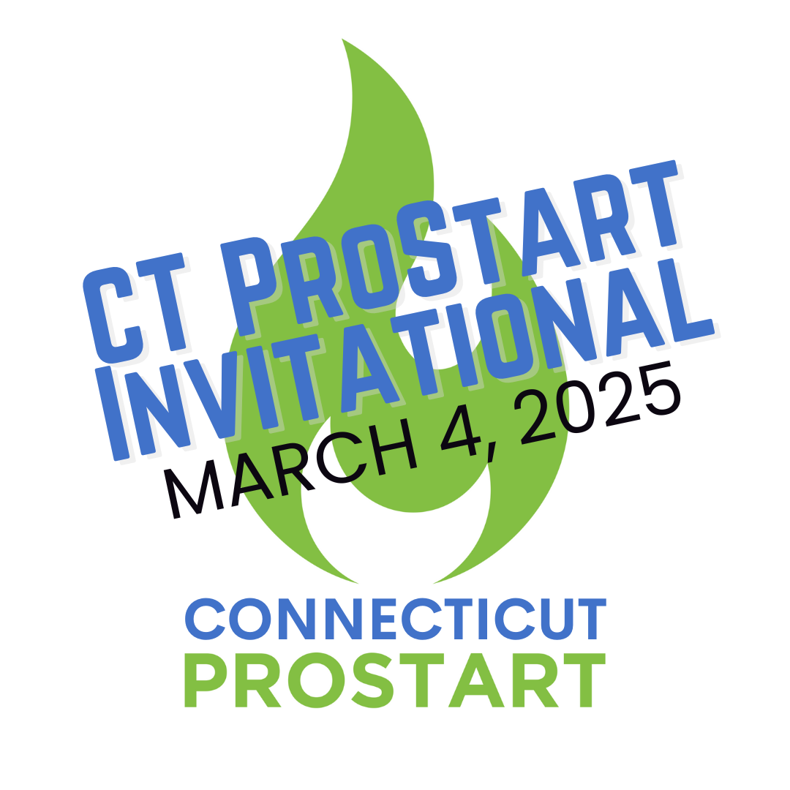
ProStart Feeding Dreams. Building Futures.

Slide 2
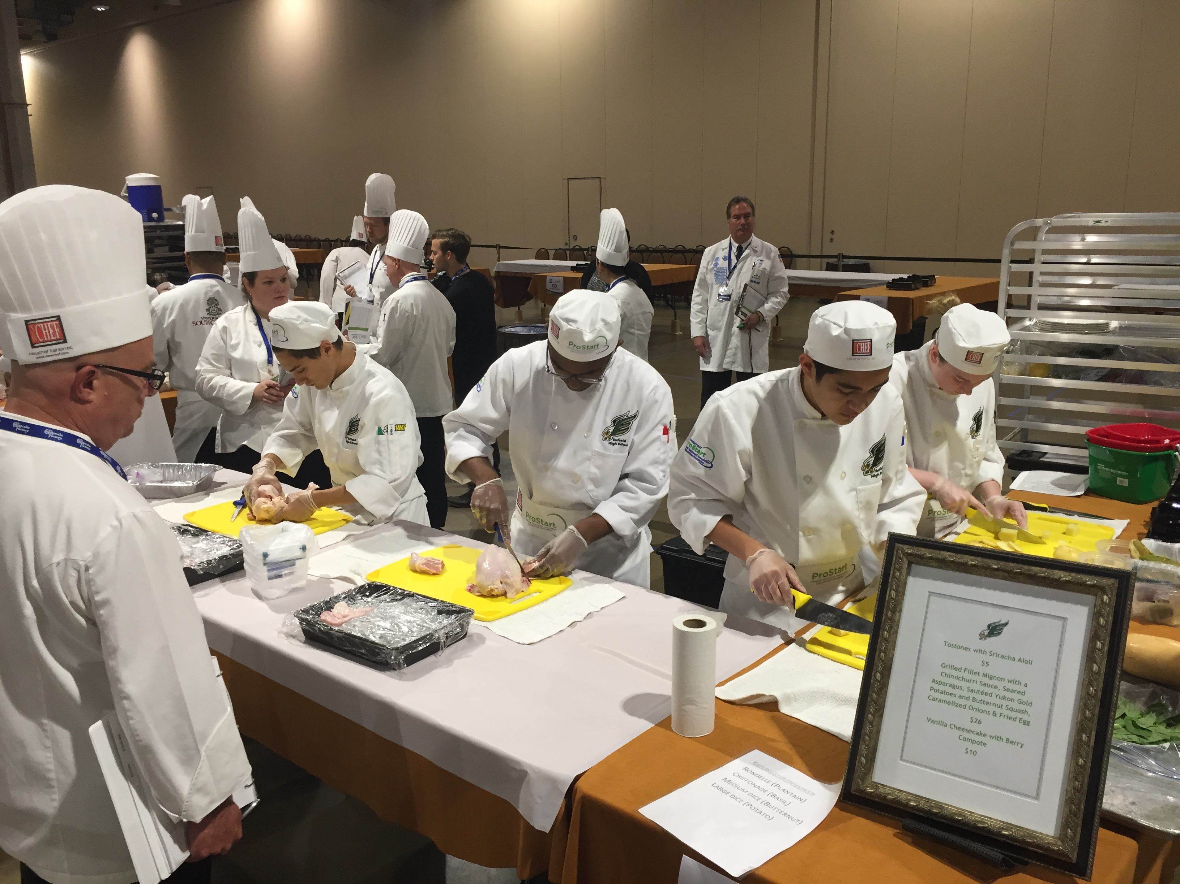
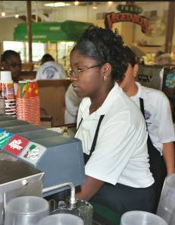
What is ProStart?
Nationwide, 2-year program
Prepares students to be tomorrow’s industry leaders
The only high school curriculum that covers both culinary and restaurant management.
Gives real-world experience and builds practical skills
Makes college more accessible and affordable

Slide 3
Where We Are – ProStart States and Schools
You’ll Join an Elite Group▬A Nationwide Movement!
States & territories: All 50 States, Guam & District of Columbia
Students enrolled: 214,000+
High schools Nationwide: 2,100+
2024-25 school year CT high schools:
Over 3,000 students at 24 high schools:
Berlin High School
Brien McMahon High School (Norwalk)
Bristol Central High School
Cheshire High School
Conard High School (West Hartford)
Crosby High School (Waterbury)
Enfield High School
Farmington High School
Fitch High School (Groton)
Hall High School (West Hartford)
Newington High School
New Haven Adult Education Center
New London High School
Newington High School
Norwich Free Academy
Simsbury High School
Stamford High School
Stonington High School
Terryville High School
Waterford High School
Wilby High School (Waterbury)
Wilbur Cross High School (New Haven) Windsor High School
Torrington High School
Tourtelotte Memorial High School (Thompson

Slide 4
Connecticut ProStart Invitational….. #RoadtoNPSI

Slide 5
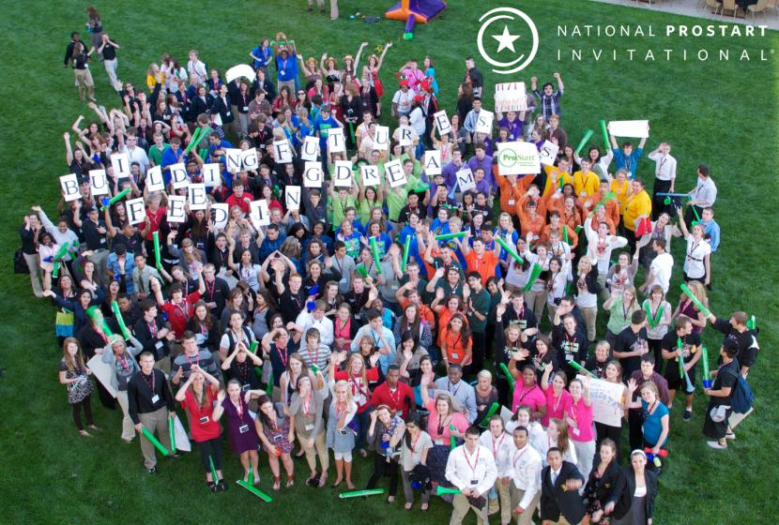
Connecticut ProStart Invitational
6 Culinary Teams from 5 High Schools
Enfield High School
Norwich Free Academy (2 teams)
Simsbury High School
Wilbur Cross High School (New Haven)
Windsor High School
2 Management Teams
Enfield High School
Wilbur Cross High School
Culinary and Management compete at the same time
Scholarships for 1st, 2nd and 3rd place = $420,000 in offers

Slide 6
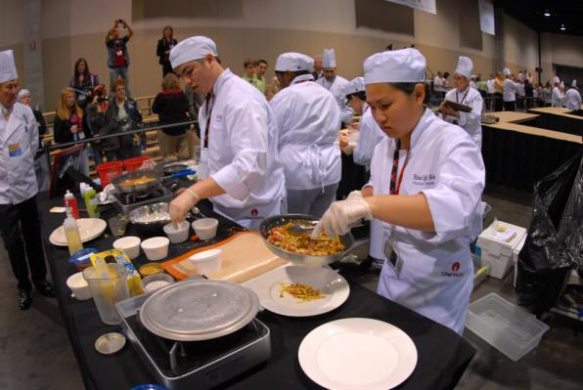
National ProStart Invitational
Culinary teams:
Prepare a 3-course meal using only 2 butane burners in just 60 minutes
Judged on teamwork, safety, sanitation, cooking techniques, taste and menu development

Slide 7
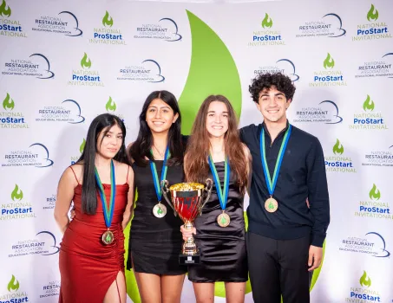
National ProStart Invitational
Management teams:
Participating teams will demonstrate their knowledge of the restaurant and foodservice industry by developing a new restaurant concept and presenting to a panel of judges. The teams will also submit a written proposal for review and will present their concepts to various groups of judges through verbal presentations, question and answer periods, and posters.
Teams are judged on: Concept, Menu, Operations, Marketing and Critical Thinking.

Slide 8
Connecticut ProStart Invitational

Slide 9
Connecticut ProStart Invitational
School | 9:00 AM | 10:45 AM | 10:50 AM | 11:00 AM | 11:10 AM | 11:20 AM | 11:30 AM | 11:40 AM | Feedback
Enfield Suite 1 | Submit Materials | Setup | Operations | Critical B | Concept | Critical A | Menu | Marketing | 12:10 pm
Wilbur Cross Suite 2 | Submit Materials | Setup | Marketing | Operations | Critical B | Menu | Critical A | Concept | 12:20 pm
Operations & Critical A (Safety & Sanitation and Menu Development & Design)–Adam Halberg, Nancy Thiel, Patrick McLleland
Marketing & Critical B Social Media & Customer Service – Chaz Tanase, Jeannette Dardenne, Jeremy Staub
Menu & Concept – Jan Jones, Mark Moeller, Jacob Rodriguez
Competition will be in Suites 1 & (first baseside)
Feedback will be in the conference room on the YG Club level.

Slide 10
Connecticut ProStart Invitational
Menu & Costing
Only 12 items allowed (very specific requirements, ask if there are gray areas)
No alcohol
Templates and Costing per rules are followed
Operations
Layout & Floorplan
Interior & Décor
Org Chart
Critical Thinking A: Safety & Sanitation& Menu
Critical Thinking B: Social Media & Customer Service

Slide 11
Connecticut ProStart Invitational
Concept
Meets requirements of ProStartville, makes sense
SWOT
Depth of Knowledge
Marketing
Limited to 2 tactics
Social media: very specific requirements. It can be one of their two tactics. They can’t use social media for both. Only Instagram or Facebook. Click rate is set in rules.
Do tactics match concept?
ROI
All sections judged on presentation

Slide 12
Connecticut ProStart Invitational
Online Scoring Tool
Psiscoring.com
If you haven’t registered, please register asap so I can assign roles.
Please bring tablet, phone or laptop.

Slide 13
Connecticut ProStart Invitational
Questions?

Slide 14
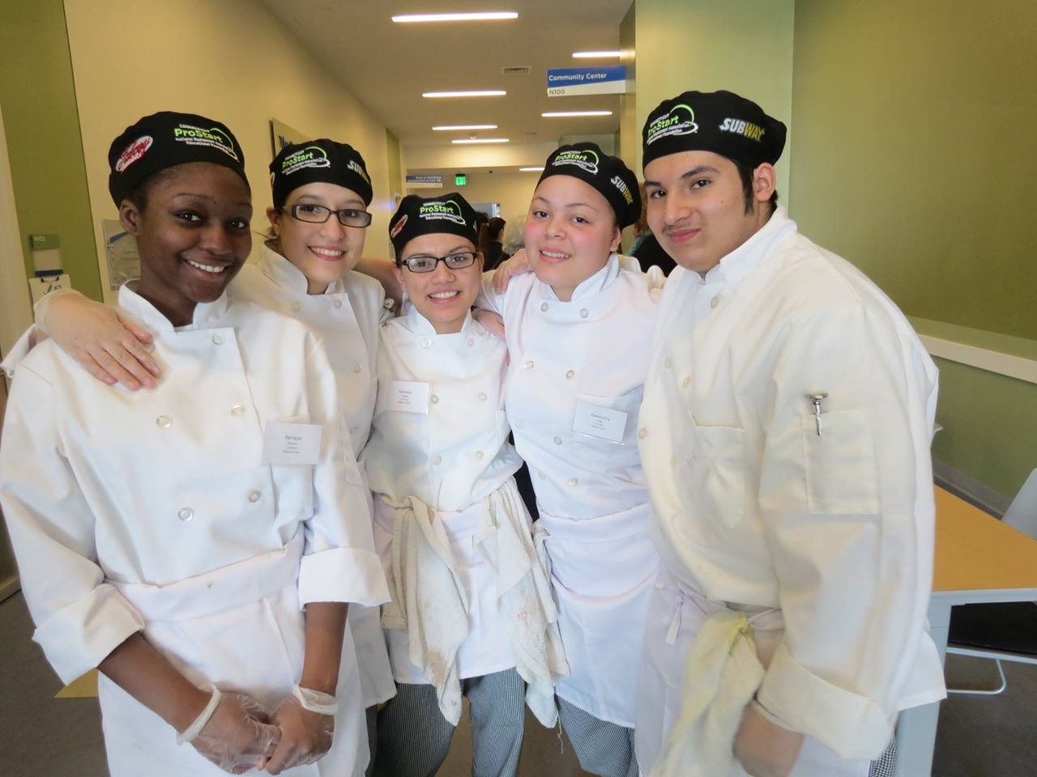
Stay in Touch
Visit www.ctrestaurant.org/prostart
Call Jennifer (860) 794-6666
Email conkling@ctrestaurant.org
murphy@ctrestaurant.org

Slide 15
@ProStart and @CTProStart
/ProStartProgram and /ctprostart
/ProStartProgram
Chooserestaurants.org
/GoProStart

