Slide 1
ProStart Feeding Dreams. Building Futures.

Slide 2
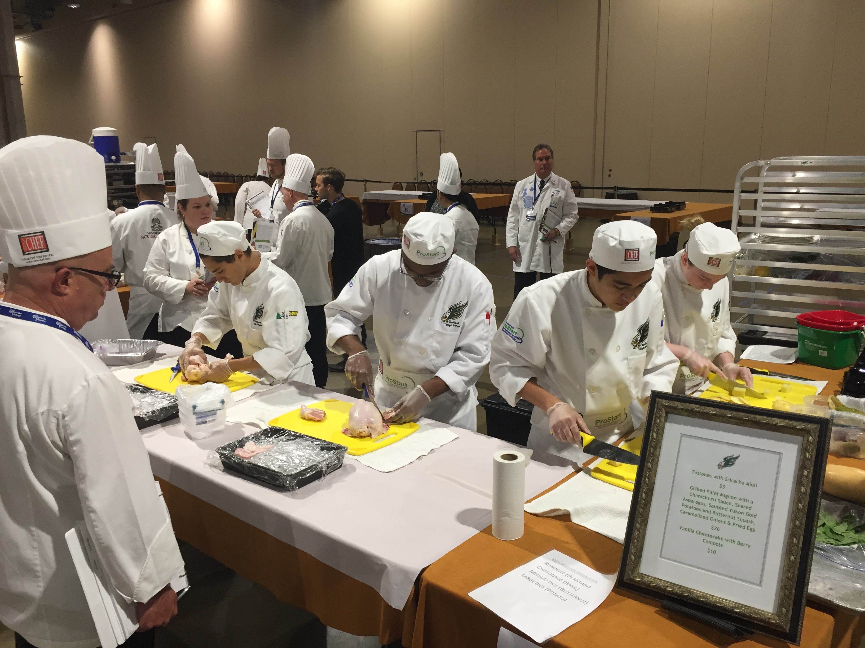
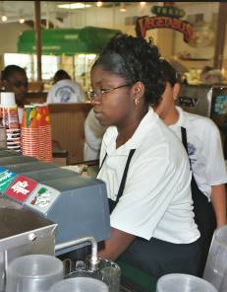
What is ProStart?
Nationwide, 2-year program
Prepares students to be tomorrow’s industry leaders
The only high school curriculum that covers both culinary and restaurant management.
Gives real-world experience and builds practical skills
Makes college more accessible and affordable

Slide 3
Where We Are – ProStart States and Schools
You’ll Join an Elite Group▬A Nationwide Movement!
States & territories: All 50 States, Guam & District of Columbia
Students enrolled: 214,000+
High schools Nationwide: 2,100+
2023-24 school year CT high schools:
Over 3,000 students at 24 high schools:
Berlin High School
Brien McMahon High School (Norwalk)
Bristol Central High School
Cheshire High School
Conard High School (West Hartford)
Crosby High School (Waterbury)
Enfield High School
Farmington High School
Fitch High School (Groton)
Hall High School (West Hartford)
Newington High School
New Haven Adult Education Center
New London High School
Newington High School
Norwich Free Academy
Simsbury High School
Stamford High School
Stonington High School
Terryville High School
Waterford High School
Wilby High School (Waterbury)
Wilbur Cross High School (New Haven) Windsor High School
Torrington High School
Tourtelotte Memorial High School (Thompson

Slide 4
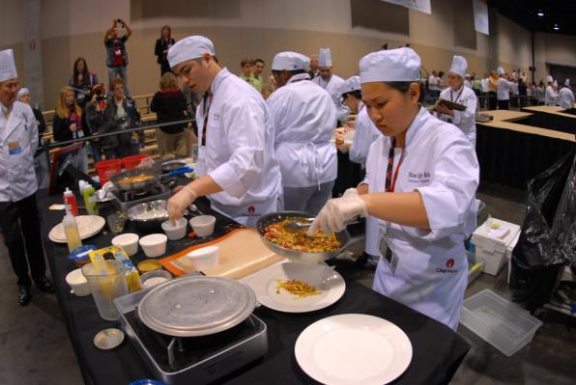
National ProStart Invitational
Culinary teams:
Prepare a 3-course meal using only 2 butane burners in just 60 minutes
Judged on teamwork, safety, sanitation, cooking techniques, taste and menu development

Slide 5
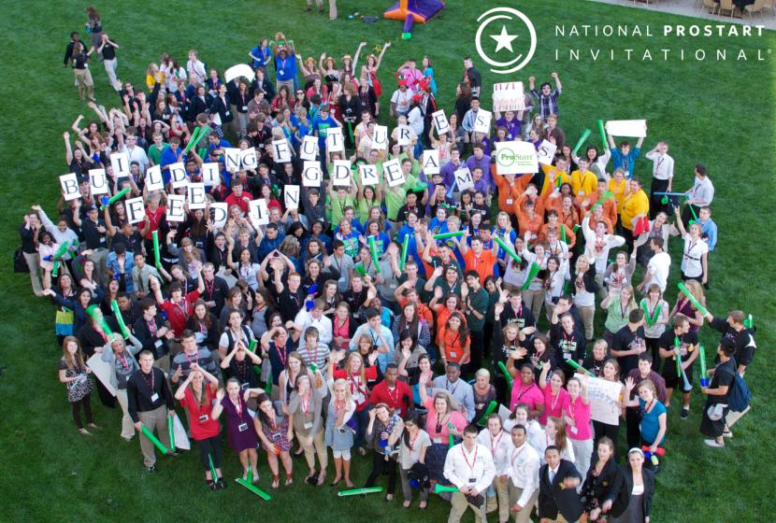
Connecticut ProStart Invitational
6 Culinary Teams from 5 High Schools
Enfield High
Norwich Free Academy (2 teams)
Simsbury High School Wilbur Cross High School (New Haven)
Windsor High School
2 Management Teams
Enfield High School
Wilbur Cross High School
Culinary and Management compete at the same time
Scholarships for 1st, 2nd and 3rd place = $420,000 in offers

Slide 6
Connecticut ProStart Invitational

Slide 7
Connecticut ProStart Invitational
 | Product Check In | Team Report to Station | Team & Menu Introduction | Production Mise en Place | Start Cooking | Present Plates/Skills Critique | Tasting Critique | Menu Critique | Cleanup | Sanitation Critique/ Dismissa | Out
Simsbury | 8:30 | 9:05 AM | 9:10 AM | 9:15 AM | 9:35 AM | 10:35 AM | 10:45 AM | 10:55 AM | 11:00AM | 11:20 AM | 11:25 AM
Wilbur Cross | 8:40 | 9:05 AM | 9:10 AM | 9:15 AM | 9:35 AM | 10:35 AM | 10:45 AM | 10:55 AM | 11:00AM | 11:20 AM | 11:25 AM
NFA 1 | 8:50 | 9:30AM | 9:35 AM | 9:40 AM | 10:00 AM | 11:00 AM | 11:10 AM | 11:20 AM | 11:25AM | 11:45 AM | 11:50 AM
Windsor | 9:00 | 9:30AM | 9:35 AM | 9:40 AM | 10:00 AM | 11:00 AM | 11:10 AM | 11:20 AM | 11:25AM | 11:45 AM | 11:50 AM
Enfield | 9:10 | 9:55 AM | 10:00 AM | 10:05 AM | 10:25 AM | 11:25 AM | 11:35 AM | 11:45 AM | 11:50 AM | 12:10PM | 12:15 PM
NFA 2 | 9:20 | 9:55 AM | 10:00 AM | 10:05 AM | 10:25 AM | 11:25 AM | 11:35 AM | 11:45 AM | 11:50 AM | 12:10PM | 12:15 PM

Slide 8
Connecticut ProStart Invitational
Judge Tips
JUDGES WILL JUDGE AND SCORE ALL TEAMS FOR THEIR ASSIGNED CATEGORIES.
Judges can discuss and collaborate but scores do not have to be the same. One person’s 4 is another’s 3.
Don’t be afraid to use half points.
DO NOT start them early for any segment just because they are ready to go

Slide 9
Connecticut ProStart Invitational
Product Check In
Which judges: Product Checkin Judges
One team at a time – Only 10 minutes per team
If they want to wash hands before product checkin, have them use the kitchen rather than on floor stations.
All food checked for temps
Proper packaging
Compare product lists to inventory
Does not look at equipment
No refrigeration prior so pack on ice
Nicole Mendieta, Craig Townsend, Chef Joe Barlett
Judge Tips
We don’t take away the product if it isn’t on the list
If something doesn’t temp correctly, let me know so we can make a plan to get them a replacement if necessary.

Slide 10
Connecticut ProStart Invitational
Report To Station
Teams may place equipment on and organize speed rack during report time and after team introduction is complete but should not use tables or begin setting anything else up until mise en place begins.
Team Presentation & Knife Skills
Team & Menu Introudction
Which Judges: Team Presentation & Knife Skills Judges
Teams introduce themselves, introduce yourself
2- 3 judges will be assigned to each team for the Introduction (YOU WILL THEN MOVE ON TO SCORE ALL TEAMS FOR TEAM PRESENTATION & KNIFE SKILLS).
After intro, all team presentation and knife skills judges should gather to discuss the presentations.
There is no score on the actual speaking, only appearance.
Appearance can be judges at the beginning or throughout.
After team is done with intro, have timer tell them how much time they have to wash their hands in the side kitchen (do not use on floor sinks for the first wash).
Judge Tip
Teams do not unpack ANYTHING prior to Mise en Place
DO NOT start them early for any segment just because they are ready to go

Slide 11
Connecticut ProStart Invitational
MISE EN PLACE
Which Judges: Work Skills/Safety & Sanitation
Mise en Place
Set up work space
Teams may place equipment on and organize speed rack during report time and after team introduction is complete but should not use tables or begin setting anything else up until mise en place begins.
Get ice, water
Wash vegetables (although these can all come pre-washed)
Measuring – note that NOTHING can come pre-measured this year
Sanitation buckets will be provided in advance
Judge Tip
Teams do not unpack ANYTHING prior to Mise en Place
NO Food prep allowed
DO NOT start them early for any segment just because they are ready to go

Slide 12
Connecticut ProStart Invitational
Cooking –
Which Judges: Knife Skills/Work Skills/Safety Sanitation
60 minutes to create two identical meals
One teams will be going at the same time, unlikely they will finish at exactly the same time, float between the two.
Alternate must be on the outside of the “L”. They can taste but not touch anything else.
Teams can finish at 57 minutes.
Do not stop if they aren’t done at 60 minutes, go until they are done.
Judge Tips:
This is a learning event, if you see them doing something wrong/dangerous correct them. Engage, ask questions, encourage them, etc. Don’t make suggestions to change something.
Students will return to workstation for feedback on cooking and work skills after dropping plates off to the tasting judges.
Scores should not be discussed with other judges to get a consensus.

Slide 13
Connecticut ProStart Invitational
Knife Skills a. Knife skills are demonstrated during the 60-minute Meal Production segment. Team Presentation/Knife Skills judges may evaluate knife cuts anytime during Meal Production segment. b. The team must demonstrate a minimum of two (2) of eleven (11) specified knife cuts to incorporate in their meal. c. Cuts must be demonstrated on fruits, vegetables, or herbs only. i. Rondelle: ¼” thick disc shaped slices ii. Diagonal: ¼” thick oval shaped slices iii. Batonnet: Cut into long, thin, rectangular pieces ¼” x ¼” x 2” iv. Julienne: Cut into long, thin, rectangular pieces. 1/8” x 1/8” x 2” v. Large Dice: Cube shaped ¾” x ¾” x ¾” vi. Medium Dice: Cube shaped ½” x ½” x ½”. vii. Small Dice: Cube shaped ¼” x ¼ “ x ¼” viii. Brunoise: Very small dice. 1/8” x 1/8” x 1/8” ix. Paysanne: Square cut ½” x ½” x 1/8” x. Chiffonade: Leafy green vegetables such as spinach or basil that are stacked, rolled tightly, and then cut into long thin strips. Approximate width is 1/8”. xi. Tourne: football shape, ¾” diameter, 2” long, seven equal sides and flat ended d. Team must identify the selected cuts anywhere on their printed menu. e. Team must set aside a 1oz. cup volume measurement for each knife cut for evaluation by Team Presentation/Knife Skills judges. Event staff will provide 1oz. containers. This may be done at any time. Judges will rotate and evaluate when available. ALL KNIFE SKILLS JUDGES WILL JUDGE EVERY TEAM.

Slide 14
Connecticut ProStart Invitational
Tasting & Menu Judging
Two teams will be competing at a time, which means two plates come at a time. Plates will come in quickly, so no more than 10 minutes for tasting and then the teams comes in for feedback.
25 minutes between teams so extra 5 minutes to help but still must stay on track.
Judges broken down by Appetizer Judge, Entrée Judge and Dessert
2/3 judges per course. One tray delivered to suite FOR TASTING. Judges have no more than 10 minutes to taste. When judges are ready for feedback, move to feedback suite. One judge per each category will deliver feedback to a team. 2-3 minutes for each dish. Then the other judge delivers feedback for next team.
The first team to present their plates will get feedback first as soon as judges are ready to begin.
Second tray delivered to second suite for feedback and Menu judge.
During feedback: Clear plates and set for next teams in tasting suite.

Slide 15
Connecticut ProStart Invitational
Skills Critique
Which judges: Work Skills, Knife Skills
After students bring their dishes to the tasting room, students return to workstation to receive skills critique
Not every judge needs to provide critique – you will be assigned who you are giving critique to but you will still be judging every team.
Clean Up and Sanitation Critique
Which judges: Safety & Sanitation
Clean up everything – everything must be removed from workstation and be put in hospitality suite after safety/sanitation feedback and dismissal
Safety & Sanitation judges give feedback and dismissed.

Slide 16
Connecticut ProStart Invitational
Clean up and Safety/Sanitation – Safety and Sanitation
Students Return to workstation
Clean up everything – everything must be removed from workstation and be put in hospitality suite after safety/sanitation feedback and dismissal
Safety & Sanitation judges give feedback and dismissed.

Slide 17
Connecticut ProStart Invitational
Online Scoring Tool
Psiscoring.com
If you haven’t registered, please register asap so I can assign roles.
Please bring tablet, phone or laptop.
DEMO

Slide 18
Connecticut ProStart Invitational
Questions?

Slide 19
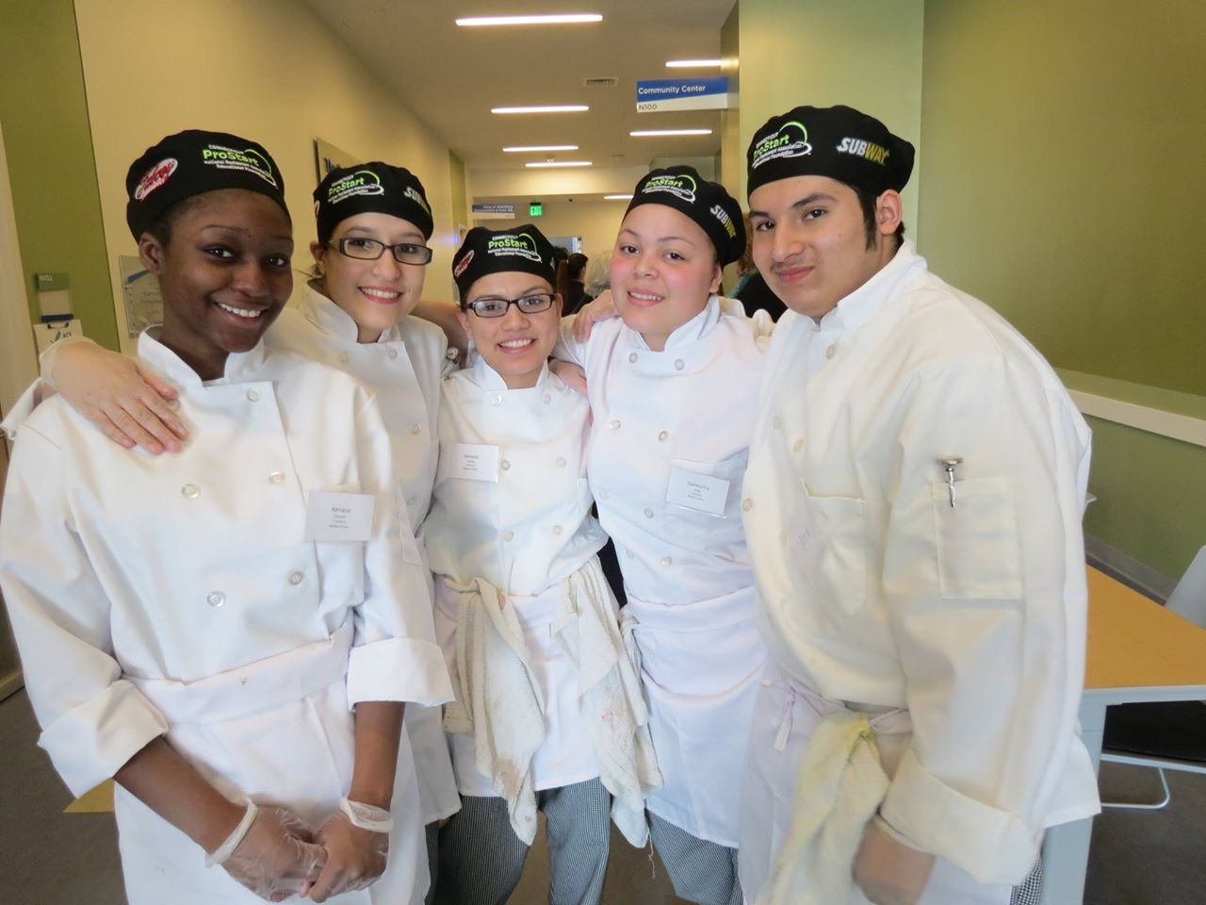
Stay in Touch
National Contact:
Visit www.chooserestaurants.org
www.ctrestaurant.org/prostart
Local (CT) Contact:
Call Jennifer (860) 794-6666
Email conkling@ctrestaurant.org

Slide 20
@ProStart and @CTProStart
/ProStartProgram and /ctprostart
/ProStartProgram
Chooserestaurants.org
/GoProStart

