Slide 1
https://www.setda.org/main-coalitions/elearning/
Notes:
SETDA Coalition for eLearning
https://www.setda.org/main-coalitions/elearning/

Slide 2
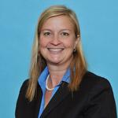
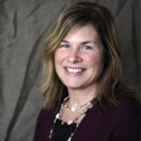
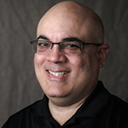
Supporting Students with IEPs During eLearning Days
Monday, March 23, 2020
Christine Fox
Deputy Executive Director
SETDA
Twitter @cafox & @SETDA
Cynthia Curry
Director
National Center on Accessible Educational Materials and the Center on Inclusive Technology & Education Systems (CITES) at CAST
Twitter @clcurry
Luis Pérez
Technical Assistance Specialist
National Center on Accessible Educational Materials at CAST
Twitter @eyeonaxs
Today’s edWebinar interpreter is Cid Pollard.
Captioning will be added within two weeks of the live event.
Join the Essential Elements for eLearning community: www.edweb.net/eLearning

Slide 3
Here are some edWebinar tips...
Post in the chat to join the live discussion.
Ask a question by clicking the question mark icon on your screen.
Close other applications that use bandwidth or resources on your device.
For audio issues you can also use your phone by clicking the phone icon at the top of your screen.
If you’re having trouble connecting, try refreshing your browser or relaunching the app.
Captioning will be added to the recording within two weeks of the live event.

Slide 4
Join the free online community for this edWebinar!
As a member, you’ll get all of the resources:
View and share the recording
Take the CE quiz
Download the slides and chat log
Join discussions
Get invitations to the upcoming edWebinars
Join this community at: edweb.net/eLearning

Slide 5
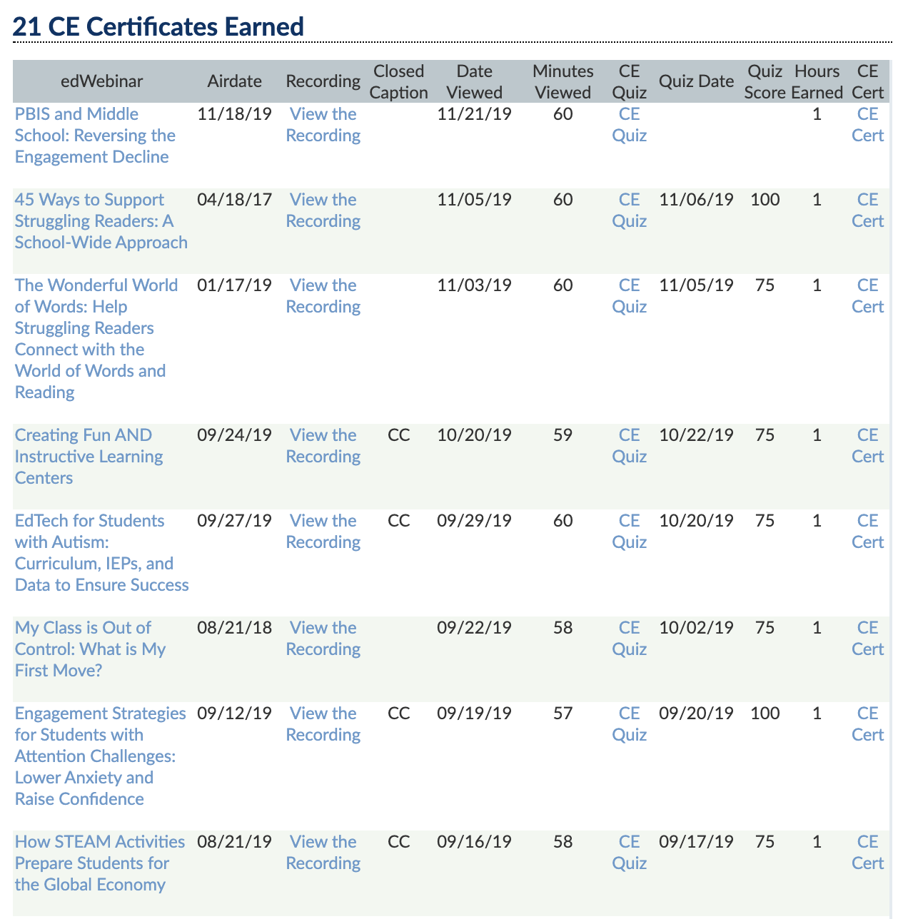
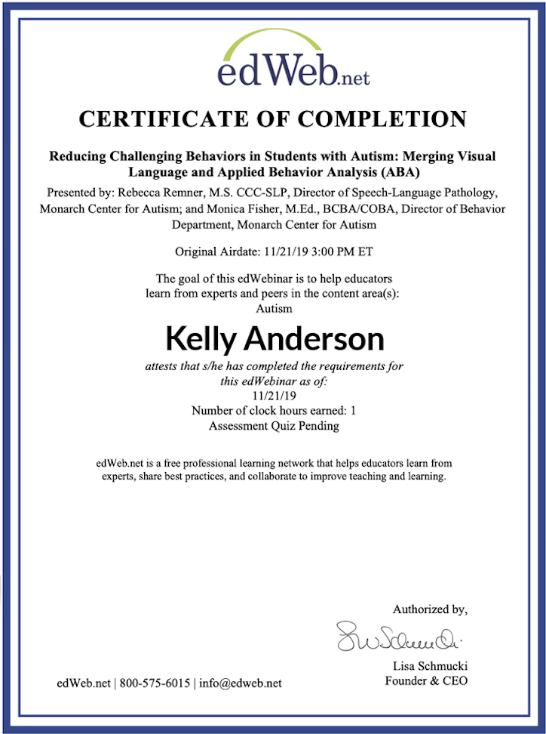
Get your CE Certificate for this edWebinar
edWeb.net is free!
If you’re an edWeb member, you can download your CE Certificate from your edWeb member transcript at the end of the next business day.
Join edWeb.net here: edweb.net/join
You can also join the community for this edWebinar and get all the free resources: edweb.net/eLearning

Slide 6
Notes:
Faster Smarter Safer by AT&T – By bringing together solutions that help protect, serve and connect, AT&T Public Sector is delivering a faster, smarter, safer future in 2019. www.att.com/publicsector

Slide 7
Christine Fox serves as Deputy Executive Director for SETDA. As the deputy executive director, she collaborates with the executive director in charting strategic direction, administration, planning, and financial decisions involving SETDA. She also facilitates the members’ professional learning opportunities, including planning and implementing the content for SETDA’s virtual and in-person events and newsletters. In addition, she manages many of SETDA’s research and product development projects from conception to publication. The management of such projects includes coordinating data collection from all states, supervising consultants and staff, ensuring member input and supervising the publishing process. Recent publications and projects include Navigating the Digital Shift reports 2015-2019, the Professional Learning and K12 Instructional Materials Dashboards, the Broadband Imperative Report Series, Guide to Quality Instructional Materials, Digital Instructional Materials Acquisition Policies for States, and The Broadband Imperative II: Equitable Access for Learning. Christine Fox’s background includes experience in education and consulting. She has worked as an educational consultant and curriculum developer for a national whole-school reform model, ESOL Coordinator, and 3rd-grade teacher. Christine has a Master of Science in teaching English as a second language from Florida International University and received her bachelor’s degree in English literature from Florida State University. She lives in South Florida with her husband and two daughters. Follow Christine on Twitter @cafox & @SETDA.
Christine Fox

Slide 8
About SETDA
SETDA is a non-profit membership organization with a mission to:
Serve, support, and represent U.S. state and territorial directors for educational technology.
Mission to build and increase the capacity of state and national leaders to improve education through technology policy and practice.
Forum for:
Advocacy for policy and practice
Professional learning
Inter-state collaboration
Public-private partnerships
Follow us @SETDA
Notes:
Introduce yourself, review the key sections and any logistics for the session.

Slide 9
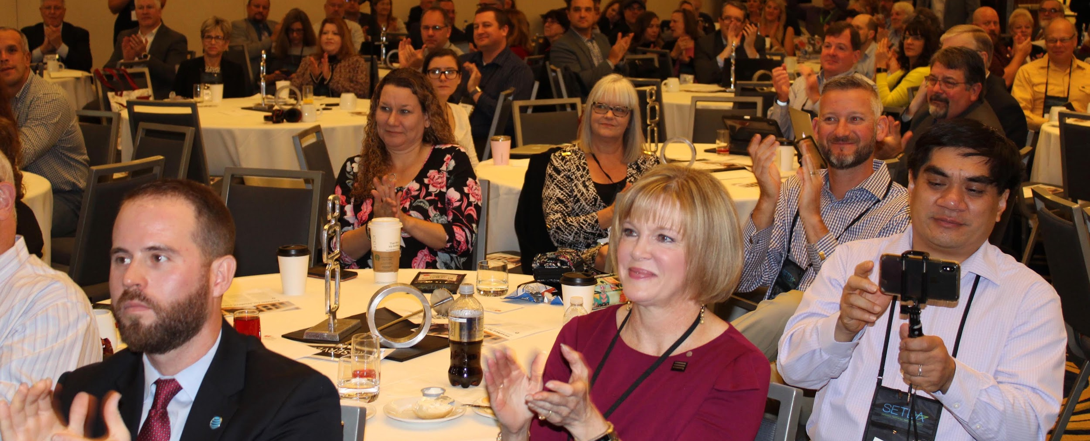
About SETDA
Members & Partners
Affiliates: Organizations that through collaboration bolster efforts to advance education through technology policy and practice. Affiliate Categories: Statewide or Regional Membership Associations, Higher Education, International, Districts.
http://www.setda.org/affiliate/
State Leaders: Members from all 50 states, the District of Columbia, Virgin Islands, Guam & American Samoa. http://www.setda.org/states/
Private Sector Partners: Non-profit & for-profit private sector partners (platinum/gold/emerging) & channel partners that align with our mission, priorities, & advocacy goals. http://www.setda.org/partners/
Notes:
Introduce yourself, review the key sections and any logistics for the session.

Slide 10
SETDA Advocates for Digital Learning
Notes:
Introduce yourself, review the key sections and any logistics for the session.

Slide 11
SETDA Partners to Support Accessibility for All
National Center on
Accessible Educational Materials
Center on Inclusive Technology & Education Systems (CITES)

Slide 12
Why?

Slide 14
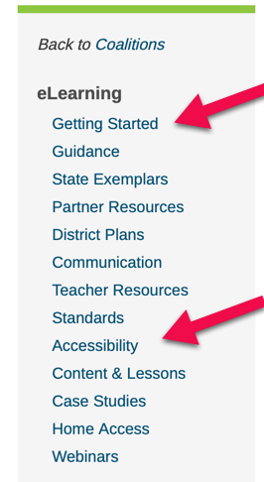
Topics
This coalition provides the opportunity to spark innovation around eLearning to ensure students continue learning from home. It is essential that educators collaborate to provide best practices and a framework for instruction.
coalitions.setda.org/elearning

Slide 15
Communication
This page offers sample language from schools and districts to coordinate with Districts, Schools, Parents and Students
https://www.setda.org/main-coalitions/elearning/communication/

Slide 16
Content & Lessons
Selecting Instructional Materials
Access Vetted Digital Content
Lesson Plans
https://www.setda.org/main-coalitions/elearning/content/
Teacher Resources
Professional Learning for Teaching Online
Online Learning Teaching Tools
https://www.setda.org/main-coalitions/elearning/teachers/

Slide 17
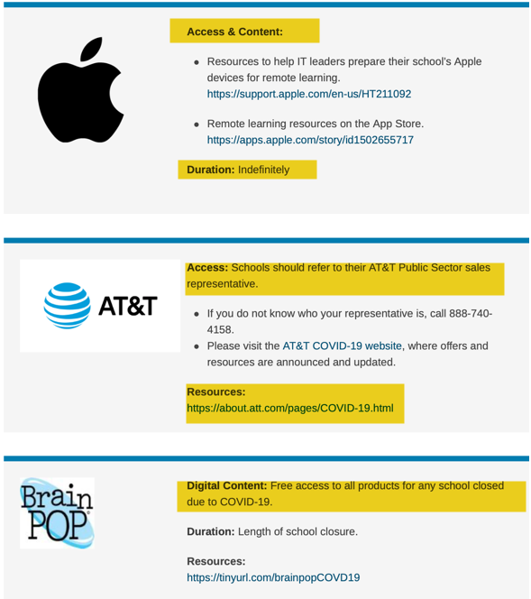
Partner
Resources
https://www.setda.org/main-coalitions/elearning/partner-resources/

Slide 18
Accessibility
Supporting Students with IEPs During eLearning Days
Creating Accessible Educational Materials
Universal Design for Learning (UDL) https://www.setda.org/main-coalitions/elearning/accessibility/

Slide 19
Cynthia Curry is Director of the National Center on Accessible Educational Materials (AEM Center) and the Center on Inclusive Technology & Education Systems (CITES) at CAST. She leads CAST’s work with stakeholders across early learning, K-12, higher ed, workforce development, families, publishers, and EdTech developers to increase the availability and use of accessible materials and related technologies for individuals with disabilities. Cynthia brings diverse career experiences to her role, including being a middle and high school science teacher, statewide technology integration mentor for the Maine Learning Technology Initiative, teacher educator at the University of Southern Maine, and disability services coordinator and instructional designer at the University of New England. Cynthia taught online for 12 years prior to joining CAST, including courses on accessible online learning. Follow Cynthia on Twitter @clcurry.
Cynthia Curry

Slide 20
Luis Pérez is a technical assistance specialist for the National Center on Accessible Educational Materials. He holds a doctorate in special education and a master’s degree in instructional technology from the University of South Florida. Luis is Past-President of the Inclusive Learning Network of the International Society for Technology in Education (ISTE), which named him its 2016 Outstanding Inclusive Educator. Luis has published three books on accessibility, mobile learning and UDL: Mobile Learning for All (Corwin Press), Dive into UDL (ISTE) and Learning on the Go (CAST Publishing). Follow Luis on Twitter @eyeonaxs.
Luis Pérez

Slide 21
About the AEM Center at CAST
Technical assistance center funded by the U.S. Department of Education Office of Special Education Programs

Slide 22
Goal of the AEM Center
To build the capacity of
states and districts,
higher ed institutions,
workforce development agencies,
families,
edtech developers and publishers,
and other stakeholders to increase the availability and use of high-quality accessible educational materials and technologies that support improved learning opportunities and outcomes for learners with disabilities.

Slide 23
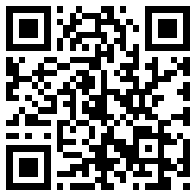
Access & Distance Education on the AEM Center website
bit.ly/AEMContinuityAccess

Slide 24
Objectives
Participants will be provided
Currently available guidance
Recommendations for a school community response
Resources and services the AEM Center is providing in direct response to school closures

Slide 25
Poll Question

Slide 26
Available Guidance

Slide 27
Current Guidance from the U.S. Department of Education
“Ensuring compliance with the Individuals with Disabilities Education Act (IDEA), Section 504 of the Rehabilitation Act (Section 504), and Title II of the Americans with Disabilities Act should not prevent any school from offering educational programs through distance instruction.”
Supplemental Fact Sheet March 21, 2020
Notes:
Link to March 21 Supplemental Fact Sheet https://www2.ed.gov/about/offices/list/ocr/frontpage/faq/rr/policyguidance/Supple%20Fact%20Sheet%203.21.20%20FINAL.pdf

Slide 28
Additional Guidance
More information from the U.S. DOE and Office for Civil Rights is available on both the
SETDA Coalition of eLearning “Accessibility” page and
AEM Center’s Access & Distance Education page

Slide 29
Recommendations for a School Community Response

Slide 30
Our Common Goal
To support the continuous progress of all learners, including students with disabilities, in this time of national emergency.
Notes:
Image by <a href="https://pixabay.com/users/cherylt23-29385/?utm_source=link-attribution&amp;utm_medium=referral&amp;utm_campaign=image&amp;utm_content=99506">cherylt23</a> from <a href="https://pixabay.com/?utm_source=link-attribution&amp;utm_medium=referral&amp;utm_campaign=image&amp;utm_content=99506">Pixabay</a>
Students at Skyline High School work together during an after-school tutoring club. www.deeperlearning4all.org/images Courtesy of Allison Shelley/The Verbatim Agency for American Education: Images of Teachers and Students in Action https://www.flickr.com/photos/all4ed/35668664324

Slide 31
Come Together as a Community: 4 Cs
Cross-functional teams can:
Coordinate
Collaborate
Communicate
(Maintain) Continuity

Slide 32
Coordinate
High-leverage coordination
Administration
General Education
Special Education
Assistive Technology (AT)
Educational Technology (EdTech)
Parents & Guardians
Students
Notes:
Image by skeeze on Pixabay
Determine and document cross-functional roles & responsibilities for providing access to materials and technologies for students with disabilities during this period of distance education.
Administrators
General Educators
Special Educators
Assistive Technology (AT) Personnel
Educational Technology (EdTech) Personnel
Parents & Guardians

Slide 33
Collaborate
Notes:
Image by civilservicelocal on Pixabay
Examples of high leverage collaborations across functions:
General and special educators on development of units and lessons, including materials and tools
AT (or special education) and EdTech on interoperability of AT with general education technologies
All technology personnel and students & families on use and troubleshooting technology

Slide 34
Communicate
Notes:
OpenClipart-Vectors on Pixabay
High-leverage communications
General Educators – Special Educators
General Educators – Students/Parents & Guardians
Special Educators – Students/Parents & Guardians
EdTech – Students/

Slide 35
Maintain Continuity
To the extent possible, continue with what was working in the classroom setting.
Minimize the introduction of new digital materials and technologies.
Collaborate and communicate with AT & EdTech in process of selecting new digital materials and technologies.
Notes:
Straight line, steady https://commons.wikimedia.org/wiki/File:Straight_Line_Steady_2.svg

Slide 36
Technical Assistance from the
AEM Center

Slide 37
Advice from Maya Angelou
“I’ve learned that whenever I decide something with an open heart, I usually make the right decision.”
Maya Angelou, American Poet

Slide 38
Selected High-Leverage Practices
Personalizing the Reading Experience
Creating High-Quality and Accessible Video
Creating Accessible Documents and Slide Decks
Making Math Notation Accessible

Slide 39
Upcoming AEM Center Activities for High Leverage Practices
Resources are currently on our website
Deeper dives beginning a week from today:
Personalizing the Reading Experience: Week of 3/30
Creating High-Quality and Accessible Video: Week of 4/6
Creating Accessible Documents and Slide Decks: Week of 4/13
Making Math Notation Accessible: Week of 4/20

Slide 40
Schedule of Events
Enhanced webinars recorded each Monday 3 PM ET
Office hours
Tuesdays 10 – 11:30 AM ET
Thursdays 4 – 5:30 PM ET

Slide 41
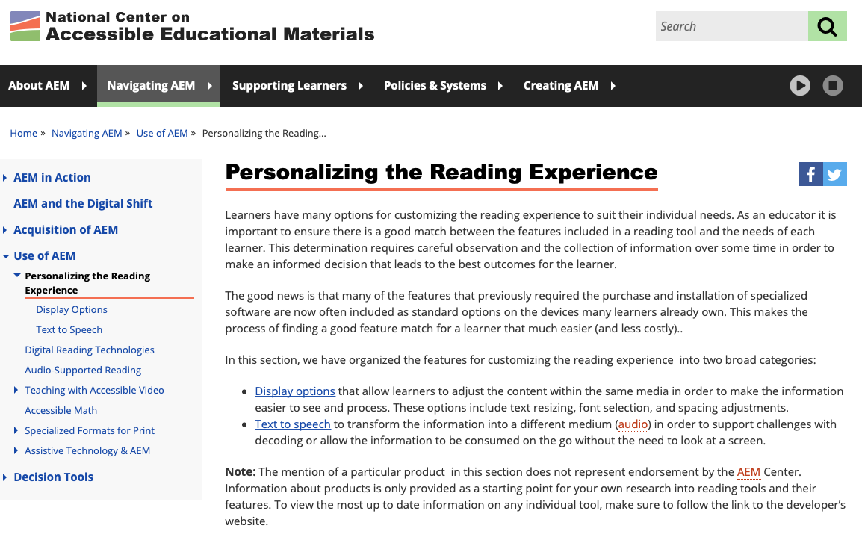
Personalizing the Reading Experience
Address learner variability by providing flexible supports
Display Options
Fonts
Text Size
Colors and More
Text to Speech

Slide 42
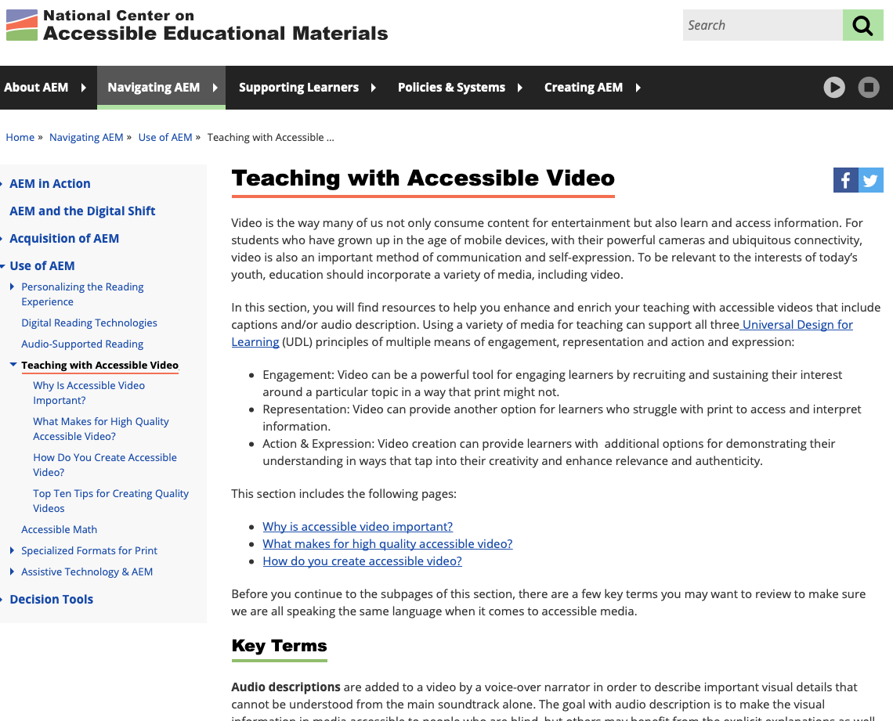
Creating High-Quality and Accessible Video
Why is accessible video important?
What makes for high-quality and accessible video?
How do you create accessible video?
Notes:
http://aem.cast.org/navigating/teaching-with-accessible-video.html

Slide 43
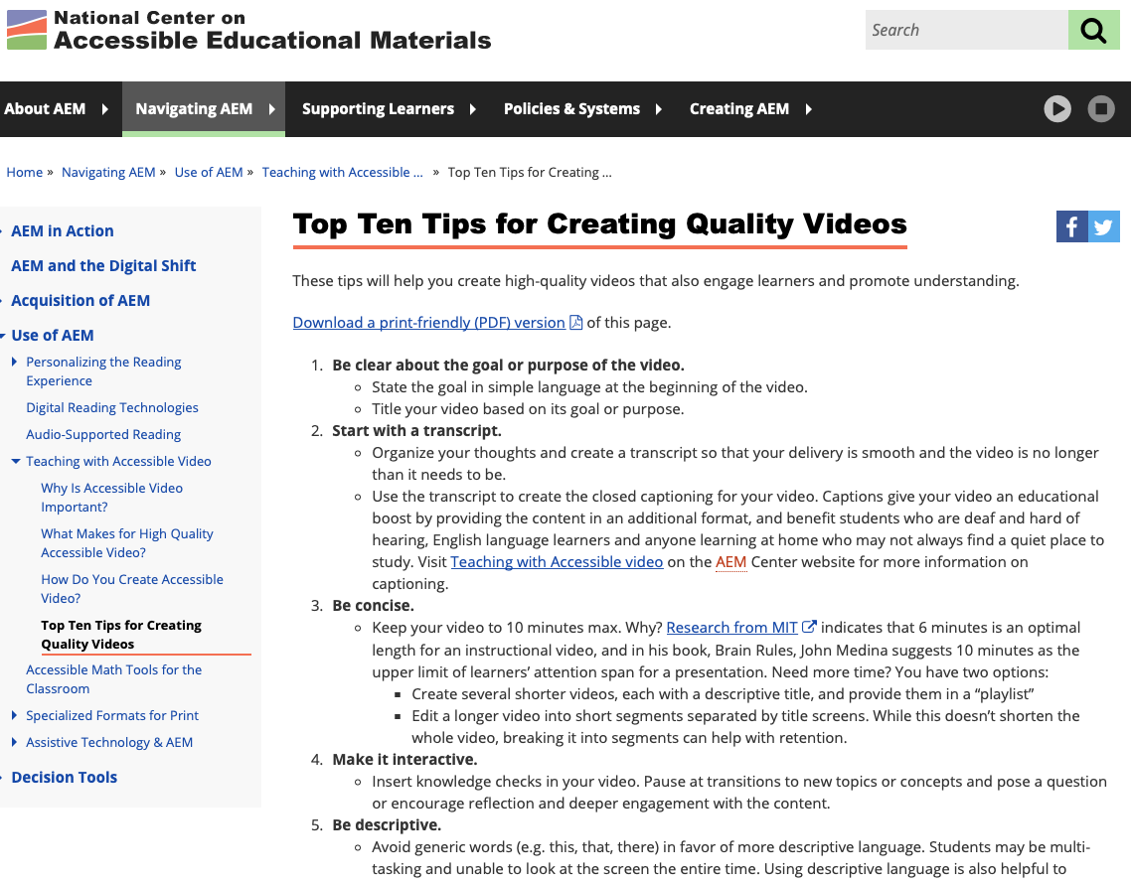
Top 10 Tips for Creating Quality Video
Multiple Representations
Tip Sheet (web page & tagged PDF)
Video
Notes:
http://aem.cast.org/navigating/teaching-with-accessible-video.html

Slide 44
Creating Accessible Documents & Slide Decks
2-Page Digital Handouts
How to Get Started with Document Accessibility
How to Get Started with Presentation Accessibility

Slide 45
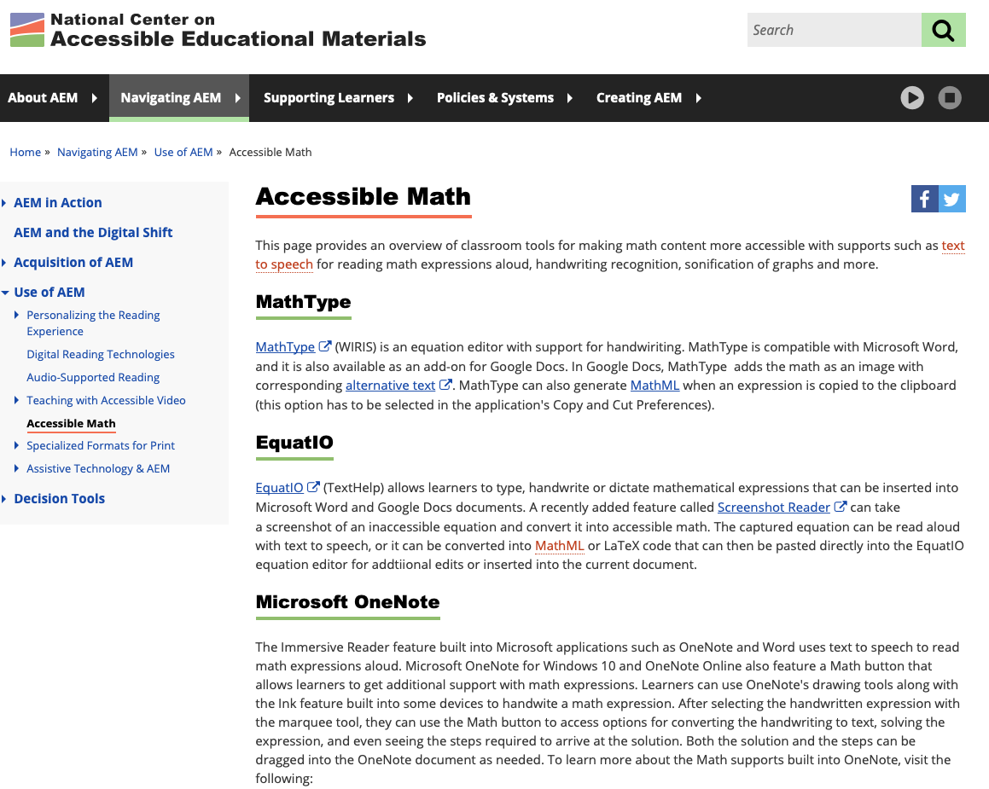
Making Math Notation Accessible
Supports for Math Notation and Symbols
Text to Speech
Handwriting Recognition
Speech Recognition

Slide 46
Key Takeaways
Coordinate, collaborate, and communicate with others in your school community
Maintain as much continuity as possible
Consider the AEM Center a part of your support network

Slide 47
Q&A

Slide 48
Contact the AEM Center at CAST
Website: http://aem.cast.org
Email: aem@cast.org
On Twitter: @CAST_UDL
On Facebook: @CASTUDL

Slide 49
AEM Center Disclaimer
The contents of this presentation were developed under a cooperative agreement with the U.S. Department of Education, #H327Z190004. However, those contents do not necessarily represent the policy of the U.S. Department of Education and you should not assume endorsement by the Federal Government, Project Officer, Tara Courchaine, Ed.D.

Slide 50
Questions & Answers
Christine Fox
Deputy Executive Director
SETDA
Twitter @cafox & @SETDA
Email cfox@setda.org
Cynthia Curry
Director
National Center on Accessible Educational Materials and the Center on Inclusive Technology & Education Systems (CITES) at CAST
Twitter @clcurry
Email ccurry@cast.org
Luis Pérez
Technical Assistance Specialist
National Center on Accessible Educational Materials at CAST
Twitter @eyeonaxs
Email lperez@cast.org
Today’s edWebinar is interpreted by Cid Pollard.
Captioning will be added within two weeks of the live event.
Join the Essential Elements for eLearning community: www.edweb.net/eLearning

Slide 51
Thank you for attending!
Christine Fox
Deputy Executive Director
SETDA
Twitter @cafox & @SETDA
Cynthia Curry
Director
National Center on Accessible Educational Materials and the Center on Inclusive Technology & Education Systems (CITES) at CAST
Twitter @clcurry
Luis Pérez
Technical Assistance Specialist
National Center on Accessible Educational Materials at CAST
Twitter @eyeonaxs
Thank you to SETDA for hosting today’s edWebinar! www.SETDA.org
Thank you to today’s sponsor, AT&T Aspire!
Learn more at about.att.com/csr/home/society/education.html
Take our short survey to give us your feedback on this edWebinar! tinyurl.com/edWebinarEval

Slide 52
Join the free online community for this edWebinar!
As a member, you’ll get all of the resources:
View and share the recording
Take the CE quiz
Download the slides and chat log
Join discussions
Get invitations to the upcoming edWebinars
Join this community at: edweb.net/eLearning

Slide 53
Get your CE Certificate for this edWebinar
edWeb.net is free!
If you’re an edWeb member, you can download your CE Certificate from your edWeb member transcript at the end of the next business day.
Join edWeb.net here: edweb.net/join
You can also join the community for this edWebinar and get all the free resources: edweb.net/eLearning

