Slide 1
Privacy Services
Q&A

Slide 2
Privacy Services Team
Heather Mogavero​
Program Support Supervisor​
Melissa Braden​
Program Support Technician​
Max Rothfeld​
Program Support Technician​

Slide 3
Why does your district
need Privacy Services?

Slide 4
FERPA (1974)
The Family Educational Rights and Privacy Act (20 U.S.C. § 1232g; 34 CFR Part 99) is a Federal law that protects the privacy of student education records. FERPA gives parents certain rights with respect to their children's education records. School Official Exception.​
​
​
The Children’s Online Privacy Protection Act is a federal law governed by the Federal Trade Commission (“FTC”) that controls what information may be collected from children under the age of 13 by companies operating websites and mobile applications. (15 U.S.C. § 6501, et seq.)
COPPA (1998)
​
California Business and Professions Code section 22584, also known as the Student Online Personal Information Protection Act, takes effect on January 1, 2016, and sets forth privacy laws for operators of websites, online services, and applications that are marketed and used for K-12 school purposes, even if those operators do not contract with educational agencies. No Targeted Advertising.
SOPIPA
(2014)
​
EdCode 49073.1 aka AB1584 requirements apply to contracts for services that utilize electronic technology, including cloud-based services, for the digital storage, management and retrieval of pupil records, as well as educational software that authorizes a third-party provider to access, store and use pupil records.
Ed Code
49073.1
(2015)
Notes:
It’s a balance between educating users on the laws we must comply with, while not limiting the usage of apps.
FERPA (1974) - We use the FERPA School Official Exception allows us to share data with Providers, under certain

Slide 5
Unsure of where
to start?
Not enough time and/or personnel?
Drowning with the number of contracts needed?
Too little funding for legal review of contracts?

Slide 6
What is Privacy Services?

Slide 7
Easily submit your vetting requests
Dedicated tech assigned to your district
We maintain and manage your contract requests
We negotiate DPAs with F3 legal counsel review, at no additional charge

Slide 8
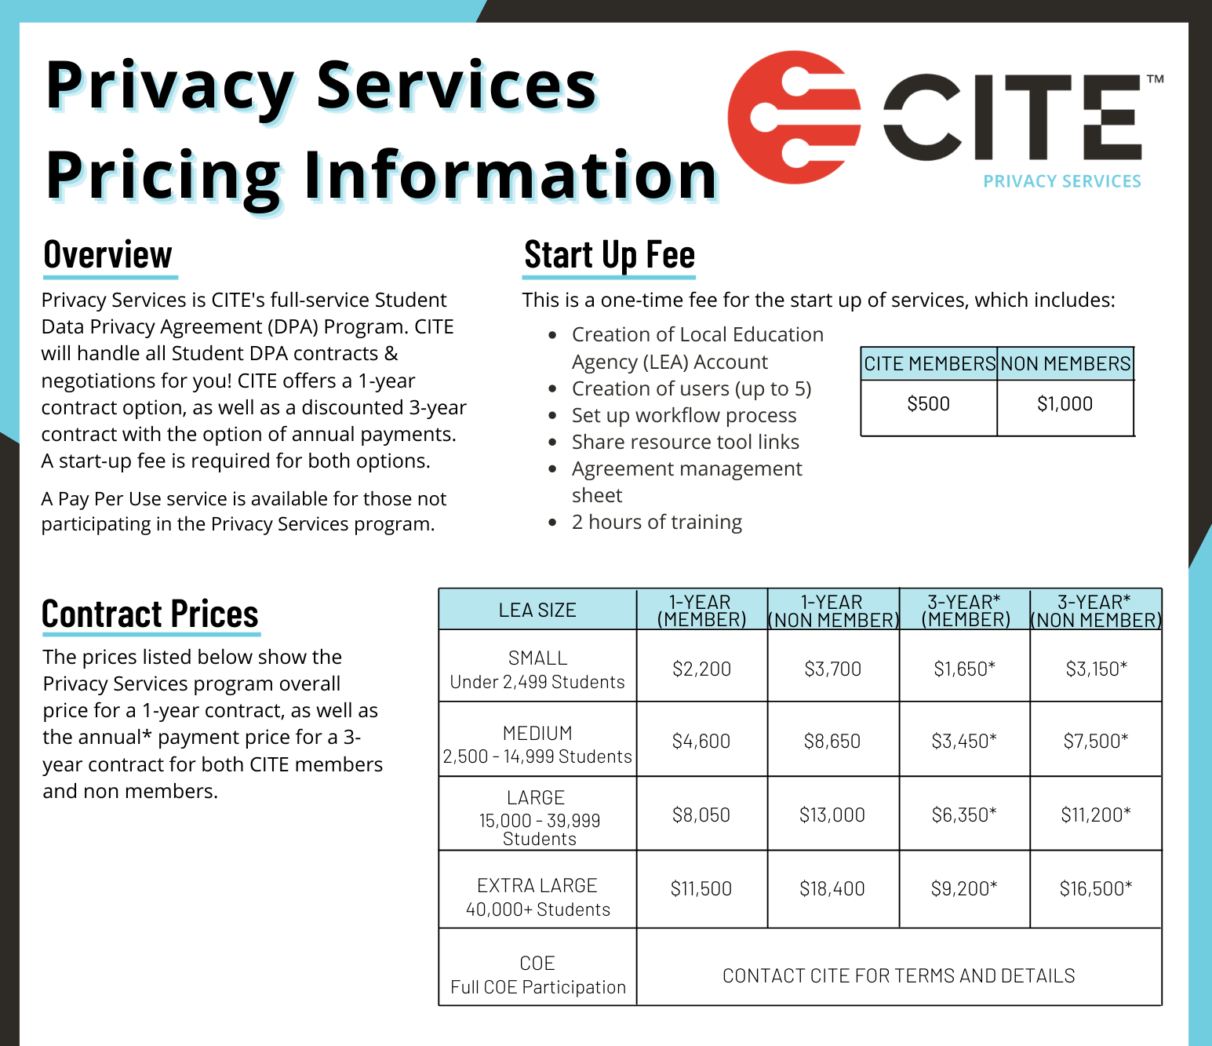
Privacy Services Pricing

Slide 9
www.CITEPrivacy.org

Slide 10
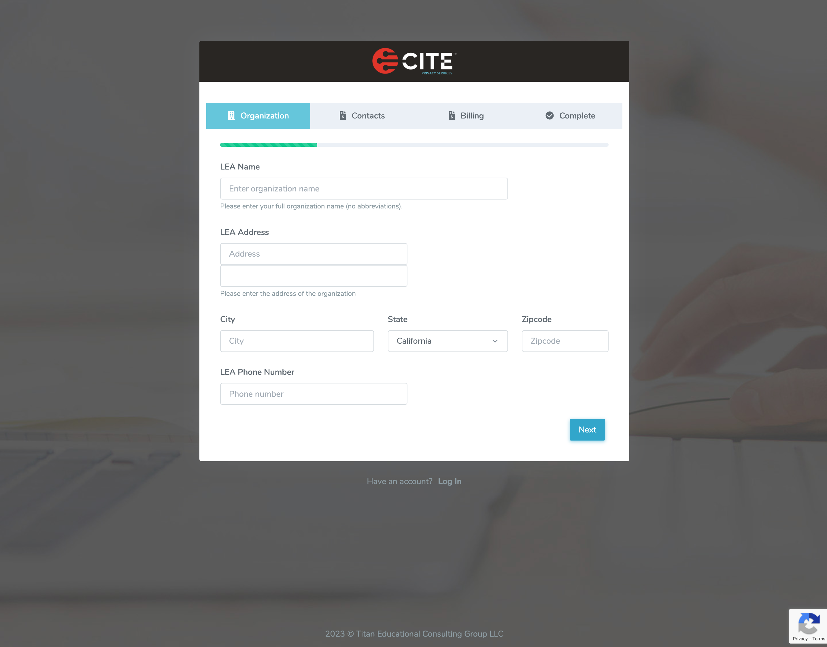
Are you a CITE member.
membership@cite.org
Select 1 year or 3-year option
CSPA Database Admin
LEA Authorized Signer

Slide 11
Privacy Services Portal

Slide 12
Privacy Services
Overview
Dedicated Technician
You request – We do the rest
Maintain and manage your DPAs
Negotiate with no added legal fees

Slide 13
Privacy Services should not take the place of your internal application review process
Help! My district's internal process looks like this!

Slide 14
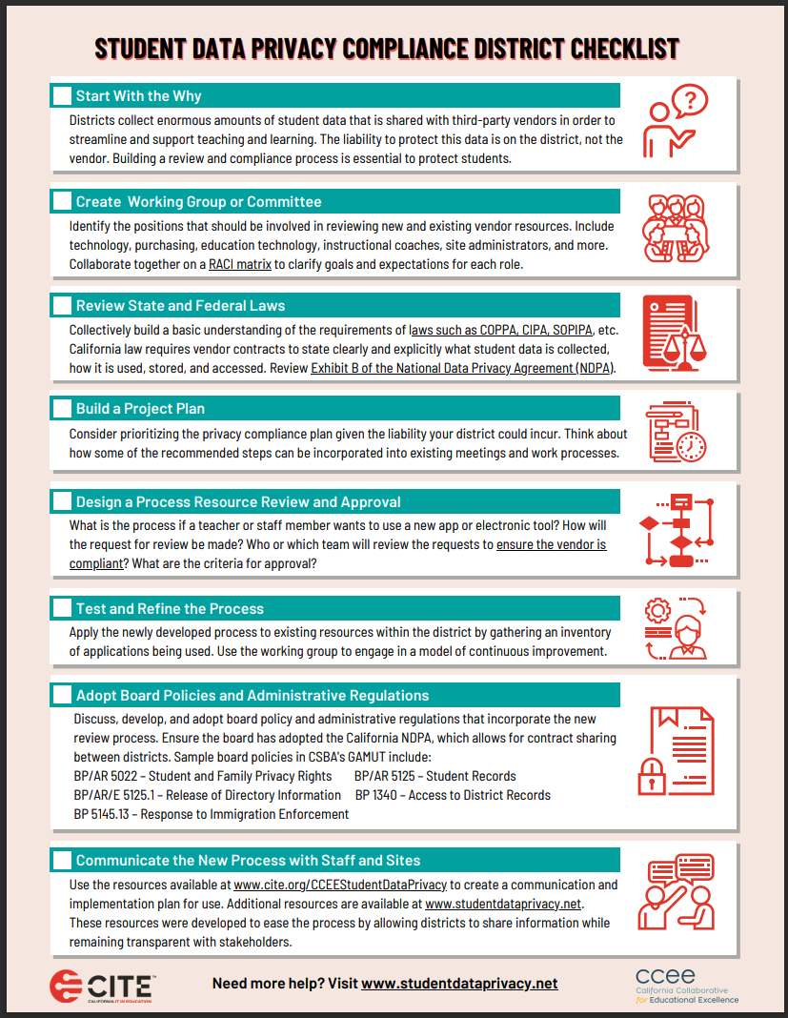
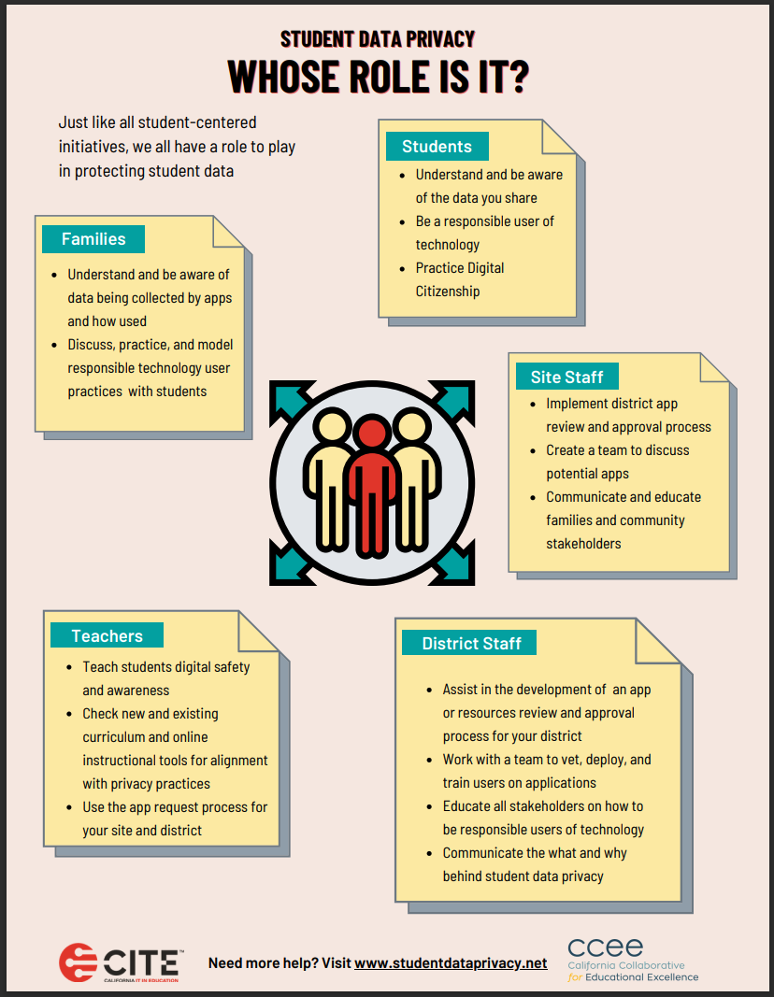
Additional Resources
www.cite.org/CCEEStudentDataPrivacy

Slide 15
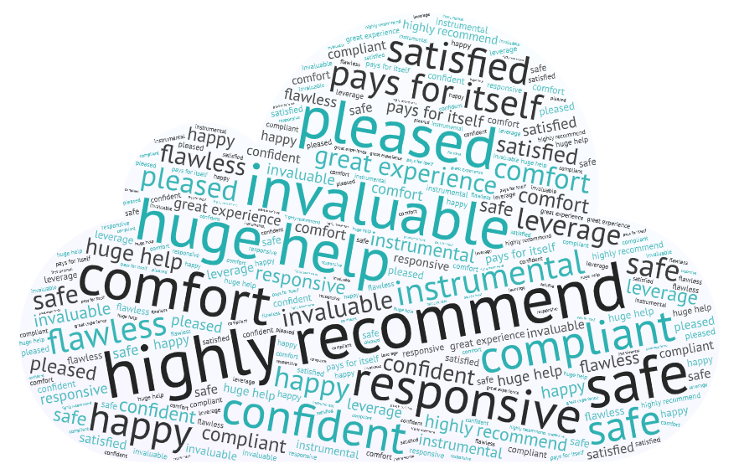
In the words of our customers
Heather.mogavero@cite.org
Melissa.braden@cite.org
Max.rothfeld@cite.org
www.citeprivacy.org

