Slide 1
CAMSA Road Tour
Sacramento, California
October
2019

Slide 2
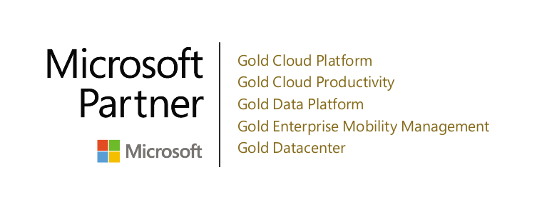
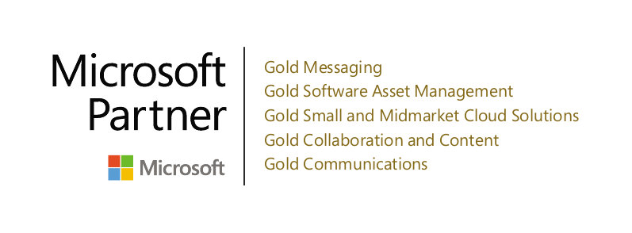
&
CAMSA Road Tour
Will Miller – Sales Manager, CAMSA
Douglas Burge – Sr. Sales Representative, Bay Area
Notes:
Ask Josh: What are the differentiators in our Microsoft qualifications from the other LSPs? Anything? Specific to SHI?

Slide 3
Agenda
Softchoice CAMSA Support Structure
Softchoice Contract Management Process
CAMSA 2.0
Softchoice Service Offerings
Questions/Wrap

Slide 4
Softchoice Support Structure

Slide 5
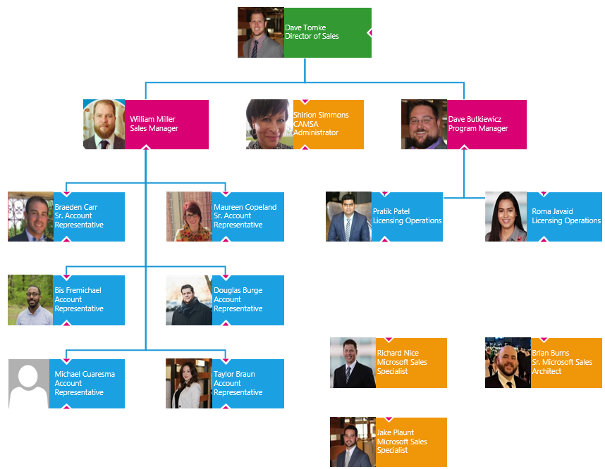
Notes:
Talk about who supports what.
Why have we created the new roles and what do they support?

Slide 6
Softchoice Contract Management Process

Slide 7
Microsoft Enterprise Lifecycle Management (ELM)
3 Common Challenges
Licensing changes
Asset Visibility
License Optimization

Slide 8
Softchoice Contract Value Process
Review your Licensing Entitlements, cloud usage, and Software Assurance usage with our Microsoft Solutions Specialists
Discuss product and licensing changes and the potential impact to your agreement
Develop a plan to activate and use the products and services available through the license agreement

Slide 9
CAMSA 2.0

Slide 10
Then: Education Desktop and now: Microsoft 365 Education
Education Desktop
Microsoft 365 A3
What’s new for CAMSA 2.0 customers?
Office Professional Plus
w/ rights to Office 365 ProPlus
Office 365 A3
w/ rights to Office Professional Plus
Office 365
Advanced Security Management
Live Meeting Broadcast
Bookings
Enterprise Mobility + Security
Intune for Education
Azure Active Directory Premium P1
Azure Information Protection Premium P1
Advanced Threat Analytics
Minecraft: Education Edition
Client Access and Server Licenses
All customers get Productivity Server licenses
Windows SA
Windows E3
EMS E3
Minecraft: Education Edition
Windows CALs (Core or Enterprise)
Windows CALs (Enterprise)
Productivity CALs (Core or Enterprise)
Productivity CALs (Enterprise)
Productivity Server Licenses (Enterprise)

Slide 11
Then: Education Desktop and now: Microsoft 365 Education
Education Desktop
Microsoft 365 A3
What’s new for CAMSA 2.0 customers?
Office Professional Plus
w/ rights to Office 365 ProPlus
Office 365 A3
w/ rights to Office Professional Plus
Office 365
Advanced Security Management
Live Meeting Broadcast
Bookings
Enterprise Mobility + Security
Intune for Education
Azure Active Directory Premium P1
Azure Information Protection Premium P1
Advanced Threat Analytics
Minecraft: Education Edition
Client Access and Server Licenses
All customers get Productivity Server licenses
Windows SA
Windows E3
EMS E3
Minecraft: Education Edition
Windows CALs (Core or Enterprise)
Windows CALs (Enterprise)
Productivity CALs (Core or Enterprise)
Productivity CALs (Enterprise)
Productivity Server Licenses (Enterprise)

Slide 12
Then: Education Desktop and now: Microsoft 365 Education
Education Desktop
Microsoft 365 A3
What’s new for CAMSA 2.0 customers?
Office Professional Plus
w/ rights to Office 365 ProPlus
Office 365 A3
w/ rights to Office Professional Plus
Office 365
Advanced Security Management
Live Meeting Broadcast
Bookings
Enterprise Mobility + Security
Intune for Education
Azure Active Directory Premium P1
Azure Information Protection Premium P1
Advanced Threat Analytics
Minecraft: Education Edition
Client Access and Server Licenses
All customers get Productivity Server licenses
Windows SA
Windows E3
EMS E3
Minecraft: Education Edition
Windows CALs (Core or Enterprise)
Windows CALs (Enterprise)
Productivity CALs (Core or Enterprise)
Productivity CALs (Enterprise)
Productivity Server Licenses (Enterprise)

Slide 13
Softchoice Services & Microsoft Cloud

Slide 14
Softchoice Service Offerings
Workload Assessments
Discovery and design / migration planning
Network Assessment
Azure and Office 365 pilots / migrations
Extensive bench expertise
Workload optimization
Licensing optimization
User Adoption
Training
Ongoing support and managed service options

Slide 15
What are the risks?
Leaping before you look!
Tenant creation best practices
Workload assessment
Cloud feasibility
Admin training
Migration Strategy
User Communications
Networking issues
Overspending
Forklifting workloads
Over-provisioning
“Just spin up another server!”
Not optimizing workloads, licensing, compute, etc.
User Adoption
Notes:
While the Microsoft cloud is obviously fantastic, there are some risks involved with any cloud migration *click through bullets and discuss*

Slide 16
Planning your migration to the Cloud
Assess
Understand financial impacts / true cost of ownership
Determine desired path forward
On-Premises Workload Assessment
Gap Analysis of existing environment
Pilot
Create “sandbox” cloud environment
Determine team members / stakeholders
Determine Best practices / requirements / compliance
Acclimate to Azure / Office 365 tools and processes
Plan
Review existing workloads / requirements / cloud feasibility
Create Prerequisites / Gap Analysis for cloud migration
Determine highest priority (EOS) and Lowest hanging fruit workloads
Create Migration plan for candidate workloads
Lay Groundwork for migration, migrate a single production workload
Migration
Review existing cloud workload(s) pilot results / cost
Lay groundwork for additional workload migrations
Create Scripts / tools for migration
Communicate with users
Create migration timeline
Begin migrations
Optimize
Utilize reports to determine workload cost
Review reports with Cloud Expert to determine optimization options (VM Scaling, Storage right-sizing, PaaS, etc.)
Begin optimization tasks
Notes:
Luckily Softchoice has assisted hundreds of cloud migrations, and have it down to a science. We want to make sure that your cloud journey goes as smoothly as possible, so we have a standard operating procedure on migration to the cloud.
We begin with the Assess phase where we begin to look at the existing environment, and determine a few things: What is the actual cost of our environment today? This would include Hardware, software licenses, networking, anti-virus, MPLS, Cooling, fire suppression, etc. This can be a daunting task, but we are here to help. We also want to determine what the actual goals are – is it 100% cost savings? Do you want additional redundancy and uptime? Do you want additional compute power? all of the above? We can then start to review the on-premises workloads (or even workloads in a colo or other public cloud), and get the raw data on what is there. We also want to discuss what the perceived shortcomings of the existing environment are today.
Click 1 – At this point we are ready to start using Azure. We typically want to stand up a “base layer” azure configuration that allows admins to get acclimated with the Azure tools and processes. This COULD be a low-risk production workload, but is typically a sandbox type environment. *Read the step under “Pilot”*
Click 2 – When we have decided that workload migration to the public cloud is a good fit, we can start planning out the actual migration. *Read the step under “Plan”*
Click 3 – Once we have thoroughly assessed the environment, and planned out the migration, we are ready to get moving! In this phase we will *Read the step under “Migration”*
Click 4 – When we are migrating over workloads, we are going to optimize as best we can based on the information we have available to us. However, you really need to have the workloads running in the cloud for a bit to determine the real optimization options. In the optimize phase we will *Read the step under “Optimize”*

Slide 17
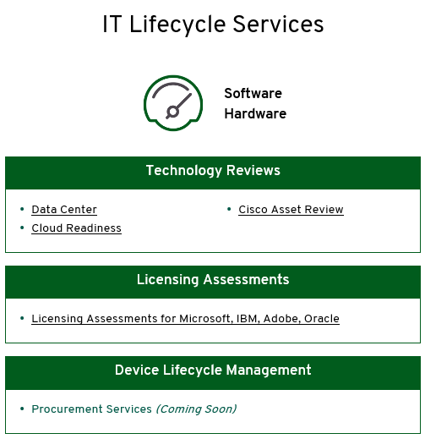
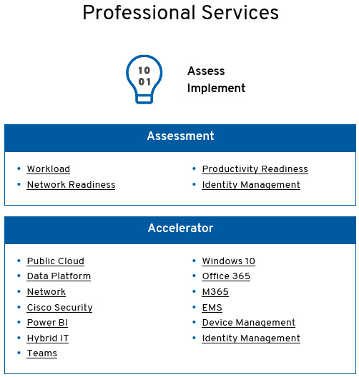
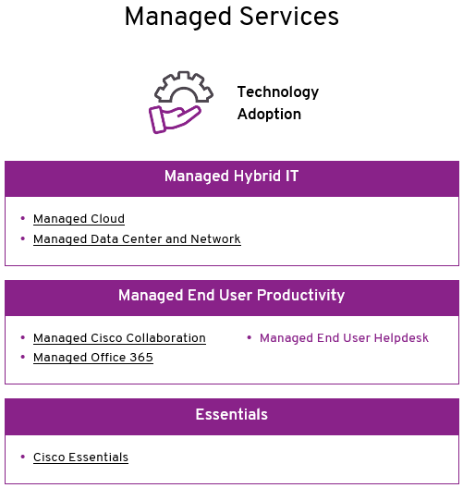
Softchoice Services

Slide 18
Softchoice Azure Accelerator
ENVISION AND PLAN
Education of Azure and the selection of a production workload to achieve success
ARCHITECT
Reference architecture built from the experience of over 300 migrations
MIGRATE
Complete Azure migration delivered from engineers certified in the Azure Accelerator offering
SUPPORT
Cost governance, technical, and configuration support from our Keystone Managed Services Team
Accelerator

Slide 19
Next Steps, Questions, or Concerns?

