Slide 1
Mobile home repairs

Slide 2
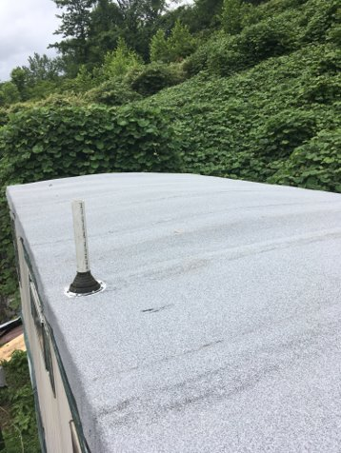
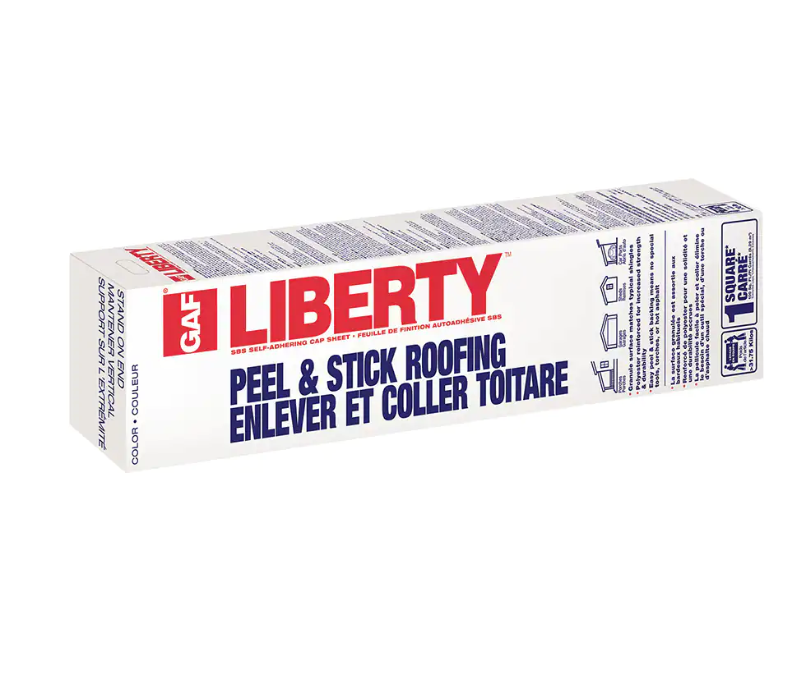
SBS ROOFING (Styrene-Butadiene-Styrene) Self Adhering Cap Sheet

Slide 3
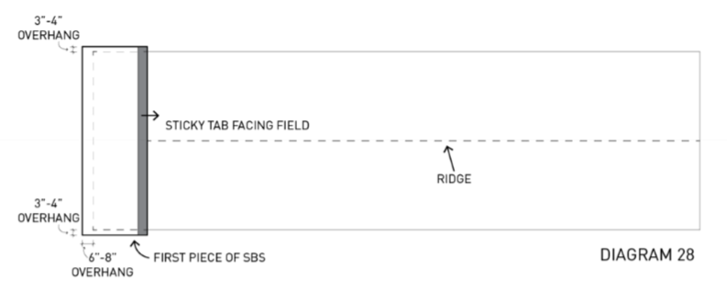
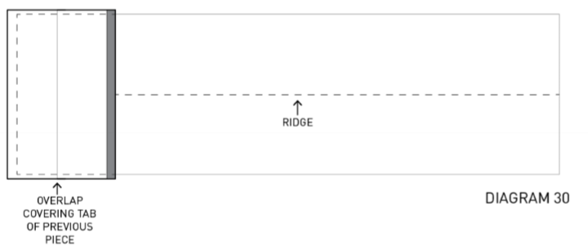
One Piece Installation Page 115
Measure and cut the pieces, they will run down the wall 3-4”
Position and stick first piece down
Use roller to apply pressure to whole piece
The next piece should cover the sticky tab of the first
Repeat for length of roof

Slide 4
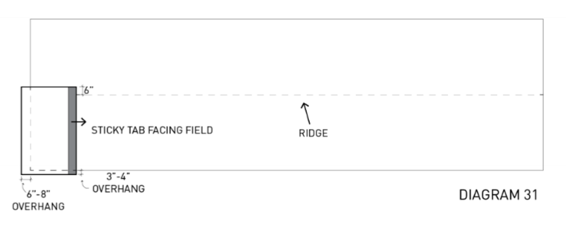
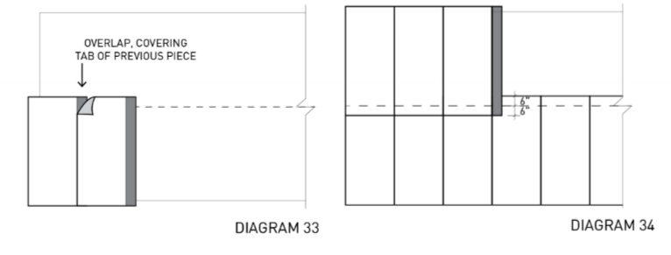
Two Piece Installation Page 117
All pieces on one side will be on the bottom of the overlap
Stick the and roll the first piece
Overhang 6” at ridge
Overlap the second piece over stick tab and repeat for length of roof
Follow the same process on the other side

Slide 5
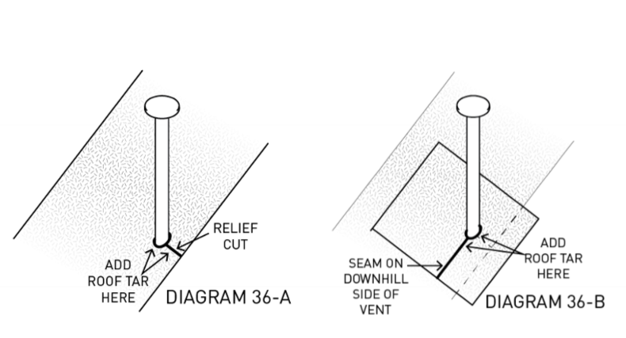
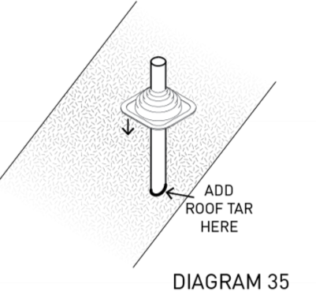
Vent Pipes Page 119
If possible, cut a hole and slide SBS over pipe and use boot
Otherwise use relief cut and cover with a small SBS square

Slide 6
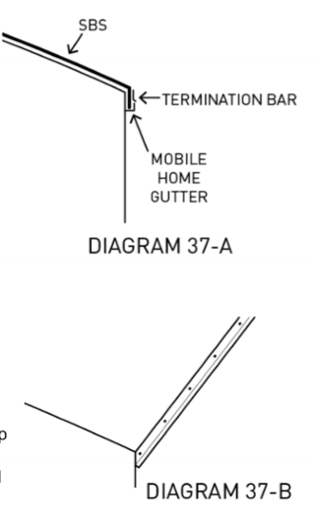
Termination Bars Page 120
Termination bar is installed around the top of the mobile home walls to hold down SBS
If overhang is built, attach termination bar to that. If no overhang, attach it to the top plate of wall
Use smaller sections on the rounded end of the mobile home

Slide 7
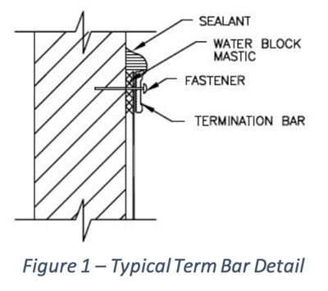

Slide 8
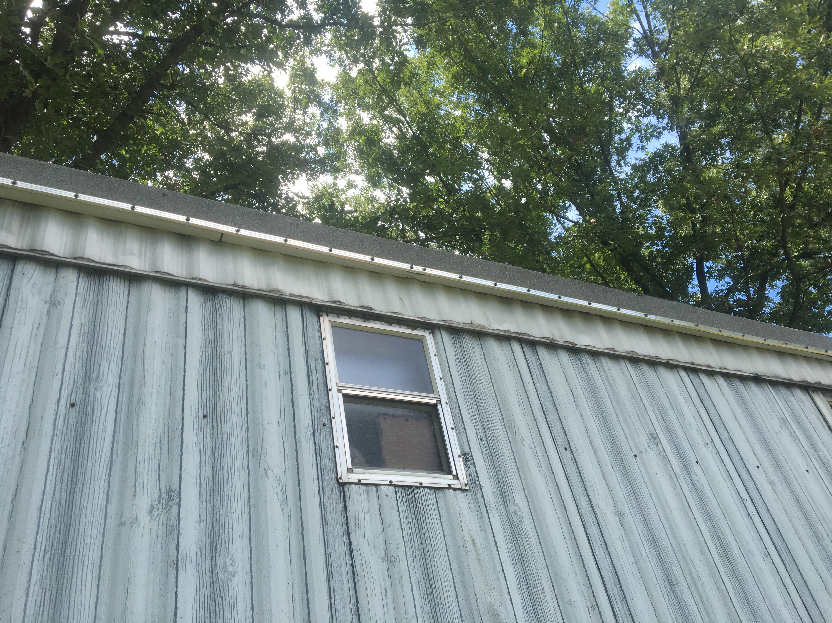
Termination Bar Example

Slide 9
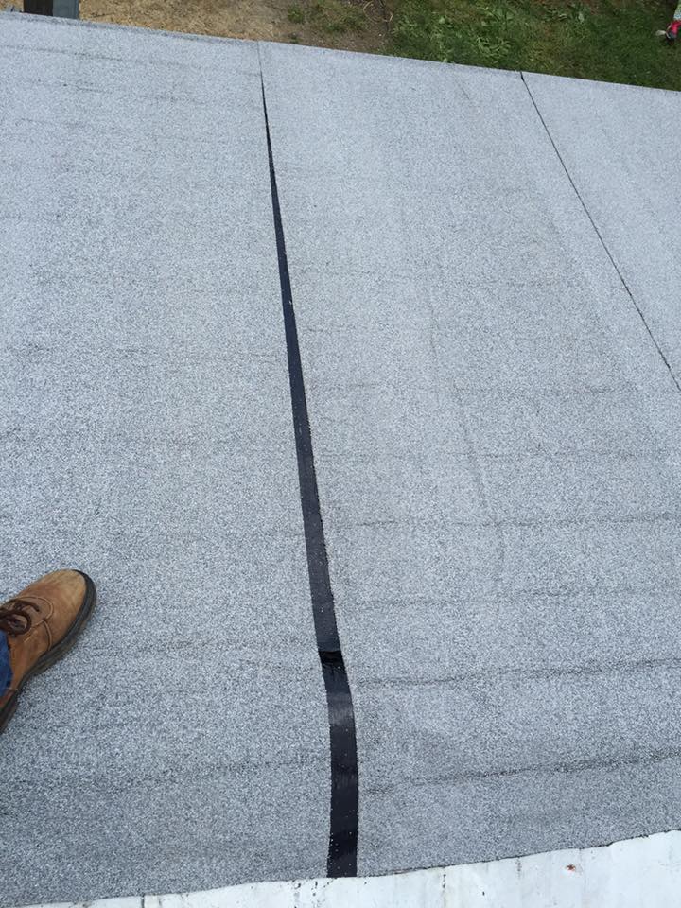
Exposed Seam

Slide 10
SBS Roof Example

Slide 11
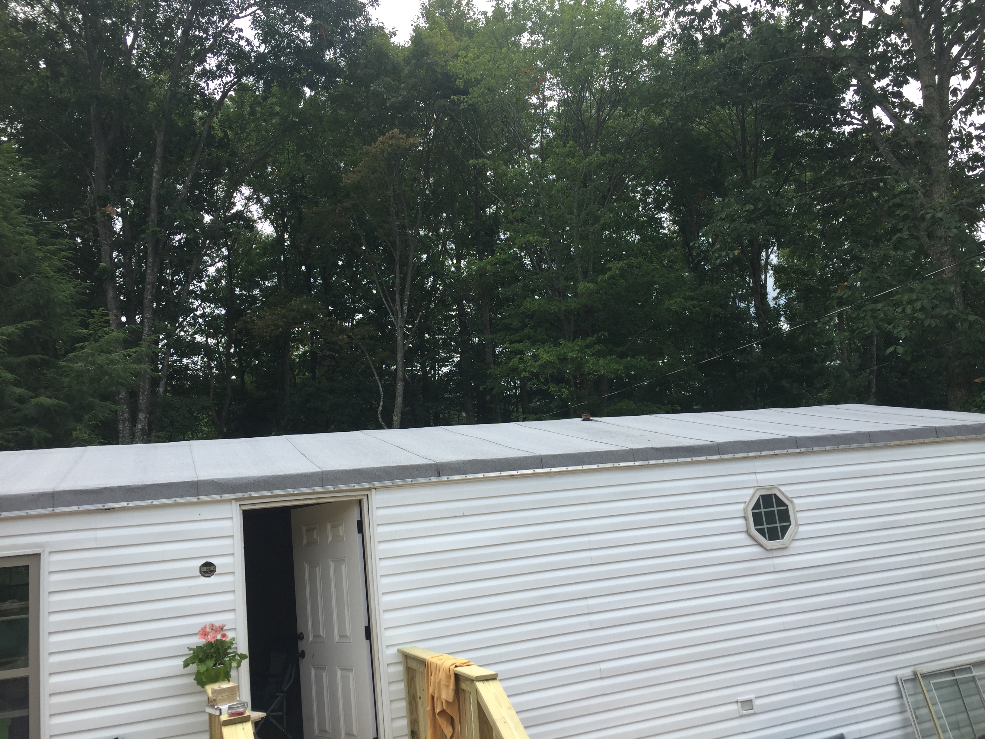
SBS Roof Example

Slide 12
Construction Corner
SBS Instructional Video

Slide 13
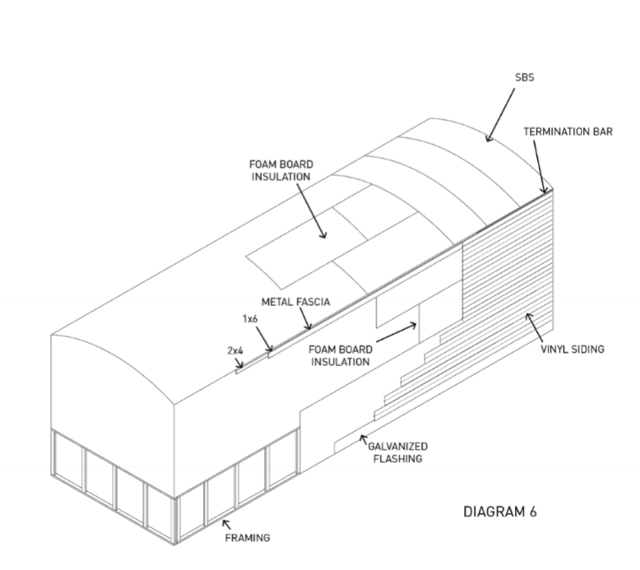
“HUG SYSTEMS”

Slide 14
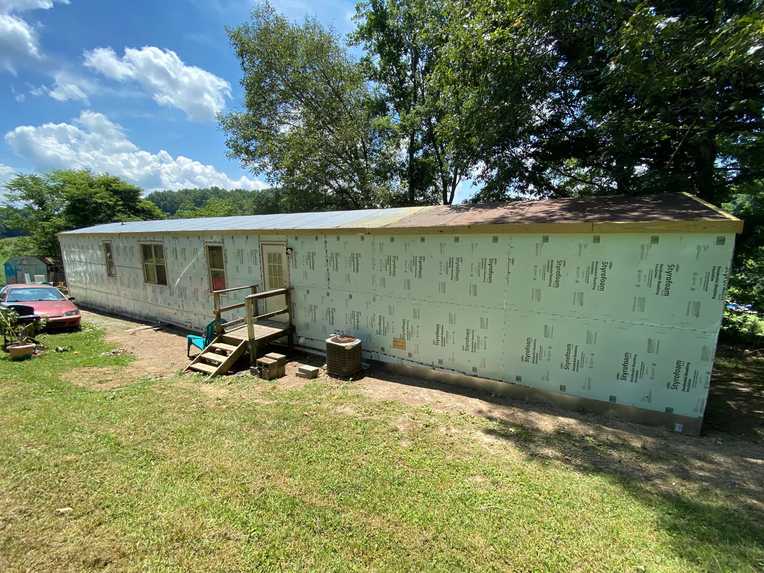
System in Progress

Slide 15
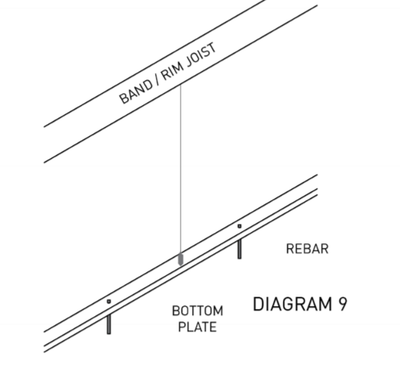
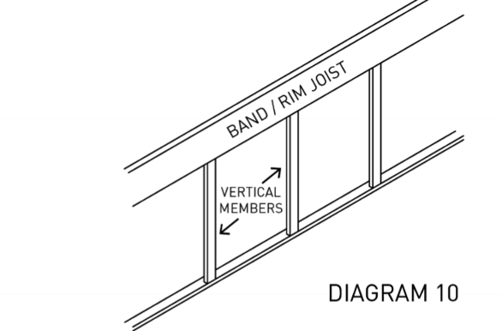
Frame Out Underpinning
Install bottom plates
Install vertical framing members

Slide 16
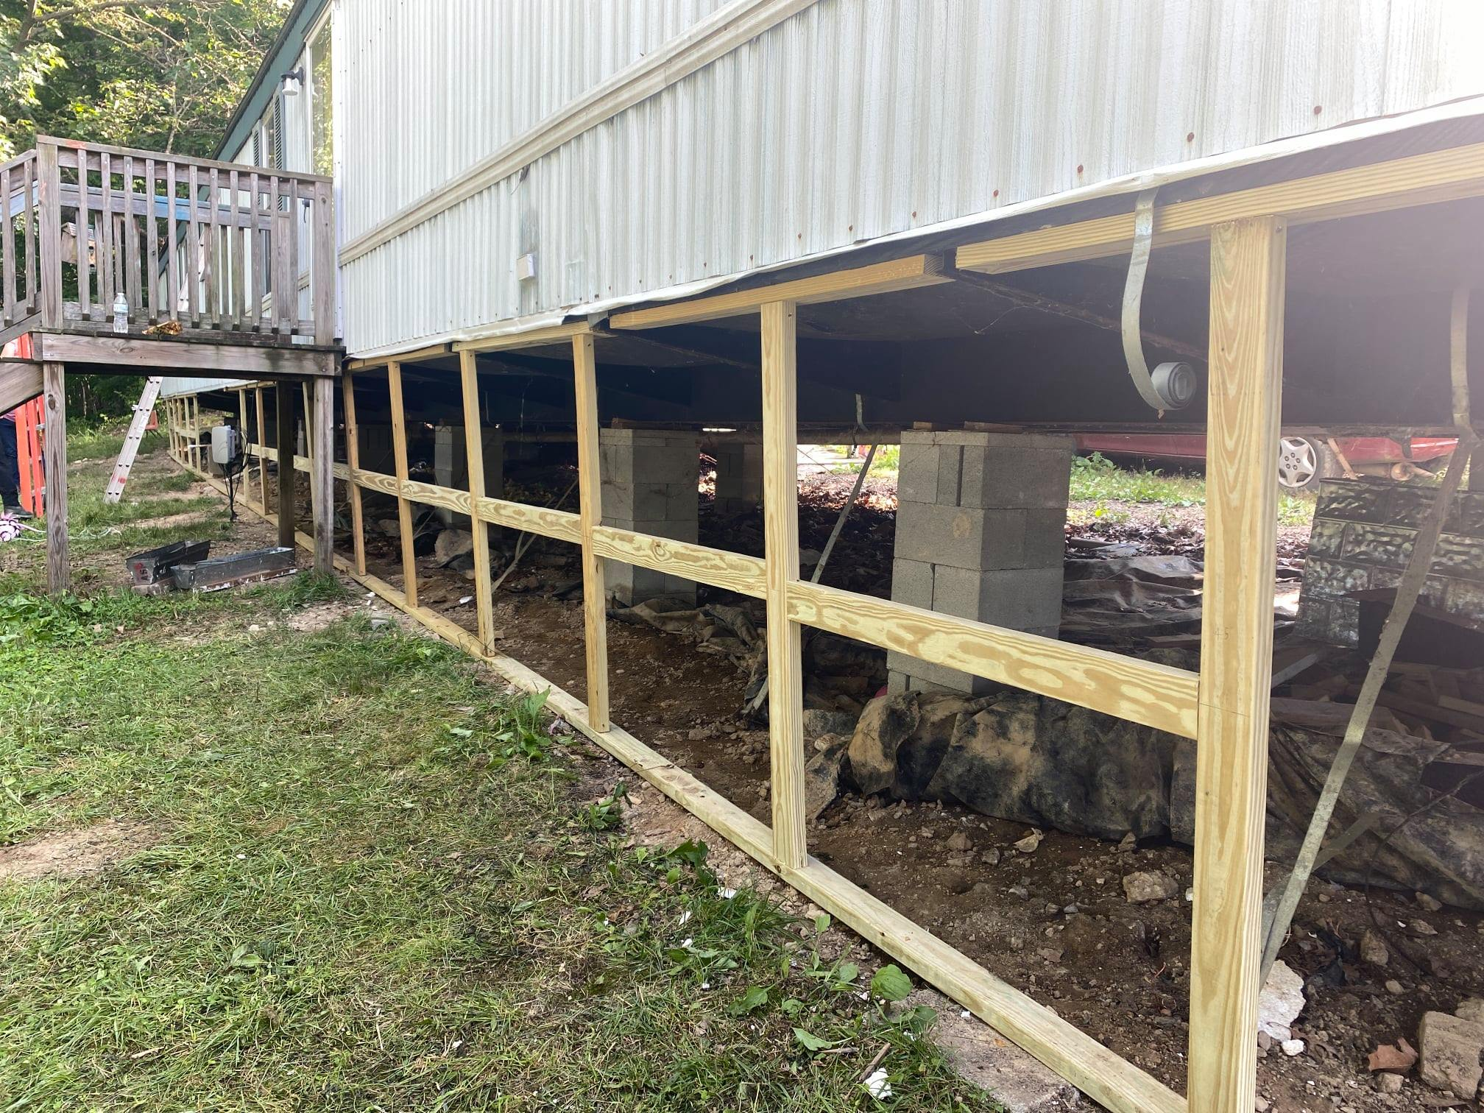

Slide 17
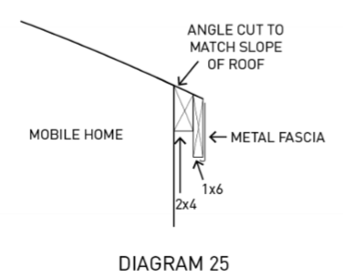
Build Out Overhang
The overhand prevents water from running down the wall

Slide 18
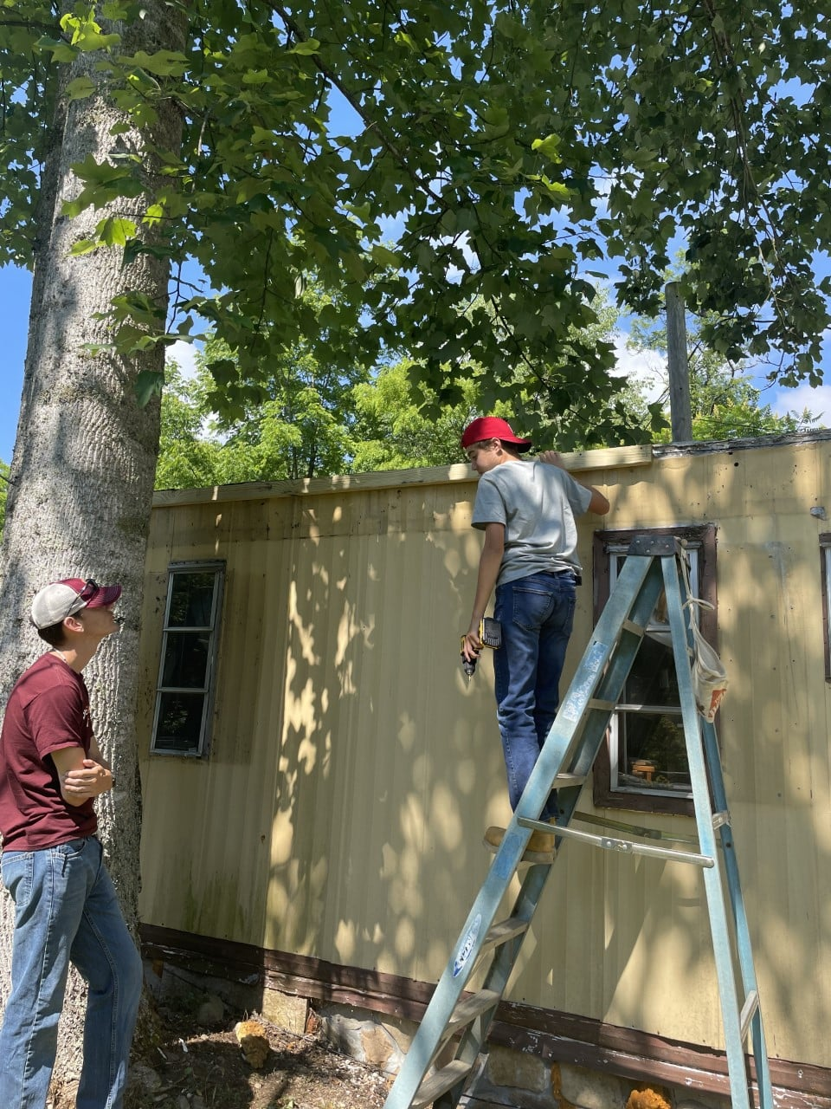

Slide 19
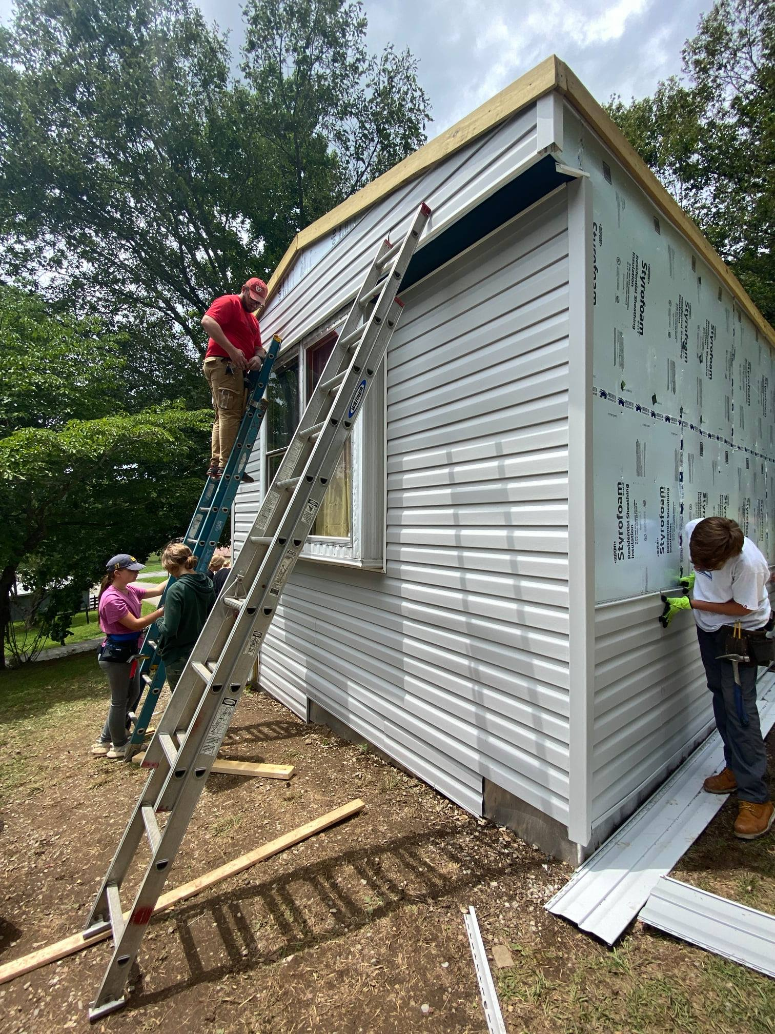

Slide 20
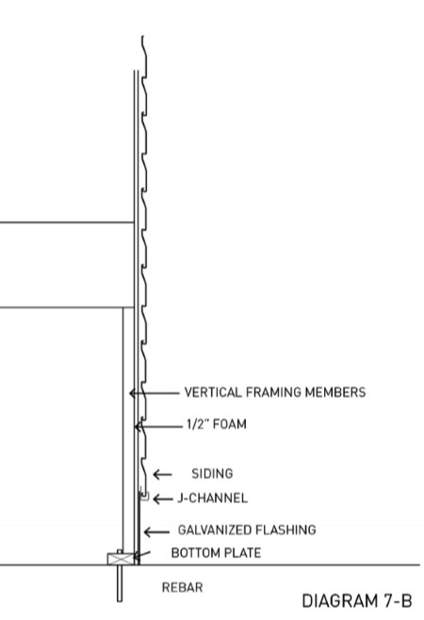
Install Flashing and Vinyl Siding

Slide 22
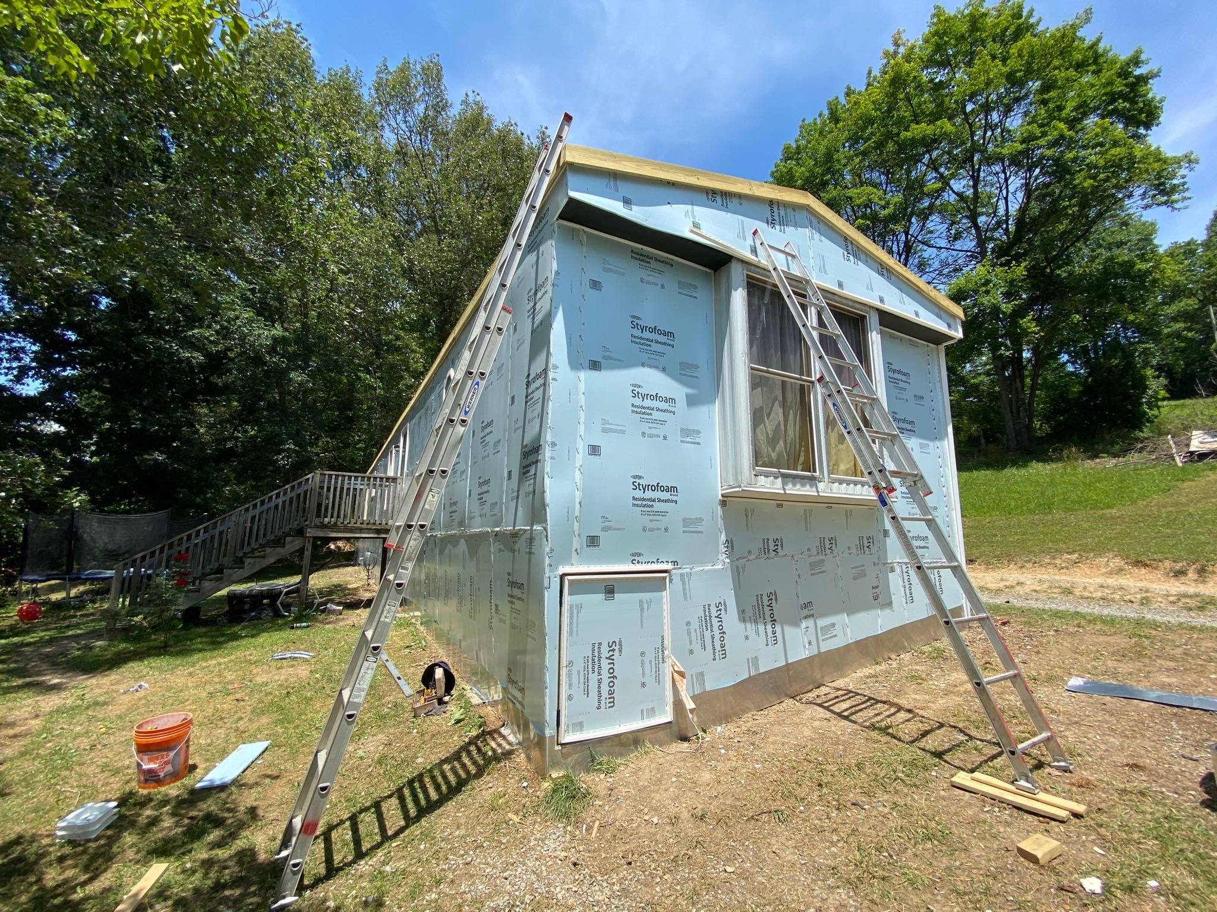

Slide 23
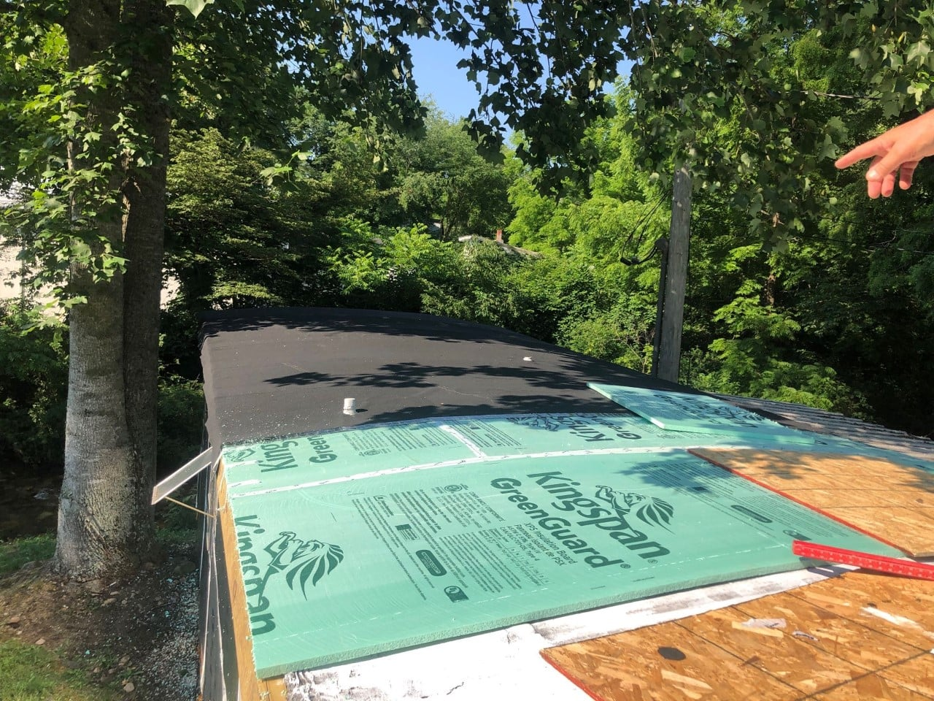

Slide 24
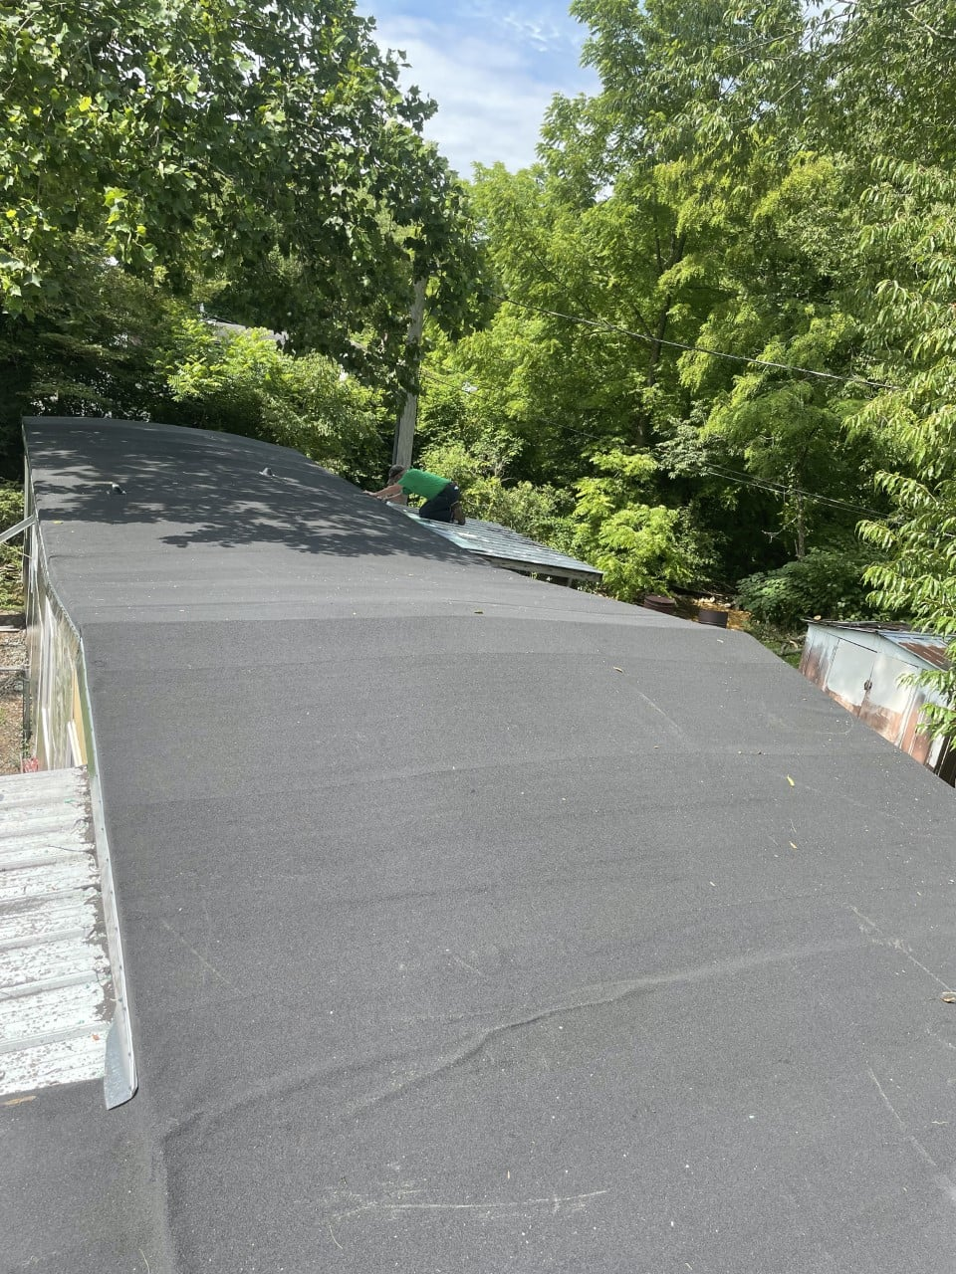

Slide 25
Things to watch for
Wires!
Details around windows
Appropriate spacing on skirting/underpinning framing
Make sure crawlspace is vented!
The minimum net area of ventilation opening must not be less than 1 square foot for each 150 square feet of under-floor space area.

Slide 26
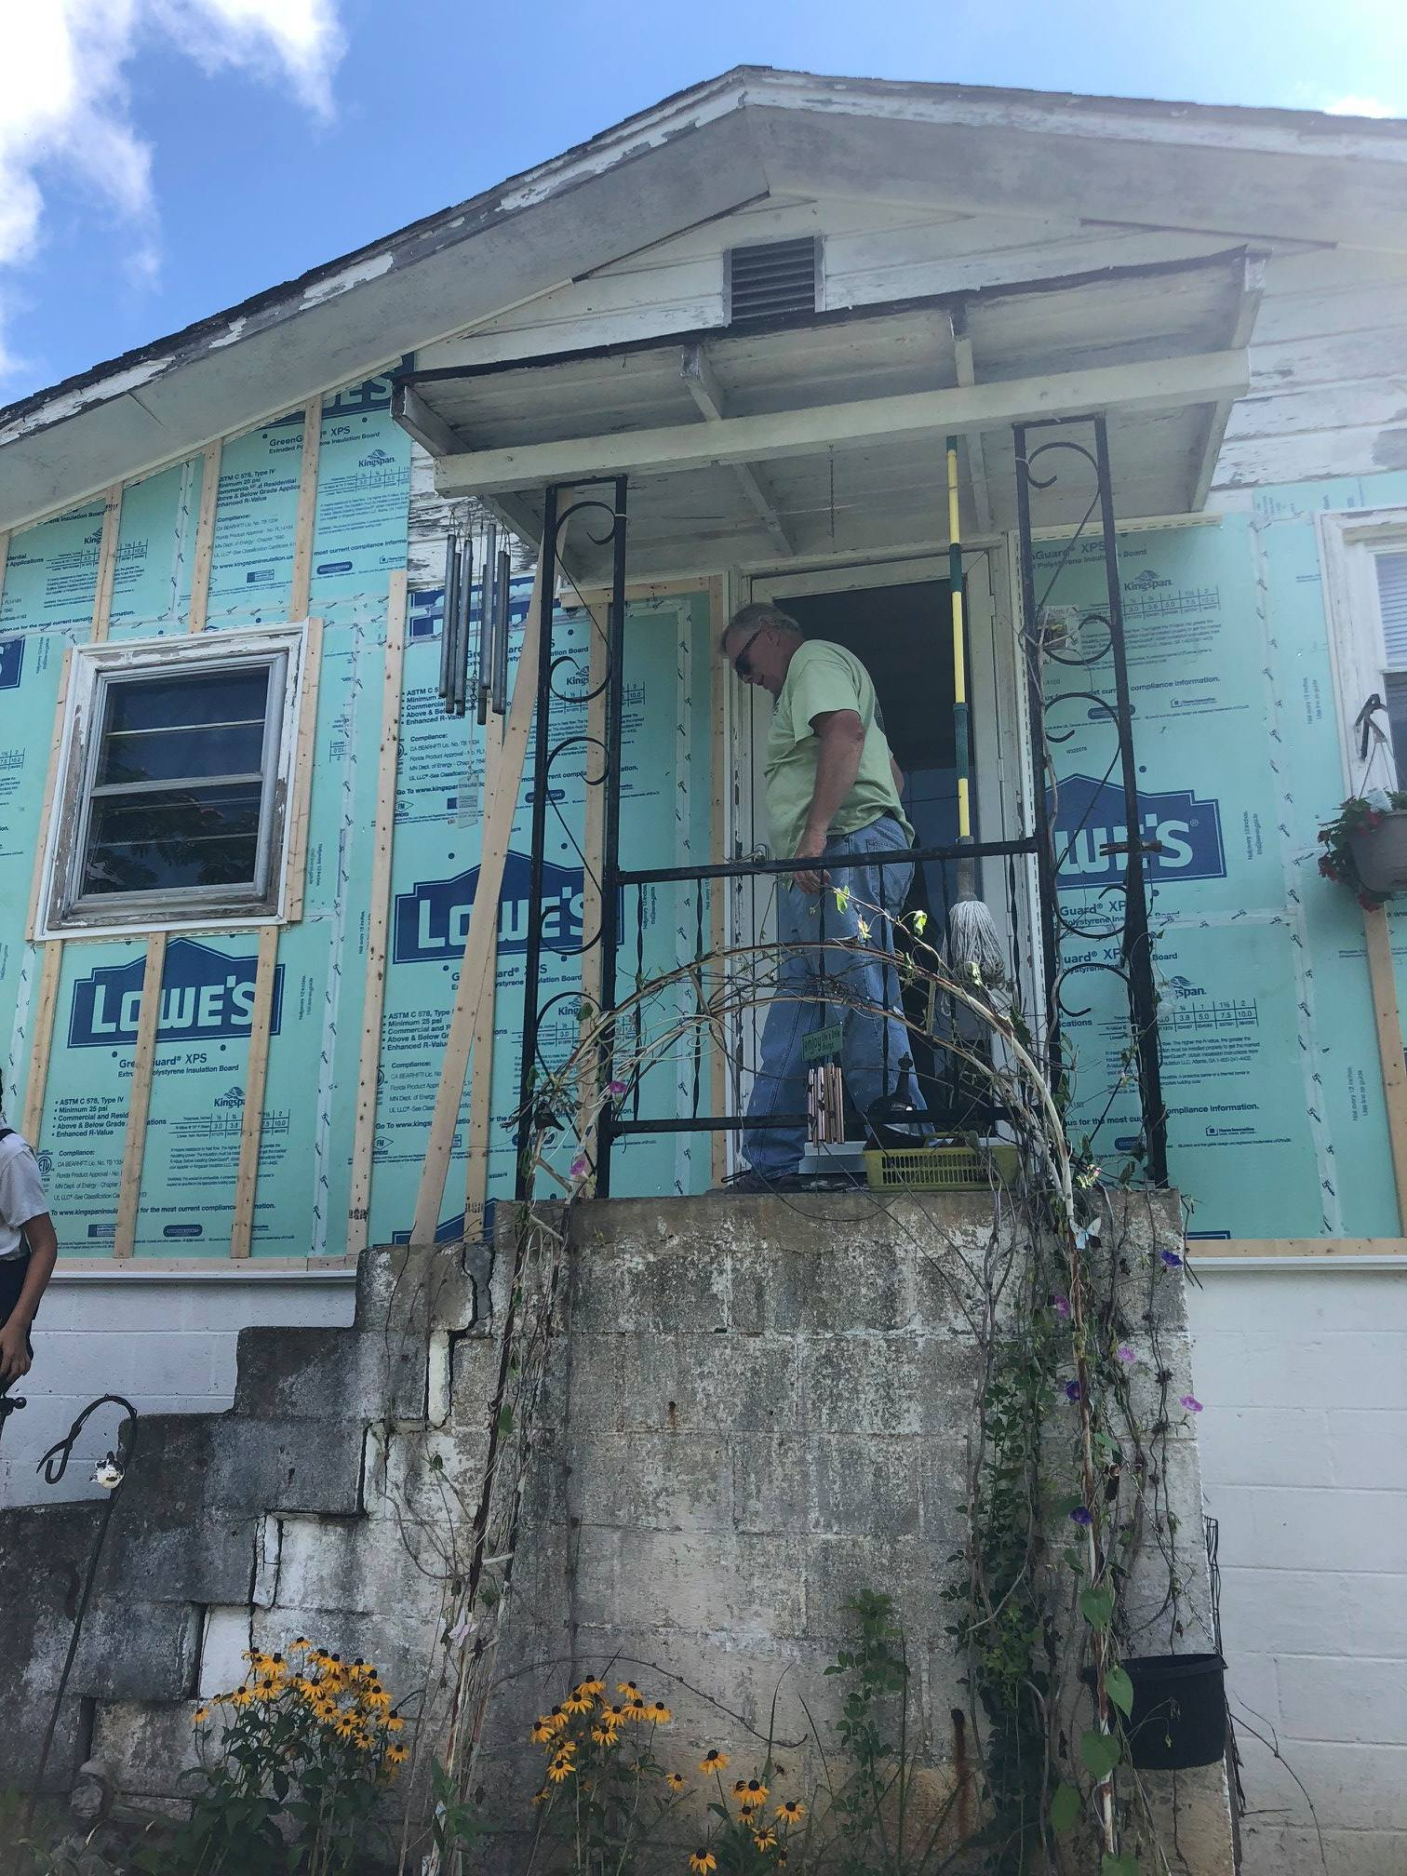

Slide 27
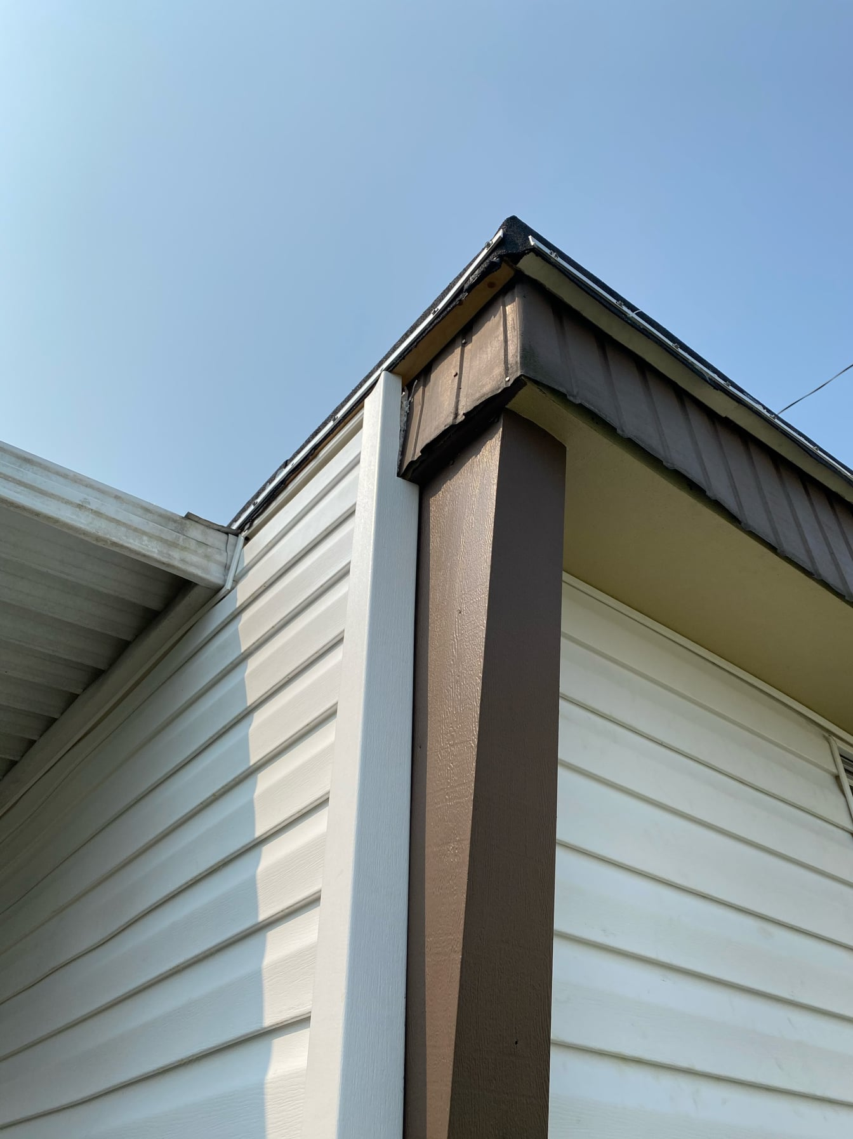

Slide 28
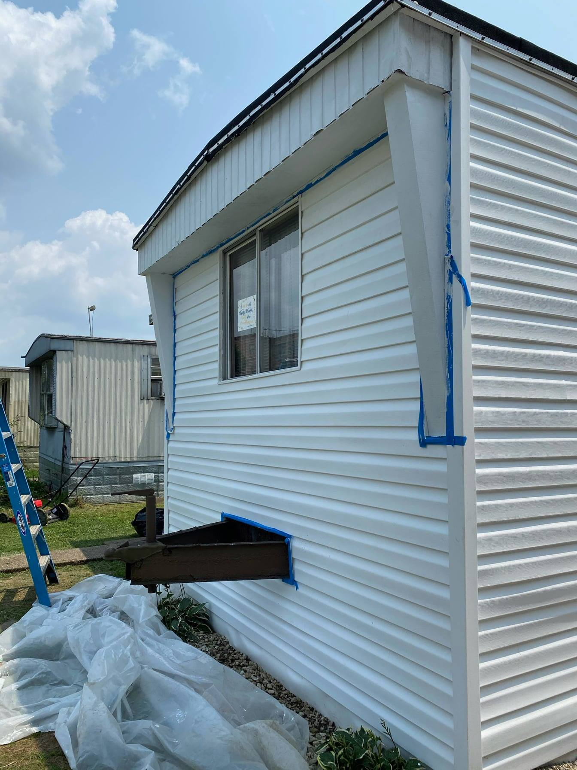

Slide 29
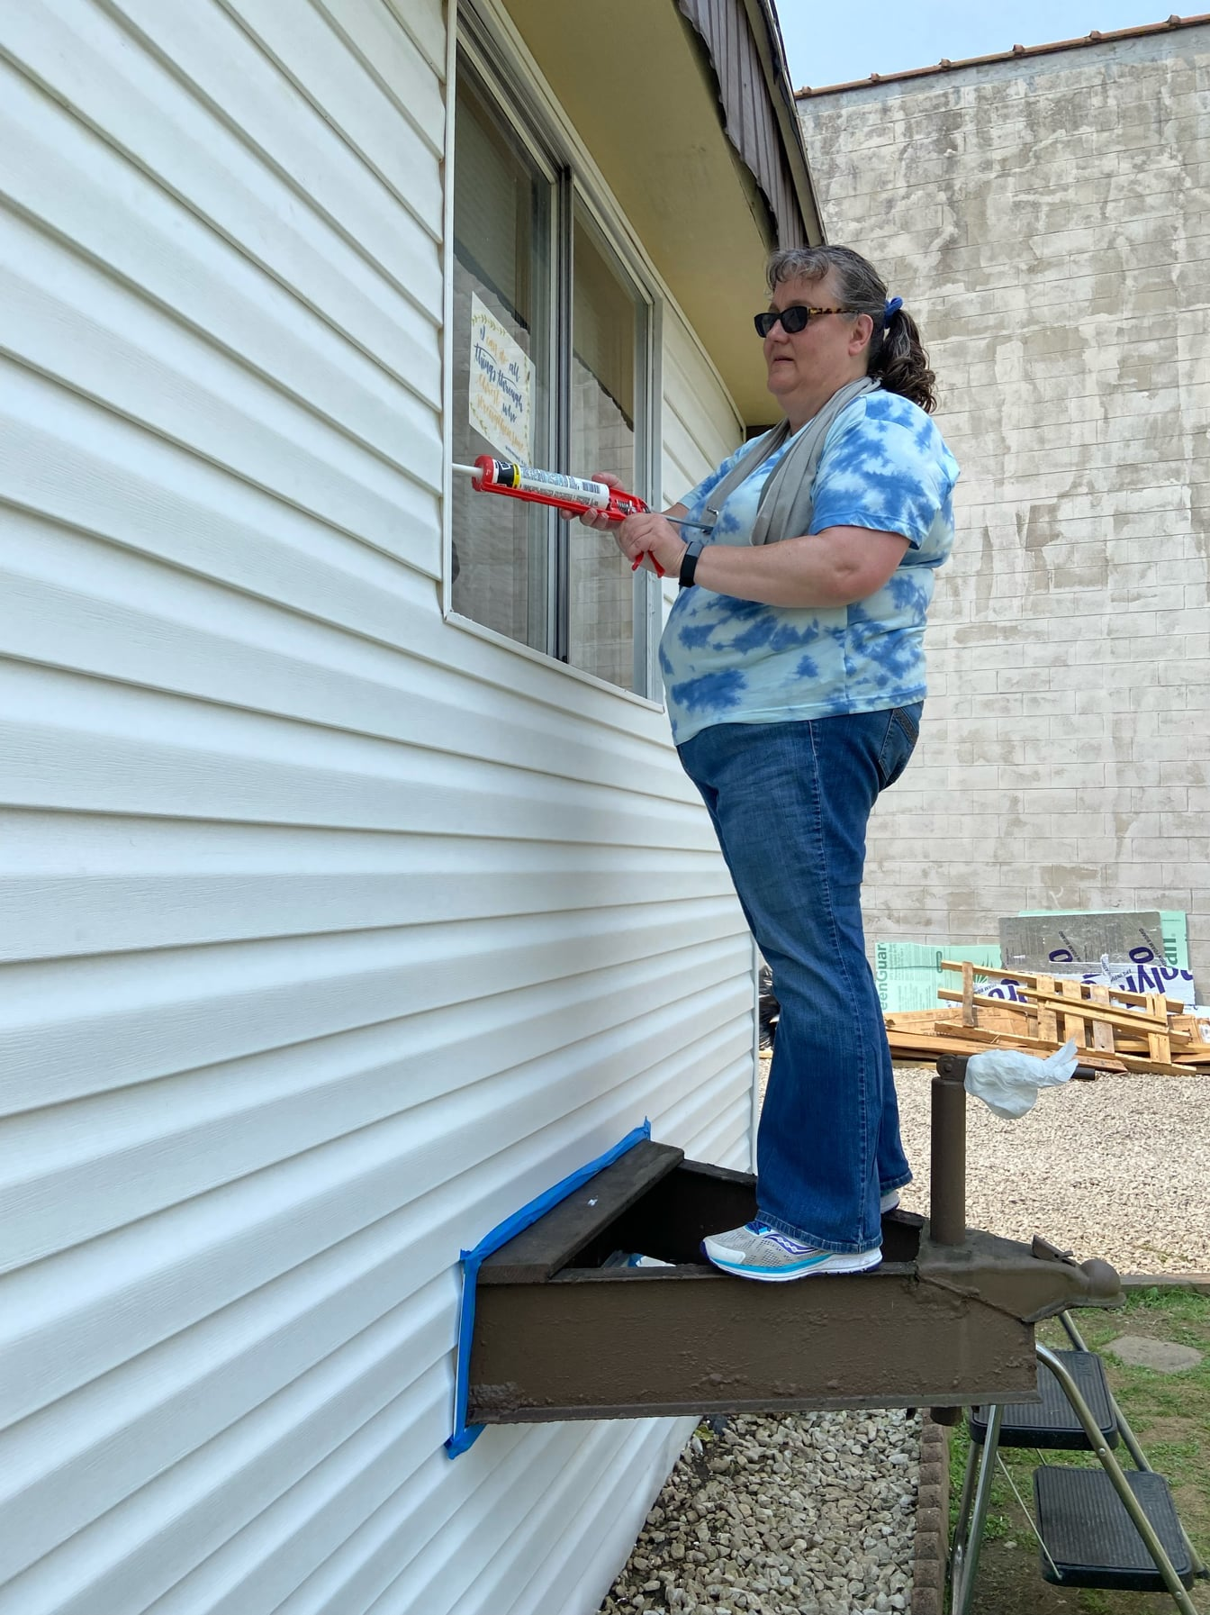

Slide 30
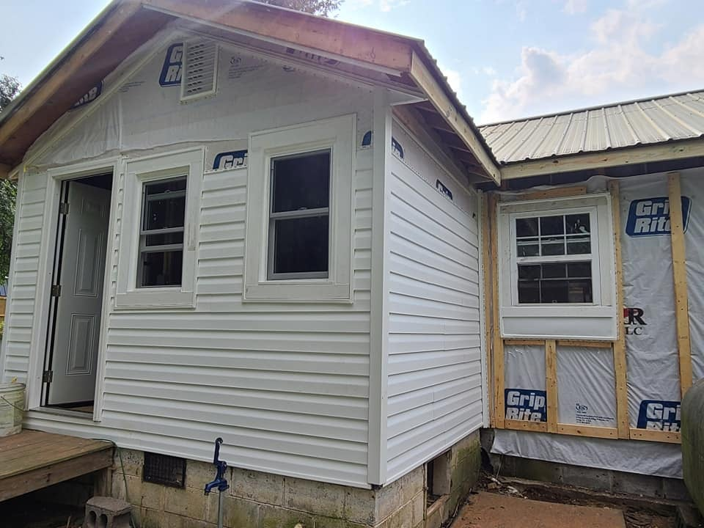

Slide 31
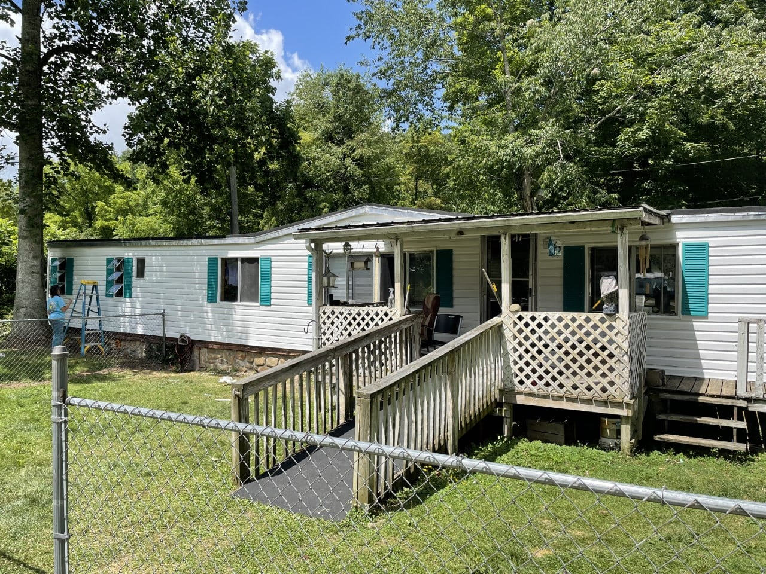

Slide 32
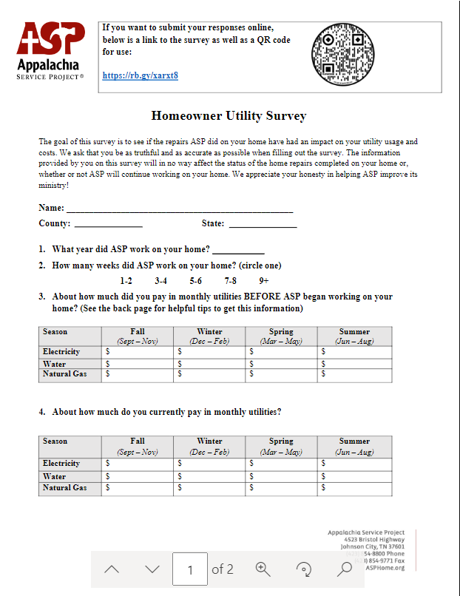
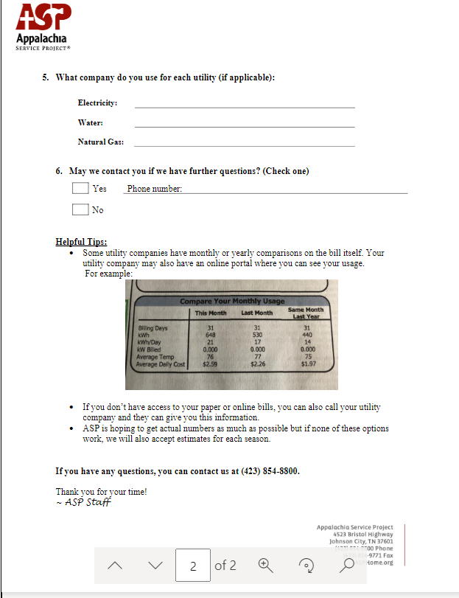

Slide 33
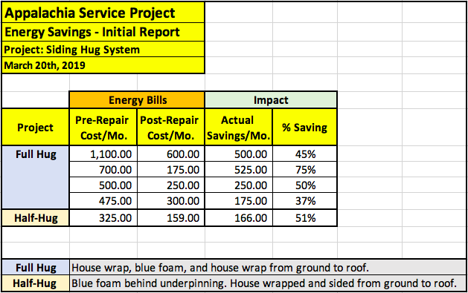
Preliminary Data

Slide 34
Mobile Home Ceiling Repair
Construction Corner Video

Slide 35
Questions?

