Slide 1
All About Grab Bars
Tools, Training, and Installation

Slide 2
Grab Bars for Every Need
Grab bars are any mounted assistance device that aids balance, movement and stability.
Grab bars are not just for bathrooms!
Grab bars are useful to maneuver stairs or navigate a change of levels.
Grab bars may also be needed to assist activities of daily living, such as getting in and out of bed, assistance in walking, or in the kitchen.

Slide 3
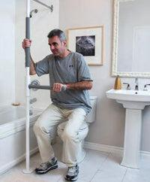
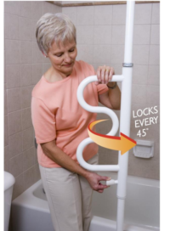
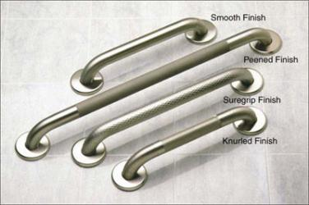
All Types of Grab Bars
FLOOR TO CEILING SECURITY POLE

Slide 4
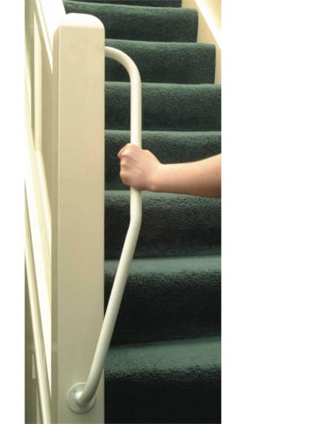
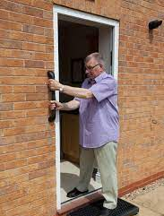
Uses Outside the Bathroom

Slide 5
ADA Recommendations VS Real-World Use
American Disability Act (ADA) guidelines are general recommendations for installation. They were developed for commercial applications where a wide variety of people may use grab bars or assistance devices.
Individual homes are exempt from strict guidelines (within reason).
Adjust the bars to fit client’s needs!
A six-foot person needs a different height than a five-foot person.
Factors such as vision loss or mental status will determine usage.
Wheelchair use may change height needed.

Slide 6
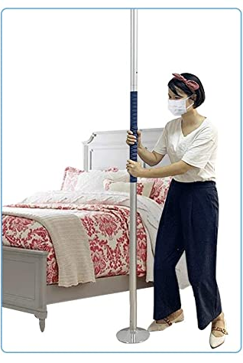
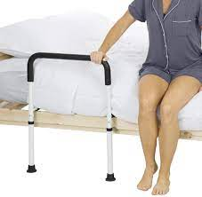
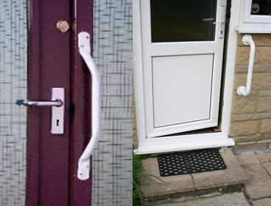
Assist the User Everywhere

Slide 7
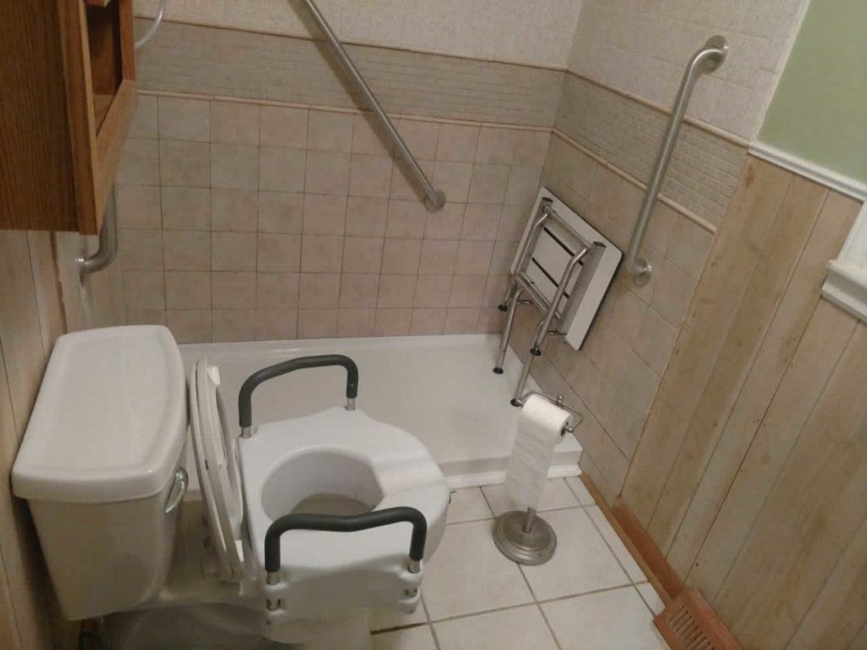
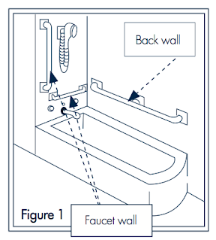
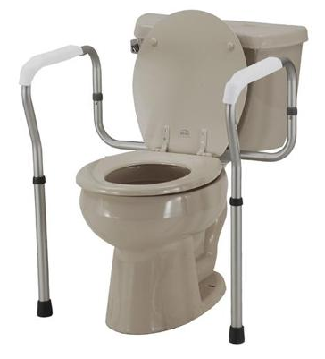
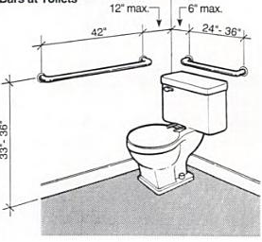
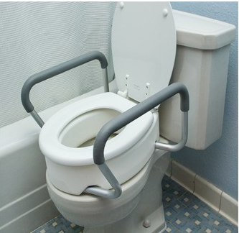
In the Bathroom
Consider need for:
A shower chair.
A handheld shower..
A raised toilet or toilet seat riser

Slide 8
Height Recommendations
ADA requirements are a suggestion!
Horizontal grab bars is usually placed 33 to 36 inches up from the floor
The bottom of a vertical grab bar should be located 39 to 41 inches up from the floor.
Let the client show you how they get in shower or on toilet.
How does client typically get in and out of tub or shower? Have them show you. Where do they put their hands to get in tub or shower?
How does client get on and off toilet? Again, where they reach is where to install.

Slide 9
Typical Tools and Materials Needed
Grab Bar fasteners
Masking or painters' tape
Plug in drill
Phillips head screwdriver
1/16" drill bit (to probe for stud)
Stud finder
Level
Sharpie or pencil
Hammer
Safety glasses (optional)
Paper to make templates
Option but helpful things:
Rubber mallet
Drop cloth
Battery operated drill
Long Phillips bit or extension for drill
Shop vac or vacuum cleaner

Slide 10
Make an Installation Kit for Your Team! (Supplemental Tools to Grab and GO!)
¼" tile bit
1¼" or ¾" or both "Apache" bit
Various types of grab bar fasteners (WingIts, etc.)
Small bottle of rubbing alcohol, or alcohol pads, to clean soap scum from tile for adhesive
Rags
Silicon or Tub and Tile caulk
Small container of Redi-mix tile and grout repair
Extra screws
Wire "hole tester"

Slide 11
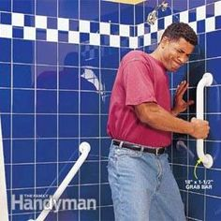
Secure the Grab Bars
First rule: They MUST be rock solid.
Second rule: The wall where they are attached must not be wet or deteriorating.
Use the "gorilla test." Grab the bar with both hands and yank on it with all your might. It shouldn't budge.

Slide 12
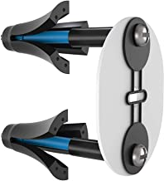
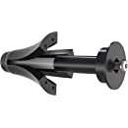
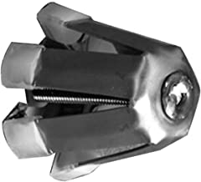
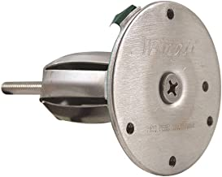
Grab Bar Fasteners
Wingit ™ Fasteners
The first and probably best for various situations, WingIts were originally manufactured for commercial use but now have several options for residential use. Note that these are easily installed using the "Apache" drill bit.
WingIts RC-MAW35-6 Master Anchor for Drywall
WingIts RC-RESGBW35-2
Bobrick 251-4 WingIts
Wingits GBW40

Slide 13
Apache Drill Bit
Apache drill bits for Wingit Fasteners
WingIts RC-WA200GT54 APACHE200 Drill Bit 1-1/4" for Grab Bar

Slide 14
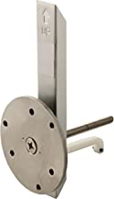
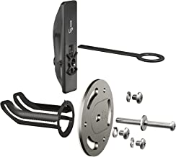
Other Fastener Options
Moen Secure Mount Anchors These are ideally used with Moen grab bars but will work with many other brands.
Delta DF549 Hollow wall anchor Delta's version of a grab bar fastener.
How it works.

Slide 15
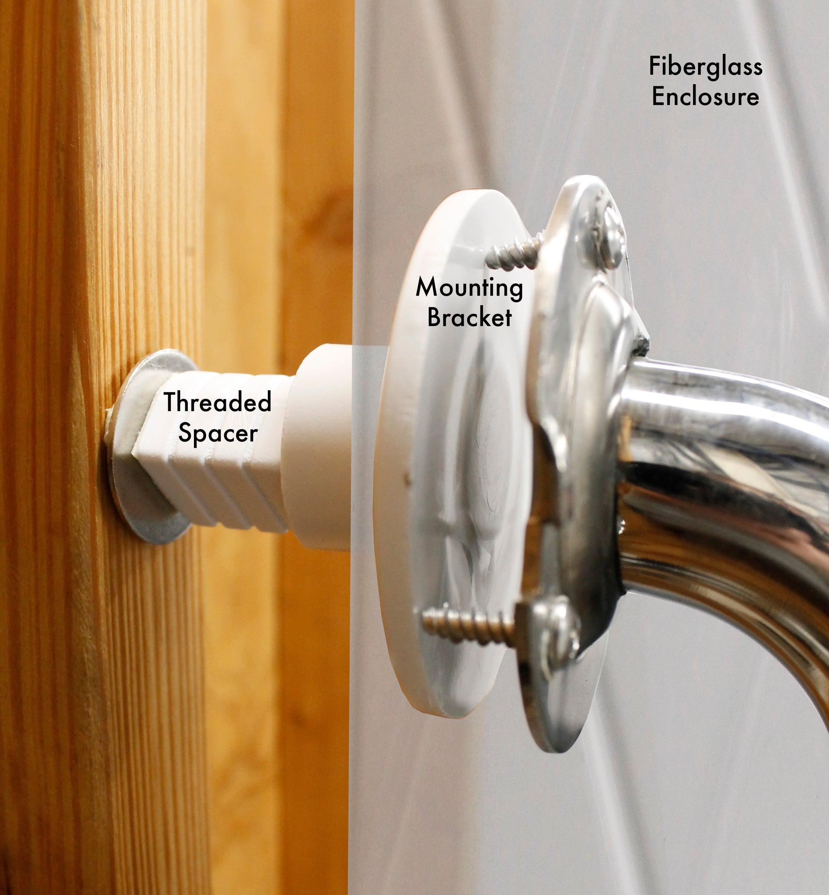
Solid Mount Fiberglass Shower Grab Bar Backer and Mounting Kit for Bathtub Safety

Slide 16
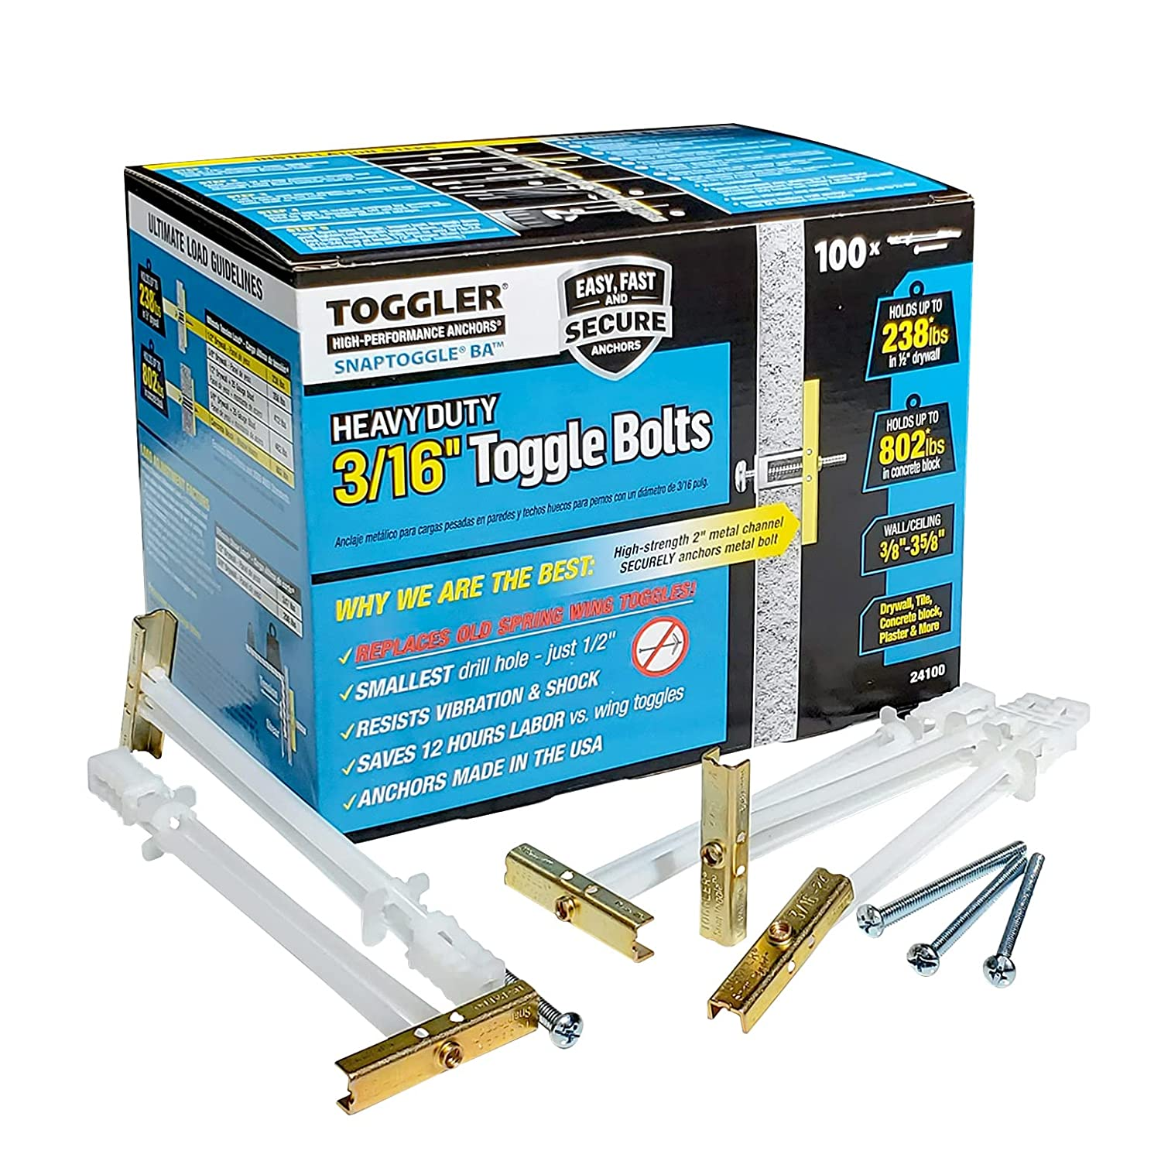
Useful to have but not recommended as the only fastener used to install grab bars.
SnapToggle ® Heavy Duty Toggle Bolts
SNAPTOGGLE heavy-duty toggle bolts carry twice the load in a smaller hole than standard wing anchors. In addition, a patented strap design with sturdier straps and smaller ratchet intervals adjusts more precisely and snaps off flush to the surface.

Slide 17
Schedule a Volunteer Training Class!
What are the volunteers' biggest concerns?
Damaging the home.
Not knowing how to install.
Installation failure.
Lack of confidence.
A training class will grow your volunteer team and instill confidence!

Slide 18
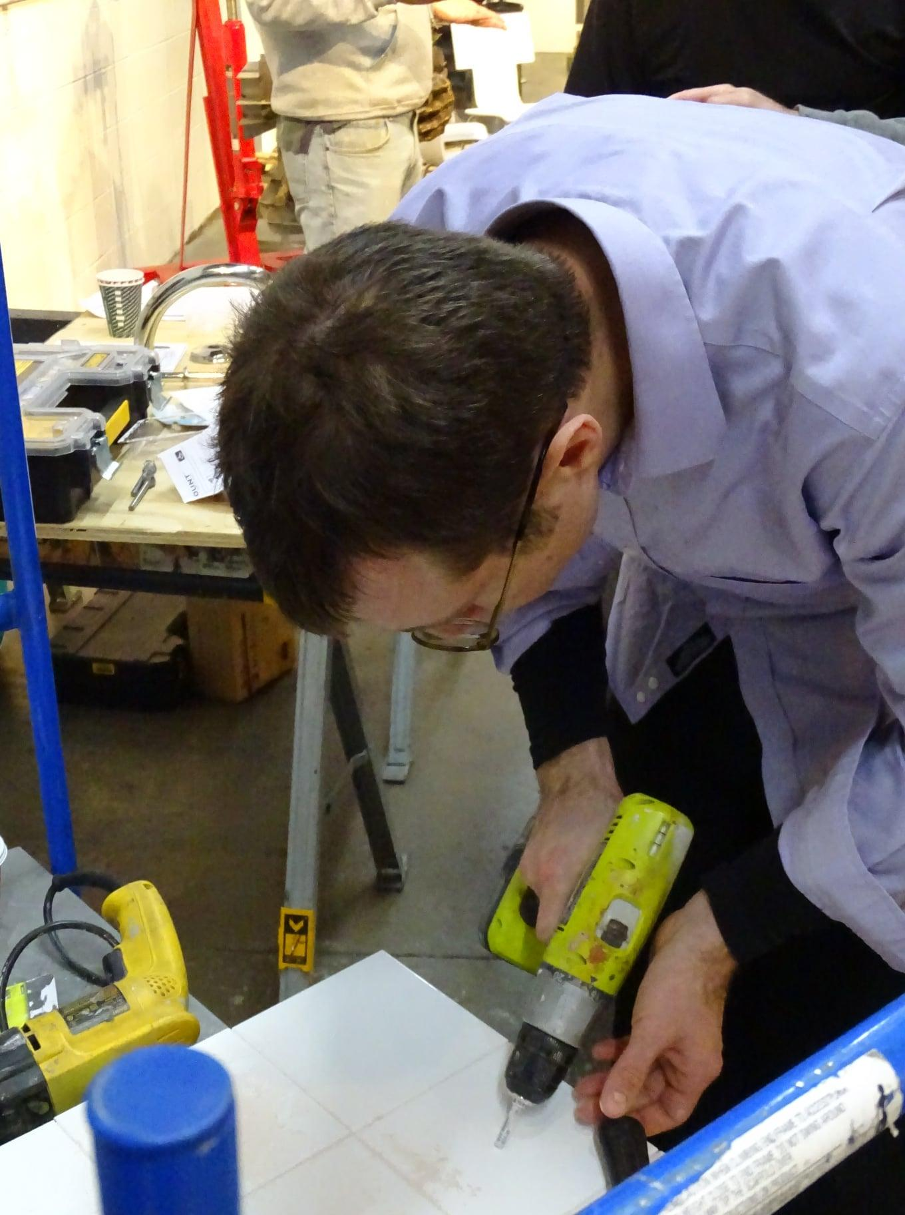
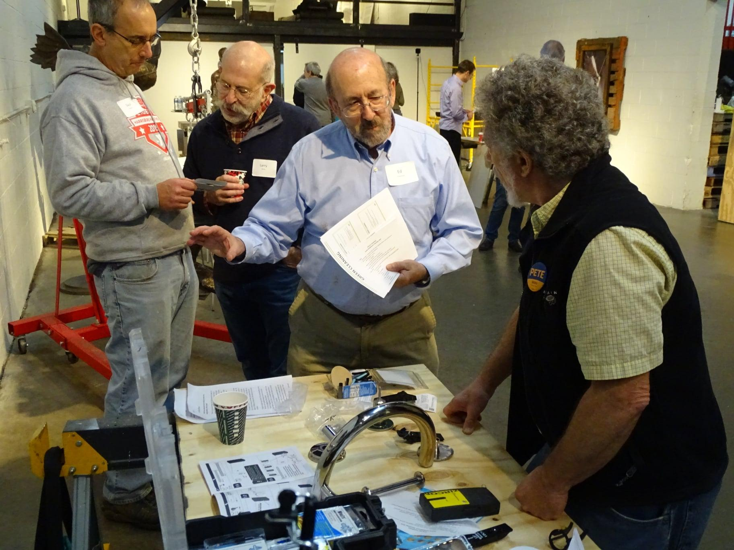
Train Your Volunteers
A class and a test drive will go a long way to instill confidence!

Slide 19
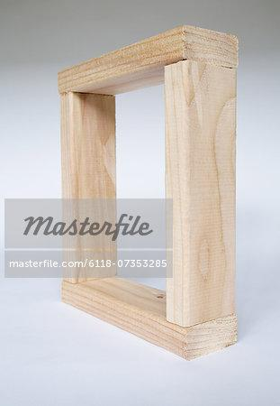
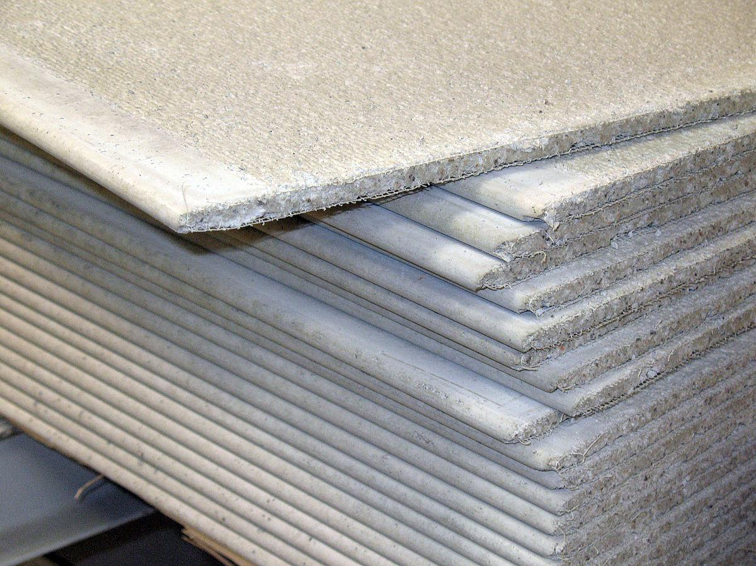
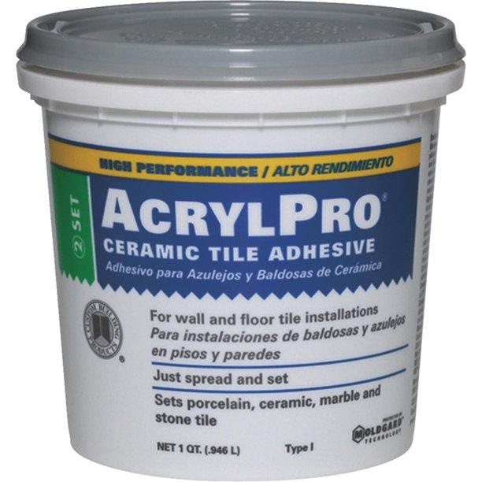
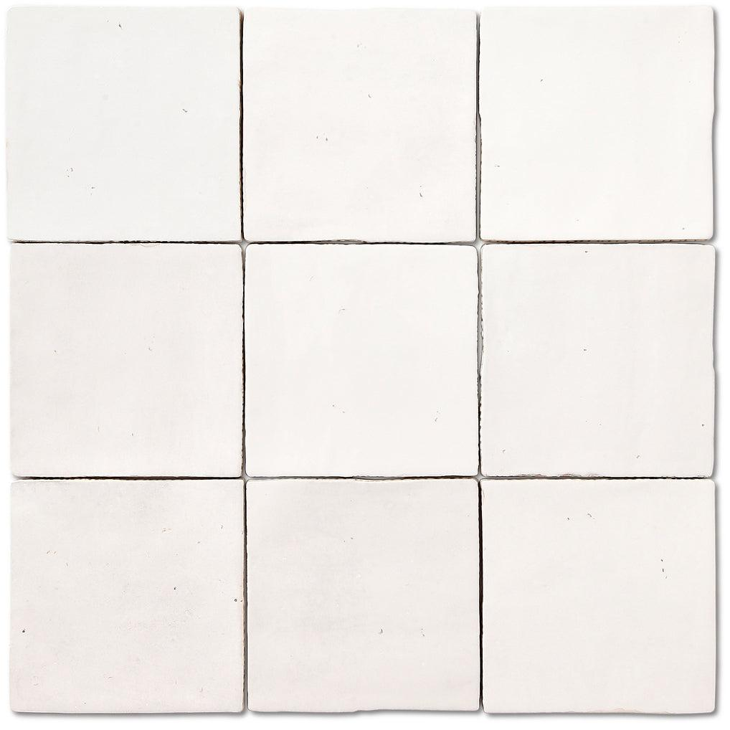
Make a Test Wall for Practice.
Let your volunteers practice drilling on tile and see how the fasteners work inside the wall.
Materials Needed:
A 2x2 frame
Cement board or drywall
About 36 ceramic tiles (4x4)
Mastic
Grout
Let your volunteers get hands-on experience with a test drive!

Slide 20
On-Site Work
Different methods for different situations.

Slide 21
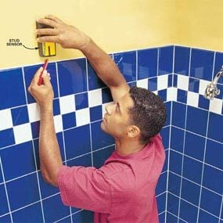
Mount In Studs Where Possible!
Use a stud finder to find studs above tile then a plumb level to locate studs behind tile.
Drill a small pilot hole to confirm stud placement. Drill in grout if possible.
OK? Then attach to studs with stainless steel screws

Slide 22
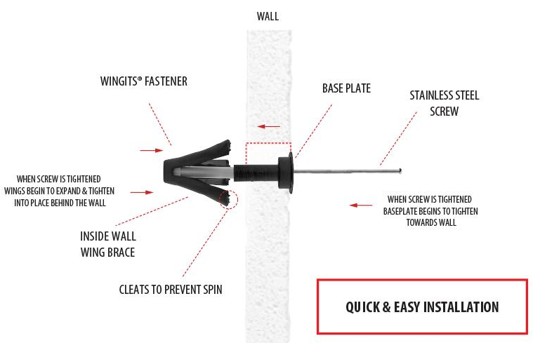
How WingIt Fasteners Work
Secure installation without drilling into studs
Inside wall
Outside wall

Slide 23
Combine the Two!
Grab bars will rarely perfectly line up with studs
You may need to combine stud installation with a hollow wall fastener!

Slide 24
Sometimes You Can Use Wood Blocking
Is there access from the back?
Sometimes you can open the wall behind tub or shower and install plywood or blocking.

Slide 25
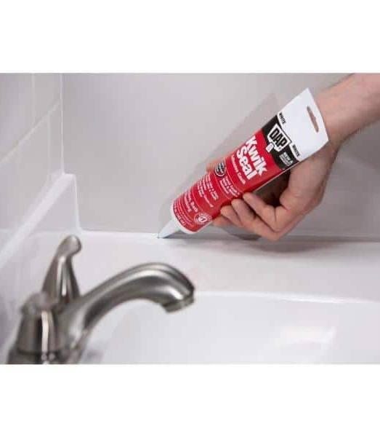
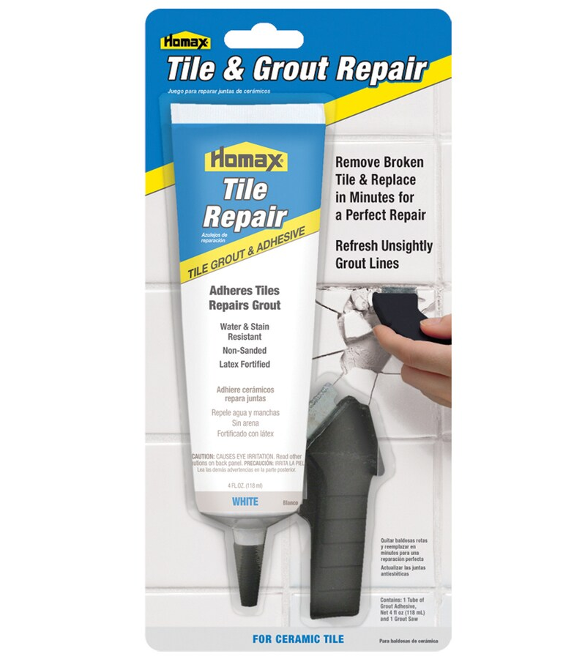
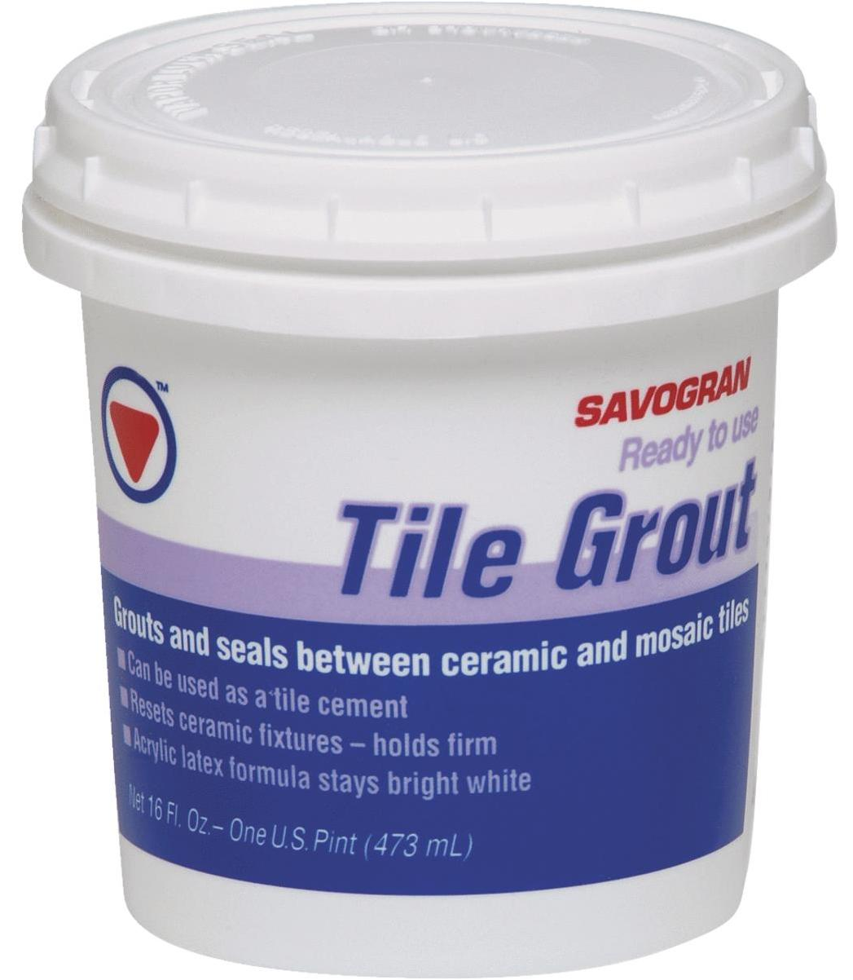
Finishing
In wet locations use stainless steel screws
Caulk all openings
Have a small container of grout repair compound to fill any holes.
Clean up your mess!

Slide 26
Need More Detailed Info??
You can find a complete manual on grab bar installation by visiting the Falls Prevention Cohort Page. Or use the link below.
(This page may only be available to Cohort Members.)
All About Grab Bars

