Slide 1
Board Engagement and Accountability
September 2021

Slide 2
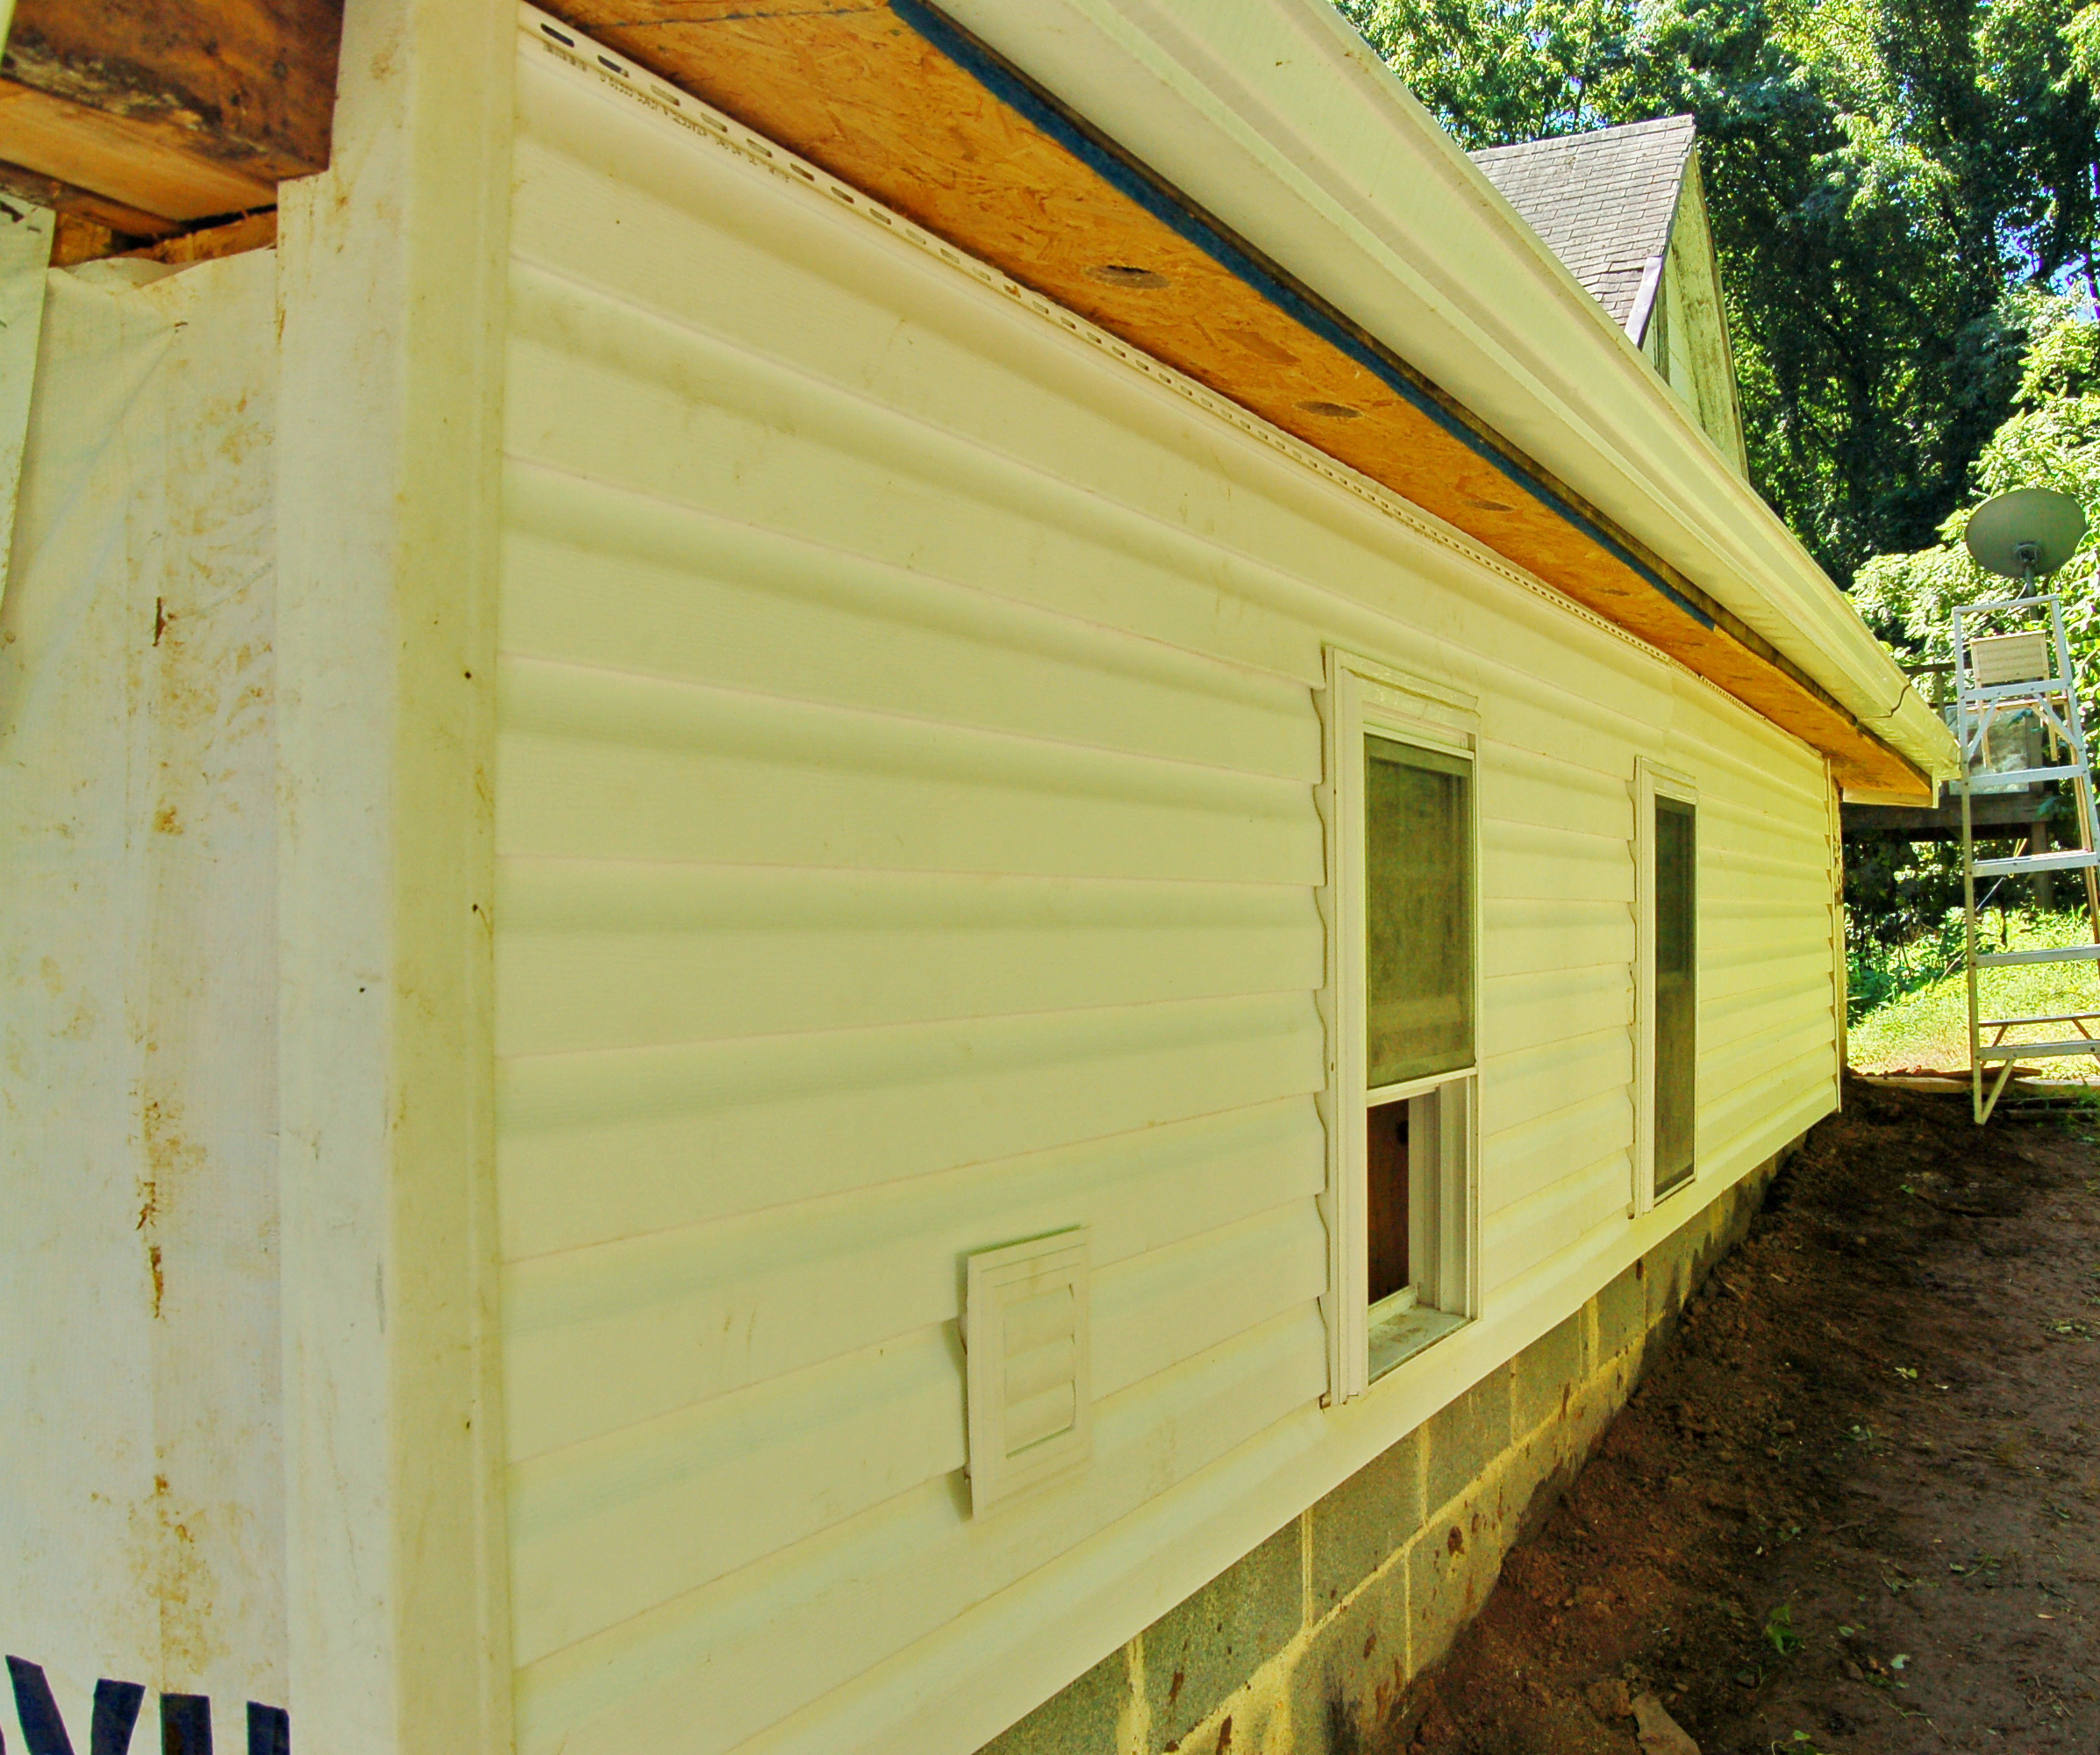
Why do we want our board to engage?
Unique skills and gifts
Unique connections and abilities to engage important constituents
Unique perspectives
Ability to share the load
Much of the relationship work

Slide 3
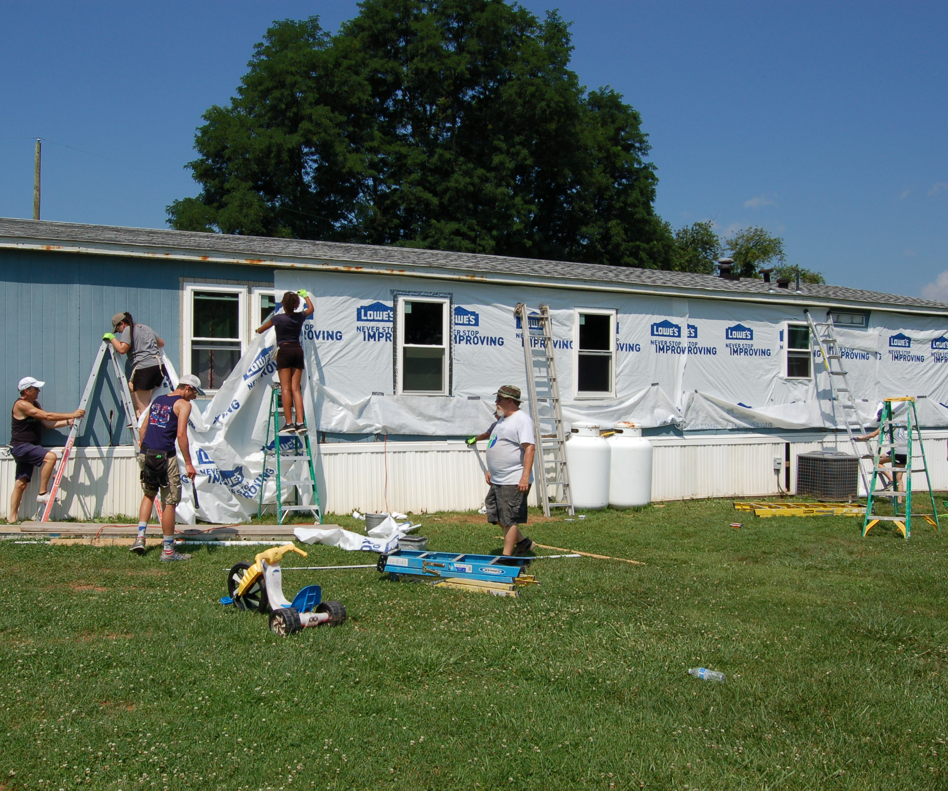
Get to know each member
Why they care about the organization
What is their perspective on the present and the future
What are one or two things that excite them
What are areas or issues that concern them
What are their time constraints

Slide 4
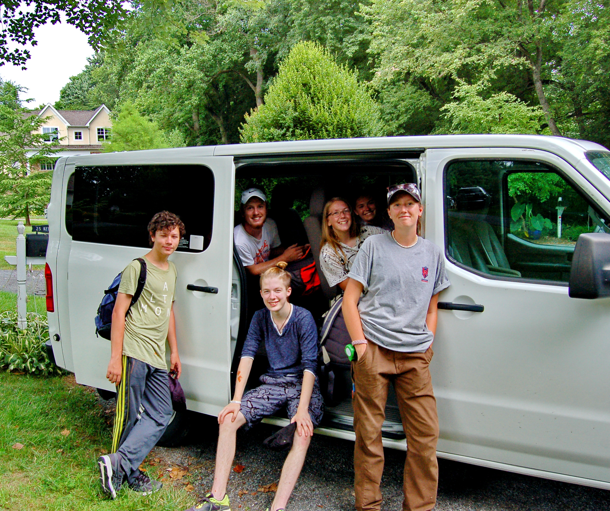
The Process
Share the near-term and longer-term goals
Discuss needs with specificity
Start small and manageable – look for an initial success (i.e. Lee)
Close the loop and thank them well

Slide 5
Accountability
Let the board member tell you the timeframe that they can meet
Ask about how you can support them
Keep the board chair informed
Share the successes
Repeat the process and increase the scope

