Slide 1


5 to 50!
Effective ways of building a white-glove customer education program (and scaling it up!)
Sylvia Pereira
Learning Experience Designer, Alteryx

Slide 2








Alteryx is
Alteryx Makes Analytics
Analytics Platform
Desktop
Cloud
ALTERYX
DESIGNER
ALTERYX
SERVER
DESIGNER
CLOUD
MACHINE
LEARNING
AUTO
INSIGHTS
LOCATION
INTELLIGENCE
Our focus today!

Slide 3

What Is a White Glove Learning Experience?
A white glove experience goes beyond standard training programs.
A white glove represents our commitment to providing an exceptional learning experience and personalized support throughout our learners' journey.
The term "white glove" is derived from the idea of wearing white gloves, which symbolizes delicacy, professionalism, and a meticulous approach.

Slide 4


Key Components
?
Learning Environment
Results
90%
Learning Transfer
Instructional Design
Content
Metrics & Evaluation
Instructional Delivery
- CEd
- ProServices
Teamwork
(Customer-Centric)
By Sylvia Pereira

Slide 5
5 to 50 Machine Learning Upskilling Program
A Quick Walkthrough

Slide 6
Reasons to Offer a White Glove Experience
Demonstrate the value and capabilities of AutoML, our new addition to the portfolio.
Leverage customers' real-world use cases and drive product usage.
Gather impactful ML use cases to craft a powerful narrative and accelerate sales growth.
Enhance sales conversations by eliminating buyer concerns about the onboarding process.

Slide 7

Who is the persona for this learning experience?
Analysts and knowledge workers with little to no experience in machine learning who want to learn how to build and implement machine learning models to solve their use cases.

Slide 8

What is our objective?
Equip and empower learners with the necessary knowledge and skills to demonstrate the value of machine learning to their business leaders.

Slide 9









Learning Experience
Learning Modalities
Virtual ILT
Approach
eLearning
5-15 learners
Group Working Session
4 to 8 weeks
1:1 Working Session
~4 hours/ week
Non-real-time activities

Slide 10

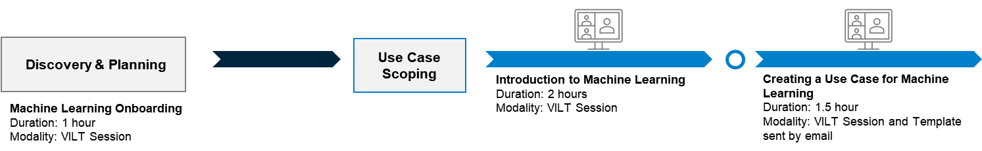
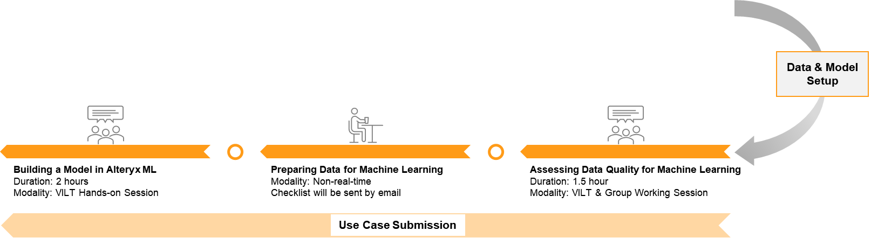
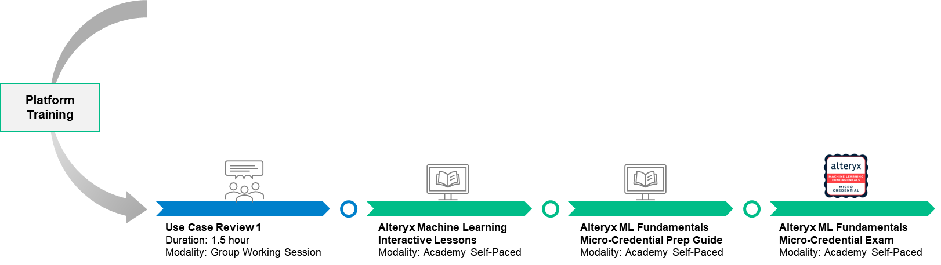
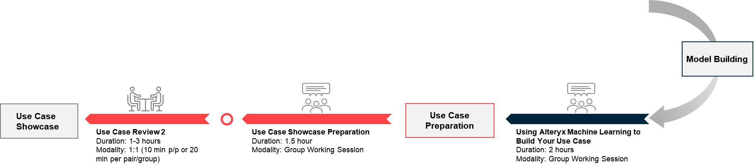

Slide 11

Communication Flow
Machine Learning Onboarding
Introduction to Machine Learning
Creating a Use Case for Machine Learning
Assessing Data Quality for Machine Learning
Building a Model in Alteryx Machine Learning
1
2
3
4
5
One Day After: ML Onboarding Session
Two Days Before: Introduction to Machine Learning
One Day After: Introduction to Machine Learning
One Day After: Creating a Use Case for Machine Learning
One Day After: Assessing Data Quality for Machine Learning
Use Case Review 1
Using Alteryx Machine Learning to Build Your Use Case
Use Case Showcase Preparation
Use Case Review 2
6
7
8
9
One Day After: Building a Model in Alteryx Machine Learning
One Day After: Use Case Review 1
One Day After: Using Alteryx Machine Learning to Build Your Use Case
One Day After: Use Case Review 2

Slide 12

Goal: Develop a comprehensive scaling plan to transition upskilling ownership.
Strategy: Engage with key stakeholders from multiple teams to review the upskilling process, identify gaps, and create a scalable plan for implementation.
Scaling Plan
Sales/Customer Success
Sales
Engineering
CEd & ProServices
Partners
Product
Central point of contact with customers.
Onboarding and showcasing.
No longer handle upskilling delivery.
Provide ongoing support.
Partners’ enablement.
Project management.
Content creation and update.
Customer training.
Partners’ enablement.
Integrate AutoML into their skills.
Supplemental resource for customer training.
Provide CEd and PS with product updates.

Slide 13

Results

Slide 14
Micro Certification in Machine Learning
Access to AutoML courses (eLearning)
Product Adoption
Customer Satisfaction
Use cases
  20% increase after the beginning of the program
  35% increase since the program launch
  66% of customers using AutoML on a weekly basis
  4.86 average rating
  12 concrete use cases
Customers going to speak about AutoML at Inspire!

Slide 15
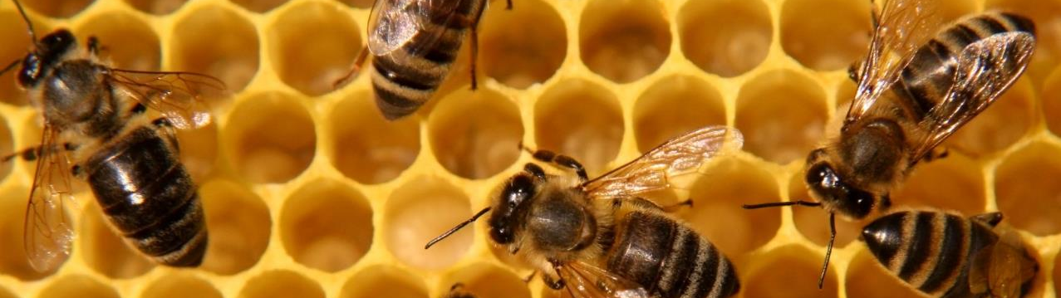
Work In Progress
Maintain training materials
updated
Who’s the program manager?
Automate more tasks
Keep flow of communication
Establish more accurate metrics

Slide 16
Q&A

Slide 17
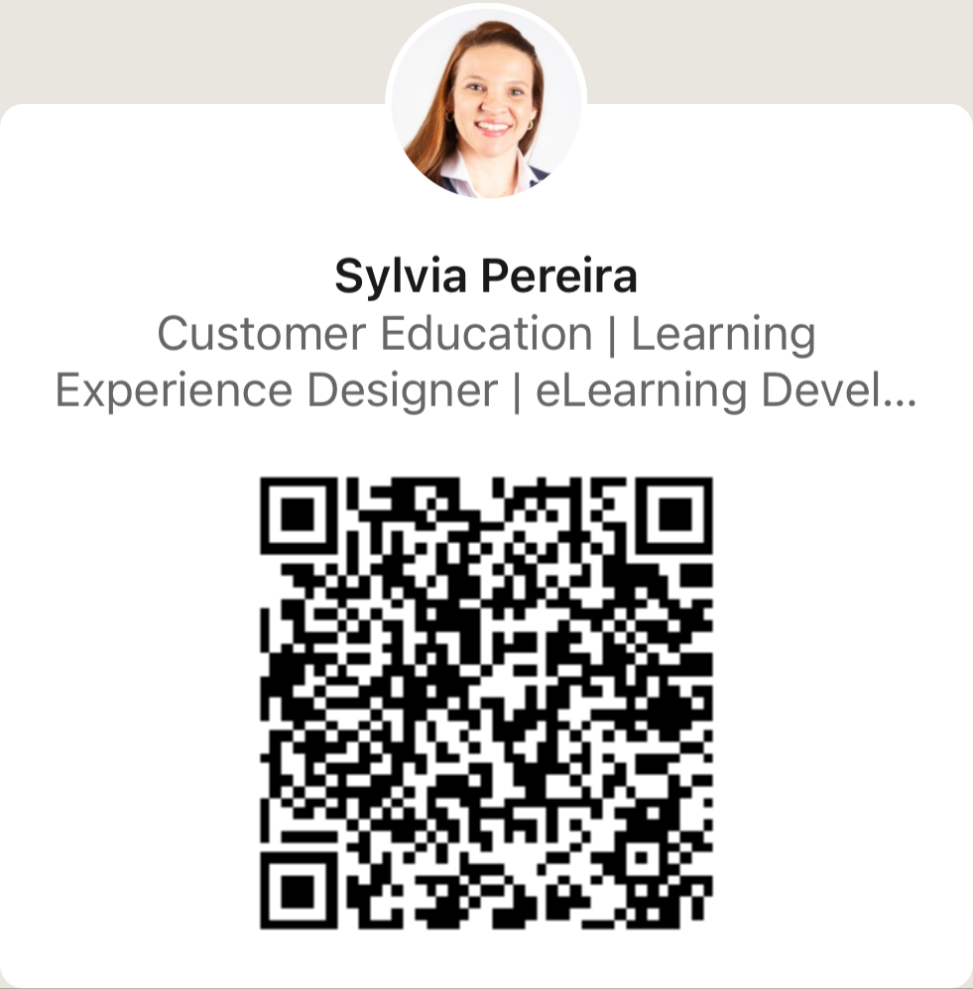
Thank you!

Slide 18
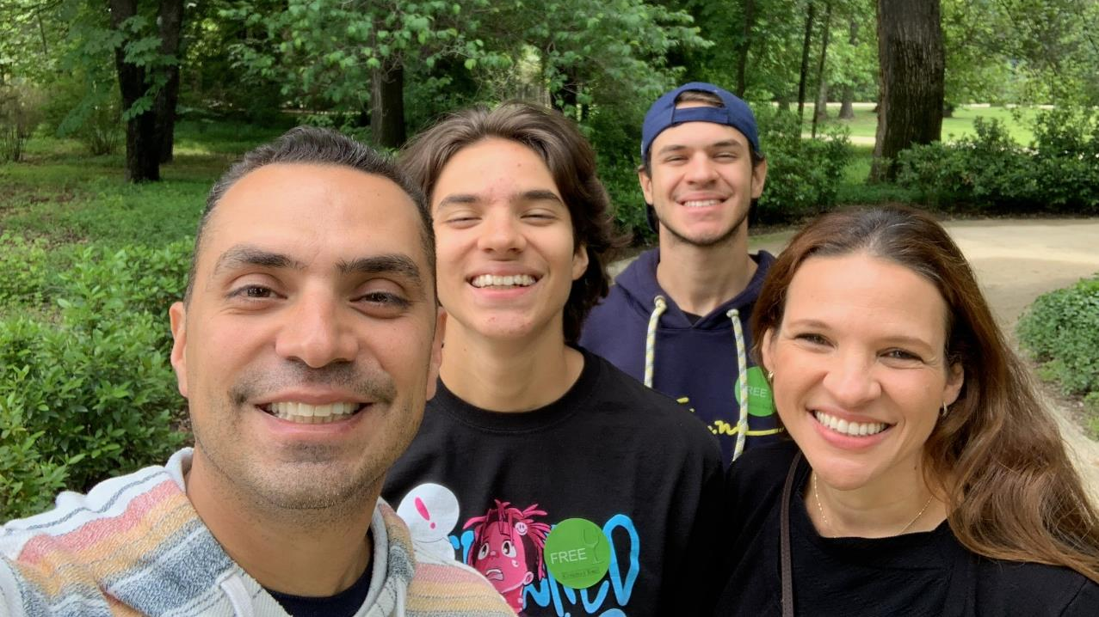
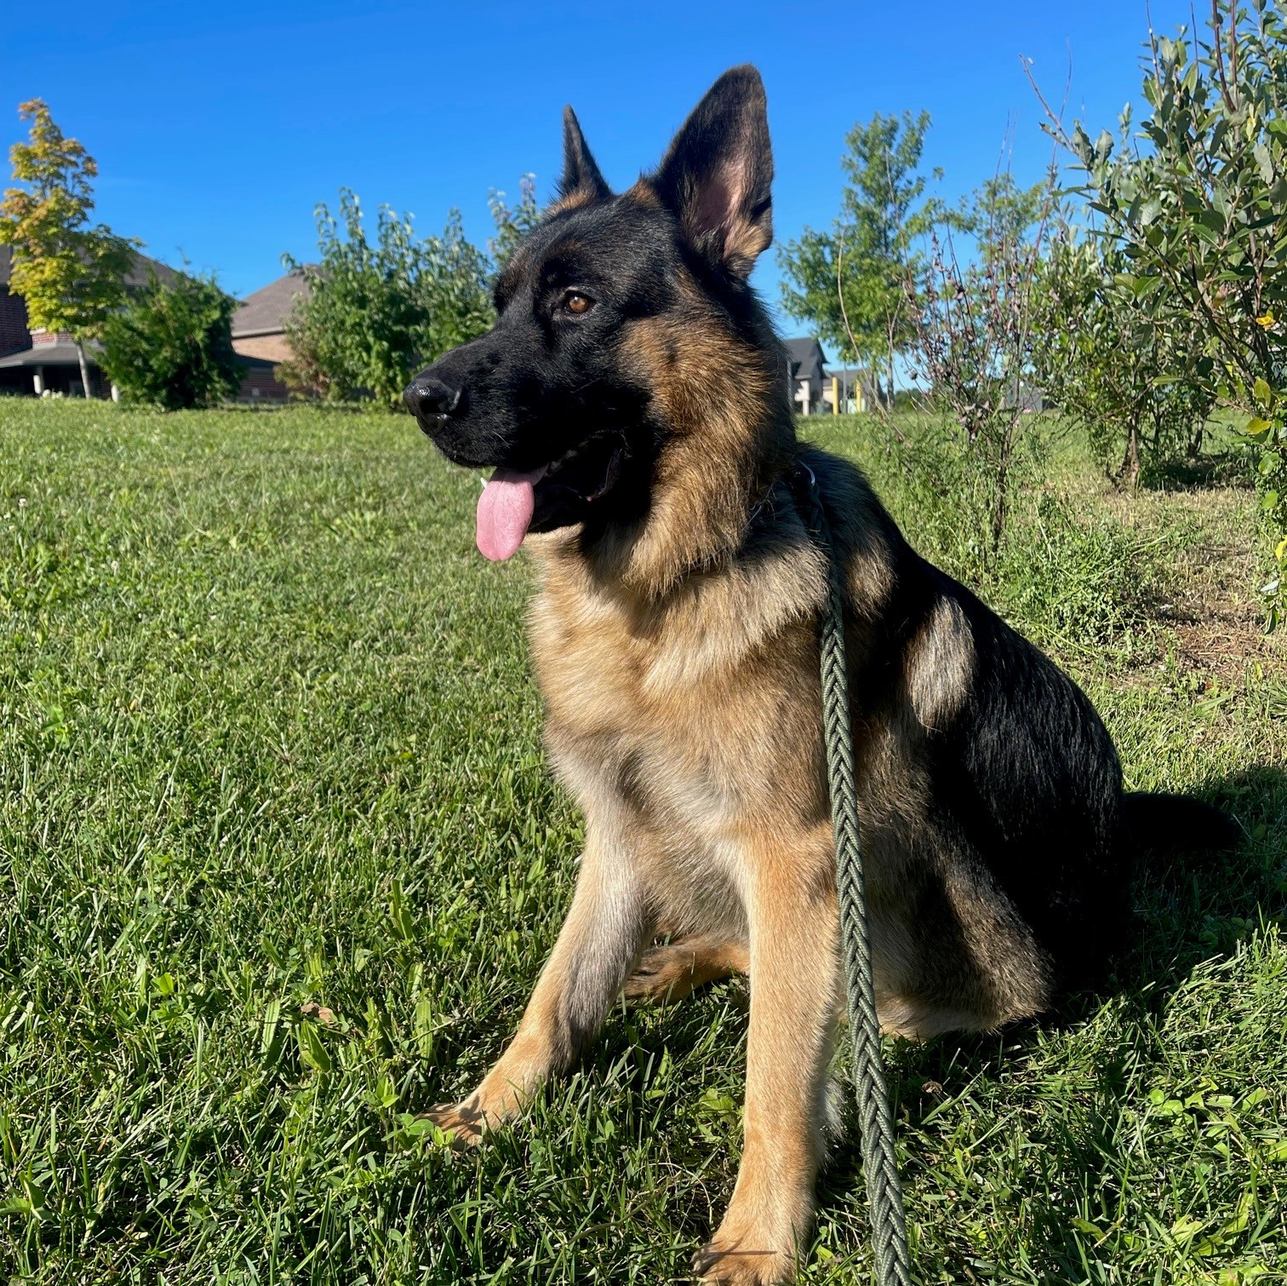
Nice to Meet You!

