Slide 1
Building a User Research Practice in Customer Education
Silvie Liao
silvie.liao@contentful.com
https://www.linkedin.com/in/silvieliao/

Slide 2
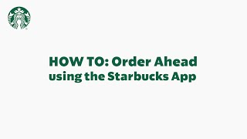

Slide 3
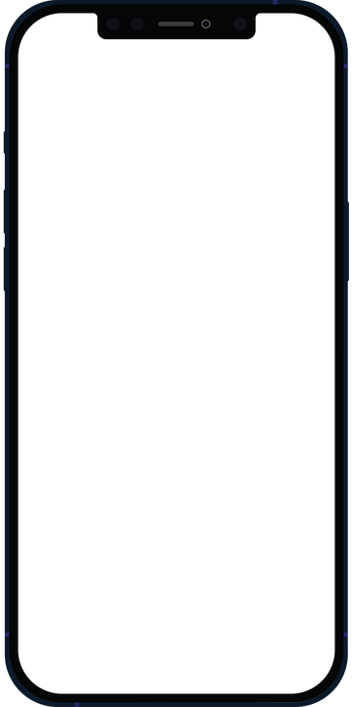
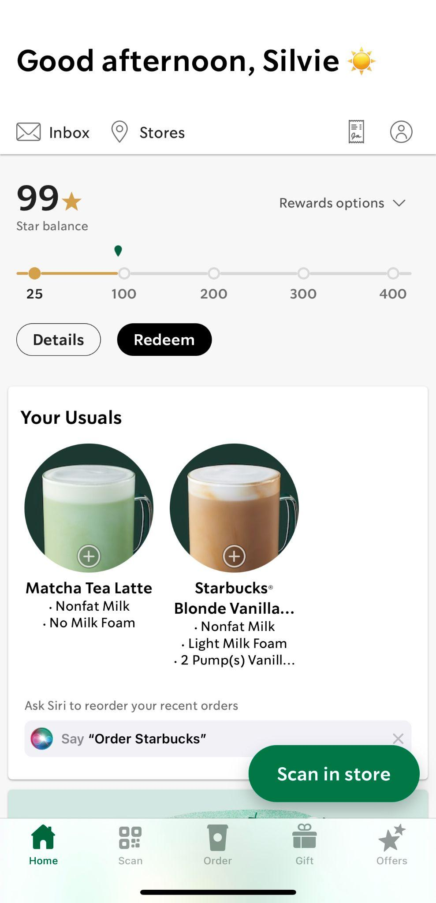
The Success of Starbucks App
2009
First mobile app
2015
Mobile order and pay
2021
Second most used mobile payment app

Slide 4
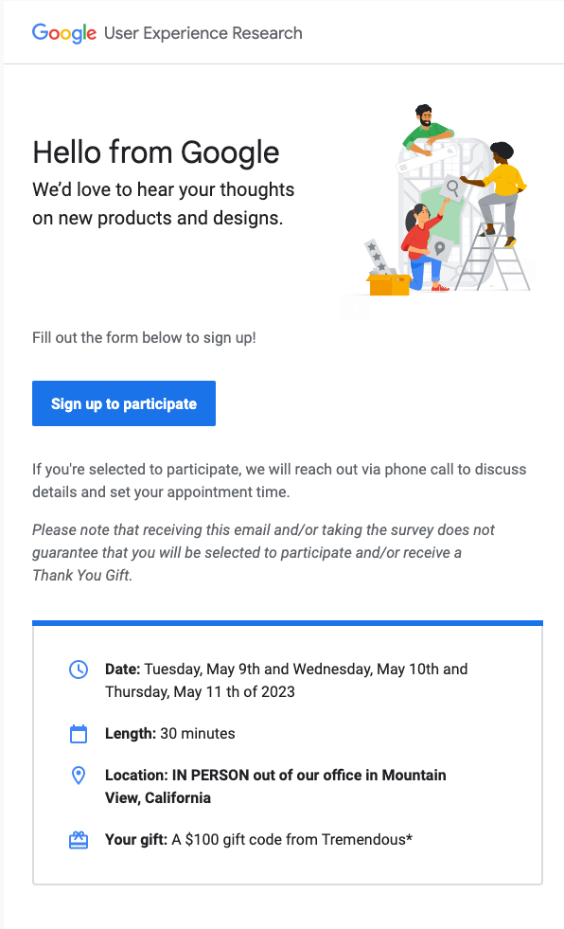
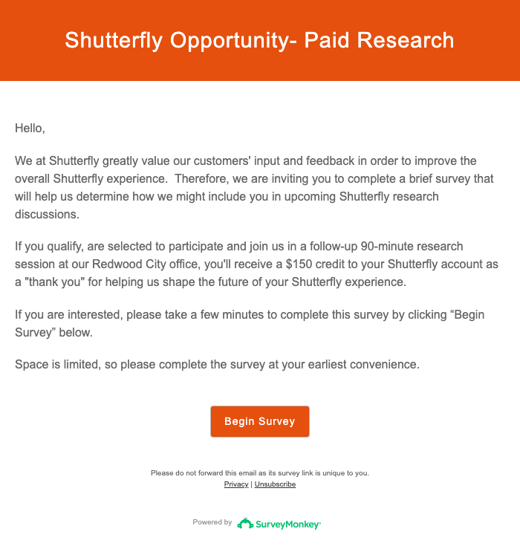
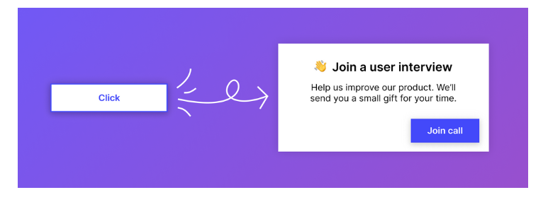
User Research
User research is a standard process in product development and design. Incorporating user research into the product development process, companies can create products that meet user needs, enhance user experience, and drive business success.

Slide 5
Customer education as a product

Slide 6



User research practice in customer education
Benefits of user research:
Understand customer needs
Improve user experience
Build relationships

Slide 7
User Research in Action

Slide 8
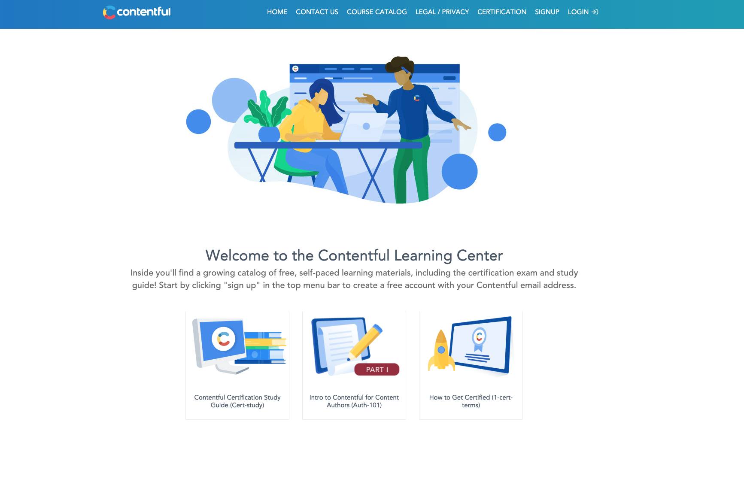
Contentful Learning Center V1

Slide 9
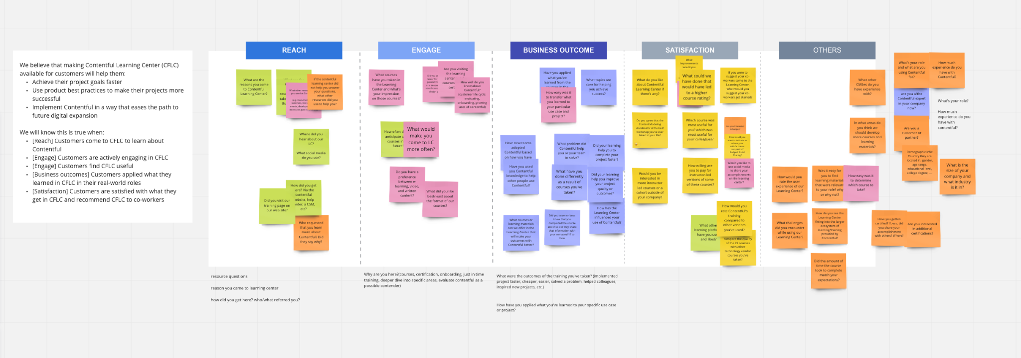
Define research objectives
Tell me about your role
How did you decide to learn about Contentful?
When was the last time you came to the Learning Center?
Why did you come to the Learning Center?
What courses did you take?
How did you decide to take the course?
What do you like about the course?
What do you struggle with the course?
Anything you took away from the learning center to your recent job?
Anything you think we could improve?

Slide 10

2. Recruit research participants
Tip:
Select the right user research participants to ensure that the insights gathered are relevant and representative.

Slide 11

3. Conduct research
Tip:
Use active listening and probing techniques. When applicable, ask participants to share screen.

Slide 12
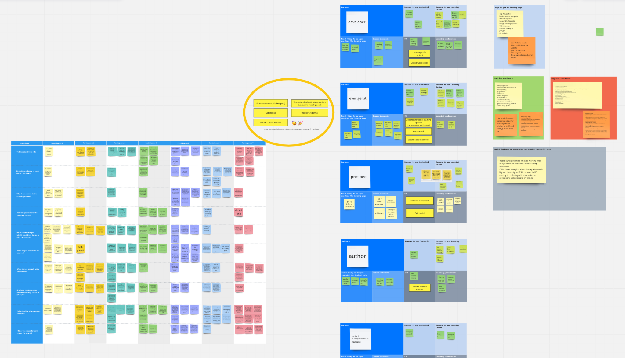
4. Analyze data and synthesize findings

Slide 13
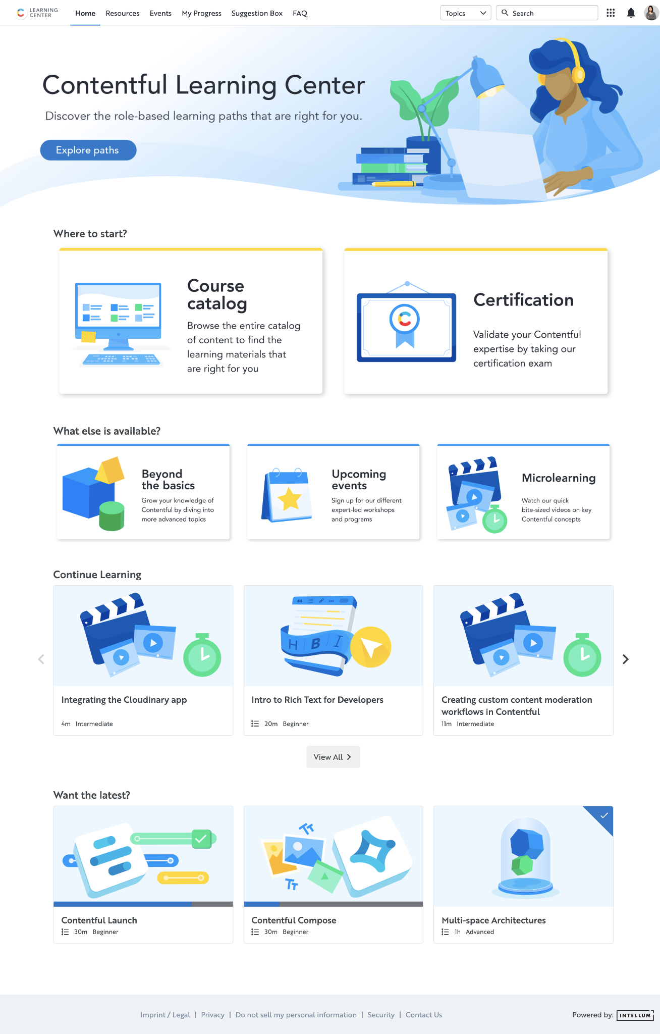
5. Use insights to improve CX
V1
V2
Unclear role alignment to various learning modules
Difficulty figuring out which courses to take and in what order
Content is not easy to find and hard to search for
Having a hard time getting back the course catalog
Difficulty navigating around LMS from your own progress area
Videos need to be easier to find and not embedded in courses
Not enough technical content

Slide 14

User research is an ITERATIVE PROCESS that ensures we’re constantly improving the experience of our customers.
Tip
User research can be conducted at various stages such as discovery, design, testing or post-launch phase.

Slide 15
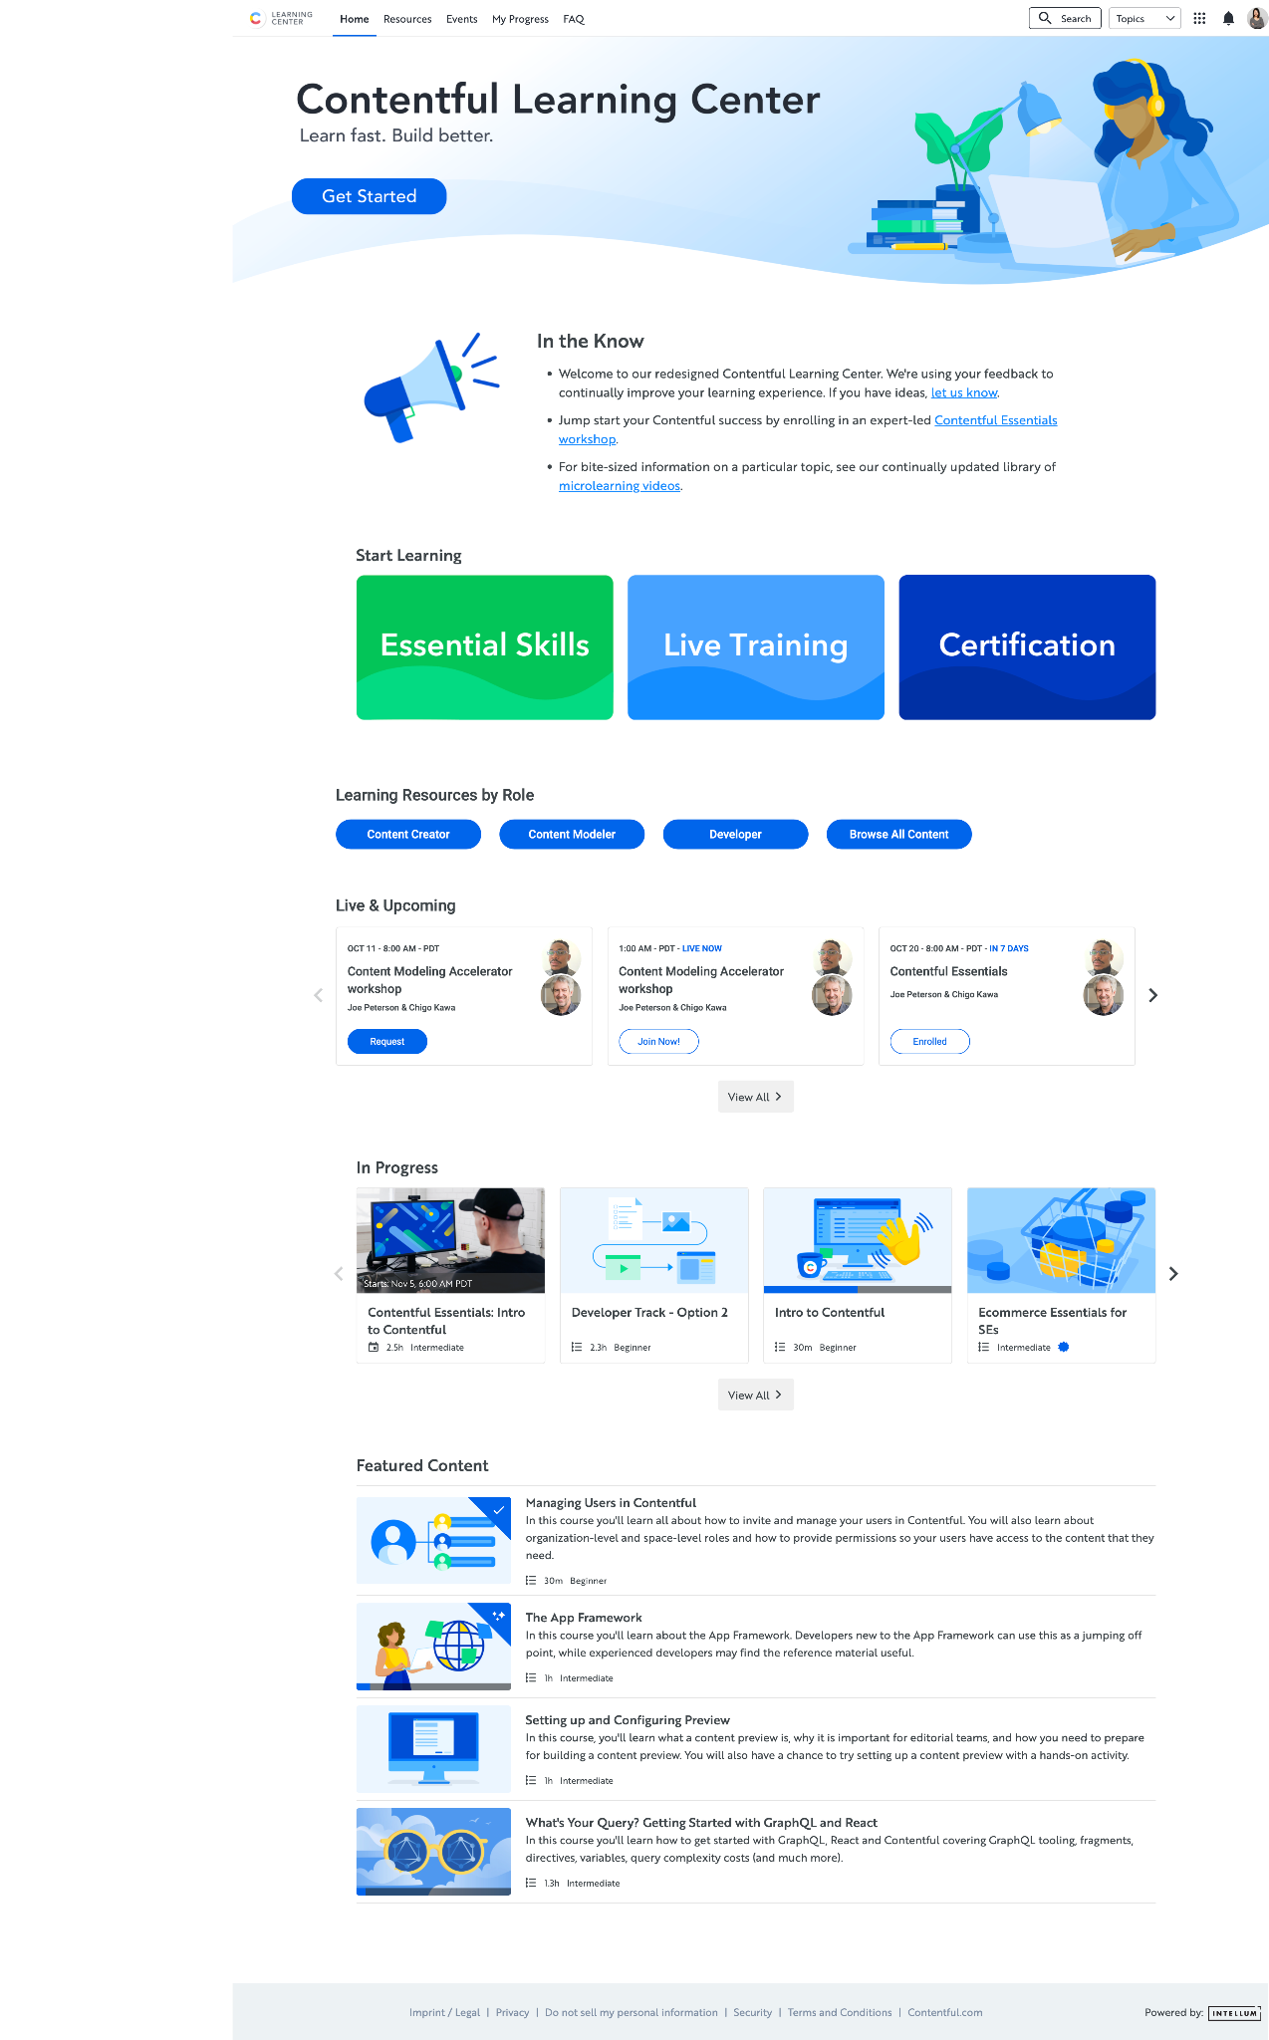

V2
V3
Information overload / lots of different choices / fewer CTAs
None of the roles in explore paths fit
Have “beyond the basics” but look for basics
Topic dropdown isn’t obvious
Want recommendation for the next course within the current course
More hands on practice, use cases, best practices
“Want the latest” should be more prominent / couldn’t find the latest on the landing page
Search is hard to use without knowing the terminology

Slide 16
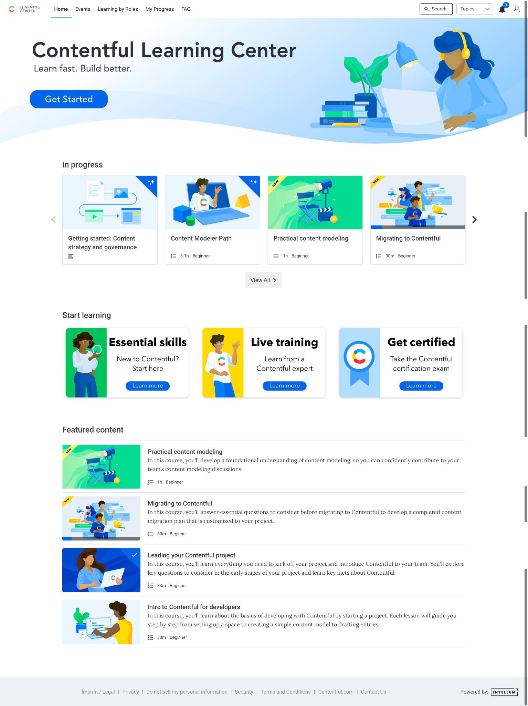
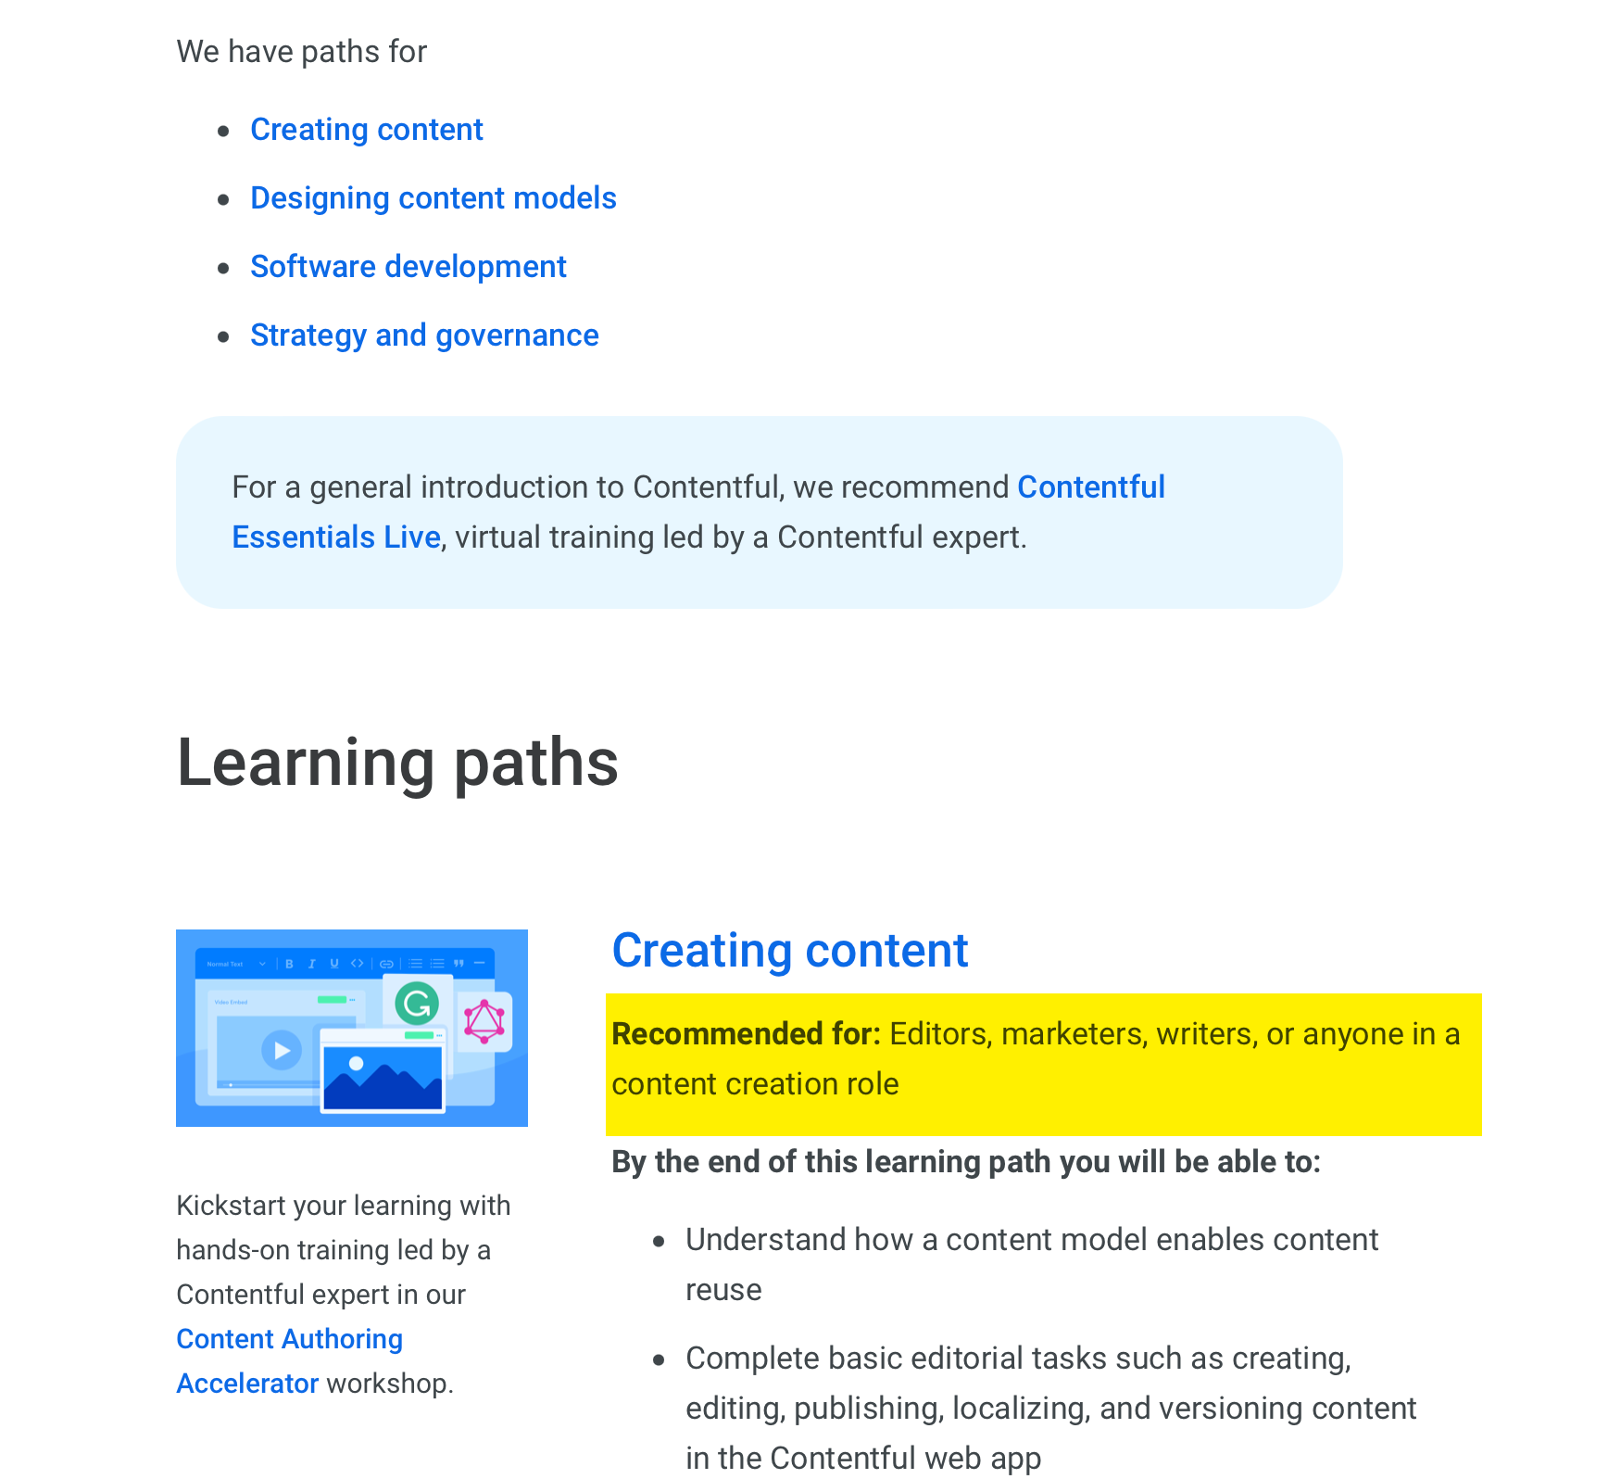
V3
Current
Not sure how to get around the site
Too too much scrolling
Not sure where to start, didn't find their roles, unfamiliar terms
Want practical hands-on how-to especially for less technical ppl
Want emails suggesting content to them
Hard time finding in progress courses to jump back into
“In the Know” is not meaningful

Slide 17
Quotes from customers
We have created some starter kits for our internal folks. We ask them to go through the courses and finish them.
The learning center was a really great tool. This is the only place to get the information on how to really use it.
My leadership recommended to a few of us that we should take these courses, so I did.

Slide 18

By investing in user research
The CE team can:
Align CE strategy to customers’ needs
Improve the quality and effectiveness of content
Differentiate your brand from competitors

