Slide 1
5 Key Concepts for
AI in Learning
Kristine Kukich
CEdMA West Conference Trustee
Director, Customer Marketing, Thought Industries
Co-host of Mixology on YouTube
Notes:
Good day, Everyone. It’s great to see you all here at the CEdMA conference. I’m Kristine Kukich, a CEdMA Conference Trustee, Director of Customer Marketing at Thought Industries, and the co-host of Mixology on YouTube, the intersection of customer marketing and customer education as scale engines to customer success.
I started my AI journey a couple of years ago just trying to figure out what made up AI and how it would impact HCM and customer education, and have continued to research and learn with the explosion of content generators and tools just in 2023! Let’s dig in.

Slide 2

What does AI look like for Customer Education?
Learner Experience
Foundational
Personalized Learning
Gamification
Assessments
Data Analytics
Ethics and Bias
Notes:
The question I started asking myself this year revolves around how we actually start to use these tools. I built the abstract for this session using Chat GPT, then as I started drafting the deeper content divided it into two areas, although they really merge and weave together more than a two column slide can display.
<Click> The Learner Experience will see the largest explosion of tools, I think. You heard Jessie Gold, from TI, talk about the headless LMS, and we’ve seen some discussions in customereducaiton.org and in the CEdMA slack on how people are already using AI to generate content. Let’s focus on <click> personalized learning, <click> gamification, and <assessments> then move over to <click> Foundational activities like <click> data analytics and understanding <click> how bias needs to be addressed up front.

Slide 3

Personalized Learning
What does that mean?
✔︎ Recommendation Engine
Personas
Experience
Geography
~ Real Time Assessments
Adaptation based on response
✔︎ Adaptive Learning Paths
Choose your own adventure
Prescriptive
Notes:
Some components of augmented reality are already available within the tools we already use. I’ve talked before about the consumer-grade experience we should be expecting from our learning portals. <Click> It all starts with a recommendation engine. Machine learning is the key here, to help the system determine what’s important based on some standardized criteria like <click>personas to help identify which role the learner plays in the various ways people use your tools. If you’re a power user, your content may be different from a casual user, or an administrator. <Click> Self-professed levels of experience may be challenging, since each person uses a different set of their own criteria to determine if they are already experienced, but this is usually good criteria on which to build. <Click> Geography may also come into play, since different countries or jurisdictions may use the tools differently than another. And of course, there are many more options to use, based on the types of tools your learners will be working with and the call to action we’re expecting from the learning.
I’ve put a check on <click> Adaptive Learning Paths, because most portal engines are including something along these lines. They don’t all define them the same way, but they do work along the same lines as the recommendation engine. You can build a learning path that corresponds to a set of criteria – preparing for and upgrade to certification, for example. You can build ALPs as a <click> “choose your own adventure” series so that learners search for their content in a traditional catalog and that can start the journey, or <click> a more prescriptive path based on any criteria required.
We’ll talk more about this later, but <click> Real Time Assessments may be personalized within a learning path to accommodate comprehension at various stages within a learning path, that <click> adapt based on correct/incorrect responses.

Slide 4
Personalized Learning
Benefits & Challenges
😀 Benefits
Boost Engagement
Quick Responses
Task Automation
🙁 Challenges
Machine Learning
Needs Data
Building Bias
Modalities
Notes:
When we talk about the <click> benefits of working with personalized learning, we can leverage a <click> boost to engagement because of the structure with recommendation engines and federated search. We can see rapid automated responses <click> to questions using chatbots, or the ability to quickly pivot a learning path based on responses to quizzes, or practical examples. <click>And finally, AI and personalization leverage automation for various tasks, from chatbot actions, to learning paths, to federated searches to integrate all knowledge access into one place.
Our organizations can gain from the benefits, the learners gain from the benefits, but there are also <click> Challenges.
I’ve talked in other presentations about machine learning and how it is the foundation of augmented intelligence. The great thing is that machine learning is constant, but as Debbie Smith says “Garbage in, garbage out”. Machine learning <click> needs data. Lots of data. People need to use the system for it to build out preferences based on what has happened in the past, so if we can’t boost engagement, there may not be enough content for the system to learn. We also need to be aware of <click> bias. As the system learns about the learners, we need to make sure it’s learning effectively and not building in bias, which we’ll talk about later. Lastly, <click> working with multiple modalities means track multiple modalities, and also means that the personalization can focus on those modalities.

Slide 5
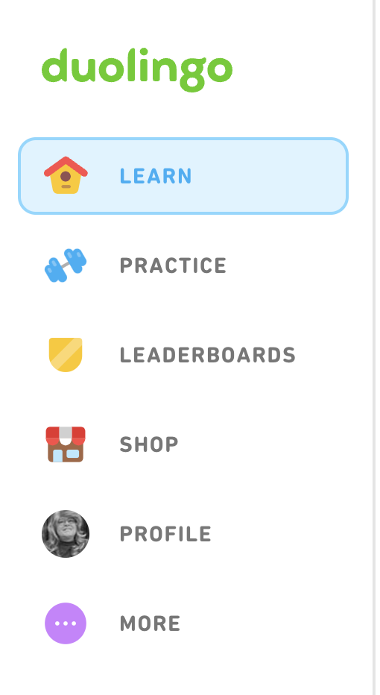
Personalization
Examples

Slide 6

Gamification
Are you using it already?
✔︎ Personalization + Gamification
Leaderboards
Badging
Progression
~ Engagement and Motivation
Build toward goals
Dynamic
✔︎ Personalization
Builds on Personalization Strategies
Leverage LPs
Notes:
Let’s move on to Gamification <click> and start with the combination of personalization that we’ve already discussed with gamification. The standards that we know and love <click> including leaderboards to develop competition, <click> badging to show learner milestones, and <click> visible progression through a learning path using something like train stops or an adventure map.
We can already see the <click> personalization as we build out the leaderboard aspect, but the gamification is an additional <click> layer that builds on the existing personalization strategies that you’ve already been thinking about or put in place, like with <click> learning paths.

Slide 7
Gamification
Benefits & Challenges
😀 Benefits
Boost Engagement
Improves Knowledge
Absorption and
Retention
Sparks Competition
🙁 Challenges
Unclear Understanding
of Path to Success
Failure as a Learning Experience
Accessibility
Notes:
Daniel Quick over at Scaled Agile started pushing gamification at a CEdMA conference pre-covid. Many of us have already built some kind of gamification, but leveraging AI will automate so many of the transactions that help <click> boost engagement, <click> improve knowledge absorption and retention, and <click> spark competition.
The challenges <click> we face are more structural and strategic – there are potential <click> misunderstandings on how the learning paths were created and what the path to success can look like. Next, should we build in <click> failure? If we do, what does that look like? How do we build process around failure to make it a true learning experience? And finally, <click> accessibility. Working with badges and leaderboards can be an accessibility nightmare depending on the technology selected to help build out the gamification strategy.

Slide 8
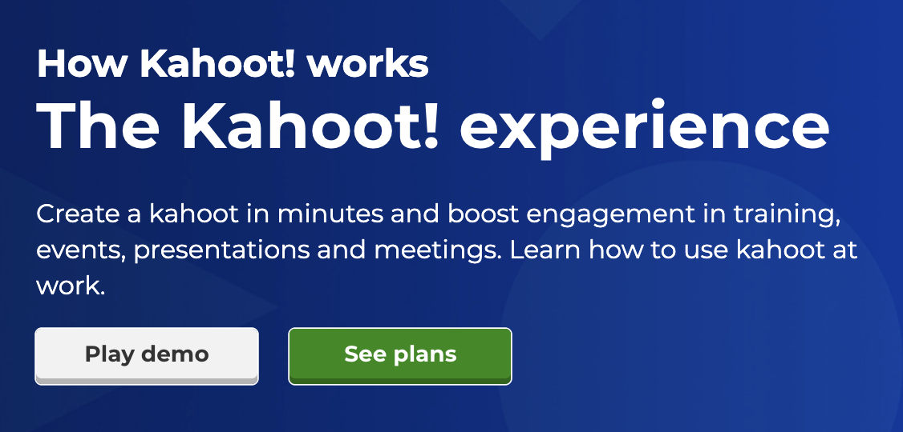
Gamification
Examples

Slide 9

Assessments
Past Kirkpatrick
~ Evaluate Knowledge
Levels 3 & higher
Practicum Style Exams
Text Based Responses
~ Feedback Loop
Building Skills
~ Assessment Forms
Assessment Paths
mimic
Learning Paths
Notes:
In some cases, we pre-test, to properly place students in the curriculum (see personalization). <click> In some cases, we evaluate as we go in the hopes of recording comprehension of the material. And then we close out an item via post-learning assessments, with the hope that the numbers increase in the post-assessment from the pre-test. Many programs will choose to do all three. Text analysis presents an opportunity to revolutionize this process. By utilizing these tools in customer education, we present ourselves with an opportunity to not only advance from choice-based questions, but combine this analysis with the concierge experience to create an elevated learning experience. For me, this is very exciting.
There are many rules to follow if you decide to offer certifications on your product or industry. Part of the structure in building a certification program includes two very distinct issues that are varying degrees of important, depending on the organization: (1) building choice-based exams (with or without scenarios), and (2) proctoring exams. The choice-based exam questions fall into the same category as assessments. We get much more power from an AI experience. Microsoft has been doing some outstanding work in this area. Exam proctoring can also leverage that concierge experience by utilizing augmented intelligence to track all of the key points required.

Slide 10
Assessments
Benefits & Challenges
😀 Benefits
Adaptive Testing
Objective Scoring
Data-driven Insights
🙁 Challenges
Bias
Testing Security
Surveillance
Notes:
This is probably my favorite category, since there is so much potential here, and the <click> benefits are significant. After discussing the ways we can use AI, <click> adaptive testing allows for many options. Duolingo is one of the best examples of how to “re-ask” questions if the incorrect response was initially provided. Objective scoring <click> gives an opportunity to do more than just a,b,c, d responses. We can use text responses, or practicum based options and let the AI tools perform the analysis. This has been something I have wanted for a very long time. And all of the this effort provides data <click> that leads us to insights across the organization.
From a challenge <click>, let’s start with bias. Machine learning learns from all of the interactions. Bad players can great bad learning for the AI tools. <Click> Testing security will always be a challenge. No matter how good we get at structuring and protecting our exams, and who takes our exams, there is always someone out there trying to figure out how to get a copy of our questions, or take a test on someone else’s behalf. Lastly, there’s surveillance <click> pedagogy.

Slide 11

Assessment
Examples

Slide 12

Data Analytics
Data driven decisions
✔︎ Audit Reporting
Multiple Applications
Data Lakes
Customer Access
✔︎ Predictive Analytics
Build Success
Real-time Data
✔︎ Analytics
Auto-generating Design
Real-time
Customer Access

Slide 13
Data Analytics
Benefits & Challenges
😀 Benefits
Scale
Speed
Accuracy
🙁 Challenges
Trust Deficit
Data Privacy/Security
Bias

Slide 14
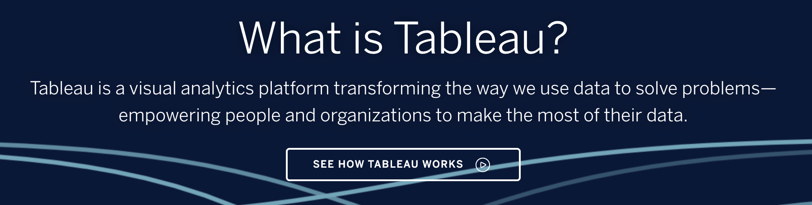
Data Analytics
Examples

Slide 15
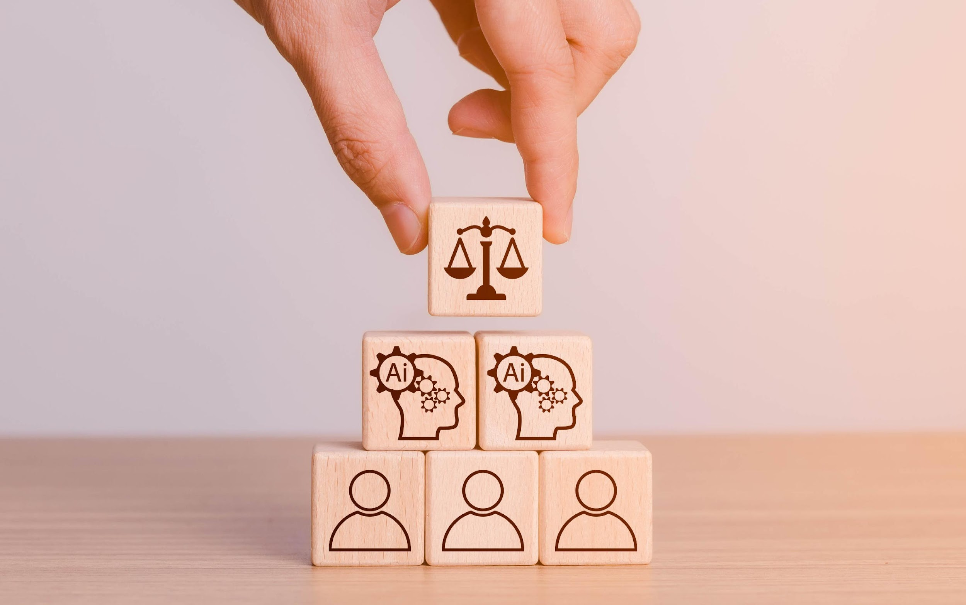
Ethics and Bias
Machine Learning/Natural Language Processing
Data Bias
Algorithmic Bias
Privacy & Fairness

Slide 16
Ethics and Bias
Addressing Bias
Data Quality & Transparency
Fairness Metrics & Evaluation
Human Oversight & Input

Slide 17
Ethics and Bias
Currently Available
Anti-Discrimination Laws
Data Protection Laws
Awareness of Risk

Slide 18
Other Posts by Kristine
Ready for the AI Explosion? 15 Terms You Should Know
The Impact of AI on the Kirkpatrick Model
How to Use Chatbots in Customer Education
Augmented Intelligence in Customer Education
5 Ways AI Supercharges Learning Experiences
Mixology Videos

Slide 19
Research - Personalization
https://elearningindustry.com/leverage-ai-for-personalized-elearning-experiences
https://elearningindustry.com/benefits-of-artifcial-intelligence-in-personalized-learning
https://www.forbes.com/sites/bernardmarr/2023/04/28/the-amazing-ways-duolingo-is-using-ai-and-gpt-4/?sh=a5ef15513466
https://www.thetechedvocate.org/using-ai-to-personalize-education-for-everyone/
https://thejournal.com/articles/2021/06/23/7-benefits-of-ai-in-education.aspx
https://elmlearning.com/blog/personalized-learning-vs-adaptive-learning/

Slide 20
Research - Gamification
https://onlinelibrary.wiley.com/doi/abs/10.1002/cae.22477
https://centrical.com/resources/gamification-ai/
https://www.sciencedirect.com/science/article/pii/S2666920X21000266
https://elearningindustry.com/science-benefits-gamification-elearning
https://arxiv.org/pdf/1708.09337.pdf
https://www.acadecraft.com/blog/gamification-education-challenges/#:~:text=There%20are%20several%20challenges%20when,resistance%20from%20students%20and%20teachers.
https://edubirdie.com/examples/benefits-and-challenges-of-gamification-in-education-argumentative-essay/
https://www.linkedin.com/advice/1/what-challenges-risks-gamification-education
https://www.elucidat.com/blog/gamification-in-elearning-examples/

Slide 21
Research - Assessment
https://www.researchgate.net/publication/314088884_Towards_artificial_intelligence-based_assessment_systems#:~:text=Artificial%20intelligence%2Dbased%20assessment%20provides,making%20towards%20their%20learning%20goals.
https://www.niallmcnulty.com/2023/04/ai-and-assessment-an-overview/
https://ness.com/wp-content/uploads/2023/03/Ness_Whitepaper_AI-Driven-Test-Assessment-and-future-of-Test-Assessment_V1.pdf
https://www.sciencedirect.com/science/article/pii/S2666920X22000303
https://senseilms.com/elearning-ai/
https://instructor-academy.onlinecoursehost.com/ai-in-online-course-creation/

Slide 22
Research - Analytics
https://www.anodot.com/learning-center/ai-analytics/#:~:text=AI%20analytics%20refers%20to%20a,data%20analyst%20would%20normally%20perform.
https://www.snowflake.com/wp-content/uploads/2022/03/Scaling-AI-ML-The-Critical-Role-of-Data-.pdf
https://www.answerrocket.com/ai-analytics-guide/#:~:text=AI%20analytics%20refers%20to%20a,analysis%20in%20an%20exhaustive%20fashion.
https://www.upgrad.com/blog/top-challenges-in-artificial-intelligence/
https://www.siliconrepublic.com/enterprise/data-analytics-ai-challenges

Slide 23
Research – Ethics & Bias
https://www.linkedin.com/pulse/can-ai-validate-data-quality-saravanan-palanivelu/
https://www.centerforfinancialinclusion.org/accountability-for-algorithms-a-balancing-act-for-governments?gclid=Cj0KCQjwpPKiBhDvARIsACn-gzAzk5XZ1JDYnysv5Ni25HWPo9VJdAny_0DqtYhj1cO8eCYBV4fvKOMaAunTEALw_wcB
https://www.carnegiecouncil.org/media/article/why-are-we-failing-at-the-ethics-of-ai

