Slide 1

The Influence of
Learner Feedback & Metrics
ON FUTURE COURSE DESIGN
David Sacco
Learning Experience Manager
Red Hat

Slide 2
What we’ll discuss today
Agenda
How did we get here?
  Red Hats journey
  Training vs. learner evaluation
We’re here but going there!
  Red Hat’s Method for Adding Value Back into Design and Development
      Live Early Access Feedback/Pilot
      Early Access
      Surveys
      Learning Community
  Wrap-up/Q&A
Notes:
What’s new 4.2 - 4.5

Slide 3
How we got here

Slide 4
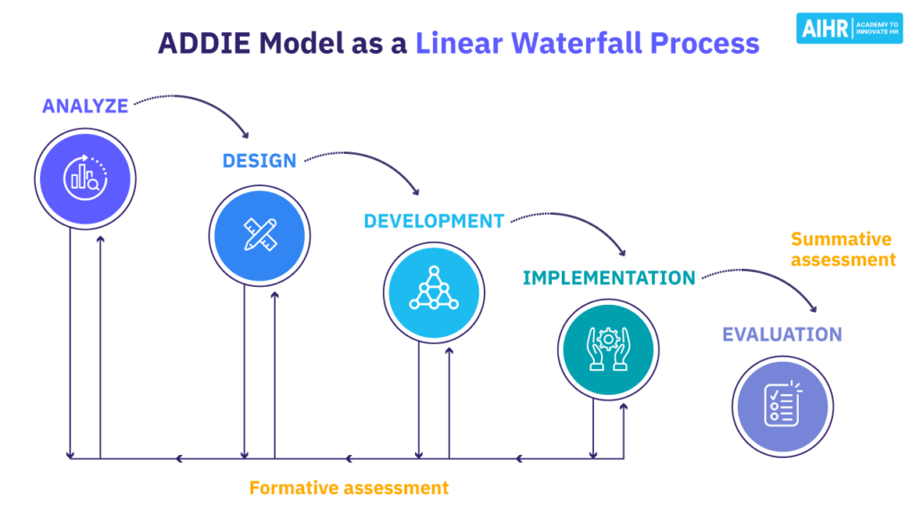
Our journey should sound familiar
The Force is Strong…
Opportunity
Waterfall vs. Continuous Improvement
Potential bottlenecks
  Define complete?
  Review cycles stack up (ID, Peer, SME, edit, etc.)
Possible to evaluate as you build?
Leverage customer feedback earlier
Iterate – “Perfect is the enemy of good” Voltaire
Involve the community
Mooijman et al., 2018

Slide 5
Distinguishing between training and user evaluation
How can we make use of data throughout the design, development and delivery lifecycle?
Bloom’s Taxonomy
  Advanced organizer for training development
  Critical for planning
  Solidify goals and measurable learning objectives
Kirkpatrick‘s Levels
  Post-training evaluation
  Measure levels of success
  Did training do what it was supposed to do?
  Did behavior change (OTJ)?
Remember Understand Apply Analyze Create Evaluate
Reaction Learning Behavior Results

Slide 6
How to get where we want to go

Slide 7
Determine Areas of Value
How can we make use of data throughout the design, development and delivery lifecycle?
What?
Where?
New opportunities or customer needs
Discussions, focus groups, Community forums, LMS chat syndication
Project feedback
Above + LEAF & pilots, surveys, analytics
Issue identification
Focus groups, surveys, Early Access
Enhancements
Learning community, surveys

Slide 8
Our methods and tools for gathering data

Slide 9
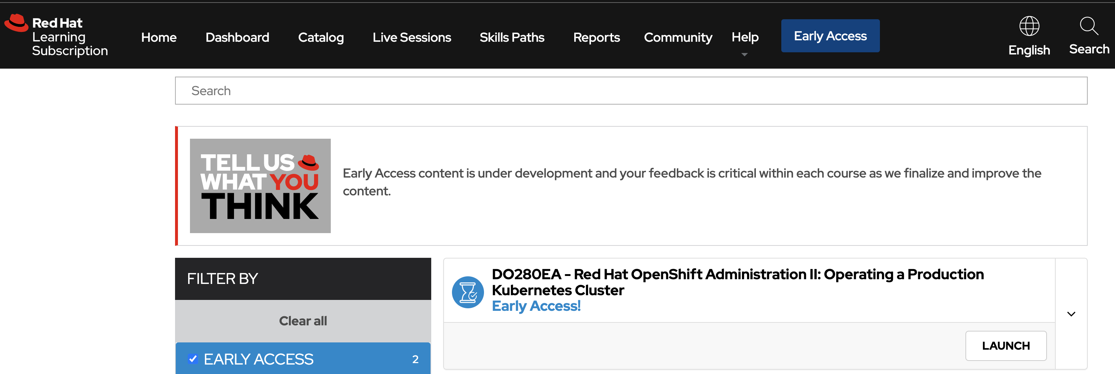
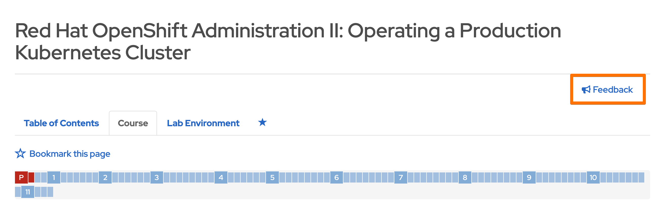
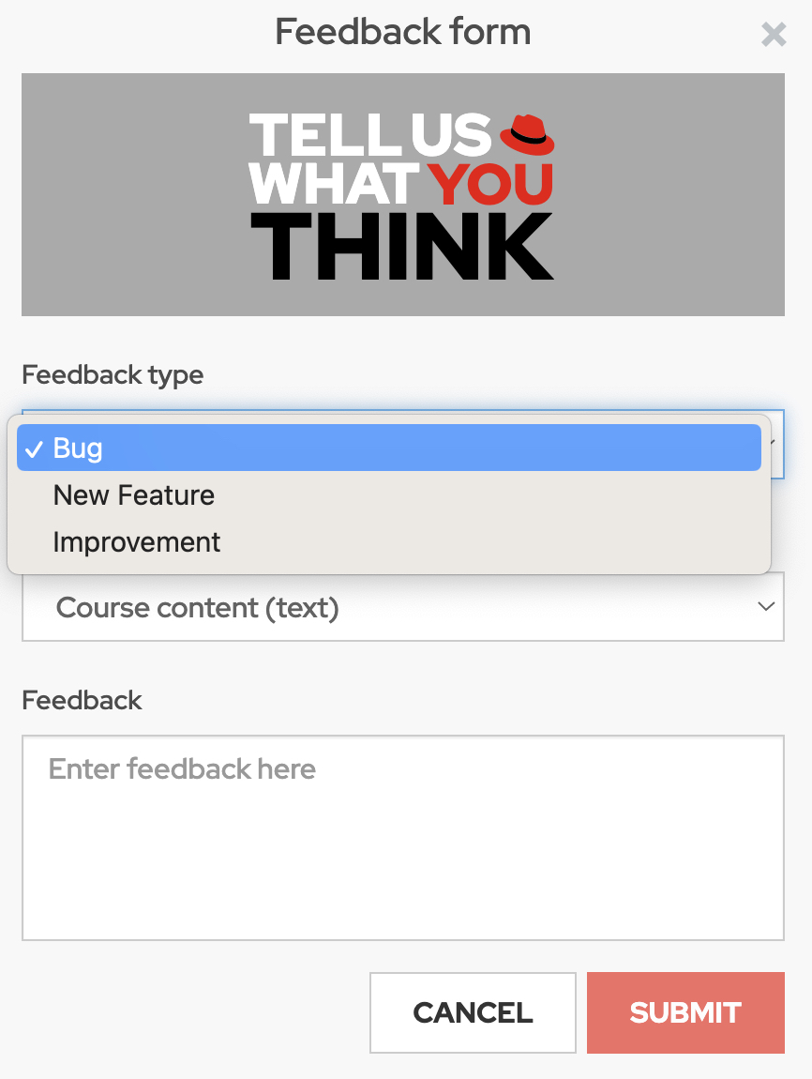
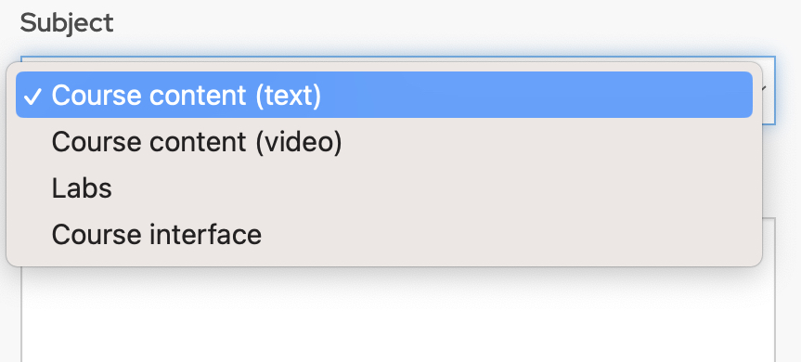
During Development - Early Access (EA)

Slide 10
During Development – LEAF Sessions
Live Early Access Feedback (LEAF)
Attendees: Internal learners – representative of our customers.
Conducted by: Course Developers
Typical Questions:
Does the ordering of material make sense?
Does the narrative provide sufficient context and detail to understand each major topic?
Do the exercises and labs target the right skills at the right level?
Were the instructions clear enough for you to follow?
What suggestions do you have for enhancing the narrative or exercises?

Slide 11
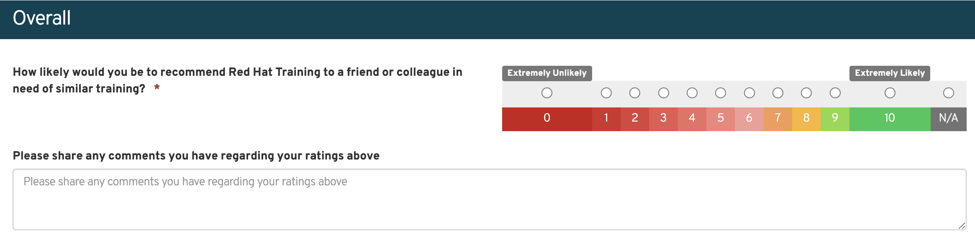
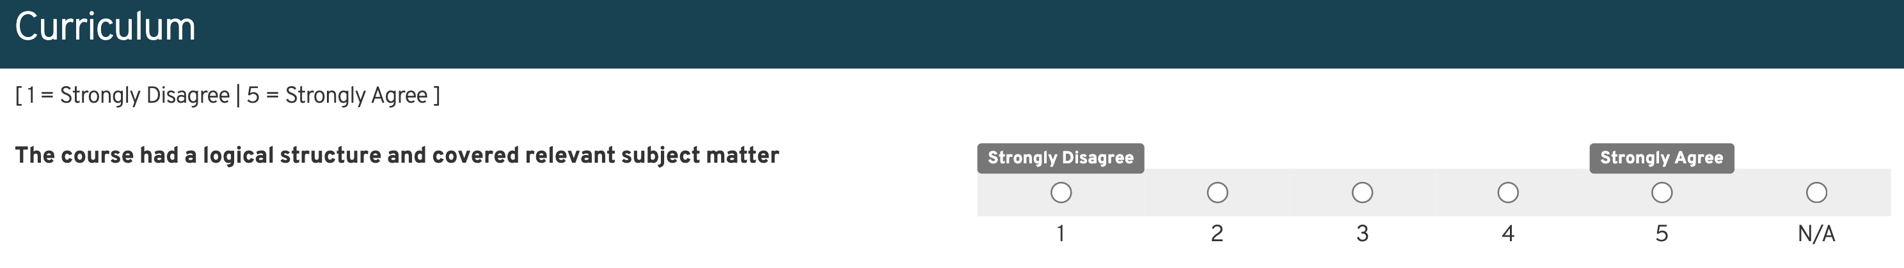
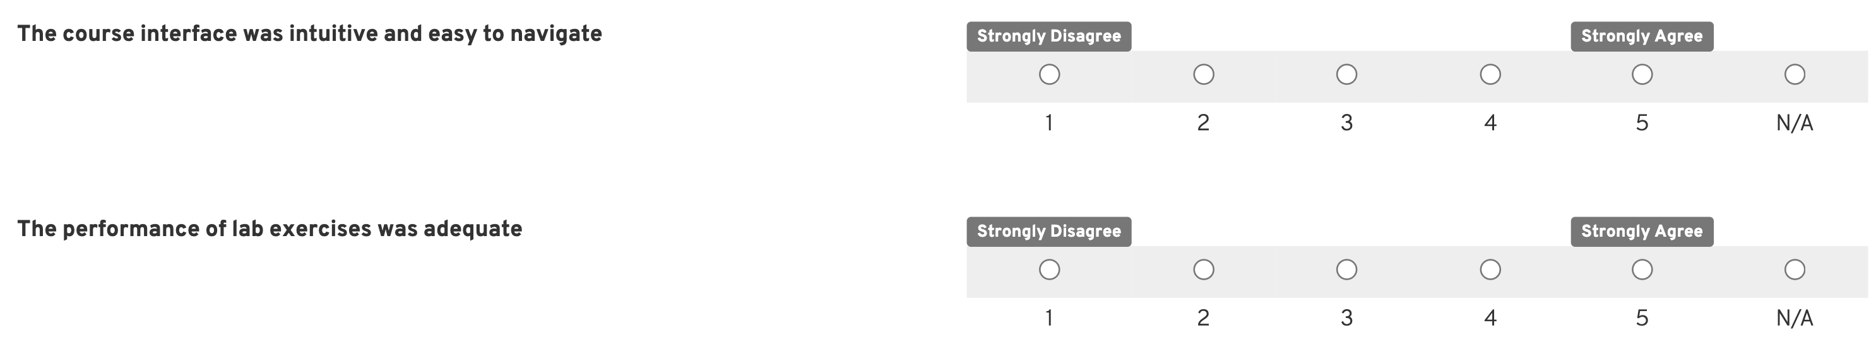
Post training: survey

Slide 12

Survey Comments
Trends and themes are noted and communicated back to the business units and development teams.
Comments are collected for:
Instructor performance
Course content
Facilities & Lab Environments
NPS

Slide 13
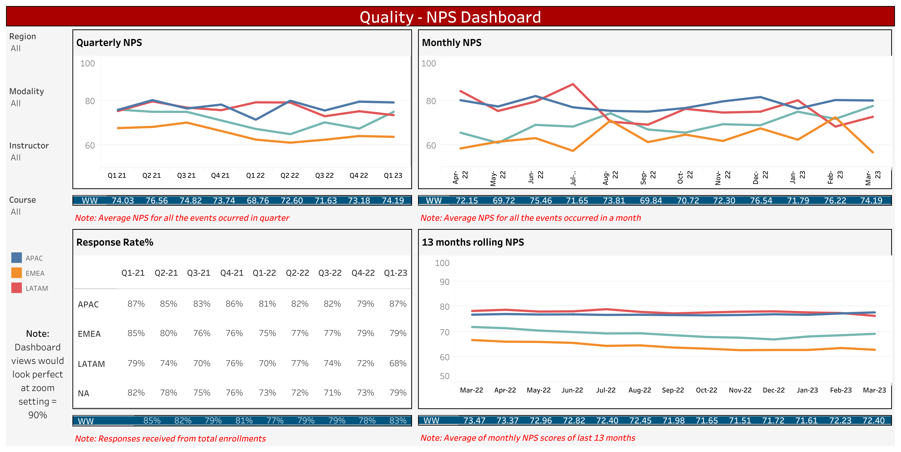
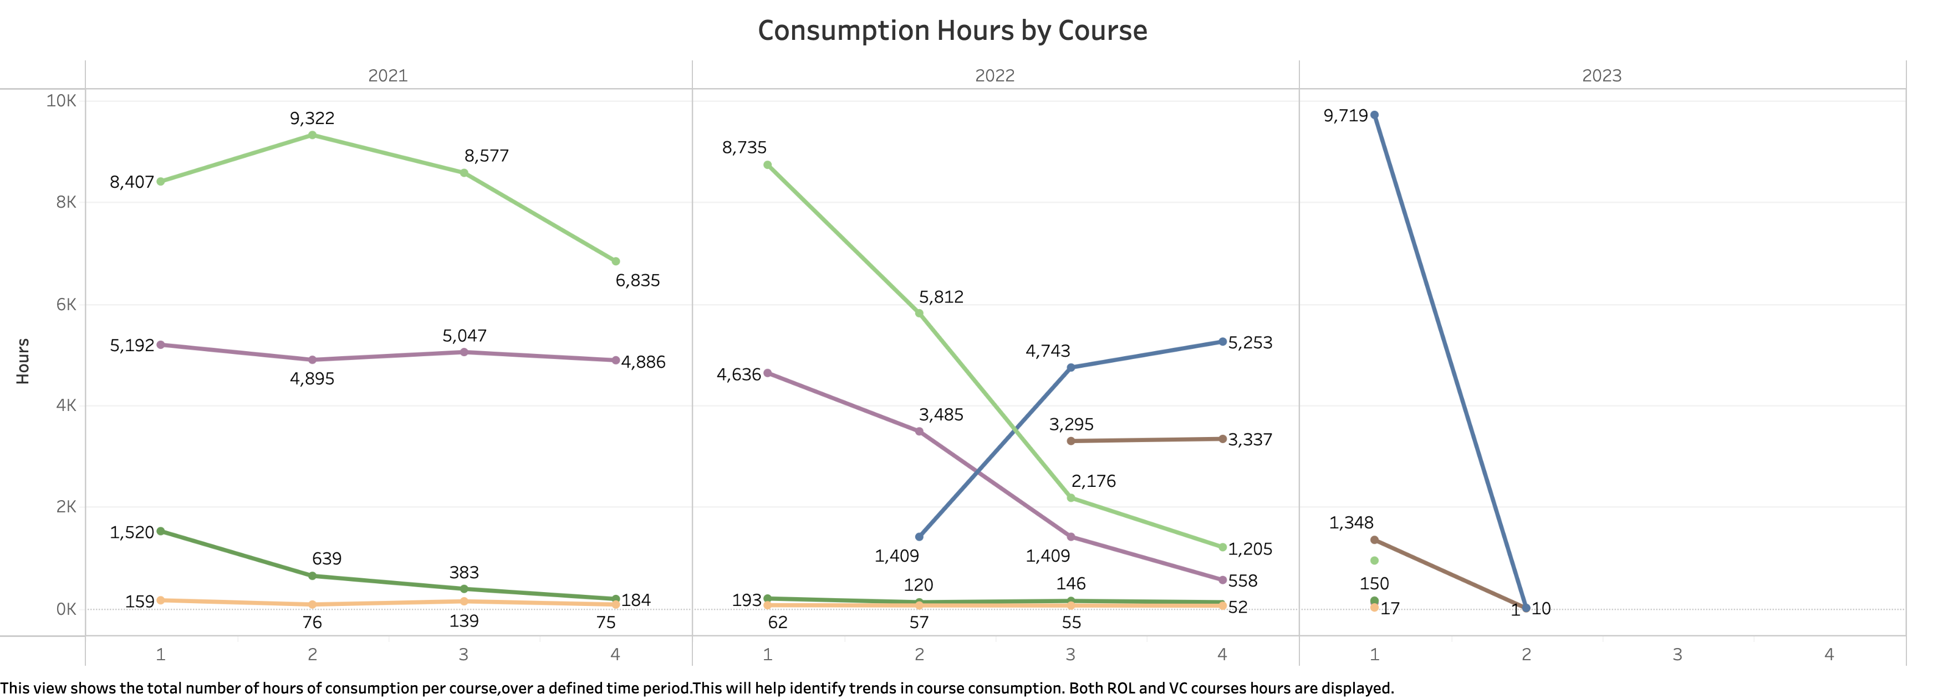
Survey data
Tableau offers dashboards and visuals of consumption, NPS, and survey responses +

Slide 14
It takes a community

Slide 15
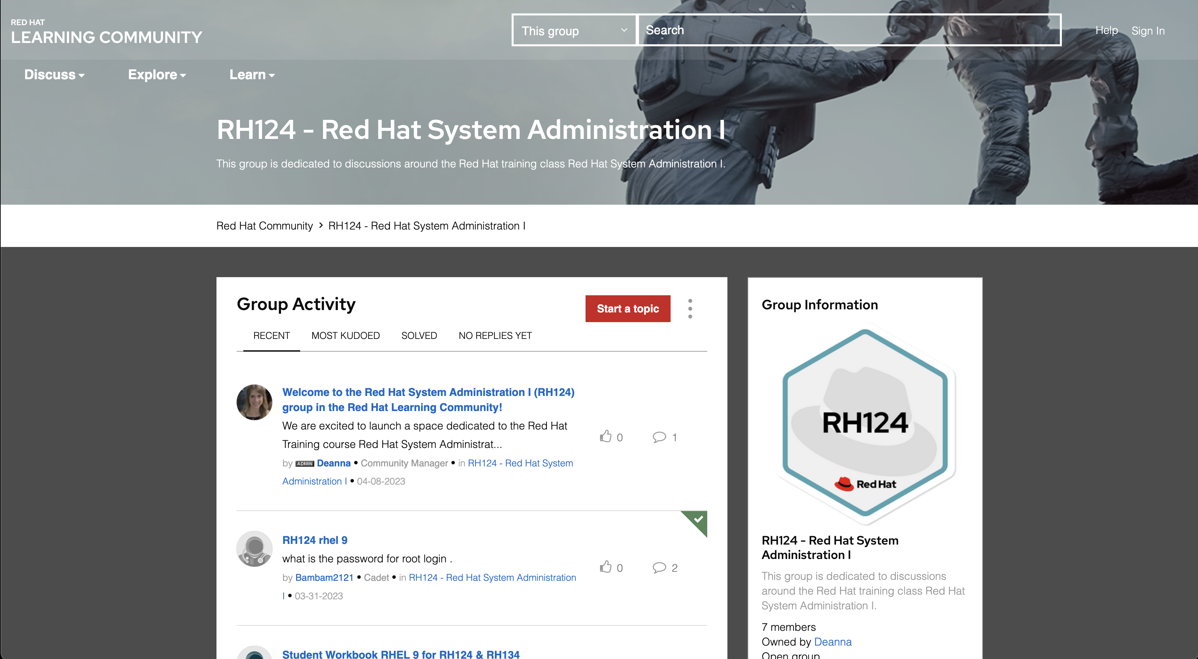
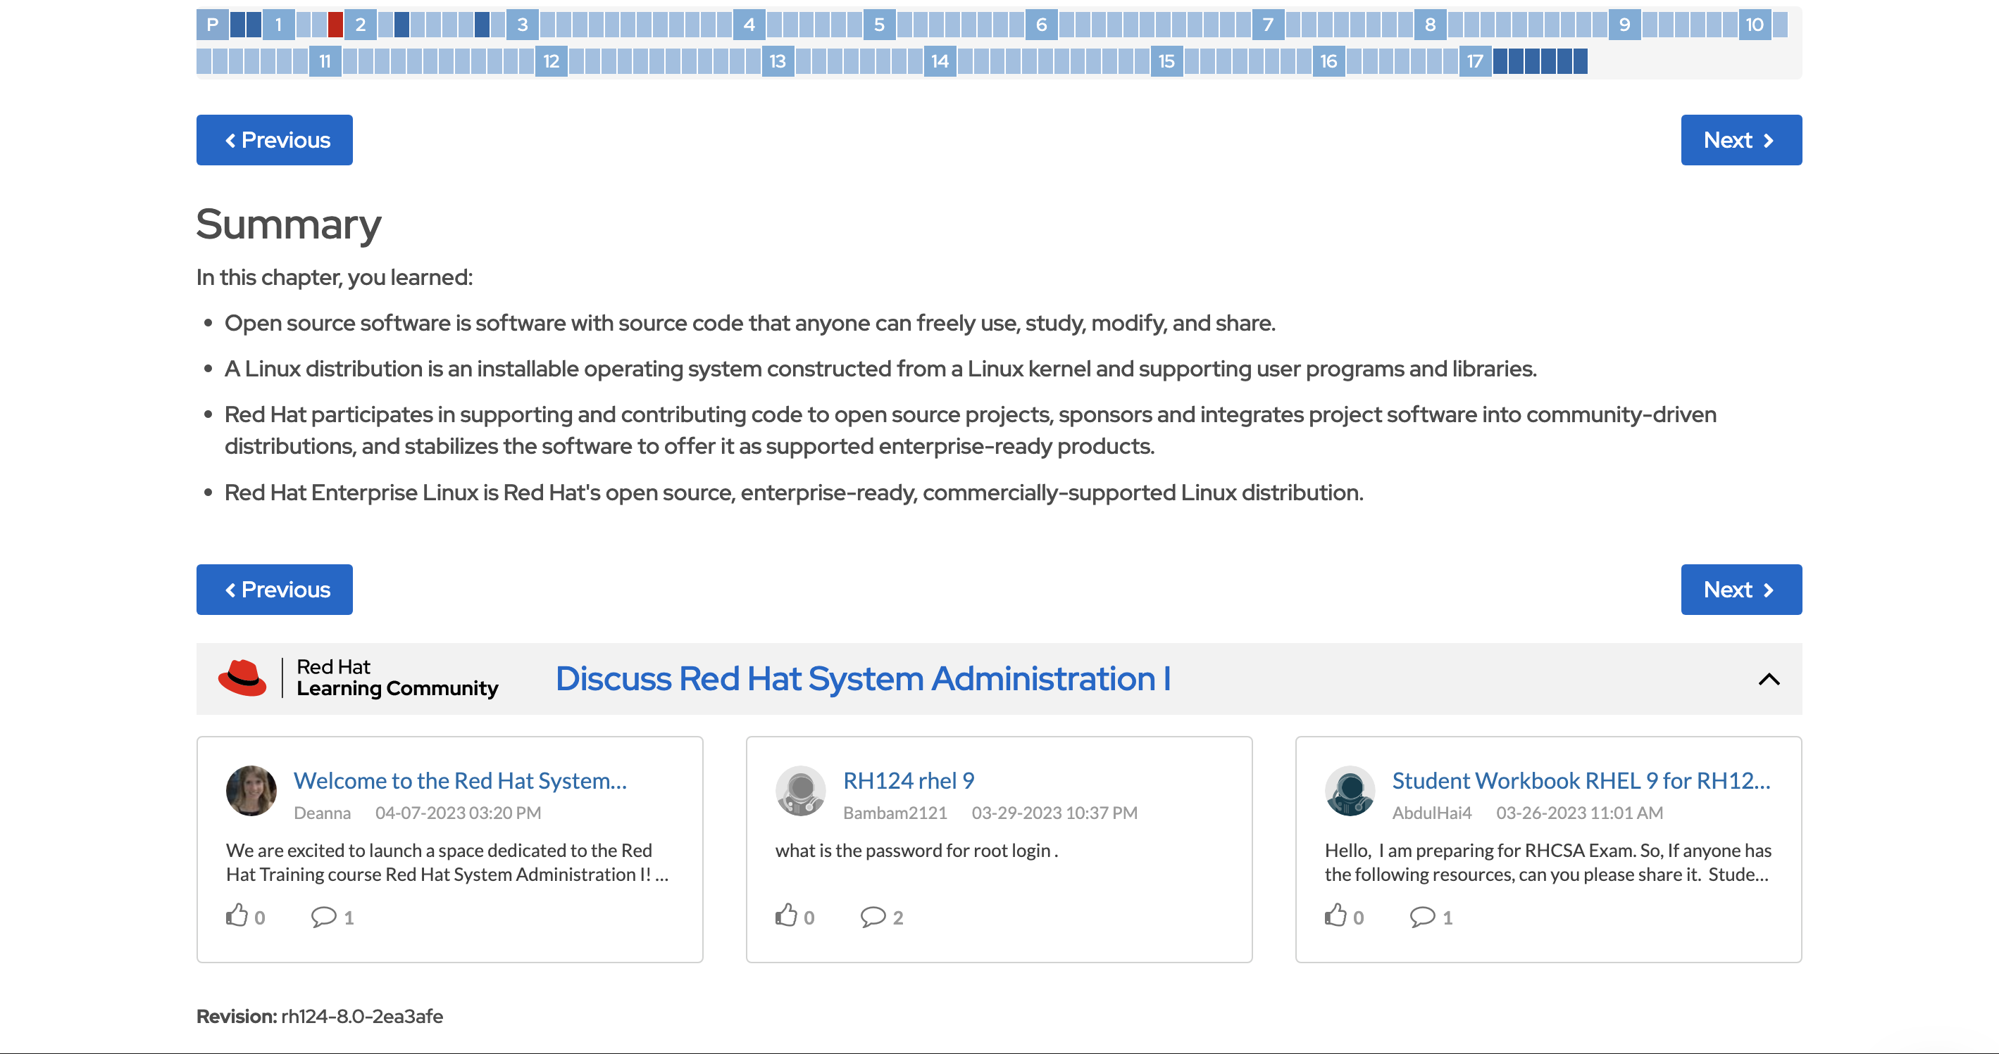
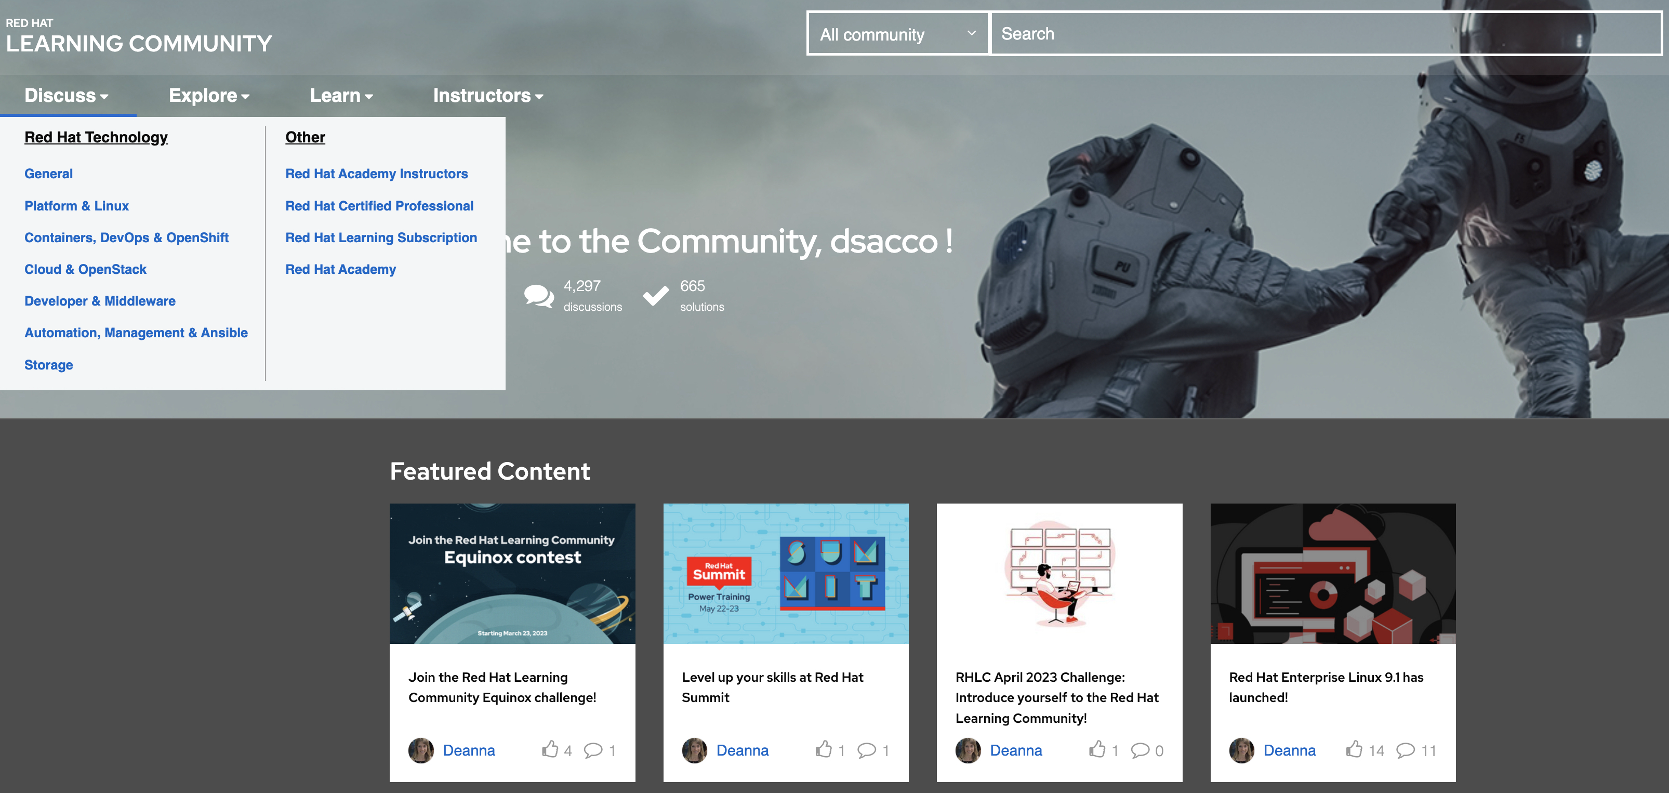
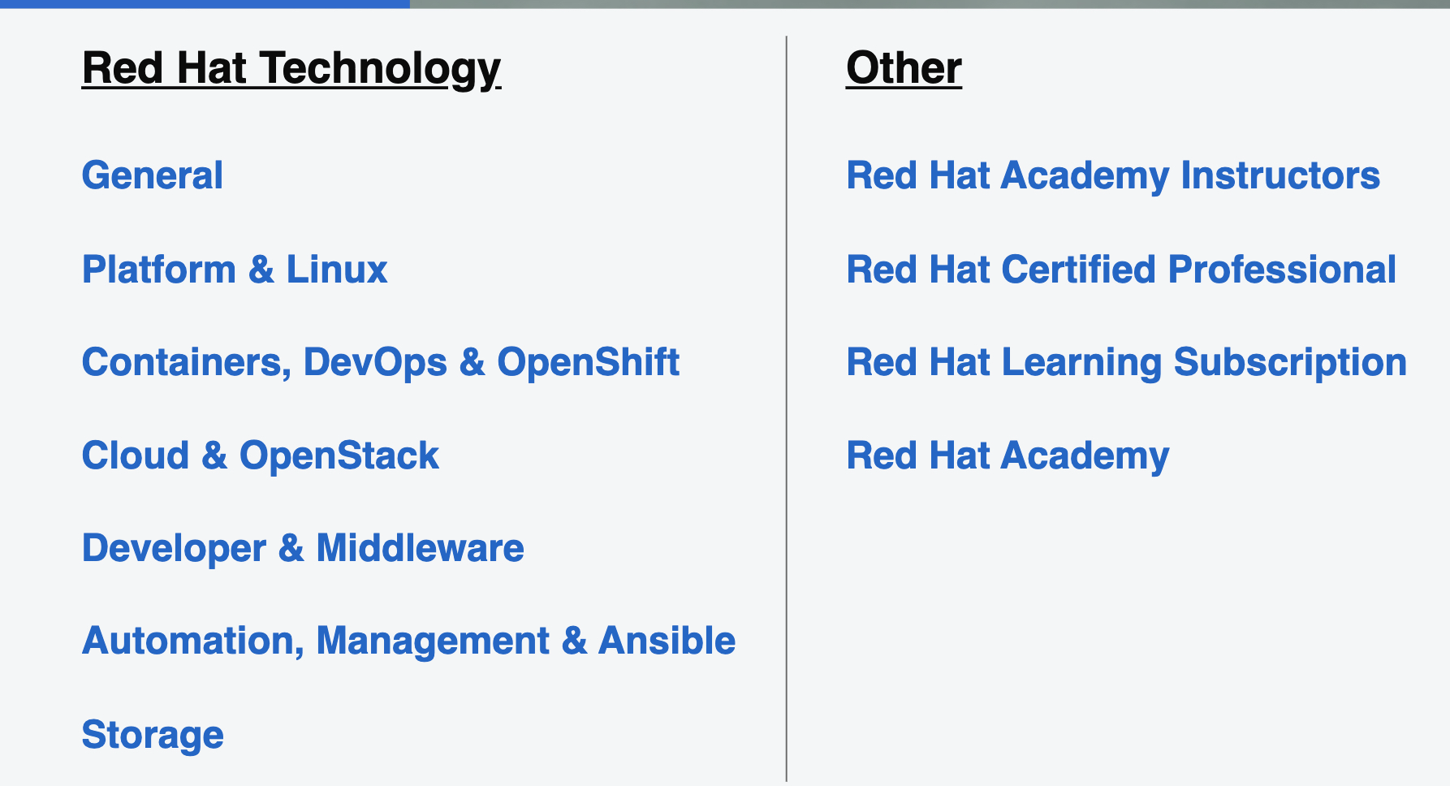
Tying RHLS Subscribers to the Learning Community via Syndicated Chat
learn.redhat.com
Connects learners to the community in the time of need

Slide 16
How you can
Lessons
move forward

Slide 17
Final thoughts
Determine what’s Valuable
What do your learners want and need?
Follow the data you collect today to inform improvements
Create a Plan
Align business drivers to your data strategy
Invite the right players
Execute
Choose a starting point/next steps that are in your grasp
Collect data at every point throughout the training lifecycle

Slide 18
Any Questions?

Slide 19
Thank you
dsacco@redhat.com
Notes:
Search if quay doesn’t need subscription

