Slide 1

Siemens EDA
The Ultimate Win-Win
Having a great LMS as a strategic enabler to customer education: The Siemens EDA experience
Bonnie Willoughby, Director Learning Services
Deb Taylor, Operations Manager Learning Services
CEdMA 2023

Slide 2
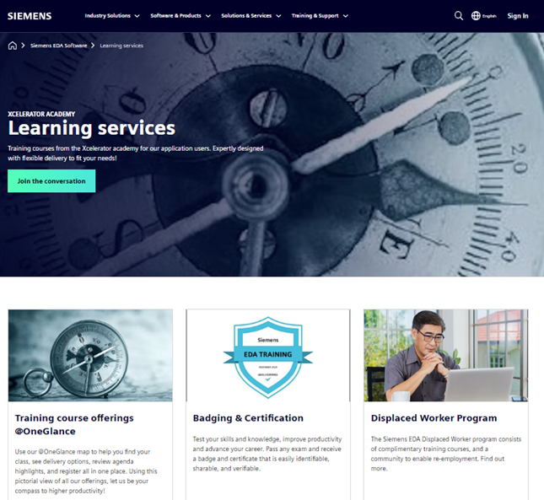
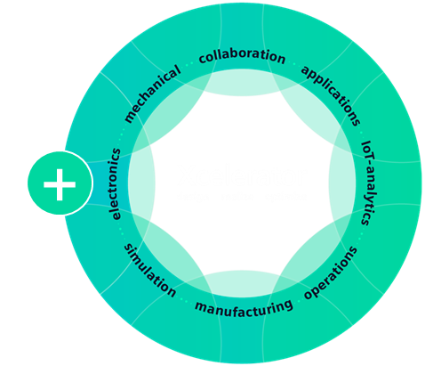
WHO WE ARE – OUR OFFERINGS
Siemens EDA Xcelerator Academy https://eda.learn.sw.siemens.com/training/
Extensive catalog. Flexible customizable delivery. Certification

Slide 3


Powerful LMS?
What’s your superpower ☺

Slide 4

Vision
Enable greater customer success
Simplify tools and processes
Automate for future support models
Ignite passion for Siemens products
Drive Continuous optimization/innovation
Build high performing teams
Notes:
Our vision is to do the above.

Slide 5
Strategic Guiding Principles
GET AGILE
Innovate and Optimize
GET UNIFIED
Centralize Tools and Methodologies
GET EASIER
Friction-Free Experiences
GET MOVING
Drive Business Outcomes

Slide 6
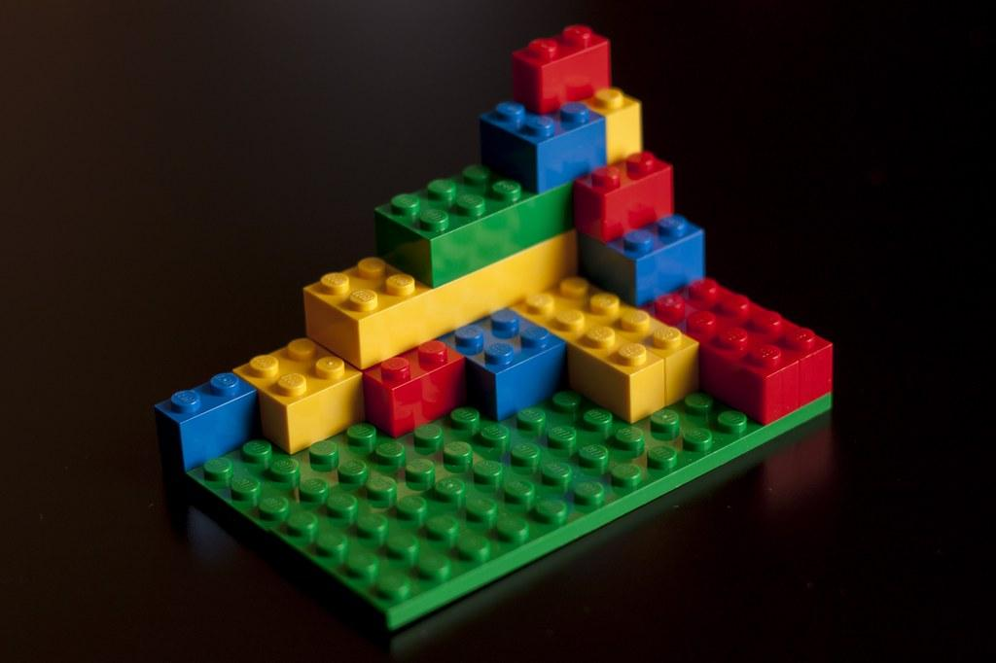
Elements of a powerful LMS?

Slide 7







Siemens Xcelerator Academy
Content Creation
Content Assembly
Registration System
User Dashboard
Subscription Manager
Badging and Certification
Analytics
Siemens EDA LMS Platform

Slide 8






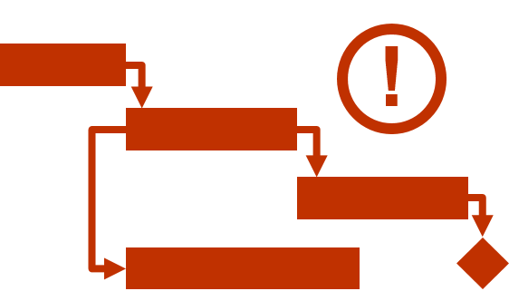
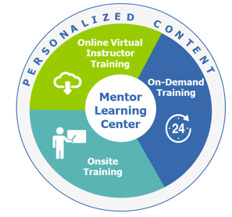
Journey to Siemens Xcelerator Academy
Up 50%
140 Role-based Learning Tracks
Up 100%
Development Methodology
Crowd-sourcing Accelerates
Virtual Labs Scale
Additional
Attendees
2x Training Libraries Released
Support Center Integration
Registration doubled
Apr 15’
Feb 16’
Mar 17’
FY 17
Aug 18’
Sept 18’
FY 19
Aug 15’
FY 16
Jul 17’
FY 18
Mar 19’
Mar 15’
Learning Strategy
Learning Center Launched
Additional
Registration above ILT
Training Libraries (6000 topics)
Additional
Registrations
Support Center
Expansion

Slide 9

Journey to Siemens Xcelerator Academy
Level 1Badging & Certification
Website Redesign
Text To Speech
2021
2022’
2023
2022
Learning Maps
Additional
Attendees + Sig growth in revenue

Slide 10
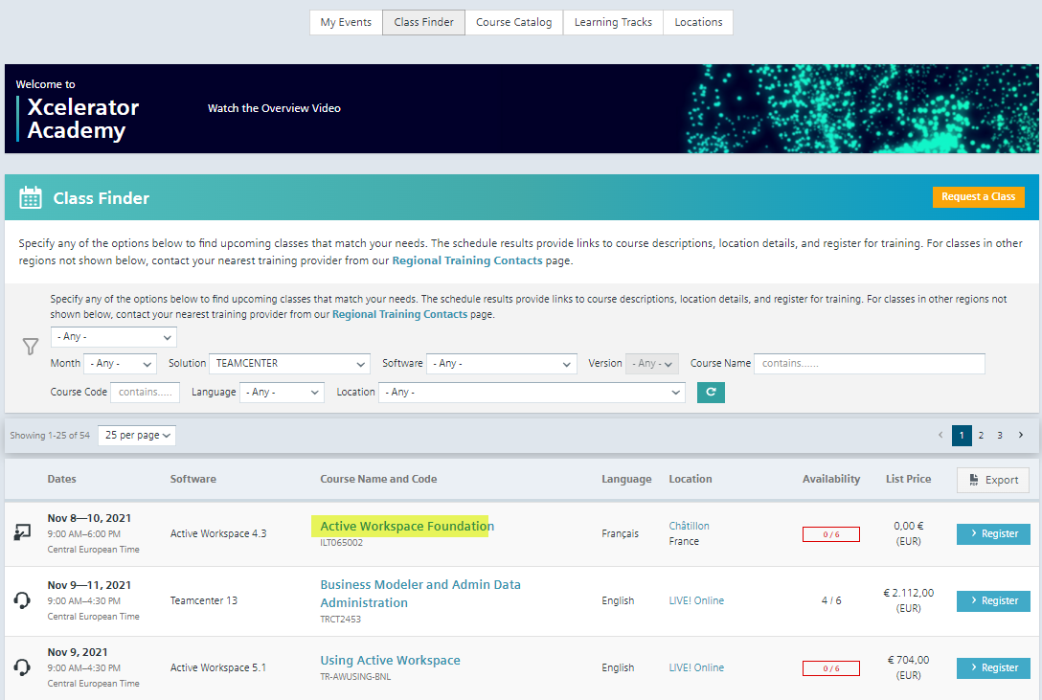
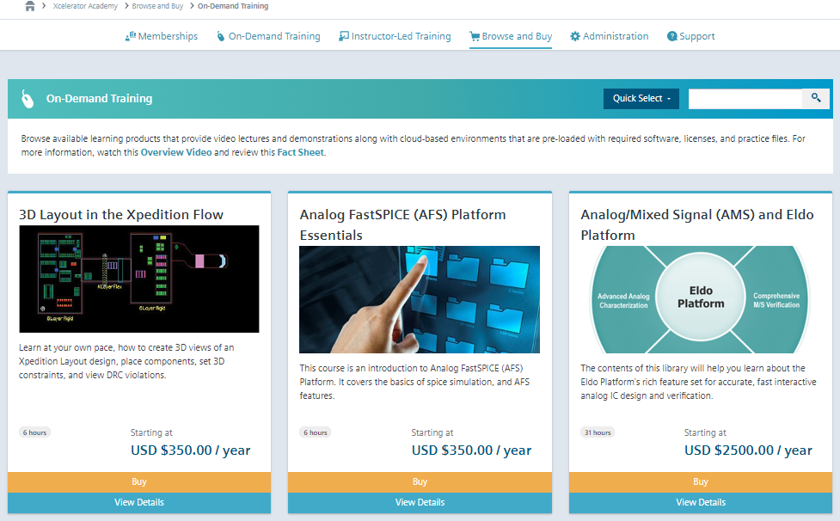
Browse and Buy & Course Catalog

Slide 11





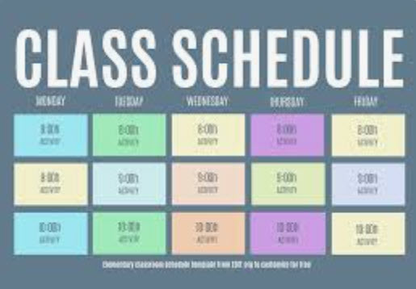

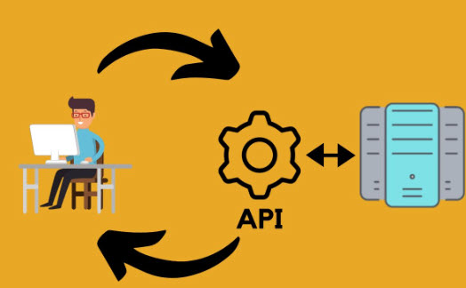
Registration and Reporting Tool
Courses and Classes
Comprehensive Materials page
Resource tracking – Instructors and locations
Payment Record
Schedule – Administrator and instructor view.
Reporting
API calls

Slide 12
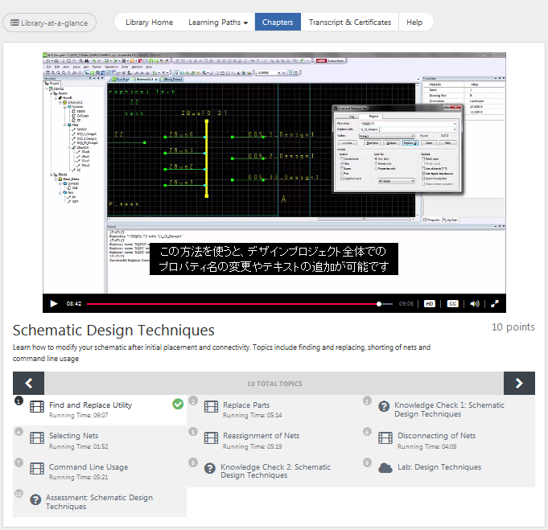








On-Demand Training – User View
Library
Learning Tracks
Chapters
Videos
Knowledge Checks
Virtual Labs
Chapter Assessment
Badging

Slide 13
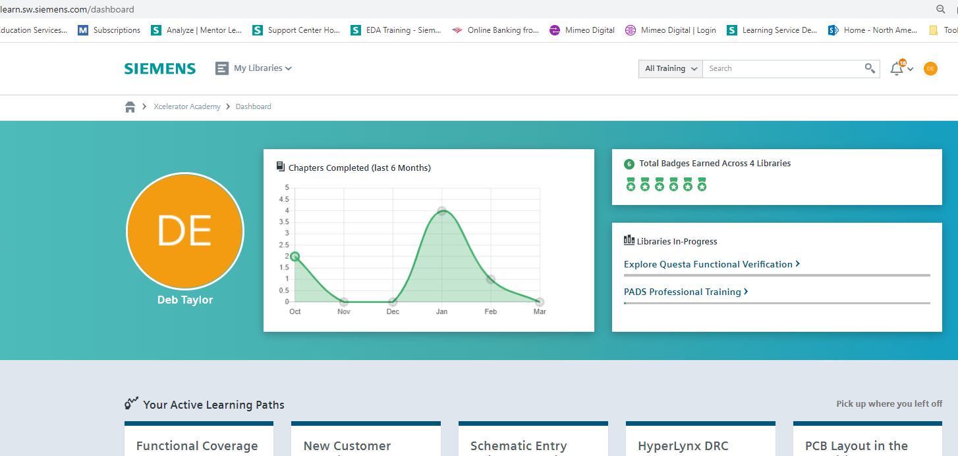
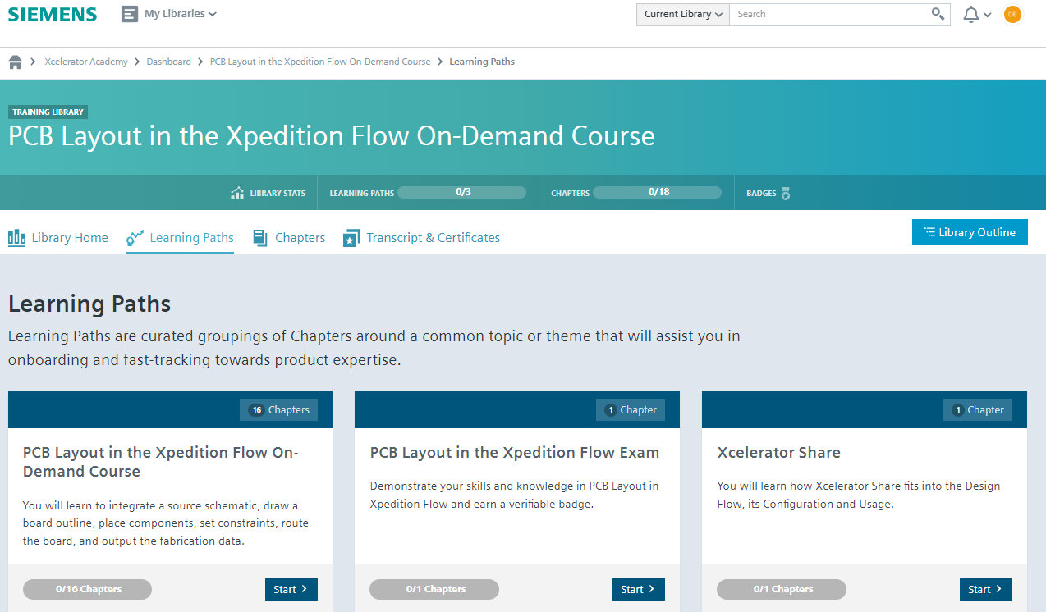
User Dashboard

Slide 14

Siemens Xcelerator Virtual Lab Environment
Launch Lab from Console
Connect to AWS
Practice with licensed software
Admin Console
  Includes lab instructions
  Builds Vlab instances on AWS
  User live experience in using the software
  Lab configuration
  Reset capability
  Testing new vlabs
  Tracking Usage

Slide 15
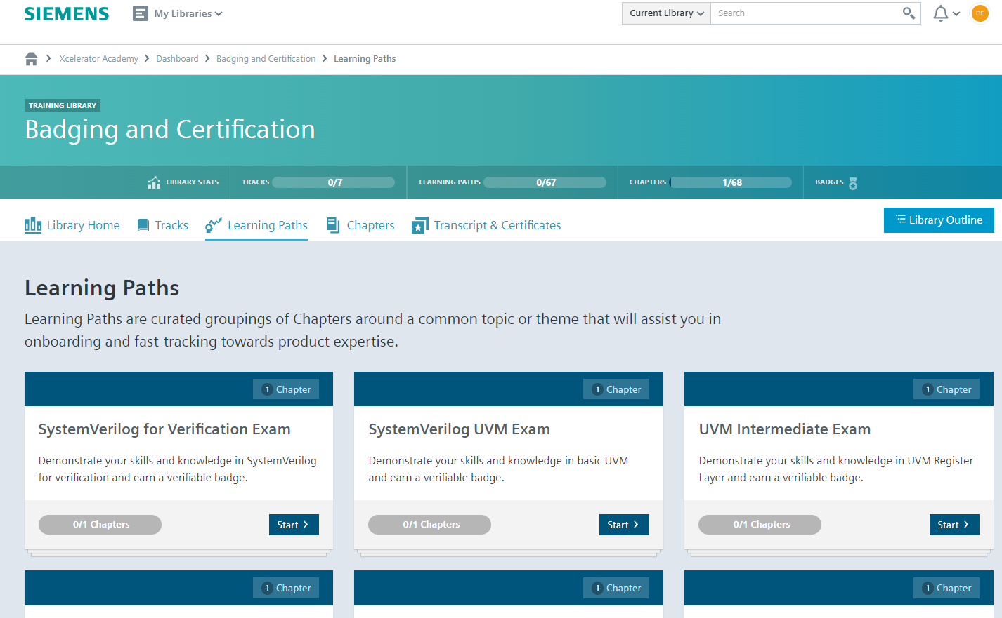
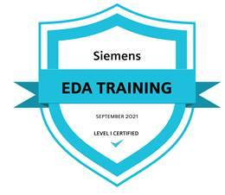
Badging
Demonstrate knowledge
Receive badge
Post to social media
Credly used for credentialing purposes

Slide 16
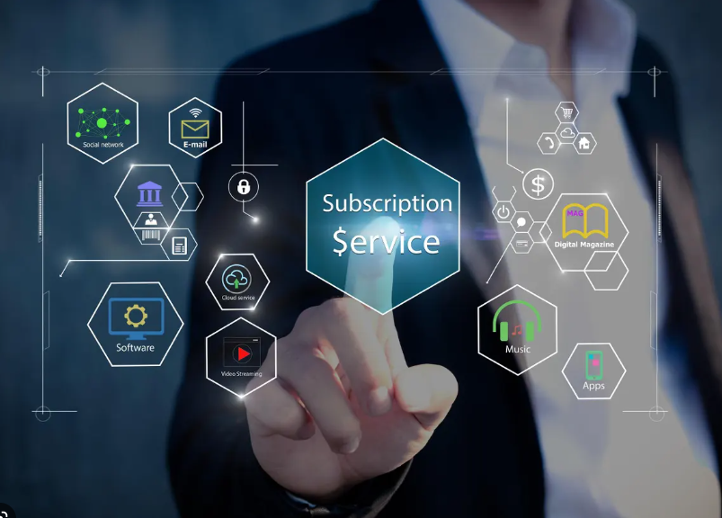
Managing Subscriptions
Motivation:
Provide a flexible way for assigning subscriptions to users.
Accomplishment:
User driven self-serve tool that allows customers to manage who they want to use a subscription
How did it affect our business:
Entices the customer to purchase larger quantities due to the ability to manage in a self-serve way.

Slide 17
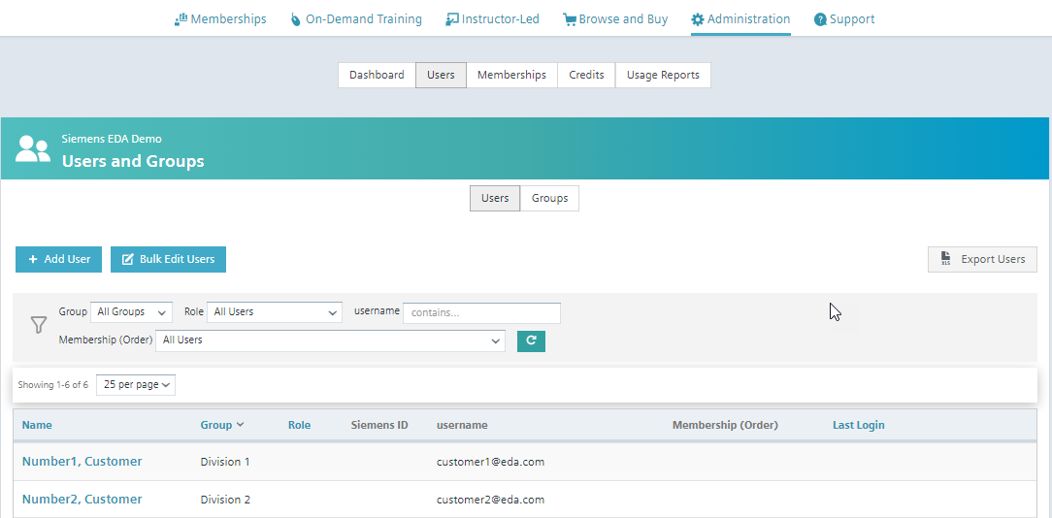
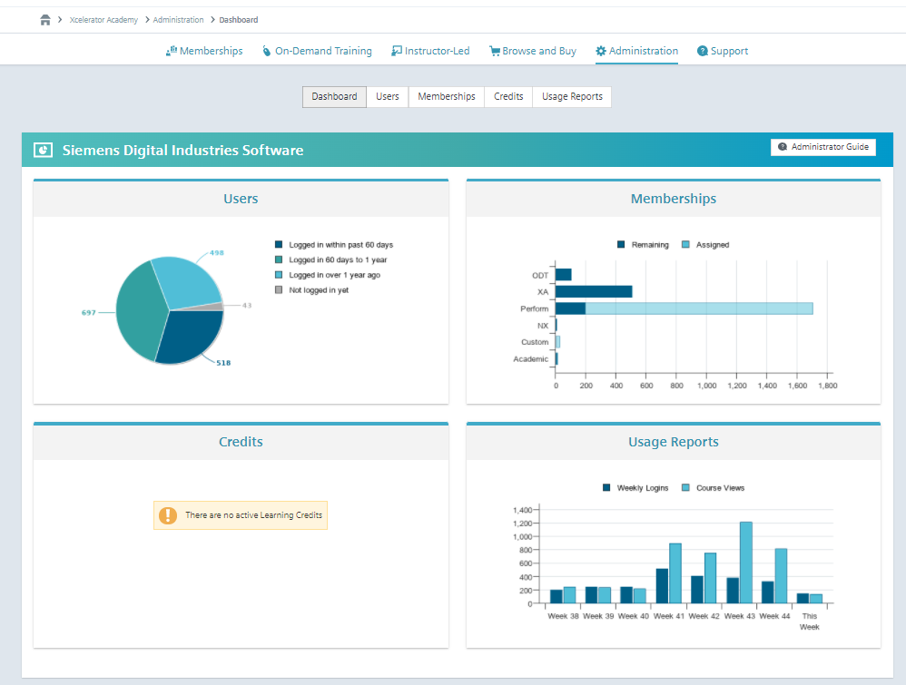
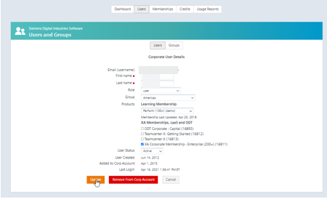
Subscription Manager
Subscription Manager for Enterprise Customers
Customer Dashboard
Customers Self Manage
Customer Usage Reports

Slide 18
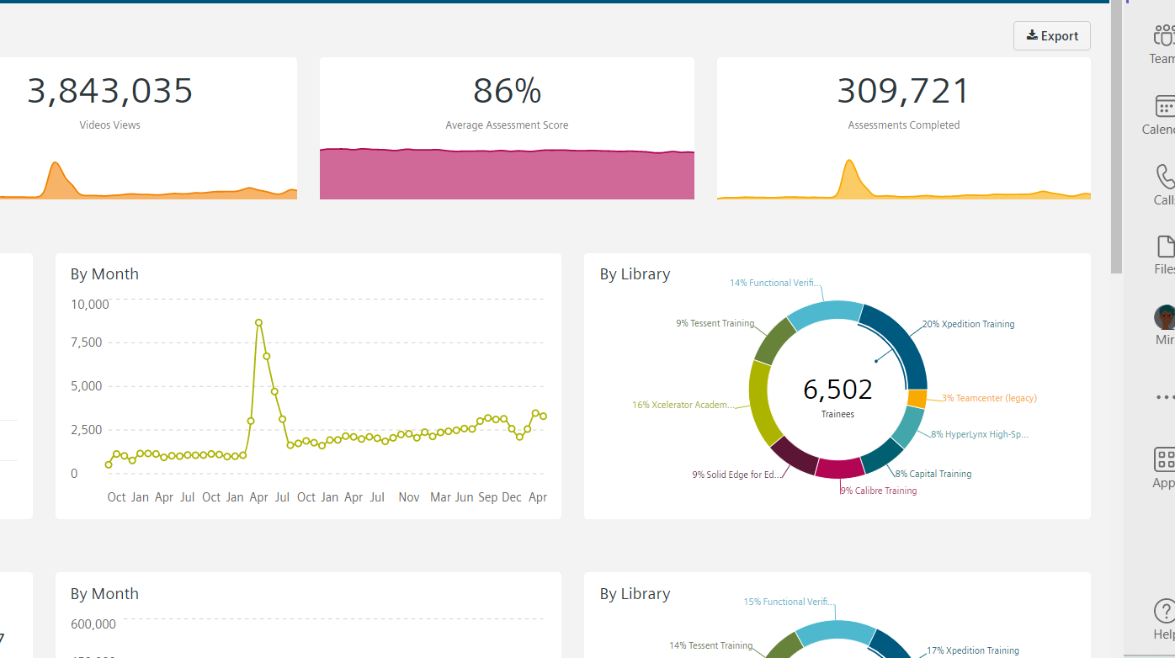
Analytics

Slide 19

QBR Data Readily Available
Revenue trending
Registrations trending
Certification numbers
Methods of delivery trends
Product area trends to help prioritize content
This Photo by Unknown Author is licensed under CC BY

Slide 20

Summary
A Winning LMS Platform
Allows flexibility
Cost Effective
Easy to interface with other internal tools
Easy to integrate with outside vendor tools
Can be leveraged by multiple groups for common good of the customer
Other ??

Slide 21


Open Discussion

