Slide 1



Growing Your Business with a Certification Program
Notes:
There are 5 core ways to grow your business through a certification program

Slide 2

If you had a recommendation that could increase profits by up to 95%, would leadership listen?

Slide 3

No,
its not AI!

Slide 4

About Me
Buzz Walker, Chief Revenue Officer, Kryterion
Engineer to P&G
Wharton MBA to HP
3 startups and an agency
Grow and open new markets
2 granddaughters and a grandson

Slide 5

Kryterion’s Expertise in Certification Programs
Kryterion has over 20 years of experience in helping top-tier technology companies, professional associations, and organizations across industries to start and grow certification programs. We offer:
Self-service SaaS platform that gives you control of your exam
Psychometricians available to support your exam development
Faster time to market. Publish exams or change test items in minutes – with no annual minimums or test publishing fees
Multi-modal test delivery
Customer success pros ready to support your program
Notes:
A self-service SaaS platform that gives you in-house control of your exam
In-house, psychometricians available to support the design and development of certification exams
Faster time to market. Publish exams or change test items in minutes – with no annual minimums or test publishing fees
Multi-modal test delivery: online, online with live remote proctoring, via Kryterion’s 1000+ test center network, or via your own test center or event
Customer success pros ready to support the successful launch and growth of your program

Slide 6

What We Will Cover
A Certification program can:
Build brand credibility
Increase product adoption
Improve customer retention
Reduce support costs
Generate more revenue
Notes:
In this session we will cover how you can leverage a product certification program to:
Build brand credibility
Increase product adoption
Improve customer retention
Reduce customer support costs
Generate more revenue

Slide 7

Hallmarks of a Quality Certification
Identity verification
Proctoring - ensure person who submitted the work is the person who did the work
Ensure that the evaluation process is valid, fair, and reliable with rigorous psychometrics
Passing the exam does not require taking a prescribed learning path
  On the job learning OK
Notes:
hallmarks of a quality certification are:
● We have confirmed that the person is who they say they are (identity verification)
● We have ensured that the person who submitted the work is the person who did the work
(proctoring)
● We have ensured that the evaluation process is valid, fair, and reliable with rigorous
psychometrics
● Passing the exam does not require taking a prescribed learning path; skills or knowledge can be
obtained through experience or on the job learning

Slide 8

Build Brand Credibility: Why it Matters
Certifications:
build confidence in product
brand credibility
>80% consider trust a deciding factor in their buying decisions
Brand credibility and trust are critical in acquiring and retaining customers
https://hbr.org/2022/06/3-ways-marketers-can-earn-and-keep-customer-trust
Notes:
https://hbr.org/2022/06/3-ways-marketers-can-earn-and-keep-customer-trust
A certification program can build confidence in your product and credibility in your brand
A 2021 survey of 1,000 consumers concluded that more than 80% consider trust a deciding factor in their buying decisions
This means that brand credibility and trust are critical in acquiring and retaining customers

Slide 9
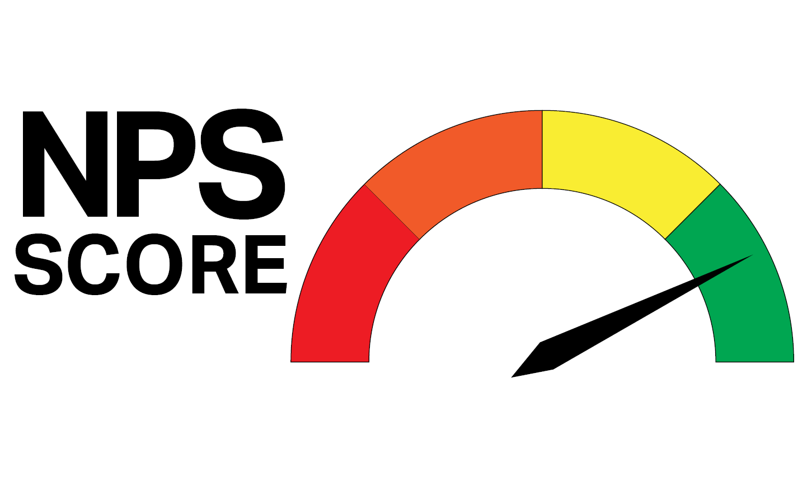
Build Brand Credibility with a Certification Program
Certified Learners can become brand promoter
88% of people trust online reviews as much as personal recommendation
Certified professionals share results on social media
  increasing word-of-mouth referrals
  recommend products
  Take skills and your product to new organizations.
Resource: “How to Market Your Certification Program”
https://www.lxahub.com/stories/word-of-mouth-marketing-stats-and-trends-for-2023
Notes:
https://www.lxahub.com/stories/word-of-mouth-marketing-stats-and-trends-for-2023
Those who become certified are equipped to become a brand promoter
88% of people trust online reviews from other consumers as much as they trust recommendations from personal contacts, according to the Local Consumer Review survey.
Certified professionals often share certification and exam results on social media increasing word-of-mouth referrals. Certified professionals also recommend products for which they are certified when they move on to new organizations. This promotion requires no added cost to your organization.

Slide 10

Product Adoption: Why it Matters
Product adoption is critical for growing and established organizations
Accelerating product adoption can establish market leadership
Increased product adoption reduces churn rate
Notes:
Product adoption is critical whether you are a growth or established organization
Accelerating product adoption can position your product as a market leader above the competition
Increased product adoption reduces churn rate

Slide 11

Increase Product Adoption with a Certification Program
Certified Customers more effectively utilize your products
  increases product adoption
68% more likely to use a product when well trained – TSIA (Technology and Services Industry Association)
Certified professionals
  deeper understanding of the product's features and capabilities
  select and recommend solutions they understand
Notes:
https://www.tsia.com/blog/leveraging-certification-to-drive-adoption
https://www.servicesbytechdata.com/hubfs/Resource%20Center/2019/Datasheet-OEM-ProductAdoptionandInnovation-Jul-19.pdf
Showing customers how to effectively use your products, through certification, can increase product adoption.
According to the Technology and Services Industry Association (TSIA) research, 68 percent of professionals are more likely to use a product if they have sufficient training.
A certification program can help customers gain a deeper understanding of the product's features and capabilities which will equip them to select and recommend the product as a solution.

Slide 12

Improve Customer Retention: Why it Matters
Improving customer retention has a direct impact on company profitability
5% increase in retention increases profits by up to 95%, HBR study
Customer retention is also a measures reliably delivering a service to customers
5X increase in cost to acquire new vs. keeping existing customer
Notes:
https://hbswk.hbs.edu/archive/the-economics-of-e-loyalty
https://smallbiztrends.com/2014/09/increase-in-customer-retention-increases-profits.html
https://www.outboundengine.com/blog/customer-retention-marketing-vs-customer-acquisition-marketing
https://www.huify.com/blog/acquisition-vs-retention-customer-lifetime-value
Improving customer retention has a direct impact on company profitability.
A 5% increase in retention increases profits by up to 95%, according to a study published by Harvard Business Review
Customer retention is also a measure of how reliably a company is delivering a service to customers.
Acquiring a new customer can cost an organization 5 times more than retaining an existing customer

Slide 13

Improve Customer Retention with a Certification Program
Certification program can nurture customers and increase retention
7.4% increase in customer retention from formalized customer education programs
  (Forrester Research)
Trained, confident professionals more:
  fully utilize features
  likely to continue using your product
  advanced use and share their knowledge
Notes:
Forrester
A certification program can be an effective strategy to nurture customers and increase customer retention.
Forrester research found that formalized customer education programs, that can include certification, drive an average increase of 7.4% in customer retention.
When customers are confident in fully utilizing all the features of your product, they are more likely to continue using your product. Certification can increase customer knowledge of your product to an advanced level.
Oct 2019 - Increase Revenue And Improve Customer Retention Through Customer Education Programs

Slide 14
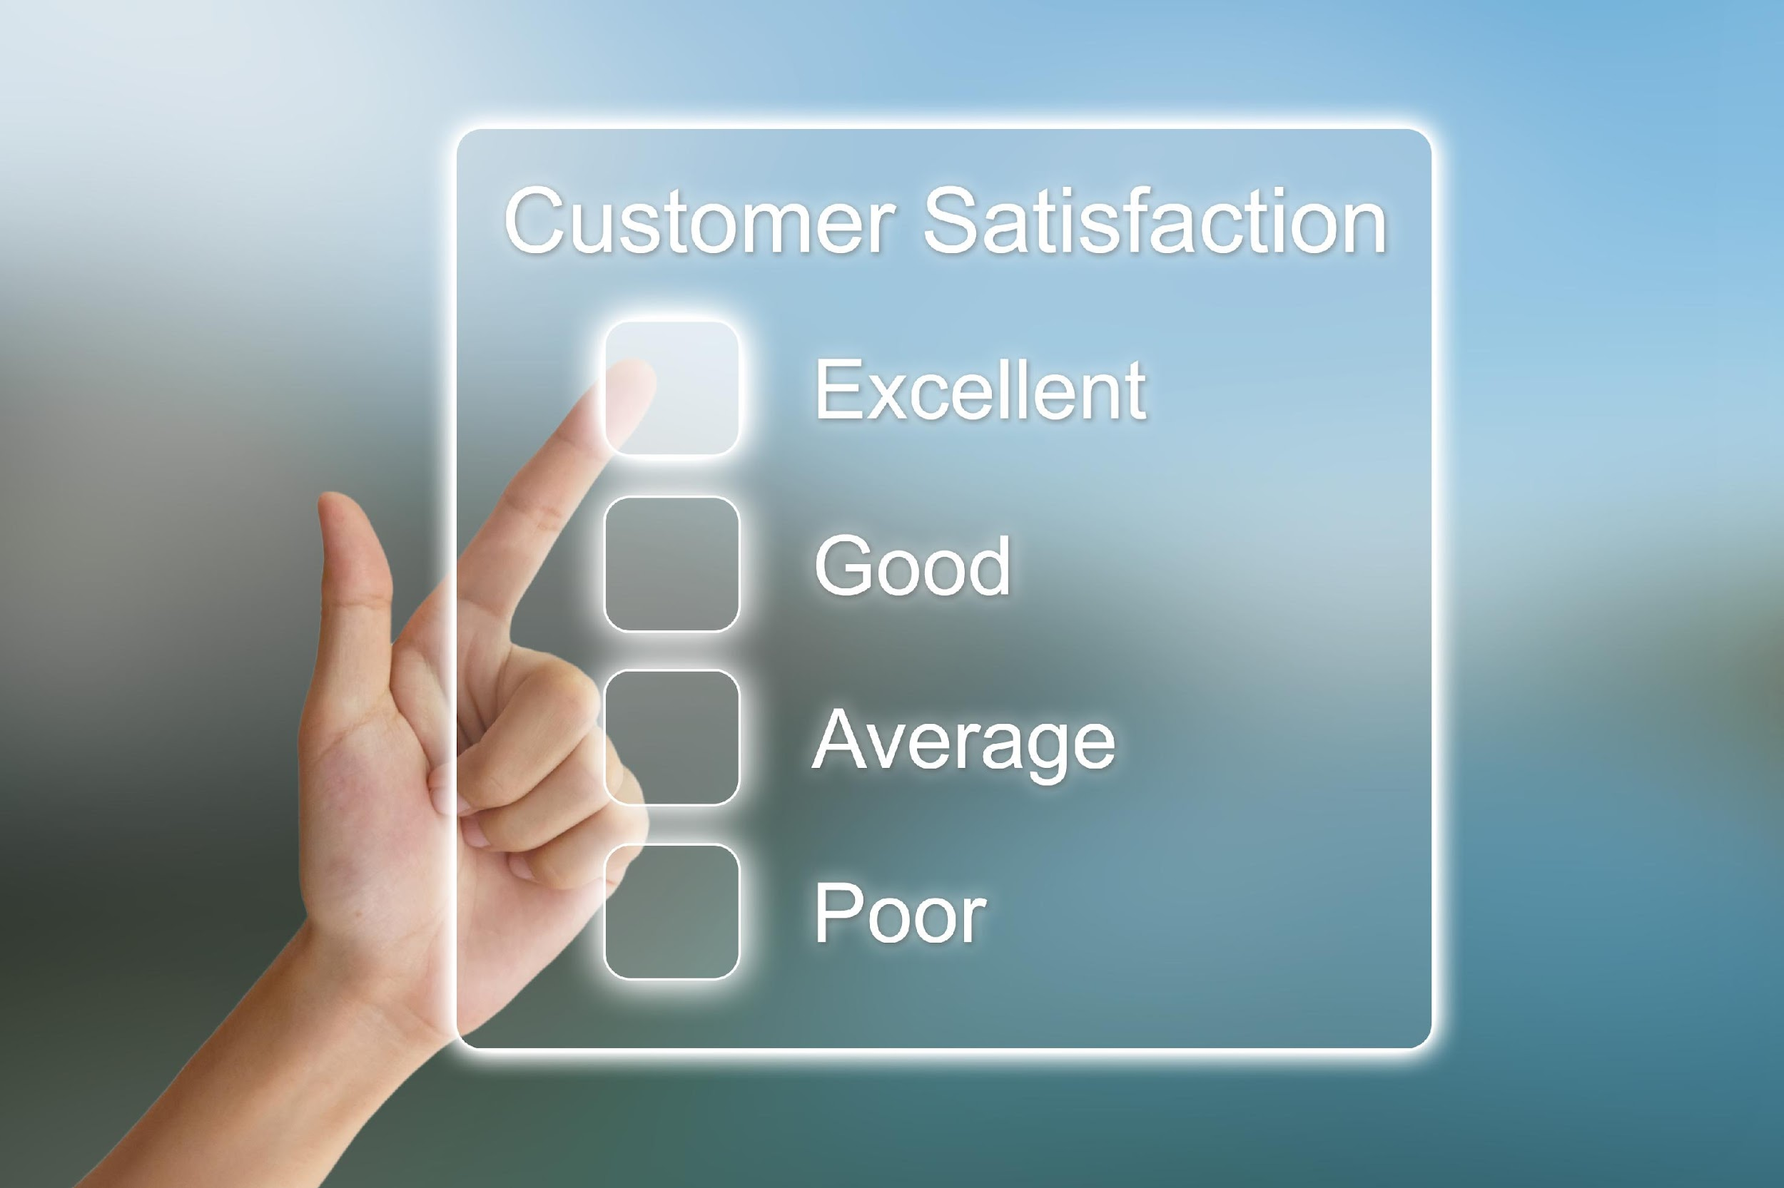
Reduce Customer Support Costs: Why it Matters
Operational efficiency increases customer satisfaction while reducing the cost of support
decreases customer churn
89% of companies with "significantly above average" customer experiences perform better financially than their competitors (Qualtrics XM Institute)
Notes:
https://www.qualtrics.com/m/assets/wp-content/uploads/2020/04/XMI_GlobalStateOfXM-2020.pdf
Increasing customer satisfaction with your product while reducing the cost of customer support can create efficiencies in operational costs
Increasing customer satisfaction can decrease customer churn
89% of companies with "significantly above average" customer experiences perform better financially than their competitors (Qualtrics XM Institute

Slide 15

Reduce Support Costs with a Certification Program
Certified learners can be advanced users reducing customer support costs
6.1% reduction in support costs from formalized education programs (Forrester)
Expanding customer expertise reduces errors and reliance on your end user support team
Notes:
A certification program can educate product users to an advanced level, in turn reducing customer support costs.
Forrester research found that formalized customer education programs, that can include certification, reduced customer support costs by 6.1%.
Certification that furthers the customer’s expertise in using the product’s features and reducing errors pays dividends by reducing reliance on your end user support team

Slide 16

Generate More Revenue with a Certification Program
Certification program can increase
product adoption
customer retention
which adds efficiency in your product’s revenue generation.
$10,000 ROI for each credentialed staff member (Global Knowledge - IT Skills and Salary report)
90% of companies have positive ROI from customer education investments (Forrester)
Notes:
A successful certification program, can further increase product adoption and customer retention, which adds efficiency in your product’s revenue generation.
IT decision makers estimate the return on investment for each credentialed staff member is about $10,000, according to Global Knowledge’s IT Skills and Salary report.
According to Forrester research, 90% of companies have seen a positive return on their customer education investments

Slide 17

Generate More Revenue with a Certification Program
Certification program can generate revenue
Charging for exam increases credential’s value
Increases partners’ credibility
Credible certification programs require renewal
Primary goal is still to increase sales, feature adoption, and customer retention
Notes:
Common question: Is the certification program itself a revenue generating opportunity?
You might also consider the opportunity to generate revenue from the exam product to individuals or organizations buying in large quantities for employees or partners.
Most credible certification programs also require renewal or re-certification which creates a recurring revenue opportunity.
While the primary revenue generation opportunity is in a certification program’s success in increasing product adoption and customer retention.

Slide 18
The Value of a Certification Program
Takeaway #1: Certification programs can be an ROI positive tool for increasing product adoption
90% of companies have seen a positive return on their customer education investments, which can be enhanced with the addition of a certification (Forrester research)
#1

Slide 19
The Value of a Certification Program
Takeaway #2: Certification programs can be an effective tool in driving customer retention
Increasing customer retention rates by just 5% increases a company’s profits by up to 95% (Harvard Business Review)
#2

Slide 20
The Value of a Certification Program
Takeaway #3: Certification programs can build confidence in your product and credibility in your brand.
80% of consumers say they consider trust a deciding factor in their buying decisions (Harvard Business Review)
#3
Notes:
https://hbr.org/2022/06/3-ways-marketers-can-earn-and-keep-customer-trust

Slide 21
The Value of a Certification Program
Conclusion:
5% increase in retention increases profits by up to 95%
7.4% increase in customer retention from formalized customer education programs
Leadership Will Listen
Notes:
https://hbr.org/2022/06/3-ways-marketers-can-earn-and-keep-customer-trust

Slide 22
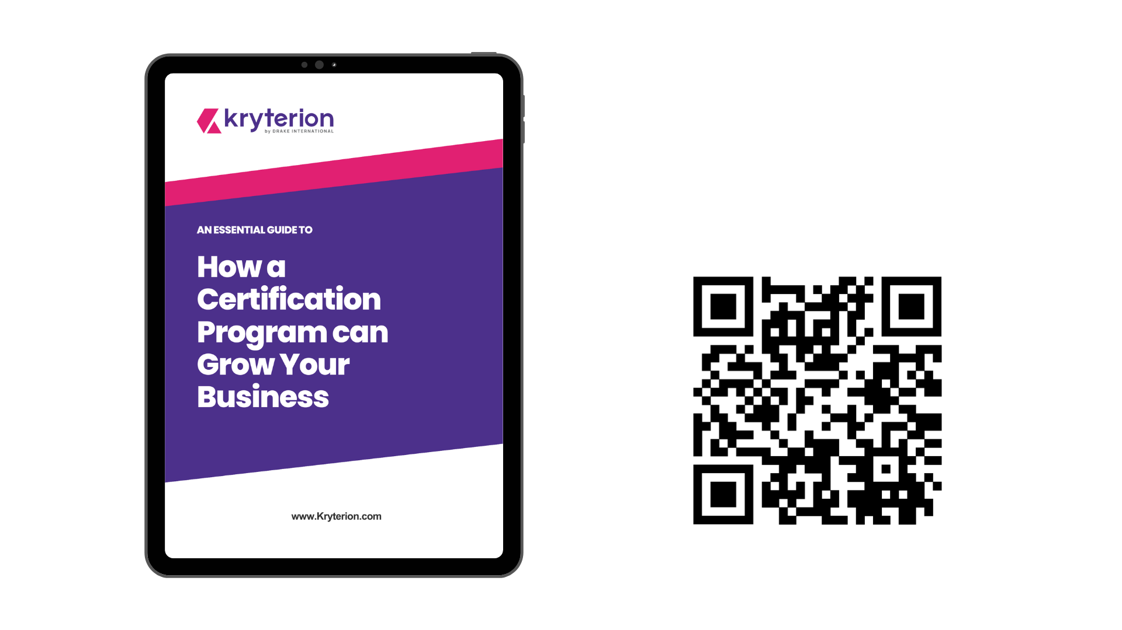
Download Your Free Guide!
Keep the insights shared today at your fingertips
Visit: Kryterion.com/guides

Slide 23

Thank you
Buzz Walker, Chief Revenue Officer, Kryterion
bwalker@kryterion.com
+1 602-476-6955

