Slide 1

Intentional
Living: Success to Significance
Susan Davis
www.shdavis.com
SH Davis Empowerment Group

Slide 2



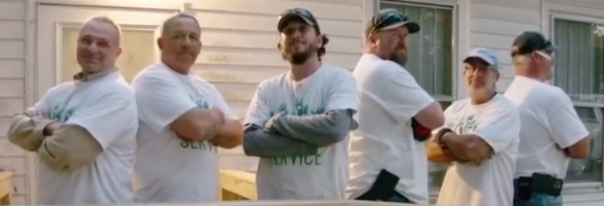

Intentional
Living
Notes:
You have been remarkable in your success during COVID, now what?
Examples of significance….
Intentional effort to move from success to significance
The video shows how focused you are on moving to significance… with members, your community…
You are doing this as an organization but the question I had to ask myself as I have been in organizations, is….. Am I doing this for myself?

Slide 3

What does Intentional Living mean to you?

Slide 4
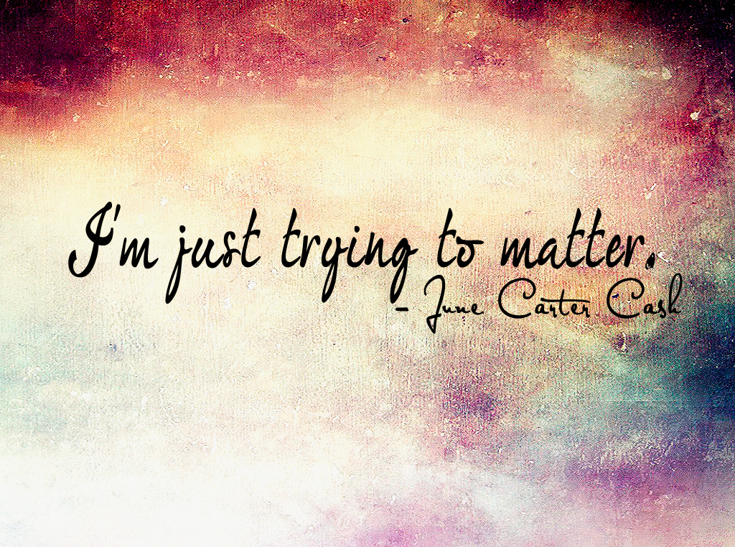
Notes:
I haven’t always known what this meant. To be quite honest. I always wanted to do the right things. I always wanted to serve and help others. I had good intentions!

Slide 5

What’s the difference between Success and Significance?
Notes:
It’s a question we all have to ask ourselves…..
I had early success…
The early success was all about me….

Slide 6
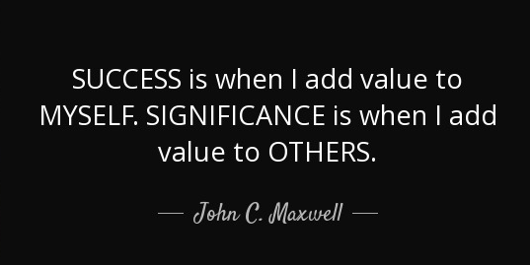
No one stumbles upon Significance; you have to be intentional
Notes:
How do you move from success to significance?
By being intentional….

Slide 7
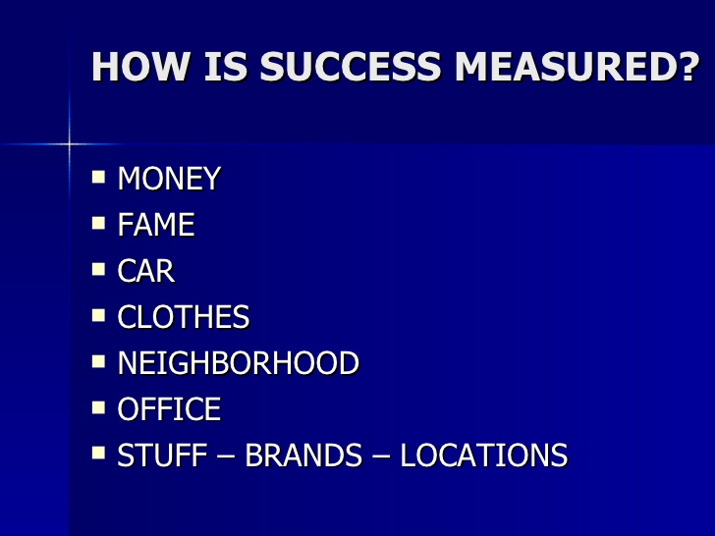

Slide 9
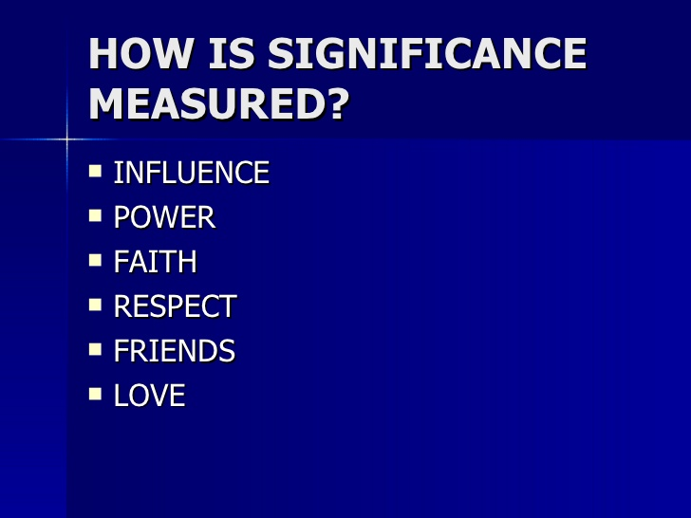

Slide 11
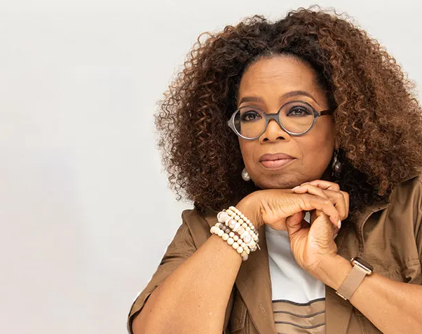
“Don’t worry about being successful but work toward being significant and the success will follow.”
Oprah Winfrey
Notes:
Making a choice to move from success to significance….
As Oprah would say……

Slide 12

When asked to describe regrets in their life…
80% describe actions they DID NOT take, rather than ones they did!
“We must all suffer from one of two pains: the pain of discipline or the pain of regret. The difference is discipline weighs ounces while regret weighs tons.”
Jim Rohn
Notes:
My story…….
My regrets…..
Tie last regret to what I learned…… I needed to be more intentional in my life…… living more intentionally…

Slide 13

Intentional Living is…
A life that brings you daily satisfaction and continual rewards for merely working to make a difference – small or large – in the lives of others.
John C. Maxwell
Notes:
What is intentional living?

Slide 14

What’s the
Difference
Between
“Good Intentions”
&
“Intentional Living”
Notes:
Reference back to my story…
I had great intentions… I wanted to add value.. I wanted to serve….. I wanted too…….
But wasn’t being intentional….

Slide 15
Good Intentions vs Intentional Living
Good
Intentions
Intentional
Living
A Life
That Matters
Desire
Wish
Someday
Fantasy
Hopefully
Passive
Occasional
Emotion
Somebody Should
Survival
“The little things we do or fail to do often speak louder than the loudest statements of our intentions.”
Thomas J Watson, Jr
Notes:
Tell my story going across the screens…. (pick one-three only)

Slide 16
Good Intentions vs Intentional Living
Good
Intentions
Intentional
Living
A Life
That Matters
Desire
Wish
Someday
Fantasy
Hopefully
Passive
Occasional
Emotion
Somebody Should
Survival
Action
Purpose
Today
Strategy
Definitely
Active
Continual
Discipline
I will
Success
“The little things we do or fail to do often speak louder than the loudest statements of our intentions.”
Thomas J Watson, Jr

Slide 17
Good Intentions vs Intentional Living
Good
Intentions
Intentional
Living
A Life
That Matters
Desire
Wish
Someday
Fantasy
Hopefully
Passive
Occasional
Emotion
Somebody Should
Survival
Action
Purpose
Today
Strategy
Definitely
Active
Continual
Discipline
I will
Success
Results
Fulfillment
Every day
Follow through
Continually
Proactive
Habitual
Lifestyle
I do
Significance
“The little things we do or fail to do often speak louder than the loudest statements of our intentions.”
Thomas J Watson, Jr
Notes:
Leads to a life that matters……
Good intention to intentional living….
Survive my life…. To find success in my life.. To significance in my life…..

Slide 18
“I didn’t intend for that to happen!”
DIRECTION, not INTENTION determines DESTINATION
“You attention affects your direction…Your direction determines your destination.”
-- Andy Stanley
Notes:
“principle of the path” - the intention is to……….
But things happen…… and you have to make course corrections in order to get your final direction.
Intentions don’t matter….. It is your course.. Charting your course….

Slide 19
What types of things move you off the path to your desired destination?
Unclear where I am going
Over committing
Not following through
Not taking care of today

Slide 20

Questions I Ask Myself When I Want to Live Intentionally
Notes:
Boundaries

Slide 21

Question #1
Am I focusing on significant things in my life?

Slide 22
Boundaries
What will you pay attention to?
What will you inhibit?
What you are experiencing today is a result of what you created and what you allowed.
Dr. Henry Cloud

Slide 23

How would an outsider know what is significant in your life?
Notes:
Behavior never lies…
Show me your calendar and your checkbook and I can tell you what is important to you
How would someone know if I am working on significance?
Where do you spend your time?
Your money?
It says a lot…

Slide 24
Question #2
Do I know my one thing?

Slide 25
Question #2
Do I know my one thing?
You Love It
You are Great It
The World Needs It
You Get Paid for It

Slide 26
Question #2
Do I know my one thing?
Passion
You Love It
Mission
You are Great It
The World Needs It
You Get Paid for It
Profession
Vocation

Slide 27
Question #2
Do I know my one thing?
Your
One Thing
(Purpose)
Passion
You Love It
Mission
You are Great It
The World Needs It
You Get Paid for It
Profession
Vocation

Slide 28
Question #3
Am I watching my words?
We -- Can -- Will -- Yes
Or
Me-- Can’t -- Won’t -- No
Stacking Rocks – Building a Wall – building a Cathedral
“Every time you open your mouth you either pull people toward you or push them away…it’s your choice.”
Perry Holley

Slide 29
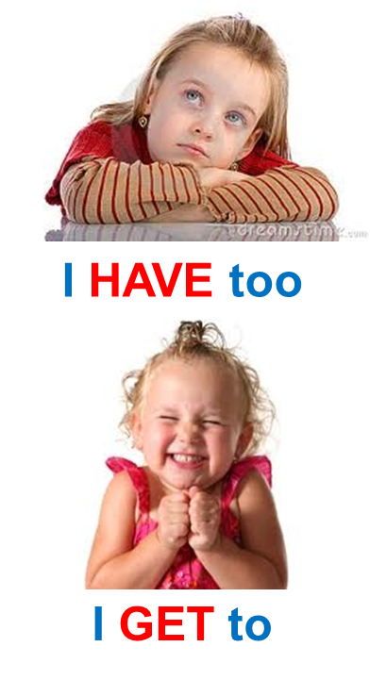
Question #3
Am I watching my words?
We -- Can -- Will -- Yes
Or
Me-- Can’t -- Won’t -- No
What Are You Doing?
“Every time you open your mouth you either pull people toward you or push them away…it’s your choice.”
Perry Holley

Slide 30

Question #4
Am I doing the small things daily that I need to do?

Slide 31
“Your only path to success is through a continuum of mundane, unsexy, unexciting, and sometimes difficult daily disciplines compounded over time.”
Darren Hardy
What are the daily disciplines that would lead to greater significance?

Slide 32
What are the daily disciplines that would lead to greater significance?
Get up earlier
Read More
Write More
Say “no” more
Schedule everything
Track what matters

Slide 33

Question #5
Do I know my why?
Helps you to focus
Gives you confidence
Increases your impact
“People don’t buy what you do, they buy why you do it.”
Simon Sinek

Slide 34
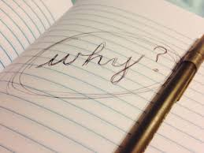
3 Questions to Find Your “Why”
1. What do you CRY about?
2. What do you SING about?
3. What do you DREAM about?
“My “why” wakes me up every single morning.”

Slide 35
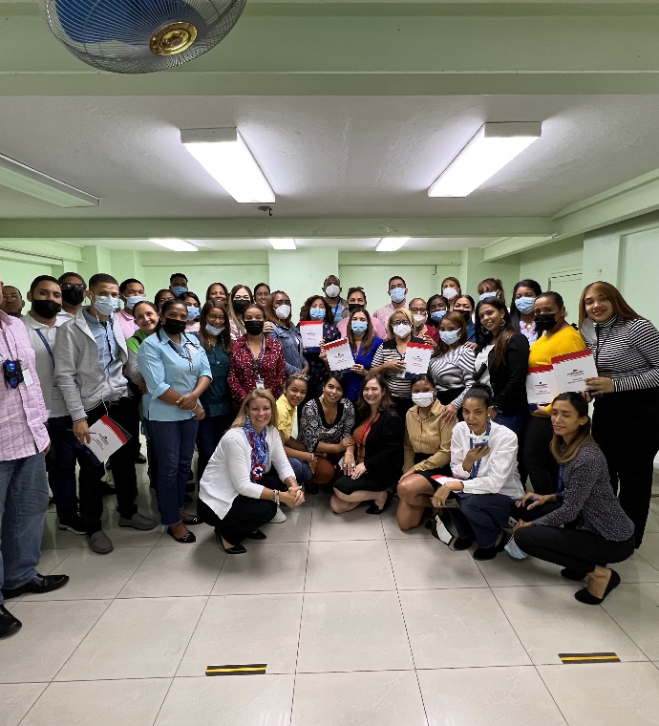
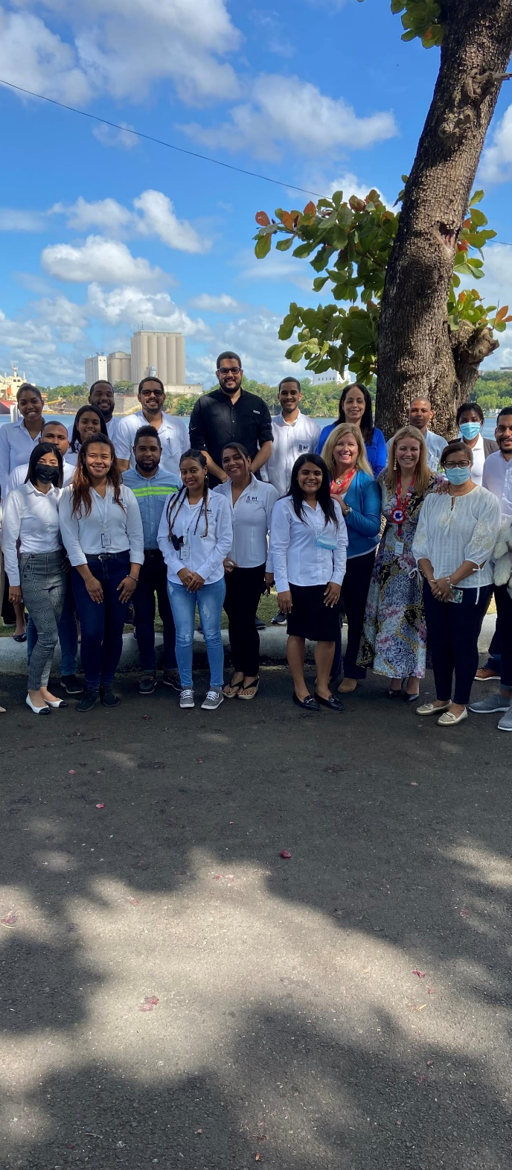
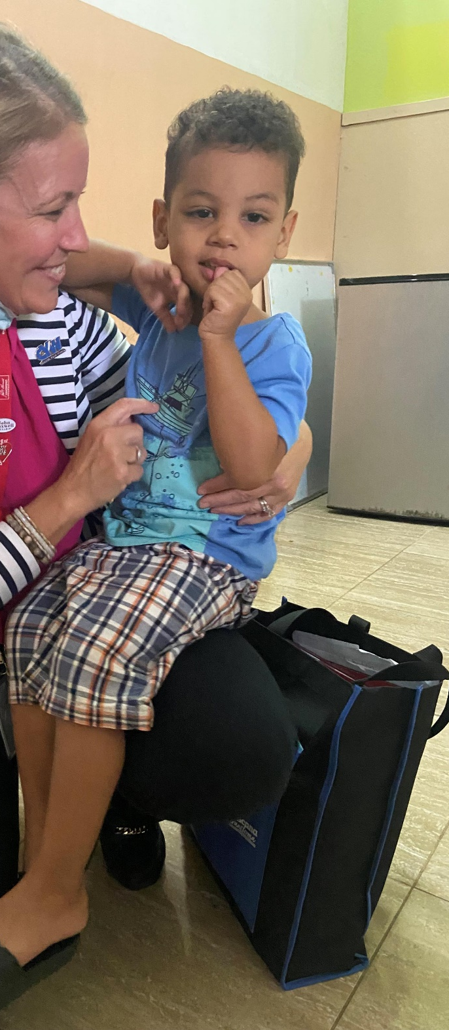
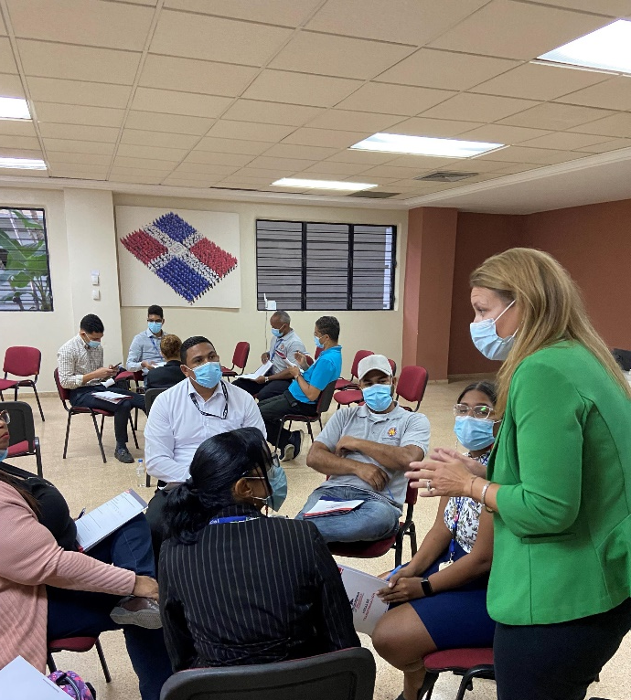

Slide 36
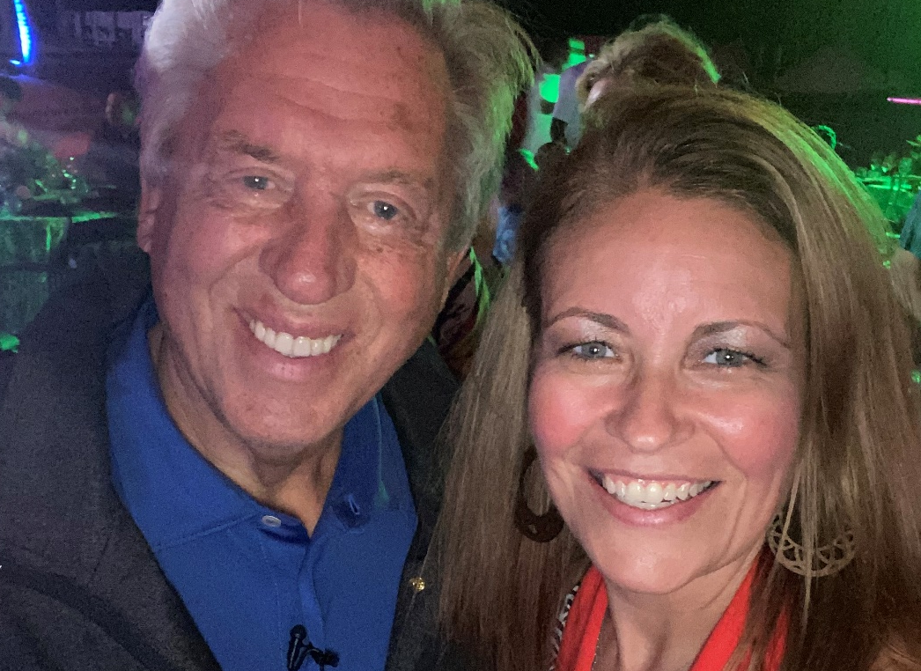
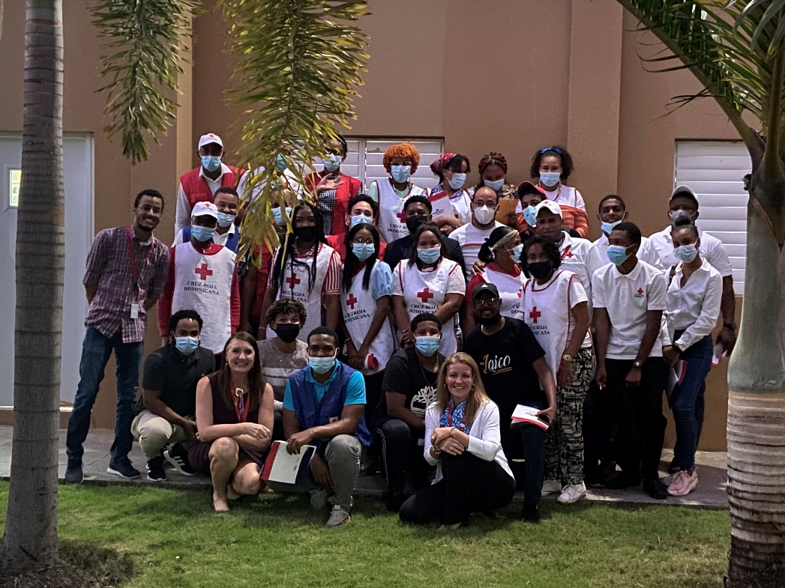

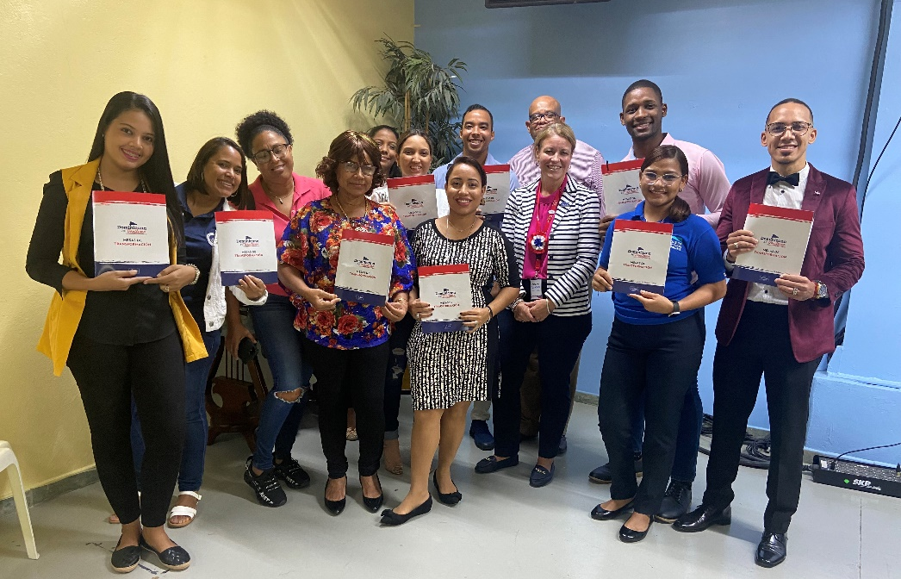

Slide 37

Find Yourself, Lose Yourself
We find ourself by discovering our why!
We lose ourself by trading the path of significance by putting others first!
RESULT = People we help, find their self!
Cycle of legacy and significance begins!
“My “why” wakes me up every single morning.”

Slide 38
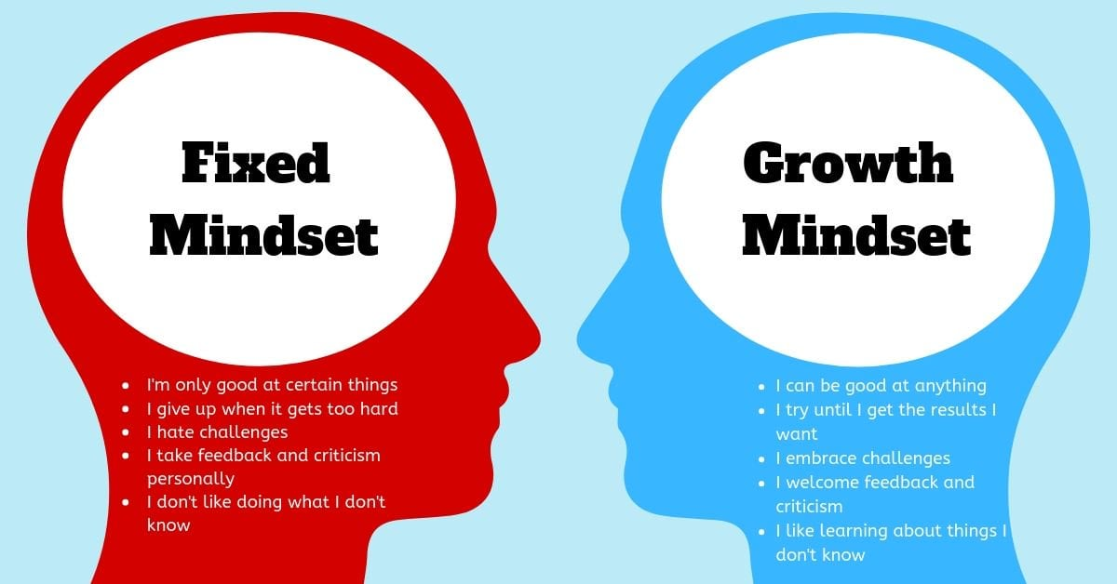
Mindset Shift!

Slide 39
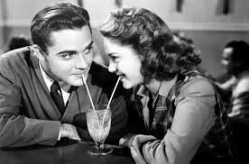
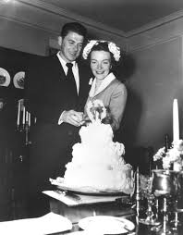
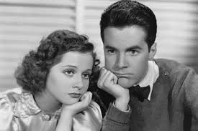
Question
Do I have an intentional mindset?
Dating
Marriage
After Marriage

Slide 40
Question
Do I have an intentional mindset?
Dating
Marriage
After Marriage
Intentional
Above & Beyond
That little extra
Looking my best
Behaving my best
Make her feel special
What Happened?

Slide 41

Question
Am I making everyday count?
Over 40% of your daily actions are not from decisions you are making, but from habits you have formed.
Duke University Study
“The secret of your success is found in your daily routine.”

Slide 42
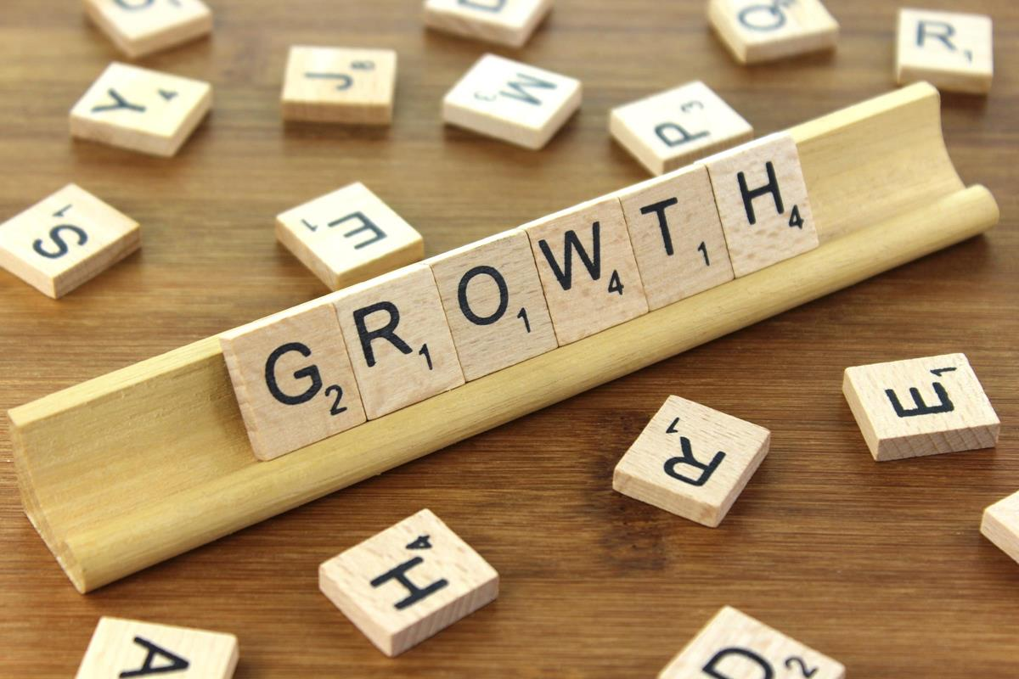
Question
Do I have a Personal Plan for Growth?
If you want to grow, you have to be intentional!
Irreducible Minimums
“The secret of your success is found in your daily routine.”

Slide 43

10 Ways to Make Every Day Your Masterpiece
Be here now
Invest in relationships – build trust
Help someone else learn & grow
Be the Chief Encouragement Officer
Be grateful – thank someone
Be preparing, not repairing
Execute your development plan
Start & End your day with purpose
Invest in your physical, spiritual & mental health
Schedule white space into your day
“Make every day your masterpiece” – John Wooden

Slide 44

Significance Begins With Wanting to Make a Difference!
Significance compounds when you partner with others

Slide 45

Start Small
Believe BIG!

Slide 46


Slide 47
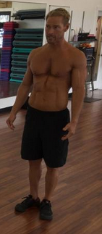
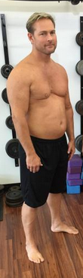
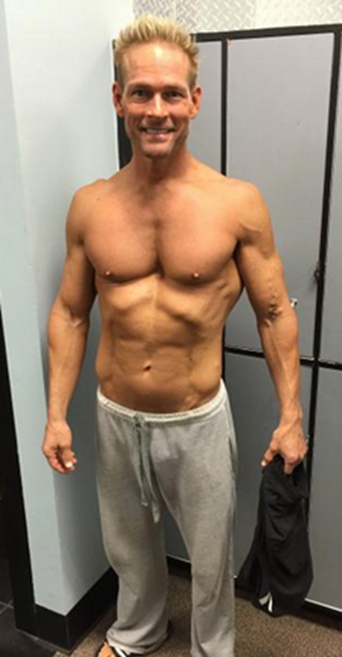
From Pride in ME, and Disappointment in YOU
To…
Empathy for YOU, and Disgust in ME
To…
Pride in YOU and ME

Slide 48
From Pride in ME, and Disappointment in YOU
To…
Empathy for YOU, and Disgust in ME
To…
Pride in YOU and ME
Good Intentions
Intentional Living
A Life that Matters

Slide 49
I Did It For ME
I Did It For YOU
I Did It WITH You

