Slide 1
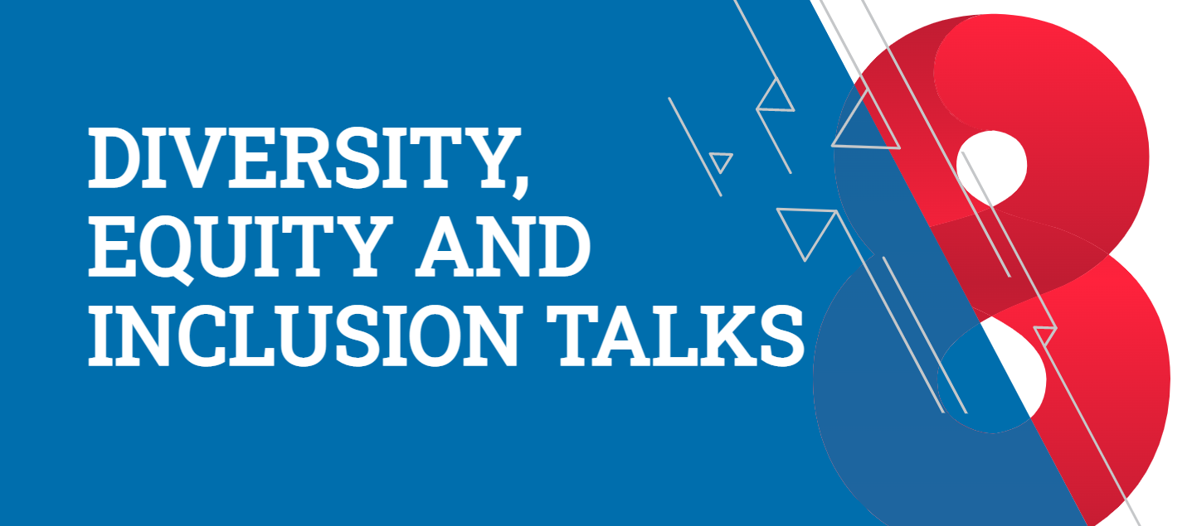

Slide 2
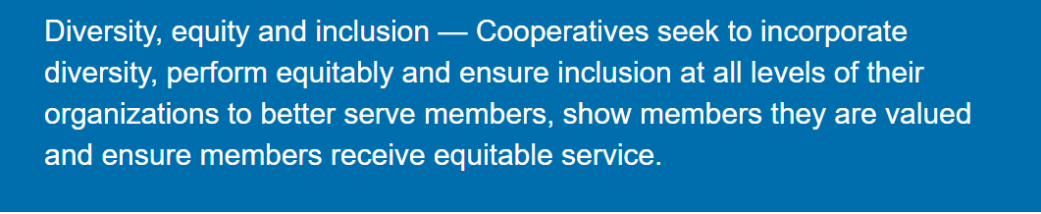
Creating a Common Language for Diversity, Equity & Inclusion
Presented by Emma Hayes
Chief Culture Officer, SECU

Slide 3
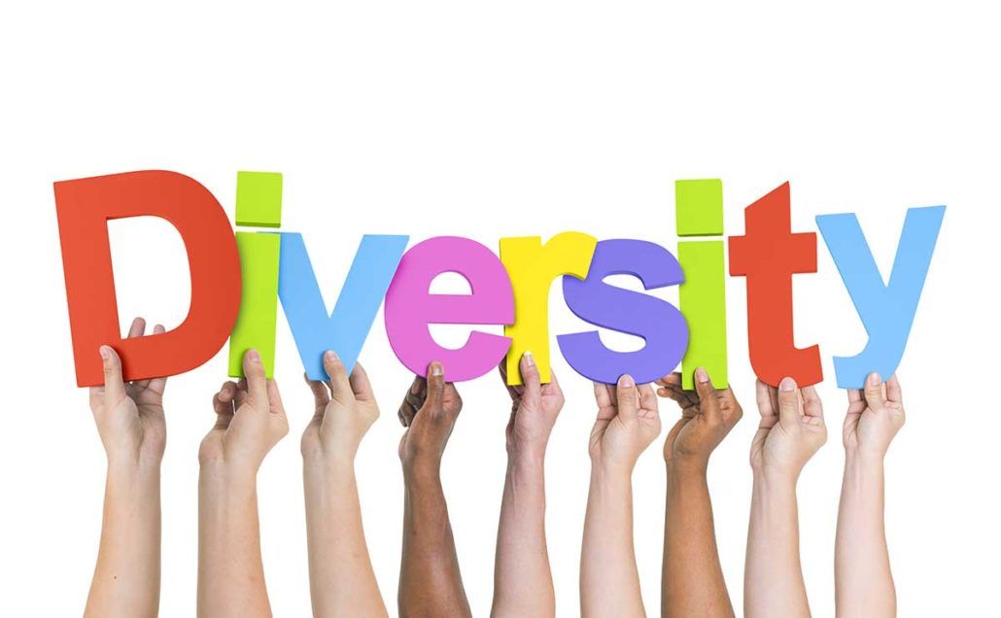
- What is Diversity?
- What does it look like?
- Why does it matter?
Table Talk

Slide 4
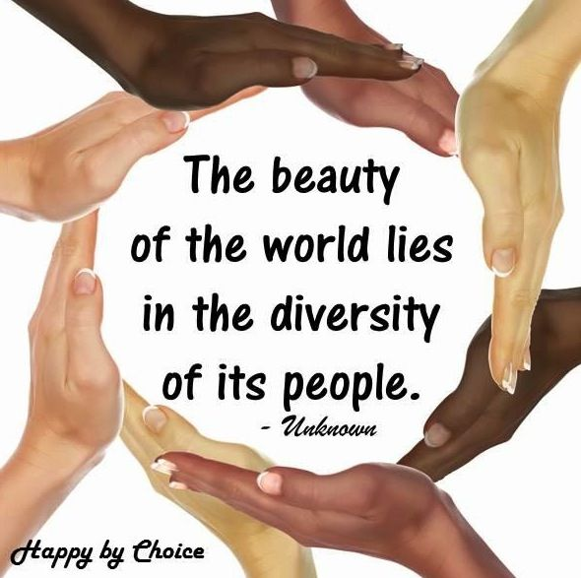
Diversity is…
the wide range of differences that exist among people

Slide 5
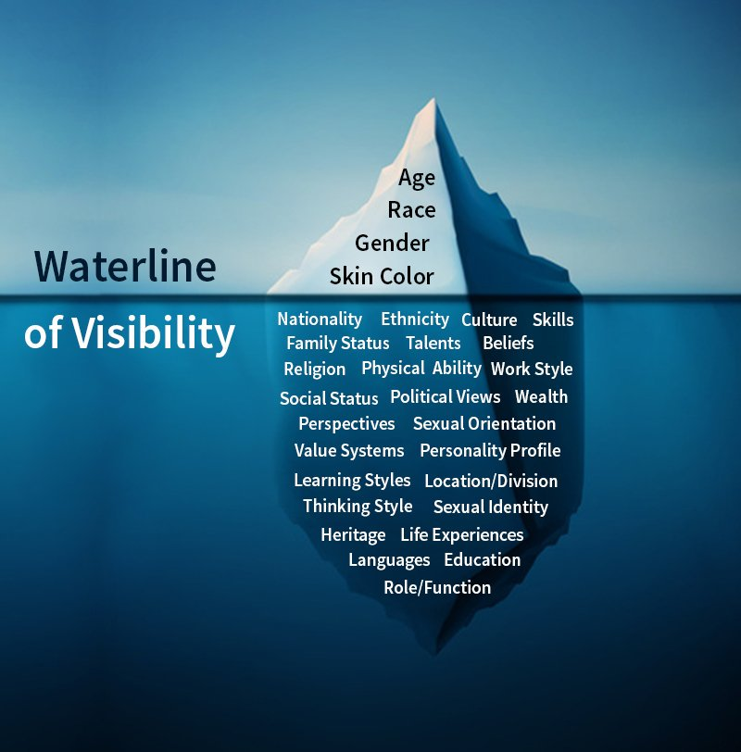
What does it look like?

Slide 6
Dimensions of Diversity
Why does it matter?
Identity
Primary
Secondary
Organizational
Cultural

Slide 7
REFLECTION:
How diverse is your organization?

Slide 8
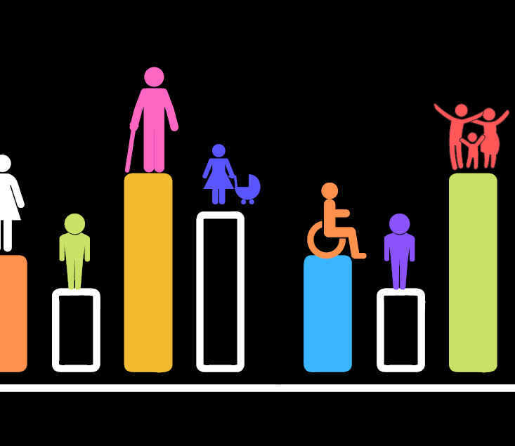
- What is equity?
- How is it different from equality?
Table Talk

Slide 9
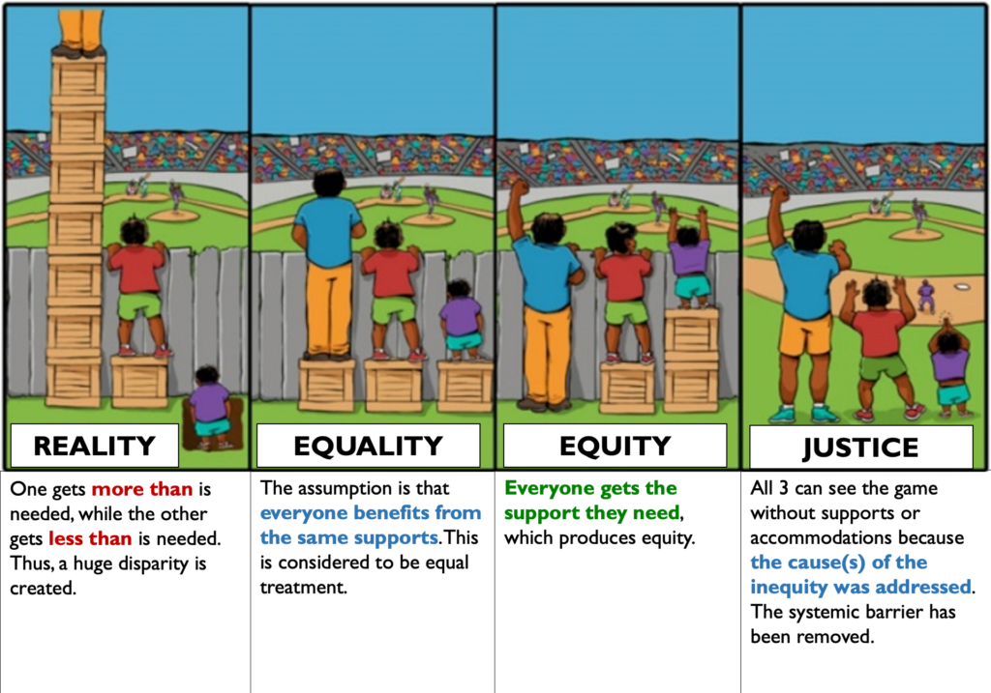

Slide 10
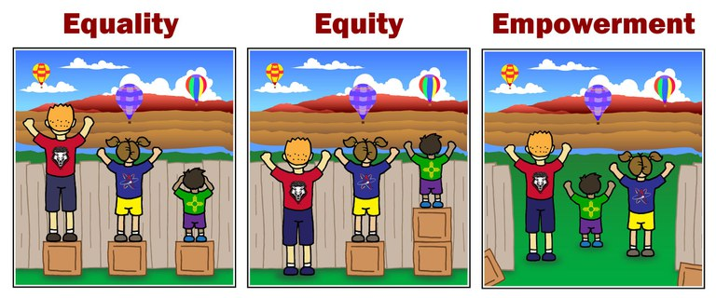

Slide 11
REFLECTION:
How equitable is your organization?

Slide 12
Table Talk
What is inclusion?
What does it look and feel like?
Why does it matter?

Slide 13
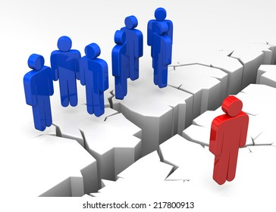
Inclusion is…
the action of embracing all people regardless of difference.

Slide 14
Why does inclusion matter?
It connects us to our communities
It makes us better & more successful
It ties to our Cooperative Principles

Slide 15
REFLECTION:
How inclusive is your organization?

Slide 16
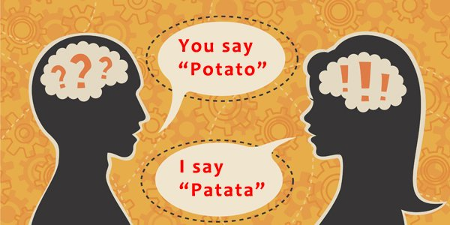

Slide 17
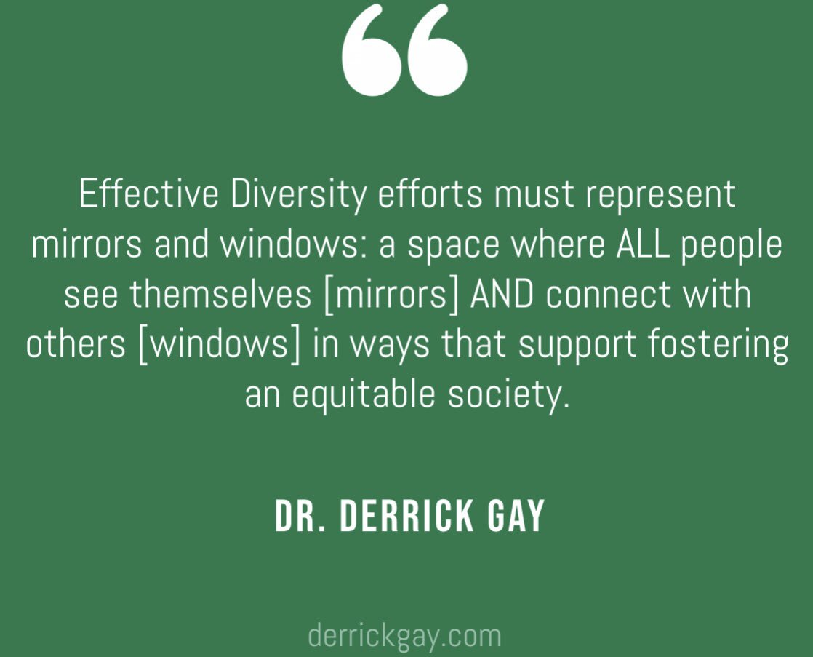

Slide 18
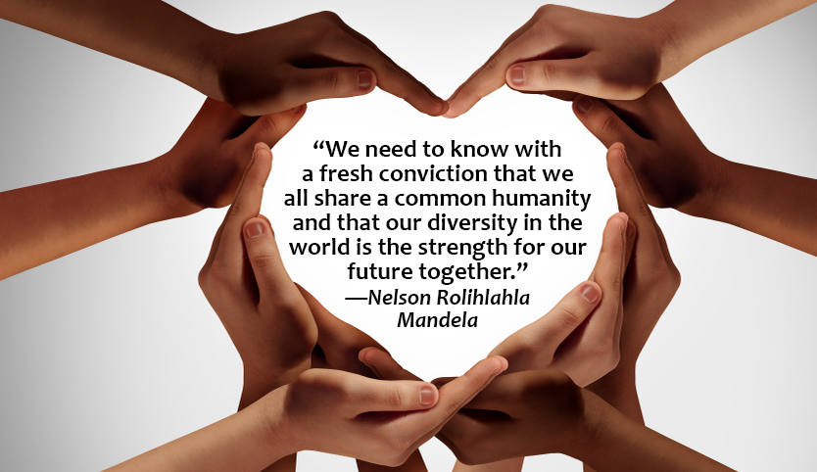

Slide 19

Questions

