Slide 2
My role as a leader fostering Diversity, Inclusion, and Equity
Veronica Calderon
Senior Vice President, Diversity, Inclusion, and Equity

Slide 3
Conversation Guidelines
Listen and observe with attention.
Ask clarifying questions.
Keep our discussions confidential: What is said in this room – stays in this room.
Invite humility while cultivating curiosity.
Have an open heart and open mind.

Slide 4
Inclusive Leadership
Inclusive leadership is energizing and motivating
Each employee feels authentically valued and respected and is engaged in achieving a shared vision.
They enable their people to feel like they have a stake in the future of the organization.
Team members can leverage their diverse perspectives (ways of thinking) and approaches (ways of doing) to enhance learning and growth.

Slide 5
6 Traits of an Inclusive Leader
Curiosity: different ideas and experiences enable growth
Cultural Intelligence: not everyone sees the world through the same cultural frame
Collaboration: a diverse-thinking team is greater than each individual alone
Commitment: staying the course is hard
Courage: talking about our differences involves risk
Awareness: bias is a leader’s Achilles’ heel
YOU

Slide 6
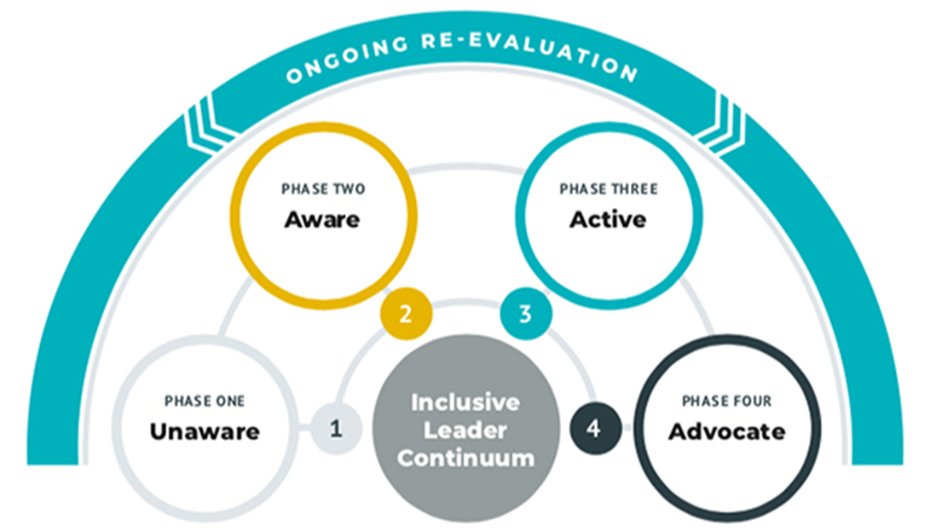
Inclusive Leader Continuum

Slide 7
Inclusive Leader Continuum
Unaware
Thinks diversity is compliance
Checking a box
Someone else’s job
Aware
You KNOW the important role you play in creating an inclusive workplace
You educate yourself on what to do to move forward
Active
You have made D, I & E a priority
You are finding your voice as you begin to take meaningful action in supporting others
Advocate
You are proactively and consistently using your voice and power to advocate for others
You consider others’ issues your issues and stand with them in solidarity

Slide 8
7 Acts for Inclusive Leaders
DEEPEN Self-Awareness
FOSTER Social Awareness
REVEAL Blind Spots
LISTEN to Understand
CREATE Connections
LEAD with Courageous Vulnerability
INVEST Resources

Slide 9
Reflection

