Slide 1
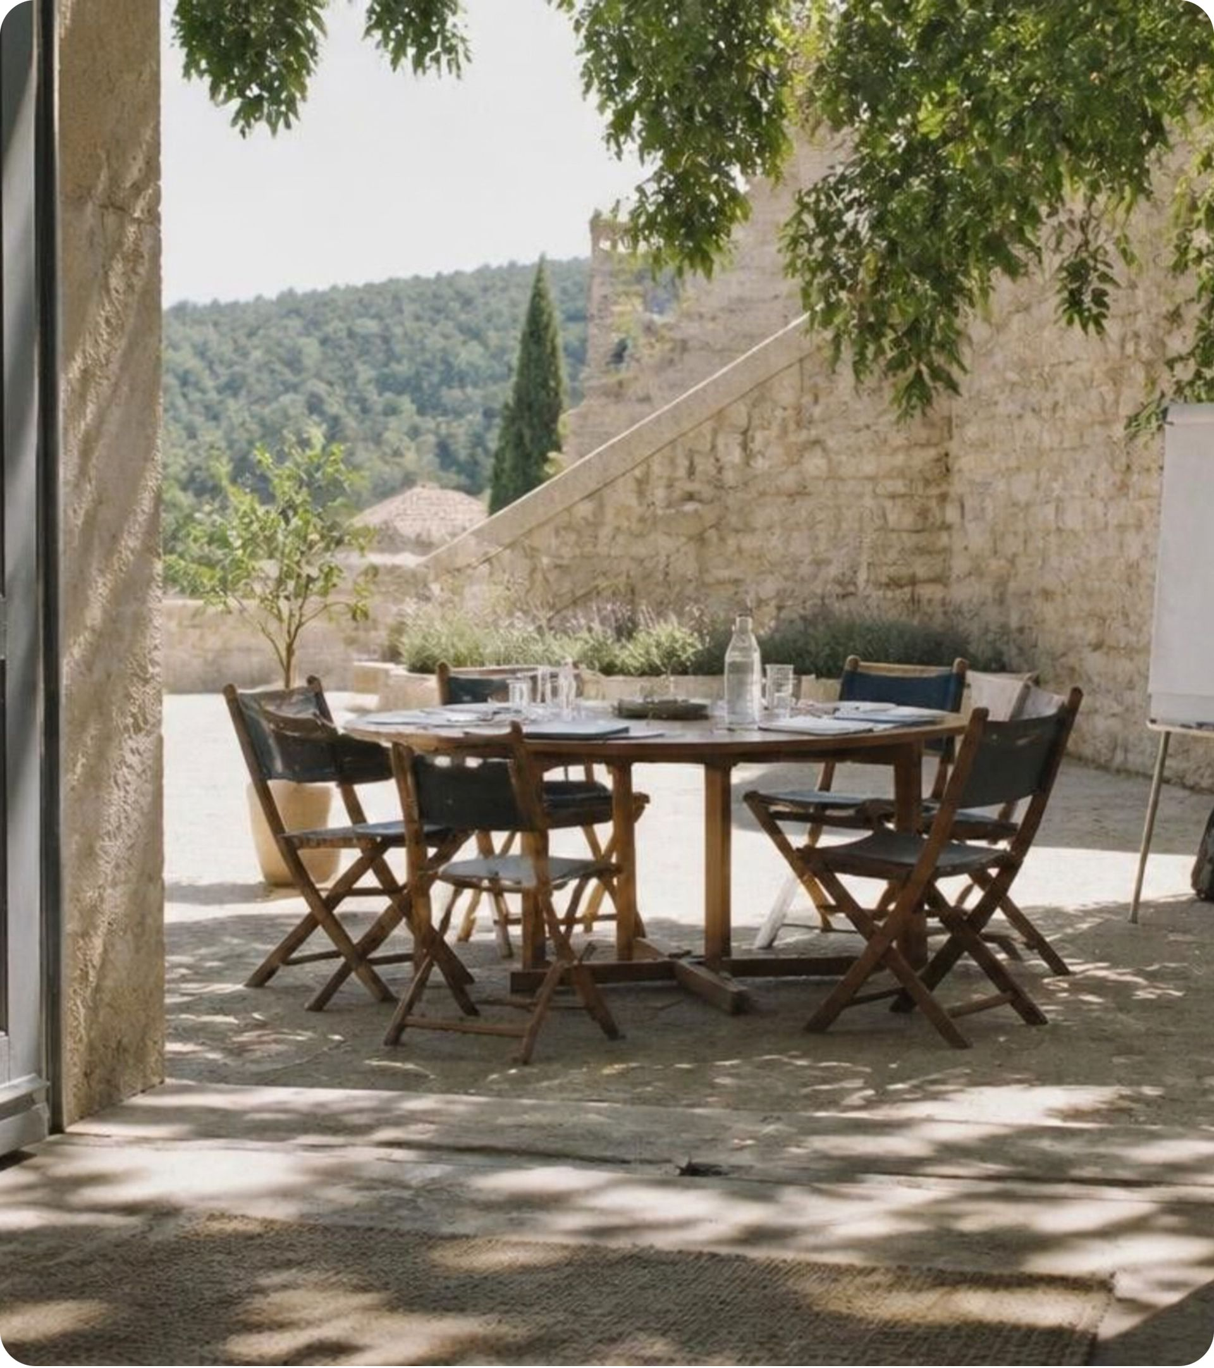
STOP SELLING
MEMBERSHIP.
START BUILDING
COMMUNITY.
Angela Richardson, CAE
Notes:
1

Slide 2
THE TRADITIONAL TRANSACTION
The Old Membership Equation
ASSOCIATION
MEMBER
WE CREATE.
YOU CONSUME.
→
Programs • Content • Events • Value
Downloads • Webinars • Discounts
THE MODEL IS TOO SMALL.
Transactional membership cannot compete with an internet full of free content.
02
Notes:
2

Slide 3

INFORMATION IS EASIER TO ACCESS THAN EVER.
WHAT CAN MEMBERS GET HERE THAT THEY CANNOT SIMPLY SEARCH OR DOWNLOAD?
03
Notes:
3

Slide 4

BEYOND PASSIVE RECIPIENTS
Members aren’t just recipients of association value.
They can be participants in creating it.
04
Notes:
4

Slide 5
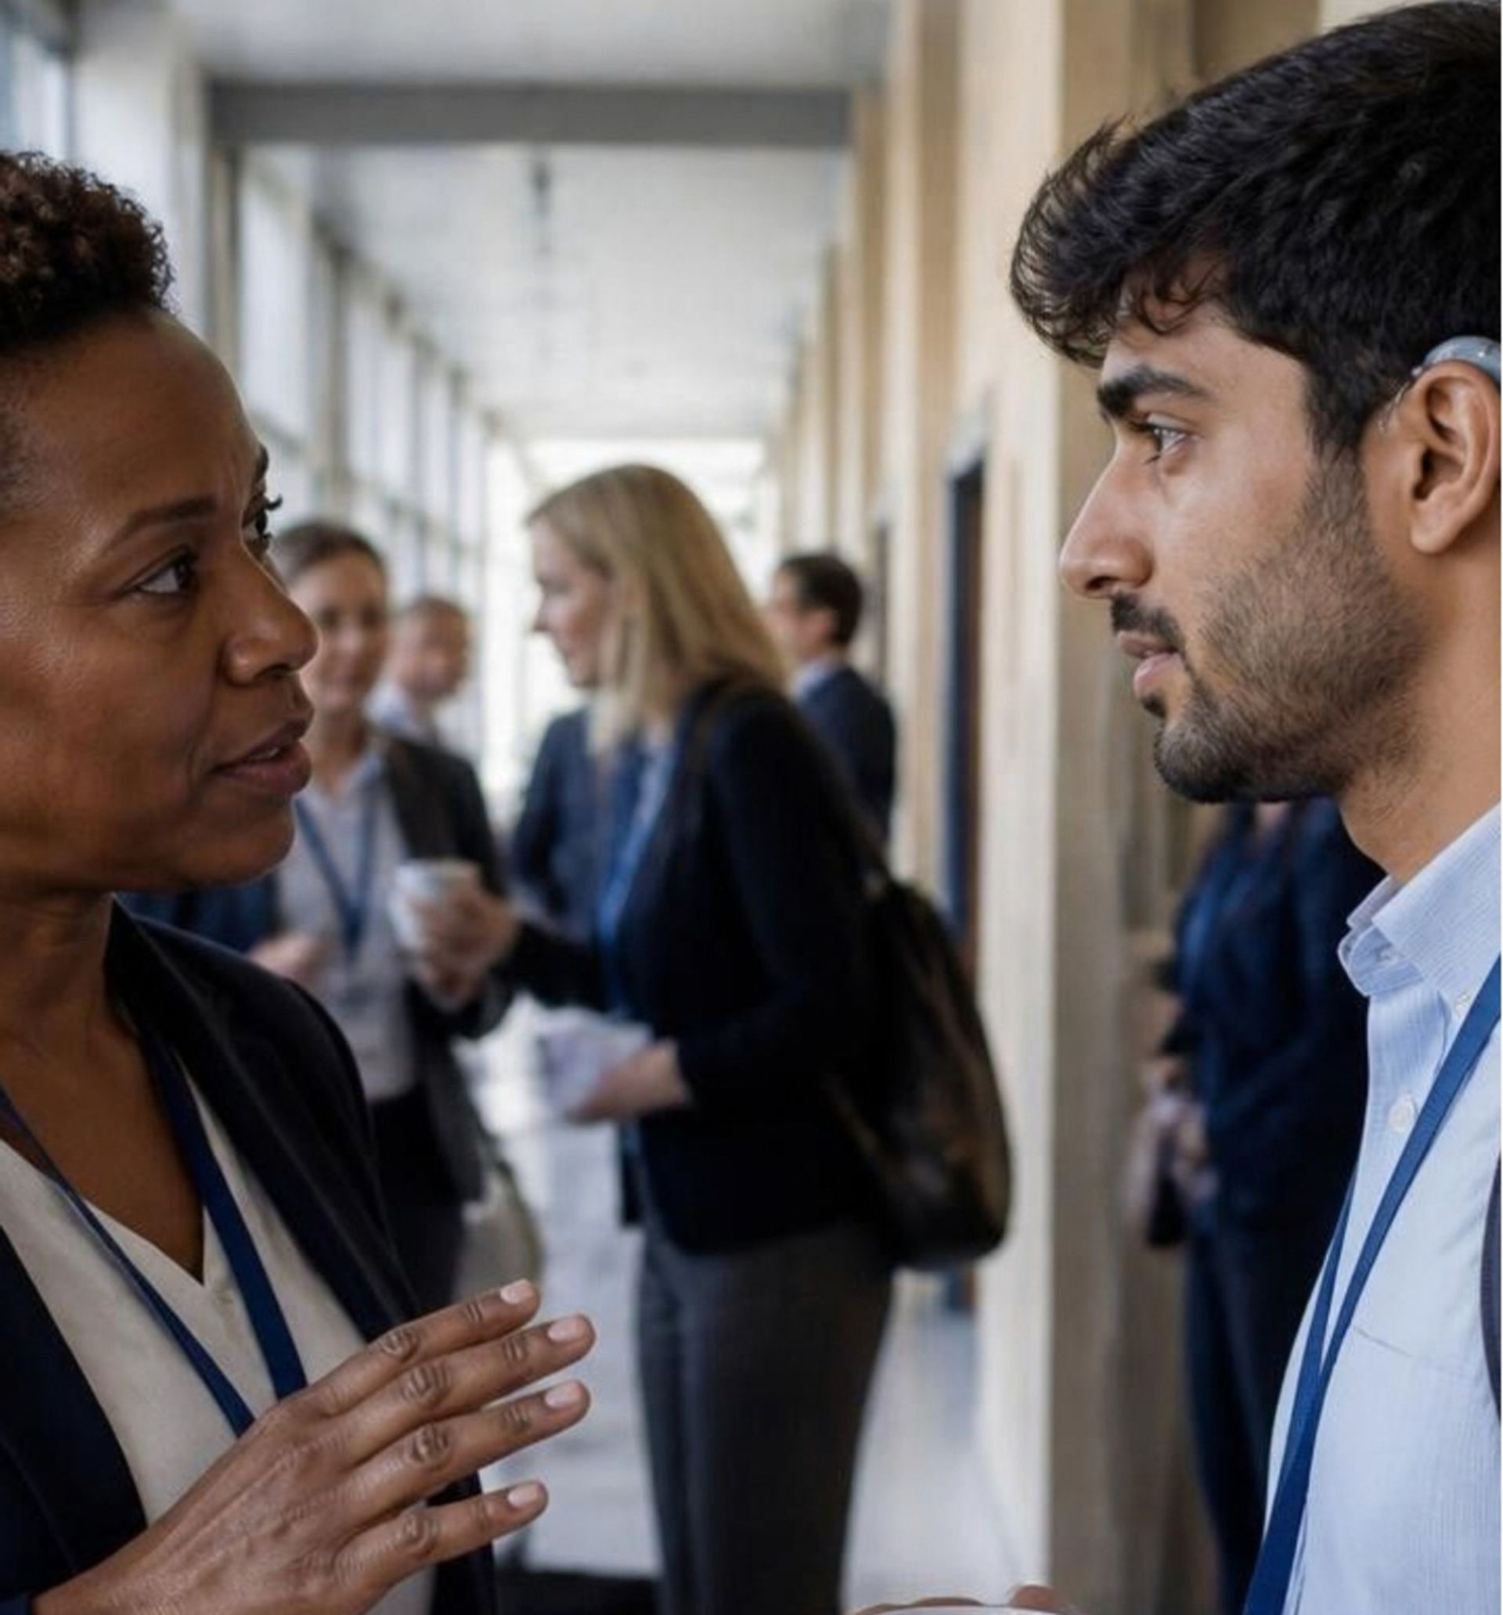
“SHE’S
WITH US.”
An introduction carried knowledge,
credibility, and trust.
05
Notes:
5

Slide 6
COULD A NEWER MEMBER FIND THAT PERSON TODAY?
Or did we get lucky with a hallway conversation?
06
Notes:
6

Slide 7
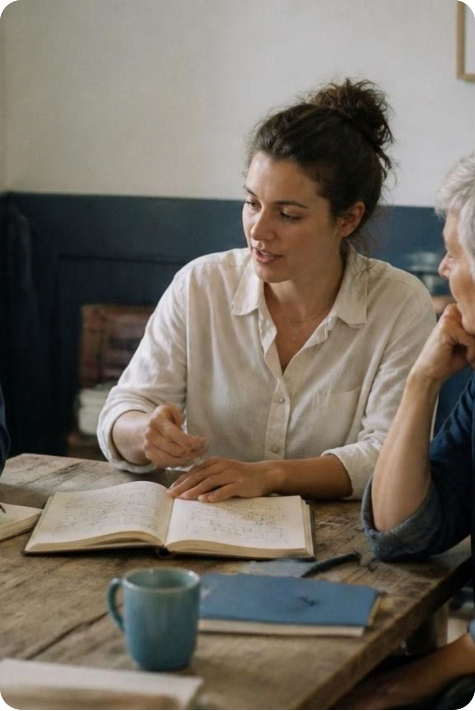
PEOPLE CARRY THINGS OTHER PEOPLE NEED.
EXPERIENCE
PERSPECTIVE
IDEAS
CONNECTIONS
07
Notes:
7

Slide 8
THE DISAPPEARANCE TEST
If your association disappeared tomorrow,
but all of your content stayed available...
what would members miss?
TABLE DISCUSSION · 5 MINUTES
1
2
3
Choose
Trace
Imagine
3–5 major sources of member value.
Who makes each one valuable?
What would be lost without members?
08
Notes:
8

Slide 9
01
WHAT CANNOT BE DOWNLOADED?
WHERE DOES
THE REAL VALUE
COME FROM?
02
WHO MAKES THAT POSSIBLE?
03
WHAT WOULD MEMBERS MISS WITHOUT THOSE RELATIONSHIPS?
09
Notes:
9

Slide 10
NETWORKING
ISN’T THE VALUE.
THE VALUE IS WHAT BECOMES POSSIBLE
BECAUSE OF THE RELATIONSHIP.
10
Notes:
10

Slide 11
VALUE MOVES IN MORE THAN ONE DIRECTION.
ASSOCIATION → MEMBER
Knowledge • Access • Opportunity
01
02
MEMBER → MEMBER
Trust • Insight • Help • Connections
MEMBER → ASSOCIATION
Stewardship • Ideas • Leadership
03
04
MEMBERS → FIELD
Advocacy • Standards • Practice • Legacy
11
Notes:
11

Slide 12
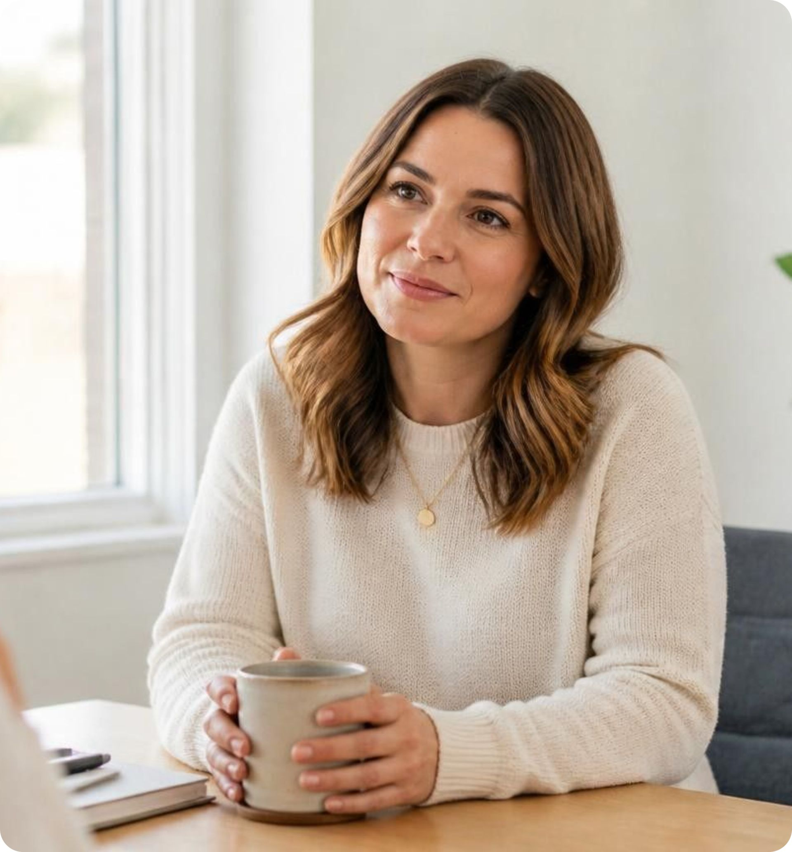
THE GOAL ISN’T MAXIMUM ENGAGEMENT.
ACTIVITY
MEANING
What someone did.
What it means to them.
≠
Clicks & logins
Event attendance
Downloads
Committee roles
Belonging & trust
Professional identity
Trusted relationships
Activity measures motion. Community creates meaning.
12
Notes:
12

Slide 13
A PRACTICAL FRAMEWORK FOR A MORE CONNECTED MEMBERSHIP
01
02
03
04
05
FIND THE
VALUE
FIND THE
PEOPLE
FIND THE
FRICTION
REDESIGN THE
EXPERIENCE
TEST WHAT
CHANGED
13
Notes:
13

Slide 14
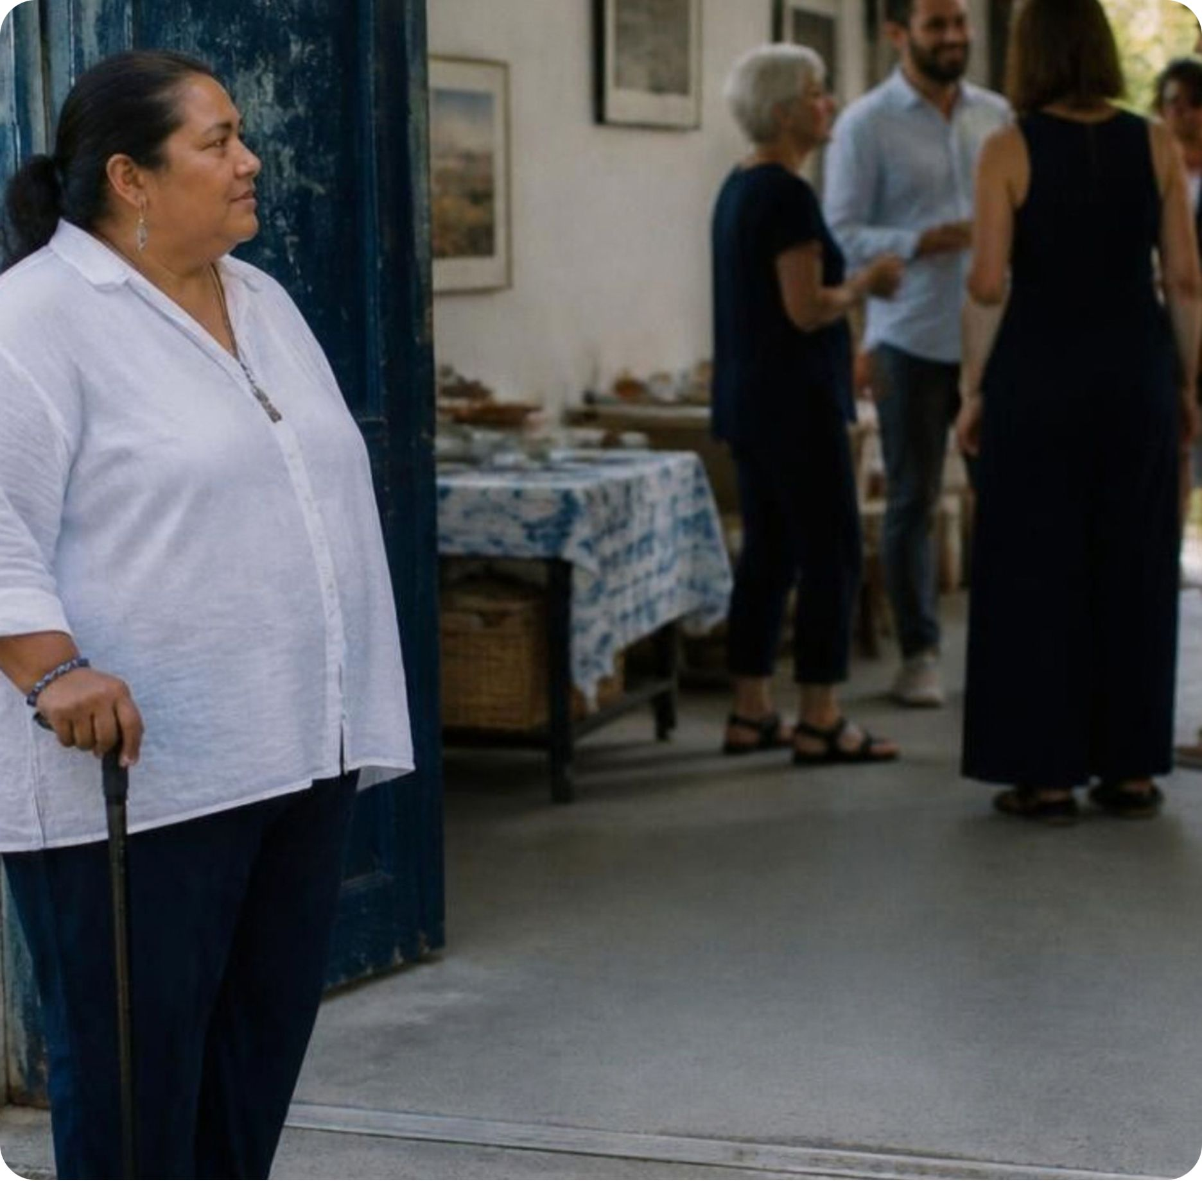
THE HIGHLY
MOTIVATED
MEMBER WILL
FIND THE DOOR.
What about the member who doesn’t know there is a door?
14
Notes:
14

Slide 15
STAFF DON’T HAVE TO
BECOME THE RELATIONSHIP.
THE SCALABLE SHIFT
THE OLD BURDEN
STAFF CREATE THE CONDITIONS.
STAFF AS THE BOTTLENECK
→
Members create the relationships.
Trying to manage every relationship, conversation, and touchpoint directly.
Scalable
Sustainable
Community-Driven
15
Notes:
15

Slide 16
THE FOUR CONDITIONS OF COMMUNITY
01
02
TRUST
SHARED PURPOSE
“Can I ask a real question here?”
“Are we doing something together?”
04
03
MEANINGFUL
CONTRIBUTION
ACCESS
“Can I figure out how to get in?”
“Can what I know or who I am matter here?”
16
Notes:
16

Slide 17
SCALE ACCESS, NOT INTIMACY.
THE MISTAKE
THE STRATEGY
DON’T AUTOMATICALLY
SCALE THE CONTAINER.
FIGURE OUT HOW THE VALUE TRAVELS.
When a trusted small group is stretched to fit the whole room, intimacy and honesty dissolve.
Multiply the small containers instead of just making the room bigger.
17
Notes:
17

Slide 18
WHAT WOULD A MEMBER LOSE IF THEY LEFT?
COMMODITY VALUE
COMMUNITY VALUE
Easier to Replace
Harder to Replace
Information
Deep Relationships
Easily found via Google or AI search.
Trusted Peers
Education & Webinars
A Defined Role & Voice
Available anywhere on YouTube or LinkedIn.
Shared Work & Influence
Vendor Discounts
Replicated or beaten by commercial competitors.
Something They Helped Build
Easily found online, replicated, or replaced by vendors.
The real reason members never walk away.
18
Notes:
18

Slide 19
THE CRITICAL QUESTION
How do we make membership matter?
01
02
03
04
START WITH NEED
BUILD RELATIONAL SAFETY
ACTIVATE EXPERTISE
SHARED OWNERSHIP
Help Solve a Problem
Use What You Know
Shape Something That Matters
Find Trusted People
Give them fast, dependable answers when they’re stuck.
Create spaces where their perspective and experience matter.
Invite them to build the future of the community together.
Connect them with peers who truly understand their world.
19
Notes:
19

Slide 20

What can people become capable of because they belong to one another here?
20
Notes:
20

Slide 21
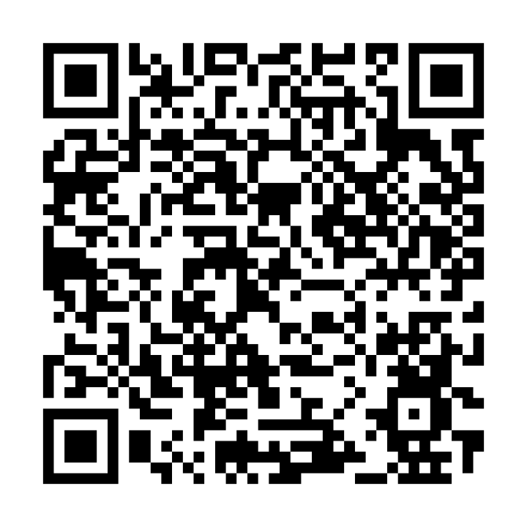
Angela Richardson, CAE
FINAL THOUGHT
Connect on LinkedIn
Community isn’t something you sell. It’s something you cultivate.
Let’s continue building together.
linkedin.com/in/angelamrichardson
21

