Slide 1



What Makes a Successful Transportation Project
A Planning Organization Perspective
Vision Northwest North Carolina
May 21, 2026
David Graham, Transportation Planner, High Country Rural Planning Organization (RPO)
Averi Ritchie, Transportation Planning Director, Greater Hickory Metropolitan Planning Organization (MPO)
Magnolia Long, Senior Planner/RPO Director, Foothills Rural Planning Organization (RPO)

Slide 2
Core Functions of MPO’s and RPO’s in Transportation Planning and Project Development
Develop Comprehensive Transportation Plans (CTP’s) in partnership with the North Carolina Department of Transportation (NCDOT) Transportation Planning Division (TPD) and local governments
Prioritization of transportation projects for funding consideration in the State Transportation Improvement Program (STIP) that local governments are interested in
Provide transportation related information to local governments and other interested parties
Provide a forum for public participation in the transportation planning process

Slide 3
Key Considerations for a Successful Transportation Project:
Is the project identified in a comprehensive transportation plan (CTP)?
Does it address an identified transportation need in the community?
Does the project score well in the North Carolina Strategic Transportation Investment (STI) project prioritization process?
Is there local support for the project?
Is there funding available to build the project?
Where is the project scheduled in the State Transportation Improvement Program (STIP)?
For the purposes of this presentation a “successful transportation project” is one that addresses an identified need, has local support, and is scheduled within the first 5 years of the STIP.

Slide 4
Is the Project Identified in a Comprehensive Transportation Plan?
The NCDOT Transportation's Planning Division (TPD) partners with rural and metropolitan planning organizations (MPO’s & RPO’s), to develop comprehensive transportation plans (CTP’s) at the county and municipal level that outline transportation priorities for a 20–25-year planning period and are based on future land use, employment, and population changes.
Each CTP includes recommendations for improvements to the overall transportation network for all modes.
NCDOT, RPO’s & MPO’s, and local governments then adopt the CTP, which becomes the blueprint for identified transportation needs in the planning area.

Slide 5
Does the Project Address an Identified Need in the Community?

Slide 6
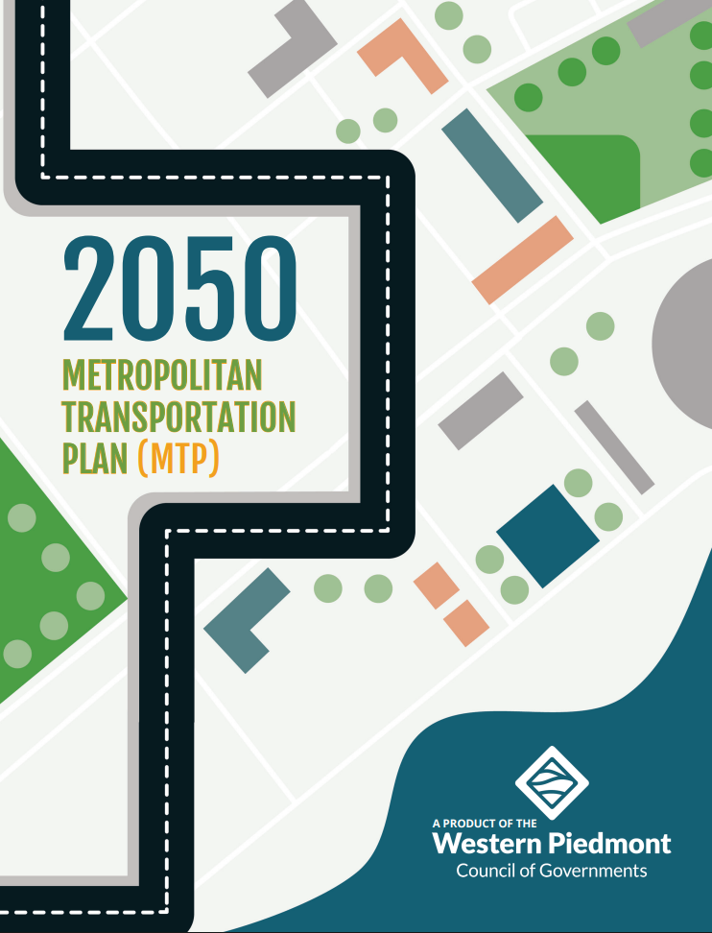
Metropolitan Transportation Plan (MPO Requirement)
Multi modal coverage
Travel Demand Modeling
Includes long-term and short-term policies, strategies, and actions
Covers capital improvements and operations
Addresses movement of people and goods
At least a 20-year planning horizon at time of adoption
Financially constrained
Key: Does the MTP reflect the region’s long-term vision for the future?

Slide 7
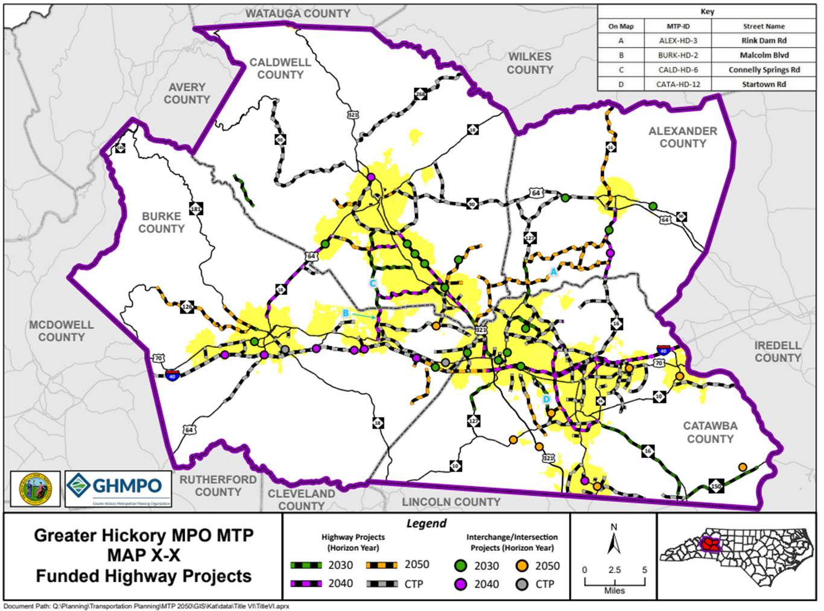
2050 MTP
Update of prior 2045 MTP
Covers 25-30 years (projects split into horizon years)
Fiscally Constrained
Plan Chapters & Appendices
  Goals and Objectives
  Natural Environment
  Financial Plan
  Highways and Roadways
  Bicycle and Pedestrian
  Transportation Integrity (Part 1 & 2)
  Congestion Management
  System Resiliency
  Freight
  Aviation
  Health and Equity
  Performance Measures
  Public Involvement and Title VI
  Safety and Security
  Population and Employment
  Public Transportation
  Appendices
    Project Background
    Transportation Integrity Explorer
    CTP Project List
    CTP Maps

Slide 8
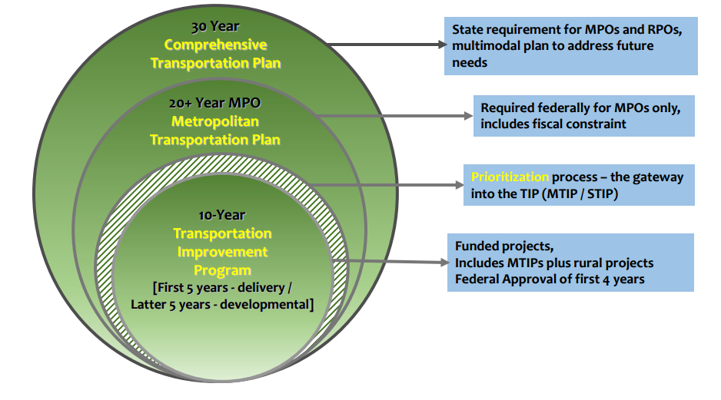
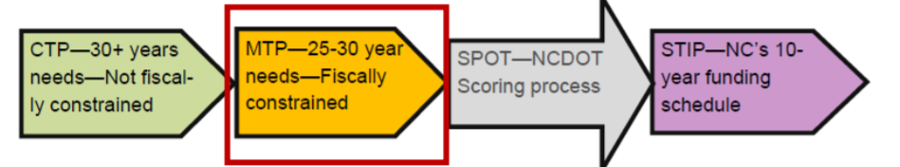
How it all works…

Slide 9
Locally Administered Project Program (LAPP)
What is it? ​
The Locally Administered Projects Program (LAPP) is a federally funded discretionary grant program administered by the GHMPO​.
This is a funding source for MPOs with a population larger than 200k within the urbanized areas.
Why is it important?​
The LAPP program allows the GHMPO to direct federal funding to transportation projects administered by local governments, including projects that may not be competitive within the Prioritization process. ​
We like to see projects selected through our Western Piedmont Bicycle and Pedestrian Plan.

Slide 10

Strategic Transportation Investment (STI) Law
Funding formula for NCDOT’s Capital Expenditures
Focus on Mobility/Expansion and Modernization projects for all modes
House Bill 817 signed into Law June 26, 2013
Considered the most significant transportation legislation in NC since 1989

Slide 11
Strategic Transportation Investment (STI) Law
Funding formula for all capital expenditures, regardless of mode. All modes must compete for the same funds
Funds come from NC Highway Trust Fund
Operations and Maintenance expenditures are funded from separate NC Highway Fund (primarily gas tax)
Projects (regardless of mode) are scored on a 0‐100-point scale using traffic volume data, safety data, connectivity, benefit/cost (travel time savings), freight data, lane width, and other data

Slide 12
How the STI Law Works
40 % of Funds
30 % of Funds
30 % of Funds
STATEWIDE
MOBILITY
Address Significant Congestion and Bottlenecks
Selection Based 100% on Data
REGIONAL
IMPACT
Improve Connectivity within Region
Selection Based on 70% Data and 30% Local Input
DIVISION
NEEDS
Address Local Needs
Selection Based on 50% Data and 50% Local Input

Slide 13
Local Support for the Project
The project is identified in a CTP that has been adopted by local governments
The project is submitted to the RPO or MPO by local governments for funding consideration in the STIP
The RPO or MPO assigns local input points to the project to help the project score the best it can
The applicable NCDOT Division assigns local input points
Public involvement and support for the project is positive

Slide 14


Funding Availability for the Project
Due to unprecedented construction cost increases and inaccurate project cost estimates, there was limited funding available for projects to be funded in the 2026-2035 STIP and funding remains uncertain for future prioritization cycles.
NCDOT is responding to funding constraints by developing more accurate cost estimates for projects through the express design/confident scope cost estimate process.
NCDOT is hopeful that funding availability will continue to improve for the next prioritization cycle as more accurate cost estimates continue to be developed.
Once funding constraints improve, more projects can be scheduled for delivery in the STIP.

Slide 15
Scheduled in the State Transportation Improvement Program (STIP)

Slide 16
State Transportation Improvement Program
A 10-year State and Federal-mandated plan that identifies the construction funding for and scheduling of transportation projects throughout the state.
Includes all modes of transportation (highway, bicycle, pedestrian, public transportation, aviation, rail, and ferry)
Projects funded in the first five years of the STIP are considered “committed” or “scheduled for delivery” making them (for the purpose of this presentation) a Successful Transportation Project!

Slide 17
Questions?
Comments?

