Slide 1
What Culture Means at Blue Ridge Energy
Compilation of data for Vision NWNC Culture Over Wages Panel Discussion
Karen Warlick, HR Manager, Blue Ridge Energy, Lenoir, NC

Slide 2
Foundational Core Values Are Evidenced In Actions Uniting Us As Our Blue Ridge “Family”
Honesty, integrity, and an excellent reputation
Exceptional customer service
Respect and appreciation for employees
Commitment to safety for employees and members and environmental stewardship
Commitment to community because we’re only as strong as the communities we serve
Cooperative principles uniting 900 NRECA Cooperatives
These core values don’t change!

Slide 3
Cooperative Principles Demonstrated In All Our Interactions
Voluntary and open membership
Democratic member control
Members economic participation
Autonomy and independence
Education, training and information
Cooperation among cooperatives
Concern for community

Slide 4
How Is Culture Measured?
Annual Employee Survey – Goal to achieve 90% participation and favorable responses
LBWA – Leadership by Walking Around
Testimonials – Employees, like families, share good times and hard times
Focus of our regular meetings (Departmental, Safety and others) share successes & seek improvements
Constant review of practices to sustain and improve work life
CEO conducts regular meetings with all levels of employees seeking feedback
Hiring the right people: CAO interviews all candidates before any offer is made to ensure right culture fit
Company Values and Employee Values – Consideration of generational views (different ages at work)

Slide 5
How Culture Keeps Employees Engaged
New employees attend Culture Assimilation sessions as an overall company introduction.
Time off is important. We enhanced our vacation leave policy starting in year two.
Allowing flex time off - alternative work scheduling where it makes business sense.
Starting on their hire date, employees are asked to share ways we can improve processes.
As trust is earned, we receive excellent suggestions from employees.
As corporate results are made available, they are shared timely with employees.
Everyone is a leader and their job is under the same directives moving us all in the same direction.
Enhanced leadership development is available for those who show initiative and desire to advance.
Retirees continue to receive information, meet annually and remain connected as a family member.

Slide 6
How Culture In Engrained In All We Do
Culture Assimilation Training
Informal Mentoring
Job Descriptions
Performance Discussions
Career Development Discussions
Key Performance Indicators – example on next slide of our 5-Year Vision/Strategy map)
Goal Setting & WorkSmart includes employee feedback & suggestions.
Everyone understands their role and its importance and contribution to our strategy.
Blue Ridge invests in employee development as needed and requested.

Slide 8
Five Key Levers of Employee Well-Being
We provide these services and constantly review how we are doing and considerations for future needs.

Slide 9
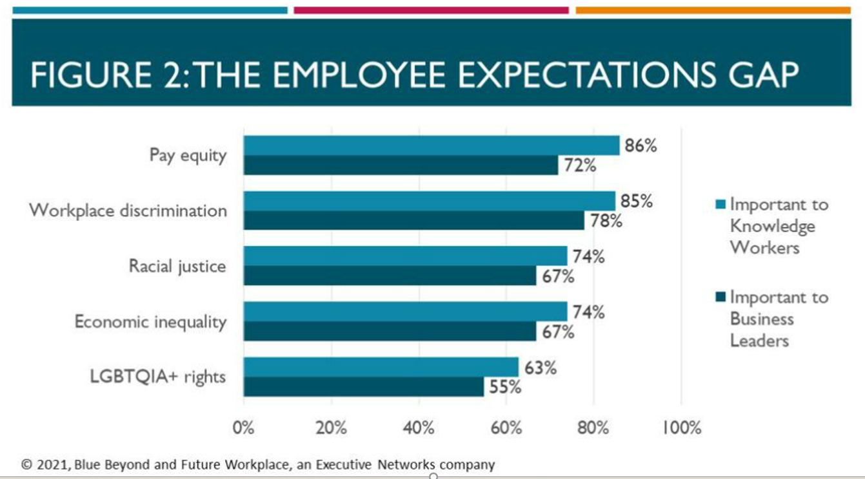
A key action we take is listening and staying in touch with expressed & unexpressed needs.

Slide 10
Our Guiding Principle: Make Life Better Our Vision: Be the Best
Providing power made life better in our rural communities in early times and continues today.
Sustaining our focus to make good decisions for members will ensure continued success.
We share a sense of pride in communities we serve and concern for protecting the environment.
Safety is our top priority.
We take ownership to maintain the reputation of Blue Ridge Energy by living our core values.

Slide 11
Quote From Julie O’Dell CAO/Ethics Blue Ridge Energy
“Everyone has the responsibility to be a leader and set a positive example for others who choose to follow. Culture will eat your strategy for lunch if it is not executed properly.”

