Slide 1
“The Economic Outlook” Presented to The 9th Annual Economic Forecast Forum Boone Area and Blowing Rock Chambers of Commerce at Boone, NC
Harry M. Davis, Ph.D.
davishm@appstate.edu
NCBA Professor of Banking and Economist
Appalachian State University
January 16th, 2025

Slide 2
The U.S. Economy
GDP growth was about 2.5% last year
Not in a recession – NBER
Germany, England, France, China
Since WWII, the US has had 12 recessions – the average duration has been 10 months
Consumer confidence fell in December but remains above 100

Slide 3
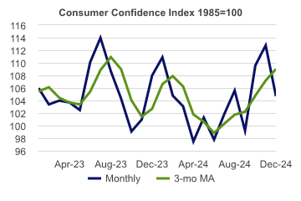
https://www.economy.com/economicview/search?query=housing%20starts

Slide 4
The U.S. Economy
The manufacturing sector continues to struggle
The ISM manufacturing index increased in November and December but remains under 50
The service sector continues to carry the economy with it’s index remaining above 50

Slide 5
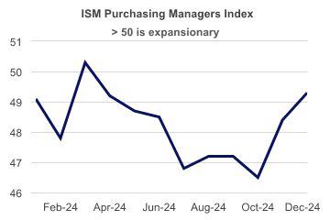
https://www.economy.com/economicview/search?query=housing%20starts

Slide 6
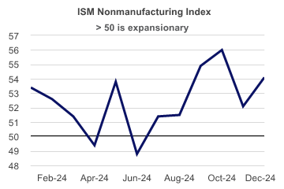
https://www.economy.com/economicview/search?query=housing%20starts

Slide 7
U.S. Economy
Average hourly earnings growing around 4% annually
Indeed, real average hourly earnings have increased for 20 consecutive months
Oil prices down in 2023 and 2024
Corporate earnings growth continues to surprise to the upside and is driving consumer spending and the economy

Slide 8
U.S. Economy
Credit card balances are growing rapidly along with credit card delinquencies
The average credit card rate is 22.75%

Slide 9
Federal Funds Rate

Slide 10
U.S. Economy
Short term interest rates have dropped 1%, but
Mortgage rates remain stubbornly high/the ten year treasury bond rate is rising
Why is 10 – year rate rising?

Slide 11
U.S. Economy
The S&P 500 stock index was up over 20% in 2023 and 2024
The markets are at record levels currently
Cash is “still” back

Slide 12
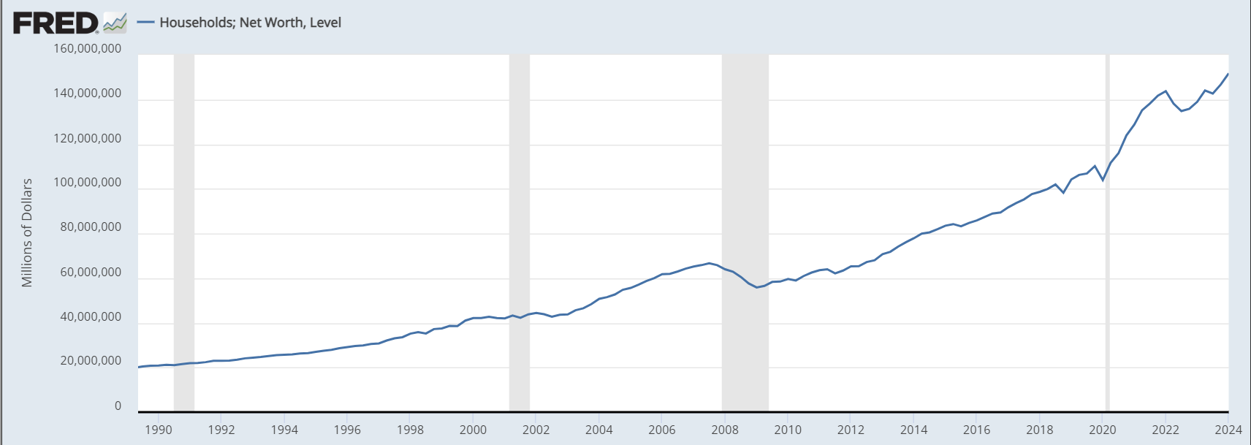
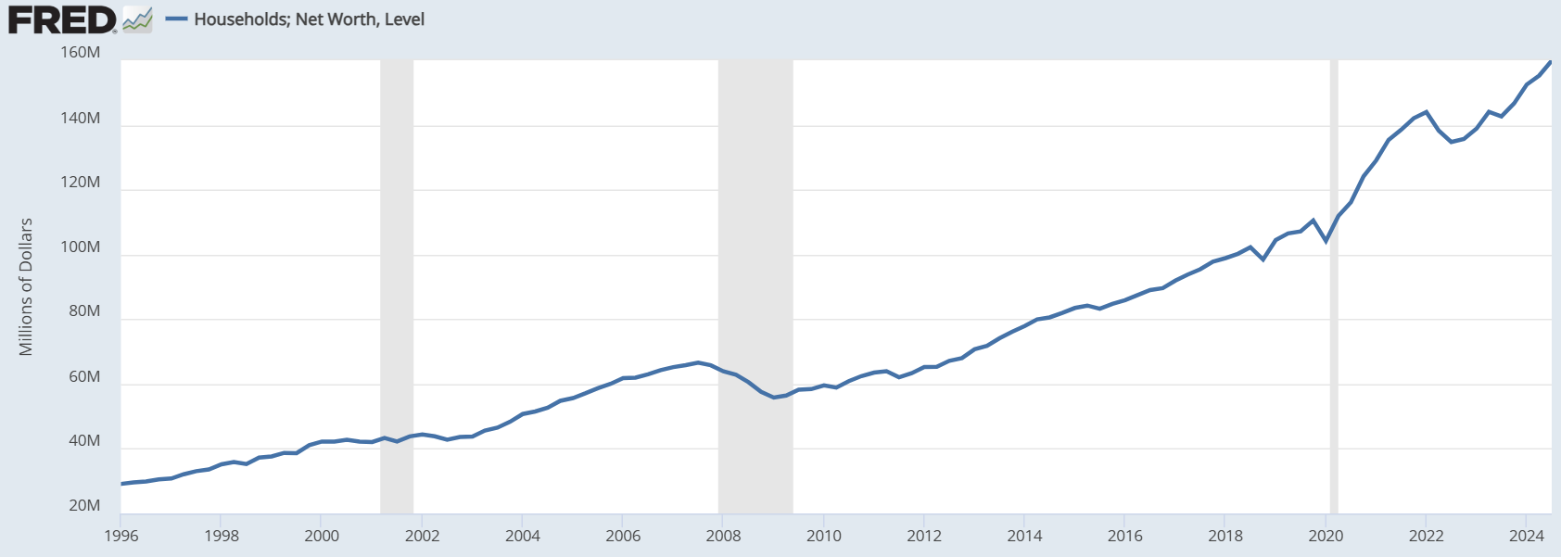
Household Net Worth

Slide 13
The FED / Inflation
The rate of inflation has dropped to about 3%
Is it stuck?
What do people care more about?
The level of prices
The rate of price increases

Slide 14
The FED / Inflation
Lower the FED funds rate to 4% in 25 basis point steps
Fed is late
Let FED funds rate move between 2.5 – 4.5%%

Slide 15
Free Trade
Carter/Reagan/Clinton
Trump Tariffs/National Security
Biden/Tariffs +Export Restrictions

Slide 16
Free Trade
Trump ??
Are Tariffs good economic policy?
H1V

Slide 17
Tariffs
Do tariffs raise inflation?
Canada/Mexico
China has experienced price deflation for the last 6 consecutive quarters
The value of the dollar just keeps rising

Slide 18
Real Estate ☹ ☹
The NAHB Sentiment Index has been under 50 most of the last 2 years
Housing starts are running about 1.3 million units annually which is the lowest rate since 2009

Slide 19
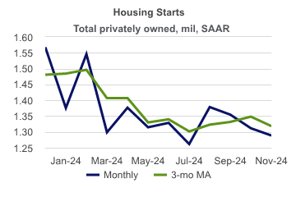

Slide 20
Real Estate ☹ ☹
Home prices (Case-Shiller) continue to increase but at a decreasing rate
Existing home sales remain anemic at about 4 million annual units
Owners and buyers are either “locked-in” or “locked-out”
If the mortgage rate falls pent-up demand will lead to further price increases??!!

Slide 21
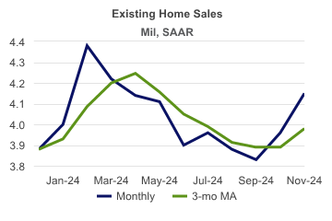

Slide 22
U.S. Employment
The unemployment rate fell to 4.1% in December
256,000 new jobs in December

Slide 23
NC Economic Situation
The unemployment rate was 3.7% in November
Tremendous population growth
After being ranked #1 for Business by CNBC in 2022 and 2023, we were ranked #2 in 2024
Work force shortages

Slide 24
Watauga County
The unemployment rate increased from 2.5% in September to 3.5% in November
County economic metrics were negatively impacted by Hurricane Helene
What is the economic impact of the hurricane and the dollars that follow

Slide 25
Economic Outlook
GDP growth will be about 2.5 % this year
Inflation will stay closer to 3% than 2%
The Fed will lower the Fed Funds Rate about 50-75 basis points this year
Mortgage rates will stay closer to 7% than 6%
Existing and new home sales and prices will be flat to slightly up this year

Slide 26
Economic Outlook
The FED has achieved a “soft-landing”
NC will continue to outperform the nation
Watauga County will see an influx of funds for years

