Slide 1
PCSK9 Inhibition and the VESALIUS-CV Trial
September 15, 2026
Notes:
This slide set was sponsored by an independent grant from Amgen

Slide 2
Disclaimer
The contents of this presentation have been reviewed and approved by
the Education Committee of the ASPC.

Slide 3
Presentation Overview
Low-density Lipoprotein (LDL): By the Numbers
Mechanism of PCSK9 Inhibition
VESALIUS-CV Trial Results
Patient Cases: Appropriate Patients for PCSK9 Inhibition
Key Takeaways

Slide 4
Low-density Lipoprotein (LDL):
By the Numbers

Slide 5
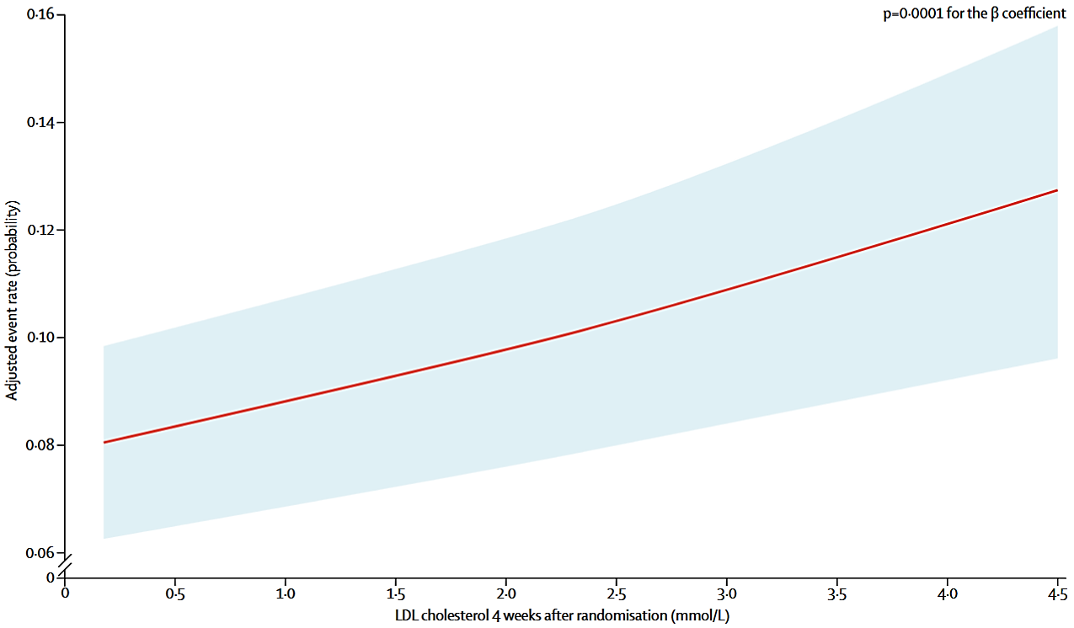
We Know That Lower Is Better
FOURIER: ASCVD Events by On-Treatment LDL-C
LDL particles are the primary
driver of atherosclerosis and have a clear causal relationship with atherosclerotic cardiovascular disease (ASCVD), including coronary artery disease, myocardial infarction, and stroke.
Lowering low-density lipoprotein cholesterol (LDL-C) has been shown to lower atherosclerotic cardiovascular disease risk in multiple, large randomized trials with multiple medications.
Consistent in
8-year follow-up
Giugliano RP, et al. Lancet. 2017;390:1962-1971; Gaba P, et al. Circulation. 2023;147:1192-1203; JACC CV Stats 2026.

Slide 6
2026 AHA/ACC Multi-society Lipid Guidelines
 | Patient Examples | LDL-C mg/dL | Non-HDL-C mg/dL | ApoB mg/dL
Borderline to Intermediate Risk | 3–<5% or 5–<10% 10y ASCVD Risk <3%10y ASCVD risk + (LDL-C ≥160 mg/dL or Fam Hx. or 30y risk ≥10%) T2DM without ASCVD or Risk Factors CAC 1–99 or mild incidental CAC | <100 | <130 | <90
High Risk | >10% 10-yr ASCVD Risk T2DM + Risk Factors HeFH without ASCVD CAC ≥100–999 AU Moderate to severe incidental CAC | <70 | <100 | <70
Very High Risk | ASCVD (optional if not very high risk) CAC ≥1000 AU (optional if ≥300 AU) | <55 | <85 | <55

Slide 7
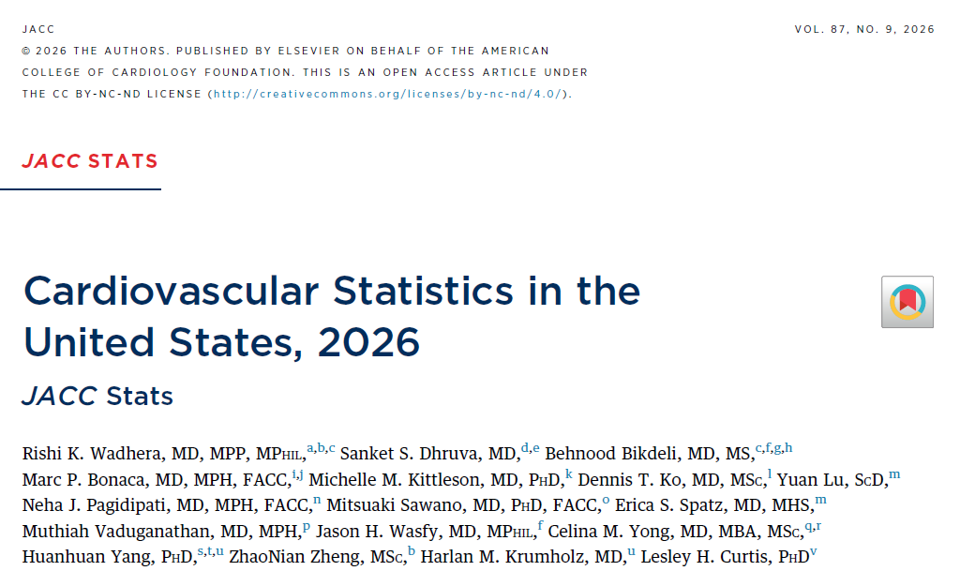
2026 Cardiovascular Statistics – LDL
“Although LDL reduction is a
proven strategy to reduce atherosclerotic cardiovascular disease risk, population-level
control remains suboptimal nationwide, and the majority of high-risk adults do not achieve guideline-recommended targets.”

Slide 8
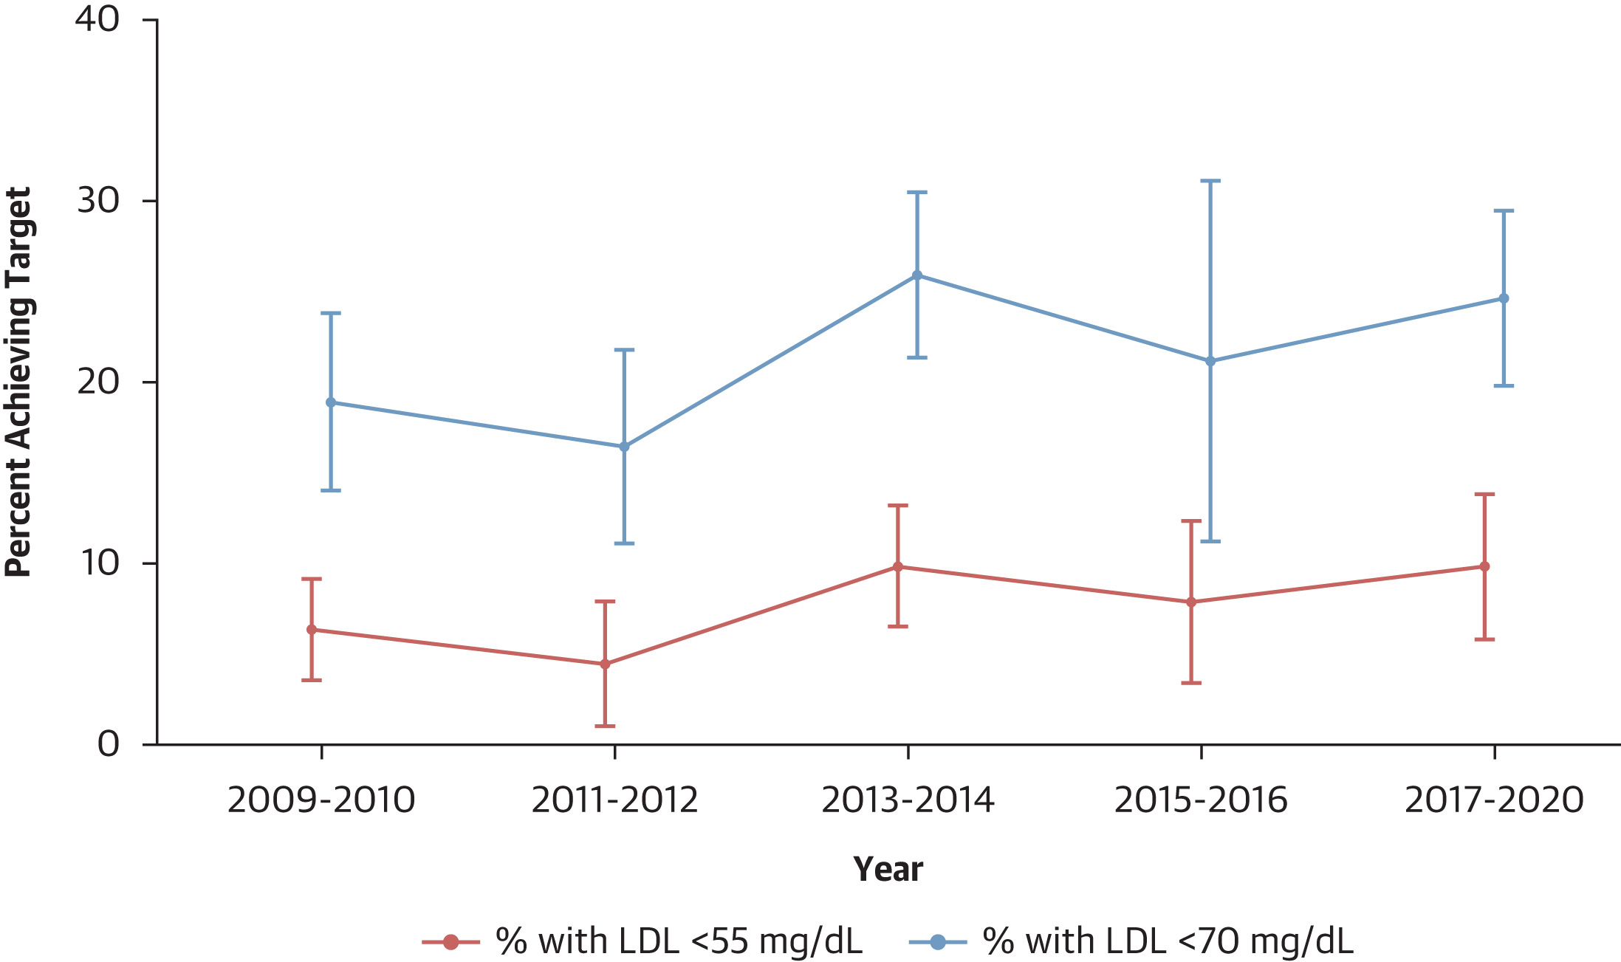
Achievement of LDL-C Targets Among U.S. Adult
Secondary Prevention Population Still Remains Low
The percentage of U.S. adults with prior ASCVD who achieved the guideline-recommended target of LDL-C <70 mg/dL remained low, from 19.0% (95% CI: 14.1%–23.8%) in 2009–2010 to 24.7% (95% CI: 19.9%–29.5%) in 2017–2020.
The percentage of those who achieved the more aggressive target of <55 mg/dL was even lower at 6.5% (95% CI: 3.7%–9.2%) in 2009–2010 and 9.9% (95% CI:
5.9%–13.9%) in 2017–2020.
24.7%
19.0%
9.9%
6.5%
Wadhera R, Dhruva S, Bikdeli B, et al. Cardiovascular Statistics in the United States, 2026: JACC Stats. JACC. 2026;87(9):1094-1134. https://doi.org/10.1016/j.jacc.2025.12.027

Slide 9
Statin + Ezetimibe Still Does Not Get Everyone to Goal
cvMOBIUS:
N=167,899 ASCVD patients
Only 22.5% with LDL-C <55 mg/dL
LDL-C Level
Achieved
≥70 mg/dL
4 in 10 need
more than
HI Statin + EZE
55 to <70 mg/dL
<55 mg/dL
Navar AM, et al. AHJ. 2025.279:107-117.
Projected Result if Additional Therapy is Added

Slide 10
ASCVD Patients Remain Woefully Undertreated
National Average, All U.S. Adults with ASCVD
HI Statin
Nonstatin
LDL-C <70
LDL-C <55
Aggarwal R et al., JAMA. 2023;330(1):80–82.

Slide 11
Mechanism of Proprotein Convertase Subtilisin/Kexin
Type 9 (PCSK9) Inhibition

Slide 12
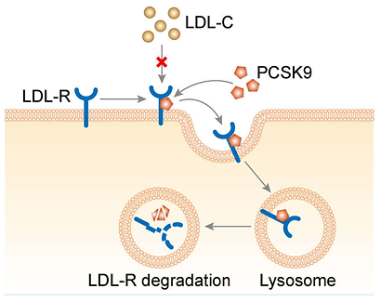
What Is PCSK9 and Its Physiology?
PCSK9 is the ninth member of
the proprotein convertase family
(a family of proteins).
It circulates in the blood that attaches to LDL receptors on the surface of
liver cells. This causes the receptors to be pulled inside the cells and destroyed instead of being returned
to the surface and reused.
With fewer LDL receptors available,
the liver cannot remove as much
LDL-C and other cholesterol-containing particles from the blood.
1. Shapiro M, et al. Circ Res. 2018;122:1420-1438; 2. Mansfield. 2026.

Slide 13
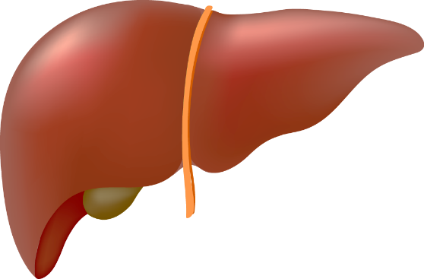
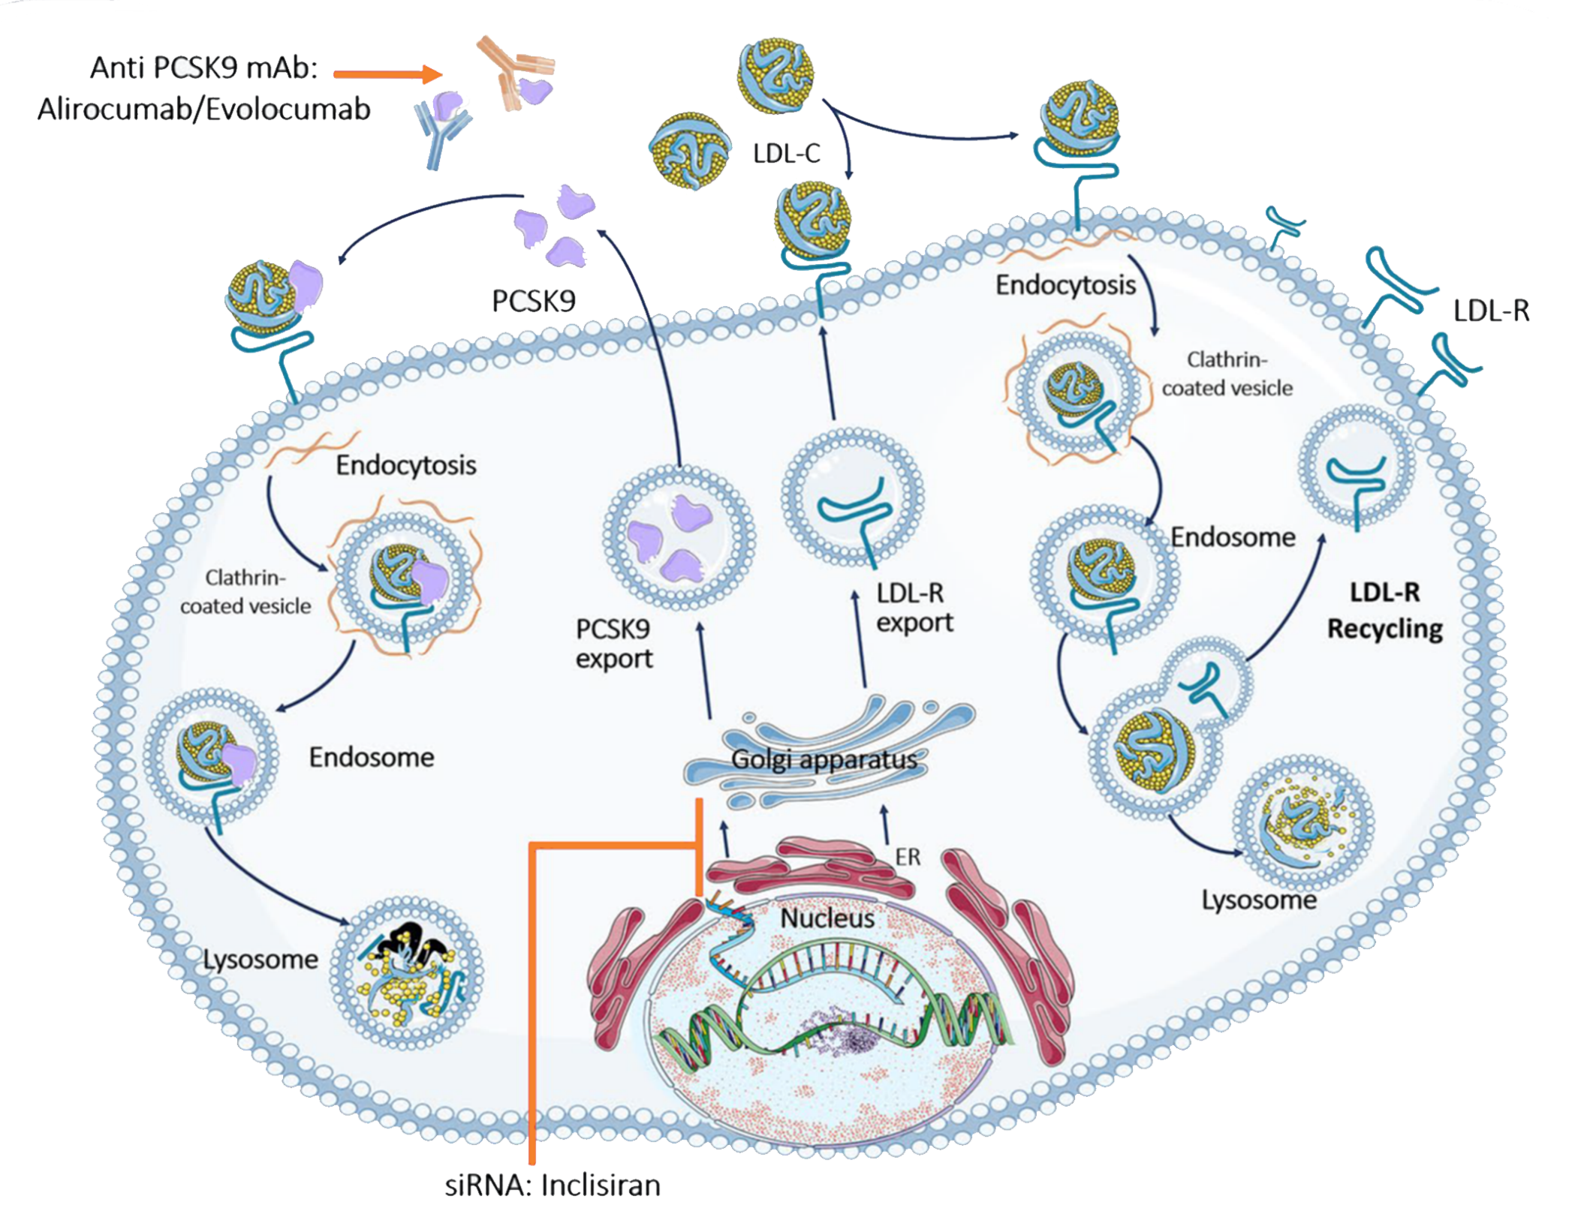
Can You Interfere with PCSK9?
You can interfere by inhibiting PCSK9 with the use of mAbs, by selectively targeting PCSK9 receptors, which prevents its binding to the LDL-R
You can interfere by inactivating PCSK9 by inhibition of its hepatic synthesis.
Increases LDL-R recycling on the hepatocyte surface and subsequent increase of LDL-C uptake and decrease of LDL-C levels in the circulation.

Slide 14
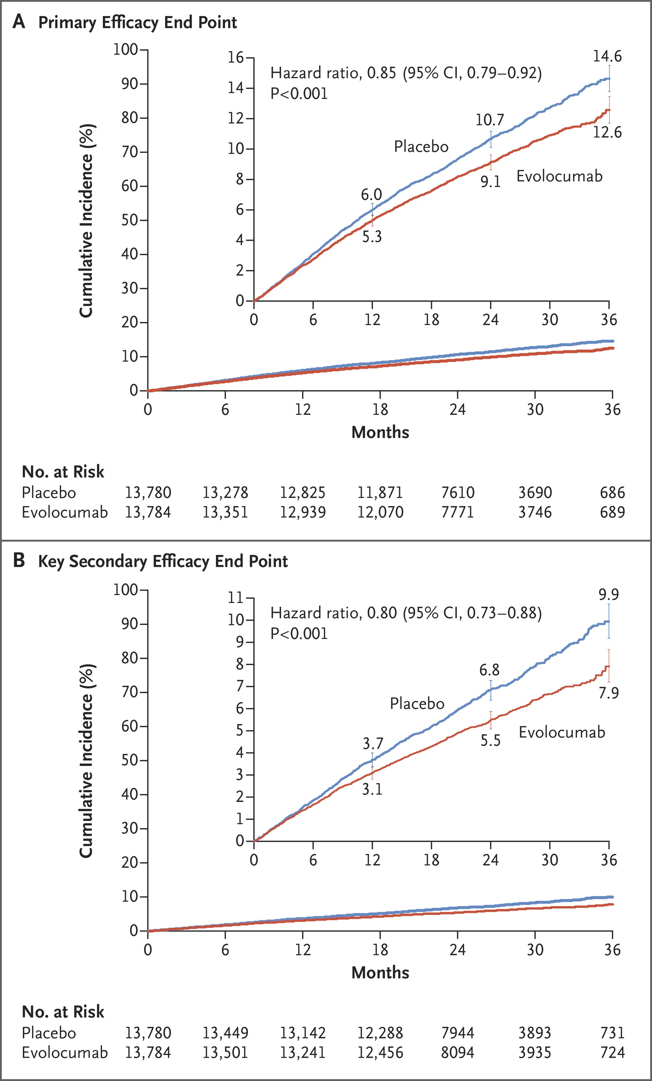
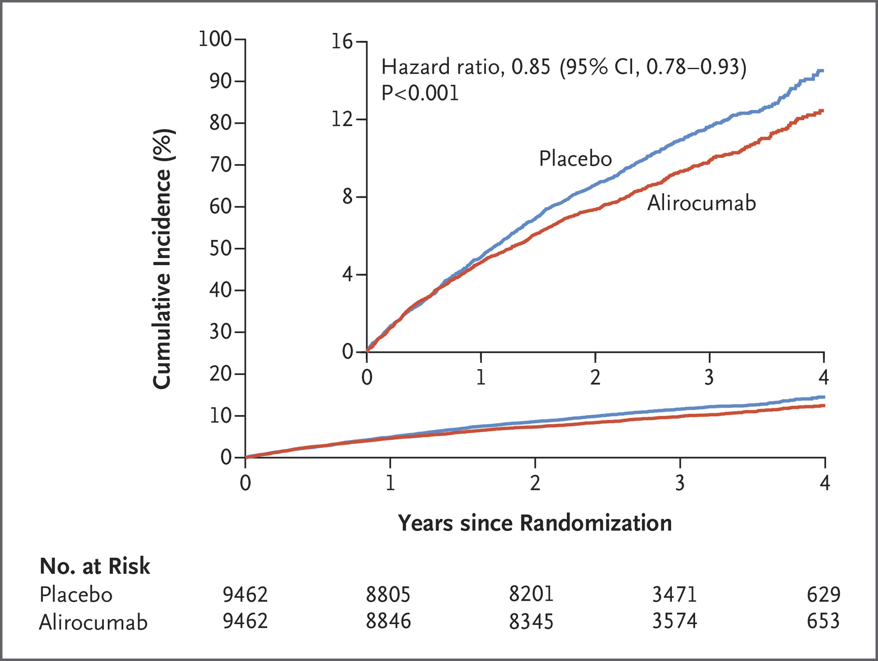
PCSK9i mAb: >60% LDL-C Lowering on a Background of Statin Therapy
FOURIER: Evolocumab¹
ODYSSEY: Alirocumab²
1. Sabatine MS, et al. N Engl J Med. 2017;376:1713-1722; 2. Schwartz GG, et al. N Engl J Med. 2018; 379:2097-2107.

Slide 15
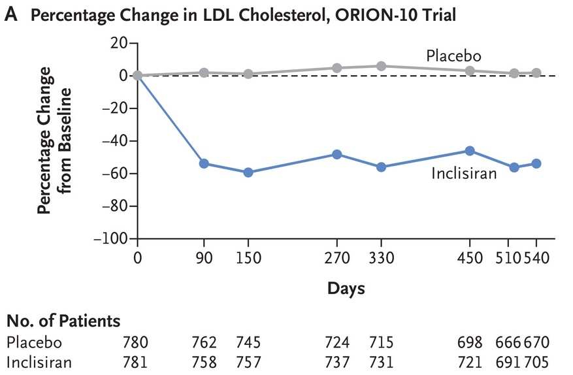

Anti-PCSK9 siRNA on a Background of Statin Therapy
ORION-10 Phase 3: n=1561 with ASCVD in the US; LDL-C >70 mg/dL on statin
54%
LDL-C
Ray KK, et al. NEJM. 2020;382:1507-1519.
Notes:
METHODS
We enrolled patients with atherosclerotic cardiovascular disease (ORION-10 trial) and patients with atherosclerotic cardiovascular disease or an atherosclerotic cardiovascular disease risk equivalent (ORION-11 trial) who had elevated LDL cholesterol levels despite receiving statin therapy at the maximum tolerated dose. Patients were randomly assigned in a 1:1 ratio to receive either inclisiran (284 mg) or placebo, administered by subcutaneous injection on day 1, day 90, and every 6 months thereafter over a period of 540 days. The coprimary end points in each trial were the placebo-corrected percentage change in LDL cholesterol level from baseline to day 510 and the time-adjusted percentage change in LDL cholesterol level from baseline after day 90 and up to day 540.
RESULTS
A total of 1561 and 1617 patients underwent randomization in the ORION-10 and ORION-11 trials, respectively. Mean (±SD) LDL cholesterol levels at baseline were 104.7±38.3 mg per deciliter (2.71±0.99 mmol per liter) and 105.5±39.1 mg per deciliter (2.73±1.01 mmol per liter), respectively. At day 510, inclisiran reduced LDL cholesterol levels by 52.3% (95% confidence interval [CI], 48.8 to 55.7) in the ORION-10 trial and by 49.9% (95% CI, 46.6 to 53.1) in the ORION-11 trial, with corresponding time-adjusted reductions of 53.8% (95% CI, 51.3 to 56.2) and 49.2% (95% CI, 46.8 to 51.6) (P<0.001 for all comparisons vs. placebo). Adverse events were generally similar in the inclisiran and placebo groups in each trial, although injection-site adverse events were more frequent with inclisiran than with placebo (2.6% vs. 0.9% in the ORION-10 trial and 4.7% vs. 0.5% in the ORION-11 trial); such reactions were generally mild, and none were severe or persistent.
CONCLUSIONS
Reductions in LDL cholesterol levels of approximately 50% were obtained with inclisiran, administered subcutaneously every 6 months. More injection-site adverse events occurred with inclisiran than with placebo. (Funded by the Medicines Company; ORION-10 and ORION-11 ClinicalTrials.gov numbers, NCT03399370. opens in new tab and NCT03400800. opens in new tab.)

Slide 16
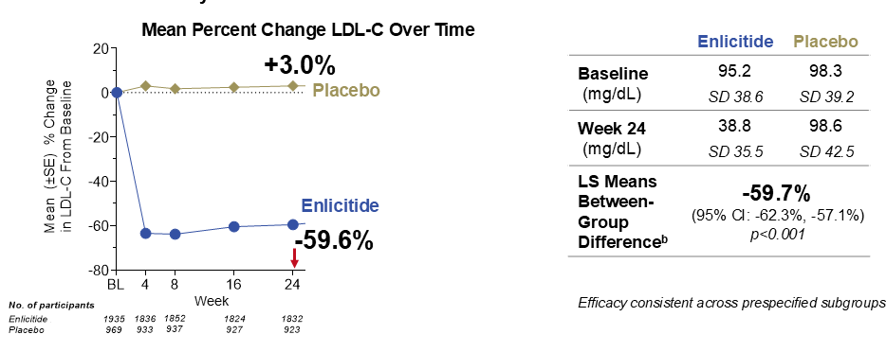
CORAL-Reef Lipids: Enlicitide in ASCVD or At-Risk
N=2909 with ASCVD & LDL-C ≥55 mg/dL or At-Risk & LDL-C ≥70 mg/dL
Randomized 2:1 enlicitide vs placebo
Navar AM et al. N Engl J Med 2026;394:529-539.
Notes:
N=2909 2:1 enlicitide vs placebo
ASCVD & LDL-C ≥55 mg/dL
At Risk & LDL-C ≥70 mg/dL
Mean LDL-C ~96 mg/dL

Slide 17
VESALIUS-CV Trial Results

Slide 18
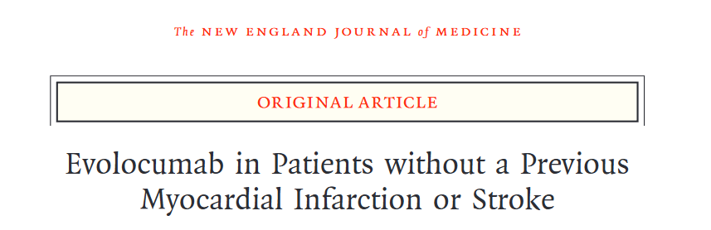

The Effect of EVolocumab in PatiEntS at High CArdiovascuLar RIsk WithoUt Prior Myocardial Infarction or Stroke
Bohula EA, et al. NEJM. 2025:doi:10.1056/NEJMoa2514428.

Slide 19
VESALIUS-CV: Trial Design
N=12,257 | Stable patients at high CV risk, no prior MI or stroke* | Median follow-up ≥4.5 years
Entry Criteria
LDL-C ≥90 mg/dL
Non-HDL-C ≥120 mg/dL
ApoB ≥80 mg/dL
On optimized statin therapy (± ezetimibe)
Qualifying Condition* — at least one:
CAD without MI (including CAC ≥100)
CeVD without stroke
PAD
High-risk diabetes mellitus
1:1 Randomization
EVOLOCUMAB SC
140 mg Q2W
PLACEBO SC
Q2W
Dual Primary Endpoints
3-P MACE: Time to CHD death, MI,
or ischemic stroke
4-P MACE: Time to 3-P MACE plus
ischemia-driven arterial revascularization
Event & Follow-up Driven:
3-P MACE: ≥751 events
4-P MACE: ≥1,254 events
MACE=Major adverse cardiovascular events
Bohula E, et al. Am Heart J. 2024;269:179-190.

Slide 20
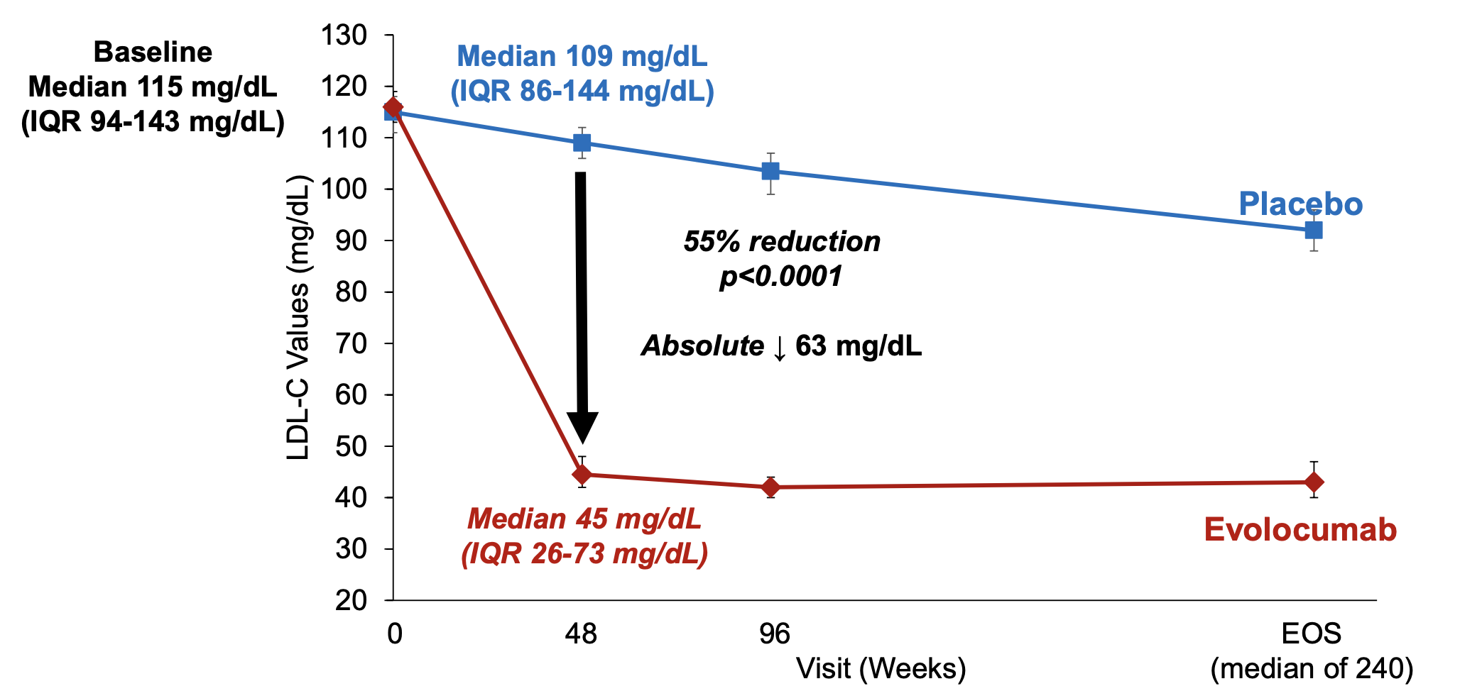
On-Treatment LDL-C ↓ by 55% to 45 mg/dL
Bohula EA, et al. NEJM. 2025:doi:10.1056/NEJMoa2514428.

Slide 21
LDL-C Reduction: Summary
Lipid substudy (N=2,014); baseline median LDL-C 115 mg/dL (IQR 94-143). Reduction rapid, sustained over 4.6-year follow-up.
Achieved LDL-C
45 mg/dL
Evolocumab arm
LDL-C Reduction
55%
p<0.0001
Absolute Reduction
63 mg/dL
vs. placebo (109 mg/dL)
LDL-C reduction was rapid, sustained throughout follow-up,
and consistent across all subgroups.
Placebo arm LDL-C also declined modestly over time (115 to 109 mg/dL),
reflecting background lipid optimization.
Bohula EA, et al. N Engl J Med. 2026;394:117-127.

Slide 22
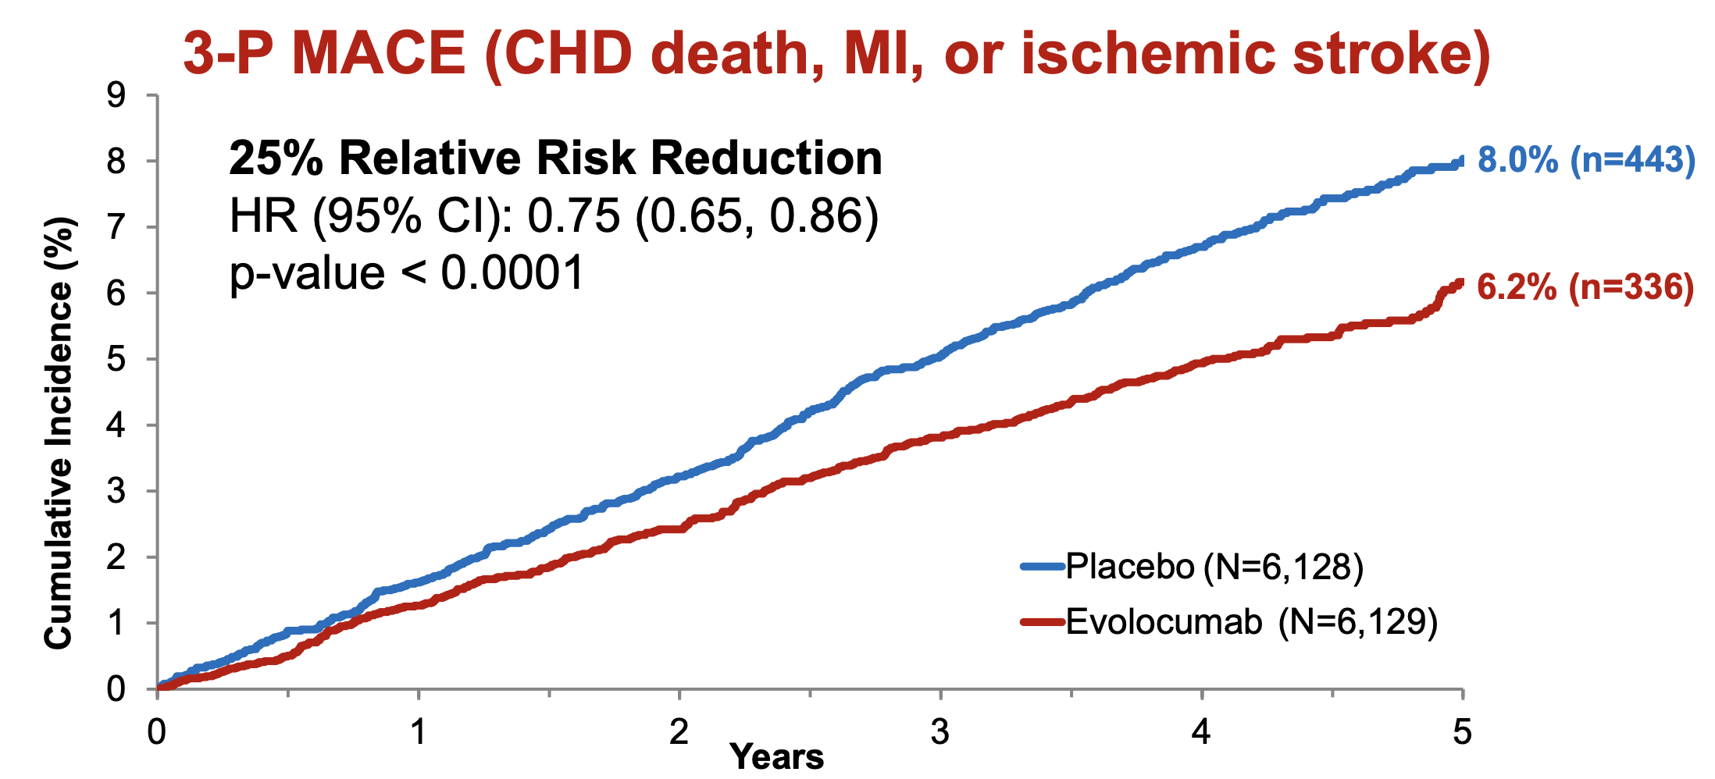
Evolocumab ↓ CV Events by 25%
3-P MACE (CHD death, MI, or ischemic stroke)
Bohula EA, et al. NEJM. 2025:doi:10.1056/NEJMoa2514428.

Slide 23
Primary Results: Summary
Both dual primary endpoints met with highly significant reductions (p<0.0001)
3-P MACE
CHD death, MI, or ischemic stroke
25%
Relative Risk Reduction
HR 0.75 (95% CI: 0.65–0.86)
p<0.0001
6.2% vs. 8.0% (Evo vs. Pbo)
4-P MACE
CHD death, MI, ischemic stroke + IDR
19%
Relative Risk Reduction
HR 0.81 (95% CI: 0.73–0.89)
p<0.0001
13.4% vs. 16.2% (Evo vs. Pbo)
IDR=ischemia-driven arterial revascularization.
Median follow-up 4.6 years.
Bohula EA, et al. N Engl J Med. 2026;394:117-127.

Slide 24
Patient Cases
Appropriate Patients for PCSK9 Inhibition

Slide 25
Patient Cases
Patient Case 1: Established ASCVD and
LDL-C Above Goal

Slide 26

Patient Case 1: Established ASCVD and LDL-C Above Goal
Maria is a 68-year-old woman with:
NSTEMI and PCI with two drug-eluting stents 18 months ago
Type 2 diabetes
Hypertension
Former tobacco use
BMI: 29 kg/m²
Normal renal and hepatic function
No recurrent angina

Slide 27
Patient Case 1: Established ASCVD and LDL-C Above Goal
Lipid Lowering History
Treatment stage | LDL-C
Before treatment intensification | 173 mg/dL
Atorvastatin 80 mg daily | 92 mg/dL
Atorvastatin 80 mg + ezetimibe 10 mg daily | 69 mg/dL
Maria reports excellent adherence and has no medication-related adverse effects.

Slide 28
Discussion Question
Her LDL-C has fallen by approximately 60% and is below 70 mg/dL. Does she need additional therapy?
Clinical Assessment
Yes. Maria has established ASCVD and multiple high-risk conditions, including a prior MI and diabetes. She therefore meets the definition of very-high-risk secondary prevention.
Rationale
The 2026 dyslipidemia guideline recommends:
LDL-C goal: <55 mg/dL
Non–HDL-C goal: <85 mg/dL

Slide 29
Patient Case 1: Established ASCVD and LDL-C Above Goal
Treatment Decision
Add a PCSK9 inhibitor while continuing atorvastatin and ezetimibe.
A monoclonal antibody PCSK9 inhibitor could be expected to lower her remaining LDL-C by approximately 50%-60%, potentially bringing it into the 25-35 mg/dL range.

Slide 30
Patient Cases
Patient Case 2: Preventing the First Event

Slide 31

Patient Case 2: Preventing the First Event
David is a 66-year-old man with:
No history of myocardial infarction, stroke, or coronary revascularization
Type 2 diabetes for 14 years
Hypertension
Stage 3a chronic kidney disease
Former tobacco use
Coronary artery calcium score of 720
Coronary CT angiography showing multivessel coronary plaque, including a 50%-60% right coronary artery stenosis
No angina or other ischemic symptoms

Slide 32
Patient Case 2: Preventing the First Event
Current Treatment and Laboratory Results
Rosuvastatin 40 mg daily
Ezetimibe 10 mg daily
Test | Result
LDL-C | 96 mg/dL
Non-HDL-C | 126 mg/dL
ApoB | 88 mg/dL
Hemoglobin A1c | 7.1%
Blood Pressure | 128/76 mm Hg
His adherence has been confirmed, and secondary causes of elevated LDL-C have been excluded.

Slide 33
Discussion Question
David has never experienced an MI or stroke. Is a PCSK9 inhibitor appropriate before a first CV event occurs?
Clinical Assessment
David closely resembles the population studied in VESALIUS-CV:
High cardiovascular risk
Documented atherosclerosis and high-risk diabetes
No previous MI or stroke
LDL-C ≥90 mg/dL despite optimized background lipid-lowering therapy
Notes:
His LDL-C of 96 mg/dL represents important residual lipid-related risk despite high-intensity statin therapy and ezetimibe. His high CAC score, CT-documented coronary atherosclerosis, diabetes, and CKD further strengthen the rationale for intensive LDL-C lowering.

Slide 34
Patient Case 2: Preventing the First Event
Treatment Decision
Following shared decision-making, add evolocumab to his existing therapy to achieve a large additional LDL-C reduction and lower his risk of a first major cardiovascular event.

Slide 35
Key Takeaways

Slide 36
Key Takeaways
Lower LDL-C is associated with lower ASCVD risk, yet most high-risk patients remain above guideline-recommended LDL-C goals.
PCSK9 inhibition provides an additional 50%-60% reduction in LDL-C when patients do not reach goal with maximally tolerated statin therapy and ezetimibe.
VESALIUS-CV expands the evidence for earlier treatment, demonstrating that evolocumab reduced three-point MACE by 25% in high-risk patients without a prior MI or stroke.
A prior cardiovascular event should not be the only trigger for intensive LDL-C lowering. Treatment decisions should reflect the patient’s overall risk, atherosclerotic burden, LDL-C level, and response to existing therapy.
PCSK9 inhibitors can benefit two important populations: (1) patients with established ASCVD who remain above goal and (2) appropriately selected high-risk patients who have not yet experienced their first major cardiovascular even

Slide 37
Thank you.

