Slide 1
Rent Control:
Countering Proposals and the Opposition’s Strength in Numbers

Slide 2
Why are we here?
States/ territories with rent control
Rent control has been proliferating in more jurisdictions.
New York
New Jersey
California
Maryland
DC
Notes:
Rent control has been traditionally confined to fives jurisdictions in the United States: New York, New Jersey, Washington DC, Maryland, and California, which you will see in red. The blue states either preempt rent control, or do not have rent control at the state or local level. That being said, across the country we are seeing rent regulation policies spread to other jurisdictions that currently lack any sort of price controls on rental housing.
Just because your state currently preempts rent control doesn’t mean it’s completely safe. Several states have recently been considering overturning rent control preemption. Even states that aren’t facing this issue currently in their legislature, should be mindful for whether your state allows for statewide ballot measures to be initiated by voters.

Slide 3
2017-2018 Rent Control Fights
Washington
Maine
Oregon
Minnesota
Michigan
New York
Massachusetts
Rhode Island
Connecticut
California
Illinois
Maryland
DC
Hawaii
Notes:
States facing attempts to repeal preemption, limits on local rent control measures, or implement at the local level or statewide has grown during the 2017-2018 legislative sessions: 2017-2018 legislative sessions.
Orange = states facing repeal of preemption or limits on rent control
Thirteen: CA, CT, HI, IL, MA, ME, MD, MI, MN, NY, OR, RI, WA
State and Local Level: 1 state-California (2017 and 2018)
State Level: 9 states-Oregon (2017), Washington state (2018), Hawaii (2017 and 2018), Minnesota (2018), Michigan (2017), Illinois (2017 and 2018), Massachusetts (2017 and 2018), Connecticut (2018), and New York (2018)
Local Level: 3 states-Rhode Island (2018), Maryland (2017), and Maine (2017)

Slide 4
Key Terms of Rent Regulation
Rent Control: a hard cap is placed on the rent that a property owner may charge residents, and significantly restricts the owners ability to evict a resident.
Rent Stabilization: a system that sets a maximum rate for annual rent increases.
Temporary Rent Control: a policy where rent control for rental housing is established for a temporary period to address natural or economic disasters.
Vacancy Decontrol: set rent at market rate, or near market rate levels when a unit becomes vacant.
Rent regulation is a broad term that encompasses rent control, rent stabilization, and temporary rent control
Notes:
Rent Control occurs when a hard cap is placed on the rent that a property owner may charge residents, and significantly restricts the owner’s ability to evict a resident. Traditional rent control is rarely still used, as many properties are rent stabilized or have units that are set-aside for a fixed rental rate. New York and the District of Columbia are the only jurisdictions that allow for rent control.
Rent Stabilization refers to a system that sets a maximum rate for annual rent increases. In rent stabilized properties, the limits can only be adjusted if approved by a government board or administrator. New York, California, Maryland, New Jersey and the District of Columbia have policies that allow for rent stabilization.
TEMPORARY RENT CONTROL is a policy where rent control for rental housing is established for a temporary period to address natural or economic disasters; however, they are also used in some instances by local governments to address “housing emergencies.” Examples of temporary rent control include the price controls enacted during the Presidencies of Franklin Delano Roosevelt, Harry Truman, and Richard Nixon, as well as more contemporary instances such as the City of Pacifica in 2017.
VACANCY DECONTROL are regulations that set the rent at market or near market levels when a unit is vacant and regulates the raising of rent. Typically jurisdictions will pass vacancy decontrol to help make rent control and rent stabilization less burdensome for property owners. California and New York both have vacancy decontrol.

Slide 5
Key Concerns about Rent Control
Acts as a deterrent and disincentive to develop new rental housing
Expedites the deterioration of existing rental housing
Causes a reduction in the amount of rental housing
Poorly Targeted as it lacks means testing to ensure that it helps low-income residents
Increases gentrification as these policies tend to confer the greatest benefits on affluent renters

Slide 6
Affiliate Experiences

Slide 7
Timeline of Rent Control in Washington State
1981: Law passes preempting local jurisdictions from regulating rent
2018: Two bills are introduced to remove statewide preemption and allow local jurisdictions to enact local rent controls without limitation
What’s ahead for Washington State and rent control in 2019?

Slide 8
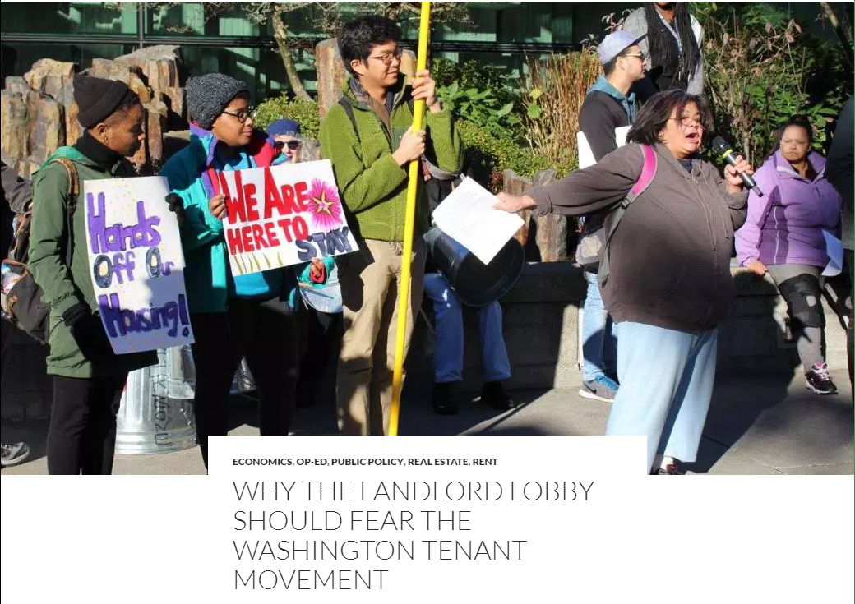
Senate Bill 6400 ~ Local Rent Regulation Public Hearing: Washington State
“I think that ultimately rent control will phenomenally make housing affordable, will help towards the standard of living of renters, it will not negatively impact small landlords, but it will make sure that some of the hand over fist greed kind of profit that big speculative investors are getting, they will not get that. We are not shedding tears for those Wall Street investors.
Kshama Sawant
Seattle City Council member

Slide 9
Nibbling at the Edges of Rent Control: Washington State
Extended notice requirements for rent increases
Limits to security deposits & nonrefundable one-time fees
Economic displacement assistance based on income and rent increases
“Although the Ordinance explicitly styles itself as an exercise of regulatory police power, the Exaction will most likely be classified and evaluated as a revenue-raising tax, not a regulatory fee. The Ordinance’s proposed Exaction is almost certainly impermissible under Washington State law as it stands today.”

Slide 10
Rent Control: Illinois Advocacy
Rent Control Pre-Emption Act - 1997
Chicago Rents
  Class A $1560; Class B $1273; Class C $1064
HB2430 (Guzzardi) SB2310 (Biss)
  Overturn Rent Control Pre-Emption Act
SB3512 (Hunter) Rent Control Act
  Overturn Rent Control Pre-Emption Act and establish rent control throughout the state

Slide 11
Rent Control: Illinois Advocacy
SB3512 Rent Control Act
  Six Regional Rent Control Boards
    3 tenants; 2 landlords; 2 tenant org reps
    Enact regs; hire staff; set Rent Stabilization Rates
    LL fee for Repair and Improvement Fund
    Reserve accounts = 10% of rent proceeds
  Penalty for exceeding rent limits = 3x monthly rent, actual damages, tenant costs, atty fees
  12 or fewer units, income tax credit = 3% property taxes

Slide 12
Rent Control: Illinois Advocacy
SB3512 Rent Control Act (cont.)
  “Just Cause” Eviction language included
    Relocation assistance for demolition, rehab, repair, family member tenancy = $3000 or 3 month’s rent
    90-day notice for rehab and repair
    120-day notice for demolition
  Evictions invalidated if rent due is paid before start of trial
  Limits use of 10-day notice to quit, requires LL to meet with tenant to remedy the violation

Slide 13
Rent Control: Illinois Advocacy
Upward pressure on rents
  property taxes
  sewer and water fees
  utilities
  recycling requirements
  sustainability mandates
  inclusionary zoning
  RLTO lawsuits

Slide 14
Rent Control: Illinois Advocacy
Coalition Partners
  Illinois REALTORS; Homebuilders Association; Neighborhood Building Owners Alliance; Illinois Rental Property Owners Association; Illinois Manufactured Housing Association; Illinois Municipal League; Illinois Building Trades
Industry Experts/Academics
Outreach to Lawmakers
  In District Meetings
  Grass Roots Lobbying
Candidate interviews; CAAPAC support and endorsements

Slide 15
Rent Control: Illinois Advocacy
Campaign Effort
  Focus Groups
  Polling
  Digital Ads
  Social Media Management
  Media Kit
  Press Conference
  Editorial Board Meetings
  Op-Ed and LTE
  TV/Radio Interviews and Political Talk Shows

Slide 16
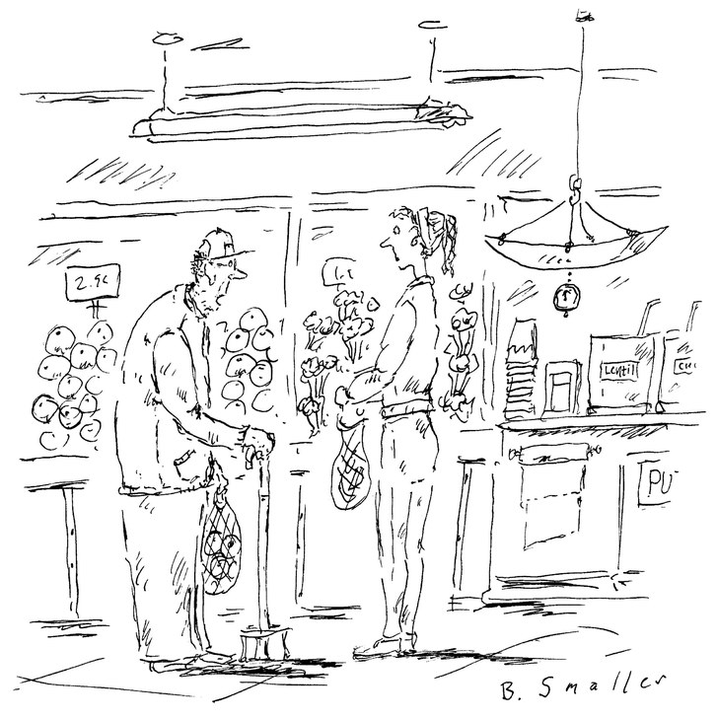
Rent Control: Illinois Advocacy
Swedish economist (and socialist) Assar Lindbeck asserted, “In many cases rent control appears to be the most efficient technique presently known to destroy a city—except for bombing.”
“I would die, but I have a rent-controlled apartment.”

Slide 17
State Level Rent Control Risks: Maryland
2018 is an election year in Maryland for all state and county officials
Republican Governor
General Assembly heavily Democratic
  Senate 70% Democratic
  House 65% Democratic
Annual General Assembly sessions
Statewide bills
Local bills

Slide 18
Impasse at State Level: Maryland
Occasional rent control proposals at state level
Neither side has had the votes to pass pro or anti rent control bills
AOBA tried 4 times in 10 year period to pass legislation requiring local fiscal studies prior to enacting rent control, without success
Tenant advocates attempted several rent control bills – all failed

Slide 19
Examples of Failed State Level Rent Control Bills: Maryland
2014 - SB 904
  Statewide rent control at CPI + .5%
  Statewide MD Rental Housing Authority and Office of Tenant Advocate
  Statewide registration of all rental units
  Registration fee of 1% of value of all rental units and pay one month’s rent to Authority ($1B fees)
2015 - SB 480
  Commission to study
    Rent stabilization
    Need for Office of Tenant Advocate
    Experiences of other states

Slide 20
Local Legislation in General Assembly a Risk: Maryland
2018 - HB 995
  Just Cause Eviction Bill for Montgomery County
  Local Courtesy means Montgomery County House and Senate Delegations likely decide the bill’s fate
  Owner must renew lease forever on “substantially the same terms” unless they can prove that tenant violated one of 11 “just causes” for nonrenewal
  After huge fight, bill sent to summer study, but likely back next year

Slide 21
Local Governments the Major Risk of Rent Control in MD
24 counties in Maryland, all but 6 of which have home rule authority, and could enact rent control
Primary risk of rent control enactment is in suburban Washington counties of Montgomery and Prince George’s

Slide 22
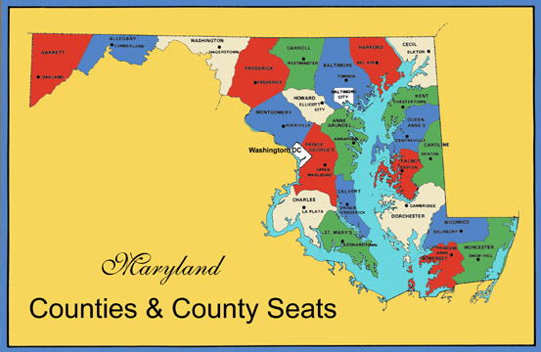
24 Maryland Counties in Maryland

Slide 23
Montgomery County High Risk for Rent Control: Maryland
2015 - Bill 19-15
  Bill enacts sweeping measures to provide new tenant rights and owner obligations
  Mandatory offer of 2-year lease initially and on renewal
  Notice of rent increase changed from 60 to 90 days
  County DHCA annually publishes and posts on their website voluntary rent guidelines and owner-supplied data on all average rent increases by unit and building type
  Many more provisions in bill beyond rent-related
  Successfully resisted provisions regarding: (1) mandatory use of model lease, (2) mandatory DHCA review of rent increases above voluntary guidelines (3) prohibition on higher rates for month to month rentals, and many other potentially damaging provisions

Slide 24
Prince George’s County a Rent Control Risk: Maryland
2015 - CB-59
  Bill proposed rent control for senior housing, which AOBA was able get amended out
  Mandatory offer of 2-year leases at senior housing enacted
Purple Line
  16- mile light rail under construction between Montgomery and Prince George’s Counties
  County discussing measures to counter perceived gentrification near rail stations, including rent control and inclusionary zoning

Slide 25
157 Municipalities in Maryland
TAKOMA PARK HAS RENT CONTROL

Slide 26
Municipal Rent Control Challenges: Maryland
157 municipalities across the state – each with the authority to enact rent control
Difficult to monitor multiple jurisdictions
Subscribe to as many municipal newsletters and meeting notices as you can
Intervene when necessary
Takoma Park is the only jurisdiction in MD with rent control
Takoma Park originally enacted rent control at 70% of CPI in 1981, later modified to full CPI for Balt/Wash region (currently 1.8%).

Slide 27
Assistance from NAA

Slide 28
What resources does NAA have available?
Almanac
Basic Talking Points
Fact Sheet
50 State Chart
Model Rent Control Preemption Legislation
NAA Policy Statement
Sample Advocacy Letters
Ongoing State and Local Tracking of Rent Control Proposals and Initiatives
Ongoing Media Review
New NAA webpage on rent control: https://www.naahq.org/advocacy/policy-issues/rent-control
Notes:
NAA currently has many resources available to members. While I am not going to dive into all the specifics, I would like to mention that you will be able to find these resources on the new NAA webpage for rent control which is listed on this slide.
**Emphasize and only mention the webpage.

Slide 29
What is else is NAA doing to help?
New external partnerships
Tailored talking points
Strategy handbook
Explainer video
Webinar on advocacy strategies
Additional research on rent control
Have ideas? Please let us know by contacting Robert Melvin at rmelvin@naahq.org
Notes:
In addition to the resources that we currently have available to members and affiliates, we are also in the process of developing new resources to help affiliates, including tailored talking points for specific audiences such as residents and investors.

Slide 30
Strategic Considerations
Preemption/ state legislation
Legislator property tours
Resident engagement
Alternative affordable housing solutions
Notes:
Combatting rent control requires a comprehensive approach to beat tenants rights activists at both the ballot box and in state capitols.
Preemption is one of the most critical components of protecting your members. Rather than fighting many different rent control initiatives, it helps to focus your efforts to a single legislative body thereby extending your resources. If your state currently has rent control preemption, consider working to enact a constitutional amendment that prohibits price controls on consumer goods to help provide an additional level of protection against attempts to repeal rent control preemption.
Encourage your members to host legislator visits at apartment communities. This will help to show the legislators what all goes into running a community and help inform them about how rent control can adversely impact these properties.
Push members to mobilize their residents against rent control. It’s critical that property owners inform their residents about the negative impacts rent control will have on the tenants.
Recommend viable solutions to provide affordable housing. Both short and long term solutions should be provide. These could be the following: the Denver LIVE program, local housing subsidies for low income residents, property tax abatement for properties that rent to low income residents, state or local income tax breaks for renters, and removing barriers to construction on affordable housing developments.

Slide 31
Questions?
Washington Multi-Family Housing Association: Brett Waller, Director of Government Affairs; 425-656-9077; brett@wmfha.org
Chicagoland Apartment Association: Michael Mini, Executive Vice President; 312-207-1890; mike@caapts.org
Apartment and Office Building Association of Metropolitan Washington: Ronald Wineholt, Vice President of Government Affairs-Maryland; 301-261-1460; rwineholt@aoba-metro.org
National Apartment Association: Robert Melvin, Manager of Government Affairs, 703-797-0672; rmelvin@naahq.org

