Slide 1
How Deep Should Your Story Go On Equity?
AHCJ 2023, 3/9/23 @ryan_levi / @tradeoffspod
Ryan Levi, Tradeoffs rlevi@tradeoffs.org

Slide 2
Tradeoffs
National health policy podcast
Weekly show
Launched in 2019
Tell stories at the intersection of people, policy and money
Notes:
What is Tradeoffs
Mention this because specifics of publication (beat, cadence, format) are factors
very white, urban, coastal, upper middle class newsroom
similar to many newsrooms
can be tough convos but need to happen
Pushed our newsroom to track source diversity and have these conversations regularly

Slide 3
Some quick definitions
What does equity mean?
How a policy affects different groups differently
There are lots of different “types” of equity: race, geography, socioeconomic, disability
Notes:
Different types of equity: race, geography, socioeconomic, disability
What does equity mean? Our answer: How a policy affects different groups differently

Slide 4
How much of your story should be about equity?
Every story has an equity angle, but not every story can be all about equity. So how do you decide?
Two big questions
How central is equity to your story?
What do you want your audience to take away?
Notes:
This is a hard question, but this is the big idea that I’ve been thinking about as I’ve prepared for this session: Every story has an equity angle, but not every story can be all about equity. So how do you decide?
Two big questions to ask yourself
How central is equity to this story?
What do you want your audience to take away?
Will the audience remember whatever equity point you make?

Slide 5
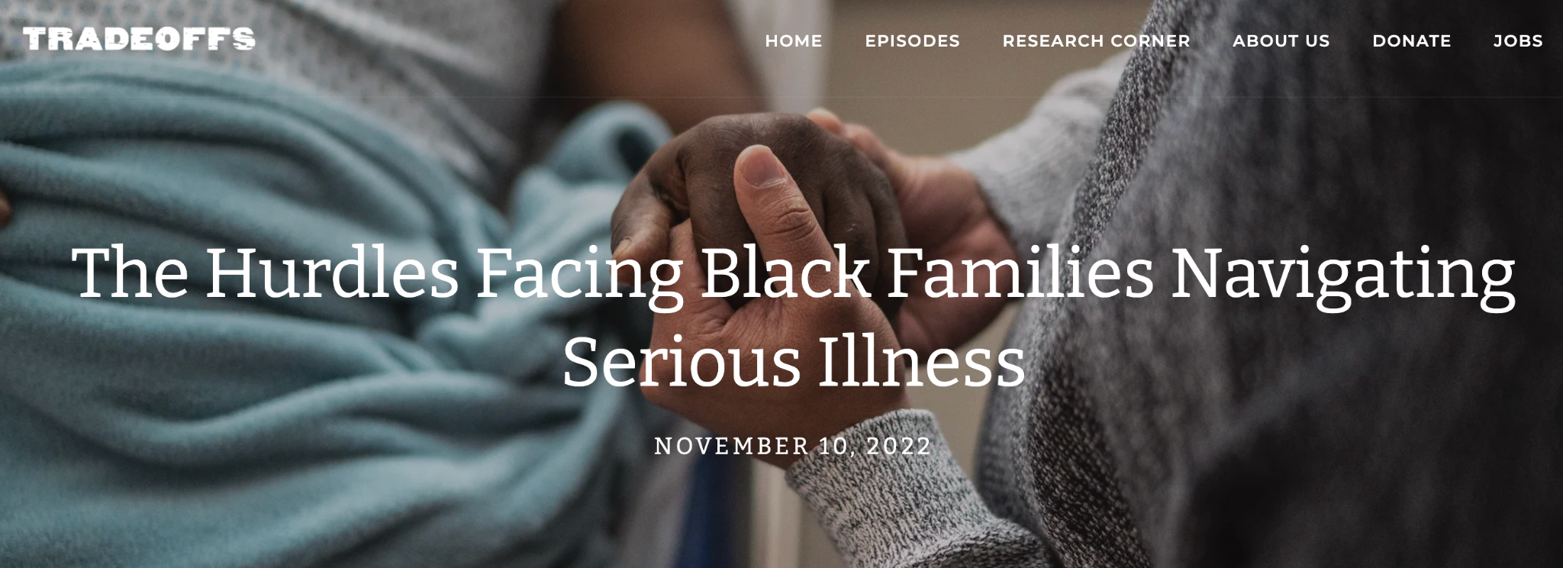
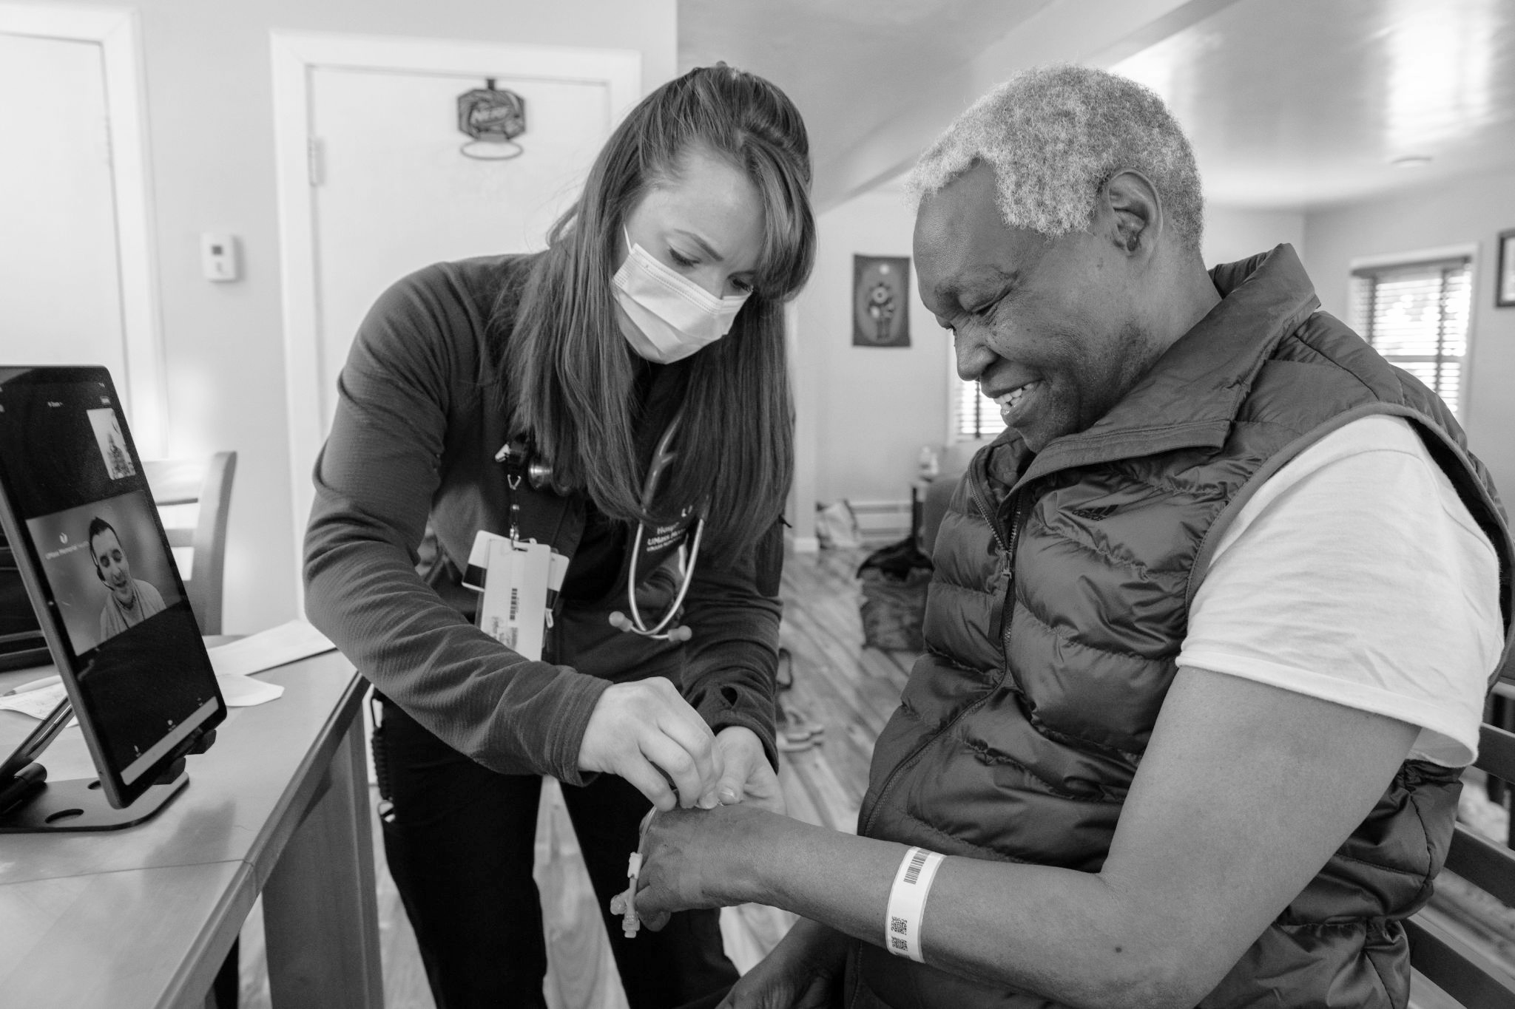
How to Decide: 2 Case Studies
Notes:
Palliative care and hospice
Example of where we decided to do a full dive on equity, in this case, racial equity
Persistent disparities in who uses palliative care and hospice … 10% gap
Often equity is about access … this story was interesting because everyone has access to hospice through Medicare … so why do Black people use it less?
How central is equity to this story?
There was a big, interesting nuanced health policy story here … lots of interesting questions:
Why do Black people use it less if they have access?
Is that a bad thing? Hospice is not everyone’s goal, especially in Black community
What would hospice care that met Black people’s needs look like?
Need to better understand why people aren’t using that thing to talk about solutions’
What do we want our audience to take away?
One liner wouldn’t actually get enough at the tension to say anything
Went hand and hand with deciding to do bigger story

Slide 6
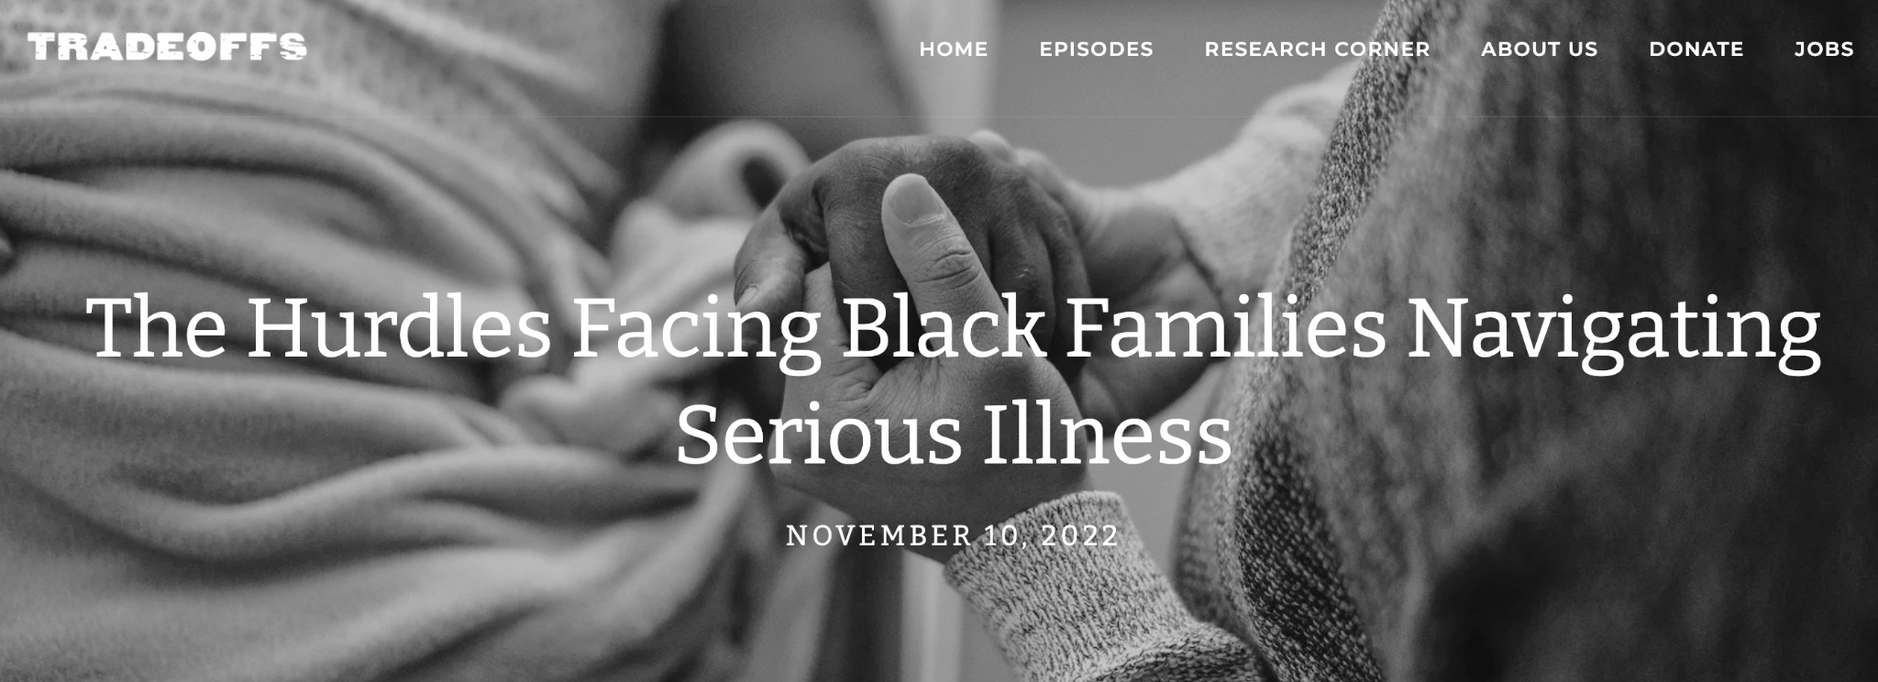
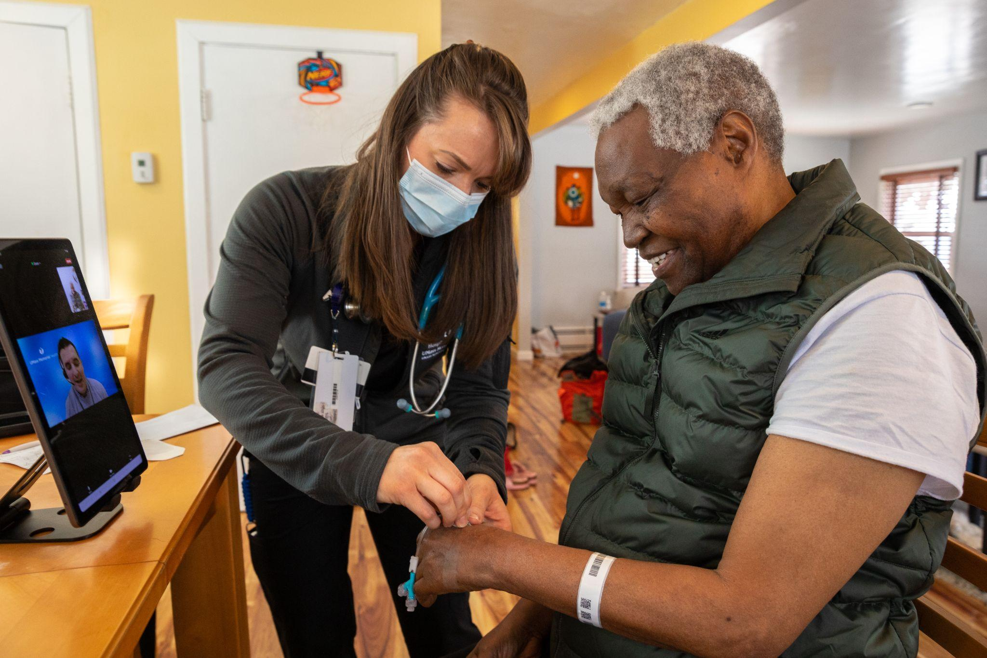
How to Decide: 2 Case Studies
Notes:
Hospital at home:
Story is not out yet
November 2020, Medicare said it would pay for hospital at home for the first time
H@H = idea that’s been around for a long time, has lots of data, but uptake has been slow
Medicare paying for it allows for chance to learn a lot about how well this works on a larger scale
How central is equity to this story?
Always been equity concerns: Would this work for people in rural areas? Communities of color? Low-income people?
Lots of other questions too: Does this even work? Is it safe? Does it make financial sense for hospitals? What have we learned on all of these?
What do we want our audience to take away?
Equity is a key part of this story
Can’t just be one sentence
Spend several minutes in the script breaking this down. Question on geographic equity. Spend a question on socioeconomic.

Slide 7
Takeaways
Think about different kinds of equity
Every story has an equity angle, but not every story can be all about equity.
Ask yourself:
How central is equity to your story?
What do you want your audience to take away?

Slide 8
How Deep Should Your Story Go On Equity?
AHCJ 2023, 3/9/23 @ryan_levi / @tradeoffspod
Ryan Levi, Tradeoffs rlevi@tradeoffs.org

