Slide 1
Reporting with an equity lens
Jyoti Madhusoodanan, freelance
AHCJ 3.9.2023

Slide 2
Why ask about demographics?
Demographic data is gathered and used in science
  Age
  Gender
  Geography (urban/ rural)
  Socioeconomic status
  Race and ethnicity

Slide 3
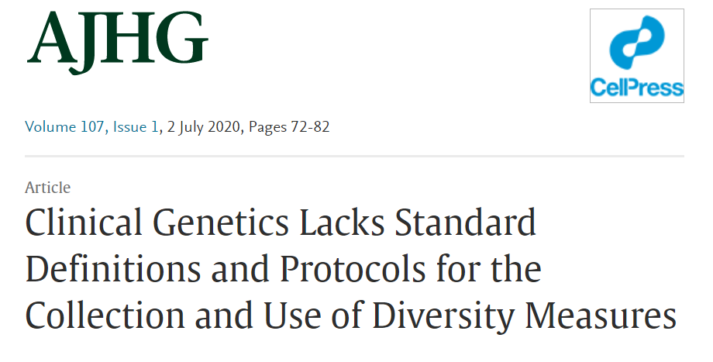
Why ask about demographics?
Lack of common definitions of race, ethnicity, and ancestry
Many ways to capture these variables

Slide 4
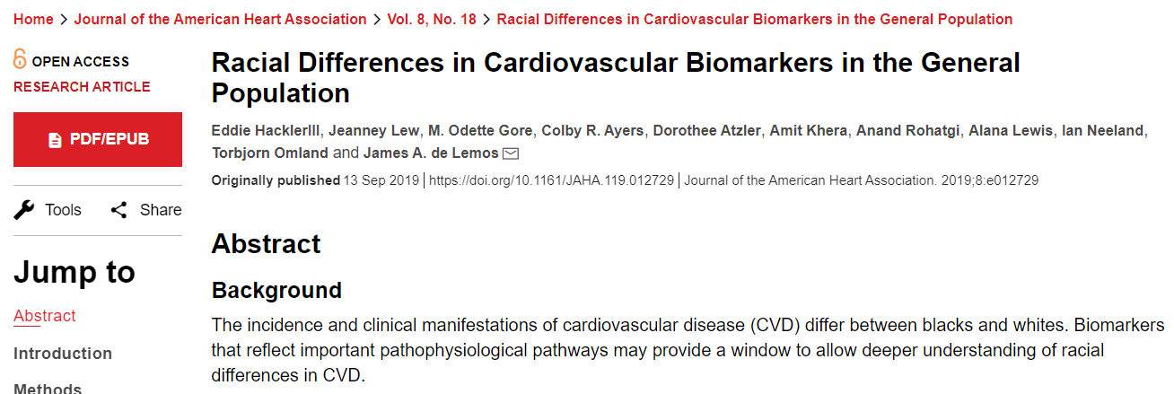
Why ask about demographics?
Reveals the limits of a study
Who does the science help? Who’s left out?

Slide 5
What questions to ask
How did a study capture race and ethnicity?
  Self-reported or data drawn from existing database?
  What categories were included in analyses and why?
Are the sample sizes meaningful?
Why is data being parsed by race or ethnicity?
  Does the analysis reinforce flawed ideas or aim to address inequity?
Place results in broader context of longstanding biases, structural racism

Slide 6
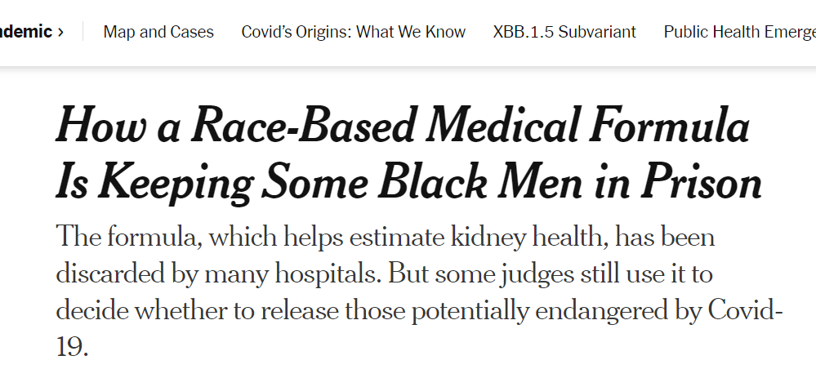
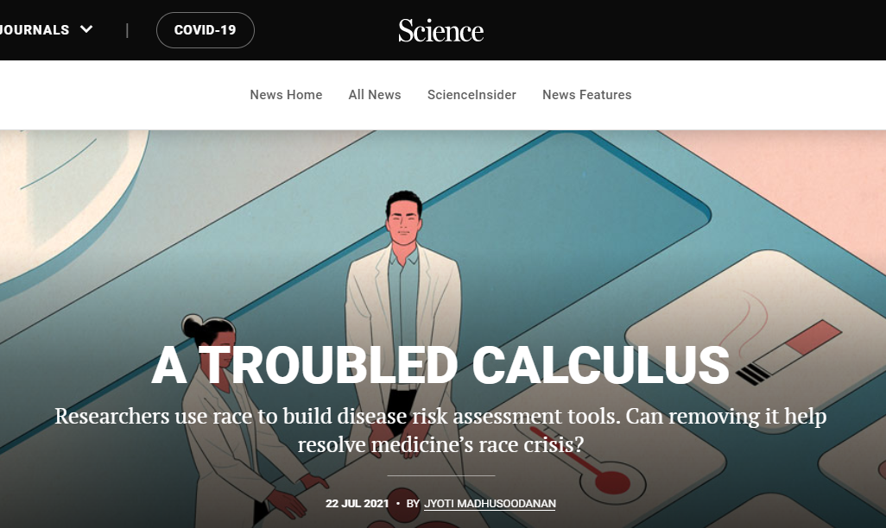
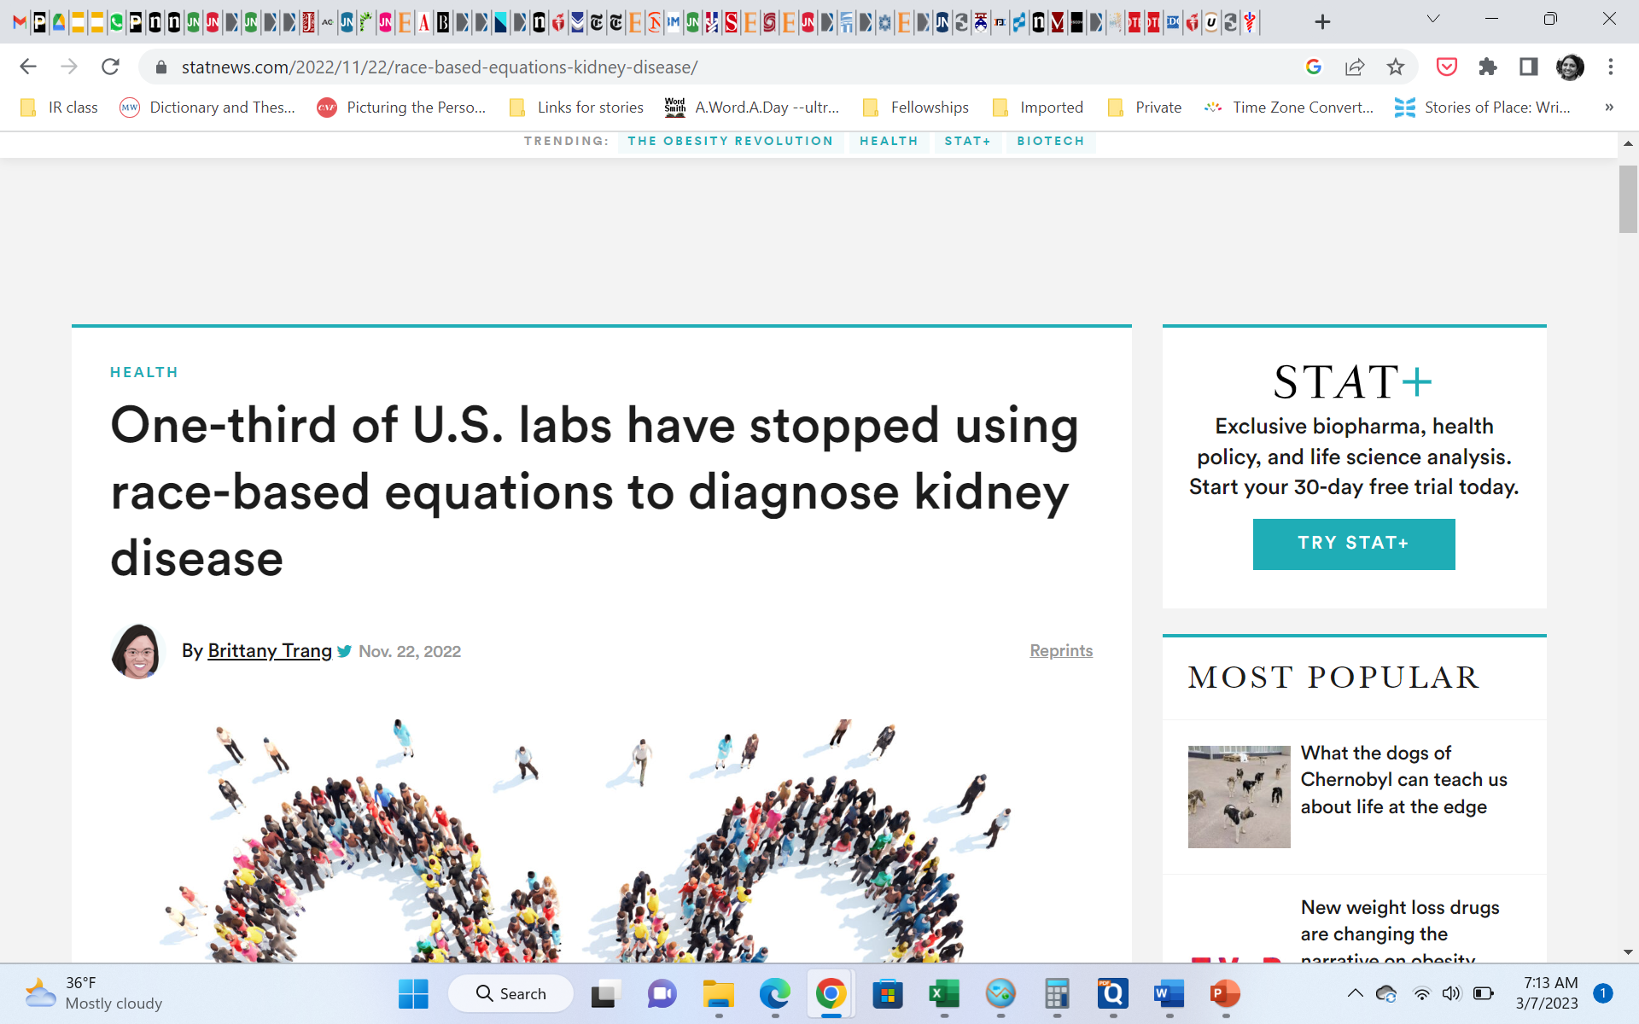
Implications: Race in clinical tools
Researchers often use race categories to explain differences seen in a study
Race corrections perpetuate bias
Removing race from an equation used to estimate kidney function

Slide 7
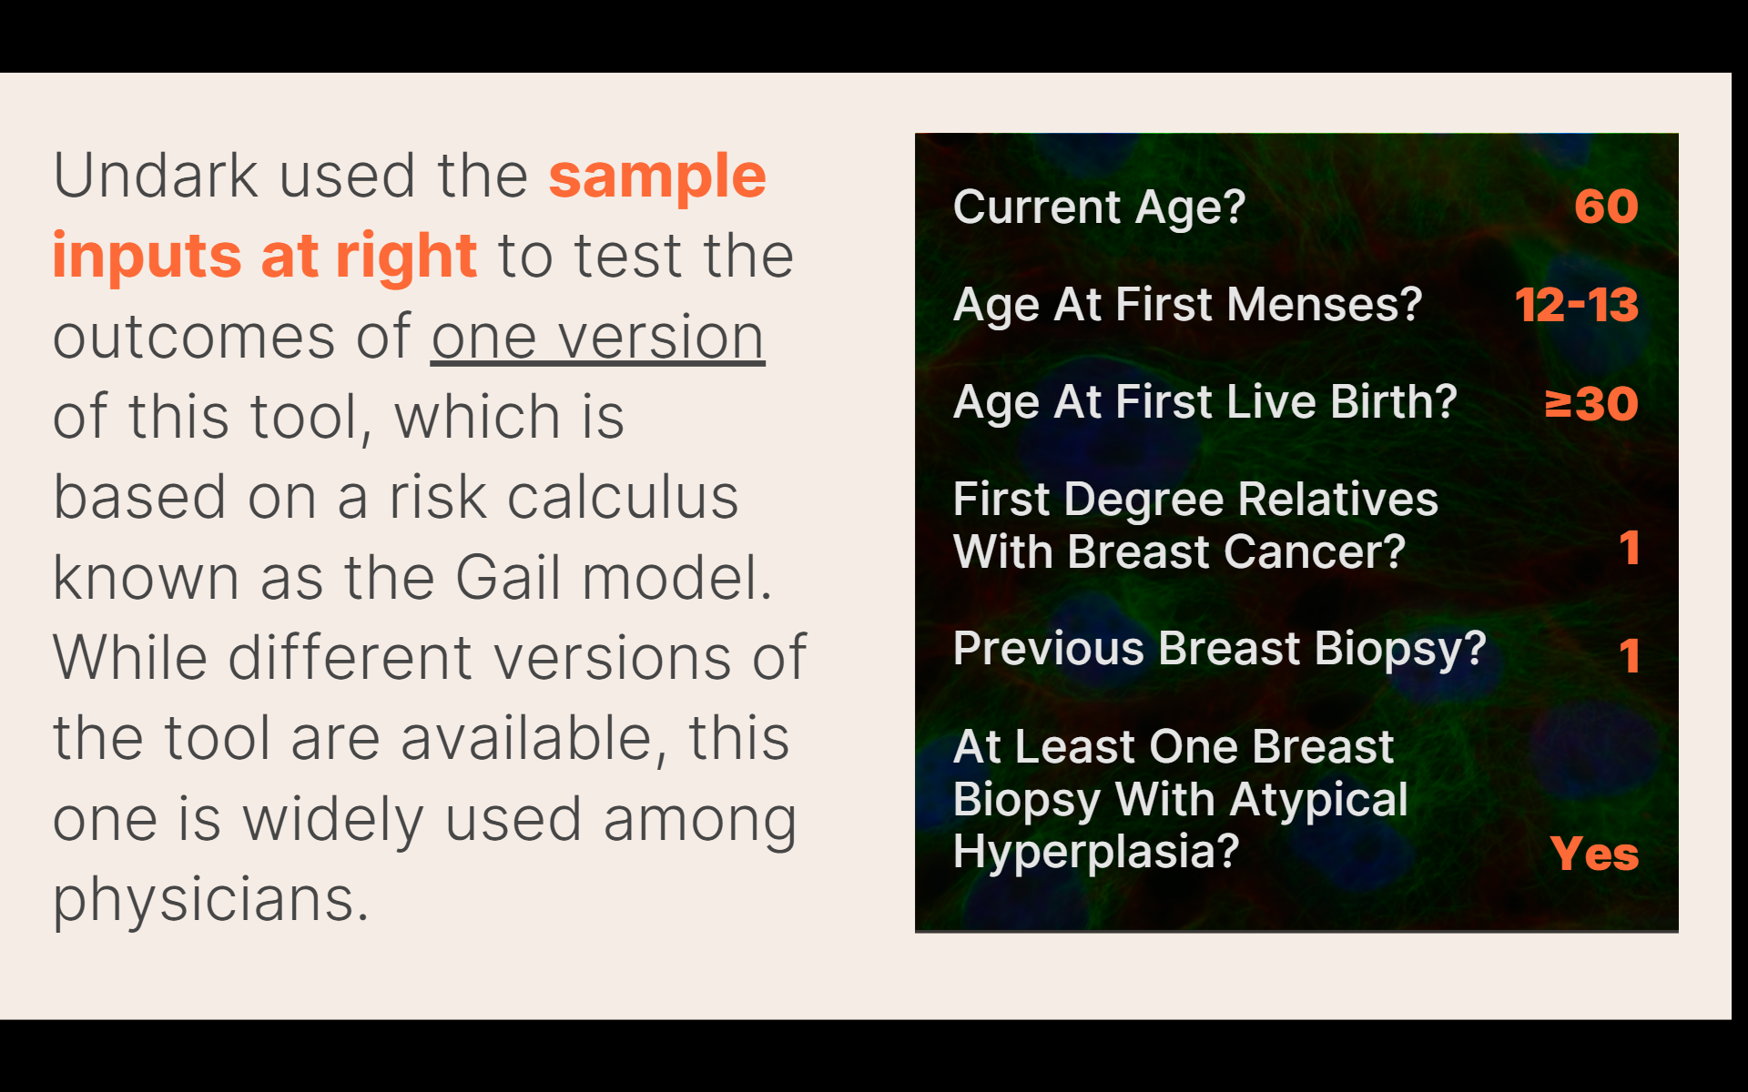
Race in clinical tools: breast cancer
As with kidney function, a tool for breast cancer risk guides clinical decisions
Source: https://race.undark.org/articles/a-crude-tool-how-race-has-influenced-breast-cancer-research

Slide 8
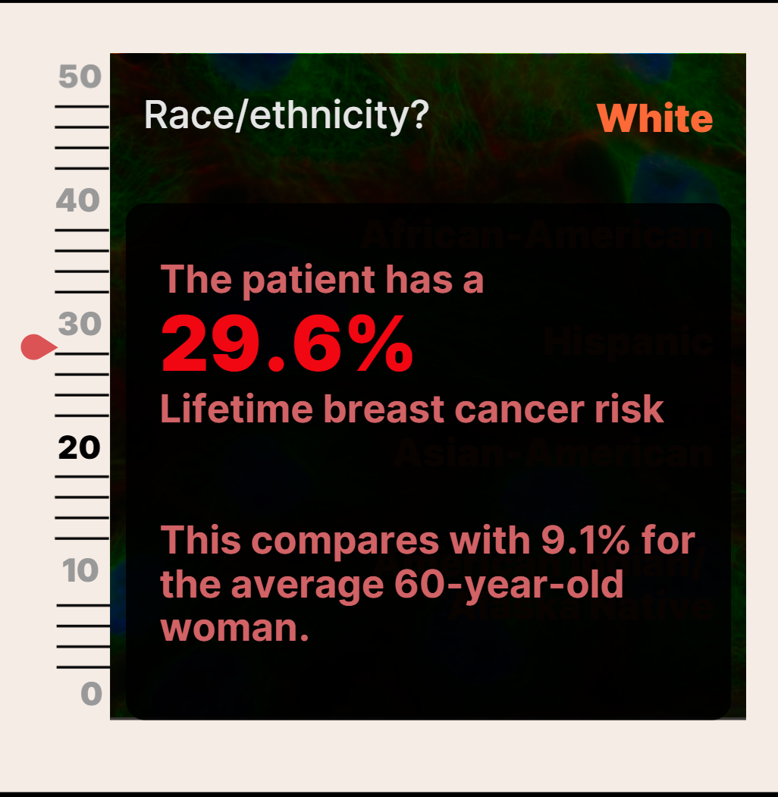
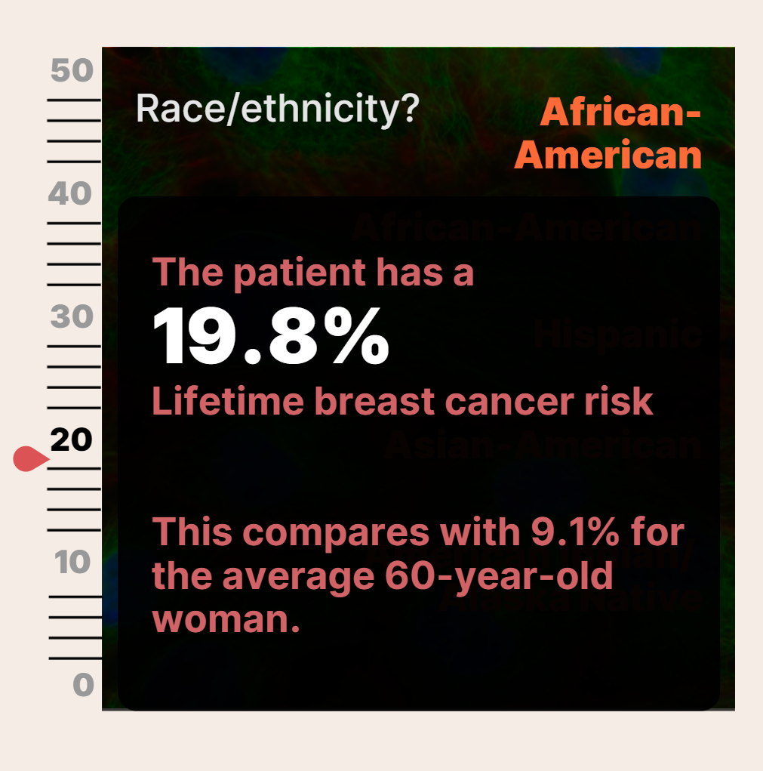
Race in clinical tools: implications
If a woman’s risk is over 20% in this model, current guidelines recommend MRI screening in addition to a yearly mammogram

Slide 9
Pushing past discomfort
Talking about barriers to equity
  Defensiveness, discomfort, pushback
  No different than asking about any other caveats in a study
  Interviews as conversation, not confrontation
Asking about equity increases:
  Accountability
  Transparency
  Accuracy
Places stories in real-world context

Slide 10
Thank you!
Jyoti Madhusoodanan
jyoti@nasw.org

