Slide 1
Unequal Access in Storytelling
Reporting on health + equity
Laura Santhanam | PBS NewsHour | AHCJ | 3.9.2023

Slide 2
About the PBS NewsHour…
Founded in 1973 and based in Arlington, Virginia by Jim Lehrer and Robin MacNeil
Amna Nawaz and Geoff Bennett are our co-anchors.
More than 2 million nightly broadcast viewers nationwide and 7.5 million monthly unique visitors online..
We’re public media, so that means we belong to and serve everyone.

Slide 3
How equity in our mission translates to our reporting
“We believe we are a stronger organization because of a diverse and inclusive newsroom representing a wide variety of backgrounds and life experiences. We further believe that the stories we select and the voices we feature should reflect the diversity of our audiences.”
- PBS NewsHour mission statement

Slide 4
Work in progress
More diverse perspectives in editorial meetings lead to more stories that reflect the lived experiences not only of staff but also audience
Multiple series include Race Matters and Searching for Justice, as well as our continued coverage of social determinants of health
Individual-led efforts to systematically track diversity in sourcing.
Many people in the newsroom are interested in learning about and adopting more systematic ways of tracking diversity and inclusion in reporting.

Slide 5
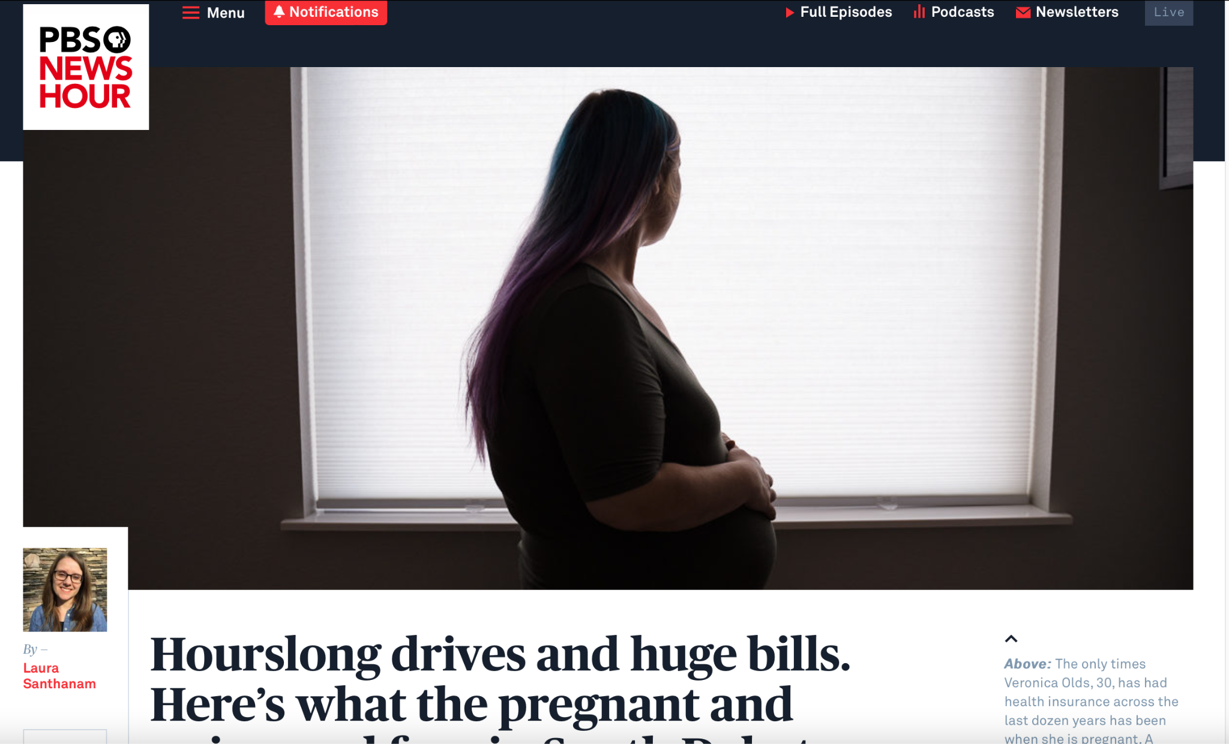
In the field
South Dakota was set to vote on Medicaid expansion months after the state made abortion illegal.
How well was the state taking care of pregnant and postpartum people who were financially vulnerable?
People of color, especially Native people, were disproportionately impacted by the status quo.

Slide 6
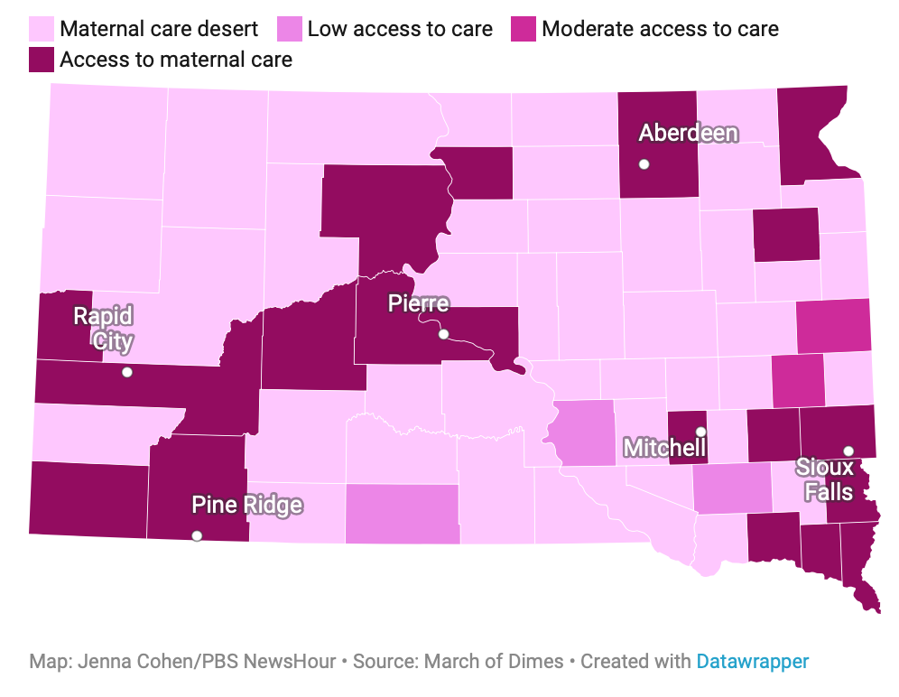
Connecting anecdotes and data
Zoom in, zoom out.
Need focus? Look at the data.

Slide 7
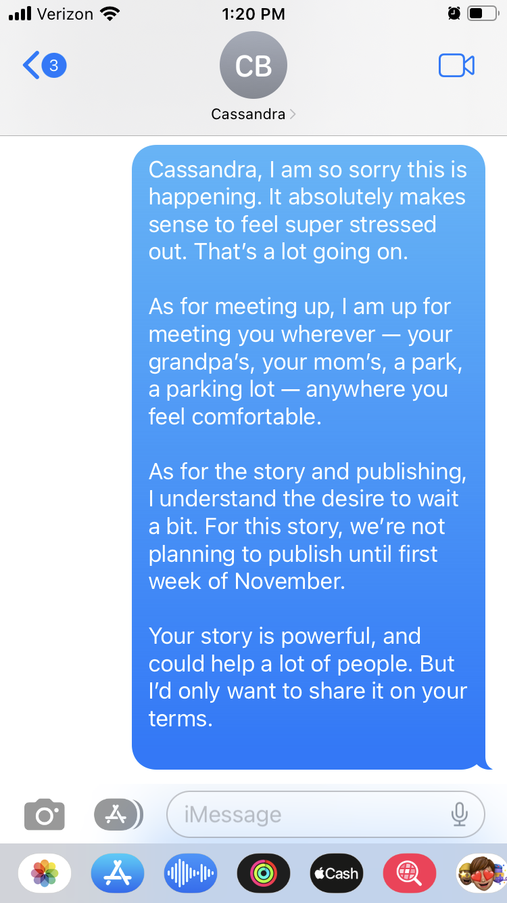
People are more than your next story
‘Respect is just a minimum.’ - Lauryn Hill
A patient never has to share their story. It’s a privilege if they choose to do so.
Someone isn’t talking? Look at your network of sources. Can someone vouch for you? That can go a long way.
‘It’s not in her interest to tell her story right now.’ - Gwen Ifill

Slide 8
Voices matter
Who is the story about? Talk to them!
Data can show trends, but each datapoint is a person’s life.
Building trust takes time and work, but it’s worth it.
Listen.

Slide 9
Thank you so much!
If you have questions or comments, please contact me!
Email: lsanthanam@newshour.org
Twitter: @LauraSanthanam
Mastodon: @laurasanthanam@newsie.social

