Slide 1
Diversity in Sourcing
Adding context on equity and access to health stories
Brittany Trang, STAT News
AHCJ 2023

Slide 2
Increasing diversity isn’t pandering. Increasing diversity results from examining our assumptions about what and whom we consider default, important, expert.

Slide 5
Finding “diverse sources” is the same as finding “normal sources”
It’s easy to find people who have been quoted before, and those people get quoted again. Find a new person!
If you need a source with a specific background or focus, you look really hard to find them, even if there aren’t many!
We all want sources with different perspectives on a topic. How different can your sources’ perspectives be if they’re all the same kind of person?
disability status | ZIP code | patient | non-MD, -PhD | community member
uninsured | religion | advocate | career stage | sexual orientation
undocumented | weight | nurse | age | socioeconomic background

Slide 6
Diverse sources aren’t just for stories about “that kind of person”
People from underrepresented groups have heart attacks and Alzheimer’s too
Will find under-reported angles by increasing diversity of sources
Specialty months: Breast cancer doesn’t exist only in October. Hispanic people also exist outside of Sep 15 – Oct 15.

Slide 7
Ways to increase source diversity
Think about who’s an authoritative source in more than one way
disability status | ZIP code | patient | non-MD, -PhD | community member
uninsured | religion | advocate | career stage | sexual orientation
undocumented | weight | nurse | age | socioeconomic background

Slide 8
Ways to increase source diversity
Directly ask PIOs: You already ask for “can I talk to someone who specializes in treating X”!
“I’m looking to feature these voices”
“We’re trying to make sure our coverage is representative of the population”
“Can you still talk to the dean?” “Yes, but I might not quote them; don’t want to waste anyone’s time.”

Slide 9
Ways to increase source diversity
Databases of sources from underrepresented populations
diversesources.org
gage.500womenscientists.org
Women in Microbiology
Female neuroscientists: anneslist.net
#DiverseBioethics
NPR Diverse Sources Database: training.npr.org/sources

Slide 10
Ways to increase source diversity
Video discussion panels
Searching for identity-based groups or lists
Association of Black Cardiologists
AMA Advisory Committee on LGBTQ Issues
Top 25 Women in AI: US Healthcare and Pharma Edition

Slide 11
I Spent Two Years Trying to Fix the Gender Imbalance in My Stories: Ed Yong, The Atlantic, 2018

Slide 12
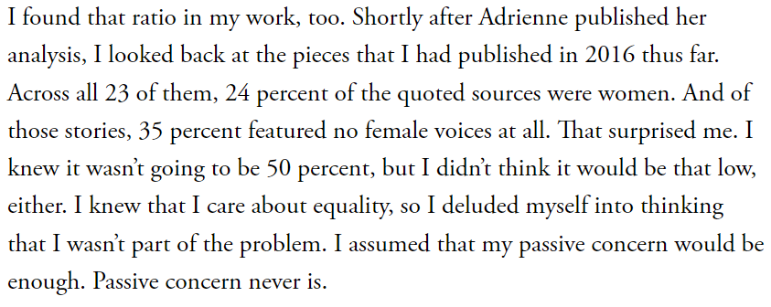
I Spent Two Years Trying to Fix the Gender Imbalance in My Stories: Ed Yong, The Atlantic, 2018

Slide 13
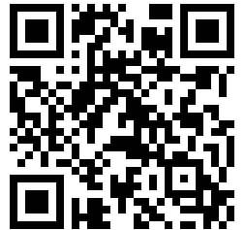
Source Tracking at STAT News
Name
STAT reporter that you spoke with or STAT podcast you appeared on
Which most closely describes your gender?
What is your race/ethnicity? (Select all that apply)
“I have one additional ask for you: At STAT, we're working to make sure the voices highlighted in our stories are representative of the world around us, and so we're asking all sources to fill out this brief, voluntary survey. If you have a moment and feel comfortable, we'd really appreciate your help. Any information you provide will be used for internal purposes only and won't be shared on our site or beyond STAT.”
STAT Source Survey

Slide 14
Source Tracking at STAT News (my results)
I need to audit my pieces to get a rough idea of where I am, since not everyone fills out the survey
I need to do a better job of asking for people’s pronouns when interviewing people
I need to do better at interviewing non-white, non-Asian people

Slide 15
Source Tracking Resources
https://www.theopennotebook.com/guide-to-tracking-source-diversity/
https://www.chalkbeat.org/2022/6/14/23167914/free-tool-journalism-track-source-diversity-source-auditing-newsrooms
https://training.npr.org/2021/07/21/diverse-sources-tracking-script-questions/

Slide 16
Transparency and Empathy
DART Center for Journalism and Trauma: Tip sheets for interviewing in the aftermath of trauma
Explain how journalism works: make sure you are on the same page about whether you can use their name if they are a sensitive source; what on the record/background/off the record mean; if you’ll contact them before the piece gets published, etc.
Don’t push your sources into a pre-conceived box; ask them what they think is important and what you need to understand

Slide 17
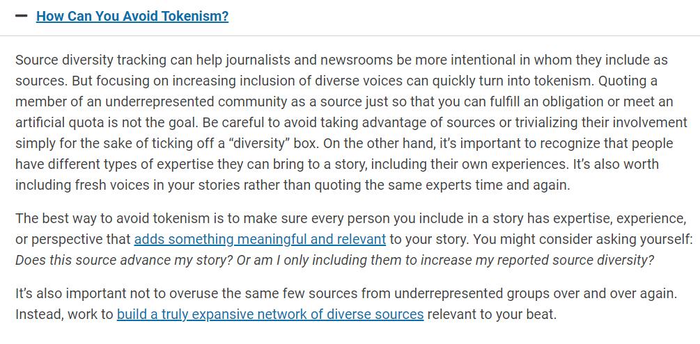
Avoiding tokenism
https://www.theopennotebook.com/guide-to-tracking-source-diversity/

Slide 18
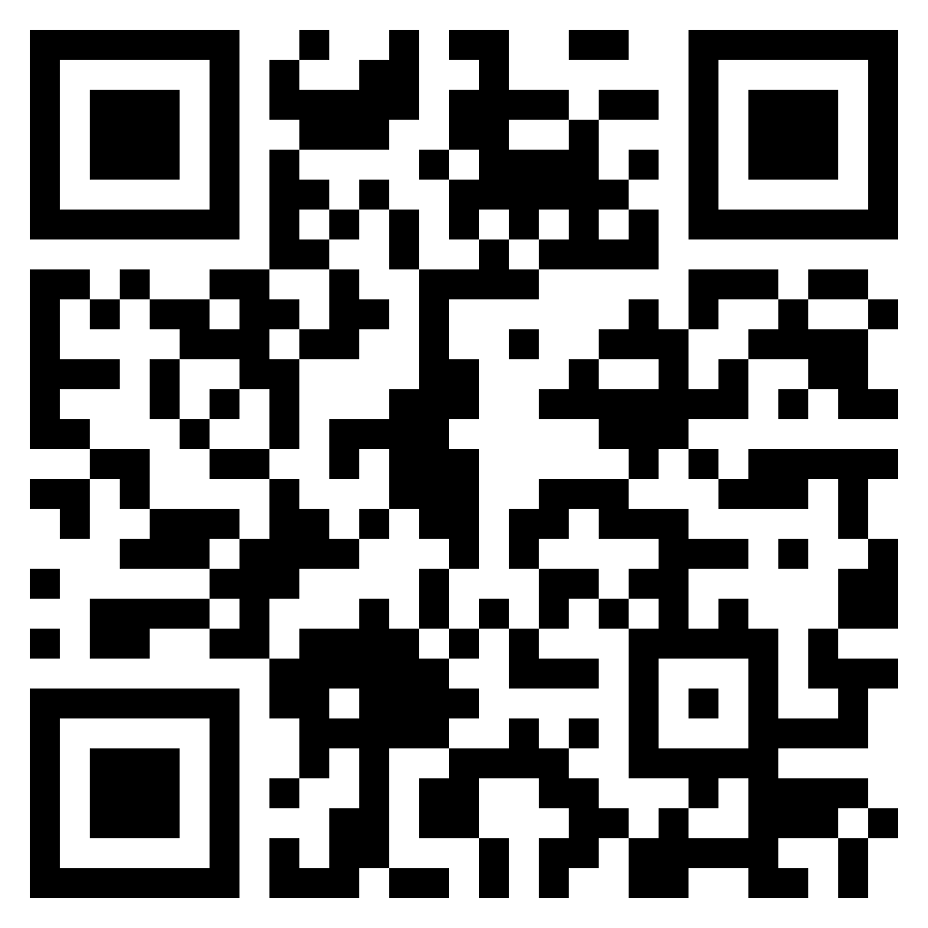
Thanks!
Usha McFarling (STAT)
Patti Wolter (Northwestern Medill)
Emma Yasinski + AHCJ
You can find me at:
@brittanytrang
@brittanytrang@newsie.social
brittanybtrang@gmail.com
brittanytrang.com
business card + website link!

