Slide 1
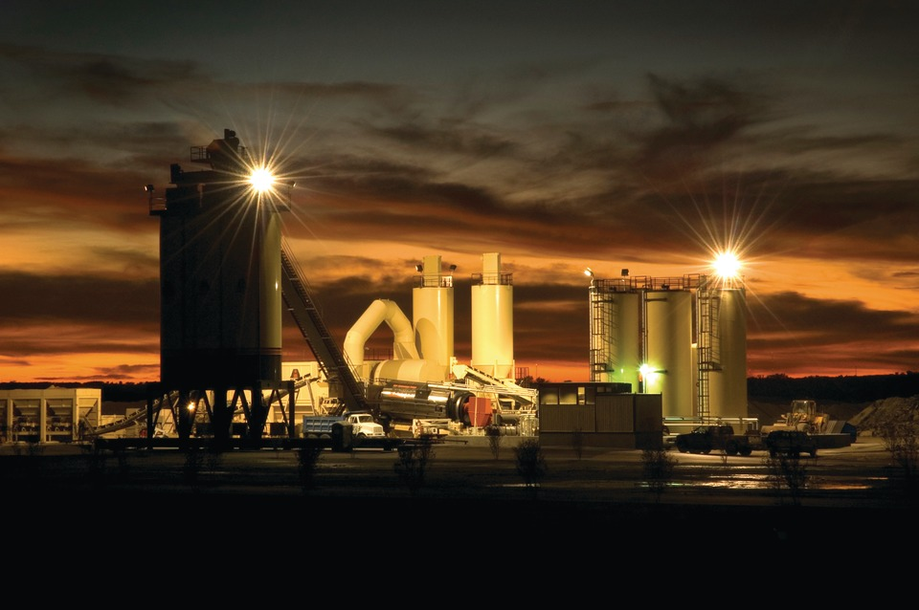
Howie Moseley State Bituminous Materials Engineer
Florida Department of
TRANSPORTATION
State of the Industry

Slide 2
My Contact Information

Slide 3
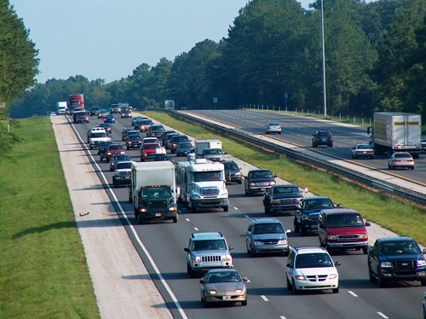
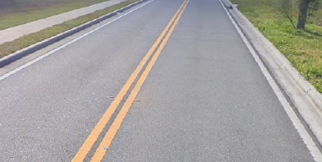
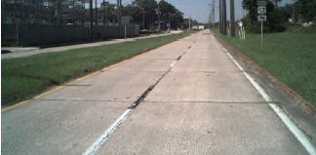
State Highway System
44,975 lane miles
8,677 interstate lane miles (19%)
33,937 arterial lane miles (76%)
2,361 Turnpike lane miles (5%)
97.3% of pavement is asphalt
2.7% of pavement is concrete

Slide 4
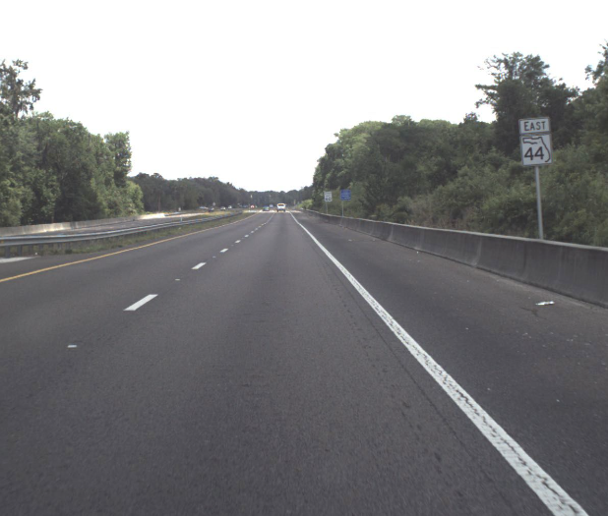
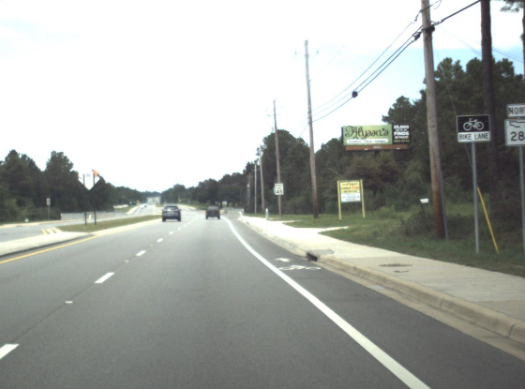
Asphalt Surfaces
50.4% of asphalt surfaces are dense graded (by lane mile)
49.6% of asphalt surfaces are open graded

Slide 5
Asphalt Producers for Florida
 | In-State | Out-of-State
Asphalt Plants | 97 | 2
Asphalt Contractors | 38 | 2
Asphalt Binder Terminals | 15 | 10
Asphalt Emulsion Terminals | 5 | 8

Slide 6
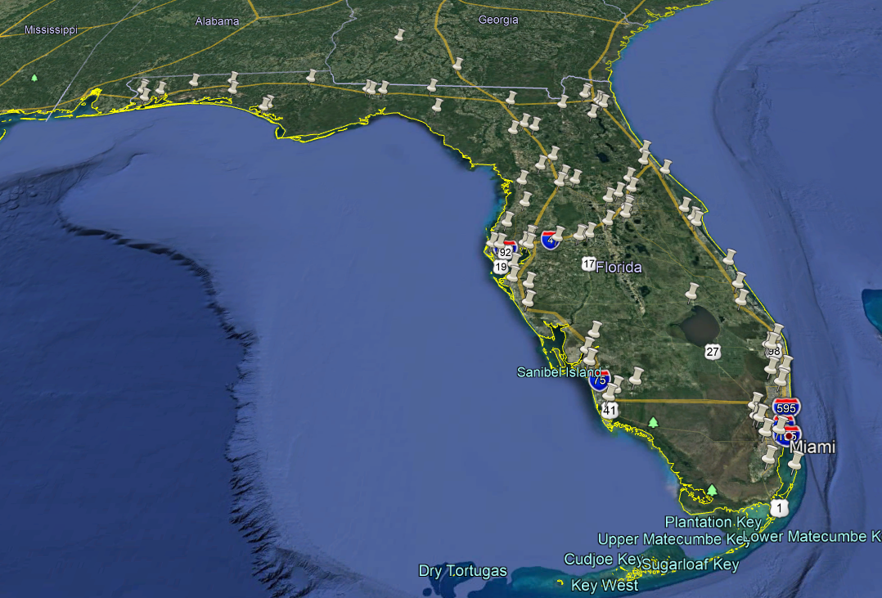
Approved Asphalt Plants

Slide 7
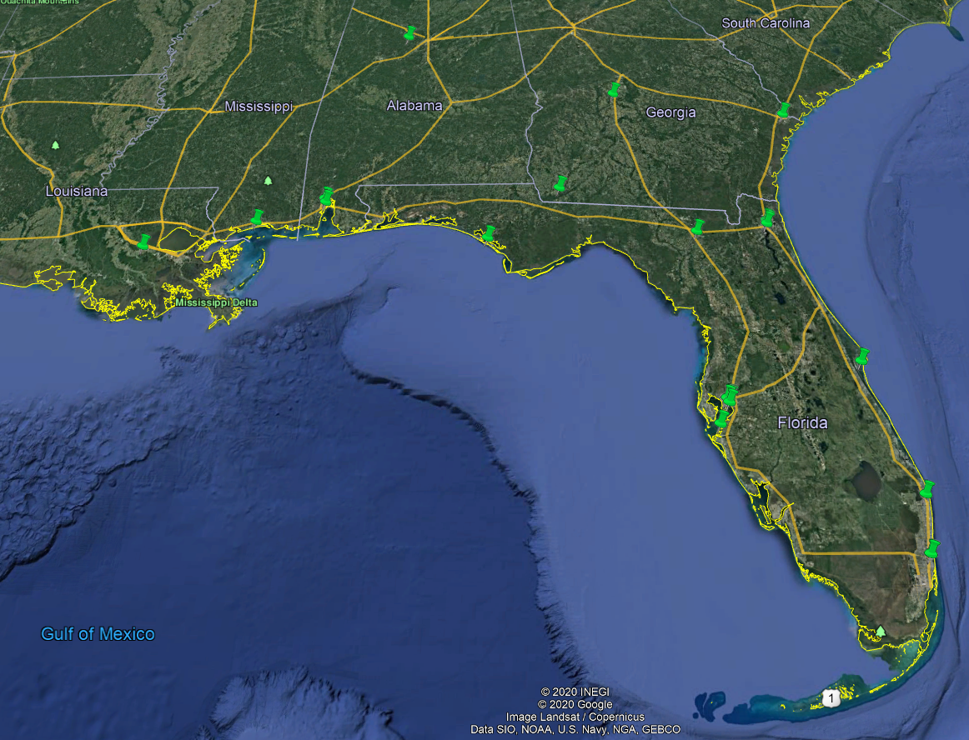
Approved Asphalt Binder Terminals

Slide 8
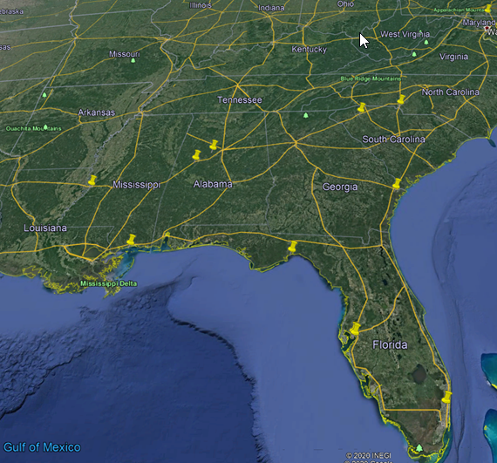
Approved Asphalt Emulsion Terminals

Slide 9
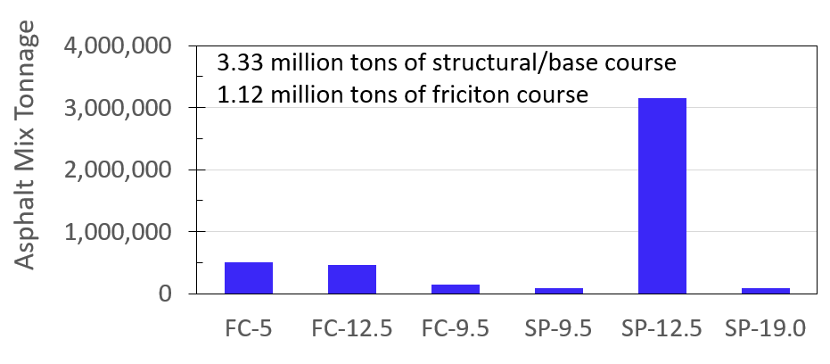
Asphalt Mix Tonnage (FY 19/20)
Friction |  |  | Structural |  |  | Total
FC-5 | FC-12.5 | FC-9.5 | SP-9.5 | SP-12.5 | SP-19.0
505,791 | 460,602 | 146,268 | 91,902 | 3,155,161 | 86,366 | 4,447,880

Slide 10
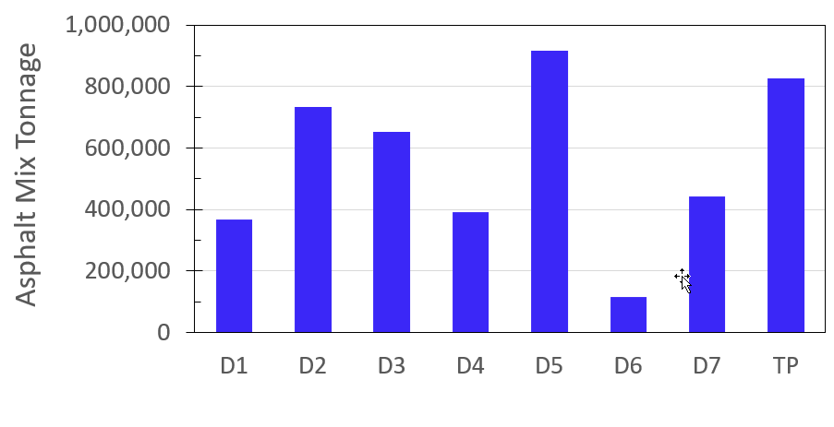
Asphalt Tonnage By District (FY 19/20)

Slide 11
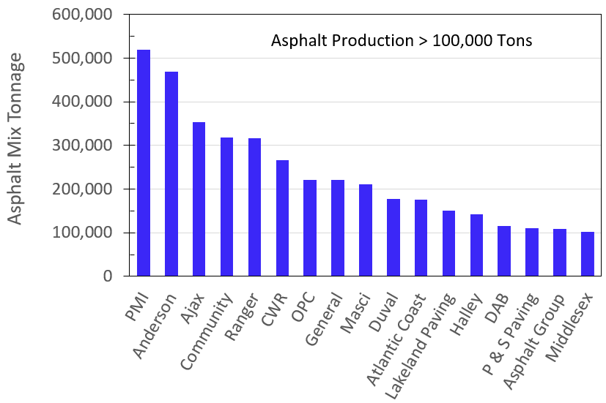
Asphalt Tonnage By Producer (FY 19/20)

Slide 12
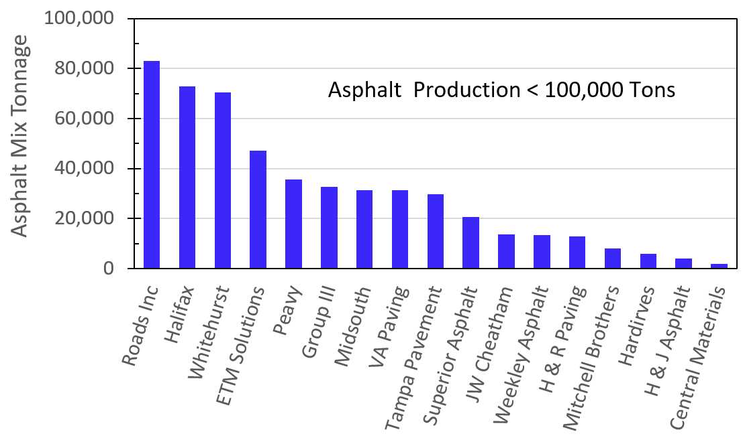
Asphalt Tonnage By Producer (FY 19/20)

Slide 13
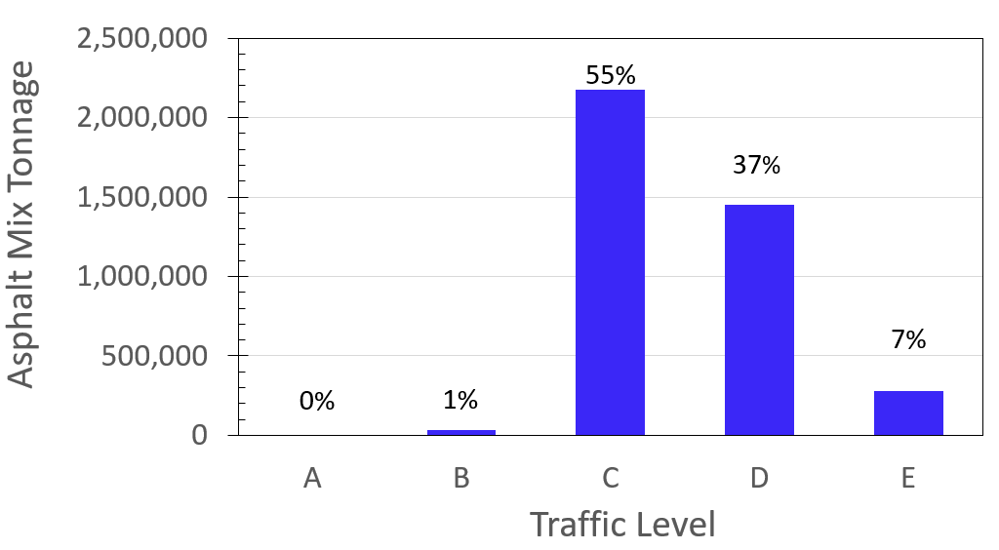
Mix Tonnage By Traffic Level (FY 19/20)

Slide 14
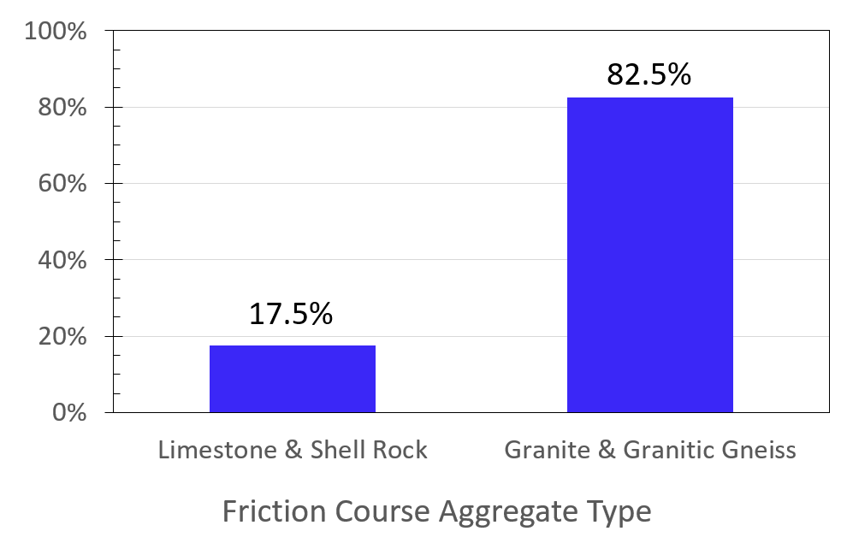
Friction Course Aggregate Type (FY 19/20)

Slide 15
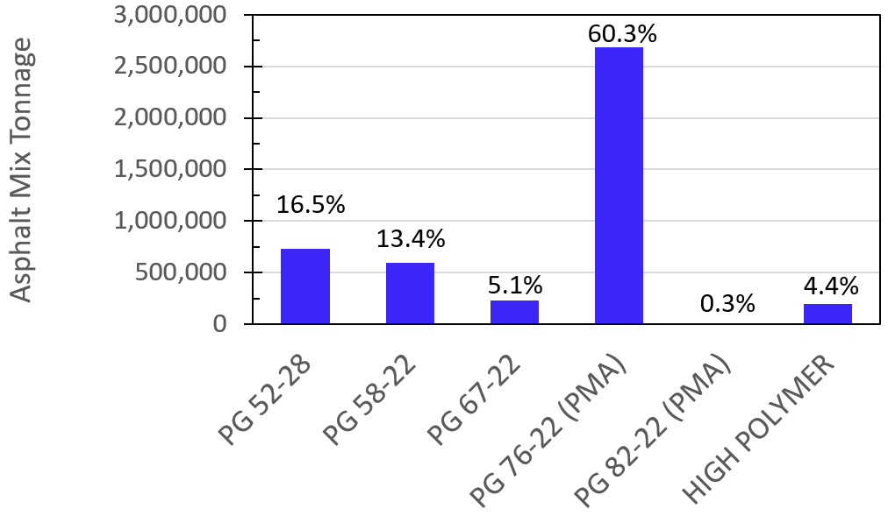
Mix Tonnage By Binder Type (FY 19/20)
Total mix tonnage 4,447,880

Slide 16
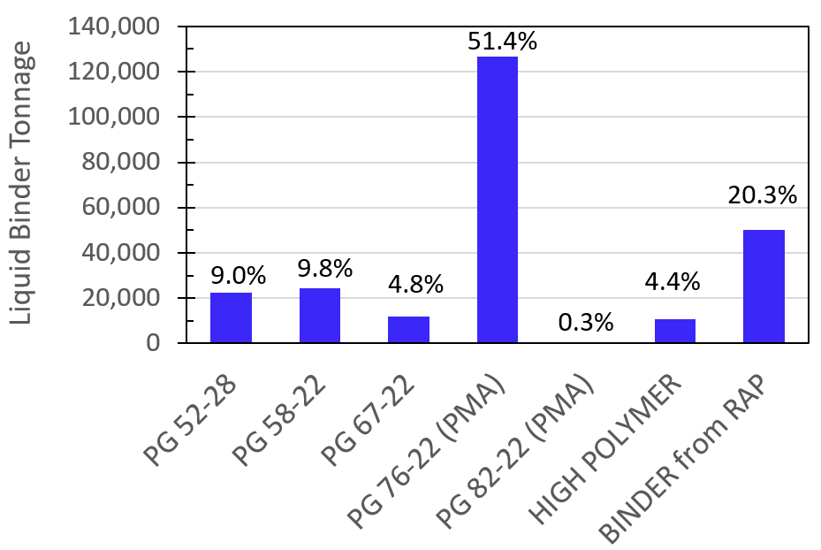
Binder Tonnage (FY 19/20)
Total binder tonnage 246,921

Slide 17
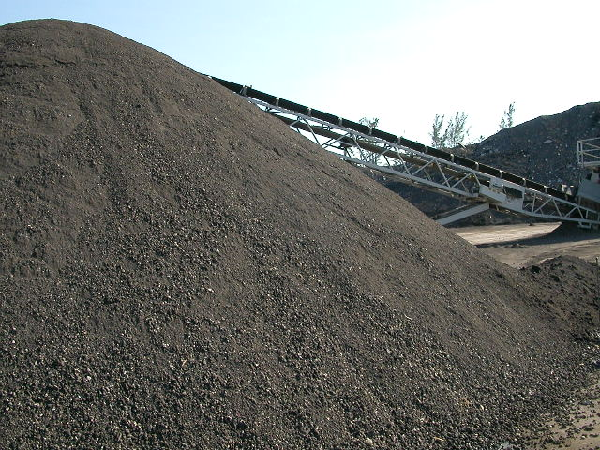
RAP Usage
- 775,000 Tons of RAP
- 50,000 Tons of Binder from RAP
- 725,000 Tons of Aggregate from RAP

Slide 18
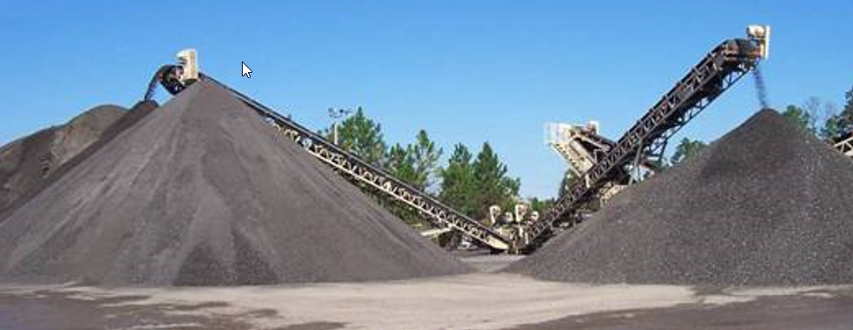
RAP Usage
Condition | FY 11/12 | FY 12/13 | FY 13/14 | FY 14/15 | FY 15/16 | FY 16/17 | FY 17/18 | FY 18/19 | FY 19/20
Unrestricted (no limit)
Average | 26% | 25% | 29% | 24% | 29% | 27% | 24% | 25% | 24%
Maximum | 38% | 39% | 45% | 50% | 50% | 50% | 50% | 50% | 50%
Restricted (Max 20%)
Average | 18% | 16% | 19% | 20% | 20% | 19% | 19% | 19% | 18%
Maximum | 20% | 20% | 20% | 20% | 20% | 20% | 20% | 20% | 20%

Slide 19
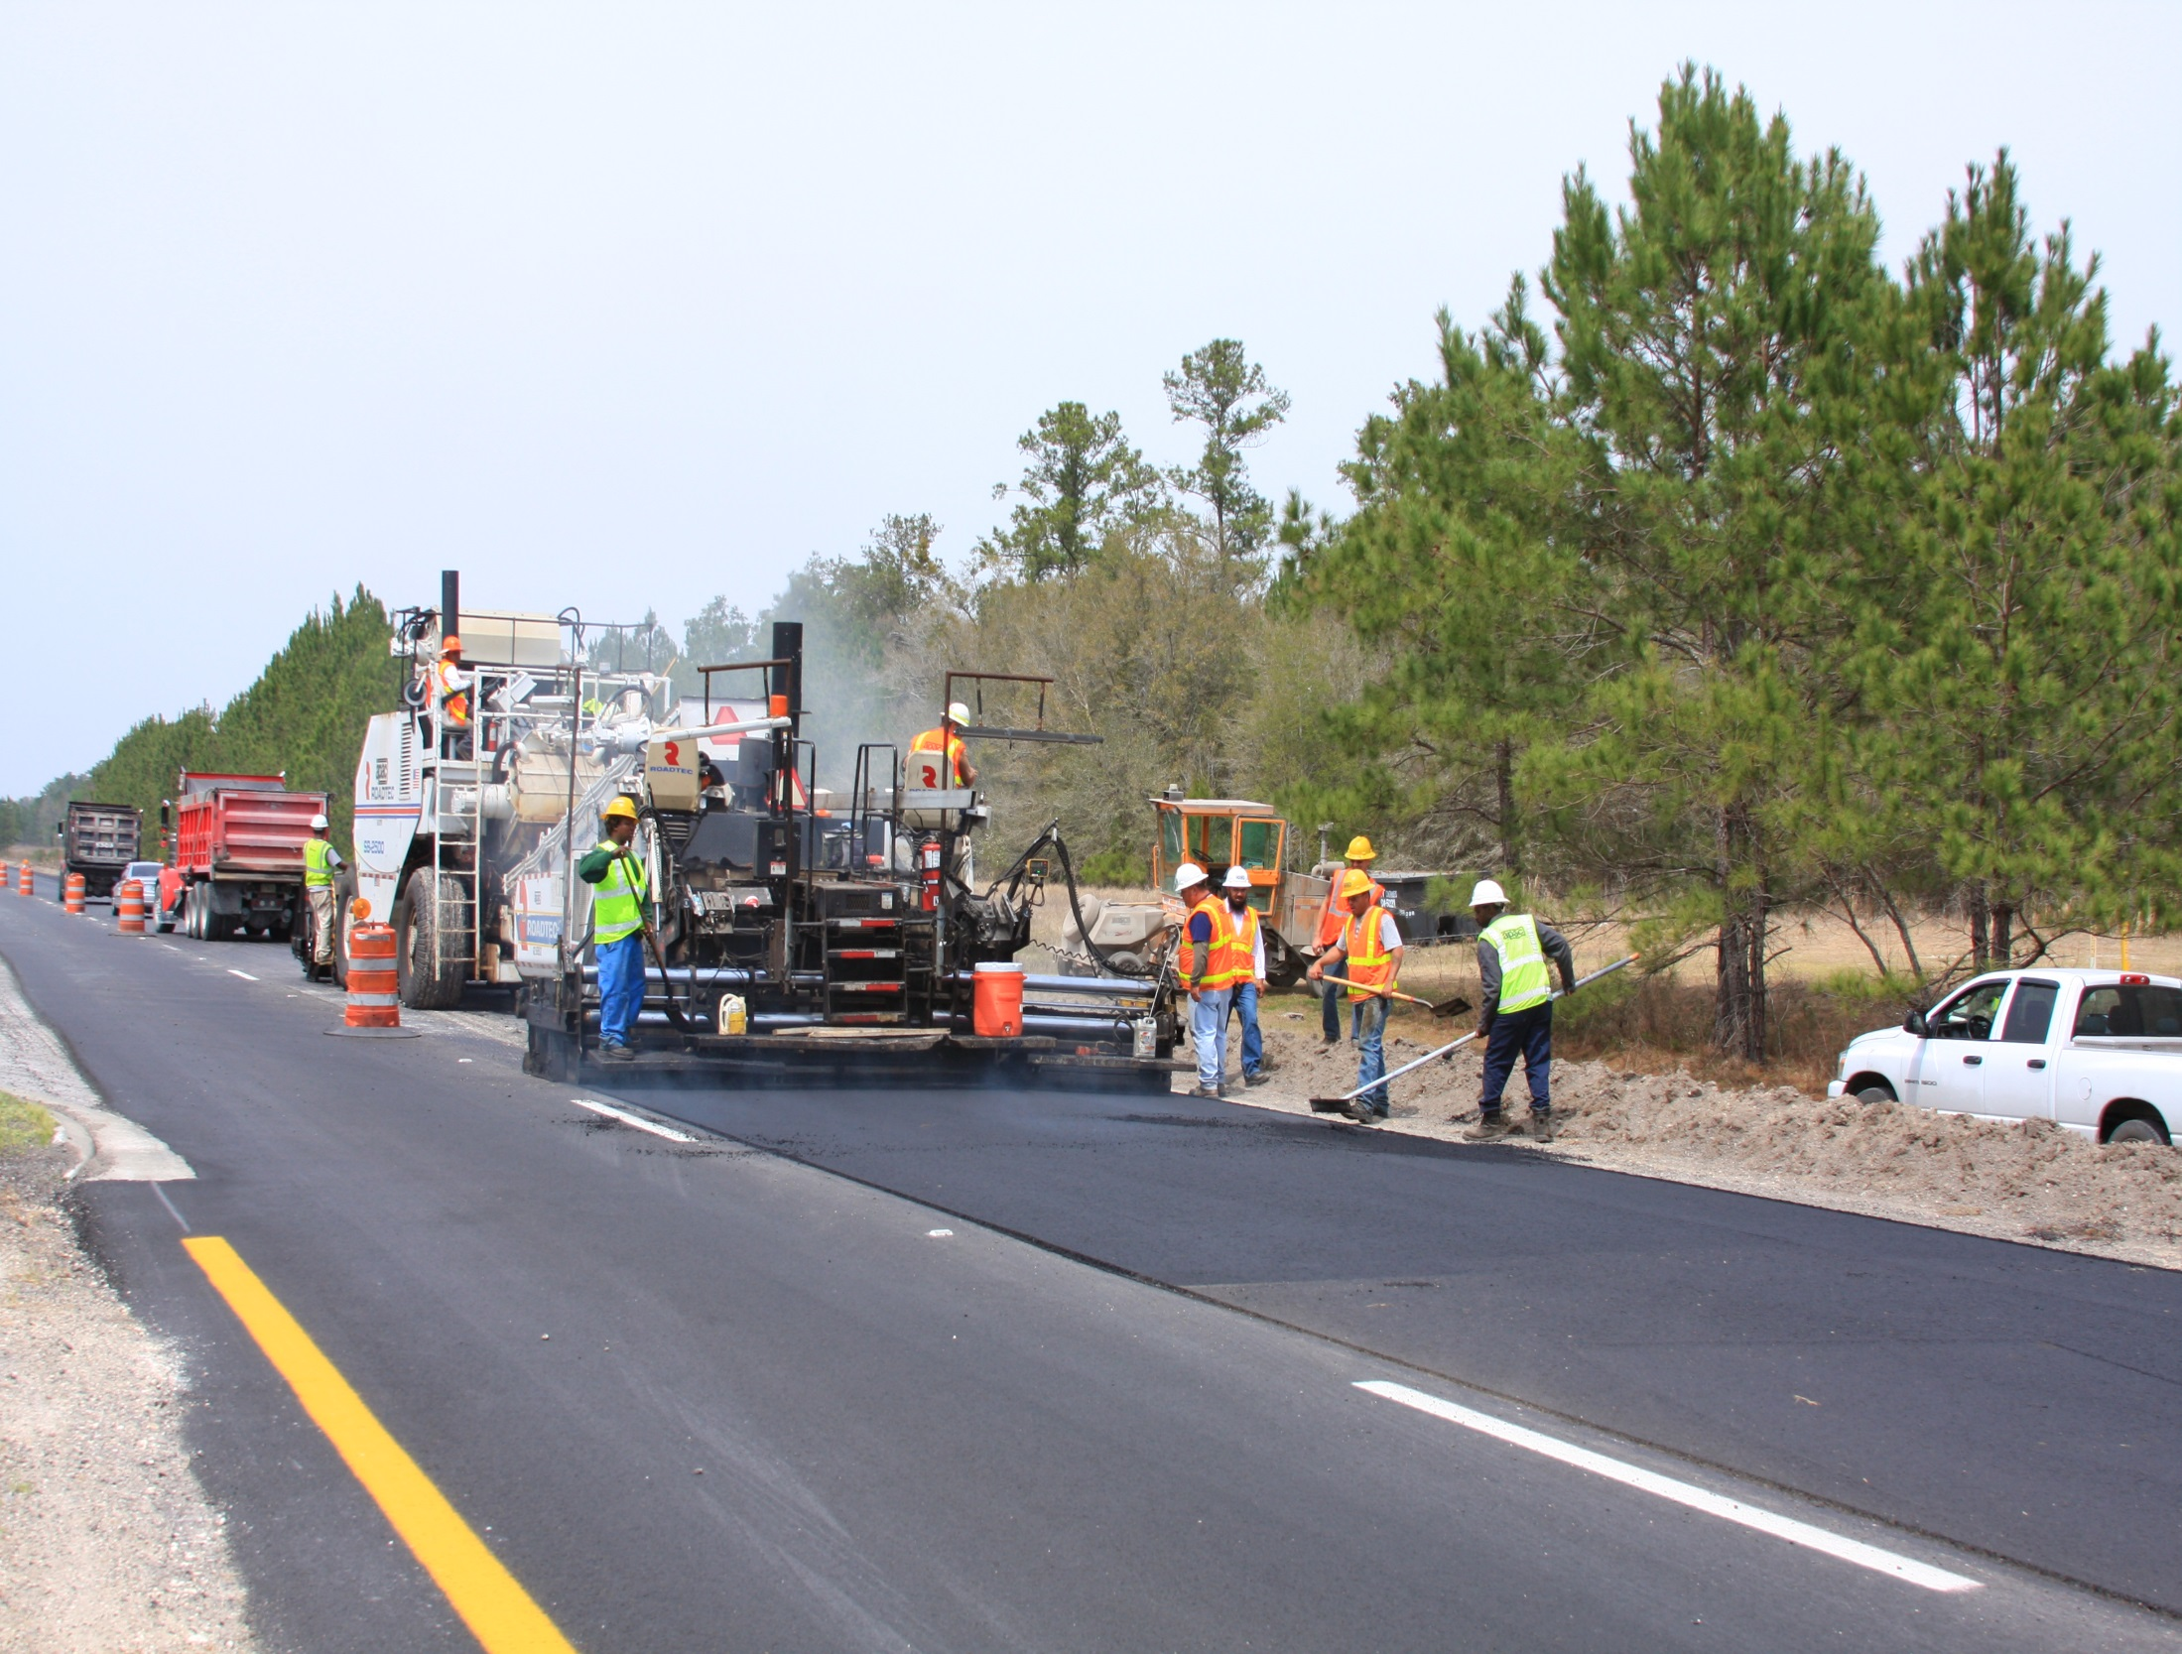
Asphalt Mix Cost

Slide 20
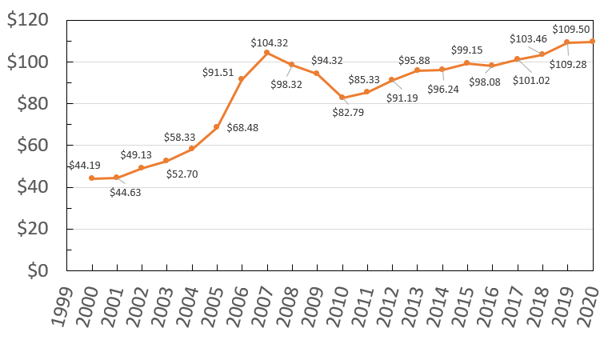
Asphalt Mix Weighted Average Cost ($/ton)

Slide 21
Asphalt Binder Cost

Slide 22
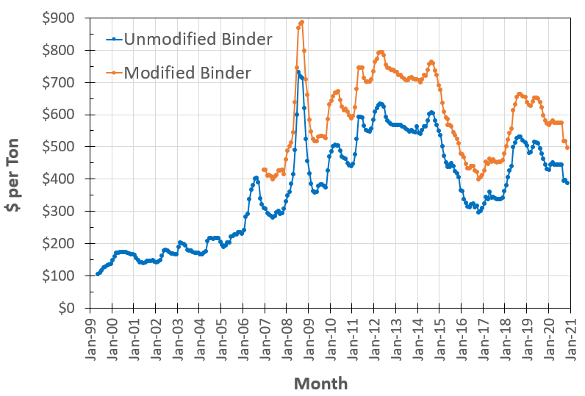
Asphalt Price Index

Slide 23
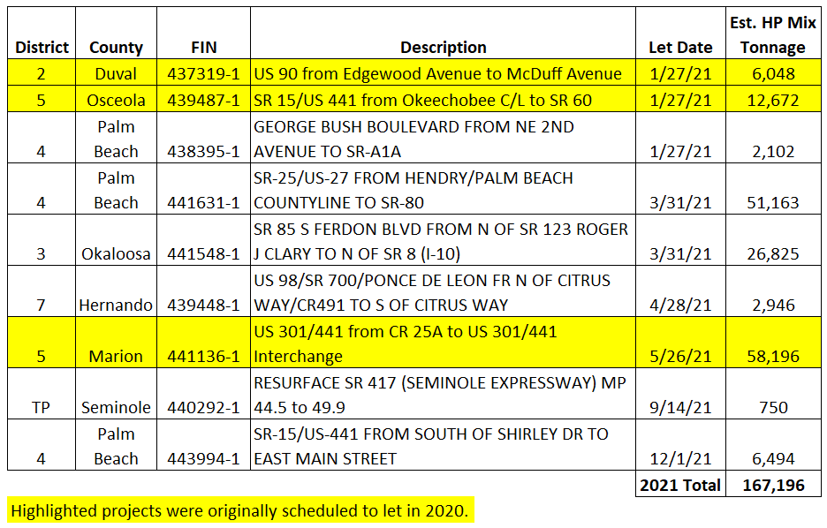
2021 High Polymer Binder Forecast

Slide 24
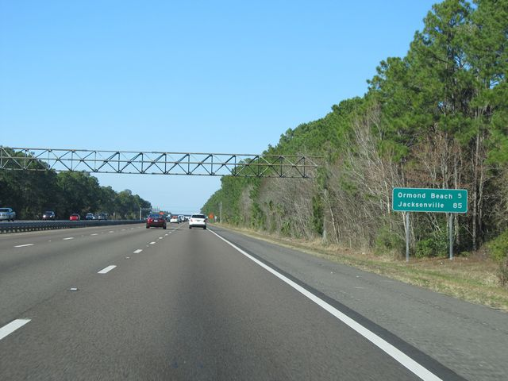
Pay Factor Data

Slide 25
Composite Pay Factor (CPF) Data
Statewide Average CPF
FY 19/20: 1.018
FY 18/19: 1.016
FY 17/18: 1.016
FY 16/17: 1.013
FY 15/16: 1.009
FY 14/15: 1.018
FY 13/14: 1.019
FY 12/13: 1.011

Slide 26
Composite Pay Factor (CPF) Data
Dense Graded Pay Factor Data
FY | Density | AC | Air Voids | #8 Sieve | #200 Sieve | CPF
19/20 | 1.000 | 1.032 | 1.027 | 1.003 | 1.033 | 1.018
18/19 | 0.992 | 1.025 | 1.021 | 1.001 | 1.028 | 1.015
17/18 | 0.999 | 1.032 | 1.023 | 1.002 | 1.027 | 1.016
16/17 | 0.992 | 1.031 | 1.024 | 0.997 | 1.025 | 1.013
15/16 | 0.994 | 1.023 | 1.013 | 1.003 | 1.019 | 1.009
14/15 | 1.004 | 1.029 | 1.024 | 0.998 | 1.031 | 1.018
13/14 | 1.003 | 1.031 | 1.026 | 1.011 | 1.030 | 1.020

Slide 27
Composite Pay Factor (CPF) Data
Open Graded Pay Factor Data
FY | AC | 3/8” Sieve | #4 Sieve | #8 Sieve | CPF
19/20 | 1.019 | 1.020 | 1.020 | 1.012 | 1.019
18/19 | 1.007 | 1.021 | 1.019 | 1.011 | 1.018
17/18 | 1.012 | 1.017 | 1.013 | 1.013 | 1.014
16/17 | 1.011 | 1.012 | 1.015 | 1.018 | 1.014
15/16 | 1.004 | 1.005 | 1.002 | 1.013 | 1.004
14/15 | 1.019 | 1.021 | 1.018 | 1.026 | 1.019
13/14 | 1.015 | 1.007 | 1.009 | 1.032 | 1.014

Slide 28
FY 19/20 Top Producer CPF (>100,000 tons)
#1 Preferred Materials (1.0361)
#2 General Asphalt (1.0274)
#3 Halley Engineering (1.0267)

Slide 29
FY 19/20 Top Producer CPF (25,000-100,000 tons)
#1 Group III (1.0413)
#2 Peavy & Son (1.0394)
#3 Asphalt Group (1.0385)

Slide 30
Quality Control That Adds Value

Slide 31
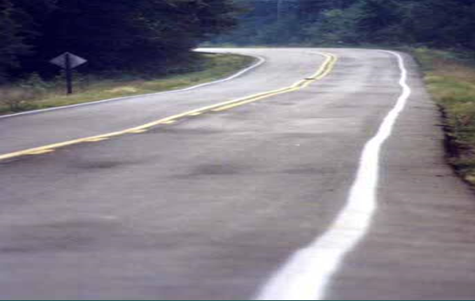
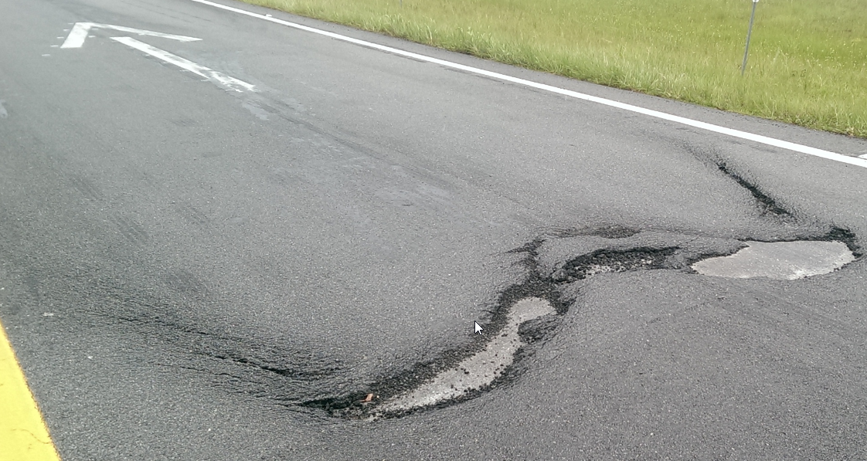
Quality Control That Adds Value

Slide 32
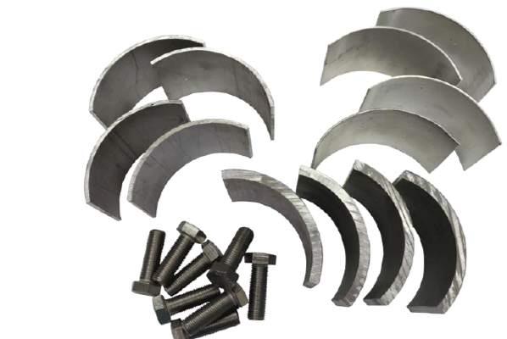
Quality Control That Adds Value
Bond Strength Testing
Most contractors already have a Marshall test press
Every contractor already cuts cores
The only other equipment that is needed is the interlayer bond strength tester and shims

Slide 33
Quality Control That Adds Value
Use test results for information purposes
Can help assess the effectiveness of your paving operations and minimize potential warranty issues
FM 5-599: Determining the Interlayer Bond Strength Between Asphalt Pavement Layers
https://fdotwww.blob.core.windows.net/sitefinity/docs/default-source/materials/administration/resources/library/publications/fstm/methods/fm5-599.pdf?sfvrsn=f8e357fc_4

Slide 34
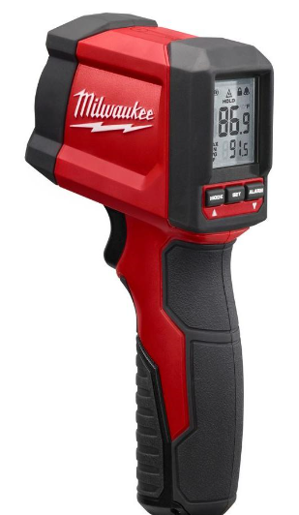
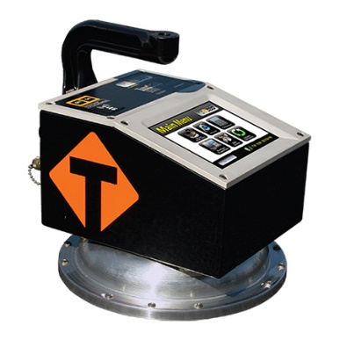
Quality Control That Adds Value
End of Load Segregation
You can’t always see it while your paving
But you can see what causes it
Monitor the temperature of the mix behind the screed from truck exchanges
Excessive differences in mixture temperature should be addressed by evaluating the density in the area in question and adjusting the paving operations accordingly

Slide 35
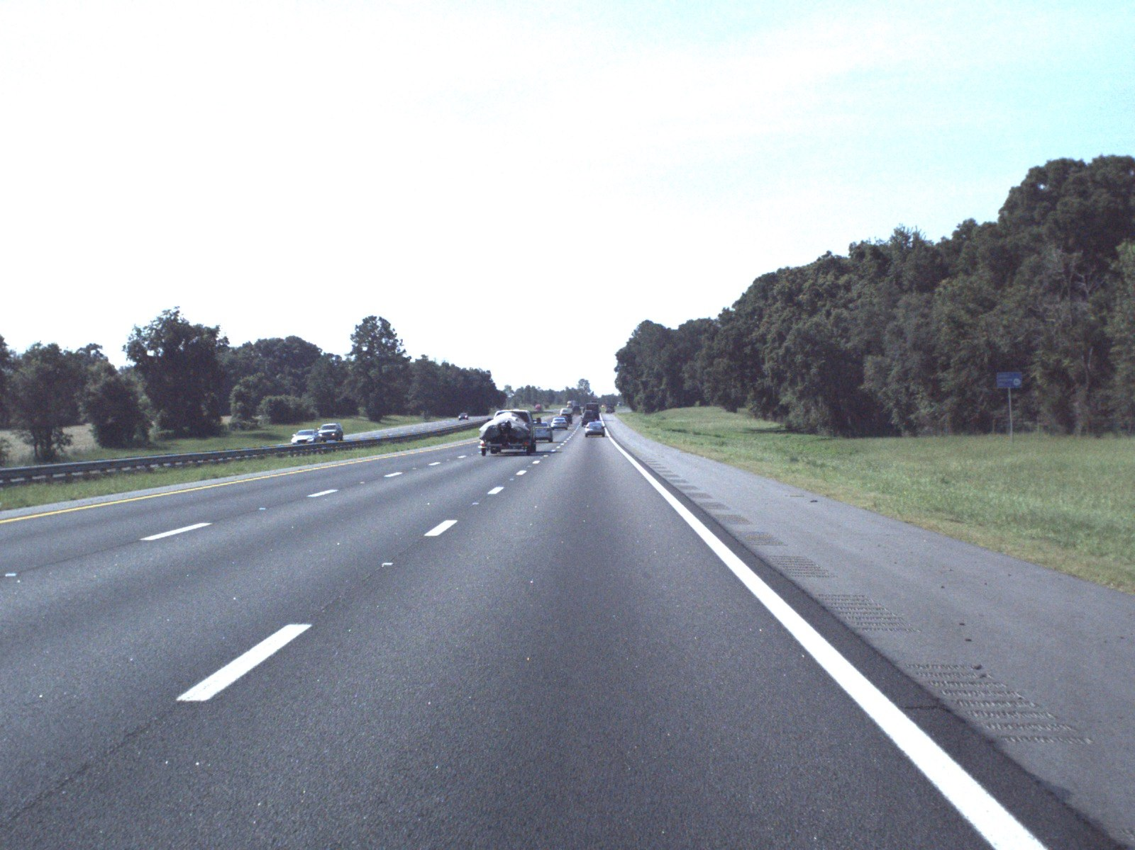
Pavement Performance

Slide 36
Statewide Pavement Performance
Statutory Requirement
Ensure 80% of pavement on the State Highway System meets Department standards.
Deficient Pavements (%)
Criteria | 2010 | 2011 | 2012 | 2013 | 2014 | 2015 | 2016 | 2017 | 2018 | 2019 | 2020
Overall | 12.4 | 11.1 | 9.4 | 8.4 | 7.3 | 7.7 | 8.5 | 8.2 | 8.7 | 12.6 | 12.5
Ride | 2.6 | 2.6 | 1.9 | 2.1 | 1.7 | 2.0 | 1.3 | 1.2 | 1.1 | 1.4 | 1.3
Crack | 10.9 | 9.7 | 7.9 | 6.8 | 6.0 | 6.4 | 7.3 | 7.1 | 7.7 | 11.4 | 11.4
Rut | 0.6 | 0.6 | 0.5 | 0.5 | 0.4 | 0.4 | 0.3 | 0.2 | 0.3 | 0.3 | 0.3

Slide 37
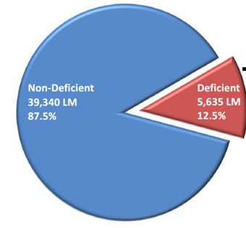
Deficient Pavements by Facility Type
Roadway | Interstate | Arterials | Turnpike
Lane Miles | 8,677 | 33, 937 | 2, 361
Deficient Lane Miles | 699 | 4,758 | 178
% Lane Miles Deficient | 8.1% | 14.0% | 7.5%

Slide 38
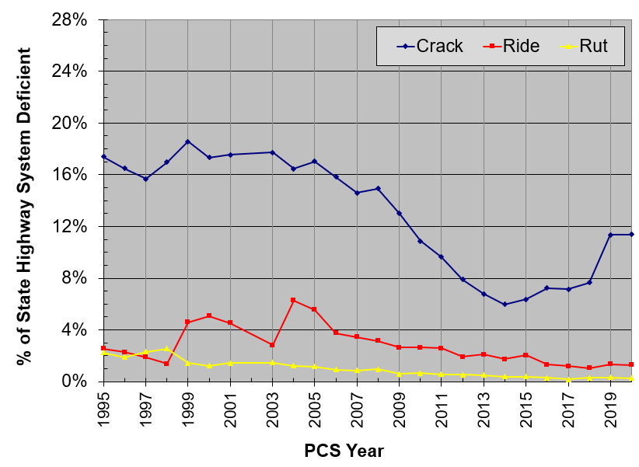
Historical Statewide Performance

Slide 39
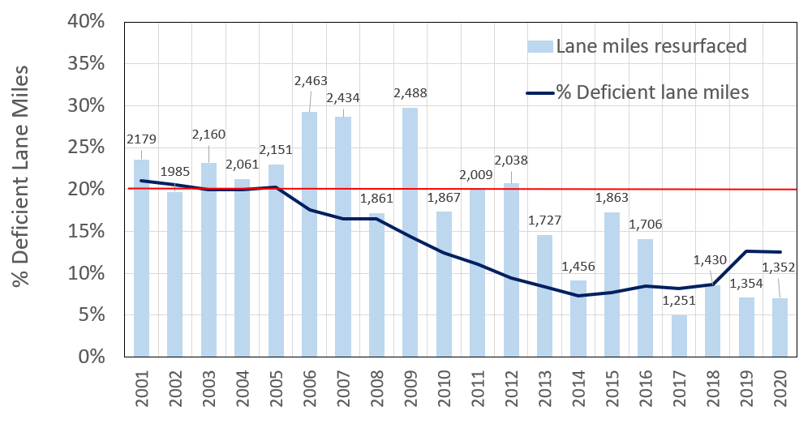
Lane Miles Resurfaced and Deficient Lane Miles

Slide 40
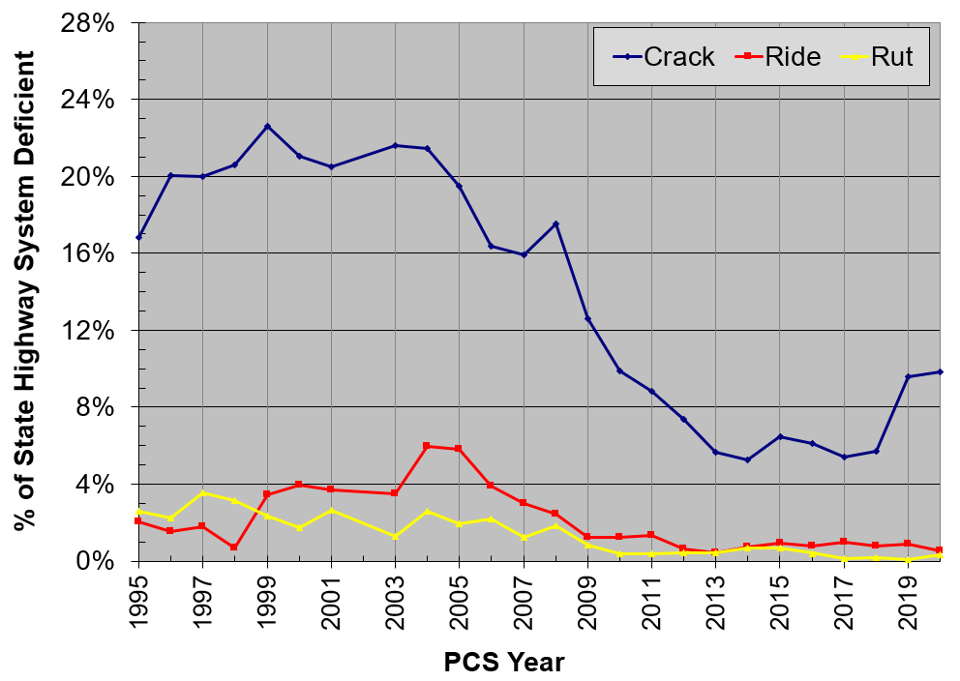
District 1 Historical Performance

Slide 41
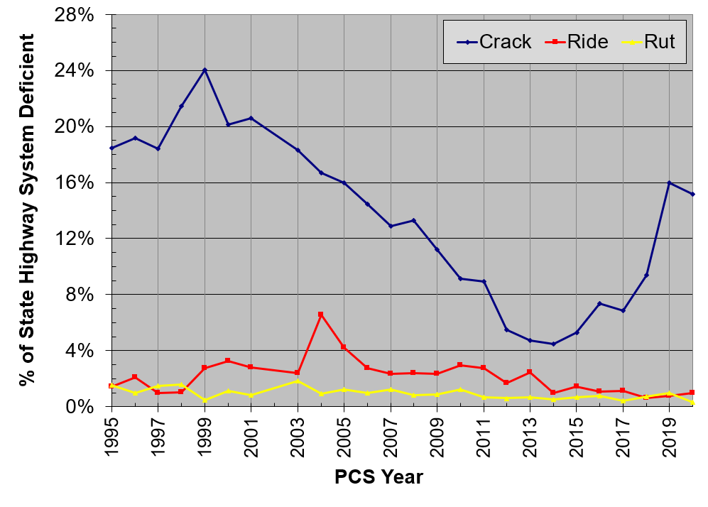
District 2 Historical Performance

Slide 42
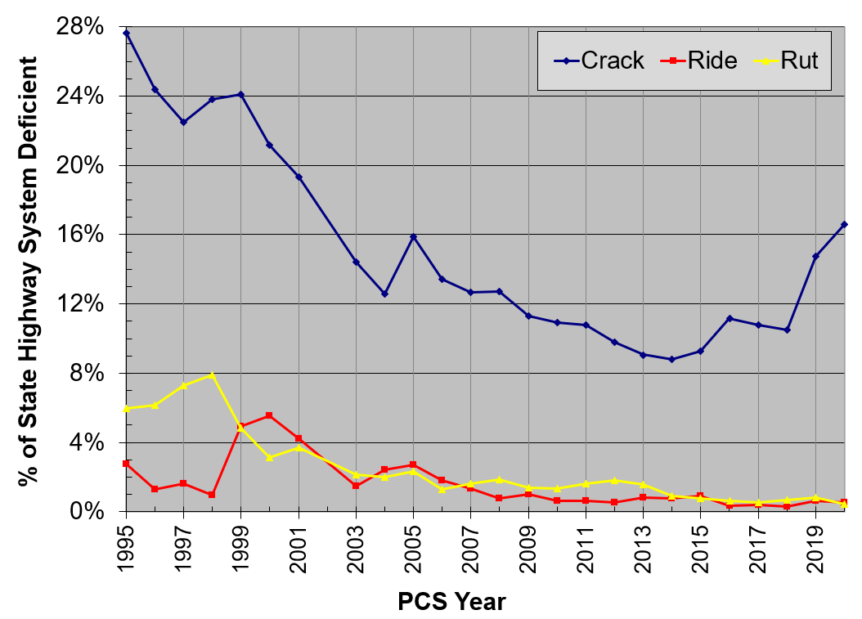
District 3 Historical Performance

Slide 43
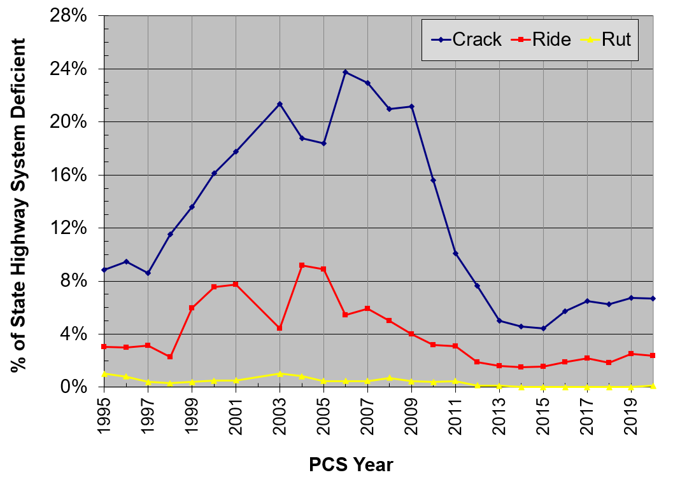
District 4 Historical Performance

Slide 44
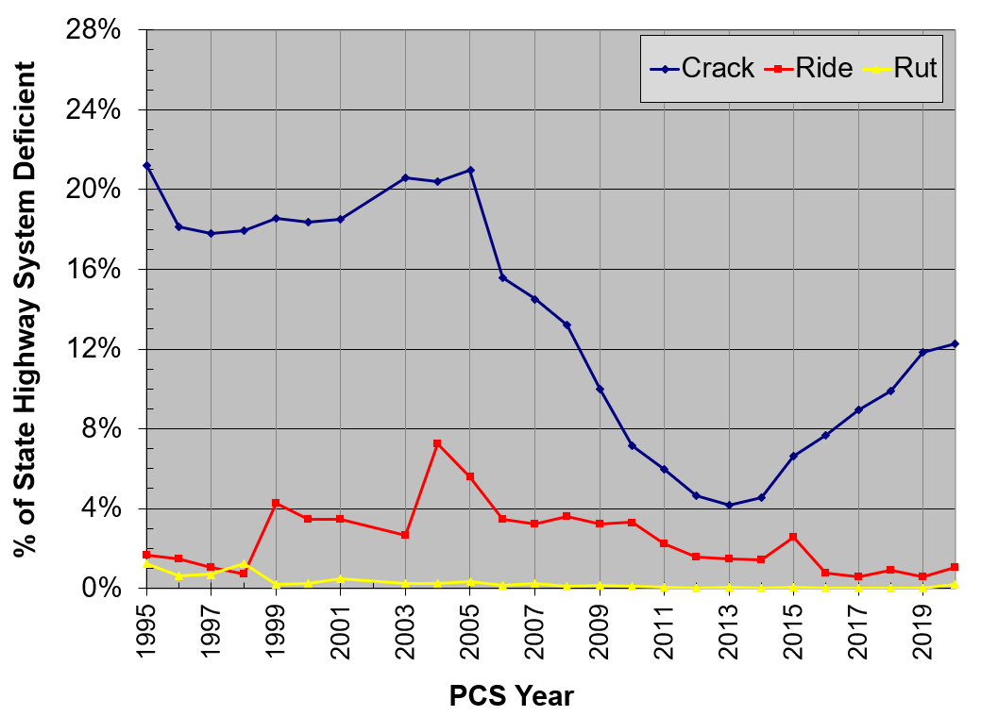
District 5 Historical Performance

Slide 45
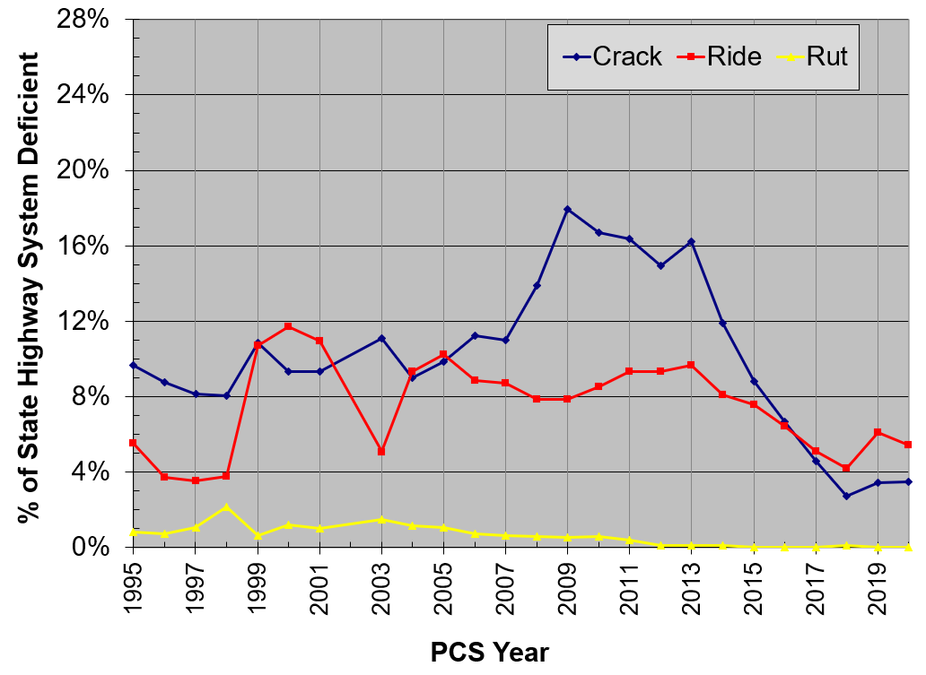
District 6 Historical Performance

Slide 46
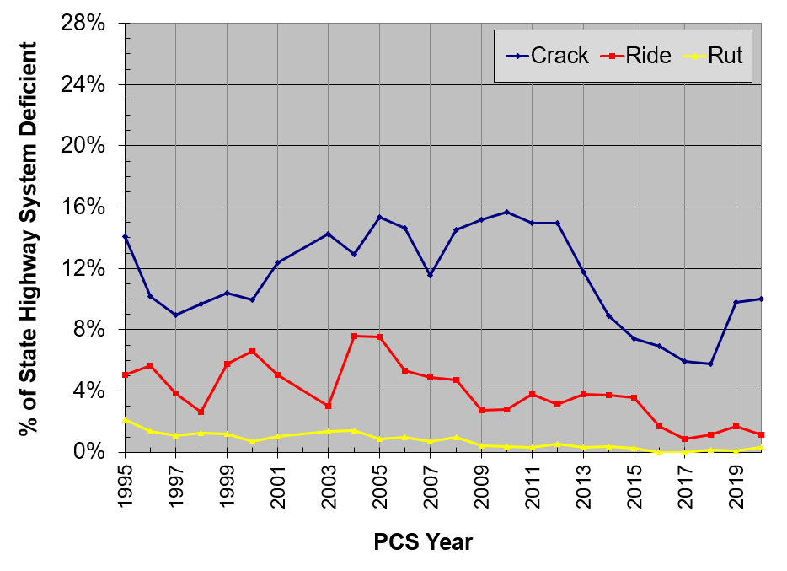
District 7 Historical Performance

Slide 47
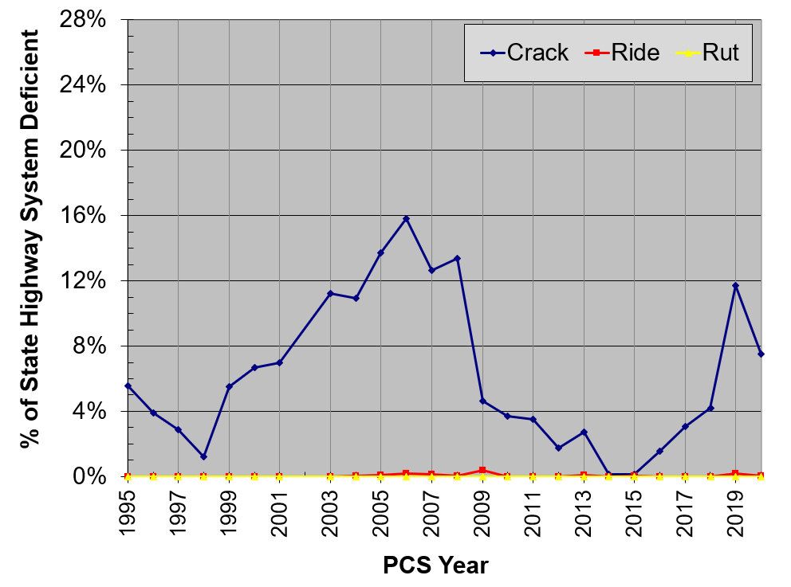
Turnpike Historical Performance

Slide 48
Specification Updates

Slide 49
July 2020 Workbook
Section 334 – Superpave Asphalt Concrete
The allowable maximum lift thickness of Type SP-12.5 mixtures was increased from 2 ½ inches to 3 inches.

Slide 50
January 2021 Workbook
Section 234 – Superpave Asphalt Base
Type SP-19.0 mixes allowed for base
New allowable layer thicknesses for base courses
Type B-12.5 & Type SP-12.5: 1 ½ to 3 ½ inches
Type SP-19.0: 2 to 4 inches
Density testing required on the first lift of base placed on subgrade if Type SP-19.0 is used or the thickness is 3 ½ inches for Type B-12.5 & Type SP-12.5

Slide 51
January 2021 Workbook
Section 334 – Superpave Asphalt Concrete
Updated requirements for continuous RAP stockpiles.
Increased allowable RAP usage (up to 30%) for structural courses containing PG 76-22 binder. RAP usage above 20% based on RAP properties (percent passing the #16 sieve and high PG grade of the recovered RAP binder).
Updated requirements for instances where SGC pills are damaged or don’t compare.
Updated language for binder and mix recovery sampling and testing.

Slide 52
Proposed changes for July 2021 Workbook
Section 334 – Superpave Asphalt Concrete
Revised density requirements for unsignalized side streets
Revised specification limits for density testing
Increased the density upper specification limit
Revised density ranges on the small quantity pay table
Section 337 – Asphalt Concrete Friction Courses
Liquid anti-strip additive required in all FC-5 mixtures
1.5% hydrated lime required in FC-5 mixtures containing Nova Scotia granite

Slide 53
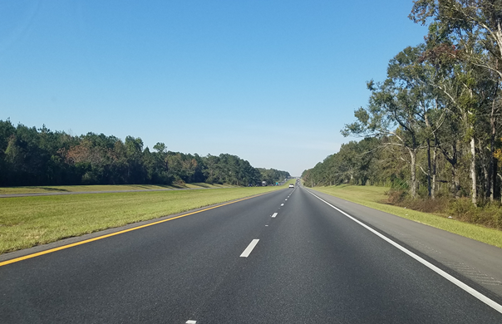
Thank You
Questions?

