Slide 1

ANNUAL ASPHALT CONFERENCE
Virtual Presentation
Assistant Secretary Stacy L. Miller, P.E.
Florida Department of Transportation

Slide 2




VITAL FEW – VISION FOR FLORIDA

Slide 3
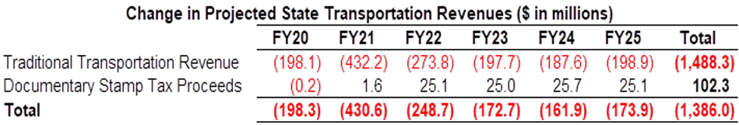
TOTAL 5-YEAR ADOPTED WORK PROGRAM $51,722M
BUDGET OVERVIEW
10.3 Billion Budget
$9.2 B, Transportation Work Program
September 2020 Figures
July 2020: Totals may not add due to rounding; excludes emergency related programming

Slide 4
RESURFACING PROGRAM OVERVIEW
2020 State Highway System
Arterials* = 33,936.9 LM
Interstate = 8,677.6 LM
Turnpike = 2,361.0 LM
Total Lane Miles: 44,975.5
(Flexible and Rigid Combined)
Deficient Pavements
Based on 2020 Pavement Condition Survey
Rigid, 2.7%
(1,220.7 LM)
Deficient
12.5%
(5,635.1 LM)
Non-Deficient
87.5%
(39,340.4 LM)
Flexible
97.3%
(43,754.8 LM)
There is $5.4 billion in the current 5-year Resurfacing Program**
*Includes MDX and CFX
**Pre-COVID

Slide 5
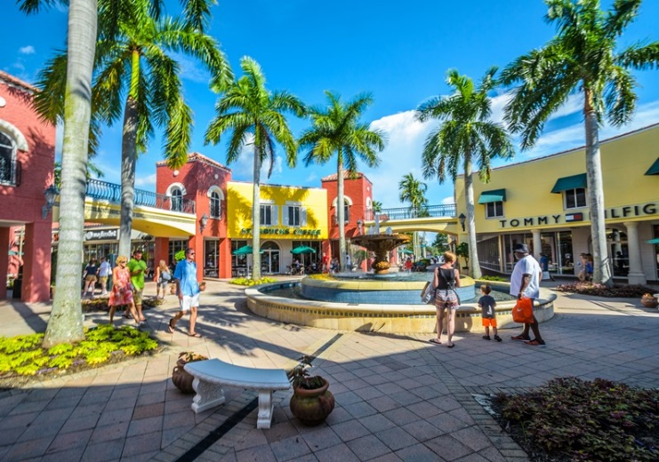
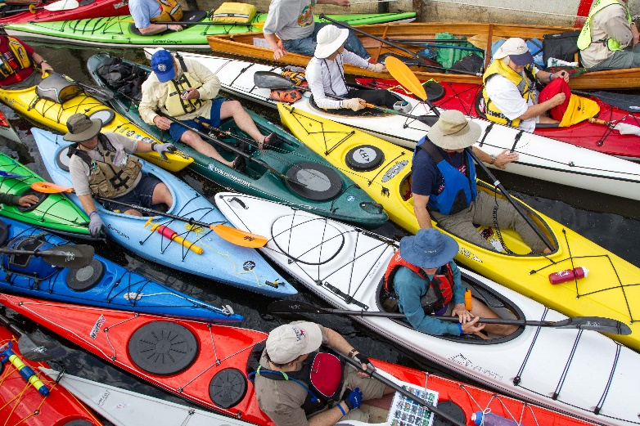
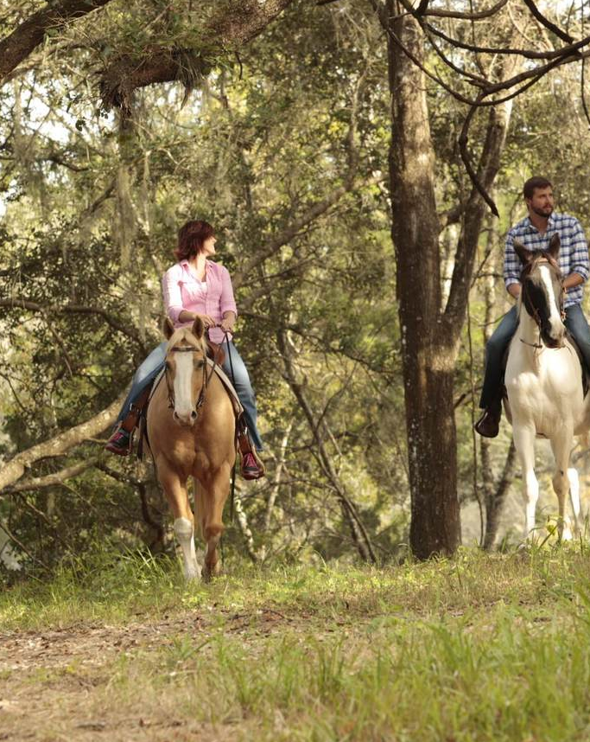
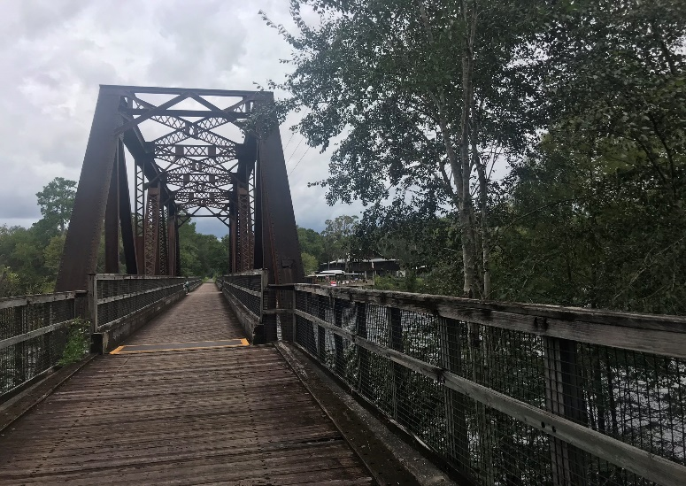
High-Level
Needs
Guiding
Principles
Instructions for Project Development & Beyond
Action Plan

Slide 6
QUESTIONS?

