Slide 1
Florida Department of
TRANSPORTATION
Bituminous Research Update
Howie Moseley, State Bituminous Materials Engineer

Slide 2
Presentation Outline
Increased RAP Usage in Type SP Mixtures with PG 76-22 Binders
Increased Anti-strip Additives in Granite FC-5 Mixtures
SR 200 Aramid Fiber Test Sections
Ongoing and Upcoming Research

Slide 3
Increased RAP Usage in Type SP Mixtures with PG 76-22 Binders
Contracted research with the University of Florida
Project title: Enhanced Characterization of RAP for Cracking Performance (BDV31-977-70)
Project Objectives:
Determine whether the current 20% max RAP content in PMA mixtures may be increased without adversely affecting performance
Determine whether additional RAP characterization is needed to implement an increase in RAP

Slide 4
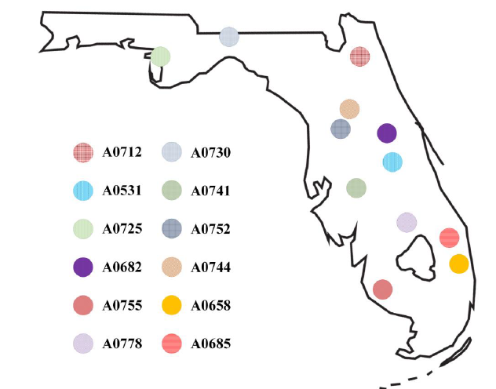
RAP Sources Considered for the Project

Slide 5
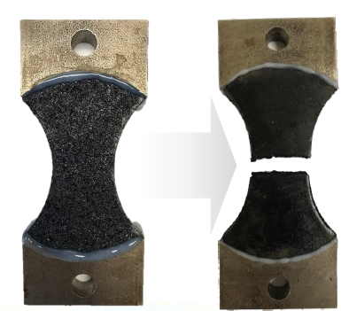
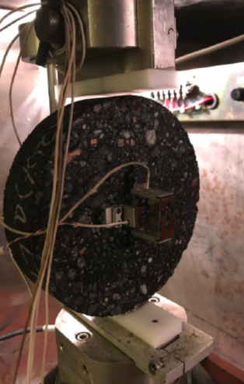
RAP Characterization Testing
Complex testing was performed to determine the RAP characteristics that affected performance
Interstitial component direct tension (ICDT) testing
Mixture testing to verify ICDT testing
Two characteristics determined
RAP aggregate gradation
RAP fineness – percent passing the #16 sieve
RAP binder stiffness
High-temperature continuous PG grade

Slide 6
RAP Characterization
Testing showed that coarse RAP performed better than fine RAP
Testing also showed that RAP binder stiffness affected performance, but wasn’t as important as the RAP aggregate gradation
In general, a coarse RAP with stiff binder would have better cracking resistance compared to a finer RAP with less stiff binder
Coarse RAP with a less stiff binder would have the best performance

Slide 7
Why is RAP Gradation Critical to Performance
Some of the RAP binder stays on the RAP aggregate
The finer portion of the RAP becomes part of the mortar between the coarse aggregate skeleton of the mix, which affects the mixture’s cracking resistance

Slide 8
Project Conclusions
Characterizing RAP fineness and RAP binder stiffness is required to increase the current RAP content in mixtures containing PG 76-22 binder
Required RAP properties are shown in Table 334-3 of the January 2021 Specification Workbook

Slide 9
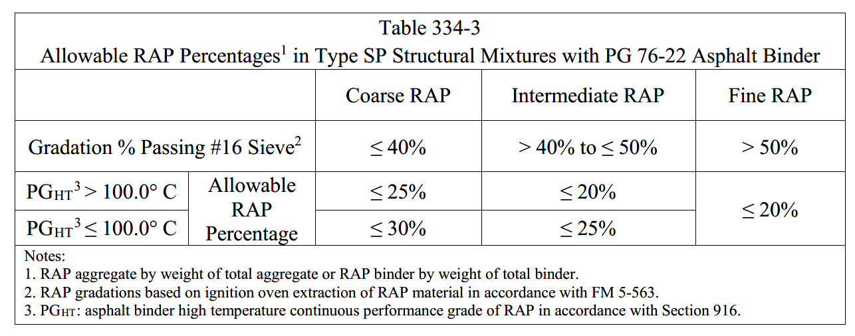
Specification Change

Slide 10
Increased Anti-strip Additives in Granite FC-5 Mixtures
Contracted research with NCAT
Project title: Study of Anti-Strip Additives on Granite Based FC-5 Asphalt Mixtures
Project Objective:
Evaluate the influence of anti-strip additives on the durability and moisture susceptibility of granite-based FC-5 mixtures.

Slide 11
Increased Anti-strip Additives in Granite FC-5 Mixtures
Project Variables
Aggregates that were evaluated
Georgia granite
Nova Scotia granite
Anti-strip additive dosages that were evaluated:
1% hydrated lime (current spec)
1% hydrated lime and 0.5% liquid anti-strip
1.5% hydrated lime
1.5% hydrated lime and 0.5% liquid anti-strip

Slide 12
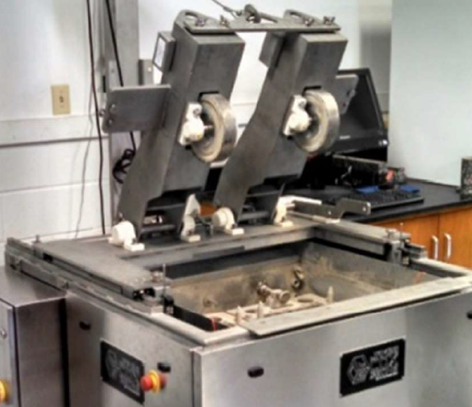
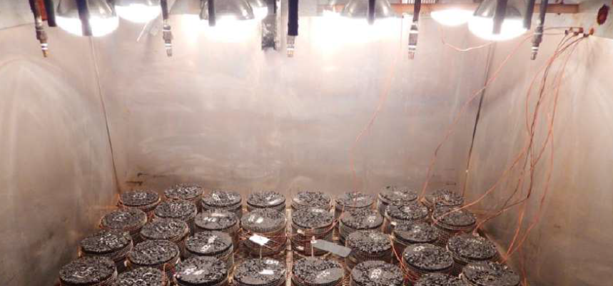
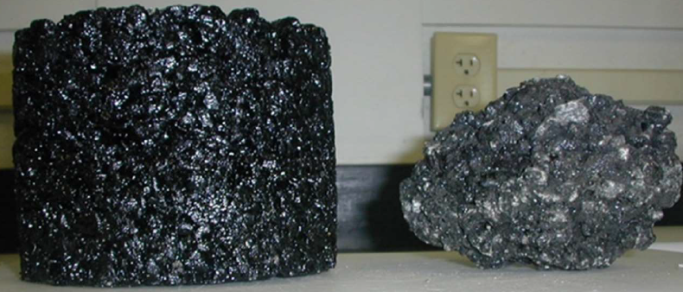
Sample Conditioning and Testing
Conditioning
Specimens were conditioned in the asphalt pavement weathering system to simulate the long-term exposure to water infiltration, vapor diffusion, and thermal and ultraviolet oxidation.
Testing
Specimen testing included the Cantabro test, tensile strength ratio test, and Hamburg wheel tracking test.

Slide 13
Project Conclusions
Georgia granite
Specimens containing 1% hydrated lime and 0.5% liquid anti-strip additive performed the best and had the best cost-benefit ratio
Nova Scotia granite
Specimens containing 1.5% hydrated lime and 0.5% liquid anti-strip additive performed the best and had the best cost-benefit ratio
A specification change has been proposed for the July 2021 workbook to incorporate these findings.

Slide 14
SR 200 Aramid Fiber Test Sections
This study will investigate the field performance of asphalt mixtures containing aramid fibers
The test sections will be placed on SR 200 in Nassau County
They are scheduled to be paved in the next couple of months
The study includes three separate 1500’ test sections in the northbound travel lanes to compare to a fourth control section
Test sections will only be constructed in the 1.5” lift of FC-12.5

Slide 15
SR 200 Aramid Fiber Test Sections
Control Section: FC-12.5 with PG 76-22 binder (20% RAP)
Test Section #1: FC-12.5 (same JMF) with PG 58-22 binder and aramid fibers
Test Section #2: FC-12.5 with PG 76-22 binder (20% RAP) and aramid fibers
Test Section #3: FC-12.5 with high polymer binder (same aggregates, but no RAP or aramid fibers)
Each section will be monitored long term for rutting, cracking, ride, and raveling
Laboratory performance testing will also be performed on each section

Slide 16
Evaluation of Roadway Worms/Distortions
Contracted research with the Applied Research Associates
The project is ongoing with an estimated completion date of Spring of 2021
Project Objectives: Determine the cause(s) of road worms and provide recommendations to address these causes.

Slide 17
Use of Epoxy Modified Asphalt in FC-5
Contracted research with NCAT
Project title: Design and Performance of Open-Graded Friction Course (OGFC) Mixtures Containing Epoxy Asphalt
Ongoing project, will be completed in the summer of 2021
Project Objectives:
Determine if epoxy asphalt (EA) can improve the performance of FC-5
And is it cost effective
Recommend design procedures for designing FC-5 mixtures with EA
Determine recyclability of FC-5 containing EA

Slide 18
Performance Evaluation of SP-9.5 and SP-12.5 Superpave Mixtures
Contracted research with the Texas A&M Transportation Institute
The project is ongoing with an estimated completion date of January 2022
Project Objectives:
Compare the performance of SP-9.5 and SP-12.5 mixtures for rutting, cracking, and durability
Determine if SP-9.5 mixtures can be used for traffic level D & E roadways

Slide 19
Replacement for the ARMI Layer
Contracted research with the University of Florida
Project Title: Practical Mix Design Guidelines for Reflective Cracking Resistant Mixtures
The project should begin early next year
Project Objectives: Provide practical guidelines for designing asphalt mixtures that will mitigate/retard reflective cracking.

Slide 20
Resilient Asphalt Pavements
Contracted research with the University of Florida
Project Title: Improved Resilience of Asphalt Pavements Due to Flooding
The project should begin early next year
Project Objectives
Evaluate the resilience of an asphalt mixture that is loaded while inundated with water
Improve asphalt mixture properties to resist the impacts of flooding

Slide 21
Review of OGFCs Suitable for Suburban Environments
Contracted research that will be advertised soon
Project Objectives:
Evaluate alternative friction courses to FC-5 for multi-lane corridors with a design speed of 50mph or greater that contain signalized intersections and midpoint turning lanes
Looking for alternative friction courses with increased durability without compromising safety

Slide 22
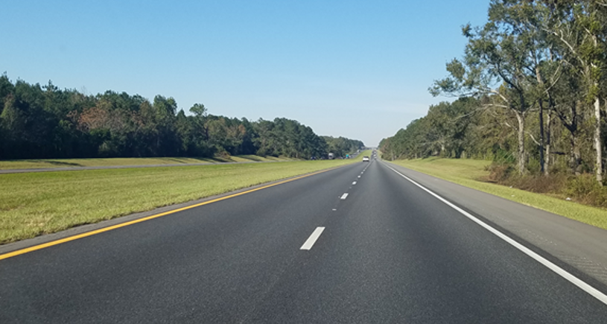
Thank You
Questions?

