Slide 1
2020 Florida Asphalt Digital Conference
Asphalt Contractors Association of Florida, Inc

Slide 2
Agenda
1.00 Mark Musselman, Introduction
1.20 Dr. Buzz Powell, HiMa & Aramid Fibers
2.00 Stacy Miller, FDOT Overview
2.30 Rich Hewitt, FDOT Construction Update
3.00 Howie Moseley, FDOT Bituminous Update
3.30 James Greene, FDOT Research Update

Slide 3
Florida’s Pavements
Highways Surfaced with Asphalt
97.3%
Rural Arterial Pavement Condition
#3
Urban Arterial Pavement Condition
#1
Urban Interstate Pavement Condition
#14
Rural Interstate Pavement Condition
#9
Overall Pavement Condition
#1
25th Annual Highway Report
November 2020

Slide 4
Statewide Pavement Awards

Slide 5
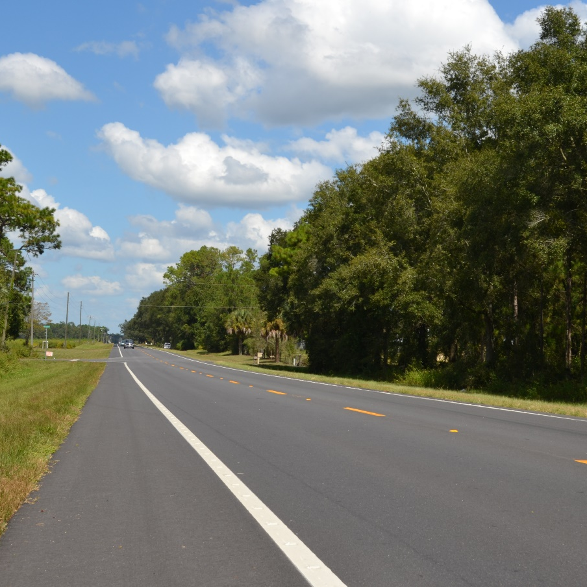
Rural Resurfacing
State primary highway or rural county highway.
10,000 tons minimum or equivalent of 5 miles of 24’ roadway
Rural is defined as 51.0% or more of the project has paved shoulders.
Preferred Materials, Inc. for SR 49/US 129 from SR 55 going North to the Gilchrist County Line in Levy County
Preferred’s team was led by Bill Sullivan, Paul Voborny, Greg Lloyd, Jodi Haviland, Randy Larkin and Jarred Coody.
Alex Ruiz served as the FDOT’s Resident Engineer and Brannon Chatwood, Consultant CEI was the Project Administrator.

Slide 6
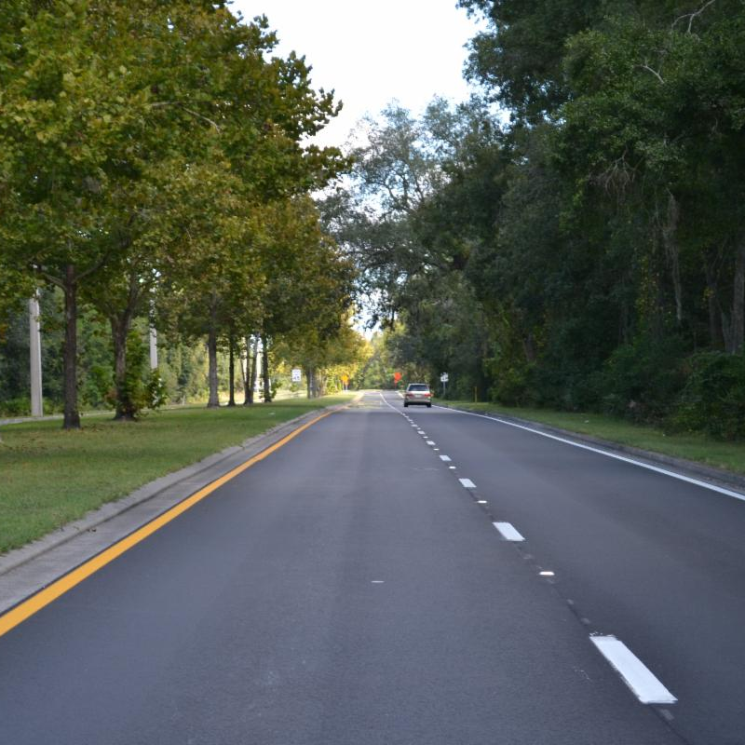
Urban Resurfacing
State primary highway or rural county highway.
10,000 tons minimum or equivalent of 5 miles of 24’ roadway
Urban is defined as 51.0% or more of the project his in a curb and gutter section.
Preferred Materials, Inc. for SR 105/Heckscher Drive from Parker Ave. going east for 2.4 miles to Fuel Farm Rd in Duval
Preferred's team was led by Jason Johns, Haimwant Seeneth, Scott Dampier, Jodi Haviland, Jason Holtonand Robert Brinson.
The FDOT's effort was led by Gregory Perry and John Patterson.

Slide 7
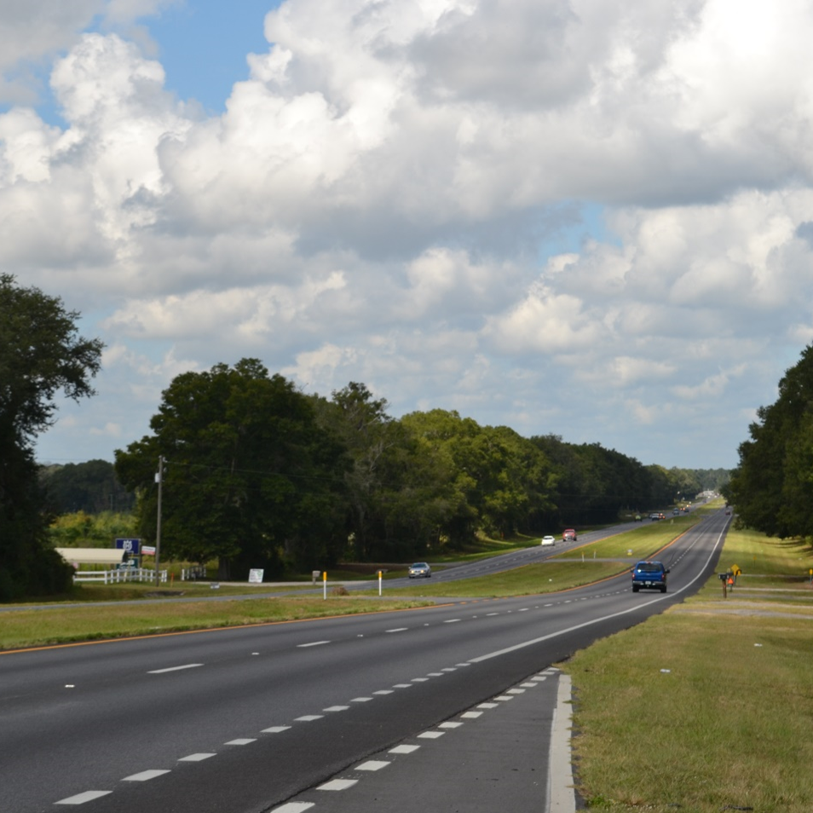
A.P. Bolton
New construction, reconstruction, or major overlay on Interstate or multi-lane primary highway.
30,000 tons minimum
Preferred Materials, Inc. for SR25/US441 from NW 167th Blvd. going North through the town on High Springs to the Columbia County Line in Alachua County
Preferred’s team was led by Bill Sullivan, Paul Voborny, Greg Lloyd, Jodi Haviland, Randy Larkin and Jarred Coody.
Alex Ruis served as the FDOT’s Resident Engineer and Kevin Wagner, Consultant CEI was the Project Administrator.

Slide 8
Smoothness Awards

Slide 9
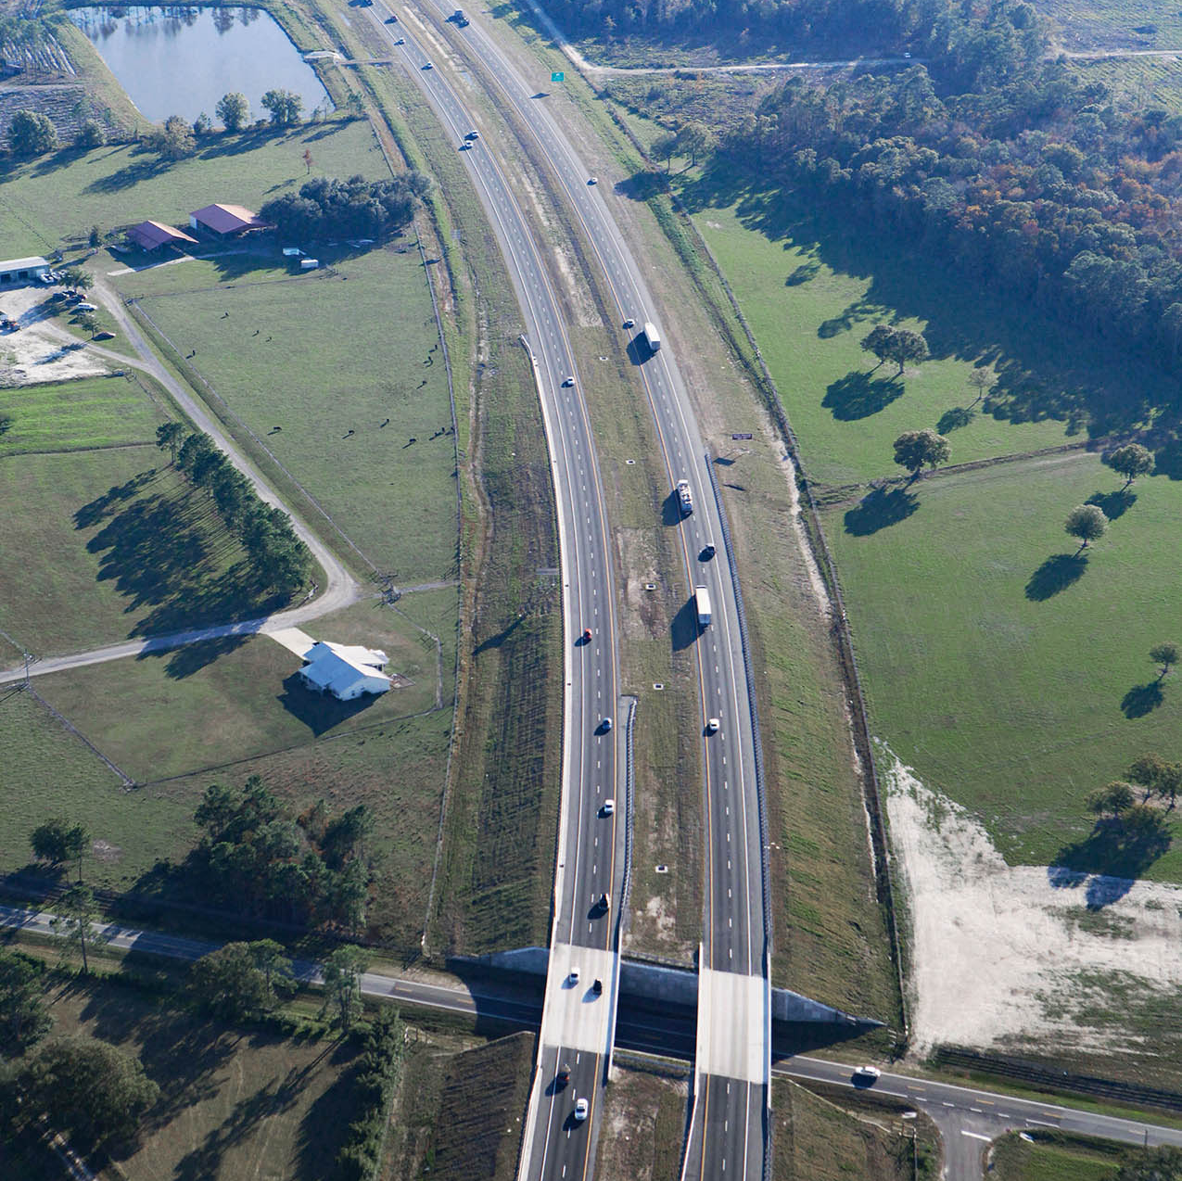
Primary Roadway: Runner Up
SR 223 from SR 100 to SR 16
4 lanes
3.5 miles
Average IRI:
34

Slide 10
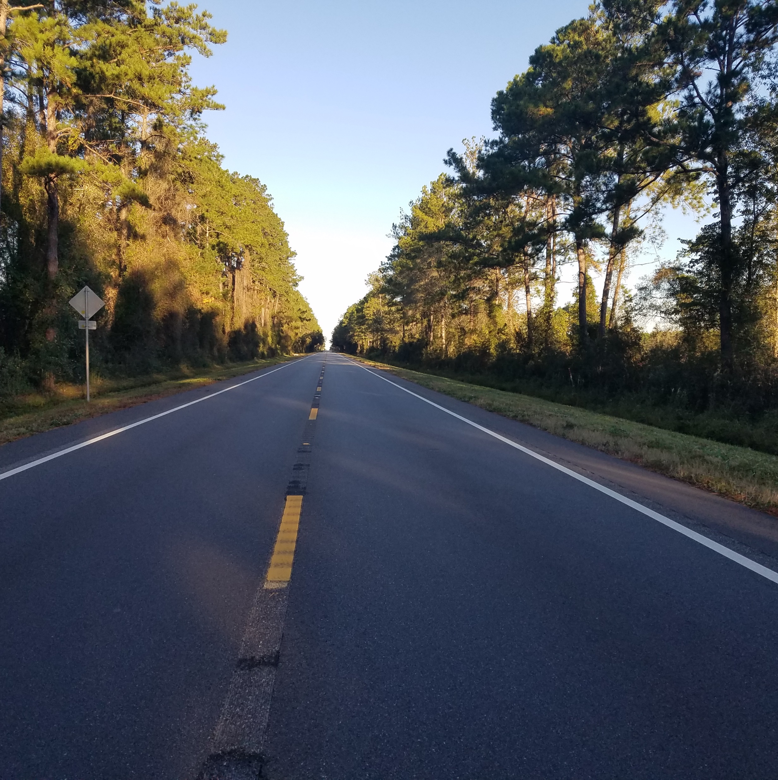
Primary Roadway: Winner
SR 100 from Union County Line to Academic Avenue
2 lanes
7.3 miles
Average IRI:
33

Slide 11
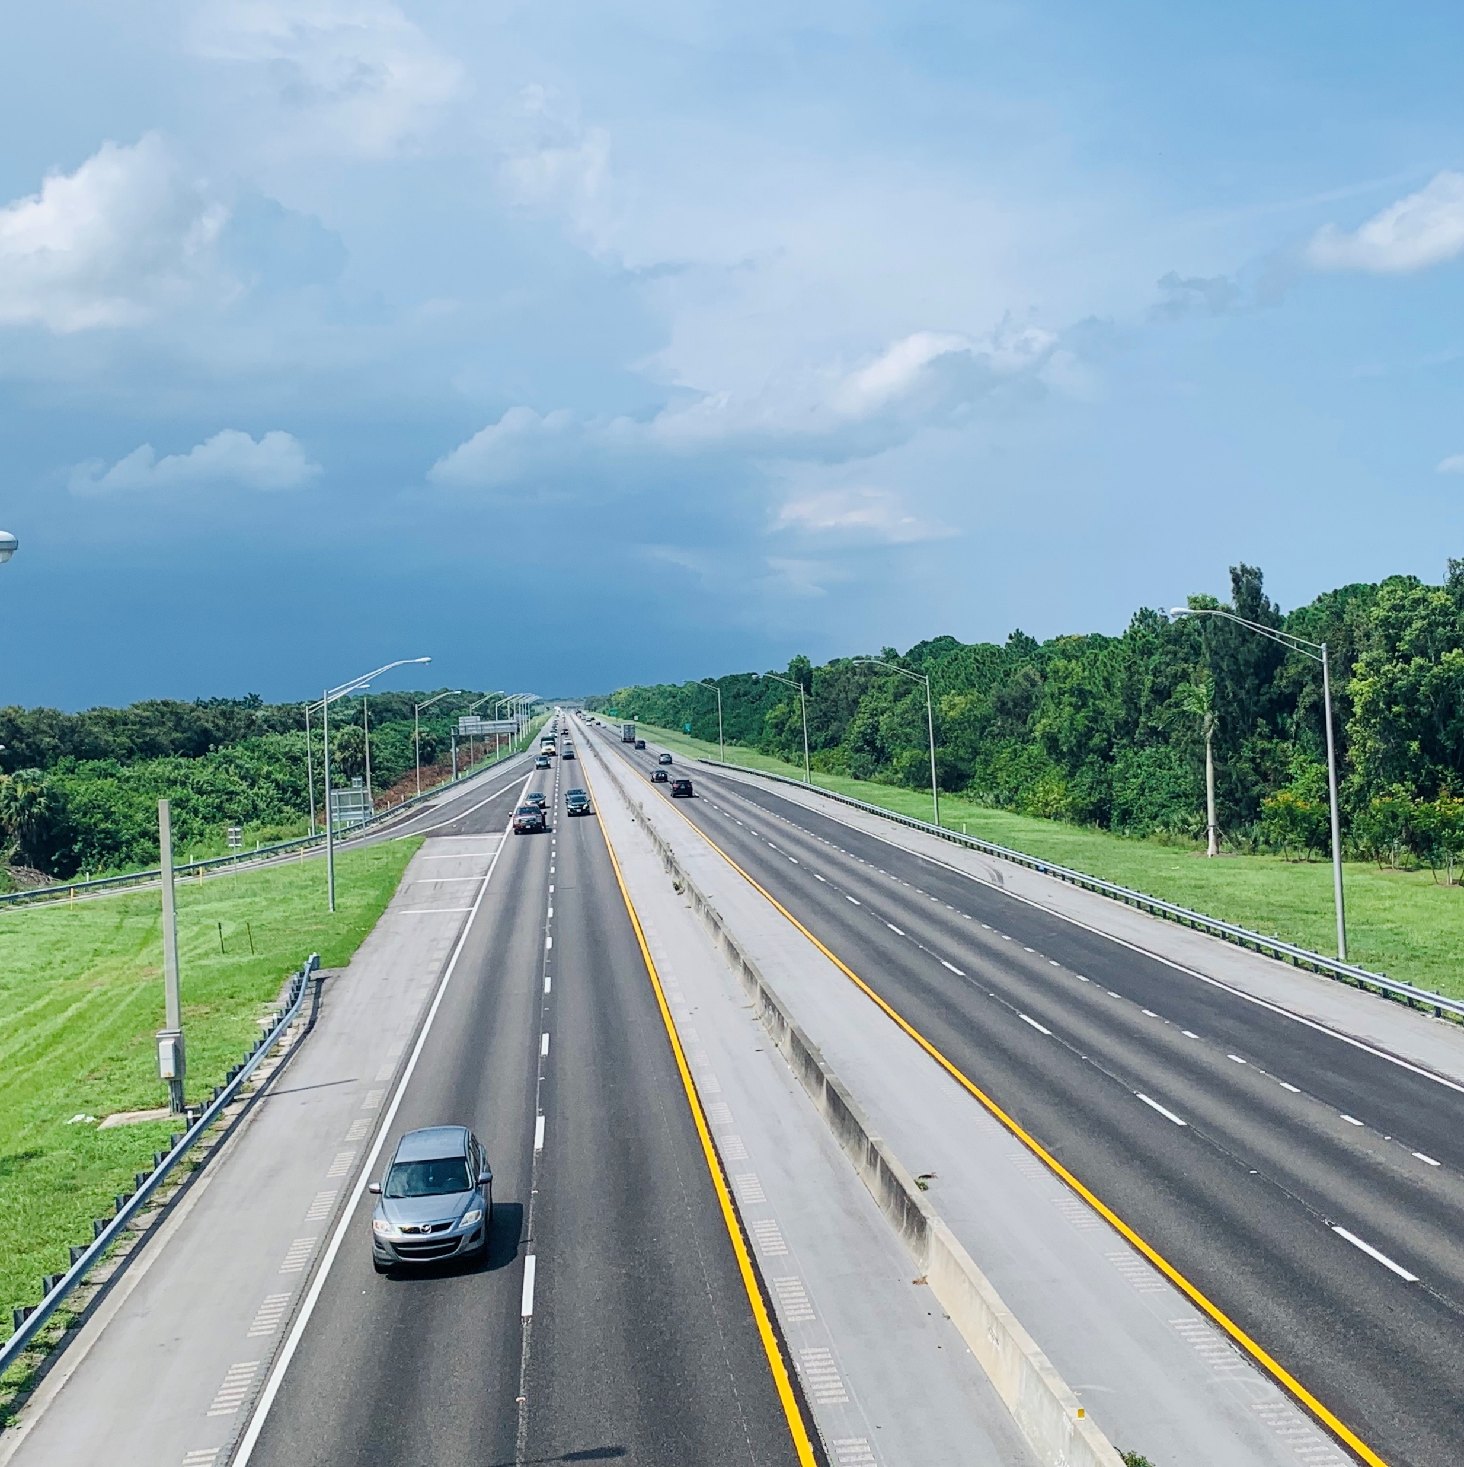
Limited Access: Runner Up
Florida Turnpike in Palm Beach County from MP 106.1 to 112.212
4 lanes
6.0 miles
Average IRI:
38

Slide 12
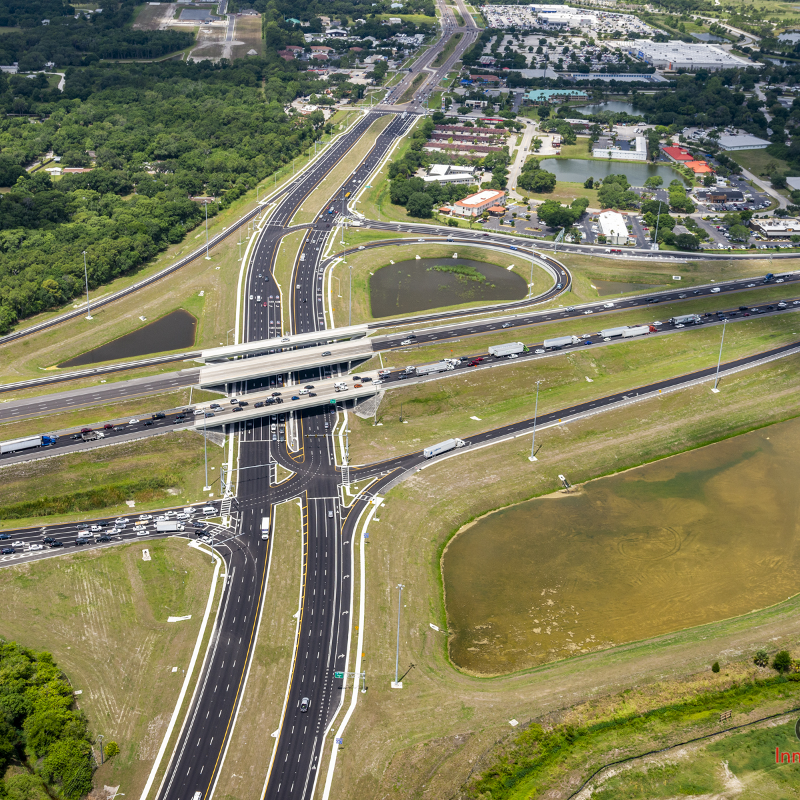
Limited Access: Winner
I-75 at SR 644 lanes
1.0 miles
Average IRI:
37

Slide 13
Perpetual Pavement Award

Slide 14
The Perpetual Pavement Award
The Perpetual Pavement Award program administered by the Asphalt Pavement Alliance, accepts award nominations for projects which are at least 35 years old, have not experienced a structural failure, received no more than four inches of newly added material over the previous 35 years, and have not been resurfaced more frequently than once every 13 years. Nominations are evaluated and selected for an award by the National Center for Asphalt Technology (NCAT) at Auburn University
State Road 9 (Interstate 95) (MP 25.504 to MP 34.855)

Slide 15
And One More Thing…

Slide 16
ACAF is Hiring!
ACAF is hiring Technical Director
For more information please visit our website, floridaridesonus.org

Slide 17
Thank You and Work Safe!
Mark Musselman
President
Asphalt Contractors Association of Florida, Ins
mmusselman@acaf.org
(850) 222-7300

