Slide 1
State Construction Office Update 2020 ACAF Conference
Richard Hewitt, P.E.
State Construction Pavement Engineer
FDOT State Construction Office

Slide 2
Construction Update Overview
Specification Changes
Limited Access Roadway Smoothness
IRI Projects
Ride Number vs IRI Projects
Non-Limited Access Roadway Smoothness System
e-Ticketing & Implementing Changes

Slide 3
Specification Changes

Slide 4
327-3.1.1
Allow Traffic On Milled Surface Up To 3 Days Before Paving
Submitted For July 2021 Workbook
Going Through Internal & Industry Review
Allowed Upon Engineer Approval, Provided There Are
Continuous, Longitudinal Milling Striations
No Drop Off or Safety Issues
No Drainage Issues
If Requirements Not Met, Go Back to Pave Day After Milling
Photos of Acceptable & Unacceptable Striations
https://www.fdot.gov/programmanagement/implemented/urlinspecs/milling-patterns

Slide 5
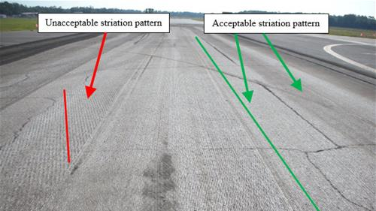

Slide 6
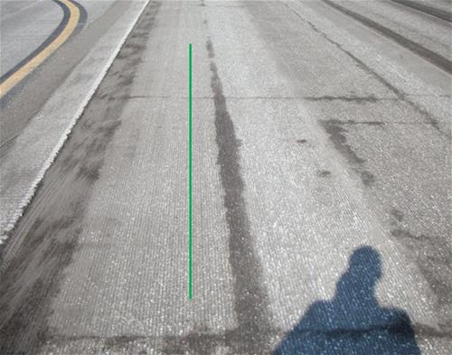
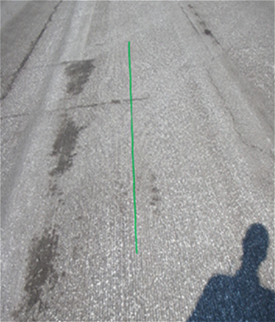
Acceptable Milling Striations

Slide 7
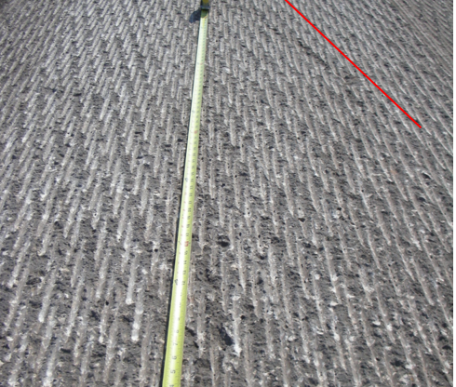
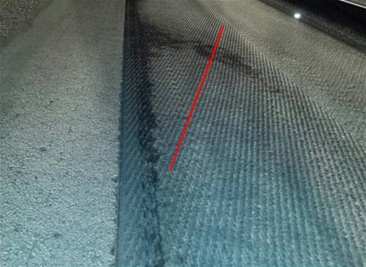
Unacceptable Milling Striations

Slide 8
Section 330 & 334
Raised Crosswalks & Speed Tables
Added to Straightedge Testing Exceptions in 330-9.4.5.2
3/8” Deficiency Requirement for Objectionable Areas
Added to Density Testing Exceptions in Section 334-5.1.2

Slide 9
Raised Crosswalks
Thanks to ACAF & ACAF Contractors Who Provided Constructability Input During Creation of Developmental Standard Plan 520-030 & Changes to Standard Specifications 330 & 334
Mark Musselman (ACAF)
Rick Crocker (Preferred Materials)
Felipe Jaramillo (Ajax Paving)
Julio Legañoa (Halley Engineering Contractors)
Chris Harris (Anderson Columbia)
Scott Fowler (Ranger Construction)
Pete Fronczak & Joe Meier (Middlesex Construction)

Slide 10
Limited Access Roadway Smoothness IRI Specification Projects

Slide 11
2018 Limited Access - IRI Spec Projects vs Interstate (2005 to 2010)
2018 Limited Access IRI Projects
Original Interstate Data 2005-2010

Slide 12
2018 Limited Access - IRI Spec Projects
Year | District | County | FIN | SR | Lane Miles | Incentive | Incentive per Lane Mile | Avg. IRI | Aggregate
2018 | 8 | Okeechobee | 435166-1 | 91 | 14.0 | $20,890 | $1,493 | 36 | Limestone
 | 8 | Indian River | 435168-1 | 91 | 8.0 | $11,020 | $1,373 | 37 | Limestone
 | 8 | Okeechobee | 435165-1 | 91 | 15.5 | $20,993 | $1,356 | 37 | Limestone
 | 8 | Indian River | 435167-1 | 91 | 10.9 | $18,267 | $1,671 | 34 | Limestone

Slide 13
2018 IRI Spec Project Overview
4 Projects
Lowest Project Average IRI = 34 in/mile
Highest Project Average IRI = 37 in/mile
All 4 Limestone Projects Received Incentives
Average Incentive = $1,473 per Lane Mile
Total Incentives = $71,170

Slide 14
2019 Limited Access - IRI Spec Projects vs Interstate (2005 to 2010)
2019 Limited Access IRI Projects
Original Interstate Data 2005-2010

Slide 15
2019 Limited Access - IRI Spec Projects
Year | District | County | FIN | SR | Lane Miles | Incentive | Incentive per Lane Mile | Avg. IRI | Aggregate
2019 | 8 | Osceola | 442901-8 | 91 | 3.8 | $(4,554) | $(1,186) | 60 | Granite
 | 4 | Martin | 434273-1 | 9 | 46.3 | $15,188 | $328 | 46 | Limestone
 | 4 | Palm Beach | 434273-2 | 9 | 11.6 | $5,440 | $467 | 44 | Limestone
 | 4 | Palm Beach | 436521-1 | 91 | 24.1 | $28,734 | $1,193 | 38 | Limestone
 | 8 | Lake | 437988-1 | 91 | 18.4 | $6,557 | $356 | 43 | Granite
 | 4 | Palm Beach | 427516-1 | 9 | 35.2 | $32,550 | $924 | 40 | Limestone

Slide 16
2019 IRI Spec Project Overview
6 Projects
Lowest Project Average IRI = 38 in/mile
Highest Project Average IRI = 60 in/mile
5 out of 6 Projects Received Incentives
All Limestone Projects Received Incentives
Average Incentive = $355 per Lane Mile
Total Net Incentives = $83,915

Slide 17
2020 Limited Access – IRI Spec Projects vs Interstate (2005 to 2010)

Slide 18
2020 Limited Access-IRI Spec Projects (Jan – mid Nov)
Year | District | County | FIN | SR | Lane Miles | Incentive | Incentive per Lane Mile | Avg. IRI | Aggregate
2020 | 8 | Brevard | 439479-1 | 528 | 61.4 | $27,698 | $451 | 44 | Granite
 | 7 | Hillsborough | 436588-1 | 400 | 156.2 | $109,970 | $704 | 42 | Granite
 | 8 | Palm Beach | 437991-1 | 91 | 33.5 | $27,348 | $817 | 41 | Limestone
 | 8 | Orange | 439478-1 | 528 | 37.6 | $45,086 | $1,198 | 38 | Both
 | 8 | Osceola | 432826-4 | 91 | 46.6 | $78,610 | $1,689 | 34 | Granite
 | 8 | Osceola | 435169-1 | 91 | 5.7 | $9,749 | $1,721 | 34 | Granite
 | 7 | Hillsborough | 437312-1 | 93 | 72.7 | $186,352 | $2,563 | 24 | Granite

Slide 19
2020 IRI Spec Project Overview (Jan – mid Nov)
7 Projects
Lowest Average Project IRI = 24 in/mile
New State Record!
Highest Average Project IRI = 55 in/mile
All 7 Projects Received Incentives
One Project Received Consistency Incentive
Avg Incentive = $1,050 per Lane Mile
Total Incentives = $353,382
Does Not Include Project Wide Consistency Incentive

Slide 20
Jan 2018 – mid Nov 2020 Limited Access - IRI Spec Project Overview
16 out of 17 Projects Received Incentives
All Limestone Projects Received Incentives
Total Net Incentives Paid = $508,467
Smoothness Incentive Spec is a Positive
Incentives for Smooth Paving
Smoother Asphalt Pavements

Slide 21
Limited Access Roadway Smoothness Ride Number vs IRI Projects

Slide 22
2018 Limited Access - RN Spec vs Interstate (2005 to 2010)
2018 Limited Access IRI Projects
Original Interstate Data 2005-2010

Slide 23
2018 Limited Access - IRI Spec Projects vs Interstate (2005 to 2010)
2018 Limited Access IRI Projects
Original Interstate Data 2005-2010

Slide 24
2019 Limited Access - RN Spec vs Interstate (2005 to 2010)

Slide 25
2019 Limited Access - IRI Spec Projects vs Interstate (2005 to 2010)
2019 Limited Access IRI Projects
Original Interstate Data 2005-2010

Slide 26
2020 Limited Access - RN Spec vs Interstate (2005 to 2010)

Slide 27
2020 Limited Access – IRI Spec Projects vs Interstate (2005 to 2010)

Slide 28
RN vs IRI Project Summary
Difference in IRI Average Between RN & IRI Projects
2018
49 - 36 = 7 IRI Points Smoother on Incentive Projects
2019
52 - 43 = 9 IRI Points Smoother on Incentive Projects
2020 (Jan – mid Nov)
53 - 43 = 10 IRI Points Smoother on Incentive Projects

Slide 29
RN vs IRI Spec Summary
IRI Incentive/Disincentive Spec Projects
Paved Smoother than Projects with Ride Number Spec
Incentivizes Contractors to Pave Smoother
Incentives Benefit Contractors, FDOT, & Travelling Public

Slide 30
Non-Limited Access Roadway Smoothness System

Slide 31
Non-Limited Access IRI-Based Smoothness System
Writing Developmental Smoothness Specification
Non-Limited Access Roads
Design Speed 55mph & Greater
i.e. Projects Currently Laser Tested with Ride Number
IRI-Based Smoothness Specification
Smoothness Incentives & Disincentives

Slide 32
Non-Limited Access IRI-Based Smoothness System
Based on Past Construction Acceptance Data
Same as Current Limited Access IRI Specs Are
However, Split Into Multiple Classes to
Account for Level of Ease or Difficulty to Pave Smoothly
Appropriately Evaluate Construction Acceptance
Fairly Incentivize Smoothness

Slide 33
Non-Limited Access vs Limited Access Roads
Non-Limited Access
2014-2019
IRI Average = 46
Std. Dev. = 12
Limited Access
2005-2010
IRI Average = 48
Std. Dev. = 13

Slide 34
IRI Pay Adjustment Limits
Class | IRI Pay Adjustment Limits
 | Incentive | Full Pay | Disincentive | R&R
1 | ≤ 36 | 37 - 42 | 43 - 95 | >95
2 | ≤ 42 | 43 - 55 | 56 - 95 | >95
3 | ≤ 52 | 53 - 62 | 63 - 110 | >110
4 | ≤ 62 | 63 - 85 | 86 - 125 | >125
5 | ≤ 85 | 86 - 105 | 106 - 125 | >125

Slide 35
Lane Miles per Class & District
Lane-Miles
District | Class 1 | Class 2 | Class 3 | Class 4 | Class 5 | Total
1 | 207 | 343 | 212 | 74 | 1 | 838
2 | 626 | 487 | 158 | 41 | 0 | 1,313
3 | 1,014 | 408 | 24 | 1 | 0 | 1,447
4 | 4 | 263 | 70 | 72 | 0 | 409
5 | 71 | 202 | 264 | 19 | 1 | 558
6 | 0 | 44 | 100 | 58 | 1 | 203
7 | 16 | 214 | 379 | 45 | 0 | 655
Total | 1,939 | 1,961 | 1,208 | 310 | 3 | 5,421

Slide 36
Net Incentive per Lane Mile - Per Class & District
Incentive/Lane Mile
District | Class 1 | Class 2 | Class 3 | Class 4 | Class 5 | Total
1 | $25 | $133 | $25 | $649 | -$305 | $124
2 | $20 | $95 | $221 | $538 | $0 | $88
3 | $44 | $55 | $604 | $0 | $0 | $56
4 | $690 | $130 | $202 | $37 | $0 | $131
5 | -$25 | $171 | $199 | $456 | -$136 | $169
6 | $0 | $3 | $75 | $435 | $874 | $166
7 | -$114 | $119 | $352 | $372 | $0 | $266
Total | $640 | $706 | $1,678 | $2,487 | $432 | $121

Slide 37
Net Incentive per Class & District 2014-2019 Data
District | Incentive | Lane Miles | Incentive/ Lane Mile
1 | $104,057 | 837 | $124
2 | $115,897 | 1,313 | $88
3 | $81,014 | 1,447 | $56
4 | $53,396 | 409 | $131
5 | $94,085 | 558 | $169
6 | $33,655 | 203 | $166
7 | $174,167 | 655 | $266
Total | $656,271 | 5,421 | $121

Slide 38
Non-Limited Access IRI-Based Smoothness System
Currently Writing Developmental Specifications
Next Steps
Try Dev Spec on Pilot Projects Throughout the State
Continue Smoothness Committee/Industry Discussion
End Goal
Move to IRI-based Standard Specification for All Laser Tested Roads
Eliminate Ride Number & Straightedging of Laser Tested Areas

Slide 39
Smoothness Data & Analysis
Thanks to Everyone in the Pavement Materials Division of the State Materials Office for Collecting & Analyzing the IRI & RN Data
Special Thanks to Mateo Carvajal of the State Materials Office for the Data Analysis, Tables, & Graphs Provided for the Smoothness Committee & This Presentation

Slide 40
e-Ticketing

Slide 41
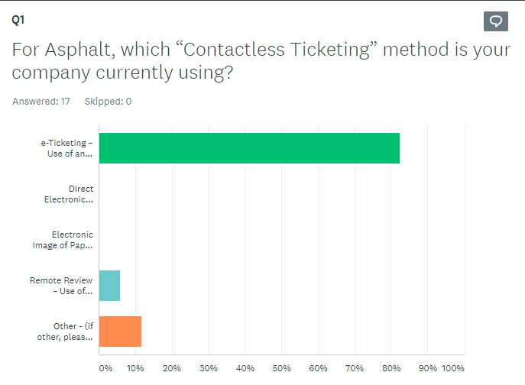
Contactless Ticketing & e-Ticketing
Implemented Contactless Ticketing In Response to COVID-19
April 20, 2020
Over 80% of ACAF Contractors Using e-ticketing

Slide 42
e-Ticketing Advantages
Advanced Mix & Truckload Information
Better Project Tracking
Increased Oversight
View Paving Progress on Multiple Projects by Phone, Tablet, or Computer
Fleet Management
Electronic Data

Slide 43
e-Ticketing
Very Few Problems
Outstanding, Considering the Immediate, Statewide Implementation
Thanks to Contractors, e-Ticketing Vendors, CEI’s & FDOT Personnel Who Made Statewide Asphalt e-Ticketing Implementation Successful
Let’s Continue Working Together To Quickly Implement Changes that Benefit Asphalt Contractors & FDOT
Regardless of How Challenging or Risky the Change Appears at First

Slide 44
Questions?
Richard Hewitt, P.E.
State Construction Pavement Engineer
State Construction Office
(386) 943-5305 (office)
richard.hewitt@dot.state.fl.us

