Slide 1
Me! And You!: Activities for Self-Expression and Authenticity in French-Language Classrooms
Audra Merfeld
Professor of French and Chair of the Department of Languages & Intercultural Studies
Coastal Carolina University, Conway, SC
amerfeld@coastal.edu

Slide 2
Part 1: Me!
Word Clouds

Slide 3
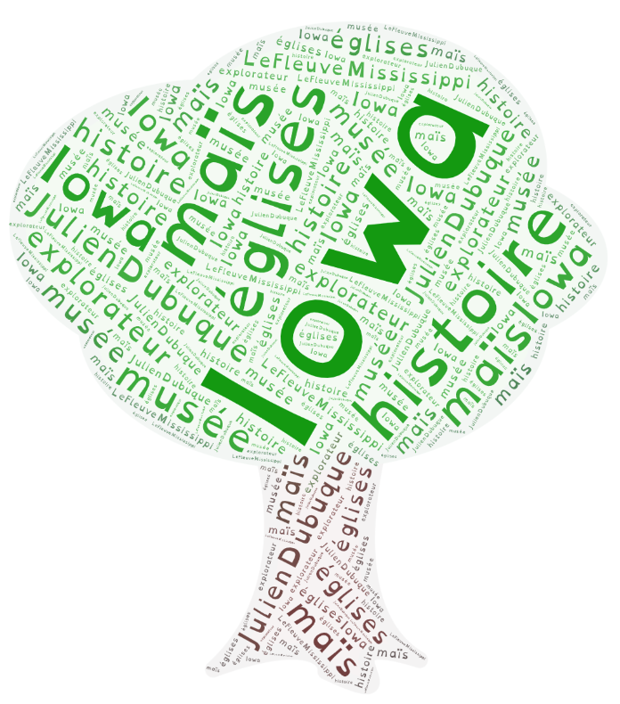
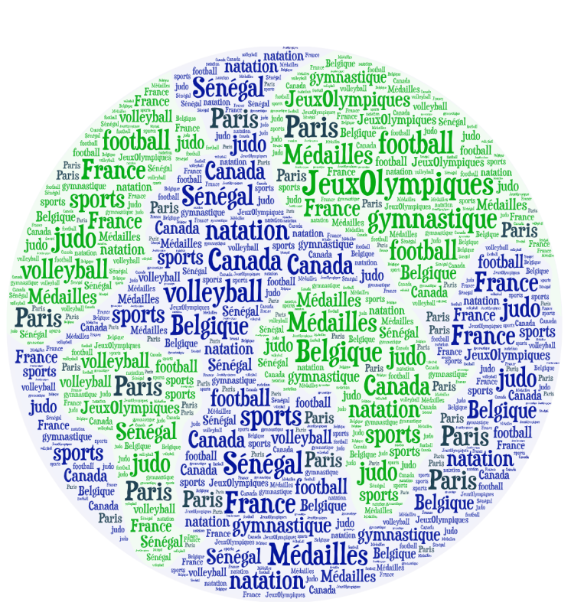
Sample Word Clouds
https://wordart.com/create

Slide 4
Part II: You!
YouTube

Slide 6
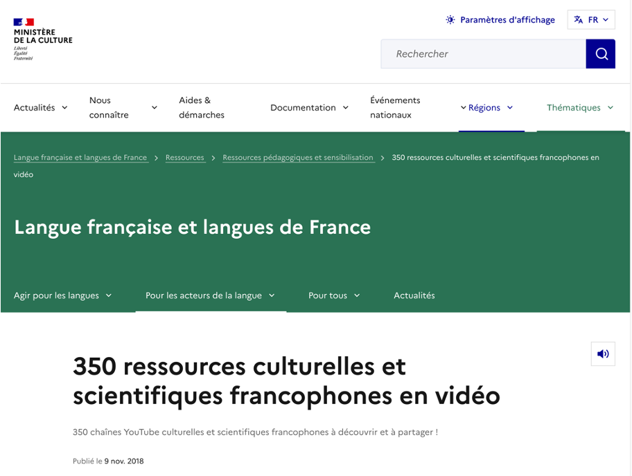
Some Ideas
Student-created playlists + follow-up activities
Compare various vloggers
Tutorials
Language learning videos
Comprehension activities and discussion of videos

Slide 7
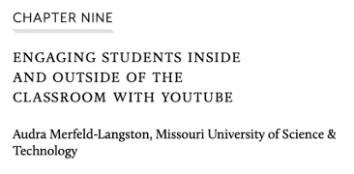
Additional Resources / Shameless Self-Promotion
The French Review, Vol. 94, No. 3, March 2021
Culture & Content in French: Frameworks for Innovative Curricula. Eds. Aurélie Chevant-Aksoy and Kathryne Adair Corbin. Lever Press, 2022.
Contact me at: amerfeld@coastal.edu

